Slide 1

Smart Tourism Communication Blueprint leveraging 5g, AR/VR, and multilingual AI monika de240057
European Institute of Innovation, Entrepreneurship, and technology

Slide 2

INTRODUCTION
Background:
  Tourism is rapidly transforming through digital technologies.
  Travelers expect real-time, personalized, and accessible information.
Goal:
  Develop a smart, inclusive, and responsive communication system.
Scope:
  Tourist Information Centers: Digital kiosks, AR maps, AI support.
  Mobile Apps & Virtual Guides: AR tours, multilingual AI, smart itineraries.
  Emergency Alert Systems: Real-time, multilingual alerts for safety.

Slide 3
Smart tourism trends
High-speed data transfer made possible by 5G technology enables responsive digital interactions across platforms, real-time updates, and more seamless virtual content streaming.
Through gamified exploration experiences, digital overlays on landmarks, and immersive virtual tours, AR/VR integration improves user engagement.
Artificial Intelligence: Enables real-time multilingual translations, voice assistants, and intelligent chatbots to customize travel services.
Accessibility and Inclusivity: Ensuring cultural sensitivity, linguistic diversity, and equal digital access are all important aspects of tourism that are becoming more and more important globally.

Slide 4

User personas
Global Solo Traveler: Needs tech-savvy, multilingual tools for independent exploration.
Elderly Couple: Requires accessible design and safety-focused communication.
Family with Kids: Looks for interactive and entertaining digital experiences.
Business Tourist: Prioritizes real-time updates and efficient service integration.

Slide 5
Tourist information centres
Interactive digital kiosks: Travelers can scan QR codes and AR maps on smart kiosks to obtain comprehensive local information, directions, and suggestions right away.
AI chatbots: AI-driven virtual assistants provide real-time responses in a variety of languages, assisting travelers with their questions whenever they arise without requiring staff assistance.
Tourists can download brochures, guides, or coupons instantly by tapping their phones on NFC tags. This eliminates the need for paper and promotes eco-friendly travel.
Visual: Add a straightforward diagram or illustration of a TIC that includes an NFC zone, chatbot screen, and smart kiosk.

Slide 6


Slide 7
Mobile apps and virtual tour guides
Multilingual emergency alert system
Features of virtual tour guides and mobile apps:
Walking tours of AR
Artificial intelligence-driven language translation
Personalized travel recommendations
5G integration for real-time information
Visual: A mock-up of an app's wireframe (a simple sketch or placeholders)
Push alerts in the user's native language based on location
Alerts in real time (weather, health, transportation)
incorporated local services and embassy contacts
Travelers with hearing or vision impairments can access

Slide 8
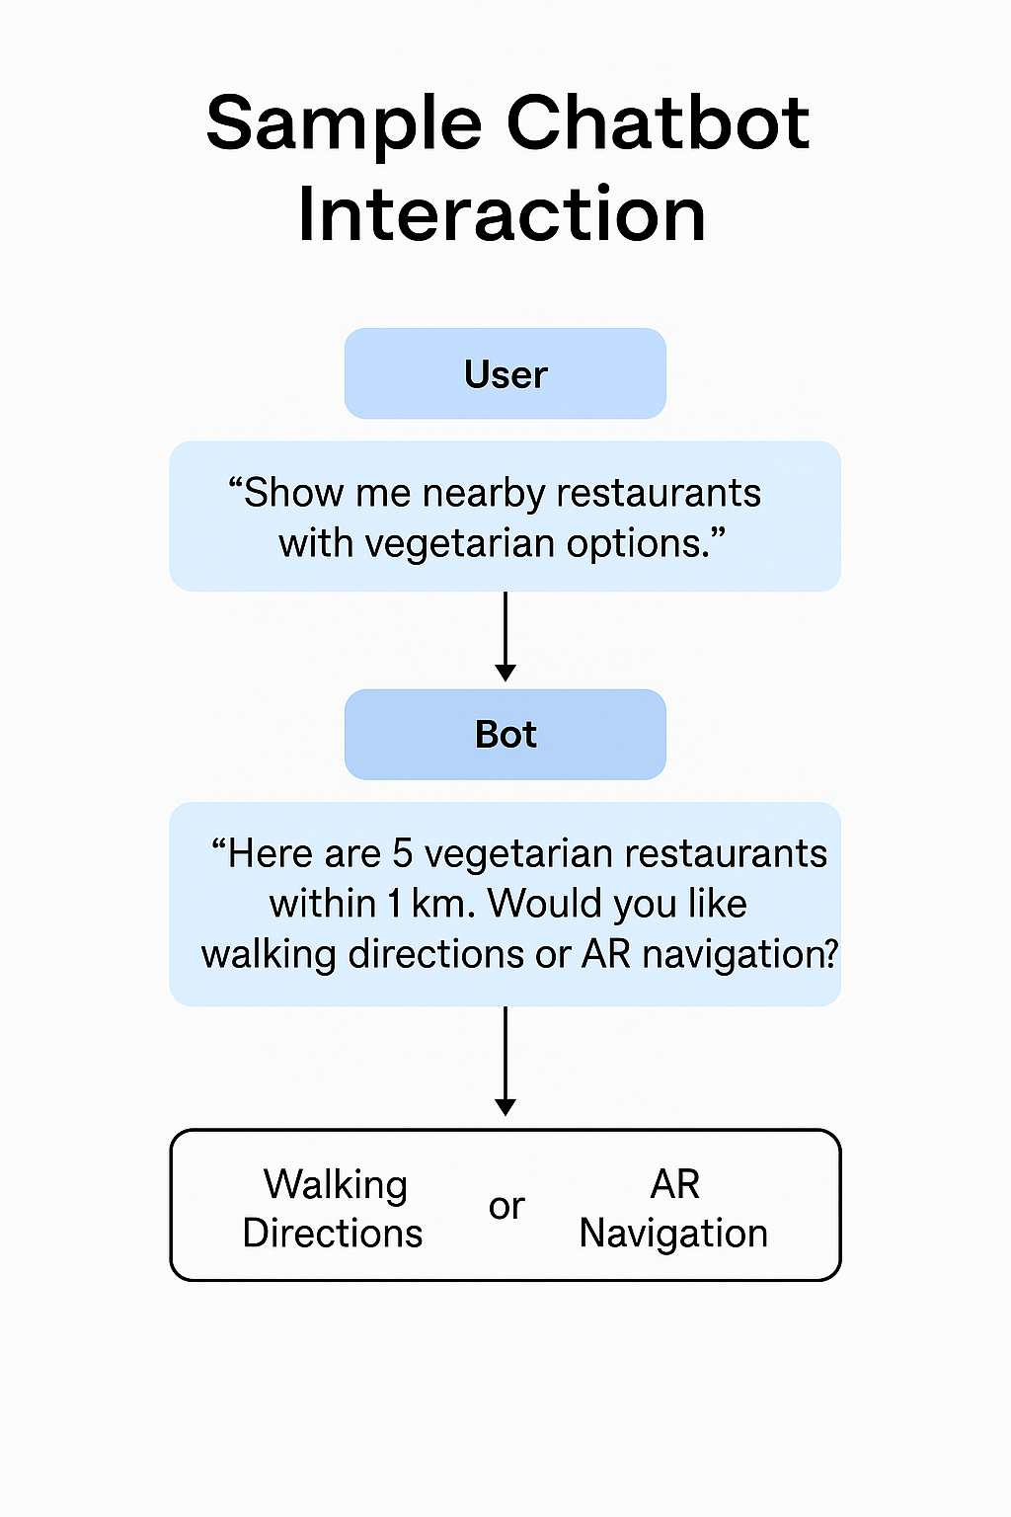
Sample chatbot interaction
Visuals
User: “Show me nearby restaurants with vegetarian options.”
Bot: “Here are 5 vegetarian restaurants within 1 km. Would you like walking directions or AR navigation?”
Purpose:
Demonstrates how the chatbot uses location, preferences, and multilingual support to deliver instant, personalized recommendations.

Slide 9
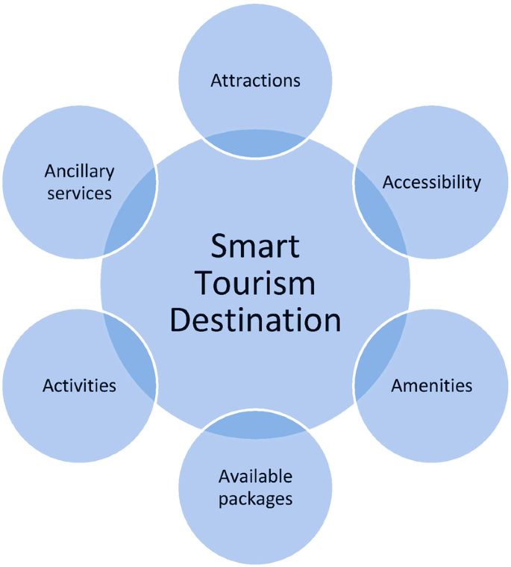
Inclusivity and accessibility qualities
The system's multi-sensory design allows users with a range of abilities to interact comfortably and successfully by combining voice, visuals, and haptic (touch-based) feedback.
Users with visual or hearing impairments can communicate using their preferred method—speaking instead of typing or listening to spoken output—thanks to text-to-speech and speech-to-text.
Culturally Appropriate Design: Icons, language, and visuals are all adapted to honor cultural variances and prevent misunderstandings, making foreign visitors more comfortable.
Standards Compliance: To guarantee equal access for all, all tools are made to comply with the Americans with Disabilities Act (ADA) and Web Content Accessibility Guidelines (WCAG).

Slide 10
Data privacy and regulations
Smart tourism systems prioritize user trust through strong data privacy measures. All user data is handled in compliance with GDPR, ensuring transparency and protection. Consent-based sharing empowers users to control their information. End-to-end encryption secures all communications. Additionally, local data hosting ensures adherence to regional and national data laws, supporting legal compliance while respecting user privacy across different jurisdictions.

Slide 11
KPI’s for success
The following key performance indicators are used to gauge how well the smart communication system is working:
App Engagement Rates: Monitor the frequency and duration of user interaction with the app.
Surveys of visitor satisfaction: Get input to evaluate system value and user experience.
Emergency Alert Response Time: Calculate the speed at which alerts are sent and received.
Multilingual Usage Analytics: Examine the frequency of use of translation tools.
Decreased Inquiries at Physical Centers: Shows that offering digital self-service options is working.

Slide 12
Platform integration plan
A smooth user experience will be guaranteed by the smart communication system's integration with several platforms:
Travel websites: Coordinate services and content, such as reservations, maps, and suggestions.
Local transport apps provide route planning, ticketing, and real-time transit updates.
Health and safety portals: Offer alerts, medical services, and emergency updates.
A unified experience guarantees seamless communication between desktops, kiosks, smart wearables, and mobile devices for reliable service delivery.

Slide 13

Visual mock-ups
To demonstrate user interface concepts and functionality, this slide displays sample visual designs of smart tourism communication tools.
The home screen of the app has a clear, user-friendly interface that provides easy access to important features like chatbot support, AR tours, local highlights, and emergency information. By default, it is accessible and available in multiple languages.
Digital Kiosk Layout: The kiosk's layout features voice assistance capabilities, an AR map projection, an interactive touch screen, and an NFC brochure section. It enables travelers to download customized content, navigate attractions, and get updates.
Emergency Alert Pop-Up: An instantaneous notification window with multilingual, easily comprehensible instructions that shows up on all devices. It contains links for quick action or help and is color-coded by the type of alert (health, weather, security, etc.).
These mock-ups demonstrate how the system sets priorities.

Slide 14
Conclusion
By increasing safety, satisfaction, and inclusivity, smart communication systems are revolutionizing the travel experience. Along the way, travelers can access personalized, easily accessible, and culturally relevant information thanks to real-time updates, multilingual support, and immersive digital tools like AR/VR and AI. In addition to making travel easier, these technologies enable confident exploration for tourists of all ages, backgrounds, and skill levels.
For smart communication to be truly effective, it must be tailored to the various needs of today's international tourists, including business, family, senior, and solo travelers. All systems must continue to prioritize user-centered design, privacy, and accessibility.
Overseeing the effective integration, standardization, and governance of these technologies is a critical responsibility of national tourism boards. By making investments in digital infrastructure that is ready for the future and making sure that it works on multiple platforms,

Slide 15
Refrences
Gretzel, U., & Koo, C. (2021). Smart tourism cities: a duality of place where technology supports the convergence of touristic and residential experiences. Asia Pacific Journal of Tourism Research, https://doi.org/10.1080/10941665.2021.1897636
Leung, R. (2022). Development of Information and Communication Technology: From e-Tourism to Smart Tourism. In Springer eBooks. https://doi.org/10.1007/978-3-030-05324-6_2-1
Russell, S. J., & Norvig, P. (1995). Artificial intelligence: a modern approach. Choice Reviews Online, 33(03), 33–1577. https://doi.org/10.5860/choice.33-1577

