Slide 1
Recreation
European Institute of Innovation, Entrepreneurship and Technology
Lessingstraße 79, 13158 Berlin, Germany
Mahmoud Abdou| Berlin
      Lessingstraße 79,
      13158 Berlin, Germany
      Phone: +49 30 233618555
      Fax: +49 30 233618556
      Email: info@eiiet.com

Slide 2
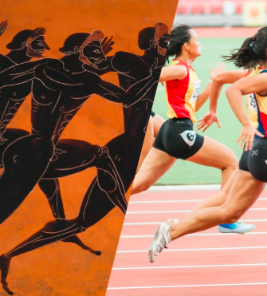
Index
- Historical Evolution of Play
- Historical Evolution of Leisure
- Historical Evolution of Recreation
- Factors Promoting the Recreation Activities
- Recreation and Leisure-Service Providers

Slide 3
1- Historical Evolution of Play
      The Meaning of Play
      Origin of the Word “Play”
      - From Anglo-Saxon: plega indicates game, sport, skirmish, or fight
      - Related to Latin: plaga refers to blow, stroke, or thrust
      Connection to Action
      - Play involves striking, moving, or engaging
      - Seen in playing a game (striking a ball) or playing a musical instrument
      Symbolic of Energy and Interaction
      - Represents activity, competition, and expression

Slide 4
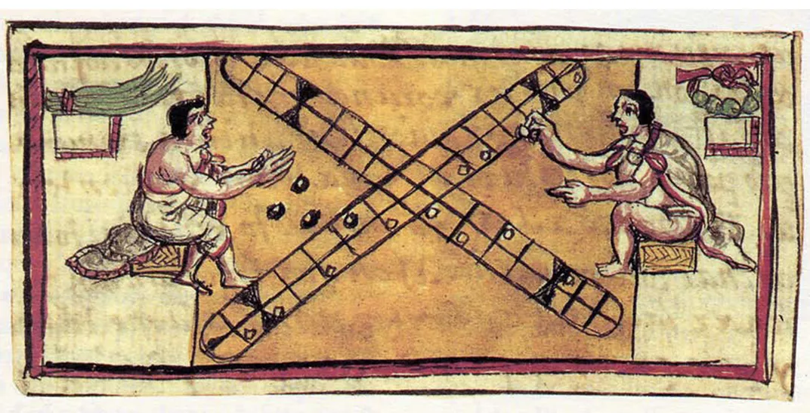
1- Historical Evolution of Play
      The Value of Play
      - viewed as childish or not worthy of serious thought
      - In reality, play is a vital part of healthy human development
      - Supports emotional, social, and cognitive growth across all ages
      In previous Puritan Societies
      - Play is commonly seen as non-serious or unproductive
      - play devalued and regarded as inferior to work
      - Work is viewed as purposeful and productive

Slide 5
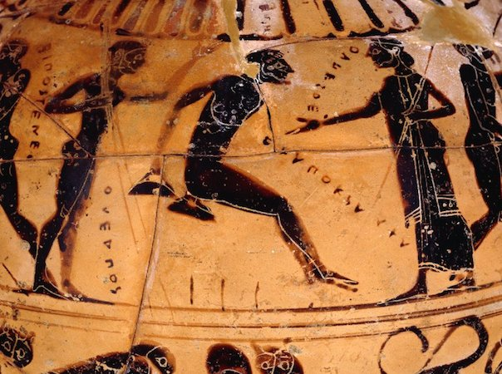
1- Historical Evolution of Play
      Play in Ancient Greece
      - Play was not merely entertainment or passing time
      - It had a meaningful role in children’s upbringing and education
      - Through play, children developed key qualities such as:
      Honor
      Loyalty
      Appreciation of beauty
      - These qualities were essential for becoming good, responsible citizens

Slide 6
1- Historical Evolution of Play
      Play in Ancient Greece
      Play was integrated into education to:
      - Shape children’s character
      - Instill core societal values
      - Teach what it meant to contribute positively to the community

Slide 7
1- Historical Evolution of Play
      Play and the Rise of the Catholic Church
      - The Catholic Church gained influence in Western Europe
      Play seen as a social threat
      - Physical pleasure and the body viewed as distractions from:
      Spiritual values
      Work and productivity
      - Efforts to restrict pleasurable play
      - Many forms of play were condemned

Slide 8
1- Historical Evolution of Play
      Concepts of Play in the 2oth Century
      A- Play as Self-Expression
      - Play seen as a natural need for self-expression
      - Humans are active, dynamic beings seeking to:
      Express personality
      Choice of play activity influenced by:
      - Physical makeup - fitness level
      - Environment - Family and social background
Release energy | Use abilities

Slide 9
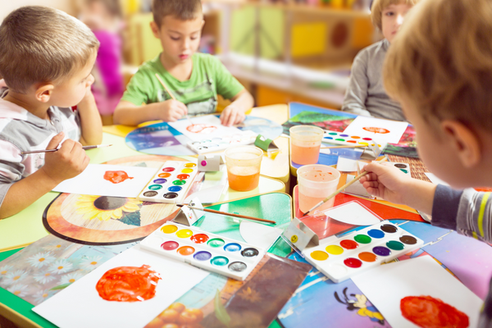
1- Historical Evolution of Play
      Concepts of Play in the 2oth Century
      A- Play as Self-Expression
      - This theory also points to some common human desires that shape how people play
      - These universal human wishes include:
      Desire for new experiences
      Participation in group activities
      Need for security
      Seeking response and recognition from others
      Appreciation of the aesthetic

Slide 10
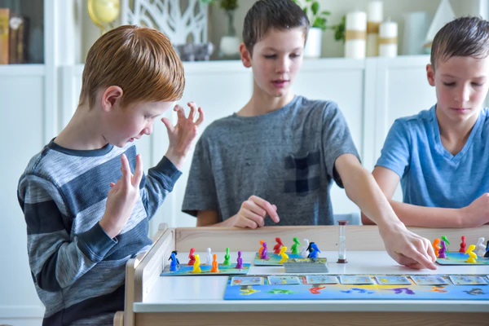
1- Historical Evolution of Play
      Concepts of Play in the 2oth Century
      B- Play as a Social necessity
      - Play seen as key to personal character development:
      discipline, sacrifice, morality
      - Not just a pleasure or a fun time
      - It is serious in children’s lives
      - Vital for community life and social preparation
      - Prepares children for adult work through:
Manual training | Coordination of bodily functions
Promoting health | Adapting to indoor environments

Slide 11
2- Historical Evolution of leisure
      Origins of the Word Leisure
      - Originates from Latin licere – “to be permitted” / “to be free”
      - Gave rise to:
      French loisir – “free time”
      English license – originally, freedom from public duties
      Liberty – freedom
      - Common theme:
      Freedom, free choice, absence of obligation
      - Reflects true nature of leisure:
      Time to choose freely what to do

Slide 12
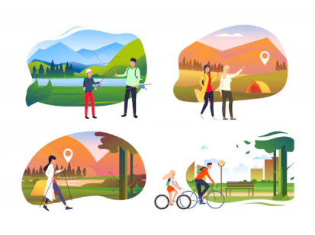
2- Historical Evolution of leisure
      The Classical View of Leisure
      - higher state of being
      - Activity done for its own sake:
      - Work seen as boring and ignoble
      - leisure not the same as idleness
      - Leisure activities include:
Creating art | Discussing philosophy
Engaging in political debate | Learning

Slide 13
2- Historical Evolution of leisure
      The Classical View of Leisure
      Five Key Principles of leisure
      - Leisure is the foundation of culture and the good life
      - Includes music, art, community, fitness, contemplation
      - Moderation is essential for true leisure
      - Peace is necessary; war-readiness undermines leisure
      - Leisure must be taught—a duty of the state

Slide 14
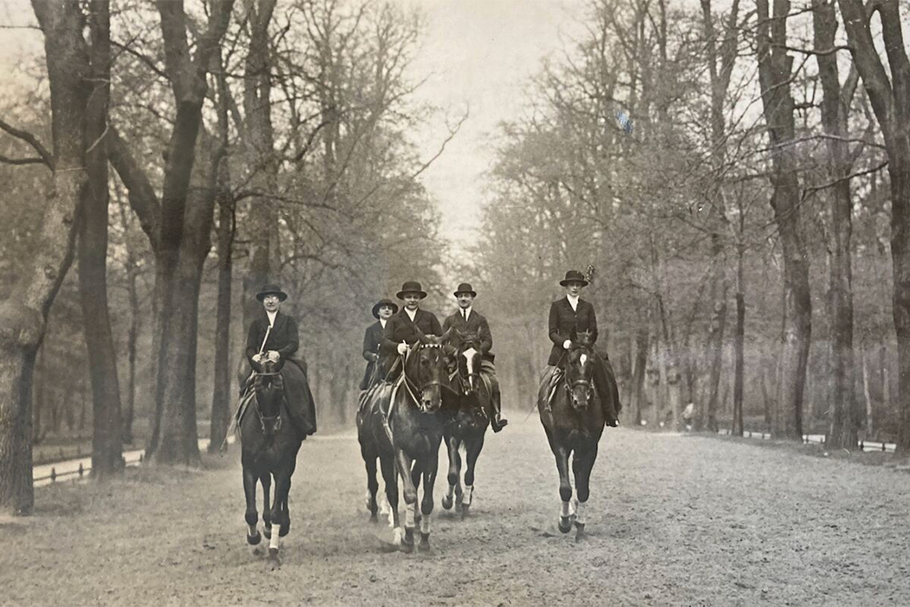
2- Historical Evolution of leisure
      Leisure Interpretations:
      1- Leisure and Social Class
      - Leisure became a symbol of power, privilege, and status
      - Across history (feudal, Renaissance, Industrial Age):
      Upper classes showed superiority by not working
      Leisure activities signaled freedom from labor
      - Leisure became a way to display social distinction

Slide 15
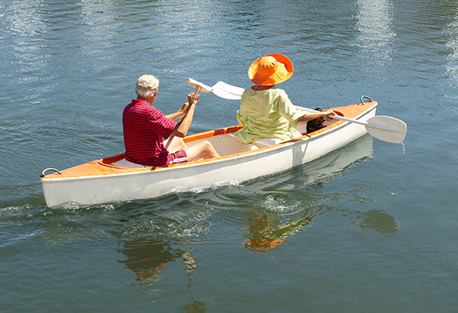
2- Historical Evolution of leisure
      Leisure Interpretations:
      2- Leisure as Unobligated Time
      - free, discretionary time after life’s necessities
      - Leisure is often defined as time free from obligations
      or duties.
      Excludes:
      - Work and work-related tasks
      - Essential activities
      Key feature:
      - Absence of obligation or compulsion

Slide 16
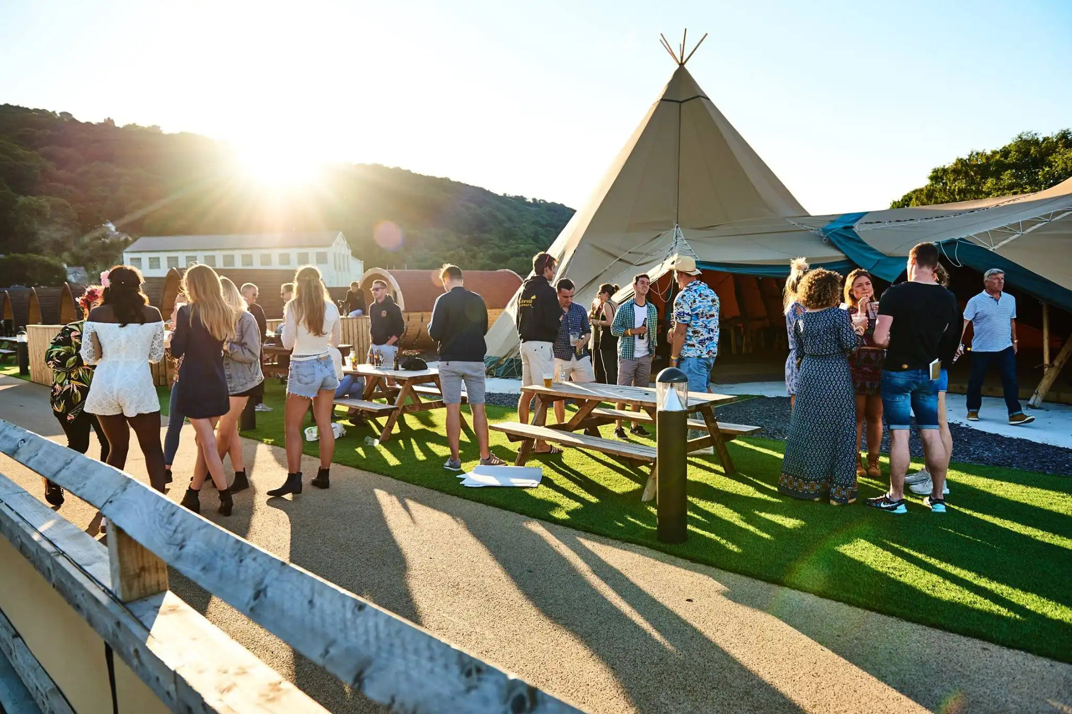
2- Historical Evolution of leisure
      Leisure Interpretations:
      3- Semi-Leisure and Free Time
      Pure leisure:
      - Activities done purely for enjoyment
      - free of obligation or work purpose
      Semi-leisure:
      - Free time activities partly influenced by work, business,
      or beliefs
      Examples:
      - Reading work-related books
      - Attending evening classes to improve job skills
      - Social events linked to work

Slide 17
2- Historical Evolution of leisure
      Leisure Interpretations:
      4- Leisure as Activity
      - Chosen freely during free time, not forced
      - Happens after fulfilling work, family, and social duties
      - Purposes of leisure:
      - Defined by freedom from obligation
      - Allows creative expression and personal growth
Rest and relaxation | Amusement and fun
Self-improvement | social participation

Slide 18
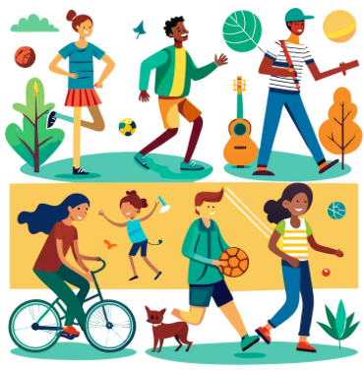
2- Historical Evolution of leisure
      Leisure Interpretations:
      5- Leisure as a State of Being
      - Goes beyond just activities done in free time
      - Focuses on how leisure is experienced
      - Emphasizes leisure’s deeper meaning in life
      - Reflects a mindset or way of living
      Freedom and Voluntariness
      - Activities done freely
      - Enables full immersion in the activity

Slide 19
2- Historical Evolution of leisure
      Leisure Interpretations:
      5- Leisure as a State of Being
      Self-Expression and Fulfillment
      - expression of true self, talents, and potential
      - Brings deep satisfaction
      A Holistic Lifestyle
      - Activities are interconnected, not separate
      - Personal growth and self-actualization
      - Creativity, expression, involvement

Slide 20
2- Historical Evolution of leisure
      Leisure Interpretations:
      6- Leisure as Spiritual Expression
      - A path to spiritual enrichment
      - Contributes to peace, reflection, and meaning
      - Leisure activities have a spiritual quality
      - Play and recreation as “holy” or uplifting
      - Moral development and spiritual well-being
      Leisure as sacred time
      - Sabbath” or sacred day of rest
      - As a time for renewal, reflection, or communion

Slide 21
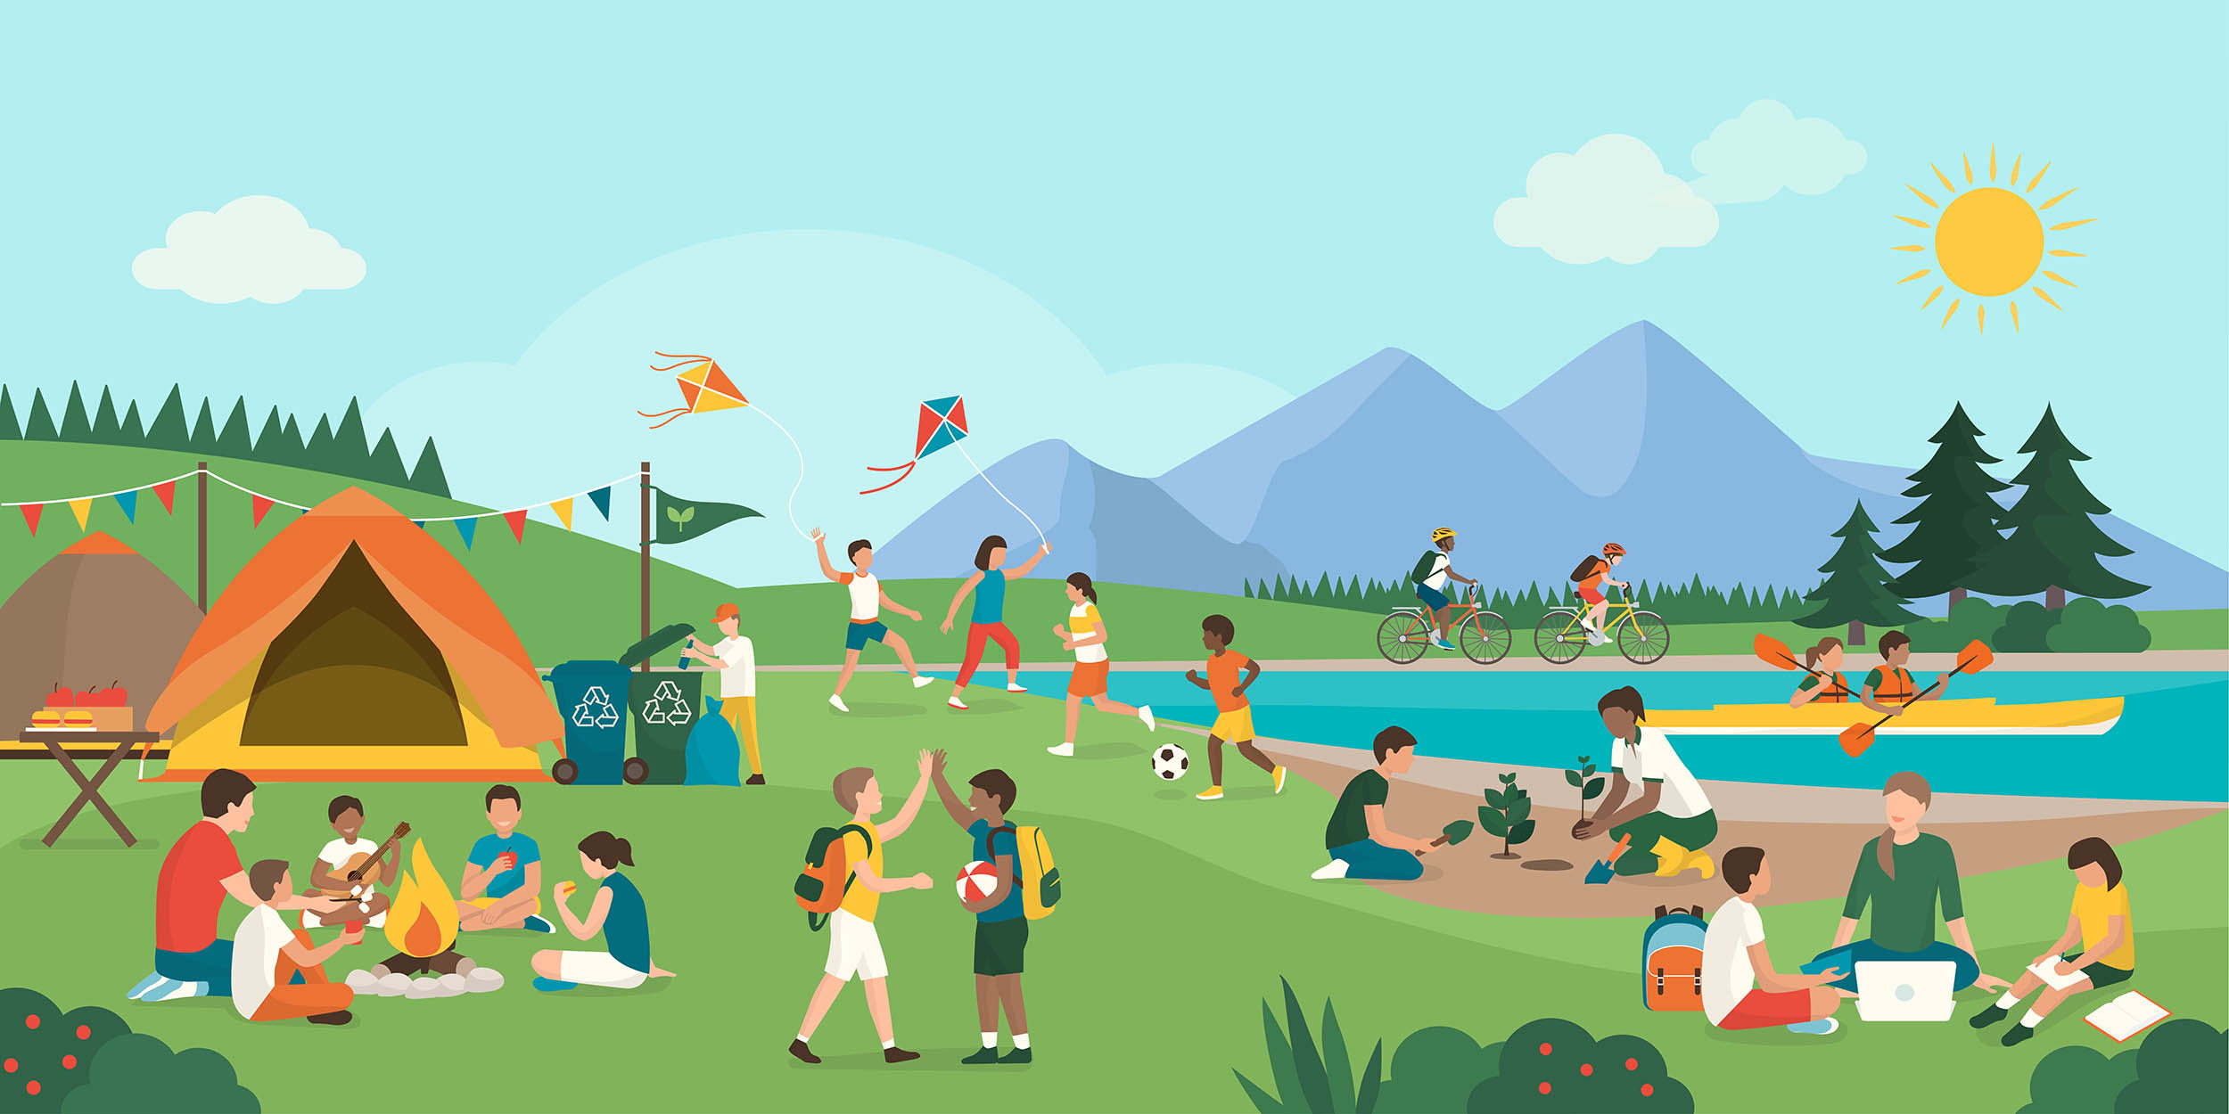
3- Historical Evolution of Recreation
      The Meaning of Recreation
      Origin of the Term
      - From Latin recreatio, means "that which refreshes or restores”
      Historical Perspective
      - Seen as a light, restful activity
      - Voluntarily chosen to regain energy after work
      - Helps restore the body and mind before
      returning to labor

Slide 22
3- Historical Evolution of Recreation
      The Meaning of Recreation
      Limitations of the Traditional View of Recreation
      Outdated Assumptions
      - Modern work is often less physically demanding
      - Recreation today can be more engaging than work
      Beyond Restoration for Work
      - Not everyone works, yet recreation still adds meaning
      - Recreation isn't just for recovery

Slide 23
3- Historical Evolution of Recreation
      The Meaning of Recreation
      Traditionally, people have viewed work and recreation as opposites:
      - Work was seen as:
      Tedious, unpleasant, and monotonous
      Something we have to do (obligatory)
      Recreation was seen as:
      Light, pleasant
      Something we choose to do to relax or recover

Slide 24
3- Historical Evolution of Recreation
      The Meaning of Recreation
      Modern, Holistic Perspective
      - A more balanced and realistic view is that:
      - Both work and recreation can be:
      Pleasant and enjoyable
      Creative and fulfilling
      Deeply involving

Slide 25
3- Historical Evolution of Recreation
      Contemporary Understanding of Recreation
      It can be understood through 3 aspects:
      1. Recreation as an Activity
      - focuses on what people do in their free time.
      - Activities done for fun, relaxation, challenge, or socializing.
      Examples:
      - playing sports, hiking, painting, gaming, or attending events.

Slide 26
3- Historical Evolution of Recreation
      2. Recreation as a Process or State of Being
      - Recreation is not just as an activity.
      - It is something that happens internally.
      - It is about how the person feels and experiences the activity.
      - It is the outcome an activity:
      fulfillment, flow, joy, or personal transformation.

Slide 27
3- Historical Evolution of Recreation
      3. Recreation as a Social Institution
      -Recreation today involves organized, collective behavior.
      Shift in Responsibility
      - In the past, recreation was mostly managed by families, churches, or local groups.
      - Now, it is the responsibility of many institutions, including:
      Public organizations
      Voluntary organizations
      Commercial enterprises

Slide 28
3- Historical Evolution of Recreation
      Types of Recreation Activities
      Active Recreation:
      - Involves physical exertion and movement
      Passive Recreation:
      - Involves minimal physical effort
      Key Difference: Active often uses prepared facilities; passive usually does not.

Slide 29
3- Historical Evolution of Recreation
      Active Recreation Examples:
      - Sports:
      Team: Basketball, soccer, volleyball
      Individual: Swimming, tennis, golf
      Outdoor Activities:
      Hiking, biking, rock climbing, kayaking, skiing
      Fitness and Movement:
      Workouts, dancing, yoga, aerobics

Slide 30
3- Historical Evolution of Recreation
      Passive Recreation Examples:
      Media and Entertainment:
      Reading, listening to music, watching TV/movies, gaming
      Nature and Observation:
      Fishing, bird watching
      Cultural Activities:
      Attending concerts, movies, events

Slide 31
      DISCUSSION
      1- Over the past week, record your own leisure, play, and recreation activities.
      Reflect on the following:
      What activities did you choose?
      Why did you choose them?
      Did the activity feel like true leisure or semi-leisure?
      What were the emotional or physical outcomes?
      2- Next, list 10–15 activities you engaged in and sort them into the following categories:
      Play
      Leisure (pure or semi)
      Recreation

Slide 32
4- Factors Promoting the Recreation Activities
      1- Increase in Discretionary Time
      Key Historical Trends (1900–1990)
      - Shift away from agrarian work
      - Rise in holidays, paid vacations, and shorter workweeks
      - Steady growth in personal free time
      Impact on Recreation
      - More opportunities for participation than ever before

Slide 33
4- Factors Promoting the Recreation Activities
      1- Increase in Discretionary Time
      Free time influenced by:
      - Career type
      - Income level
      - Family status
      Changing Availability of Free Time
      - 40-hour workweek increasingly rare
      - Manufacturing: mandatory overtime is common
      - Executives, managers, supervisors: 24/7 work culture

Slide 34
4- Factors Promoting the Recreation Activities
      1- Increase in Discretionary Time
      Discretionary time varies by:
      -Age, education, and gender
      Children and seniors have more discretionary time.
      Children have limited choice over activities
      Seniors may face physical, mental, or economic barriers.
      Professionals and college-educated individuals usually work fewer hours
      Nonprofessional workers tend to work longer hours

Slide 35
4- Factors Promoting the Recreation Activities
      2- Commodification of Leisure
      - Leisure activities increasingly developed as complex.
      - Profit-driven businesses dominate leisure markets.
      - Large conglomerates (Disney) control:
      Music, TV, and movie industries
      Sports stadiums & professional teams
      Cruise ships, theme parks, and other leisure venues
      - Leisure experiences often shaped by corporate interests

Slide 36
4- Factors Promoting the Recreation Activities
      3- Population Growth
      - More people mean greater demand for recreational spaces and services.
      - Increases demand for parks, sports, entertainment, and cultural events
      Aging Population
      - Preference shifts to low-impact, health-focused activities
      - More senior-friendly and wellness programs
      Migration and Cultural Diversity
      - Introduces new leisure activities and festivals
      - Encourages multicultural recreation programs

Slide 37
4- Factors Promoting the Recreation Activities
      4- Recreation and Urban Revitalization
      - Recreation and parks key to revitalizing cities
      - Former industrial/waterfront areas transformed into:
      Shopping districts
      Cultural and entertainment hubs
      - Recreation improves:
      - New facilities include water parks, tennis centers, arts venues, marinas
City livability | Attracts tourists
Retains residents

Slide 38
4- Factors Promoting the Recreation Activities
      5- Influence of Technology
      - Airlines, cruise ships, resorts, and parks maintain websites
      - Online platforms provide:
      Information access
      Reservation services
      Expanded vacation options

Slide 39
4- Factors Promoting the Recreation Activities
      6- Health and Fitness Considerations
      - Public interest in exercise and physical fitness
      - Inactive and stressful modern lifestyle
      Benefits:
      - Physiological (improved health, vitality)
      - Psychological (better mood, self-esteem)
      Fitness trend driven by:
      - Social values and health awareness
      - Personal motivation and vanity
      - Business promotion and marketing

Slide 40
4- Factors Promoting the Recreation Activities
      7- Environmental Considerations
      - Outdoor activities need resources
      - Common activities:
      Camping, biking, fishing, hunting, skiing, climbing
      - Recreation depends on clean air, water, and healthy land
      - Recreation groups support protecting the environment
      - Responsible use of natural resources is vital

Slide 41
5- Recreation and Leisure-Service Providers
      5.1- Government agencies:
      Federal agencies
      State and provincial agencies
      Local departments of recreation and parks

Slide 42
5- Recreation and Leisure-Service Providers
      5.2- Voluntary organizations:
      Nongovernmental agencies
      Nonprofit in nature
      They can be:
      Sectarian or Nonsectarian
      They serve:
      The public at large
      Or selected elements of the public

Slide 43
5- Recreation and Leisure-Service Providers
      5.3- Private membership organizations :
      Their main functions:
      Provide recreational and social activities
      support community recreation needs as well
Golf clubs | Tennis clubs
Yacht clubs | Athletic clubs
Country clubs

Slide 44
5- Recreation and Leisure-Service Providers
      5.5- Commercial recreation enterprises are:
      Privately owned
      Operated for profit
      They include a wide variety of businesses such as:
      Ski centers
      Bowling alleys
      Nightclubs
      Movie houses or theaters
      Health spas or fitness centers
      Dancing schools
      Amusement parks or theme parks

Slide 45
4- Factors Promoting the Recreation Activities
      Discussion
      Analyze Leisure and Recreation Patterns Based on Your Country of Origin
      Please address the following points:
      Attitudes Toward Work vs. Leisure
      Factors That Support Leisure and Recreation
      Preferred Leisure and Recreation Activities

Slide 46
Thank you
      European Institute of Innovation, Entrepreneurship and Technology
      Lessingstraße 79,
      13158 Berlin, Germany
      Phone: +49 176 55524449
      Email: info@eiiet.com
Discover the world of eiIET

Slide 47
Header
      This passage highlights how, in ancient Greece—especially in Athens—play wasn’t just seen as a way for children to have fun or pass time. Instead, it had an important and meaningful role in their upbringing and education. The Athenians believed that through play, children could develop key qualities like honor, loyalty, and an appreciation for beauty. These qualities were essential for becoming good citizens who contribute positively to society.
      Play was therefore integrated into their educational system as a tool to shape children’s characters and instill the core values that Greek society treasured. It wasn’t merely about physical activity or entertainment; it was a purposeful practice aimed at nurturing responsible, ethical, and socially aware individuals. In other words, play was part of how children learned what it meant to be part of their community and uphold its ideals.

Slide 48
Header
Leisure as perceived freedom:
The core of leisure here is that the activity is done freely and voluntarily, without external pressure or obligation.
This freedom allows a person to fully immerse themselves in the activity.
Leisure as self-expression and fulfillment:
Leisure activities allow a person to express their true self, talents, and potential.
It’s about doing something that brings deep satisfaction and pleasure, engaging one’s whole being.
A holistic lifestyle:
Instead of seeing life as separate compartments—work, family, religion, free time—this concept sees all life’s activities as interconnected.
Leisure is part of a continuous process of personal growth and self-actualization (becoming fully who you are).
It includes being creative, expressive, involved, and fully alive in all aspects of life.

