Slide 1


Management and Comunication Skills
Oral and Written Communication
Prof. Dr. Jay Krishna Thakur | Berlin

Slide 2

Objectives
Understand key management skills in the hospitality industry.
Explore the role of communication in effective hospitality management.
Focus on oral and written communication techniques.
Apply concepts to real-world hospitality scenarios for Master's level analysis.

Slide 3
Communication Problem in Hotels
    Language Barriers: Diverse guests - multiple languages - misunderstandings or errors in conveying requests and instructions.
    Cultural Differences: Varying cultural norms and expectations about communication style, gestures, and politeness can cause unintentional - offense or confusion.
    Information Silos: Poor internal communication between departments like front desk, housekeeping, and kitchen leads to delays or errors in service delivery.
    Lack of Clear Protocols: Absence of structured communication procedures results in inconsistent messaging and inefficient handling of guest needs or complaints.
    Over-reliance on Technology: Sometimes technology replaces direct communication, causing gaps when systems fail or staff are inadequately trained.
    Stressful Work Environment: High workload and time pressure
    Inadequate Training: Communication skills, cultural competency, and conflict resolution undermines staff effectiveness.

Slide 4
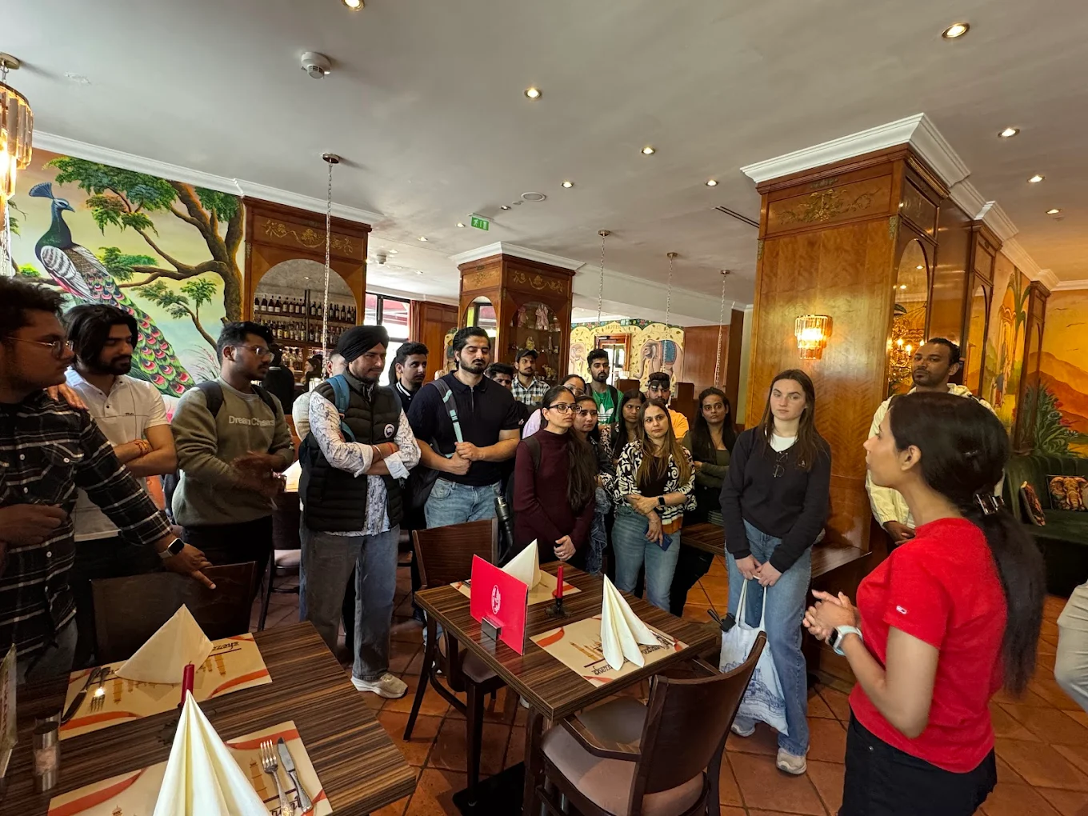
Communication Problem in Restaurant
      Order Miscommunication:,- leading to incorrect or delayed dishes for guests.
      Lack of Standardized Procedures: Absence of clear processes or protocols = inconsistent service and makes training new staff difficult.
      Language Barriers: Diverse teams and clientele increase the risk of misunderstandings, especially in multicultural or international restaurants.
      Inadequate Information Flow
      Staff Turnover and Training Gaps
      High-Pressure Environment
      Technology Gaps

Slide 5
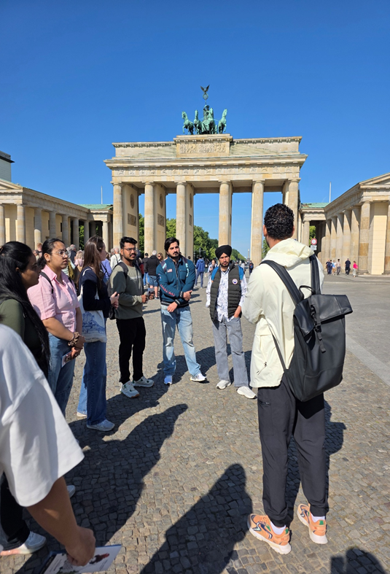
Communication Problem in Tourism Industry
Language and Cultural Barriers: misunderstandings and discomfort.
Rapidly Changing Information: safety protocols, schedules, and local conditions make it difficult to convey accurate, timely messages to travelers.
Digital Communication Challenges: slow responses and inconsistent customer service.
Information Overload: Tourists are overwhelmed by excessive or unclear information.
Internal Coordination Issues: Poor information flow between departments or organizations.

Slide 6
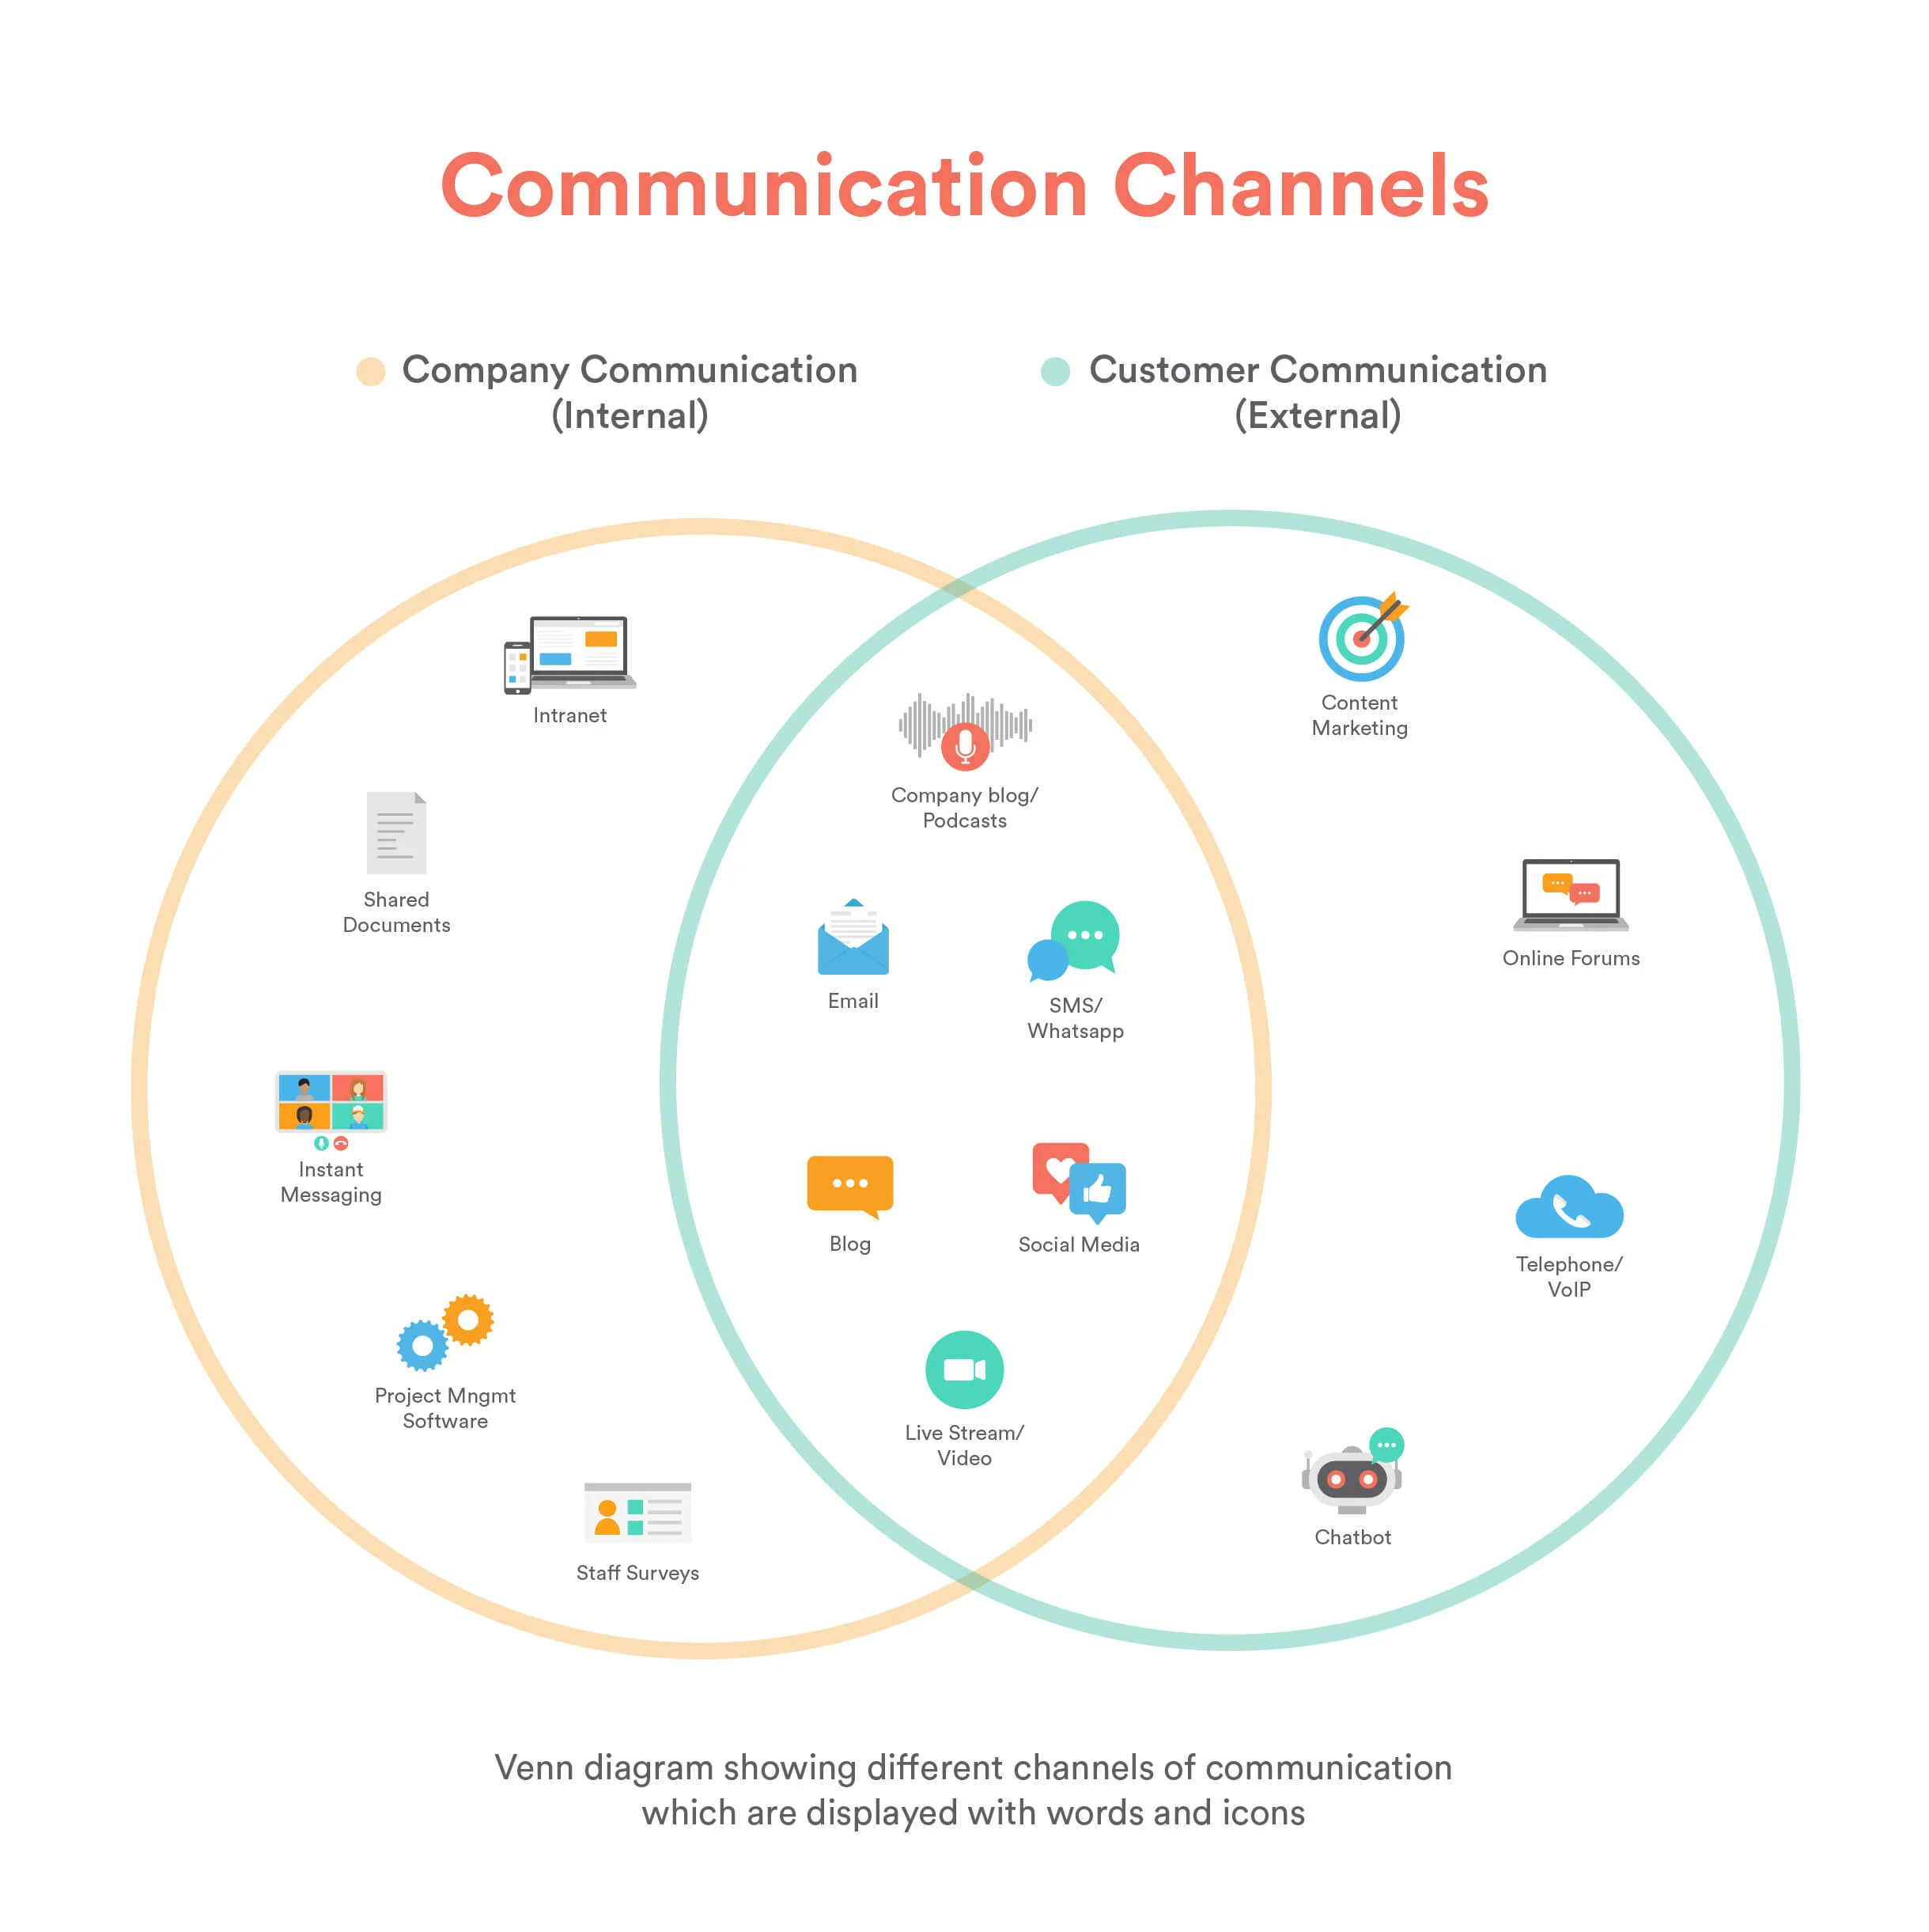
Communication Channel Source
Face-to-Face Interaction: Direct verbal communication between staff and guests (e.g., check-in greetings) or within teams (e.g., briefings), allowing immediate feedback and non-verbal cues.
Written Correspondence: Emails, memos, or guest letters ensuring clear documentation and professional tone.
Digital Platforms: Tools like Booking.com, Microsoft Teams, or hotel apps
Telephone: Calls for reservations or guest support.
Public Address Systems: Announcements in lobbies or dining areas, ensuring broad, immediate reach.

Slide 7

7 Major Elements of Communication
Sender
Message: verbal, written, or non-verbal
Channel: face-to-face, email, or phone
Receiver: recipient who decodes and interprets
Feedback: response from the receiver
Context: The environment or situation influencing communication
Noise: Any interference that distorts the message, such as language barriers or distractions

Slide 8

Communication Methodology
Set Clear Objectives: Define goals for internal and external
Know Your Audience: Tailor messages
Use Multiple Channels: Combine meetings, messaging apps, social media, and email.
Maintain Consistency: Ensure clear, transparent, and aligned messaging.
Train Staff: Provide guidelines and communication skills training.
Leverage Technology: Utilize digital tools like POS, chatbots, and automated messaging.
Evaluate Regularly: Gather feedback and adjust strategies for improvement.

Slide 9

7 Cs of communication
Clarity: Ensure the message is clear and easily understandable
Conciseness: Deliver the message briefly without losing meaning
Concreteness: Use specific, vivid details
Courtesy: Be respectful and considerate
Correctness: Ensure accuracy in grammar, facts, and tone
Consideration: Tailor the message to the audience’s needs and perspectives.
Completeness: Provide all necessary information for the recipient to act.

Slide 10

Key Management Skills in Hospitality
Leadership: Motivating teams and making decisions.
Problem-solving: Handling guest complaints and operational issues.
Time management: Balancing multiple tasks in a fast-paced environment.
Financial awareness: Budgeting and revenue management
Advanced skills : Strategic planning, innovation, and ethical leadership.

Slide 11

Importance
The backbone of operational effectiveness and guest experience is communication.
Establishment of relationships, conflict resolution, and the seamless facilitation of interdepartmental cooperation.
Greater guest satisfaction, culminating in repeat business.

Slide 12
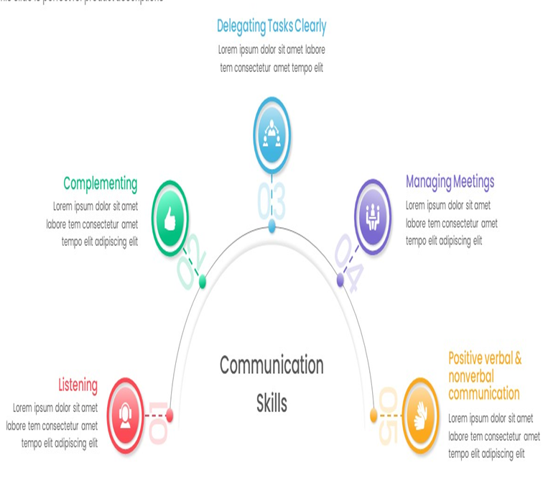
The Role of Communication in Hospitality Management
Coordination and Cooperation among Employees = effective Interaction with Clients.
This assists in harmonizing activities between the front desk operations, housekeeping, kitchen, and upper management.
Improved guest satisfaction results from the provision of relevant, precise, and swiftly disseminated information.
Communication removes informational barriers and covers all forms—spoken, unspoken, written, and electronic.
Trust and loyalty
Uplifting organizational atmosphere

Slide 13

Oral Communication Skills in Hospitality
Guests and teammates = straightforward and well-communicated details.
Comprehending problems, desires, and responses is possible through active listening.
Resolving complaints, having patience and understanding are necessary.
The way a message is received and the type of exchange can be profoundly influenced by tone and non-verbal communication.
The multicultural hospitality industry benefits from cultural and linguistic diversity in communication.

Slide 14
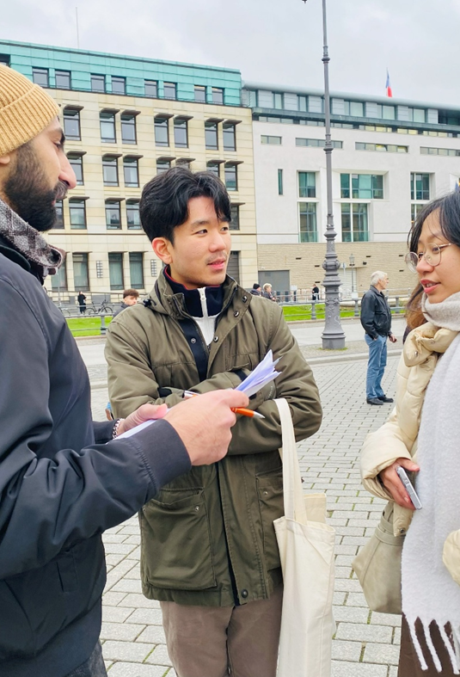
Examples
Guest interactions: Greetings, informing, and resolving issues encountered communicatively.
Staff meetings: Daily briefing, feedback session, and motivational talk.
Crisis management: During emergencies, providing precise and clear directions.
Negotiation: Between suppliers and conflict resolution.

Slide 15
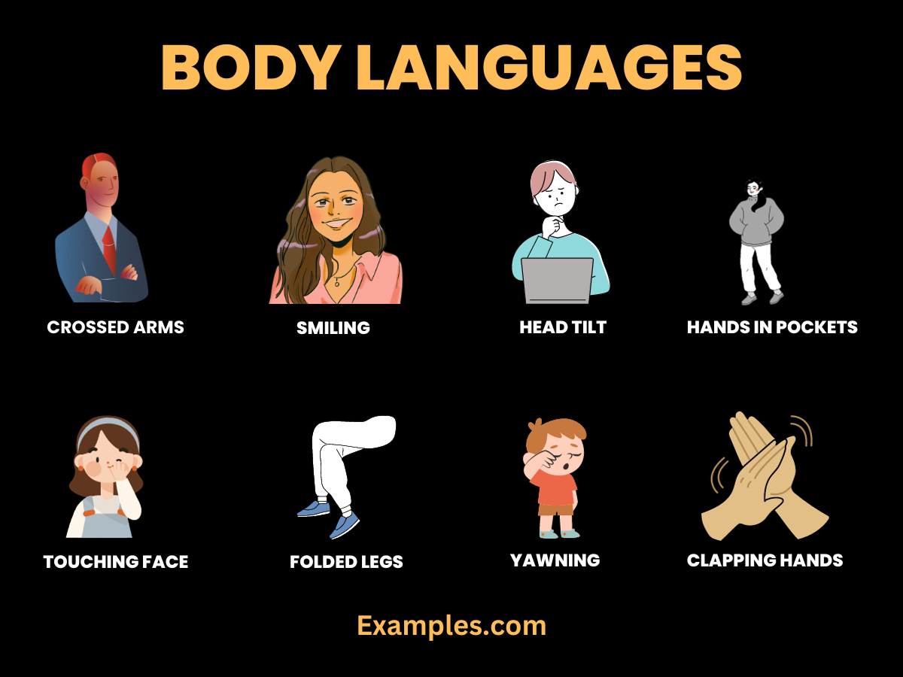
Components of Non‑Verbal Communication
Kinesics (movement)
Posture, stance, gestures, facial expressions
Oculesics (eye behavior)
Quality, frequency, and cultural meaning of eye contact
Proxemics (amount of space)
Use of personal space and positioning at the desk or table
Haptics (touch and motion)
Touch policies: hand‑offs, handshakes, guiding gestures
Paralanguage
Tone, pitch, pace, volume, pauses, warmth
Appearance & Grooming
Uniform, neatness, name tag placement
Chronemics (time and communication)
Timing, punctuality, response latency

Slide 16
Body Language Do’s & Don’ts
Do | Don’t
Stand upright, open shoulders | Slouch, lean on counter, cross arms
Use open-palm guiding | Point with a single finger
Maintain comfortable distance | Invade space or step back abruptly
Warm tone, steady pace | Sharp, rushed, or monotone speech
Acknowledge emotion visibly | Smile inappropriately during complaints
Notes:
Use during practice as a quick reference.

Slide 17
Quick Self-Audit (Before Each Shift)
Area | What to Check
Posture | Upright, open, relaxed; no fidgeting
Facial Expression | Neutral-friendly baseline; appropriate smile
Eye Contact | Comfortable, inclusive; culturally sensitive
Hands/Gestures | Visible, open-palm, controlled
Proxemics | Comfortable distance; effective angle
Paralanguage | Warm tone, steady pace, moderate volume
Barriers | Screens/items not blocking connection
Congruence | Words and non-verbals match
Notes:
Encourage screenshot/print for workstation use.

Slide 18
Body Language Checklist
Scenario | Key Non-Verbal Behaviors
Check-In Greeting | Open stance; friendly smile; brief eye contact; slight forward lean; open-palm invite.
Complaint Handling | Neutral-open posture; concerned expression; slower pace; acknowledge; avoid barriers.
Upselling/Recommendations | Soft, confident tone; open gestures; check consent to explain; watch micro-cues.
Concierge Directions | Open-hand pointing on map; stand side-by-side at 45°; confirm understanding.
Fine Dining Service | Approach within view; minimal intrusion; low voice; controlled gestures; attentive nods.
Notes:
Practice in triads: guest, staff, observer with checklist.

Slide 19
Assessment Rubric (10 Criteria)
Criterion | Exemplary Performance Indicators
Posture & Presence | Consistently open, professional stance; appropriate orientation.
Facial/Affective Cues | Authentic warmth; expressions fit the context.
Eye Contact | Engaging without staring; inclusive in groups.
Gestures & Hands | Open-palm guiding; no distracting fidgeting.
Proxemics | Respects space; positions to reduce confrontation.
Paralanguage | Warm, steady tone; clear articulation; good pace.
Cultural Adaptation | Adjusts style to guest norms respectfully.
Congruence | Verbal and non-verbal messages align.
Professionalism | Appearance, timing, SOP adherence.
Reflection | Accurate self-assessment and improvement plan.
Notes:
Use for graded role-plays or station assessments.

Slide 20
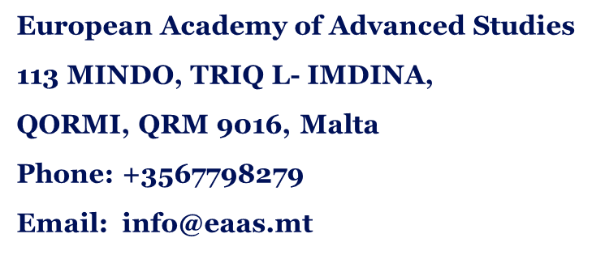
Thank you
Discover the world of EIIET

