Slide 1

Crisis Communication in Tourism: The Travel Tribe
Here is where your presentation begins

Slide 2
Introduction
Overview of The Travel Tribe: An emerging sustainable tourism brand
Importance of crisis communication in the tourism industry
Purpose: Explore how The Travel Tribe manages crisis effectively

Slide 3
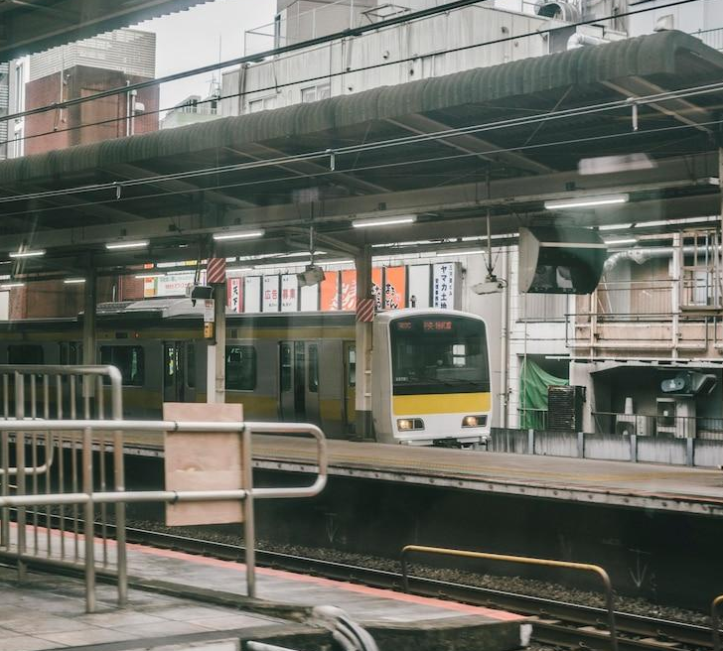
What is Crisis Communication?
Strategic response to unexpected events
Protects brand image and ensures stakeholder trust
Vital in fast-moving sectors like tourism

Slide 4
Common Crises in Tourism
Natural disasters (e.g., bushfires, floods)
Pandemics and health outbreaks (e.g., COVID-19)
Negative social media or customer complaints

Slide 5
Recent Case Study – Crisis Faced by The Travel Tribe
Cancellation of eco-tours due to severe weather
Loss of bookings and reputational damage
Event
Damage
Satisfaction
Immediate customer backlash on social media

Slide 6
The Travel Tribe’s Initial Response
Issued public apology and safety explanation
Offered full refunds and booking flexibility
Acknowledged issue on all platforms within 4 hours

Slide 7
Key Components of The Travel Tribe’s Crisis Plan
Pre-approved communication templates
Adaptability in the face of change
Innovation and its impact
Intersection of art
24/7 social media monitoring
Dedicated crisis response team
Customer service training for emergencies

Slide 8
Communication Channels Used
Social media (Instagram, Facebook, Twitter)
Company website banners and pop-ups
Direct emails and SMS to affected customers
Press release for broader media coverage

Slide 9
Stakeholder Engagement
Tourists:
Transparent and timely updates
Partners:
Real-time coordination with hotels and guides
Employees:
Internal memos and support
Media:
Controlled narrative via press kits

Slide 10
Lessons Learned by The Travel Tribe
Speed and transparency are critical
Proactive engagement prevents escalation
Customers value empathy and flexibility

Slide 11
Best Practices in Crisis Communication (Tourism)
1
Have a clear crisis management plan
2
Train staff regularly
3
Always prioritize guest safety and wellbeing

Slide 12
Thanks

