Slide 1

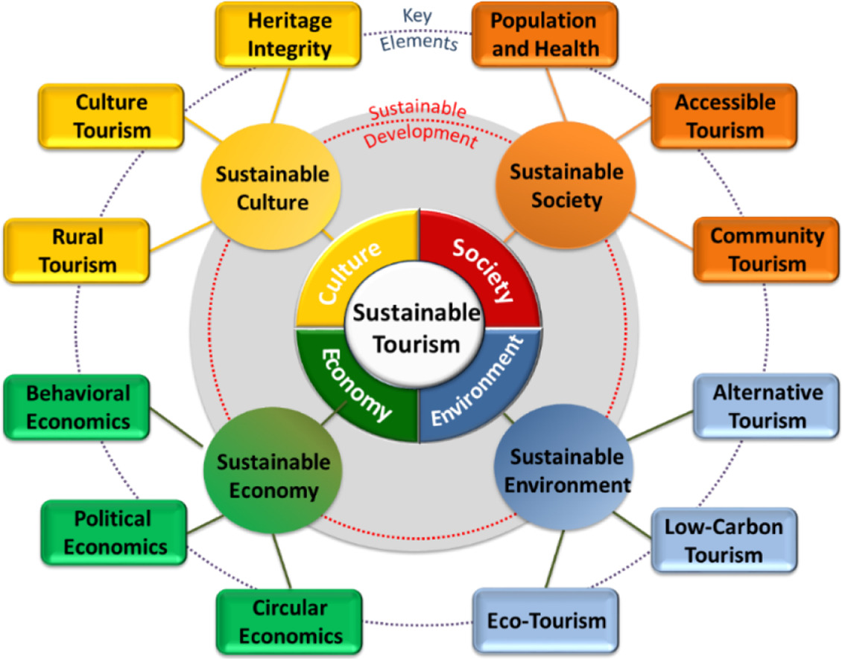
Sustainable Tourism in India
Concept, Challenges, and Roadmap for Implementation
PRADEEP SUBHASH

Slide 2

What is Sustainable Tourism?
Tourism that meets present needs without harming future generations.
Focuses on environmental, socio-cultural, and economic balance.
Aims to minimize waste, emissions, and overuse of resources.
Promotes community well-being and cultural heritage protection.
Guided by UN SDGs and global sustainability standards.

Slide 3
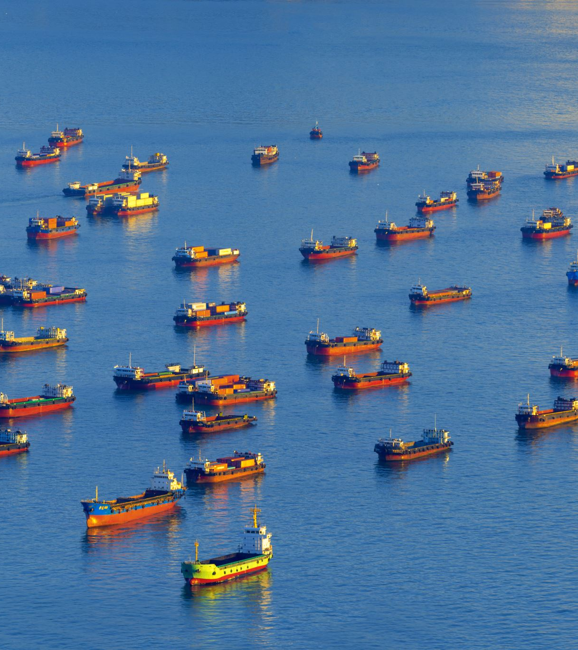
Why It Matters for India
India has diverse assets: Himalayas, beaches, forests, and heritage cities.
Tourism supports rural livelihoods, crafts, and small businesses.
Growing eco-tourism market creates opportunities for green jobs.
Climate risks make sustainable practices essential for resilience.
Global travelers increasingly prefer responsible destinations.

Slide 4
Key Challenges: Environmental
Poor waste management and plastic pollution at popular sites.
Water stress and seasonal overuse in hill and desert regions.
Biodiversity disturbance and human–wildlife conflicts.
Emissions from transport and diesel-based last-mile mobility.
Climate change: floods, landslides, and heatwaves impacting tourism seasons.

Slide 5
Key Challenges: Socio-economic & Governance
Overtourism strains infrastructure and local communities.
Revenue leakage to large operators, limiting local benefits.
Skill gaps in sustainable tourism and visitor management.
Weak enforcement of eco-standards across states.
Unequal adoption of certifications and green practices

Slide 6
India’s Policy Landscape
National and state eco-tourism guidelines promote responsible practices.
Heritage and wildlife protections through ASI and protected areas.
Government support for rural tourism clusters and homestays.
Push for digital payments, EV mobility, and smart tourism hubs.
Growing adoption of eco-certifications and green building norms.

Slide 7
Case Examples
Kerala: Responsible Tourism Mission links local producers to hotels.
Sikkim: Organic farming image supports nature-based tourism.
Rajasthan: Heritage reuse of forts and havelis for cultural tourism.
Ladakh: Visitor caps and waste rules in fragile high-altitude zones.
Goa & Andamans: Reef-friendly practices with dive operator codes

Slide 8
Implementation Strategies
Set visitor capacity limits and zoning norms.
1
Promote green mobility: EV shuttles, cycling, and walking routes.
2
Improve water and waste management systems at destinations.
3
Strengthen local value chains: crafts, farm-to-table, community guides.
4
Train operators with GSTC-aligned certification programs.
5

Slide 9
Stakeholders & Their Roles
Government: Standards, enforcement, destination planning.
Local bodies: Manage waste, water, mobility, and community needs.
Communities: Operate homestays, act as cultural custodians.
Private sector: Invest in green operations and fair sourcing.
NGOs/Academia: Build capacity, monitor impacts, evaluate outcomes.

Slide 10
Financing Sustainable Tourism
Subsidies and tax rebates for eco-friendly retrofits.
Green bonds and blended finance for infrastructure projects.
Performance-linked incentives for certified operators.
Public-private partnerships for waste and mobility systems.
Tourist user fees reinvested into site management.

Slide 11
Measuring Progress
Climate: Carbon emissions per tourist and EV usage share.
Water: Litres used per guest and % water recycled.
Waste: Kg waste per visitor and % recycled.
Economy: % of local spend and MSME participation.
Culture/Nature: Sites with conservation plans and biodiversity indicators.

Slide 12
12-Month Roadmap
Pilot two destinations with visitor capacity limits.
Adopt plastic-free festival protocols at state events.
Launch EV shuttle and walking routes in one tourist hub.
Train 1,000 operators on sustainable tourism standards.
Publish annual sustainability scorecards for pilot sites.

Slide 13

Conclusion
India’s tourism can grow while protecting culture and nature.
Focus on capacity, green mobility, and resource efficiency.
Empower communities for inclusive and fair growth.
Use transparent measurement and reward best practices.
Sustainability strengthens Brand India’s global competitiveness.

Slide 14
References
Global Sustainable Tourism Council. (2019). GSTC criteria for sustainable tourism. Retrieved September 23, 2025, from https://www.gstcouncil.org
Ministry of Tourism, Government of India. (2022). Sustainable tourism practices in India. Retrieved September 23, 2025, from https://tourism.gov.in
United Nations World Tourism Organization (UNWTO). (2020). Tourism and the sustainable development goals – Journey to 2030. UNWTO. https://www.unwto.org
Kerala Responsible Tourism Mission. (2021). Responsible tourism initiatives in Kerala. Retrieved September 23, 2025, from https://www.responsibletourism.kerala.gov.in
Sati, V. P. (2020). Sustainable tourism development in the Indian Himalayan region: Issues and challenges. GeoJournal of Tourism and Geosites, 32(4), 1269–1276. https://doi.org/10.30892/gtg.32401-568
Sharma, K., & Banerjee, S. (2021). Ecotourism in India: Opportunities and challenges for sustainable development. Journal of Environmental Management and Tourism, 12(1), 23–31. https://doi.org/10.14505//jemt.v12.1(49).02

