Slide 1
Quality and Sustainability in Tourism and Hospitality
European Institute of Innovation, Entrepreneurship and Technology
Lessingstraße 79, 13158 Berlin, Germany
Mahmoud Abdou| Berlin
      Lessingstraße 79,
      13158 Berlin, Germany
      Phone: +49 30 233618555
      Fax: +49 30 233618556
      Email: info@eiiet.com

Slide 2

Outline:
Resource Planning and Destination Development
Destination Development Elements
Sustainability in Destination Development
Conservation Standards Framework

Slide 3
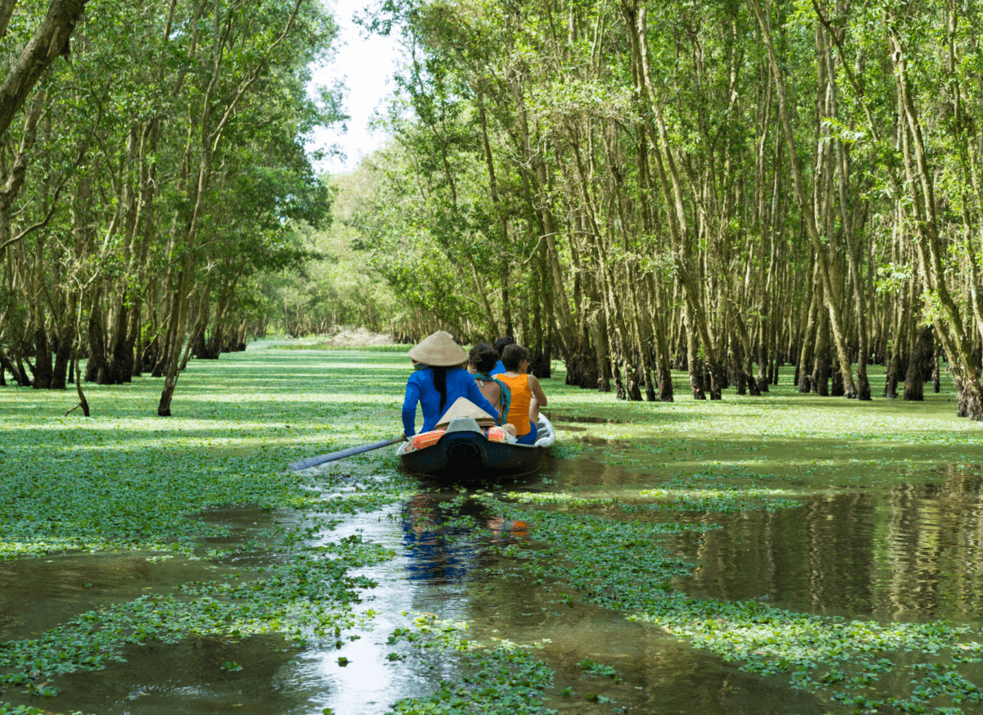
1- Resource Planning and Destination Development

Slide 4
1- Destination Management
      - It is the coordinated and strategic organization of all the elements that contribute to a tourist destination.
      - This includes:
Attractions | Amenities
Access | Marketing
Pricing

Slide 5
1- Destination Management
      - Destination Mangement helps:
      - Prevent duplication in:
      Promotion
      Visitor services
      Training and business support
      -Identify management gaps
      Unaddressed issues or underdeveloped areas
      - Encourage collaboration across sectors

Slide 6
1- Destination Management
      - The key Benefits of Destination Management
      Establishing a competitive edge
      Ensuring tourism sustainability
      Spreading the benefits of tourism
      Improving tourism yield
      Building a strong and vibrant brand identity

Slide 7
1- Destination Management
      Common Drivers Behind Destination Management:
      A- Improving Tourism Yield
      - Lengthen visitor stay
      - Increase visitor spending
      - Maximize capacity usage
      B- To protect communities and provide viable livelihoods.
      - Creates alternative income streams
      - Revitalizes local businesses
      - Underpins community stability and long-term viability

Slide 8
1- Destination Management
      C- To reduce seasonality.
      - Distribute visitor flow more evenly across the year
      - Improve employment stability and ROI for businesses
      - Maximize use of tourism infrastructure year-round
      - Promote off-season activities
      D- To spread the benefits of tourism more widely.
      - Encourage broader visitor dispersal across regions
      - Support under-visited areas to participate in tourism growth
      - Ease pressure on over-visited hotspots

Slide 9
1- Destination Management
      E- To increase awareness and enhance the image of the destination.
      - Develop unique and memorable visitor experiences
      - Promote creatively and strategically
      - Use travel influencers and social media
      F- To ensure long term sustainability.
      - Maintains destination quality over time
      - Supports local communities and culture
      - Can have a positive or regenerative effect on the destination

Slide 10
1- Destination Management
      G- To protect cultural or natural assets
      - Supports site preservation and funding
      - Stimulates tourism revenue to fund protection efforts
      - Helps balance visitor access with conservation

Slide 11
2- Destination Development Elements

Slide 12
2- Destination Development Elements
      2.1- Infrastructure and facility planning
      A- Roads and Signage
      - Ensure well-maintained, connected roads
      - Use clear, multilingual signage
      - Improve orientation and visitor safety
      B- Transportation Systems
      - Plan for efficient and accessible transport.
      - Create designated parking zones to reduce congestion.
      - Encourage low-impact transport options to support sustainability.

Slide 13
2- Destination Development Elements
      C- Visitor Centers
      - Offer maps, brochures and local info
      - Provide rest areas and visitor amenities
      - Support education and destination interpretation.
      D- Communication Networks
      - Provide internet and mobile access
      - Enable digital bookings and navigation
      - Support emergencies with reliable channels

Slide 14
2- Destination Development Elements
      2.2- Accessibility and Inclusivity
      A- Adapting Activities:
      - Offer inclusive programs for all ages and abilities.
      - Provide adaptive equipment and modifications.
      - Engage underserved and diverse groups.
      B- Inclusive Design:
      - Ensure wheelchair accessibility (ramps, paths, restrooms).
      - Address sensory needs (quiet spaces, visual cues, tactile signage).
      - Provide multilingual signs/materials to reduce language barriers.

Slide 15
2- Destination Development Elements
      2.3- Zoning and Land-Use Planning
      A- Designated Areas
      - Allocate land for tourism use
      - Prevent land-use conflicts
      - Support organized development
      B- Sustainable Development
      - Align tourism with conservation goals
      - Protect nature and heritage
      - Avoid overdevelopment

Slide 16
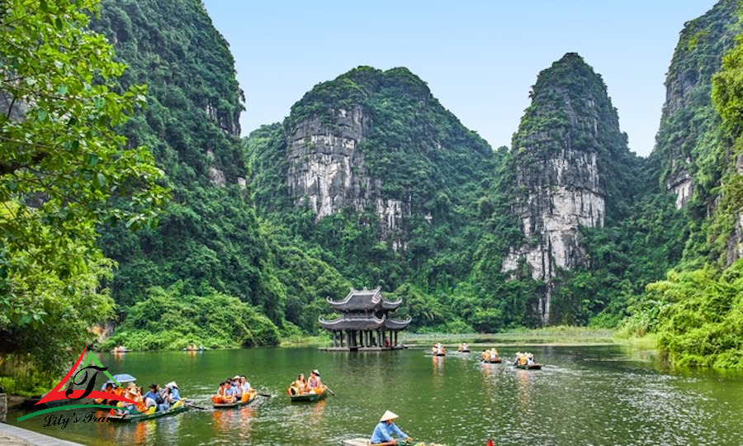
3- Sustainability in Destination Development

Slide 17
3.1- Environmental Impact Mitigation
      - A systematic process to identify and evaluate potential effects
      - Applied to projects, plans, programs, or policies
      - Assesses impacts on physical, biological, cultural
      and socioeconomic environments.
      - The EIA includes 7 stages:
EIA
Screening
Impact Management
The EIA Report
Review & Licensing
Monitoring
Scoping
Impact Assessment & Mitigation

Slide 18
3.1- Environmental Impact Mitigation
      A- Screening in EIA
      - First stage of the EIA process
      - Determines whether a full assessment is needed or not
      - Follows legal procedures to ensure consistency across projects
      Key Contributions of Screening
      - Enables informed decision-making through factual analysis
      - Filters out unsound proposals early
      - Helps refine projects or policies to reduce negative impacts
EIA
Screening
Impact Management
The EIA Report
Review & Licensing
Monitoring
Scoping
Impact Assessment & Mitigation

Slide 19
3.1- Environmental Impact Mitigation
      B- Scoping in EIA
      - Identifies key issues to focus on
      - Eliminates less relevant concerns
      - Sets the boundaries and framework for the EIA process
      Purpose of Scoping
      - Define what to analyze and how
      - Reduce risk of overlooking or overloading issues
      - Ensure a focused, efficient assessment
EIA
Screening
Impact Management
The EIA Report
Review & Licensing
Monitoring
Scoping
Impact Assessment & Mitigation

Slide 20
3.1- Environmental Impact Mitigation
      C- Impact Assessment in EIA
      - Evaluates the environmental and social impacts.
      - Uses qualitative and quantitative data
      - Supports informed decision-making and alternative selection
      Mitigation Measures
      - Actions to prevent, reduce, or compensate for identified impacts:
      Prevention: Avoiding impacts completely
      Reduction: Minimizing severity or duration of impacts
      Compensation: Offsetting unavoidable impacts
EIA
Screening
Impact Management
The EIA Report
Review & Licensing
Monitoring
Scoping
Impact Assessment & Mitigation

Slide 21
3.1- Environmental Impact Mitigation
      D- Impact Management in EIA
      - Involves planning, managing, and monitoring mitigation actions throughout the project lifecycle
      - Aims to address ongoing risks, such as:
      Technology failures
      Natural disasters
      Environmental Management Plan (EMP)
      - A mandatory component of most EIA reports
      Specific mitigation measures
      Monitoring protocols
      Roles and responsibilities for implementation
      Emergency response strategies
EIA
Screening
Impact Management
The EIA Report
Review & Licensing
Monitoring
Scoping
Impact Assessment & Mitigation

Slide 22
3.1- Environmental Impact Mitigation
      E- The EIA Report
      - A comprehensive document that compiles all findings from the EIA process, including:
      - Project description
      - Environmental and social impact assessment
      - Mitigation measures
      - Management and monitoring plans
EIA
Screening
Impact Management
The EIA Report
Review & Licensing
Monitoring
Scoping
Impact Assessment & Mitigation

Slide 23
3.1- Environmental Impact Mitigation
      F- Review and Licensing
      - Final Step of the EIA Process
      - To evaluate the quality of the EIA report and decide whether the project can be approved.
      In the Review stage:
      - Authorities assess the data, methods, and conclusions in the EIA report.
      - Determine whether the project adequately addresses environmental
      and social risks.
      Can result in:
      - Project approval (license granted)
      - Request for changes or more data
      - Rejection of the project
EIA
Screening
Impact Management
The EIA Report
Review & Licensing
Monitoring
Scoping
Impact Assessment & Mitigation

Slide 24
3.1- Environmental Impact Mitigation
      G. Monitoring
      - To track environmental and social impacts throughout the entire project lifecycle.
      Ensures that:
      - Mitigation measures are implemented effectively
      - The Environmental Management Plan (EMP) is followed
      - Contingency plans are ready for unexpected issues
EIA
Screening
Impact Management
The EIA Report
Review & Licensing
Monitoring
Scoping
Impact Assessment & Mitigation

Slide 25
3.1- Environmental Impact Mitigation
      Task:
      Explain a site / place that experiences a development process and highlight:
      - The main risks/ threats of this project on the social/ economic/ environmental aspect.
      - Rate these risks qualitatively and quantitatively
      - Suggest strategies/actions to overcome these risks/threats

Slide 26

4- Conservation Standards Framework

Slide 27
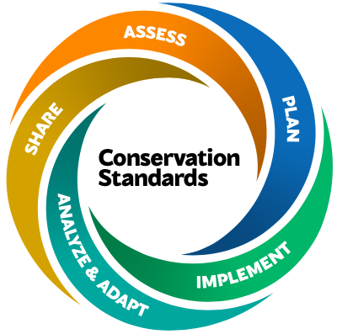
4- Conservation Standards Framework
    The Conservation Standards Framework
    - Provides an evidence-based, structured approach to
    conservation initiatives
    - Ensures effectiveness, impact, and continuous learning
    Five Key Steps of the Conservation Standards:
    - Assess - Plan
    - Implement - Analyze and Adapt
    - Share

Slide 28
4- Conservation Standards Framework
5.1- Assess:
A- Purpose and Team
- Define the aim of the assessment
- Identify and organize a multidisciplinary planning team
Assess
Purpose & team
Scope & vision
Targets & viability
Threats
Conservation situation

Slide 29
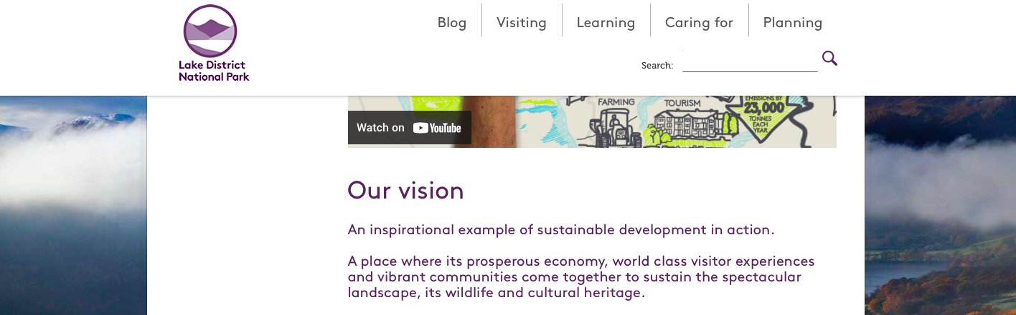
4- Conservation Standards Framework
Assess
Purpose & team
Scope & vision
Targets & viability
Threats
Conservation situation
B- Scope and Vision
- Establish the geographic and thematic boundaries
- Create a shared long-term vision for conservation success

Slide 30
4- Conservation Standards Framework
C- Targets and Viability
- Identify key conservation targets
- Evaluate the health and viability of each target
Assess
Purpose & team
Scope & vision
Targets & viability
Threats
Conservation situation

Slide 31
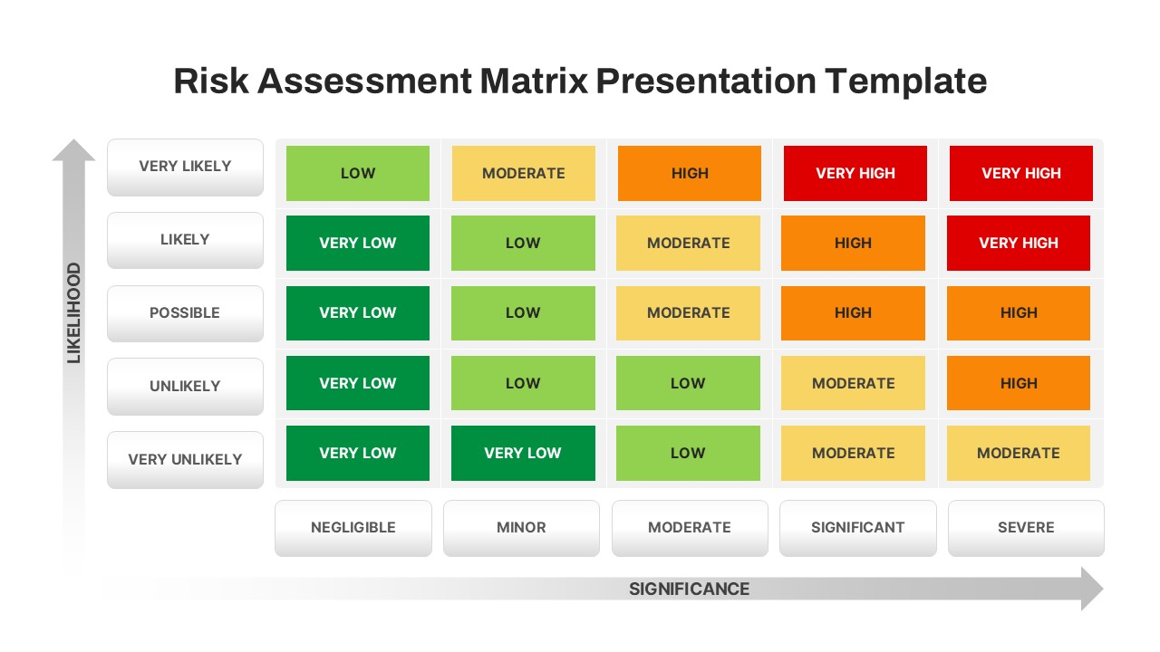
4- Conservation Standards Framework
D- Threats
- Identify direct and indirect
threats to conservation targets
- Rank threats by severity, scope,
and irreversibility

Slide 32
4- Conservation Standards Framework
E- Conservation Situation Analysis
- Summarize the context:
ecological, social, political, and economic
- Map relationships between targets, threats, and key actors
Assess
Purpose & team
Scope & vision
Targets & viability
Threats
Conservation situation

Slide 33
4- Conservation Standards Framework
5.2- Plan:
- Summarize the context:
ecological, social, political, and economic
- Map relationships between targets, threats, and key actors

Slide 34
4- Conservation Standards Framework
5.2- Plan:
A- Goals
- Define the desired long-term outcomes
- Should be SMART:
Specific, Measurable, Achievable, Relevant, Time-bound
- Aligned with the vision and based on assessment findings
Plan
Goals
Strategies
Theories of change
Monitoring
Operational

Slide 35
4- Conservation Standards Framework
B- Strategies
- Define how to achieve the goals
- Combine direct actions, policy efforts, and community engagement
- Prioritize strategies based on feasibility and impact
Plan
Goals
Strategies
Theories of change
Monitoring
Operational

Slide 36
4- Conservation Standards Framework
C- Theory of Change
- Why do you believe your actions will work
- Logical model showing how strategies lead to desired outcomes
- Links inputs → outputs → outcomes → long-term impacts
- Helps test assumptions and refine actions
Plan
Goals
Strategies
Theories of change
Monitoring
Operational

Slide 37
4- Conservation Standards Framework
D- Monitoring Plan
- Identify indicators to track progress
- Include baseline data, targets, and data collection methods
- Supports learning and accountability
Plan
Goals
Strategies
Theories of change
Monitoring
Operational

Slide 38
4- Conservation Standards Framework
E- Operational Planning
- Translate strategies into specific activities
- Assign responsibilities, set timelines, and budget
- Plan for risk management, partnerships, and resource needs
Plan
Goals
Strategies
Theories of change
Monitoring
Operational

Slide 39
4- Conservation Standards Framework
5.3- Implement
- Put your strategies and plans into action
Key Activities:
- Carry out fieldwork, restoration, community outreach,
or policy efforts
- Manage logistics (staffing, budgeting, timelines)
- Coordinate with stakeholders and partners
- Ensure compliance with legal and environmental standards

Slide 40
4- Conservation Standards Framework
5.4- Analyze and Adapt
- Monitor progress and evaluate the effectiveness of actions.
Key Activities:
- Collect data based on the monitoring plan
- Compare results to goals and expected outcomes
- Identify what’s working and what’s not
- Adjust strategies and operations as needed

Slide 41
4- Conservation Standards Framework
5.5- Share
- Communicate results, lessons, and experiences.
Key Activities:
- Publish reports and case studies
- Present findings to communities, funders, and partners
- Facilitate knowledge exchange across conservation projects
- Promote transparency and learning in the conservation field

Slide 42
4- Conservation Standards Framework
Discussion
Based on conservation standards:
- Choose a site and describe five major hypothetical threats.
- Categorize each threat according to its likelihood and severity;
- And outline strategies to mitigate or overcome them

Slide 43
Thank you
      European Institute of Innovation, Entrepreneurship and Technology
      Lessingstraße 79,
      13158 Berlin, Germany
      Phone: +49 176 55524449
      Email: info@eiiet.com
Discover the world of eiIET

