Slide 1
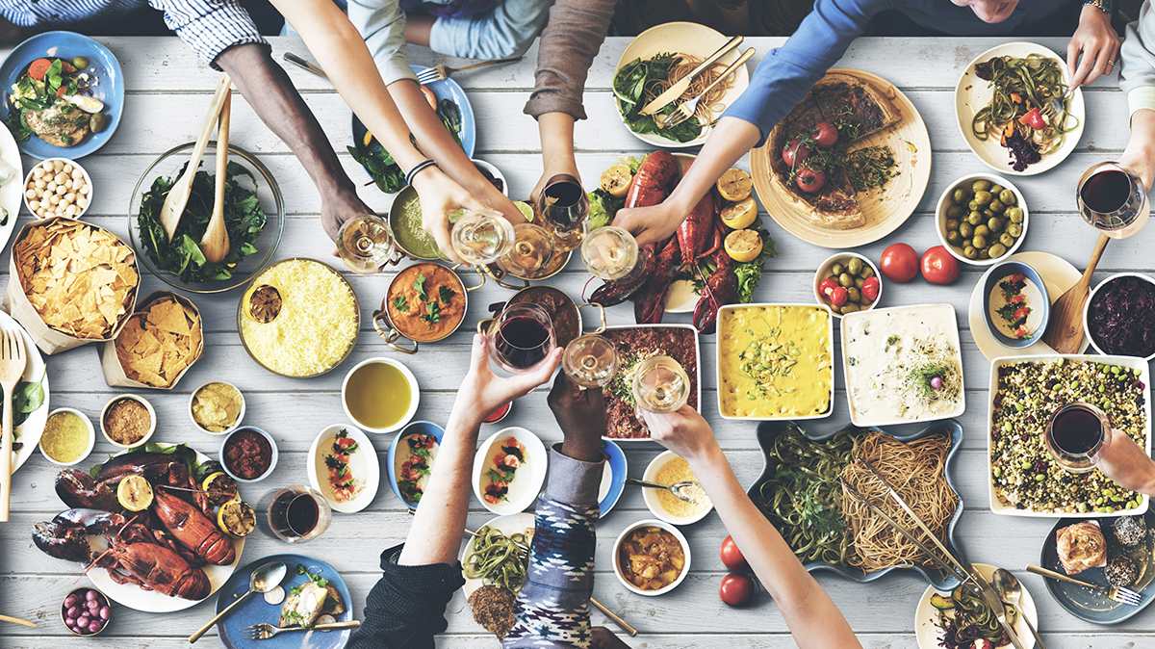
Culturally Adaptive Meal Planning for International Tourists

Slide 2
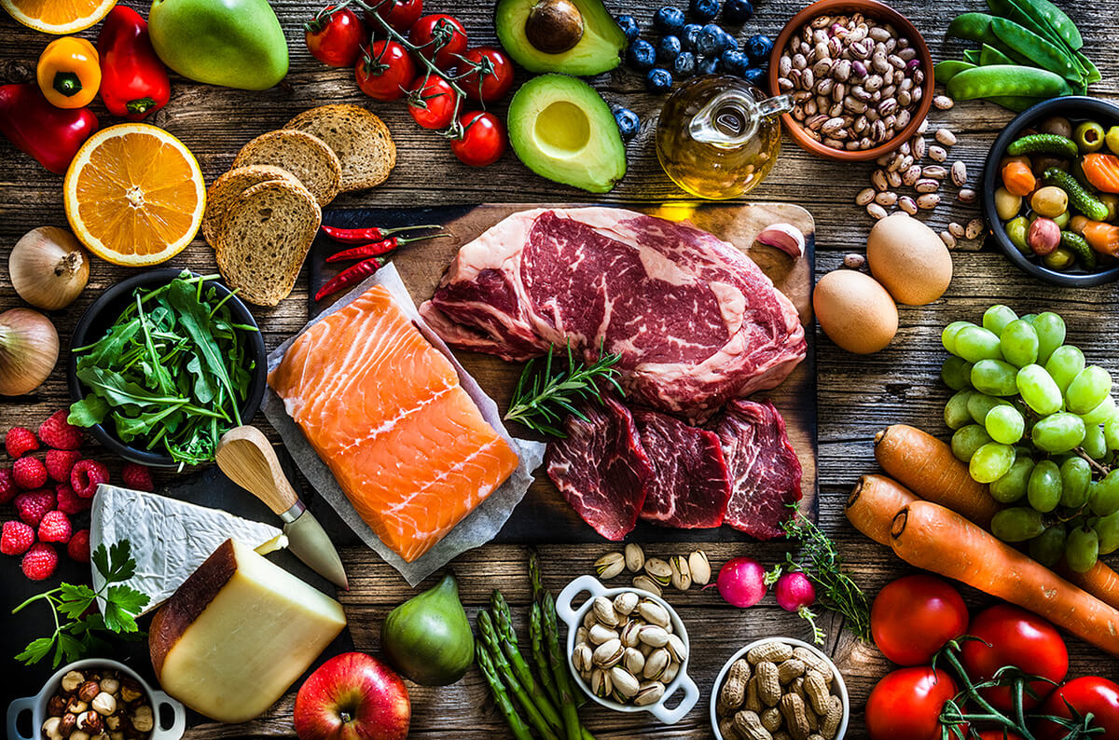
Introduction
A healthy diet is crucial to sustain tourist mobility. In a cross-sectional environment, tourists may face some complex health issues by eating strange local environmental foods in tourist places.
Due to this, scientists undergo some research on food consumption by tourists and the complex health issues addressed from the biomedical perspective by involving food nutrition and hygiene (Lin et al. 2022).
While travelling, tourists often face new cultures, cultural shocks cause disturbance of both health and mental adjustments experiences under cultural stimuli. Cross-cultural adaptation refers to the process of needful adjustment in the individual's internal changes to be able to function in the host culture (Malota et al. 2023).
(Source: iga.com.au, 2025)
Notes:
This current study is focused on the culturally developed adapted meal plans for UK tourist’ spots- London, Edinburgh and the Lake District. The main objective in this study is to provide well-planned cultural adaptive meals which are vegan, diabetic, gluten-free and have religious restrictions for the tourists visiting UK tourist’s spot mainly for London, Edinburgh and Lake districts to adapt cross-cultural food and environment to avoid any complex health issues.
Cultural adaptive Meal planning enhances the tourism activity in which the visitor’s motivation to learn, discover and experience to attain the desired knowledge and can consume any tangible and intangible dishes without causing any health disturbances in the destination.

Slide 3
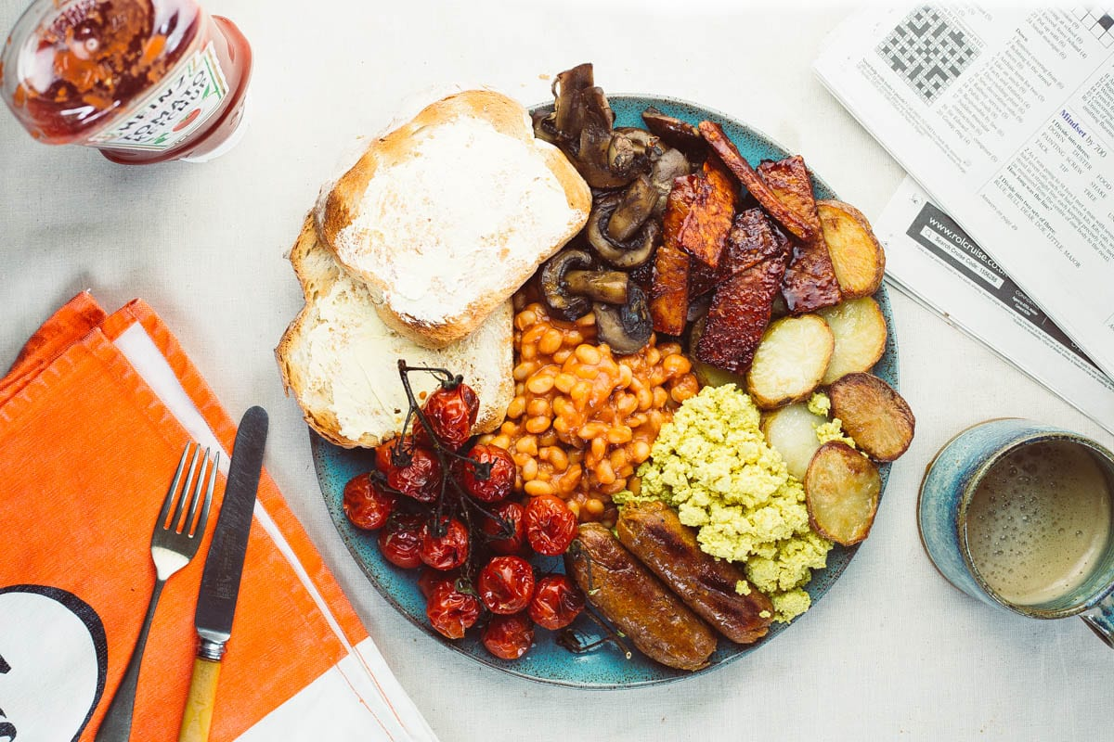
Culturally adaptive meal plans with full nutritional breakdown in three tourism destinations
The culturally adaptive meal plans mainly focus on the tourist dietary needs. The meal plans focus on the type of dietary plans like vegan diets, diabetic diets, gluten free diets and diets based on religious restriction.
London
Breakfast: The travel agency offers various options for vegan meals like, Berry-Kefir smoothie, cinnamon rolls using oats and non-dairy milk, and low-fat plain Greek yoghurt with halved strawberries (eatingwell.com, 2025). The agency offers many vegetarian meal options for tourists for respective restrictions according to their religion.
For tourists with diabetes, the agency provides low-sugar and gluten-free diets like, multigrain bread, puffed rice and vegetables, salmon with scrambled eggs, whole grain toast with mushrooms and grilled tomatoes (diabetes.org.uk, 2025)
Lunch: For lunch for Vegan tourists, the agency offers options like, green salad and Pita Bread with Hummus, chopped salad with Sriracha- Tofu and peanut dressing, eggs in tomato sauce with spinach and hummus sandwich (tasteofhome.com, 2025).
(Source: Frainbowplantlife.com, 20252)
Notes:
The agency offers diabetic options for lunch like turkey stuffed tomatoes with whole wheat and couscous salad, roasted spiced broccoli soup, healthy pancakes with lemon cream and cheese, blueberry bran muffins, peanut butter and raspberry porridge.
For tourists who want vegetarian food, the agency provides cauliflower soup, chick-pea potato curry, grilled sandwiches, eggplant sandwiches, California spaghetti salad, and tofu chow mein .
Dinner: vegan dinner includes vegan tacos, quinoa black bean salad, ravioli with spinach and tomatoes, avocado toast and avocado salad. Diabetic dinner includes chicken and lemon skillet pasta, wild rice soup, charred shrimp, pesto and quinoa bowls, brussel sprouts and maple roasted chicken, black bean nacho soup, and white bean soup. Vegetarian options like green salad with chickpeas, vegan white bean chilli, creamy fettuccine with sprouts and mushrooms, cilantro bean burgers, roasted veggies and spiced lentils are provided.

Slide 4
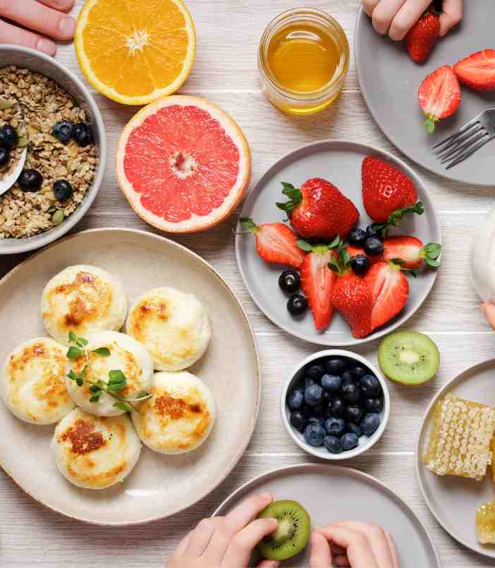
CONTD.
Edinburgh
Breakfast: For tourists who prefer gluten-free products, in Edinburgh, the agency will provide Bread Meats Bread, a Canadian-style burger piece that has adapted gluten-free products.
For vegan travellers, the agency can provide the famous rumble thumbs made with rooted vegetables and mashed potatoes served with a healthy fulfilling soup (contiki.com, 2025).
For diabetic patients, the agency will provide a balanced whole grain sandwich or brown bread to avoid any sugar hike in the early morning. It is important to provide well-balanced food in the morning for diabetic travellers.
Lunch: travellers who prefer gluten-free products can have options like pizza and Gluten-free hand-ripped noodles made up of a gluten-free base, loaded with green veggies and customized seafood on top, (thegoodfoodguide.co.uk, 2025).
(Source: Mykidstime.com, 2025)
Notes:
For vegan travellers, pasta dishes are available along with curries and burgers with any dairy products. For diabetic patients, the agency will provide a plate of brown rice, black beans, or whole-wheat pasta for lunch.
Dinner: For dinner, the agency will provide some local gluten-free dishes like baked, grilled or roasted chicken and seafood along with a bowl full of veggies. Edinburgh is renowned for its fresh seasonal vegetables which promotes ecotourism by avoiding any unwanted complex health issues.

Slide 5

CONTD.
For vegan travellers, a traditional bowl of oatmeal which contains various seasonal fruits like strawberries and bananas, can also be for travellers who have religious norms. For dinner, the diabetic visitor is provided with a plate of healthy protein like chicken breast, whole fried fish and meat (cdc.gov 2025).
Broil, grill or pan-fry meat is also a good gluten-free option for the travellers. The platter is full of green veggies and a touch of peanuts along the side. The rumblede thumps are named so because of the sound of the ingredients they make as they thumb around a wooden spoon in a baking dish. Gluten-free hand-ripped noodles are renowned for their rich-flavoured Chinese dish, which are best for a fulfilling lunch.
Notes:
Edinburgh is renowned for its fresh seasonal vegetables. And the best traditional dinners are provided such as a bowl of soup, or bowl of oatmeals. The bowl of oatmeal is cooked slowly with salt and water, which helps in maintaining the body temperature which will keep you warm. For diabetic travellers, the agency will provide a well-balanced time-to-time food to avoid any unwanted sugar fall or rise during travelling. It is important to have a balanced diet of carbs and fresh vegetables along with meat. For religious restrictions, both breakfast, lunch and dinner have no cruelty-free items and mainly have green vegetables.

Slide 6
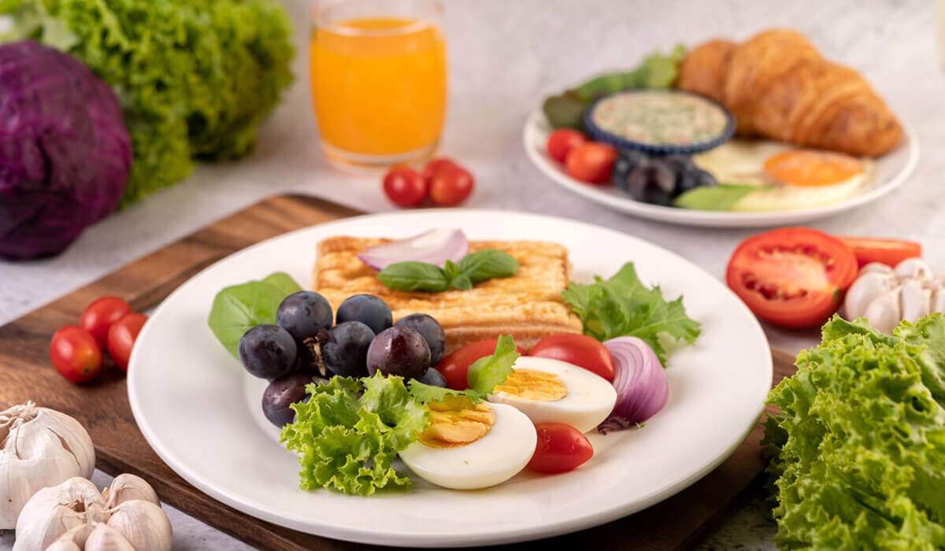
CONTD.
Lake District
Breakfast: For the tourists who are visiting the Lake District, the agency provides all of them with proper vegan, diabetic and dietary options that are restricted in respective religions.
The agency includes vegan options like vegan cereals, chia seed pudding, porridge, vegan protein pancakes, tofu scramble, tofu omelette and healthy vegan fry up (purition.co.uk, 2025).
The vegetarian options include hash browns, baked beans, peanut butter banana shakes, rosemary and rye muffins. The agency provides diabetic tourists with wholemeal toast and eggs, quinoa breakfast bowls, and fruity French toast. The agency provides pulses, grains, fish or meat for tourists who want gluten-free options as well. The agency provides the vegan tourists of the Lake District with vegan burritos, falafel, salads and vegan pizza.
The vegan tourists of Lake District get dinner options like, salt pepper tofu, butter bean curry, stuffed pumpkin, vegan lentil stew and sweet potato cottage pie. The diabetic meals provided by the agency include crispy salmon salad, mexican bean stew, simple roast chicken with sweet potato, healthy chicken curry, berry yoghurt, creamy mushroom curry (bbc.co.uk, 2025)
(Source: Iowadiabetes.com, 2025)
Notes:
For diabetic meals, the agency offers whole grain sandwiches with chicken/ veggies/ ham, stir-fried veggies, puffed rice with veggies and pancakes made with overnight oats.
For religious-restricted diets, the agency provides options like chillies, cauliflower cheese, falafel wraps, roasted vegetables and shepherd's pie. The gluten-free options for lunches are salads with quinoa or rice along with gluten-free options like meat/ fish/ egg.
For tourists who have certain restrictions in their religion, the company provides several options for them like, vegetable pasta bake, macaroni cheese, veggie burger, vegetable lasagna, carrot lentil soup, quinoa salad with grilled veggie and stuffed cauliflower. The gluten-free option includes spicy carrot tacos, lemony chicken lentils, spiced fried rice with sausage, vegetable stew with coconut, black pepper chicken and lemon yoghurt.

Slide 7
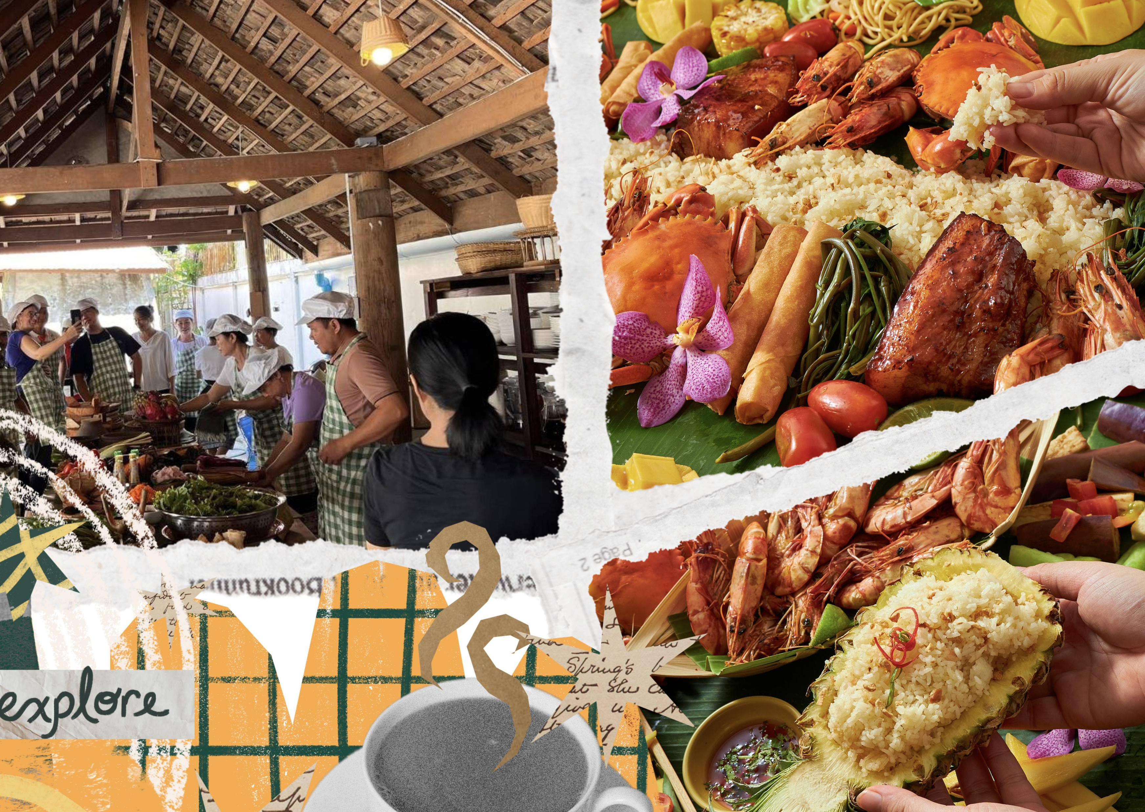
Specific challenges faced by tourists
During travelling, travellers often face some specific challenges which often cause many complex health issues and travelling complexity.
Indeed the term ‘cultural shock’ is described in the tourist context to describe the disturbance of emotion or anxiety experienced by the tourists visiting a foreign destination encountering specific cultural differences (Garrod et al. 2022).
In the UK, destinations such as London, Edinburgh, and Lake Districts have multicultural cuisines which may be not vegan, diabetic, or not approved by the religious norms.
(switch-asia.eu, 2025)
Notes:
London cuisines are worldwide, renowned for a vibrant multicultural flavour of cuisines that offers a wide range of varieties but some travellers find it difficult to navigate and choose based on personal preferences, dietary plans and religious norms. Edinburgh is well known for its Scottish cuisines which have distinctive labours and ingredients that may cause disturbance in dietary restrictions and may cause severe allergens. However, in Lake District, they have well-known local cuisines which contain meat, beef, pork and shellfish which is quite impossible for the tourists to cooperate according to their dietary preferences.

Slide 8

Guidelines for local hospitality partners
In London, the 10 and 5 rule will be helpful for local partners to build good relationships with them. Reciprocal benefits will be offered in order to build mutually beneficial partnerships.
Corporate hospitality should be modest and demonstrate good value for taxpayer money. It must align with the project's budget and be suitable for the type of hospitality provided by VisitScotland.
Employees should never make or be seen to make facilitation payments meaning payments to third parties to speed up a business transaction, as these are illegal (visitscotland.org, 2025)
(source: Medium.com, 2025)
Notes:
In the Lake District there are several options related to accommodations that can be taken into account for the tourists visiting the Lake District. This will be helpful in mitigating the wastage of time for looking for something better there.

Slide 9
COMMUNICATION TEMPLATE
Tick the destinations that you will be visiting
London
Edinburgh
Lake District
Dietary Requirements:
Name of the traveller:
Please show any dietary requirements you may have
Vegetarian
Vegan
Gluten-Free (Please specify if you have any disease or gluten sensitivity): _________________________
Notes:
Dairy-Free (Please specify the reason)
_________________________
Nut Allergy (Please specify): _________________________
Other Allergies (Please specify): _________________________
Diabetic (Please provide any specific guidelines or restrictions your doctor has provided): _________________________
Religious Dietary Restrictions (Please specify):
Halal
Kosher
Other (Please specify): _________________________
Other Dietary Preferences or Restrictions (Please specify): _________________________
Specific Likes and Dislikes:
In order to further personalize your meals, please feel free to list any specific foods you particularly enjoy or dislike. This is useful for our chef to understand the preferences.
Likes: _________________________________________________________________________
Dislikes: _____________________________________________________________________
Severity of Allergies:
If you have any allergies, please indicate the severity:
Mild (Intolerance or discomfort)
Severe (Potentially life-threatening anaphylaxis)
Language preferences throughput the tour for any instructions for communicating any issues:

Slide 10
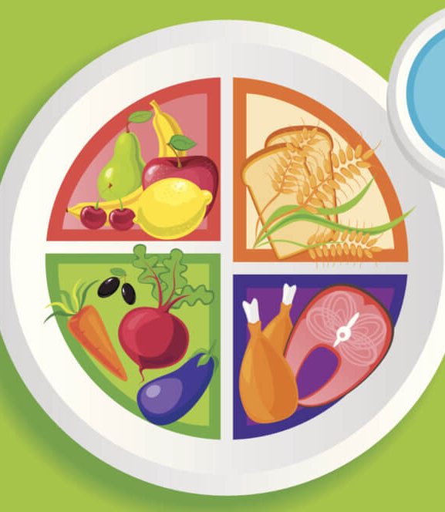
Dietary guidelines by WHO
Consume a variety of foods, including fruits, vegetables, legumes (such as lentils and beans), nuts, and whole grains (like unprocessed maize, millet, oats, wheat, and brown rice).
Aim for at least 400 grams (approximately five servings) of fruits and vegetables daily, not including starchy options like potatoes, sweet potatoes, cassava, and other roots.
Limit free sugars to below 10% of your total energy intake, which translates to about 50 grams (or around 12 teaspoons) for someone of healthy weight consuming about 2,000 calories per day; ideally, this should be less than 5% for better health benefits (who.int, 2025)
(Communitycare.com, 2025)
Notes:
Incorporating vegetables into meals, snacking on fresh fruits and raw vegetables, choosing seasonal produce, and eating a diverse range of fruits and vegetables. These guidelines are helpful for the tourists travelling to three destinations who are vegan, religious restrictions, diabetic and gluten free. It will help in maintaining a healthy diet for every tourist with different food preferences.

Slide 11
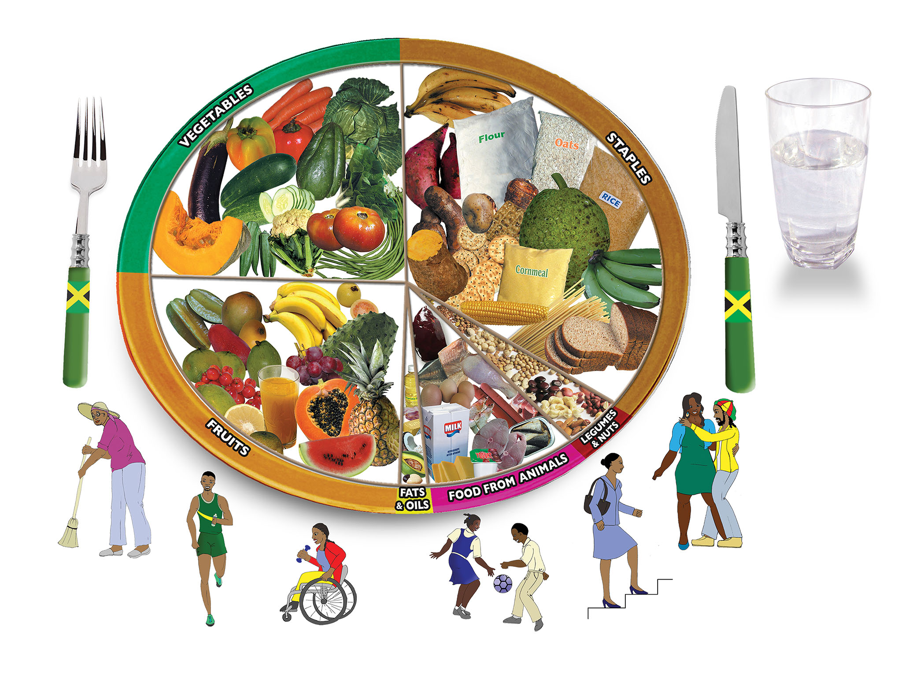
CONTD.
Dr. Walter Willett, Professor of Epidemiology and Nutrition, criticized the new WHO recommendation to limit total fat intake to 30% of calories, labeling the supporting meta-analysis deeply flawed.
(Source: moh.gov.jm, 2025)
Notes:
These guidelines in this travel will promote ecotourism by lowering the negative impact on the environment to wastage and consumption of harmful chemical products.

Slide 12
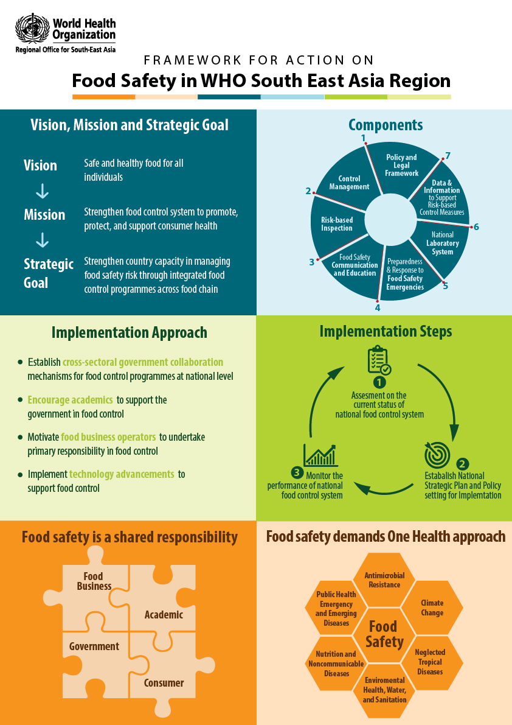
Real Life examples from global tourism chain
Numerous international tourism organizations and destinations have adopted WHO guidelines, particularly in light of the COVID-19 pandemic and other health emergencies.
For instance, Rwanda has embraced the WTTC Safe Travels global protocols, while the UNWTO has collaborated with WHO to create universal guidelines for reviving tourism.
(Source:Who.int, 2025)
Notes:
These guidelines emphasize health and safety measures, hygiene standards, and responsible tourism practices aimed at safeguarding traveller well-being as well as protecting local communities and the environment. According to the World Travel & Tourism Council (WTTC), Rwanda has made visitor health and safety a priority by implementing the WTTC Safe Travels protocols and stamp. This involves enforcing health and safety practices across various tourism sectors, including safaris and cultural sites.

Slide 13

Conclusion
As a nutrition and food service consultant of an eco-tourism agency, it is suggested to follow a healthy dietary plan.
Consuming healthy food that is locally sourced is nutritious and makes the tour of the tourists overall healthy.
The tourists can explore nature with their good health. For tourists who support eco-tourism, vegan and vegetarian meals are provided.
Notes:
The agency promotes healthy eating habits by providing low-fat, gluten-free options and vegan options. The tourists are provided with healthy as well as tasty food that aligns with the basic goal of ecotourism. The tourists are always welcome to send their feedback so that the agency can improve as per customer needs.

Slide 14
References
bbc.co.uk “Diabetic dinner for lake district tourists” Retrieved from: www.bbc.co.uk [Accessed on: 3 May 2025]
cdc.gov “Diabetic meal plan for Edinburgh tourist.” Retrieved from: www.cdc.gov [Accessed on: 3 May 2025]
contiki.com “Diet plan for vegan tourists” Retrieved from:: www.contiki.com [Accessed on: 3 May 2025]
diabetes.org.uk “diabetic breakfast ideas for tourists” Retrieved from: www.diabetes.org.uk [Accessed on: 3 May 2025]
eatingwell.com “dinner for diabetic tourists of London” Retrieved from: www.eatingwell.com [Accessed on: 3 May 2025]
Garrod, B., & Nicholls, S. (2022). British tourists’ adjustment to cultural expectations in Muslim-majority countries. Tourism Management, 91, 104500. Retrieved from: https://www.sciencedirect.com/science/article/pii/S0261517722000139
Lin, J., Cui, Q., Xu, H., & Guia, J. (2022). Health and local food consumption in cross-cultural tourism mobility: An assemblage approach. Tourism Geographies, 24(6-7), 1103-1122.,. Retrieved from: https://dugi-doc.udg.edu/bitstream/handle/10256/24384/037437.pdf?sequence=1
Malota, E., & Mucsi, A. (2023). Tasting a new culture: adjustment to a foreign culture through traditional local cuisine. Food, Culture & Society, 26(1), 209-229. Retrieved from: https://www.researchgate.net/profile/Attila-Mucsi-2/publication/356266045_Tasting_a_new_culture_adjustment_to_a_foreign_culture_through_traditional_local_cuisine/links/671b974fedbc012ea13db60f/Tasting-a-new-culture-adjustment-to-a-foreign-culture-through-traditional-local-cuisine.pdf

Slide 15
CONTD.
purition.co.uk “vegan breakfast for lake district tourist” Retrieved From: www.purition.co.uk [Accessed on: 3 May 2025]
tasteofhome.com “vegetarian lunch ideas” Retrieved from: www.tasteofhome.com[Accessed on: 3 May 2025]
thegoodfoodguide.co “Diet plan for gluten-free tourist.” Retrieved from: www.thegoodfoodguide.co.uk [Accessed on: 3 May 2025]
visitscotland.org “Hospitality guidelines” Retrieved From: www.visitscotland.org [Accessed on: 3 May 2025]
who.int “healthy-diet” Retrieved From: www.who.int [Accessed on: 3 May 2025]
wttc.org “global-protocols for safe travel” Retrieved From: wttc.org [Accessed on: 3 May 2025]

Slide 16


