Slide 1
NAME : PUSHPENDER
USERNAME : PUSHPENDER100
TOPIC : HEALTH THREATS IN TOURISM COURSE

Slide 2
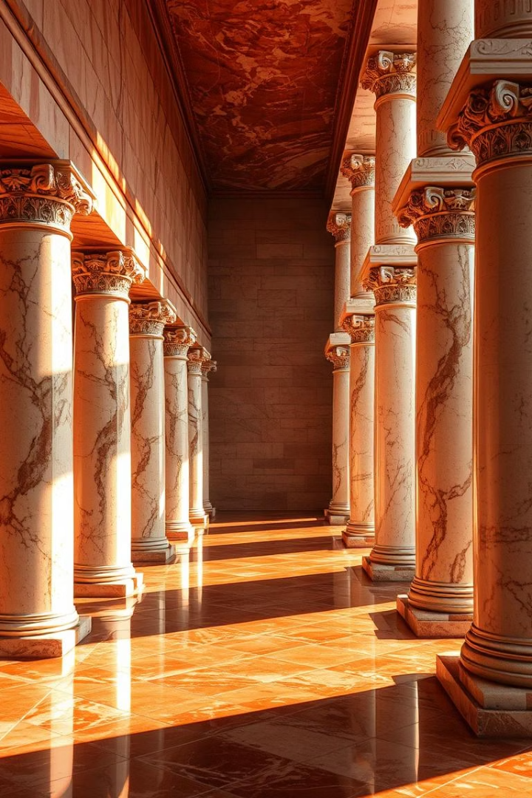
Introduction: A Journey Through Ancient Bathing Cultures
Bathing has been a vital aspect of human civilization for millennia, transcending basic cleanliness to embody health, social connection, and spiritual renewal. Civilizations such as the Romans, Greeks, Ottomans, and Egyptians played pioneering roles in shaping the development and prevalence of bathing culture and spa traditions.
This webpage explores how these ancient societies influenced spa culture through architecture, social customs, and hygiene philosophies. We will also compare motivations for bathing in European and Egyptian contexts and examine how baths served as dynamic public spaces for social interaction.

Slide 3
The Greeks: Foundations of Health and Hygiene
The Greeks pioneered bathing rituals centered on personal hygiene and health, integrating baths within gymnasia like those at Olympia. This combination of exercise and cleansing underscored a holistic approach to well-being.
The Greek emphasis on cleanliness was both practical and philosophical, reflecting ideals of balance and harmony in body and mind. Bathing was primarily private or small-scale, contrasting with the grand public bath complexes that later flourished.
Hippocratic medicine further linked bathing to physical health, promoting purification through water. Bathing technologies evolved with the development of advanced drainage and heating systems, supporting daily hygiene practices.
Their innovations set the stage for sophisticated bathing cultures in successive civilizations.

Slide 4
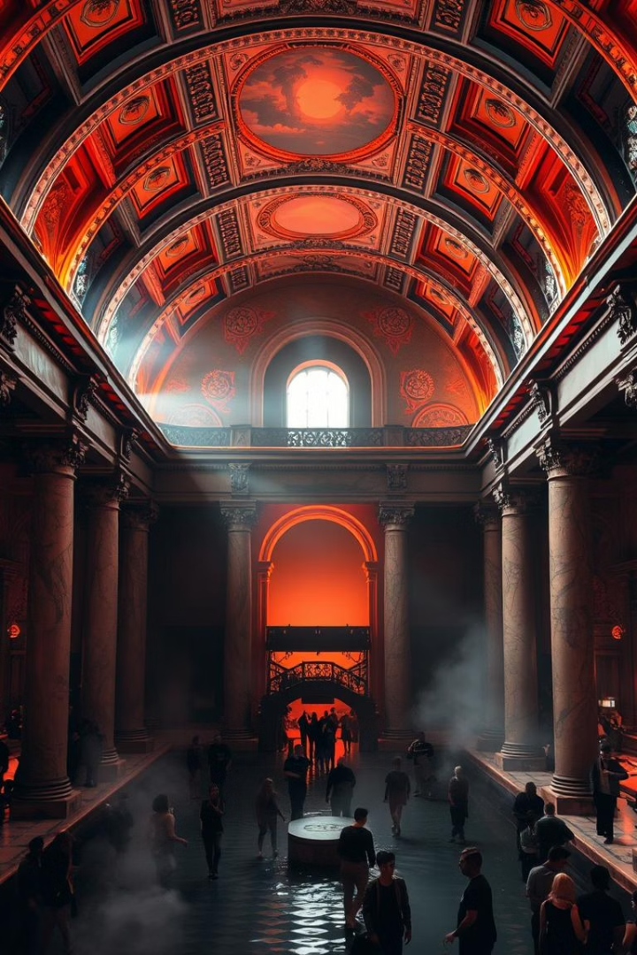
Roman Baths: Engineering Marvels and Social Hubs
Advanced Architecture
Romans engineered hypocaust heating systems and designed specialized rooms like caldarium, tepidarium, and frigidarium for varied bathing experiences.
Public Magnificence
Massive bath complexes like the Baths of Caracalla served thousands daily, showcasing Roman wealth and engineering prowess.
Social Daily Ritual
Baths were central to daily life, offering spaces for men and women (at different times) to relax, socialize, and exercise.
Reliable Water Supply
Innovations like aqueducts ensured the consistent flow of fresh water to baths, essential for their extensive use.

Slide 5
Ottoman Bathhouses: A Synthesis of Tradition and Culture
Ottoman hamams drew inspiration from Roman and Byzantine traditions but added unique cultural rituals emphasizing cleansing and spiritual renewal.
Hamams were integral to Ottoman social life, serving as places for communal bathing, relaxation, celebrations, and even matchmaking among women.
The architecture featured central domes, marble surfaces, and private cubicles, creating a luxurious and intimate environment.
These bathhouses were more than hygiene centers—they were vibrant hubs of communal interaction and tradition.

Slide 6

Ancient Egypt: Ritual Purity and Rejuvenation
Ritual Purity
Bathing in ancient Egypt was closely tied to religious ceremonies, symbolizing spiritual cleanliness and rebirth.
Temple Baths
Many baths were located near temples and used during sacred rituals.
Natural Elements
Use of essential oils, minerals, and scented substances enhanced rejuvenation and health benefits.
Pharaoh's Rituals
Royal bathing ceremonies highlighted luxury and divine connection, setting cultural benchmarks.

Slide 7
Motivations Compared: Europe vs. Egypt
European Bathing Motives
Egyptian Bathing Motives
Centered on hygiene, social interaction, and relaxation. Public baths encouraged community gatherings and leisure.
Focused on ritual purity, religious observance, and spiritual rejuvenation. Baths were often private or temple-associated.
Architectural designs favored large public access, supporting daily social rituals and physical wellness.
Structural designs reflected sacredness and symbolic importance rather than public access.

Slide 8
Baths as Social Spaces: Case Studies
Roman Baths
Ottoman Hamams
Centers for business deals and political discussions
Women's social gatherings and celebrations
Popular for casual gossip and networking
Matchmaking and community bonding events
Greek Gymnasia
Egyptian Baths
Spaces for intellectual debates and physical training
Sites for ceremonies marking birth, marriage, and death
Bathing integrated with education and culture
Spiritual cleansing intertwined with social traditions

Slide 9
Conclusion: Legacy and Modern Spa Culture
Ancient civilizations left a rich legacy that informs today's spa culture—from the engineering brilliance of Roman baths to the spiritual rituals of Egyptian cleansings and the social harmony of Ottoman hamams.
Bathing remains a timeless cultural practice that fosters physical health, mental relaxation, spiritual renewal, and community bonding.
Exploring these historical roots enriches our appreciation for contemporary spa experiences and their continuing role in wellness worldwide.N
Modern spas borrow architectural designs, treatment philosophies, and social functions that keep ancient bathing traditions alive in new forms.

