Slide 1
Basics of Marketing
European Institute of Innovation, Entrepreneurship and Technology
Lessingstraße 79, 13158 Berlin, Germany
Presenter Vaibhav Sai Sri| Berlin
      Lessingstraße 79,
      13158 Berlin, Germany
      Phone: +49 30 233618555
      Fax: +49 30 233618556
      Email: info@eiiet.com

Slide 2

Index
What is Marketing?
Importance of Marketing
The Marketing Process
Core Marketing Concepts
Marketing Mix – The 4 Ps
Product Strategy
Pricing Strategy
Place (Distribution Strategy)
Promotion Strategy
Promotion Budget Allocation (Pie Chart)
Customer Preference by Channel (Bar Graph)
Case Study 1: Coca-Cola
Case Study 2: Apple Inc.
Conclusion & Q&A

Slide 3

Introduction
Marketing is identifying and meeting human and social needs.
It involves creating value for customers and building strong relationships.
Focuses on delivering customer satisfaction profitably.
More than selling or advertising – it's a broad strategic activity.
Includes research, branding, communications, and delivery.

Slide 4
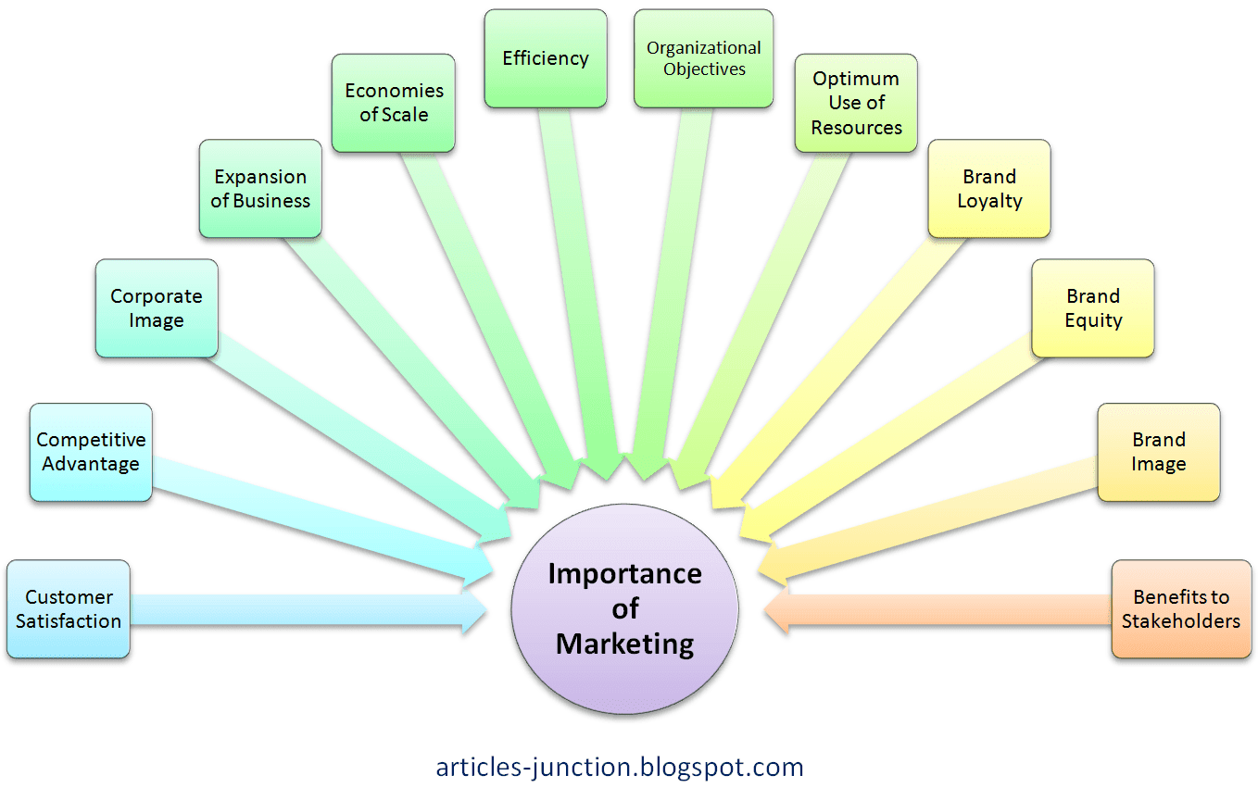
Importance of Marketing
Drives revenue and business growth.
Enhances brand visibility and awareness.
Builds customer loyalty and trust.
Supports product development with market feedback.
Helps businesses stay competitive in the market.

Slide 5
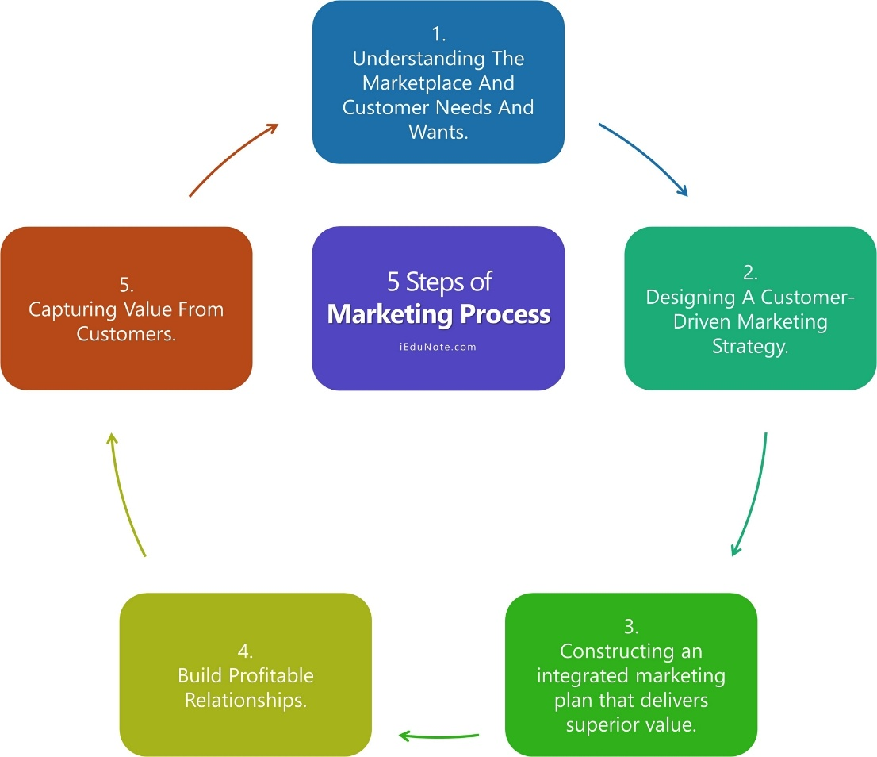
The Marketing Process
Understand customer needs and the marketplace.
Design a customer-driven marketing strategy.
Develop an integrated marketing program.
Build profitable customer relationships.
Capture value from customers to create profits.

Slide 6
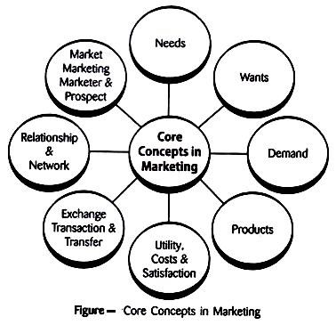
Core Marketing Concepts
Needs, Wants, and Demands – the basis of marketing.
Market Offerings – products/services to satisfy needs.
Value and Satisfaction – perceived benefits vs. cost.
Exchange and Relationships – mutual value trade.
Markets – potential customers sharing a need or want.

Slide 7
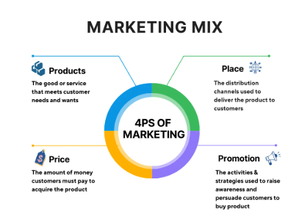
Marketing Mix – The 4 Ps
Product – features, quality, branding.
Price – competitive pricing, value-based strategies.
Place – distribution channels and logistics.
Promotion – advertising, PR, personal selling.
All four Ps must be aligned with customer expectations.

Slide 8
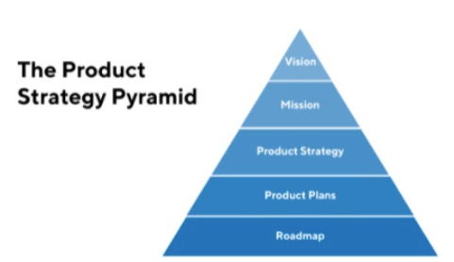
Product Strategy
Define product features, design, and quality.
Understand customer needs and preferences.
Plan product lifecycle stages: Intro, Growth, Maturity, Decline.
Include branding and packaging strategies.
Provide post-sale services and warranties.

Slide 9
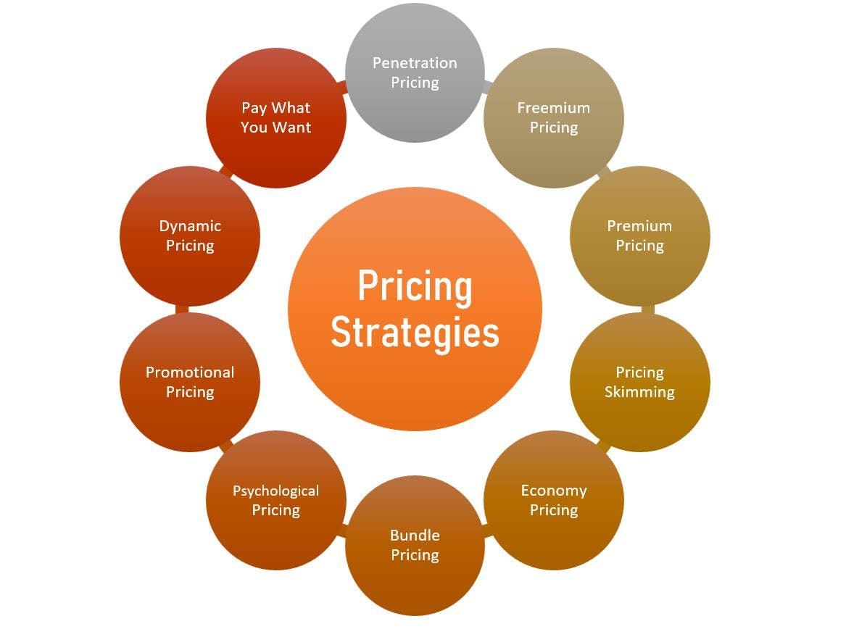
Pricing Strategy
Set price to match perceived customer value.
Common strategies: Penetration, Skimming, Competitive.
Price sensitivity depends on market and product type.
Includes discounting, seasonal pricing, bundling.
Influenced by costs, competitors, and demand.

Slide 10
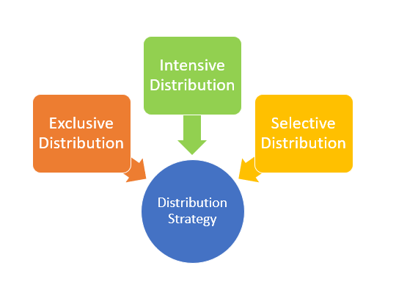
Place (Distribution Strategy)
Direct vs. indirect distribution (retailers, wholesalers).
Online vs. offline channels.
Logistics: warehousing, inventory, transportation.
Ensure product availability where and when needed.
E-commerce platforms are becoming dominant.

Slide 11
Promotion Strategy
Implementation of tourism-focused upskilling and reskilling programs.
Promotion of formal contracts to reduce informal employment.
Financial incentives for businesses to retain tourism workers.
Policy frameworks targeting youth, women, and marginalized groups.
Partnerships with private tourism operators to provide apprenticeships.

Slide 12
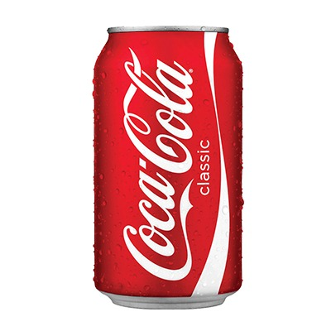
Case Study: Coca-Cola
Coca-Cola focuses heavily on brand identity and global appeal.
Uses emotional advertising and consistent packaging.
Maintains a vast distribution network globally.
Offers personalized marketing (name bottles, events).
Invests heavily in sponsorships and social media.

Slide 13

Case Study: Apple Inc.
Strong brand positioning: Innovation and premium quality.
Focus on minimalistic design and customer experience.
Controls product, price, and place tightly (own stores).
Promotion via sleek ads, influencer buzz, and launches.
Loyal customer base due to integrated ecosystem.

Slide 14

Conclusion
Marketing is key to business success in today’s world.
Understanding customer needs is central.
The 4 Ps form the backbone of any marketing plan.
Modern trends: digital, personalized, sustainable marketing.

Slide 15
Thank you
      European Institute of Innovation, Entrepreneurship and Technology
      Lessingstraße 79,
      13158 Berlin, Germany
      Phone: +49 176 55524449
      Email: info@eiiet.com
Discover the world of eiIET

