Slide 1
Health Threats in Tourism
European Institute of Innovation, Entrepreneurship and Technology
Lessingstraße 79, 13158 Berlin, Germany
Mahmoud Abdou| Berlin
      Lessingstraße 79,
      13158 Berlin, Germany
      Phone: +49 30 233618555
      Fax: +49 30 233618556
      Email: info@eiiet.com

Slide 2

Index
- Climate Change and Tourism
- Carbon Footprint of Tourism
- Construction and Tourism Development
- Interactions Between Climate Change
and the Tourism System
5. - Climate Change Risks for International Tourism

Slide 3
1- Climate Change and Tourism
      - Tourism and climate change research began in the mid-1980s
      - Initial studies focused on how climate change affects tourism
      Main concerns were high-risk tourism sectors, such as:
      - Winter sports
      - Coastal tourism
      - Emphasis on destination vulnerability..

Slide 4
1- Climate Change and Tourism
      In 1996, research began highlighting:
      - Tourism’s contribution to greenhouse gas (GHG) emissions.
      - Aviation identified as a major emission source per tourist.
      A Closer Look at Long-Haul Travel
      - Long-haul destinations—especially islands— face greater climate-related challenges.
      - Tourism to these areas generates high carbon emission.

Slide 5
1- Climate Change and Tourism
      First International Conference on Climate Change and Tourism, in 2003
      Location: Djerba, Tunisia
      Organized by: United Nations (UN)
      Key Outcomes of the 2003 Conference:
      - Recognized the interrelationship between tourism and climate change
      - Stressed the need to understand climate change implications
      - Especially for the sustainability of tourism
      Highlighted the tourism sector’s obligations to:
      - Reduce greenhouse gas (GHG) emissions
      - Support and comply with international climate agreements

Slide 6
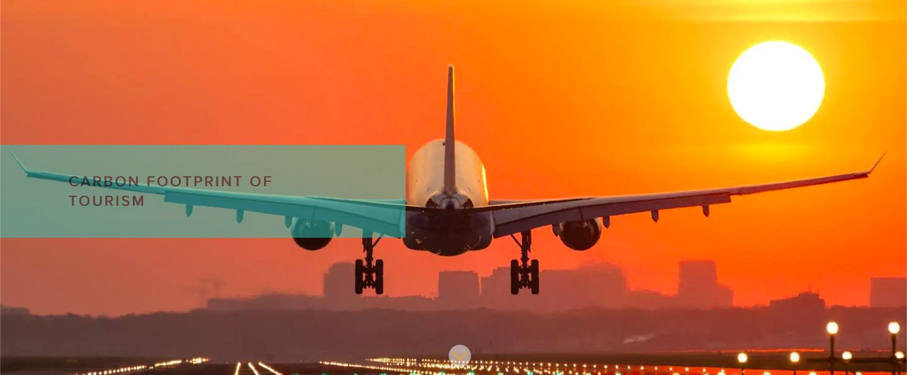
2- Carbon Footprint of Tourism
      - The carbon footprint of tourism refers to the total greenhouse gas emissions generated by activities related to travel and tourism.
      - This includes transportation (air, road, sea), accommodation, food and beverage services, recreational activities, and the supply chains supporting these sectors.
      - It is usually measured in units of carbon dioxide equivalent.

Slide 7
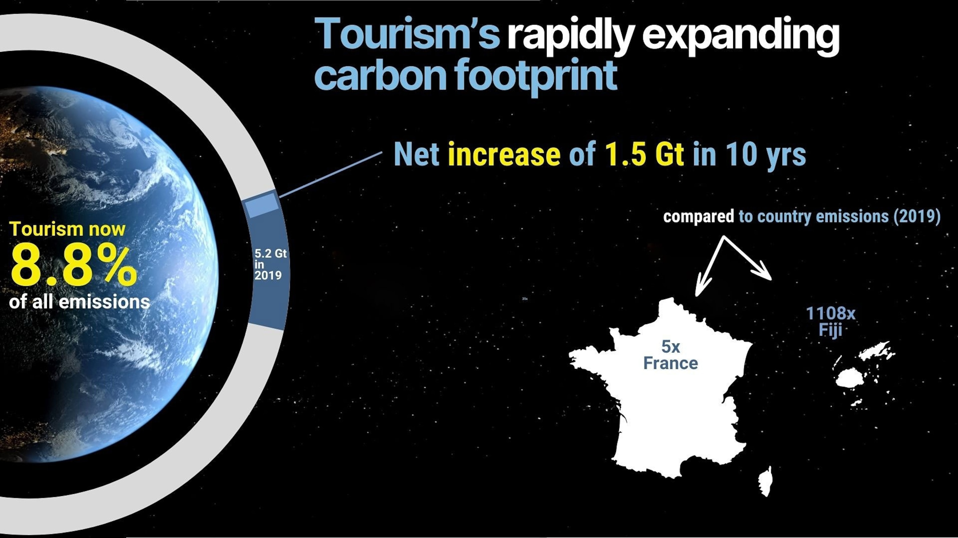
2- Carbon Footprint of Tourism

Slide 8
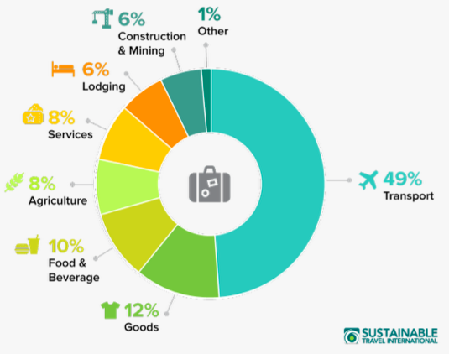
2- Carbon Footprint of Tourism
      In 2023, Travel & Tourism contributed:
      - 6.5% of all global greenhouse gas emissions
      - Down from 7.8% in 2019 – when the sector
      was at its peak.
      - Currently, tourism is responsible for roughly
      8% of the world’s carbon emissions.
Carbon Footprint of Tourism. Source: https://sustainabletravel.org/issues/carbon-footprint-tourism/

Slide 9
2- Carbon Footprint of Tourism
    Tourism’s Carbon Footprint: A Global Inequality
    - Majority of emissions come from high-income countries
    - The United States leads in tourism-related emissions
    - As global affluence rises, tourism’s environmental impact is expected to increase
    Top 20 emitting countries (including the U.S., China, and India):
    - Responsible for 75% of global tourism’s carbon footprint

Slide 10
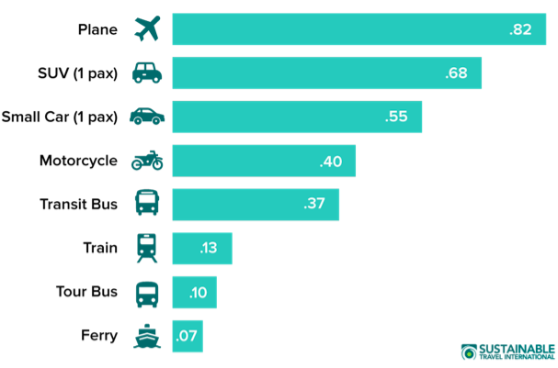
2- Carbon Footprint of Tourism
    Transport
    - Tourism is powered by planes, cars, trains,
    boats, and even hot air balloons.
    - These modes of transport help us explore
    the world.
    - But they come with a significant carbon
    Cost.
    Transport as the main source of greenhouse gas emissions in tourism
    - Planes and cars produce the most CO2 per
    passenger mile.
    - Tour buses, ferries, and trains emit much
    less by comparison.

Slide 11
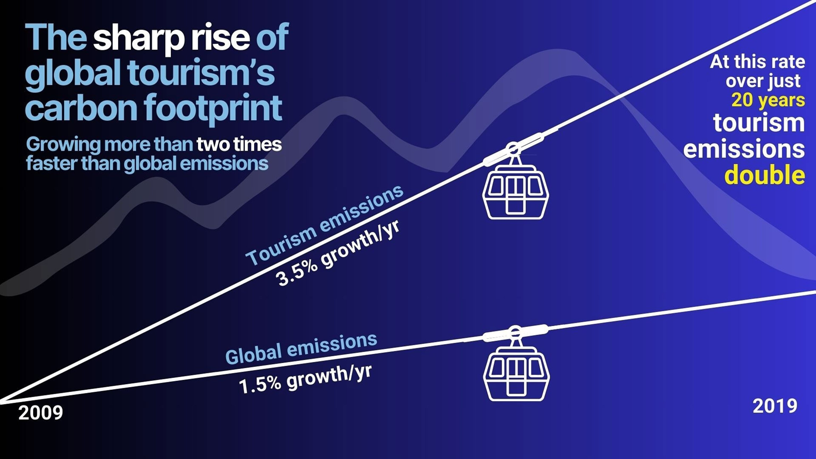
2- Carbon Footprint of Tourism
    Transport
    - More people flying due to cheaper
    airfare.
    - Between 2005 and 2016,
    transport-related tourism emissions:
    Increased by over 60%

Slide 12
2- Carbon Footprint of Tourism
    Lodging and Emissions:
    - Lodging generates emissions similar to residential buildings
    - Emissions result from energy use in accommodations such as:
    Hotels
    Homestays
    Rental homes

Slide 13

2- Carbon Footprint of Tourism
    Lodging and Emissions
    - Heating and air conditioning systems used for climate control
    - Water heaters for showers, pools, and spas
    Electricity consumption for:
    Lighting
    Televisions
    Refrigerators
    Laundry machines
    Other equipment

Slide 14
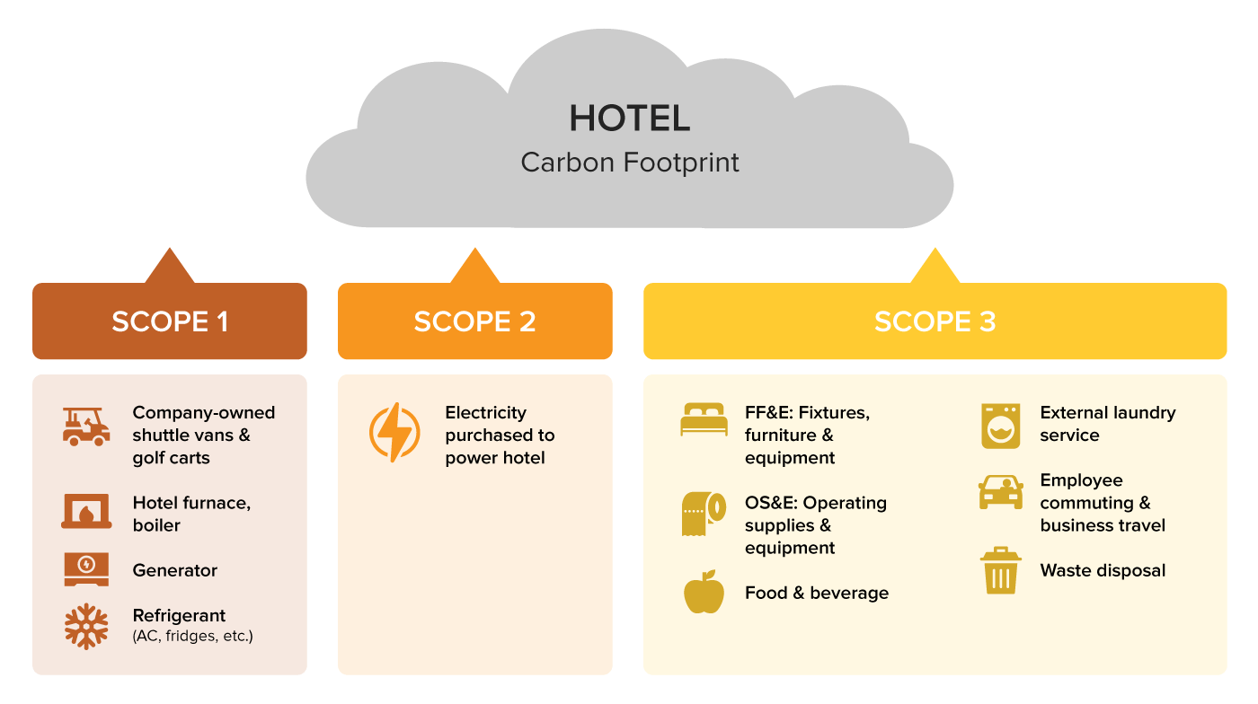
1- Climate Change and Tourism

Slide 15
2- Carbon Footprint of Tourism
    Lodging and Emissions
    - Older or inefficient systems increase energy consumption
    - Areas with outdated infrastructure tend to have higher emissions
    Emission Levels by Lodging Type
    - Emissions are generally higher in resorts and modern hotels
    - Emissions are generally lower in smaller lodgings, such as:
    Homestays
    Guest houses

Slide 16
2- Carbon Footprint of Tourism
    Lodging and Emissions
    - Hotels can reduce emissions by using clean energy sources
    - However, the majority still rely on fossil fuels for most of their energy needs
    Renewable Energy Adoption in Hotels
    - According to the 2018 Green Lodging Trends Report:
    Only 21% of hotels have on-site renewable energy systems
    The adoption rate of renewables in lodging remains limited

Slide 17
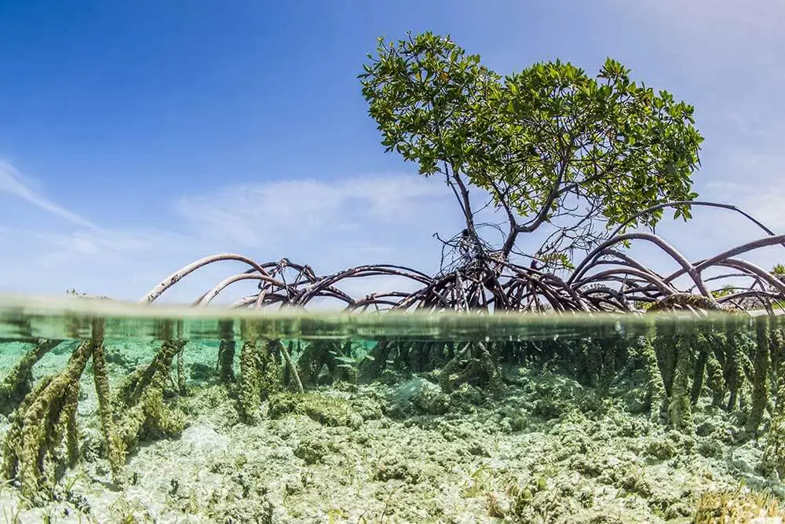
3- Construction and Tourism Development
      Construction and Carbon Emissions:
      - Construction of tourism facilities generates significant carbon emissions.
      Energy-intensive activities include:
      - Manufacturing building materials.
      - Transporting materials to the construction site.
      - The actual building process.
      Also:
      - Emissions are not limited to buildings alone
      - Development of roads and other tourism.
      infrastructure also contributes to carbon footprint.

Slide 18
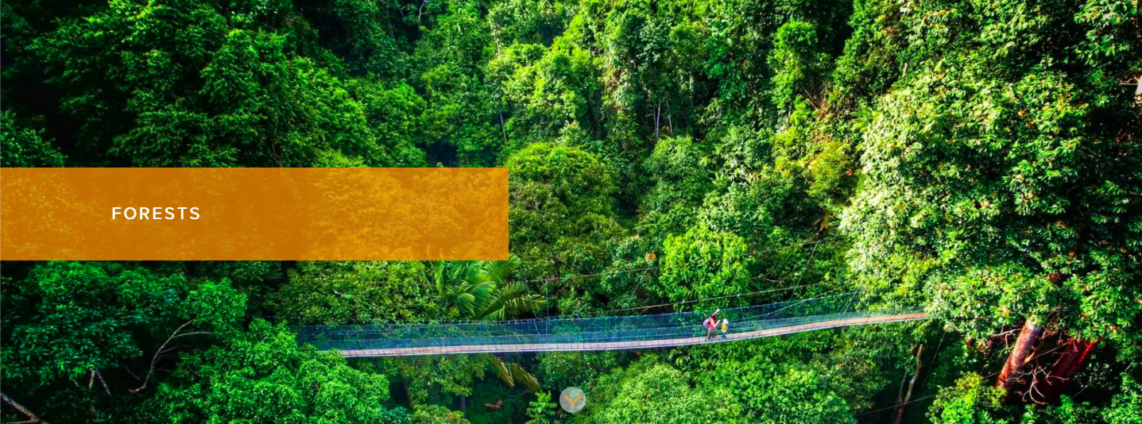
3- Construction and Tourism Development
      Destruction of Carbon Sinks:
      - Tourism development can emit carbon by clearing natural areas
      - Ecosystems like forests act as carbon sinks
      - They absorb and store carbon dioxide (CO2)
      - Removing vegetation releases stored CO2 back into the atmosphere

Slide 19
3- Construction and Tourism Development
      Destruction of Carbon Sinks:
      Mangrove Forests and Tourism:
      - Mangrove forests found along tropical coastlines store large amounts of carbon
      - Research shows mangroves can store up to 4 times more carbon than other tropical forests
      - Mangroves are often cleared for:
      - Seaside resorts
      - Beaches
      - Marinas
      - Entertainment areas

Slide 20
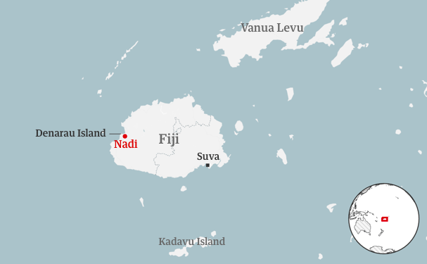
3- Construction and Tourism Development
      Case Study: Building a Tourist Paradise – Fiji’s Strategy
      - Fiji has embraced tourism as a key economic
      development strategy.
      - Objective: Present Fiji as a “Pacific paradise” to attract
      international tourists.
      In the 1980s and 1990s, Fiji implemented a pro-tourism
      investment policy.

Slide 21
3- Construction and Tourism Development
      Case Study: Building a Tourist Paradise – Fiji’s Strategy
      According to the UNDRR report:
      - International hotel chains were offered attractive
      Incentives.
      - Included tax-free status for 20 years.
      - Focused on development in Denarau Island, near Nadi.

Slide 22
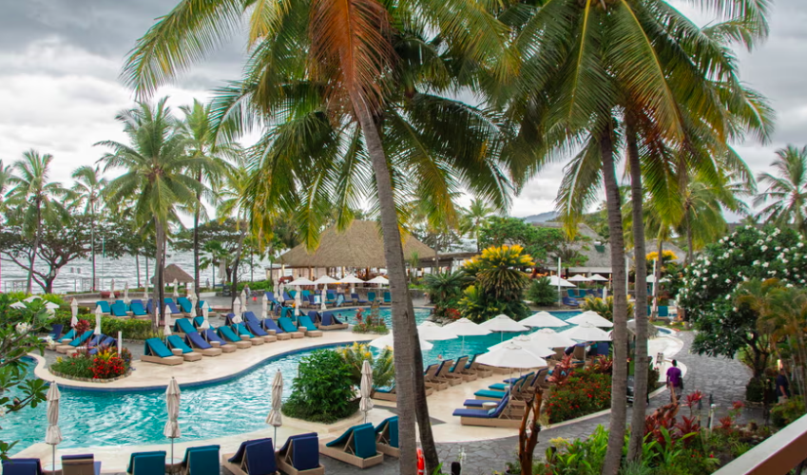
3- Construction and Tourism Development
      Case Study: Building a Tourist Paradise – Fiji’s Strategy
      Land Clearing for Resort Development:
      - Developers cleared hundreds of acres of land for resort construction.
      - Hotels selected sites based on proximity to the sea
      and scenic appeal.

Slide 23
3- Construction and Tourism Development
      Case Study: Building a Tourist Paradise – Fiji’s Strategy
      Loss of Natural Buffers:
      - Mangroves, effective natural buffers
      against storms and floods, were removed
      According to the UNDRR report:
      - Mangroves were destroyed because they interfered
      with sea access.
      - They did not fit the manicured aesthetic of resort
      landscapes.

Slide 24
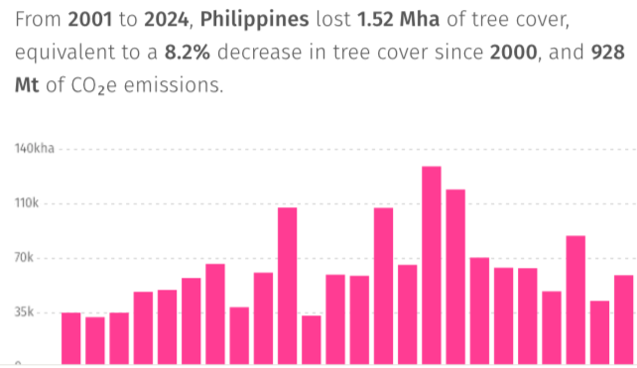
3- Construction and Tourism Development
      Case Study: Deforestation in the Philippines (2002–2021)
      - 158,000 hectares of primary forest lost
      - 1.34 million hectares of total tree cover
      Lost.
      - Equivalent to 7.2% of the country’s
      total tree cover.
https://resoilfoundation.org/en/environment/philippines-tourism-deforestation/

Slide 25
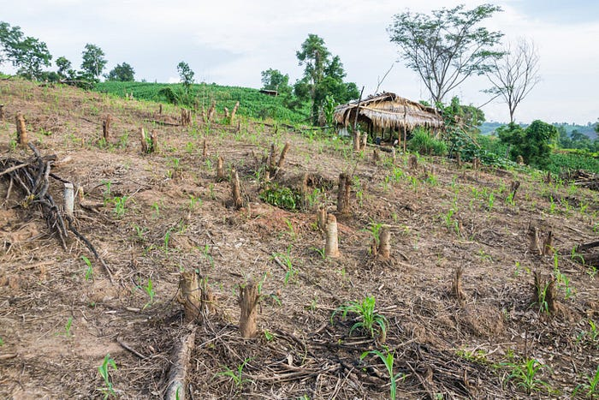
3- Construction and Tourism Development
      Case Study: Deforestation in the Philippines (2002–2021)
      Main Drivers of Deforestation
      - Shifting agriculture
      - Urbanization
      - Forestry industry
      Top driver: Commodity-driven deforestation
      - Mined minerals
      - Palm oil
      - Construction materials
https://medium.com/@maxierebadulla/nurturing-nature-addressing-deforestation-in-the-philippines-20618f70c2cb

Slide 26
3- Construction and Tourism Development
      Case Study: Deforestation in the Philippines (2002–2021)
      Timber Trade and Shifting Demand
      - Historically, timber was exported mainly to Malaysia and Indonesia.
      - Recently, domestic demand has increased due to tourism development.
      - Wood is now widely used in constructing new accommodation facilities.
https://medium.com/@maxierebadulla/nurturing-nature-addressing-deforestation-in-the-philippines-20618f70c2cb

Slide 27
3- Construction and Tourism Development
      Tourim and Climate Change
https://medium.com/@maxierebadulla/nurturing-nature-addressing-deforestation-in-the-philippines-20618f70c2cb

Slide 28
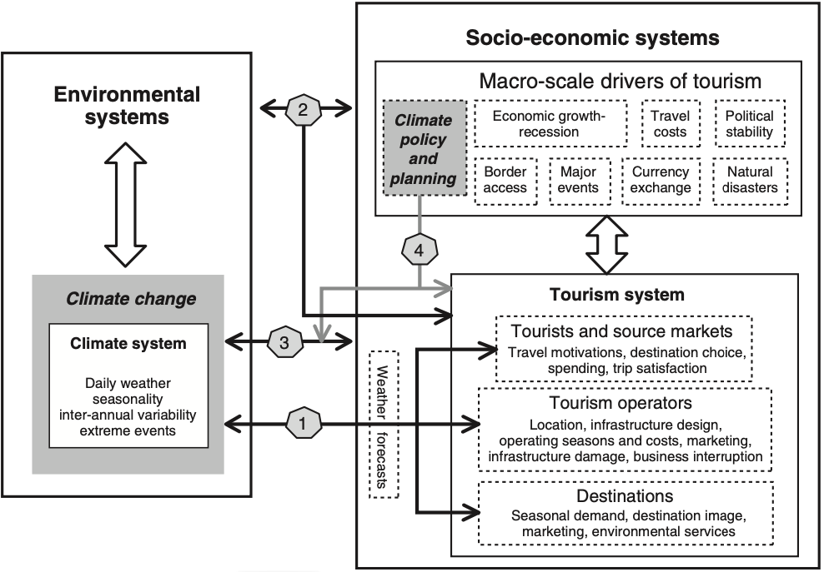
4- Interactions Between Climate Change and the Tourism System
      There are four main pathways
      through which climate change
      affects the international tourism
      system:
      - Direct climatic impacts.
      - Indirect climate-induced environmental
      change.
      - Indirect climate-induced socioeconomic
      Change.
      - policy responses of other sectors.
Source: Scott, Gössling, and Hall (2012).

Slide 29
4- Interactions Between Climate Change and the Tourism System
      4.1- Direct Climatic Impacts:
      - Alters length and quality of tourism seasons (ski
      seasons with less snow).
      - Affects operating costs, location decisions,
      and design (for cooling, maintenance).
      - Causes infrastructure damage and business
      Interruptions (storms, floods).
      - Impacts destination attractiveness.
      - Influences tourist demand and destination choice.
Source: Scott, Gössling, and Hall (2012).

Slide 30
4- Interactions Between Climate Change and the Tourism System
      4.2- Indirect Environmental Change
      - Damage to natural attractions (coral reefs, glaciers).
      - Changes in environmental conditions that may
      deter tourists.
      Declining destination image (loss of green landscapes).
      - Worsening environmental conditions that discourage
      tourists (air pollution, wildfires).
      - Reduces the capacity for sustainable
      business operations.
Source: Scott, Gössling, and Hall (2012).

Slide 31
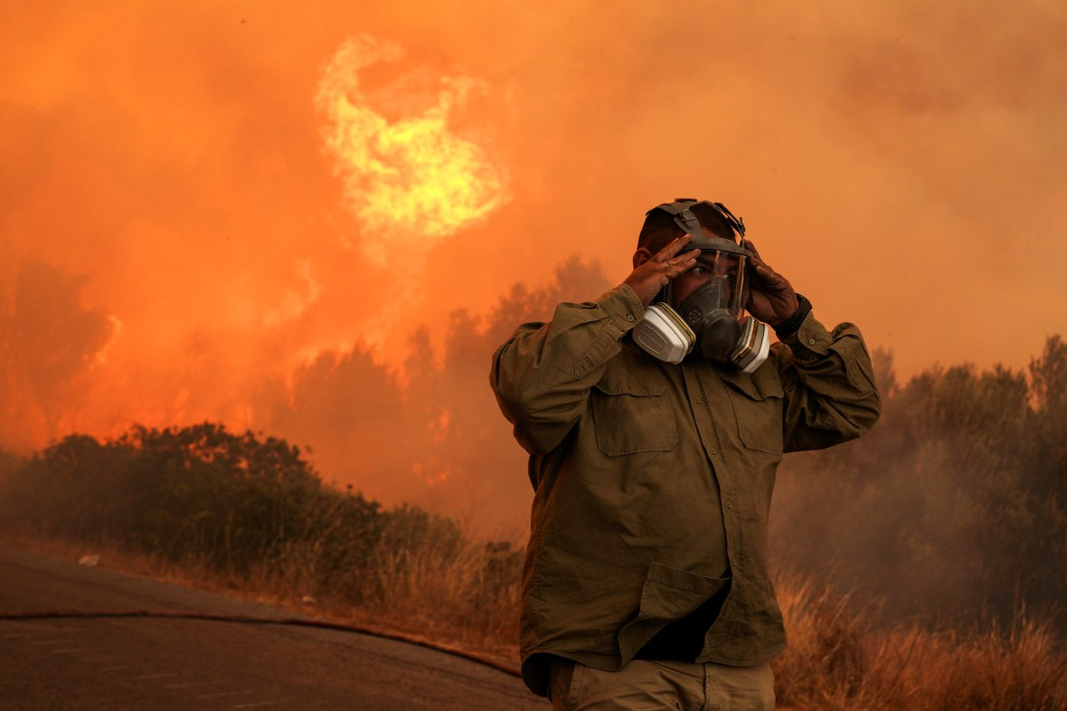
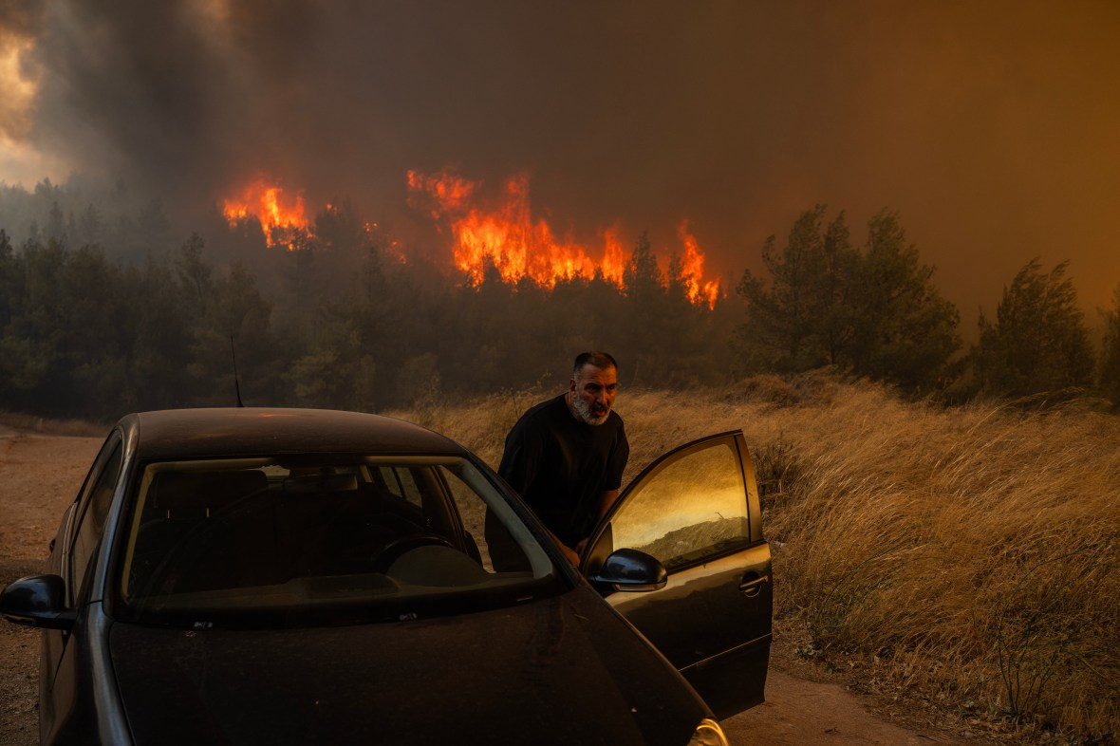
4- Interactions Between Climate Change and the Tourism System
      Wildfires in Greece due to high temperature and
      strong winds, in 2024

Slide 32
4- Interactions Between Climate Change and the Tourism System
      4.3- Indirect Socioeconomic Change
      - Decreased economic growth and discretionary income.
      - Increased political instability and security risks.
      - Changing public attitudes toward travel and tourism
      (long- and short-haul destinations).
Source: Scott, Gössling, and Hall (2012).

Slide 33
4- Interactions Between Climate Change and the Tourism System
      4.4- Policy Responses in Other Sectors
      Mitigation policies can alter:
      - Transport cost structures
      - Destination and modal choices
      Adaptation policies affect:
      - Water rights
      - Insurance costs
      - These changes influence tourism development
      and operating costs.
Source: Scott, Gössling, and Hall (2012).

Slide 34
5- Climate Change Risks for International Tourism
      5.-1 Climatic Change and Altered Geographic and Seasonal Tourism Demand
      - Climate impacts tourism operators, destinations, and tourists
      - Changes in geographic and seasonal distribution of climate resources will influence:
      Tourism demand
      Destination appeal
      Travel patterns

Slide 35
5- Climate Change Risks for International Tourism
      5.-1 Climatic Change and Altered Geographic and Seasonal Tourism Demand
      Tourism demand:
      This refers to how many people want to travel, and where they want to go.
      - Destinations that become less comfortable or less safe (too hot, prone to hurricanes) may see declines in demand.
      - Conversely, places with stable climates might become more attractive, leading to increased tourist numbers.
      - Some regions may benefit temporarily, while others suffer long-term declines.

Slide 36
5- Climate Change Risks for International Tourism
      5.-1 Climatic Change and Altered Geographic and Seasonal Tourism Demand
      Destination appeal:
      Climate affects the overall attractiveness of destinations:
      - Winter resorts may struggle due to shorter snow seasons.
      - Beach destinations may lose appeal due to rising sea levels, damage to coral reefs, or extreme heat.
      - Destinations with stable, comfortable climates year-round may become more popular.

Slide 37
5- Climate Change Risks for International Tourism
      5.-1 Climatic Change and Altered Geographic and Seasonal Tourism Demand
      Travel patterns:
      This refers to when and how people travel:
      Seasonality may shift:
      - some summer destinations may become too hot, pushing travel to shoulder seasons (spring or fall).
      - Travelers might choose closer destinations to reduce cost or carbon footprint.
      - Extreme weather risks may make tourists more cautious, avoiding regions with unpredictable or dangerous conditions.

Slide 38
5- Climate Change Risks for International Tourism
      5.-1 Climatic Change and Altered Geographic and Seasonal Tourism Demand
      Tourists from Northern Europe, Japan, USA, and Canada may:
      - Adapt travel patterns
      - Favor destinations closer to home due to improved climate conditions
      Expected decline in demand for international travel to:
      - Subtropical, tropical, and some Middle Eastern countries

Slide 39
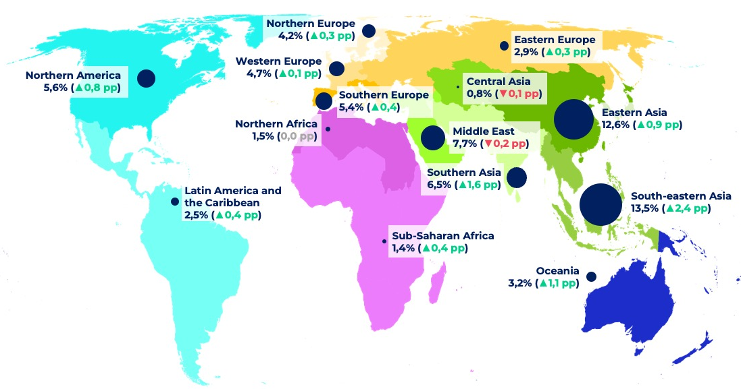
5- Climate Change Risks for International Tourism
      5.-1 Climatic Change and Altered Geographic and Seasonal Tourism Demand
      Scandinavia:
      Projected positive impacts
      Mediterranean Europe:
      - Projected negative impacts
      Canada and Russia:
      - Expected to benefit more than
      their regional counterparts.

Slide 40
5- Climate Change Risks for International Tourism
      5.-1 Climatic Change and Altered Geographic and Seasonal Tourism Demand
      Indicators also show increased domestic tourism in UK, ireland, and Germany.
      - Tourists are more likely to holiday within their home country
      - Comes at the expense of traditional warm-weather destinations (Greece and Spain).
      Warmer summers in the UK led to:
      - Increased domestic tourism
      - Decreased outbound tourism

Slide 41
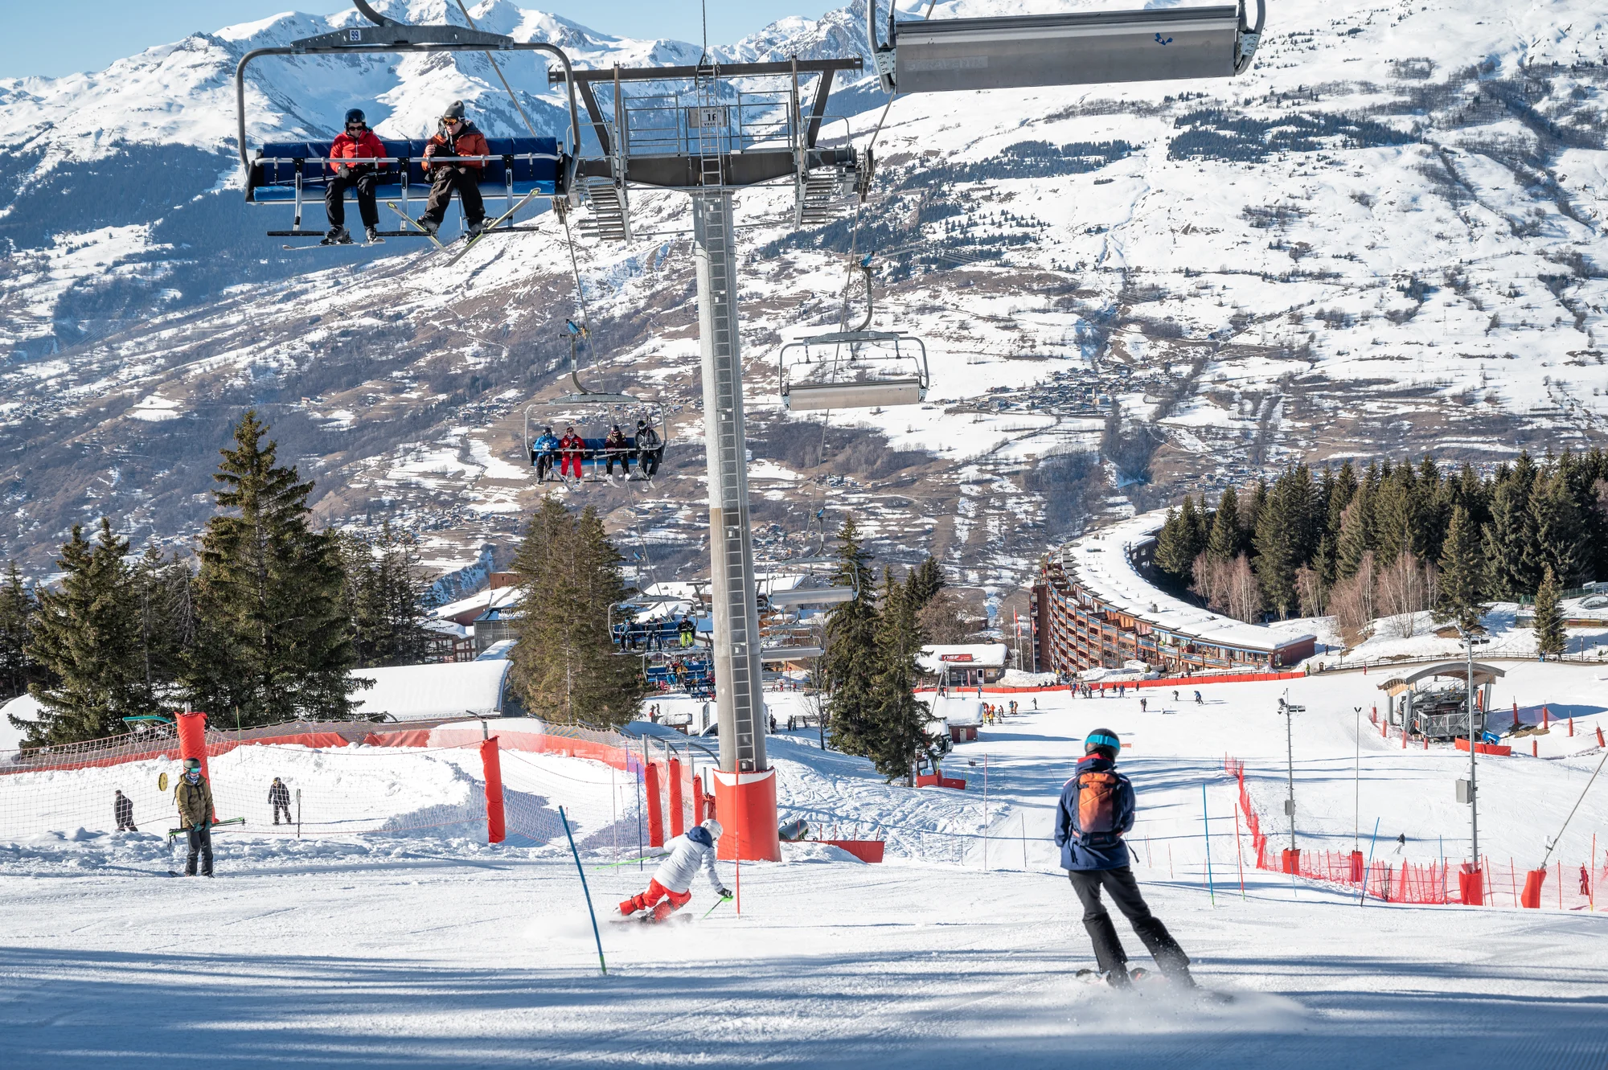
5- Climate Change Risks for International Tourism
      5.2- Winter Sports Tourism
      - Ski tourism is highly sensitive to climate variability.
      - Shorter winters and decreased natural snowfall observed.
      - Artificial snowmaking is increasingly used.

Slide 42
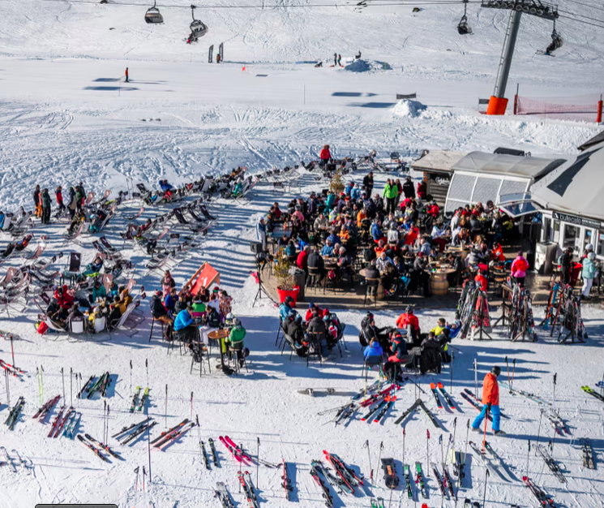
5- Climate Change Risks for International Tourism
      5.2- Winter Sports Tourism
      Importance of Alpine Tourism
      - The Alps receive around 120 million tourists/year.
      - Tourism is vital to local economies in Alpine regions.
      Climate Trends in the Alps:
      Snow cover has declined by 8.4% per decade over
      the past 50 years.
      Skiing and snowboarding, key attractions,
      are under threat.

Slide 43
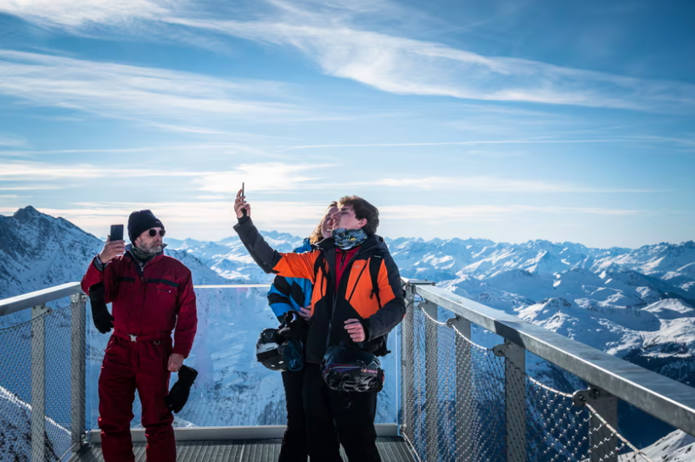
5- Climate Change Risks for International Tourism
      5.2- Winter Sports Tourism
      Risks from Global Heating:
      - Unreliable snowfall threatens winter sports tourism
      - Small, low-elevation resorts risk becoming unsustainable
      Future Market Trends:
      Larger, high-elevation resorts may dominate a shrinking
      Market.
      Serious economic impacts expected for towns dependent
      on winter tourism.

Slide 44
5- Climate Change Risks for International Tourism
      5.3- Sea Level Rise and Coastal Tourism
      - Global climate change has serious potential impacts, including sea level rise.
      - This rise threatens ecosystems, economies, and societies.

Slide 45
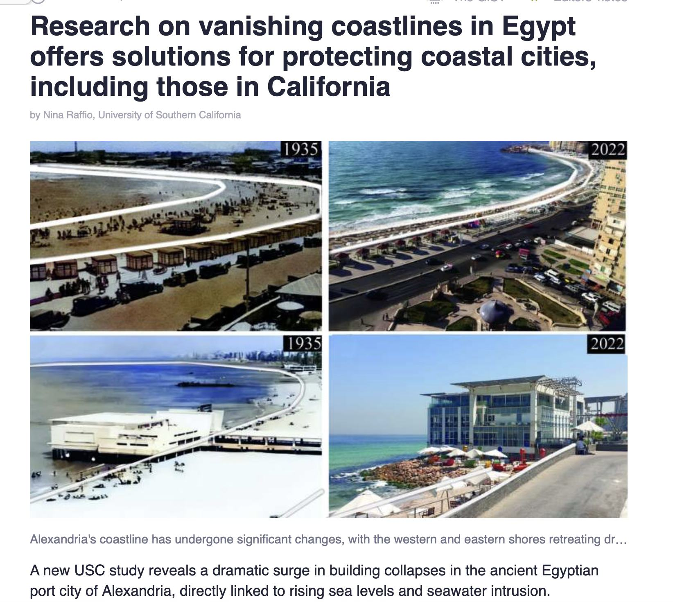
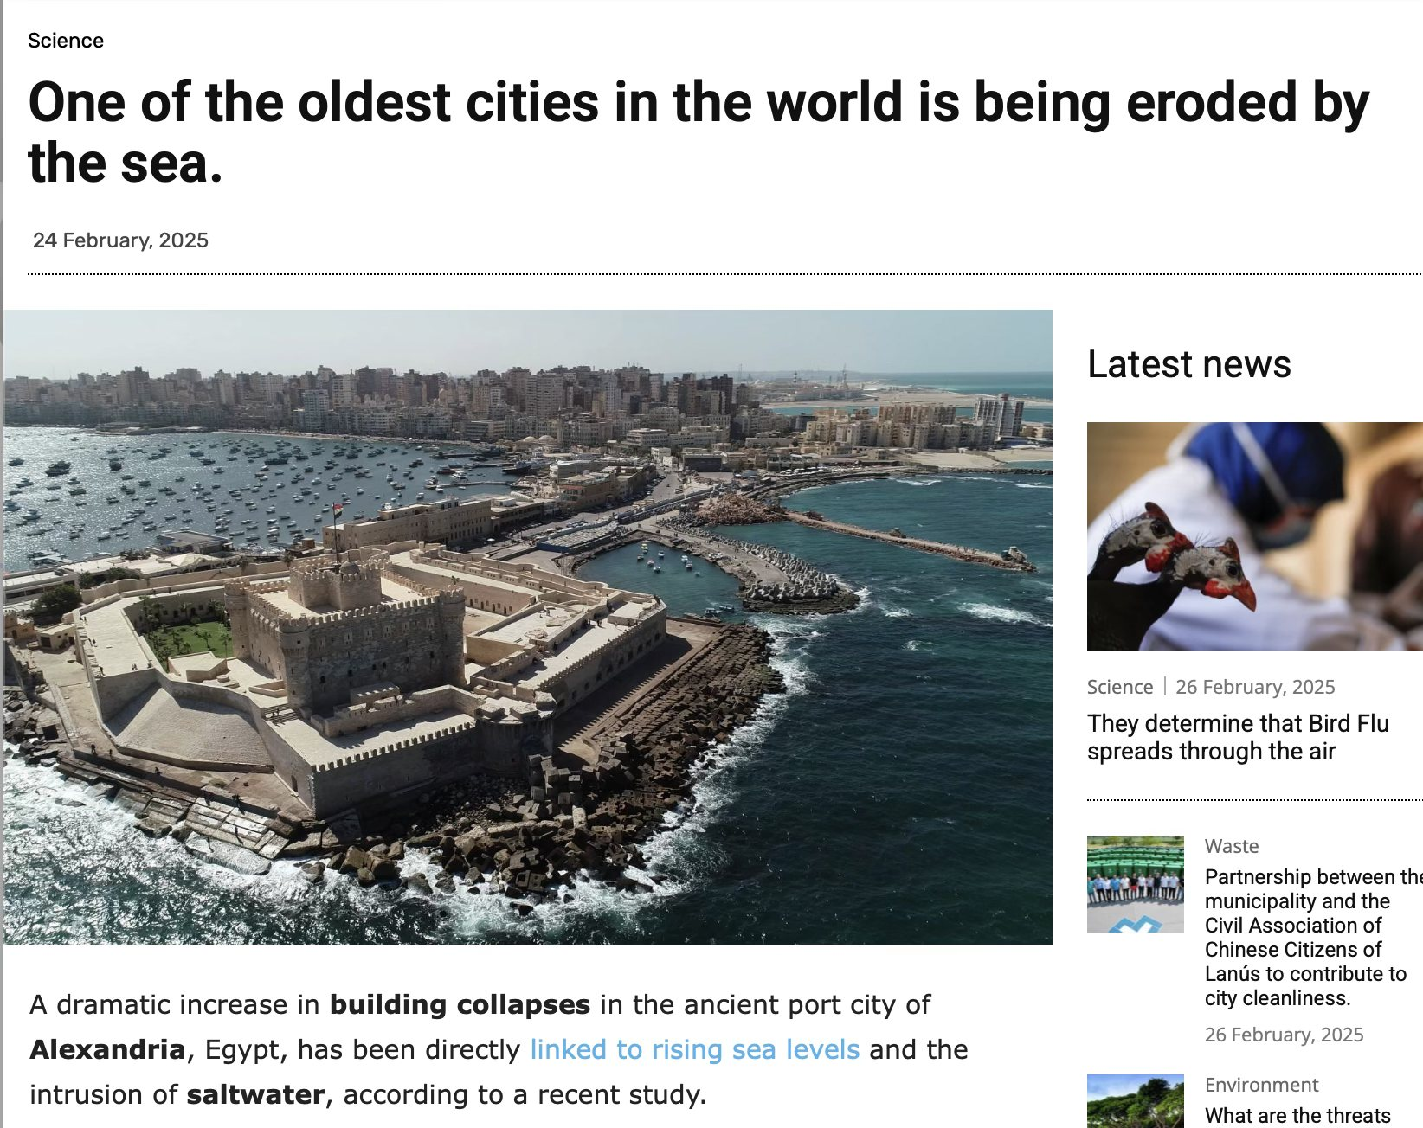
5- Climate Change Risks for International Tourism
      5.3- Sea Level Rise and Coastal Tourism: Alexandria, Egypt

Slide 46
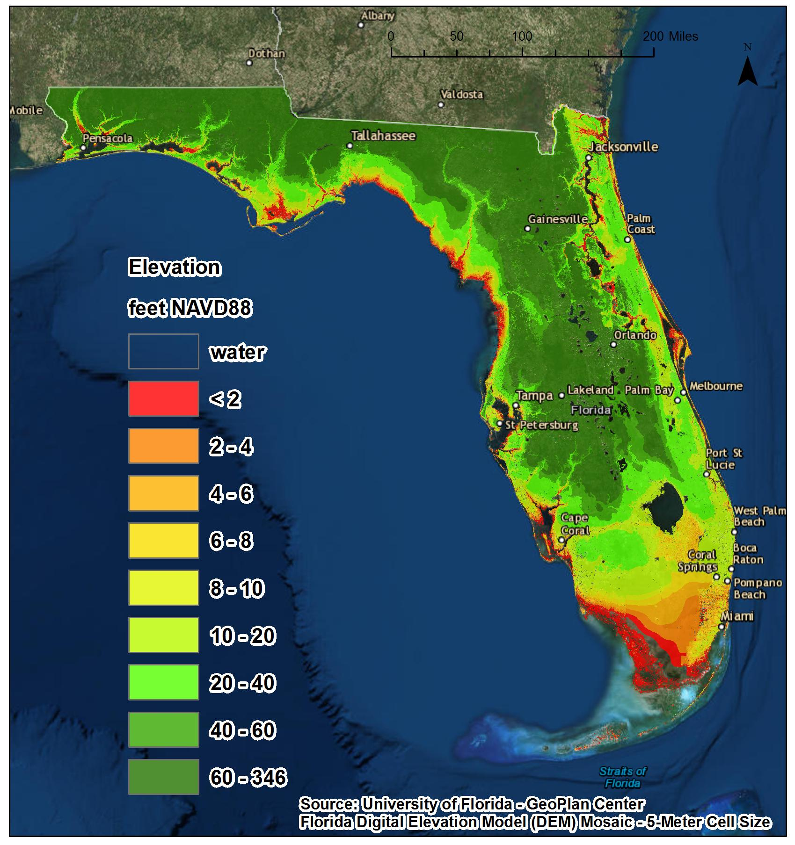
5- Climate Change Risks for International Tourism
      5.3- Sea Level Rise and Coastal Tourism: FLorida, USA
      It is assumed that:
      - 50% of Florida’s beaches
      - Multiple airports
      - Thousands of hotel rooms
      - Numerous historic buildings and landmarks

Slide 47
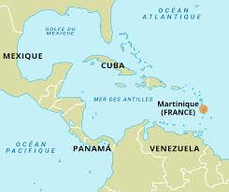
5- Climate Change Risks for International Tourism
      5.3- Sea Level Rise and Coastal Tourism: Rhe Caribbean Island of Martinique
      In Martinique, studies estimated that:
      - 83% of tourist beaches and
      - 62% of coastal infrastructure are at risk from sea level
      rise (SLR)-induced erosion.

Slide 48
5- Climate Change Risks for International Tourism
      5.3- Sea Level Rise and Coastal Tourism: Rhe Caribbean Island of Martinique
      - A multinational study covering coastal tourism resorts in 22 Caribbean nations found that:
      - Approximately 25% of resorts are vulnerable to partial or full inundation with a 1-meter SLR.
      - A much higher proportion are vulnerable to coastal erosion associated with SLR.
      - Resort front beaches are at greater immediate risk from sea level rise.
      - They are projected to disappear before any significant damage occurs to the tourism resort infrastructure itself.

Slide 49
      Discussion
      Describe the main impacts of climate change on tourism sector in your country:
      - highlighting the main impacts on destinations' appeal/attractiveness
      The rise/decline of tourism patterns
      The role of the government in relieving these impacts and;
      The role of the private developers in minimising the climate change-related tourism impacts

Slide 50
Thank you
      European Institute of Innovation, Entrepreneurship and Technology
      Lessingstraße 79,
      13158 Berlin, Germany
      Phone: +49 176 55524449
      Email: info@eiiet.com
Discover the world of eiIET

