Slide 1
Tourism Law and Legislation
European Institute of Innovation, Entrepreneurship and Technology
Lessingstraße 79, 13158 Berlin, Germany
Mahmoud Abdou| Berlin
      Lessingstraße 79,
      13158 Berlin, Germany
      Phone: +49 30 233618555
      Fax: +49 30 233618556
      Email: info@eiiet.com

Slide 2

Outline:
1- Legal Instruments
2- The Global Code of Ethics for Tourism
3- Framework Convention on Tourism Ethics

Slide 3

1- LEGAL INSTRUMENTS

Slide 4
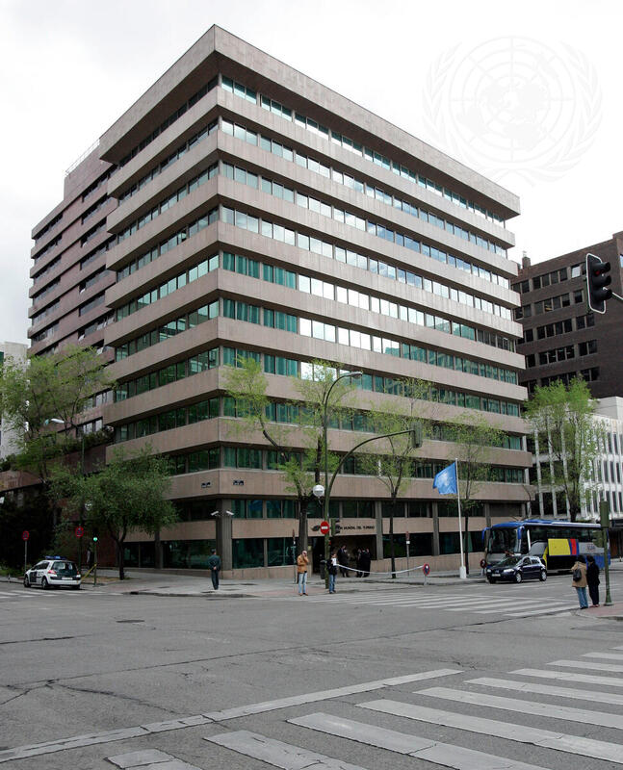
1- Legal Instruments
A- Legally binding instruments
For instance, international conventions
B- Not legally binding instruments
For instance, soft law instruments
Includes recommendations, definitions, international statistics measurements, other standards, and declaration of principles, etc

Slide 5
1- Legal Instruments
Recommendation and Declarations:
- Non-legally binding instruments enacted by the organization
- However, it does not mean that they do not affect member states.
- They remarkably influence subsequent decision-making of the organization as they establish common principles and policies from which it will be difficult to depart.

Slide 6
2- THE GLOBAL CODE OF ETHICS FOR TOURISM

Slide 7
2- The Global Code of Ethics for Tourism
- An example of soft law is the Global Code of Ethics for Tourism.
- It was adopted in 1999.
- Established to compile and present a synthesis of the various documents enacted by the UNWTO in one single document.
- Endorsed by the General Assembly in 2001

Slide 8
2- The Global Code of Ethics for Tourism
- Although established as a voluntary set of principles and standard of behaviour in tourism and not as a legally-binding document, the code effectively compiled state practice as well general principles applying to tourism stakeholders.

Slide 9
2- The Global Code of Ethics for Tourism
- Also, the code has widely accepted as a reference document for the development of national legislation, contractual agreements, and the development of policy in tourism.

Slide 10
2- The Global Code of Ethics for Tourism
- The majority of the UNWTO members have either formerly accepted the code through their national legislative bodies, or have incorporated some or all of its principles in their national legislative framework.

Slide 11
2- The Articles Global Code of Ethics for Tourism
- Tourism’s contribution to mutual understanding and respect between peoples and societies
Tourism should promote tolerance, dialogue, and respect between peoples and cultures.
Community-based tourism, where tourists stay with local families and learn about traditions.
Cultural exchange programs and guided heritage tours that explain local customs to visitors.
Campaigns against tourist misbehavior

Slide 12
2- The Global Code of Ethics for Tourism
- Tourism as a vehicle for individual and collective fulfilment
Tourism should support human dignity, education, and personal development.
Accessible tourism initiatives for people with disabilities in destinations
Wellness and spiritual tourism (yoga retreats, pilgrimage tourism).
Educational tourism

Slide 13
2- The Global Code of Ethics for Tourism
- Tourism, a factor of sustainable development
All tourism stakeholders must protect the natural environment
Tourism should support sustainable and continuous economic growth
Development must meet the needs of present and future generations

Slide 14
2- The Global Code of Ethics for Tourism
- Tourism, a user of the cultural heritage of mankind and a contributor to its enhancement
Tourism should protect and respect cultural heritage
Restrictions on photography or visitor numbers in museums and sacred sites.
Heritage conservation funded through entrance fees

Slide 15
2- The Global Code of Ethics for Tourism
- Tourism, a beneficial activity for host countries and communities
Local populations should benefit economically and socially from tourism.
Local employment in hotels, tour guiding, handicrafts.
Fair-trade tourism initiatives supporting local producers.

Slide 16
2- The Global Code of Ethics for Tourism
- Obligations of stakeholders in tourism development
Tourism businesses and authorities must act ethically
Hotels implementing child protection policies against exploitation.
Tour operators providing accurate information
Health and safety standards for adventure tourism

Slide 17
2- The Global Code of Ethics for Tourism
- Right to tourism
Tourism is a social right linked to rest, leisure, and freedom of movement.
Social tourism programs subsidizing holidays for low-income families.
Paid annual leave laws supporting tourism participation.

Slide 18
2- The Global Code of Ethics for Tourism
- Liberty of tourist movements
Tourists should enjoy freedom of movement while respecting laws and cultures.
Schengen Area facilitating cross-border travel in Europe.
Simplified visa systems
Tourist responsibilities to respect local laws

Slide 19
2- The Global Code of Ethics for Tourism
- Rights of the workers and entrepreneurs in the tourism industry
Tourism workers should have fair wages, decent working conditions, and social protection.
Minimum wage laws for hospitality workers.
Training programs for tour guides and hotel staff

Slide 20
2- The Global Code of Ethics for Tourism
- Implementation of the principles of the Global Code of Ethics for Tourism
The Code should be promoted, monitored, and applied through cooperation.
World Committee on Tourism Ethics handling complaints.
Governments integrating ethics into national tourism strategies.

Slide 21
3- FRAMEWORK CONVENTION ON TOURISM ETHICS

Slide 22
3- Framework Convention on Tourism Ethics
- Adopted in 2019
- First treaty of the organization
- Intended to boost the Code’s implementation
- Providing legal obligations at the international level
to the members ratifying it.

Slide 23
3- Framework Convention on Tourism Ethics
- The Main Objectives of the Conventions:
It aims to promote responsible, sustainable, and universally accessible tourism through the implementation of the ethical principles in tourism.
Increase accountability of governments
Improve implementation and compliance

Slide 24
3- Framework Convention on Tourism Ethics
- The World Committee on Tourism Ethics is a subsidiary body of the UNWTO General Assembly.
- It works not only on the Global Code of Ethics for Tourism but also on other related matters.
- The Committee is responsible for monitoring the implementation of this Convention.
- It also carries out additional tasks assigned by the Conference of States Parties.

Slide 25
DISCUSSION
- How can your own country benefit from applying the Global Code of Ethics for Tourism in practice?

Slide 26
Thank you
      European Institute of Innovation, Entrepreneurship and Technology
      Lessingstraße 79,
      13158 Berlin, Germany
      Phone: +49 176 55524449
      Email: info@eiiet.com
Discover the world of eiIET

