Slide 1
Business Organizations
European Institute of Innovation, Entrepreneurship and Technology
Lessingstraße 79, 13158 Berlin, Germany
Presenter Name : Dr. Naresh Seetharam| Berlin
      Lessingstraße 79,
      13158 Berlin, Germany
      Phone: +49 30 233618555
      Fax: +49 30 233618556
      Email: info@eiiet.com

Slide 2
Index
Sole Proprietorship (Einzelunternehmen)
Partnership (Personengesellschaft)
Limited Liability Company (GmbH)
Public Limited Company (AG)
Limited Liability Entrepreneur Company (UG)
Cooperative (eG)
Branch Office (Zweigniederlassung)
Joint Venture

Slide 3
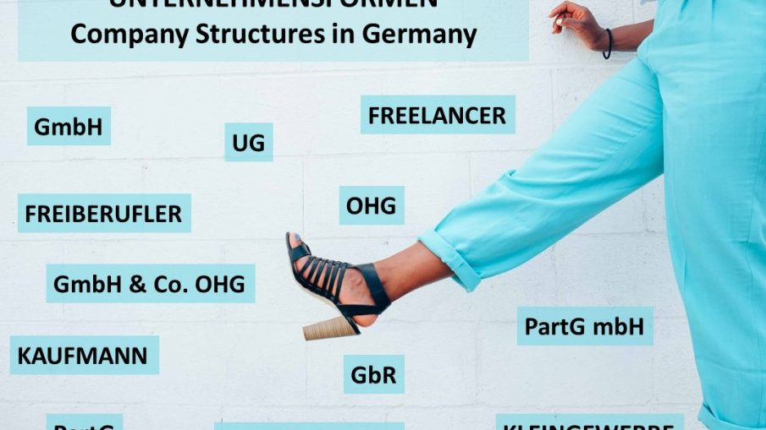

Slide 4
Sole Proprietorship (Einzelunternehmen)
Owned and operated by one individual
Unlimited personal liability
Income taxed as personal income
Easy setup and full control
Limited access to capital

Slide 5
Partnerships (Personengesellschaft)
OHG: All partners have unlimited liability
KG: General and limited partners
Profits taxed at partners’ personal level
Shared responsibility and capital
Personal liability risks

Slide 6
Limited Liability Company (GmbH)
Separate legal entity
Liability limited to capital contribution
Minimum capital: €25,000
Corporate income tax applies
High credibility, more administration

Slide 7
Public Limited Company (AG)
Suitable for large-scale businesses
Shares can be publicly traded
Minimum capital: €50,000
Supervisory and management boards required
High regulatory requirements

Slide 8
Entrepreneurial Company (UG)
Known as the mini-GmbH
Minimum capital from €1
Limited liability
Lower credibility than GmbH
Profits retained until €25,000 capital

Slide 9
Cooperative (eG)
Member-based legal entity
Democratic decision-making
Limited liability for members
Focus on mutual economic benefit
Complex governance structure

Slide 10
Branch Office (Zweigniederlassung)
Extension of a foreign company
Not a separate legal entity
Parent company fully liable
German taxation on local profits
Lower setup effort

Slide 11
Joint Venture
Cooperation between two or more parties
Shared resources, risks, and profits
Flexible legal structure
Access to new markets
Potential partner conflicts

Slide 12
Liability Comparison Diagram
Unlimited
Liability
Mixed
Liability
Limited
Liability
Corporate
Structures

Slide 13
Choosing the Right Legal Form (Flowchart)
GmbH / UG / AG
Need
Limited
Liability?
Start Business
Sole Prop.
/ Partnership

Slide 14
Case Study: Sole Proprietorship (Einzelunternehmen)
Example: Independent IT Consultant (Freelancer) in Berlin
Owner operates under personal name or registered trade name
Low setup cost and flexible operations
High personal risk due to unlimited liability
Common among freelancers, designers, and consultants

Slide 15
Case Study: Partnership (OHG / KG)
Example: ALDI Einkauf SE & Co. OHG
Operates as a partnership-based structure
Family-owned with shared management responsibilities
Unlimited liability for general partners
Allows strong internal control and long-term planning

Slide 16
Case Study: GmbH
Example: Robert Bosch GmbH
One of Germany’s largest privately held companies
Limited liability protects shareholders
Highly trusted corporate structure
Suitable for industrial and technology firms

Slide 17
Case Study: Unternehmergesellschaft (UG)
Example: Early-stage Berlin tech startups
Often used by founders with limited capital
Allows quick market entry with minimal funding
Profits retained to build capital
Frequently converted into GmbH later

Slide 18
Case Study: Aktiengesellschaft (AG)
Example: BMW AG
Publicly traded on Frankfurt Stock Exchange
Access to international capital markets
Clear separation of ownership and management
Strong governance and transparency requirements

Slide 19
Case Study: Cooperative (Genossenschaft)
Example: REWE Group eG
Owned by independent retail members
Democratic decision-making model
Members benefit from shared purchasing power
Strong presence in German retail sector

Slide 20
Case Study: Branch Office (Zweigniederlassung)
Example: Google Germany (Branch Operations)
Extension of foreign parent company
Focus on sales and marketing activities
Parent company bears full liability
Common for international market entry

Slide 21
Case Study: Joint Venture
Example: HERE-Technologies
Joint venture between BMW, Mercedes-Benz, and Audi
Shared investment in digital mapping technology
Risk and cost sharing among partners
Strategic collaboration for innovation

Slide 22
Case study key facts about Mercedes/BMW/Audi Merger
Key Facts
Formed: 2019
Legal Form: GmbH (Limited Liability Company)
Goal: Create unified software backbone for next-gen vehicles
Result: Accelerated capability but later restructured due to strategic differences
Lesson: Pre-competitive collaboration works for base layers; differentiation remains at brand level.

Slide 23
Thank you
      European Institute of Innovation, Entrepreneurship and Technology
      Lessingstraße 79,
      13158 Berlin, Germany
      Phone: +49 176 55524449
      Email: info@eiiet.com
Discover the world of eiIET

