Slide 1
Student Name: RAM PRABESH SAH
Student ID: DE240026
Submission Date: 27-June-2025

Slide 2
Kathmandu's Heritage

Slide 3
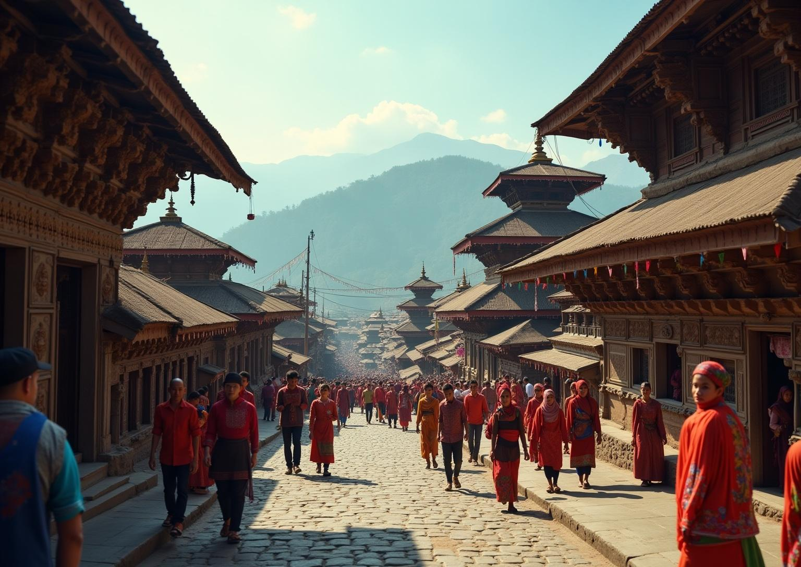
Introduction
This presentation explores the historical background and cultural significance of Kathmandu, focusing on its unique heritage, festivals, and tourism potential.

Slide 4
01
Historical Background

Slide 5
Founding of Kathmandu
Kathmandu, the capital of Nepal, was established in the 3rd century AD. It served as a key trade route between India and Tibet, fostering diverse cultural exchanges. The city quickly became a political and economic center, influencing the region's development.

Slide 6
Key Historical Events
Several dynasties, including the Licchavis and Malla, played pivotal roles in shaping Kathmandu's history. Significant events such as the unification of Nepal in the 18th century and the impact of the 2015 earthquake have profoundly influenced the city’s progression.

Slide 7
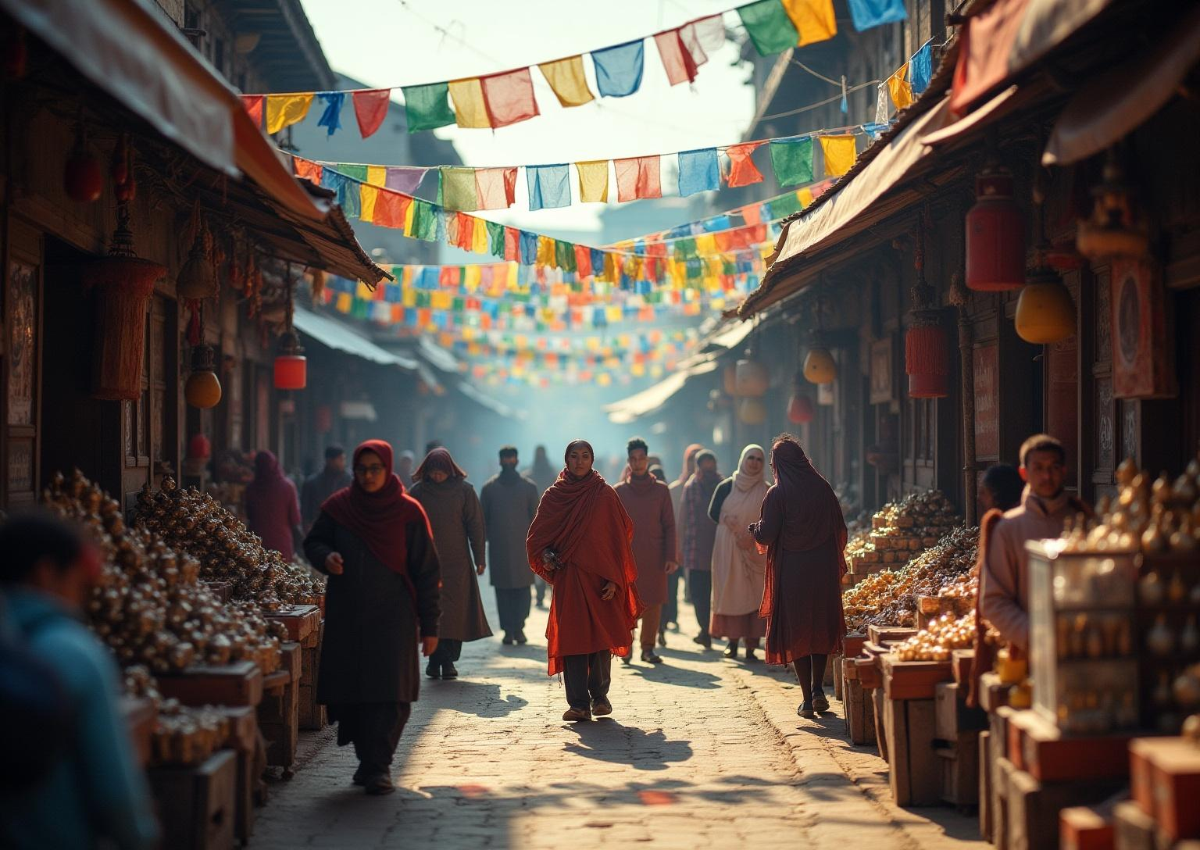
Cultural Evolution
Over centuries, Kathmandu has absorbed influences from various cultures, enriching its own traditions. The blending of Hindu and Buddhist practices is particularly notable, creating a unique cultural tapestry that continues to thrive today.

Slide 8
02
Cultural Features

Slide 9
Festivals and Celebrations
Kathmandu hosts numerous vibrant festivals, such as Dashain and Tihar, which are rooted in Hindu and Buddhist traditions. These festivities feature colorful processions, traditional music, and elaborate rituals, celebrating the community's rich cultural heritage. Events like the Indra Jatra showcase local customs and unity, attracting both residents and tourists.

Slide 10
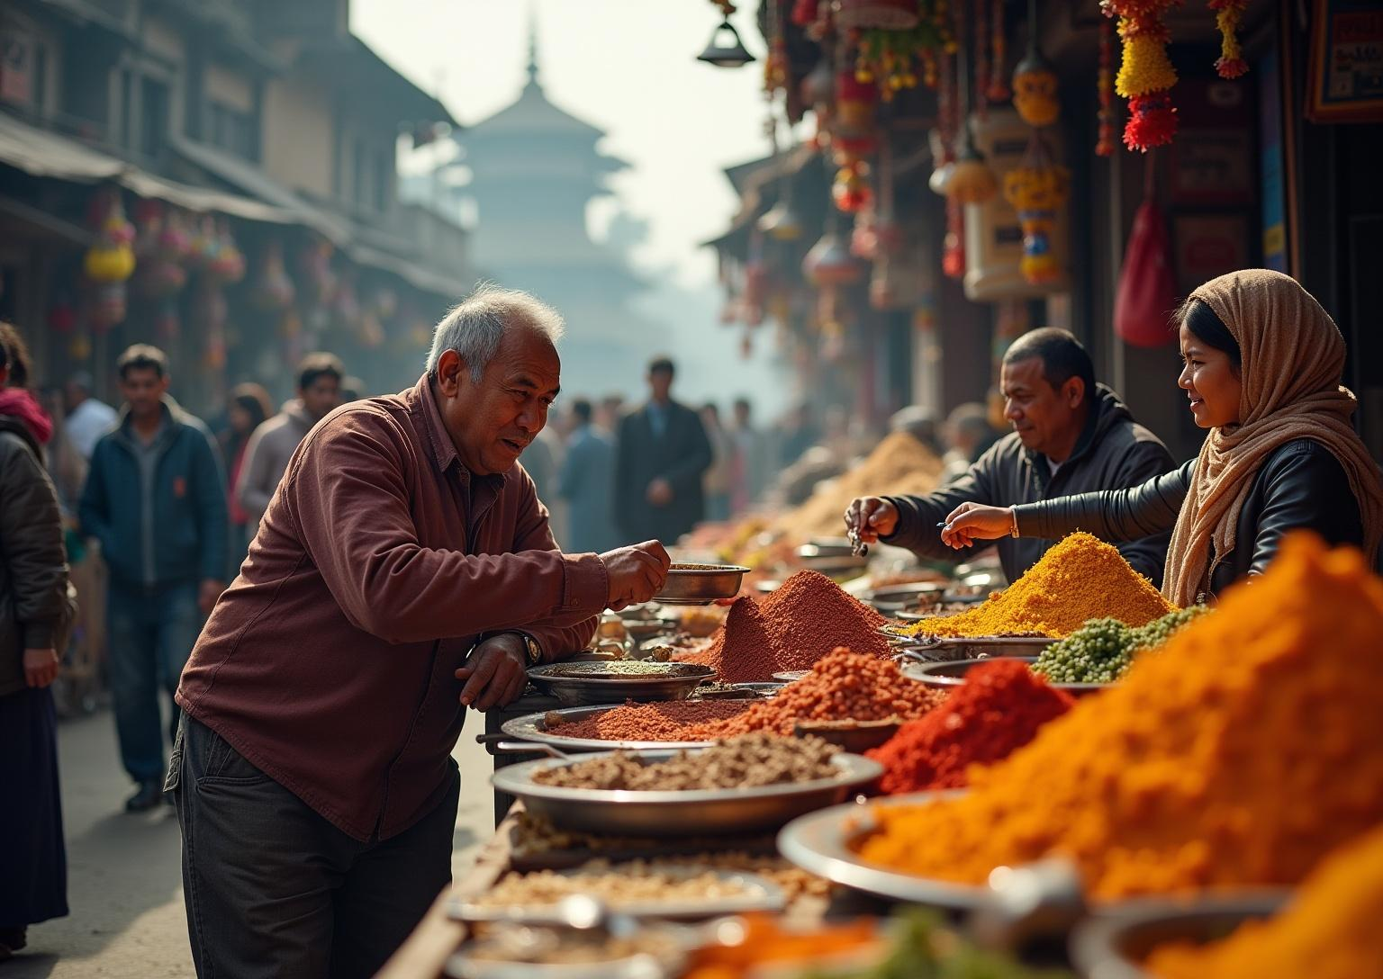
Customs and Habits
The people of Kathmandu engage in various customs that reflect their diverse cultural background. Daily rituals, such as prayers at temples and shrines, are common. Family gatherings are significant during festivals, fostering community bonds. Local markets and street food stalls also play a vital role in daily life, offering a glimpse into the city's customs.

Slide 11
Cultural Traditions
Kathmandu's cultural traditions blend Hinduism and Buddhism, evident in religious practices, art, and architecture. Temples and stupas display exquisite craftsmanship while serving as spiritual hubs. Local dances, music, and crafts are integral to the city's cultural identity, preserving the unique heritage for future generations.

Slide 12
03
Tourism Development

Slide 13
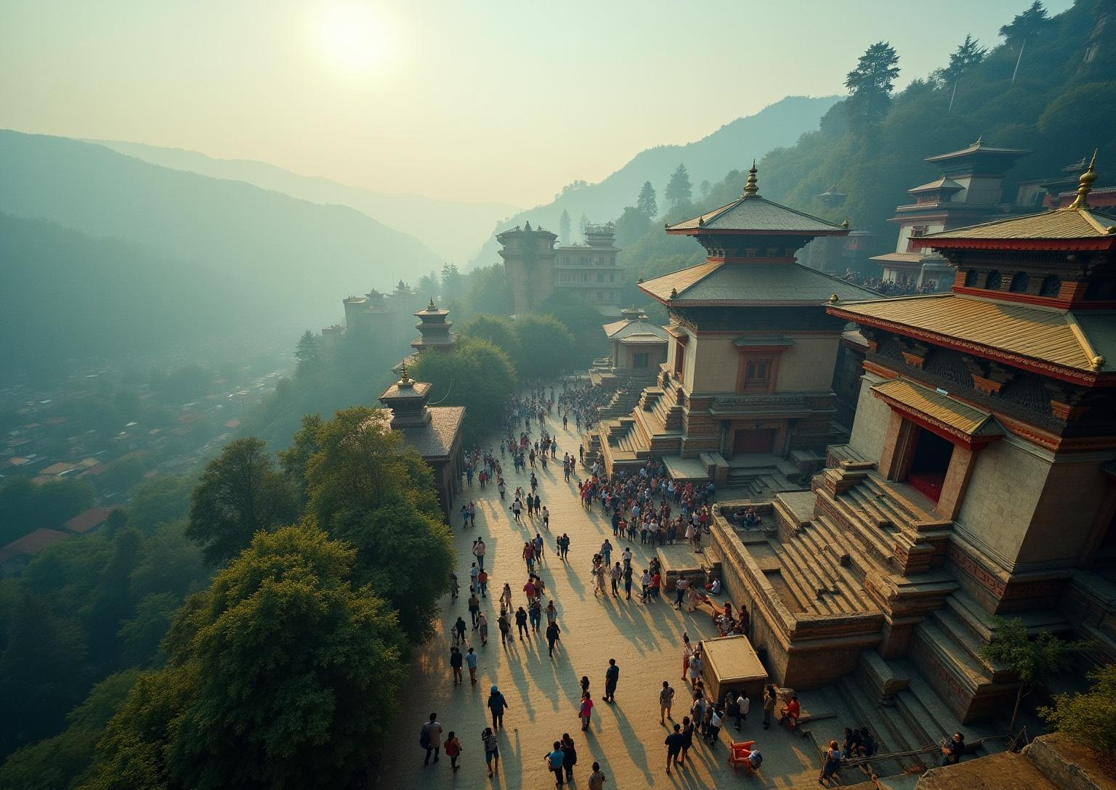
Tourism Significance
Tourism is a crucial aspect of Kathmandu's economy, generating revenue and employment opportunities. The city attracts visitors with its rich historical sites, cultural experiences, and natural beauty, positioning itself as a gateway to exploring the Himalayas. Sustainable tourism initiatives are essential for preserving its cultural and natural resources.

Slide 14
Annual Tourist Statistics
Kathmandu receives millions of tourists annually, drawn by its historical significance and religious importance. Recent trends show a recovery in tourist numbers post-pandemic, with a steady increase in international visitors. These statistics underscore the city's importance as a major tourist destination in South Asia.

Slide 15
Touristic Activities
In Kathmandu, tourists can engage in a variety of activities, including trekking, cultural tours, and heritage walks. Attractions such as the Durbar Square, Swayambhunath, and local artisan workshops offer immersive experiences. Outdoor activities, such as hiking and paragliding, further enhance the appeal of the city.

Slide 16
Conclusions
Kathmandu represents a unique confluence of history, culture, and tourism. Its vibrant festivals, customs, and historical significance contribute to a rich cultural landscape. Continued emphasis on sustainable tourism practices will ensure the preservation of this remarkable city for future generations.

Slide 17
Thank you!

