Slide 1
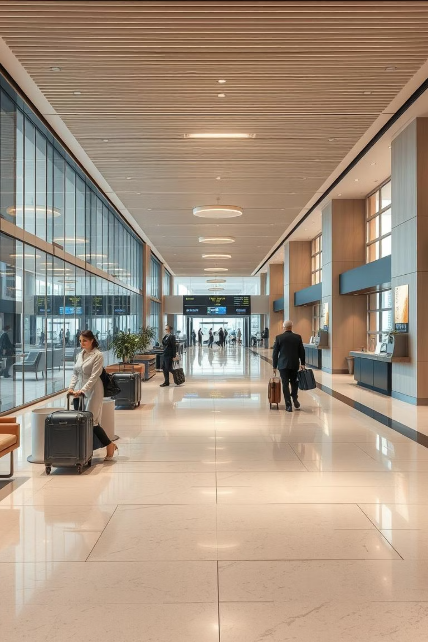
Service Quality Challenges in the German Hospitality & Airline Sector
An Analysis of Hotel Berlin & Lufthansa Airlines
Presented by: Ajay Kumar

Slide 2
Agenda: Navigating Service Excellence
This presentation provides an in-depth analysis of service quality challenges within Germany's prominent hospitality and airline sectors. Through a detailed examination of case studies involving Hotel Berlin, Berlin, and Lufthansa Airlines, we will pinpoint common service quality failures and propose actionable strategies for improvement, culminating in comprehensive recommendations for achieving service excellence.
Introduction & Scope
Defining service quality and outlining the focus of our analysis on the German hospitality and airline industries.
Hotel Berlin, Berlin: Profile & Operations
An overview of Hotel Berlin, Berlin, highlighting its market position and operational context within the German hospitality sector.
Lufthansa Airlines: Profile & Operations
A strategic overview of Lufthansa Airlines, examining its role and operational scale in the global and German aviation market.
Service Quality Failures: Hotel Berlin, Berlin
Detailed analysis of specific instances and patterns of service quality shortcomings observed at Hotel Berlin, Berlin.
Service Quality Failures: Lufthansa Airlines
Examination of service quality failures and customer pain points identified within Lufthansa Airlines' operations.
Strategies to Improve: Hotel Berlin, Berlin
Proposed actionable strategies and recommendations tailored to address the service quality issues at Hotel Berlin, Berlin.
Strategies to Improve: Lufthansa Airlines
Recommended interventions and strategic approaches aimed at enhancing service quality for Lufthansa Airlines.
Final Recommendations & Conclusion
Synthesizing findings to present overarching recommendations for fostering a culture of service excellence across both sectors.

Slide 3
Introduction & Scope
This presentation looks closely at service quality. Simply put, service quality is how well a service meets or goes beyond what a customer expects. It includes things like being reliable, responding quickly, showing care, and building trust. All these parts work together to create the customer's overall experience. In today's competitive market, excellent service isn't just a bonus; it's key to keeping customers, building a good brand, and growing the business over time.
We will specifically focus on the challenges and chances in Germany's competitive hotel and airline industries. Germany is a major economy and travel center, so customers there expect a lot. We will show important points about service quality by looking at two main examples: Hotel Berlin, Berlin (for hotels) and Lufthansa Airlines (for airlines). By studying these specific cases, our goal is to find common problems and service issues. We also want to suggest practical ways to make things better in both industries.

Slide 4
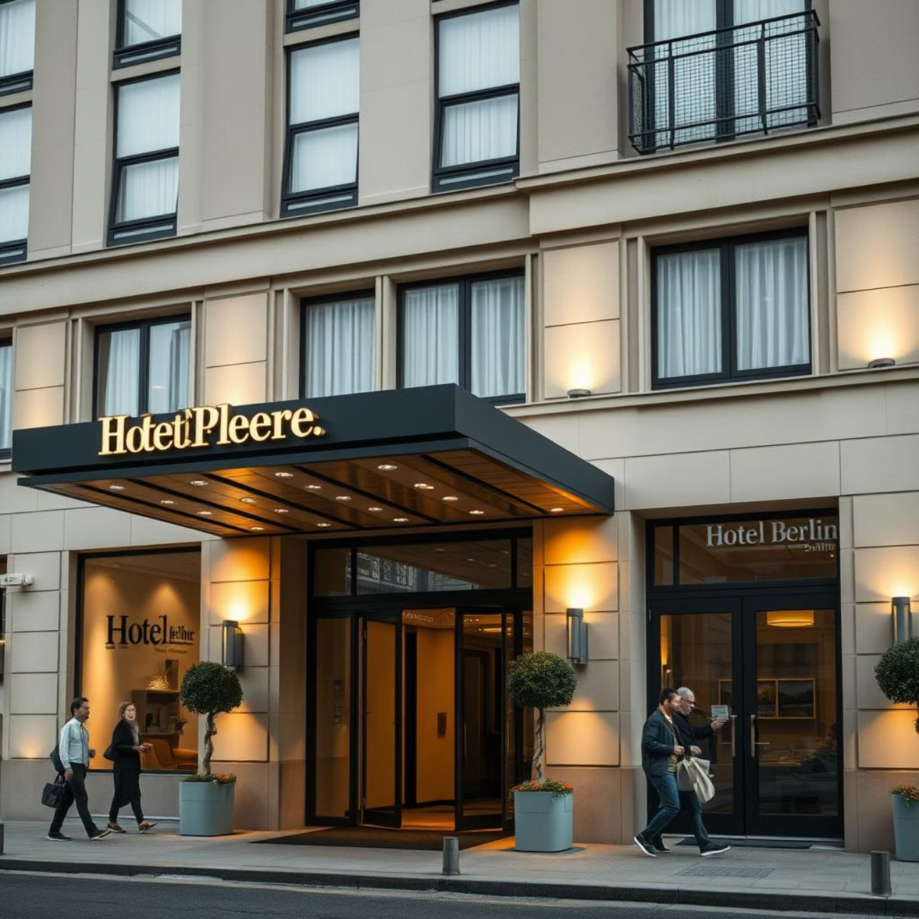
Hotel Berlin : An Overview
The Hotel Berlin, Berlin is a prominent 4-star establishment located in the heart of Berlin, making it a popular choice for both leisure and business travellers. With over 700 rooms, it's one of the larger hotels in the city, known for its commitment to sustainability initiatives.
Despite its prime location and eco-friendly focus, the hotel has recently faced a wave of negative customer feedback.
Unfriendly staff attitudes
Inconsistent room cleanliness, particularly in bathrooms
Frequent booking errors and issues with late check-ins

Slide 5
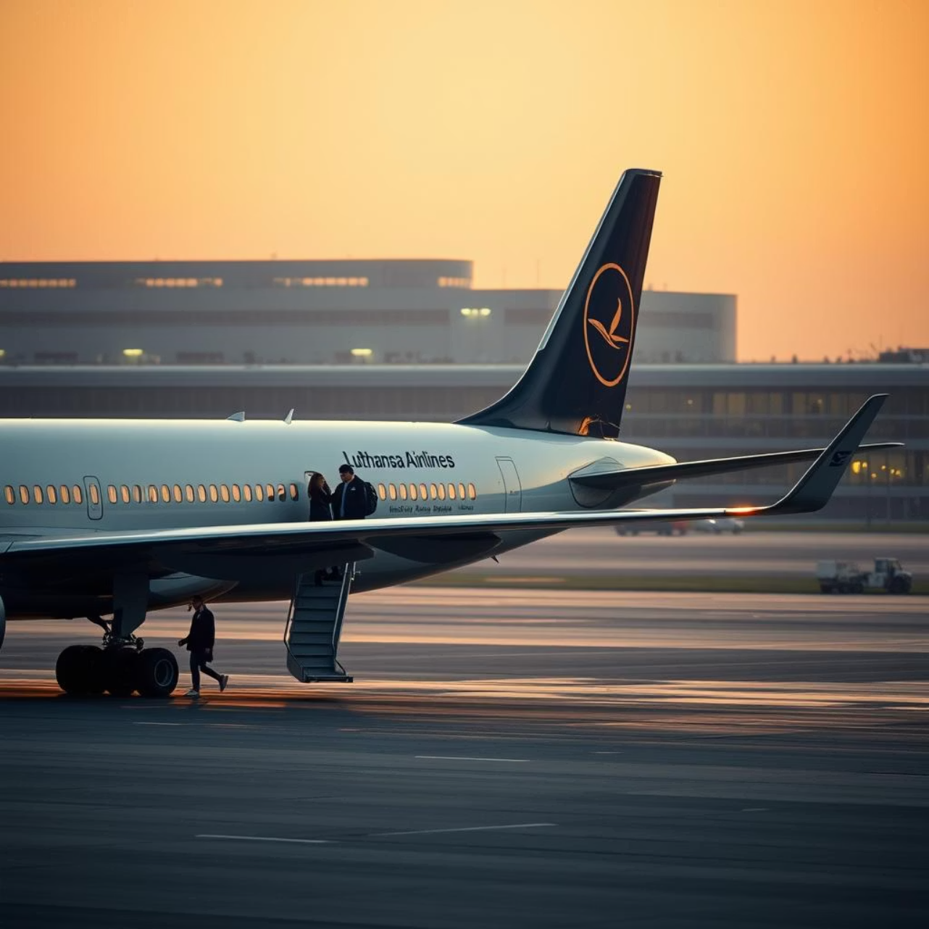
Lufthansa Airlines: A Strategic Player
As Germany's national carrier and a founding member of the Star Alliance, Lufthansa connects over 100 international destinations, offering both premium and economy cabin experiences. It's a key player in global aviation, renowned for its extensive network.
However, recent years have seen a significant decline in service quality perceptions due to:
Frequent staff strikes leading to widespread disruptions
Poor and delayed communication regarding flight changes
A perceived lack of empathy from customer service representatives

Slide 6
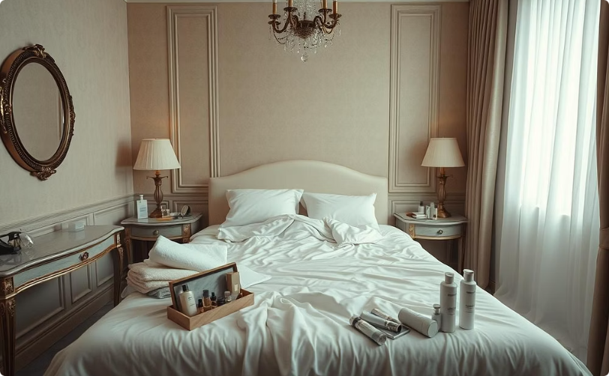
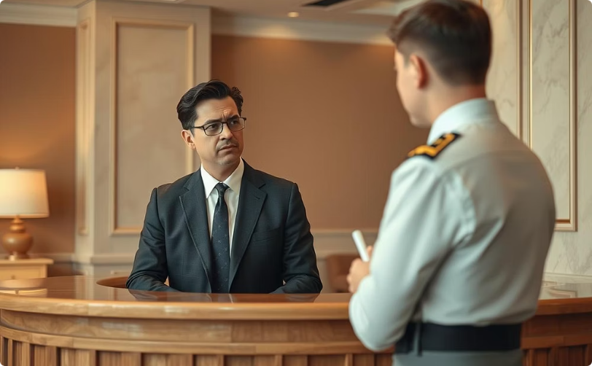


Service Quality Failures: Hotel Berlin, Berlin
Customer reviews consistently highlight systemic issues across several dimensions of service quality at Hotel Berlin, Berlin. These failures directly impact guest satisfaction and brand reputation.
Service Design & Delivery
Staff Performance
Communication Breakdown
Operational Reliability
Inconsistent room cleanliness, especially in bathrooms, and an error-prone online booking system frequently result in guest dissatisfaction and incorrect reservations.
Reports of rude and unhelpful front desk behaviour create a poor first impression, with staff often inattentive to explicit guest needs and requests, leaving issues unresolved.
Rooms are frequently not ready at the promised check-in time, impacting guest schedules. There are also frequent mismatches between booked room types and assigned rooms upon arrival.
Slow and inadequate responses to customer complaints prolong guest frustration. The absence of real-time updates for check-ins causes uncertainty and delays for guests.

Slide 7
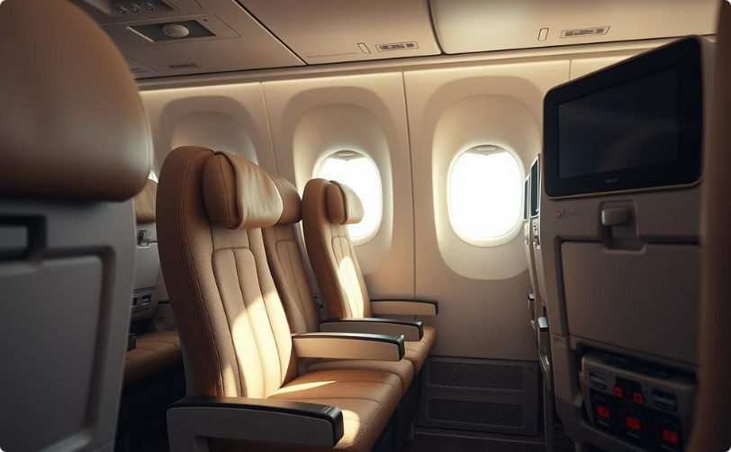


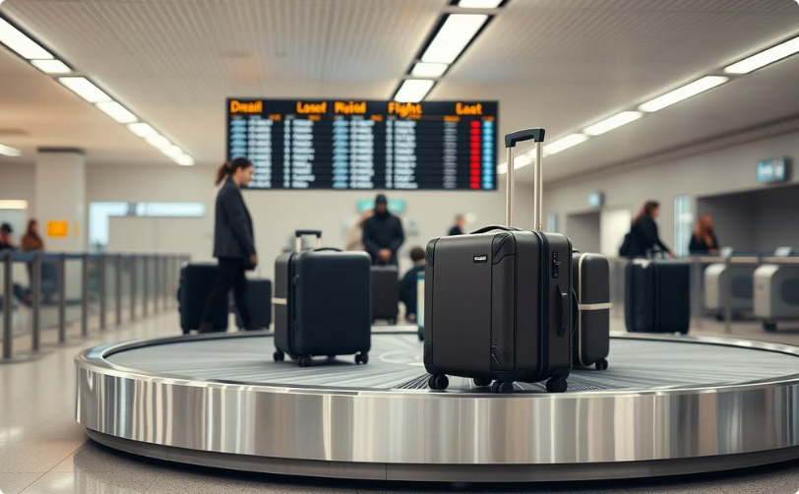
Service Quality Failures: Lufthansa Airlines
Lufthansa, despite its premium positioning, faces significant challenges in delivering consistent service quality, leading to a decline in customer trust and satisfaction, as observed in industry reports and customer feedback.
Service Design & Delivery
Staff Behaviour
Communication Shortfalls
Operational Reliability
Uncomfortable and cramped seating configurations in economy class, impacting long-haul flights. Outdated and frequently non-functional inflight entertainment systems.
Flight attendants often perceived as cold or dismissive, lacking a welcoming demeanor. Poor handling of frustrated passengers during delays or challenging situations.
Infrequent and delayed updates on flight disruptions, leaving passengers uninformed. Excessively long wait times on customer service lines, exacerbating passenger stress.
A high incidence of flight delays and cancellations, leading to missed connections. Persistent issues with lost baggage and overbooked flights, causing significant inconvenience.

Slide 8

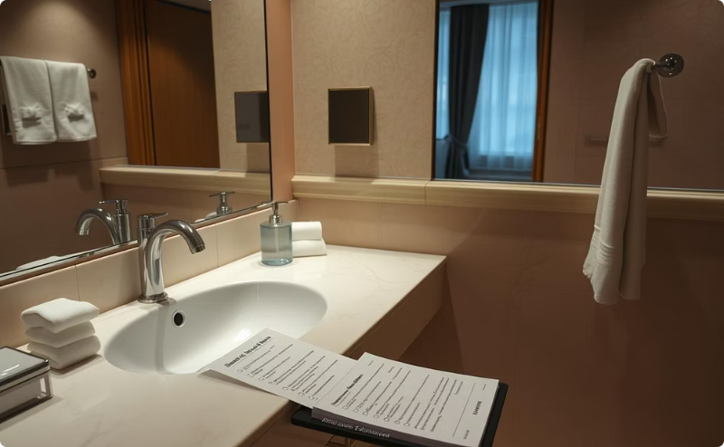
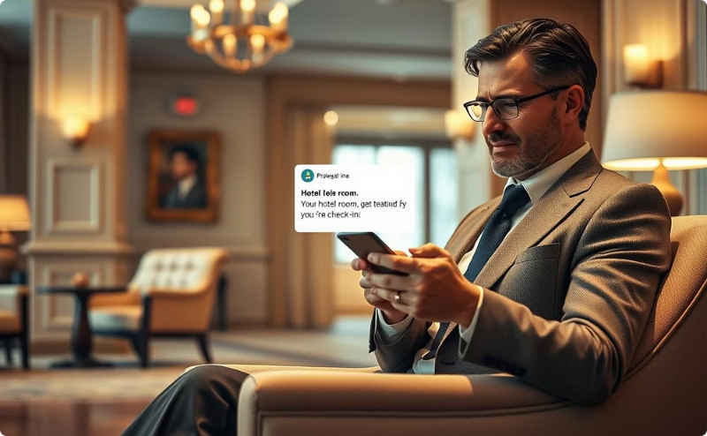

Strategies to Improve: Hotel Berlin, Berlin
To reclaim its reputation for quality service, Hotel Berlin, Berlin should implement targeted strategies focusing on staff empowerment, operational efficiency, and technological integration.
Staff Training Program
Room Quality Audits
Live Check-In System
AI Chatbot Integration
Develop comprehensive training focusing on hospitality, empathy, and multilingual communication skills to enhance guest interactions.
Implement daily, rigorous cleanliness checklists and surprise audits to ensure consistent standards across all rooms.
Introduce a mobile notification system for guests to receive real-time updates on room readiness and key collection.
Deploy AI-powered chatbots for instant handling of common booking queries and FAQs, reducing wait times.

Slide 9
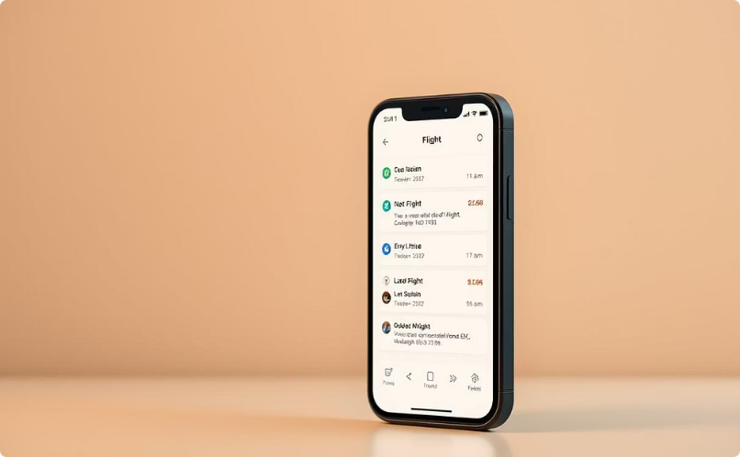
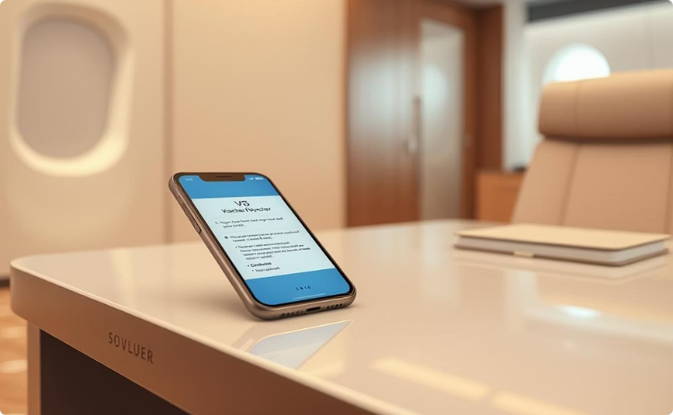

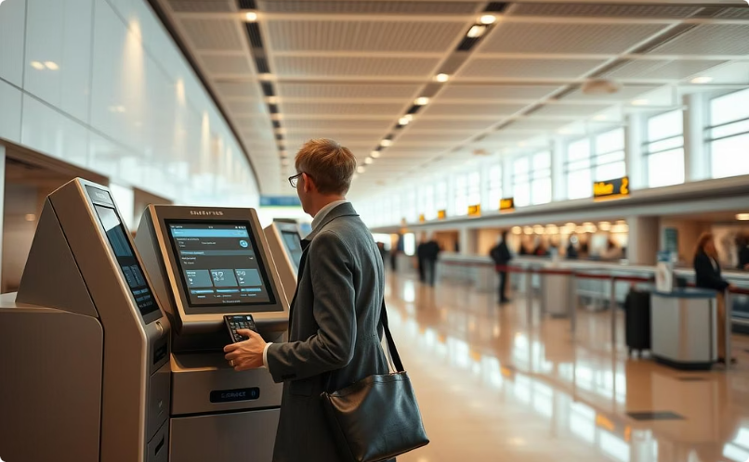
Strategies to Improve: Lufthansa Airlines
Lufthansa can restore passenger confidence and operational efficiency by modernizing its communication channels, re-evaluating its compensation processes, and investing in employee well-being.
Mobile App Enhancement
Automated Compensation
Employee Wellness & Incentives
Self Check-In Kiosks
Expand the availability and functionality of self check-in kiosks to streamline processes and alleviate stress on ground staff during peak times.
Upgrade the mobile application to provide immediate push notifications for all delay, cancellation, and gate change updates.
Implement an automated system for issuing vouchers or compensation to passengers for disrupted flights, ensuring transparency and speed.
Introduce programmes to reduce staff burnout and improve morale, fostering a more positive service attitude among flight and ground crews.

Slide 10

Final Recommendations: A Path to Service Excellence
Achieving service excellence requires a holistic approach, combining human-centric strategies with technological advancements across both the hospitality and airline sectors.
People-Centric Approaches
Technology & Operational Focus
Prioritise staff training and well-being: Empower employees with skills and support to deliver exceptional service.
Leverage technology to improve communication: Utilise apps and digital tools for real-time updates and seamless interactions.
Streamline customer complaint processes: Implement clear, efficient, and empathetic resolution pathways.
Ensure robust quality control in daily operations: Regular audits and system improvements to maintain high standards consistently.
By focusing on these interconnected areas, both Hotel Berlin, Berlin and Lufthansa Airlines can rebuild trust, enhance customer satisfaction, and secure their positions as leaders in service quality.

Slide 11
References
Aggregated Data from Customer Review Platforms (e.g., TripAdvisor, Google Reviews). (n.d.). Guest feedback and passenger experiences for Hotel Berlin, Berlin and Lufthansa Airlines.
Market Research Firms. (Year, various). Industry reports on service quality trends and challenges in the German hospitality and airline sectors (e.g., Statista, Deloitte).
Academic Journals. (Various years). Studies on service failure, recovery strategies, and customer satisfaction in tourism and transport industries.
Hotel Berlin, Berlin & Lufthansa Airlines. (Various years). Company press releases & annual reports detailing operational performance and customer service initiatives.
Reputable Media Outlets. (Various dates). News articles & business publications covering recent service incidents and strategic responses (e.g., Handelsblatt, Frankfurter Allgemeine Zeitung, AeroTelegraph).

Slide 12

Thank You!

