Slide 1
Operations Management in Hospitality
European Institute of Innovation, Entrepreneurship and Technology
Lessingstraße 79, 13158 Berlin, Germany
Mahmoud Abdou| Berlin
      Lessingstraße 79,
      13158 Berlin, Germany
      Phone: +49 30 233618555
      Fax: +49 30 233618556
      Email: info@eiiet.com

Slide 2
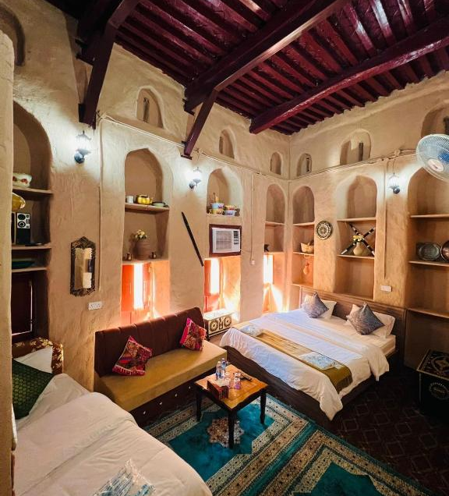
Outline
Hospitality Decisions and Processes
The Strategic Service Vision
Operations Strategy for Hospitality Services
Competitive Dimensions of Operations Strategies

Slide 3

1- Hospitality Decisions and Processes

Slide 4
1- Hospitality Decisions and Processes
      1.1- Service Concepting
      - Identifies the “what” and “how” of a service
      - Reflects how customers, staff, and shareholders should perceive the service
      1.2- Service-Profit Chain
      - Explains the link between customer satisfaction, loyalty, and profitability
      - Customer loyalty is a key source of competitive advantage and improved performance

Slide 5
1- Hospitality Decisions and Processes
      Importance of Service Concept in Hospitality:
      - Ensures customers understand what they are buying or receiving
      - Helps staff know what they are selling and how to deliver it
      - Serves as the foundation for operations strategies
      - Service Concept includes:
      The organizing idea
      The Service Provided
      The Service Received
The organizing idea
The Service Provided
The Service Received
The Service Concept

Slide 6
1- Hospitality Decisions and Processes
      A- The Organizing Idea
      - Represents the core service that customers are purchasing
      - Guides resource allocation and service design decisions
      Example
      - Hotel organizing idea: “Providing a home-like environment”
      - Focus on creating rooms and spaces that make guests feel at home
The organizing idea
The Service Provided
The Service Received
The Service Concept

Slide 7
1- Hospitality Decisions and Processes
      B- The Service Provided
      - Represents the complete service process and outcomes
      - Reflects how the service concept is brought to life for the guest
      Example: “Home-like Environment” Hotel
      - Pleasant check-in experience supported by helpful staff
      - Beyond basic amenities:
      In-room kitchenettes
      On-site laundry facilities for guest use
The organizing idea
The Service Provided
The Service Received
The Service Concept

Slide 8
1- Hospitality Decisions and Processes
      C- The Service Received
      - Encompasses the customer experience and the service outcomes
      Customer Experience
      - Reflects the customer’s positive or negative response
      Service Outcomes
      - Represent what the customer gains from the service, such as:
The organizing idea
The Service Provided
The Service Received
The Service Concept
Products | Benefits
Emotions | Intentions

Slide 9
1- Hospitality Decisions and Processes
      1.2- Service-Profit Chain
      - Explains the link between customer satisfaction, loyalty, and profitability
      - Customer loyalty is a key source of competitive advantage and improved performance
      Core Principles:
      - Retaining existing customers is as crucial as attracting new ones
      - Customer satisfaction drives customer loyalty
      - Satisfied customers are more likely to return and recommend
      - It connects employee satisfaction → service quality →
      customer satisfaction → customer loyalty → profitability.
service-profit chain
employee satisfaction
service quality
customer satisfaction
customer loyalty
profitability

Slide 10
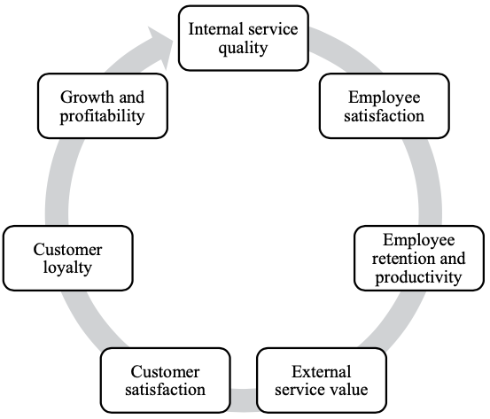
1- Hospitality Decisions and Processes
      1.2- Service-Profit Chain
      - Logic of the Service-Profit Chain is as follows:
      A- Internal Service Quality
      - Drives overall employee satisfaction
      - Influenced by the quality of the working environment
      - Key aspects of internal service quality:
      Equipping employees with skills and authority to serve customers
      Positive internal interactions among staff

Slide 11
1- Hospitality Decisions and Processes
      B- Employee Satisfaction
      Drives retention:
      - Satisfied employees are less likely to leave the company
      Boosts productivity:
      - Higher satisfaction leads to better performance and efficiency
      Reduces turnover costs:
      - Turnover rates can be up to three times lower for satisfied employees

Slide 12
1- Hospitality Decisions and Processes
      C- Employee Retention
      - High productivity enhances customer value perception
      - External service value includes:
      Timely service delivery
      Friendly and helpful employees
      Impact on customers:
      - Customers value not only physical attributes but
      also quality of service interactions

Slide 13
1- Hospitality Decisions and Processes
      D- External Service Value
      - External service value drives customer satisfaction
      - Customers are increasingly value-oriented as services/products
      become commoditized
      - Value is created at the point of consumption
      - Customers judge the experience and outcomes themselves

Slide 14
1- Hospitality Decisions and Processes
      E- Customer Satisfaction, Customer Loyalty
      - Satisfaction is key to loyalty
      - Satisfied customers:
      Visit more often
      Recommend the service to friends and family

Slide 15
1- Hospitality Decisions and Processes
      F- Customer Loyalty, Growth and Profitability
      - Drives revenue growth
      - Boosts profitability even with a small increase in loyal customers
      - Encourages repeat business and long-term relationships
      - Strengthens brand reputation

Slide 16

4- The Strategic Service Vision
2- The Strategic Service Vision

Slide 17
2- The Strategic Service Vision
      2- The Strategic Service Vision
      - A framework for strategic planning in service firms
      - Systematically guides a set of ideas and actions to maximize performance
      - Elements of the Strategic Service Vision
Target Market Segment | Service Concept
Operating Strategy | Service Delivery System

Slide 18
2- The Strategic Service Vision
      A- Target Market Segment:
      - Who is the business serving?
      - Hospitality operations cannot satisfy everyone
      Key Considerations for Targeting
      - Market Segmentation Dimensions
      - Primary Market Segment Characteristics
      - Customer Needs Priorities
Target Market Segment
Service Concept
Operation Strategy
Strategic Service Vision Elements
Service Delivery System

Slide 19
2- The Strategic Service Vision
      B- Service Concept
      - What is the business providing to customers?
      - Describes the nature of the service for customers, employees, and stakeholders
      Key Questions for Developing a Service Concept
      - Customer Expectations and Needs
      - Important Service Elements
      - Perceptions of the Service Concept
Target Market Segment
Service Concept
Operation Strategy
Strategic Service Vision Elements
Service Delivery System

Slide 20
2- The Strategic Service Vision
      C- Operations Strategy
      - What needs to change for us to advance?
      - It is a set of strategies, plans, and policies that guide how an organization manages its:
      Key Considerations
      - Role of Business Functions
      - Focus of Efforts and Investments
      - Quality and Cost Control
Target Market Segment
Service Concept
Operation Strategy
Strategic Service Vision Elements
Service Delivery System
Operations | Financing
Marketing | Human resources
Control systems

Slide 21
2- The Strategic Service Vision
      D- Service Delivery System
      - Does the process support our strategy?
      - It is designed to execute successful service offerings and
      ensure smooth, consistent service encounters.
      Key Considerations
      - Features of the Service Delivery System
      - Capacity Management
      - Quality, Differentiation, and Barriers to Entry
Target Market Segment
Service Concept
Operation Strategy
Strategic Service Vision Elements
Service Delivery System

Slide 22

3- Operations Strategy for Hospitality Services

Slide 23
3- Operations Strategy for Hospitality Services
      - Operation Strategy is defined as:
      “Major decisions about, and strategic management of: core competencies, capabilities and processes, technologies, resources, and key tactical activities necessary in any supply network, in order to create and deliver product and service combinations and the value demanded by a customer. The strategic role also involves the blending of various building blocks into one or more unique, organizational-specific, strategic architectures”

Slide 24
3- Operations Strategy for Hospitality Services
      Operations strategy:
      - defines how a business serves its customers
      - Guides the organization of resources and activities
      - Aims to deliver a valuable customer experience
      - In hospitality, guest experience strategy is formulate as follows:
      Guest experience = Service product + Service setting + Service delivery system
Service product
Service setting
Service delivery system
Guest experience

Slide 25
3- Operations Strategy for Hospitality Services
      Service Product (Service Package):
      - Refers to “what is offered”
      - Bundle of tangible and intangible outcomes
      - Includes physical products
      - Includes service interactions
      - Encompasses residual memories of the experience
      - Example:
      Restaurant dining combines all of the above into the service product
Service product
Service setting
Service delivery system
Guest experience

Slide 26
3- Operations Strategy for Hospitality Services
      Service Setting (Service Site)
      - Refers to “where it is offered”
      - Place where the service occurs
      - Can include specific areas within a location
      Bar, dining room, private event space
      - Macro-level:
      Geographic location and proximity to other venues
      - Can be digital or virtual
      Apps, websites, online ordering, virtual queuing
Service product
Service setting
Service delivery system
Guest experience

Slide 27
3- Operations Strategy for Hospitality Services
      Service Delivery System
      - Refers “how it is offered”
      - Encompasses people, technology, and processes
      - Responsible for creating and delivering the service product
      - In a restaurant, includes:
      Greeting guests upon arrival
      Coordinating seating and waiting
      Serving and attending to guests during meals
      Processing transactions
      Preparing the setting for the next guests
Service product
Service setting
Service delivery system
Guest experience

Slide 28

4- Competitive Dimensions of
Operations Strategies

Slide 29
4- Competitive Dimensions of Operations Strategies
      - Key factors defining a business’s competitive focus
      - Aim to attract and satisfy customers
      - Help the business stand out in the market
      - Guide how services are designed and delivered

Slide 30
4- Competitive Dimensions of Operations Strategies
      Availability
      - Guests often prefer services with high availability
      - Example: McDonald’s – open 24 hours, easily accessible
      - Limited availability can also create exclusivity and prestige
      Convenience
      - Ease of access, purchase, and consumption of a service
      - Key factor influencing customer choice
      - Example: McDonald’s – global network ensures easy access worldwide
Availability
Convenience
Dependability
Operations Strategies Competitive Dimensions
Personalization
Price
Quality
Safety

Slide 31
4- Competitive Dimensions of Operations Strategies
      Dependability
      - Guests seek assurance of service effectiveness before purchase
      - Builds trust and reliability in service performance
      - Example: Marriott’s Fairfield – service guarantees
      - Example: Airlines – publish on-time performance for transparency
      Personalization
      - Services tailored to meet individual customer needs
      - Creates unique and memorable guest experiences
      - Loyalty programs enhance recognition and strengthen relationships
Availability
Convenience
Dependability
Operations Strategies Competitive Dimensions
Personalization
Price
Quality
Safety

Slide 32
4- Competitive Dimensions of Operations Strategies
      Price
      - Direct basis for customers to compare services
      - Some seek low-cost options to meet basic needs
      - Others value luxury and status through higher prices
      - Prices should align with the target customers’ value perceptions
      Quality
      - Evaluated by guests based on service process efficiency
      - Evaluated by guests based on effectiveness of service results
      - Measures how well the service meets customer needs
Availability
Convenience
Dependability
Operations Strategies Competitive Dimensions
Personalization
Price
Quality
Safety

Slide 33
4- Competitive Dimensions of Operations Strategies
      Safety
      - Guests seek protection from physical harm
      - Guests seek security of their property
      - Influences decisions on which service to purchase
      Speed
      - Timeliness is critical to customer satisfaction
      - Minimize total service transaction time
      - Reduce waiting periods and delays
Availability
Convenience
Dependability
Operations Strategies Competitive Dimensions
Personalization
Price
Quality
Safety

Slide 34
4- Competitive Dimensions of Operations Strategies
Availability
Convenience
Dependability
Operations Strategies Competitive Dimensions
Personalization
Price
Quality
Safety
      Reputation
      - Customers seek assurance that services meet or exceed expectations
      - Influenced by reviews and ratings
      - Builds customer confidence before purchase
      - Can provide a sense of status through brand or service affiliation

Slide 35
Thank you
      European Institute of Innovation, Entrepreneurship and Technology
      Lessingstraße 79,
      13158 Berlin, Germany
      Phone: +49 176 55524449
      Email: info@eiiet.com
Discover the world of eiIET

