Slide 1
Recreation
European Institute of Innovation, Entrepreneurship and Technology
Lessingstraße 79, 13158 Berlin, Germany
Mahmoud Abdou| Berlin
      Lessingstraße 79,
      13158 Berlin, Germany
      Phone: +49 30 233618555
      Fax: +49 30 233618556
      Email: info@eiiet.com

Slide 2
Index
What is Recreational Resource Planning?
Recreational Resource Planning and Sustainable Tourism
The importance of Recreational Resource Planning for Sustainable Tourism
Resource Inventory and Assessment
Recreation and Conservation Standards

Slide 3
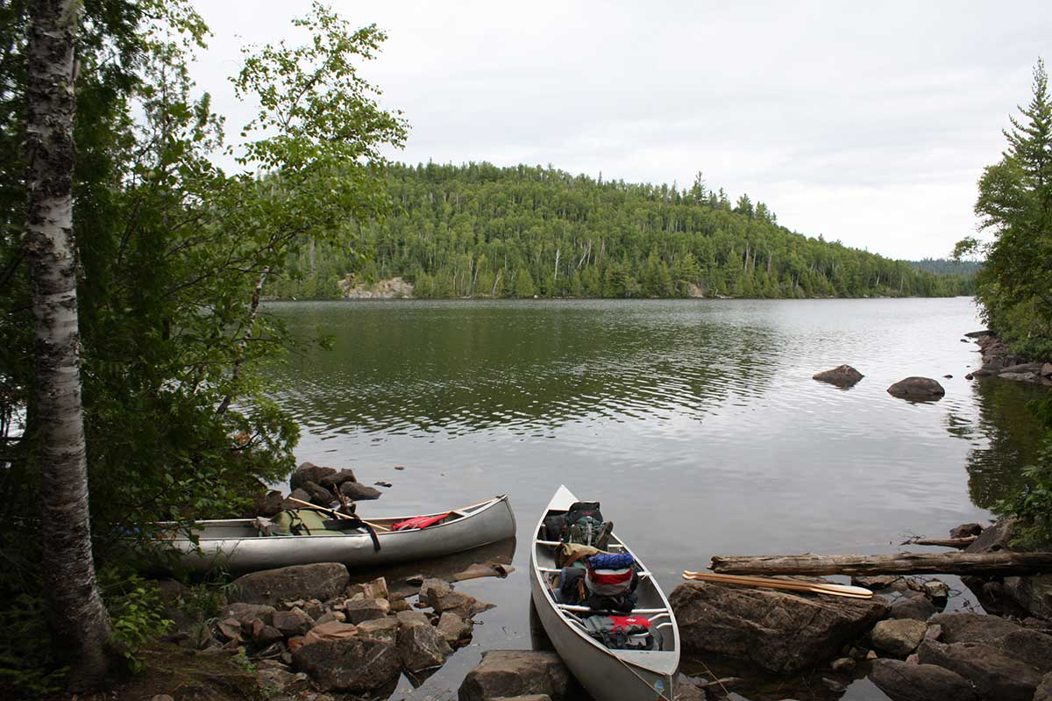
    1- What is Recreational Resource Planning?

Slide 4
1- Recreational Resource Planning
      Systematic Management of Resources
      - Ensures long-term recreational opportunities
      - Integrates environmental, social, and economic factors
      Assessment of Existing Resources
      - Inventory of natural, cultural, and built assets
      - Identification of gaps and opportunities
      Planning for Future Needs
      - Forecasting demand and visitor trends
      - Adapting to changing community and environmental conditions

Slide 5
1- Recreational Resource Planning
      It includes:
      Infrastructure and Program Development
      - Creation of trails, parks, facilities, and services
      - Supporting sustainable tourism and local engagement
      Balancing Competing Goals
      - Protecting natural and cultural resources
      - Enhancing visitor experience
      - Generating economic benefits for local communities

Slide 6
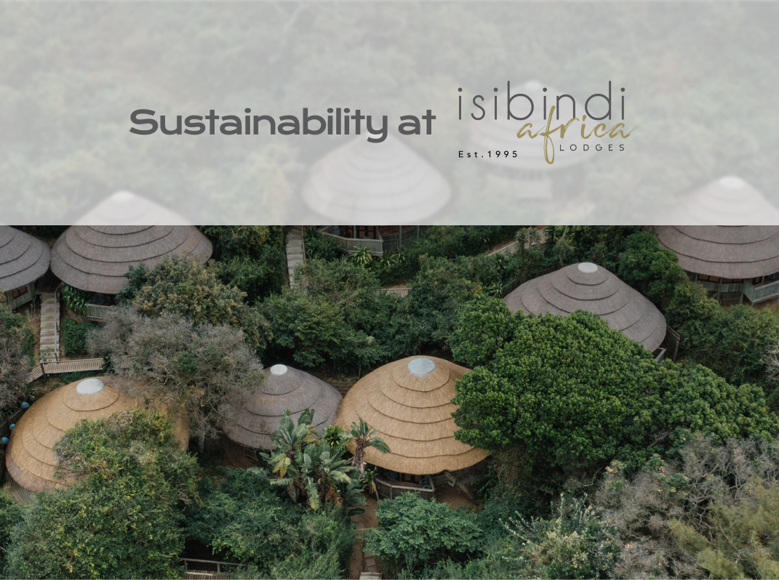
    2- Recreational Resource Planning and Sustainable Tourism

Slide 7
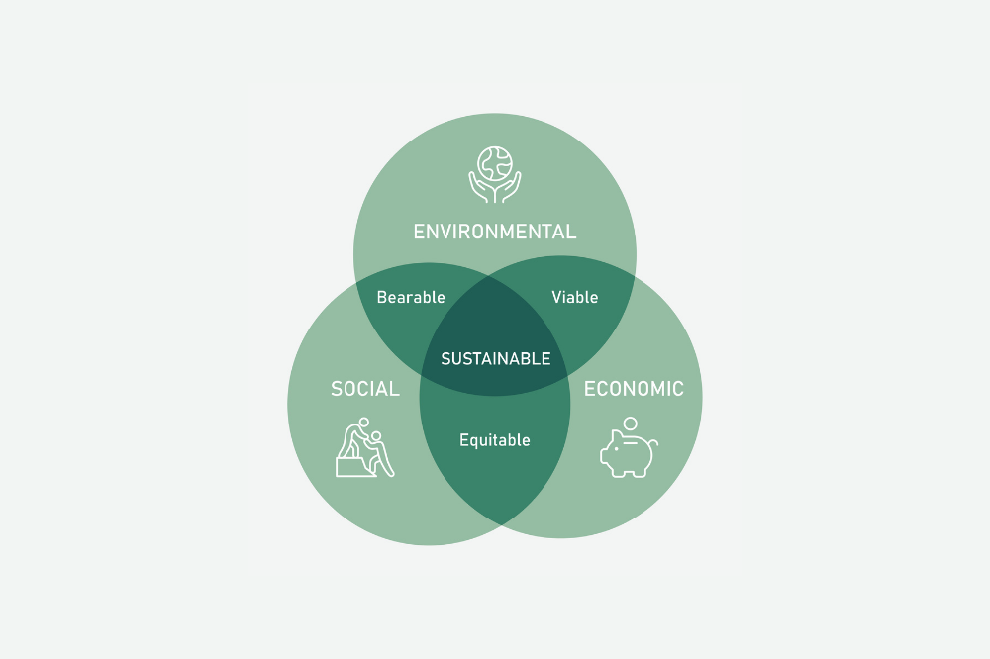
2- Recreational Resource Planning and Sustainable Tourism
      - Sustainability refers to the capability of maintaining or continuing an entity, outcome, or process over time.
      - It emphasizes human activities and their capacity to meet needs and desires without depleting or exhausting available productive resources.
      - Sustainable Development has 3 dimensions:
      Social Sustainability
      Economic Sustainability
      Environmental Sustainability

Slide 8
2- Recreational Resource Planning and Sustainable Tourism
    Social Sustainability:
    - Poverty and socio-economic inequality
    - Discrimination, prejudice, and social exclusion
    - Lack of access to resources
    - Insecurity and conflict
    - Poor governance

Slide 9
2- Recreational Resource Planning and Sustainable Tourism
    Economic Sustainability:
    - Promote Renewable Energy
    - Adopt Energy Efficiency Policies
    - Encourage the Circular Economy
    - Foster Social and Economic Inclusion
    - Invest in Technological Innovation

Slide 10
2- Recreational Resource Planning and Sustainable Tourism
    Environmental Sustainability:
    - Reducing greenhouse gas emissions
    - Expanding the production and use of energy from renewable sources.
    - Implementing policies to protect biodiversity
    - Adopting sustainable agricultural practices

Slide 11
    3- The importance of Recreational Resource Planning for Sustainable Tourism

Slide 12
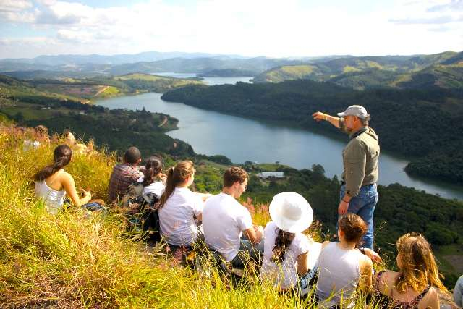
3- The Importance of Recreational Resource Planning for Sustainable Tourism
    The Social Aspect:
    Enhances Visitor Experience
    - Provides high-quality, well-managed recreational spaces
    - Reduces overcrowding and improves safety and accessibility
    Addresses Community Needs and Values
    - Involves local stakeholders in planning processes
    - Aligns tourism development with community goals and identity

Slide 13
3- The Importance of Recreational Resource Planning for Sustainable Tourism
    The Economic Aspect:
    Fosters Economic Development
    - Attracts tourists and boosts local economies
    - Encourages investment in tourism infrastructure and services
    Supports Strategic Decision-Making
    - Provides data and guidelines for informed planning
    - Ensures balanced growth between conservation and development

Slide 14

3- The Importance of Recreational Resource Planning for Sustainable Tourism
    The Environmental Aspect:
    Promotes Sustainable Use of Resources
    - Prevents overuse and degradation of natural and cultural assets
    - Ensures long-term viability of recreation and tourism areas
    Supports Environmental Conservation
    - Integrates ecological considerations into planning
    - Minimizes negative impacts on biodiversity and ecosystems

Slide 15
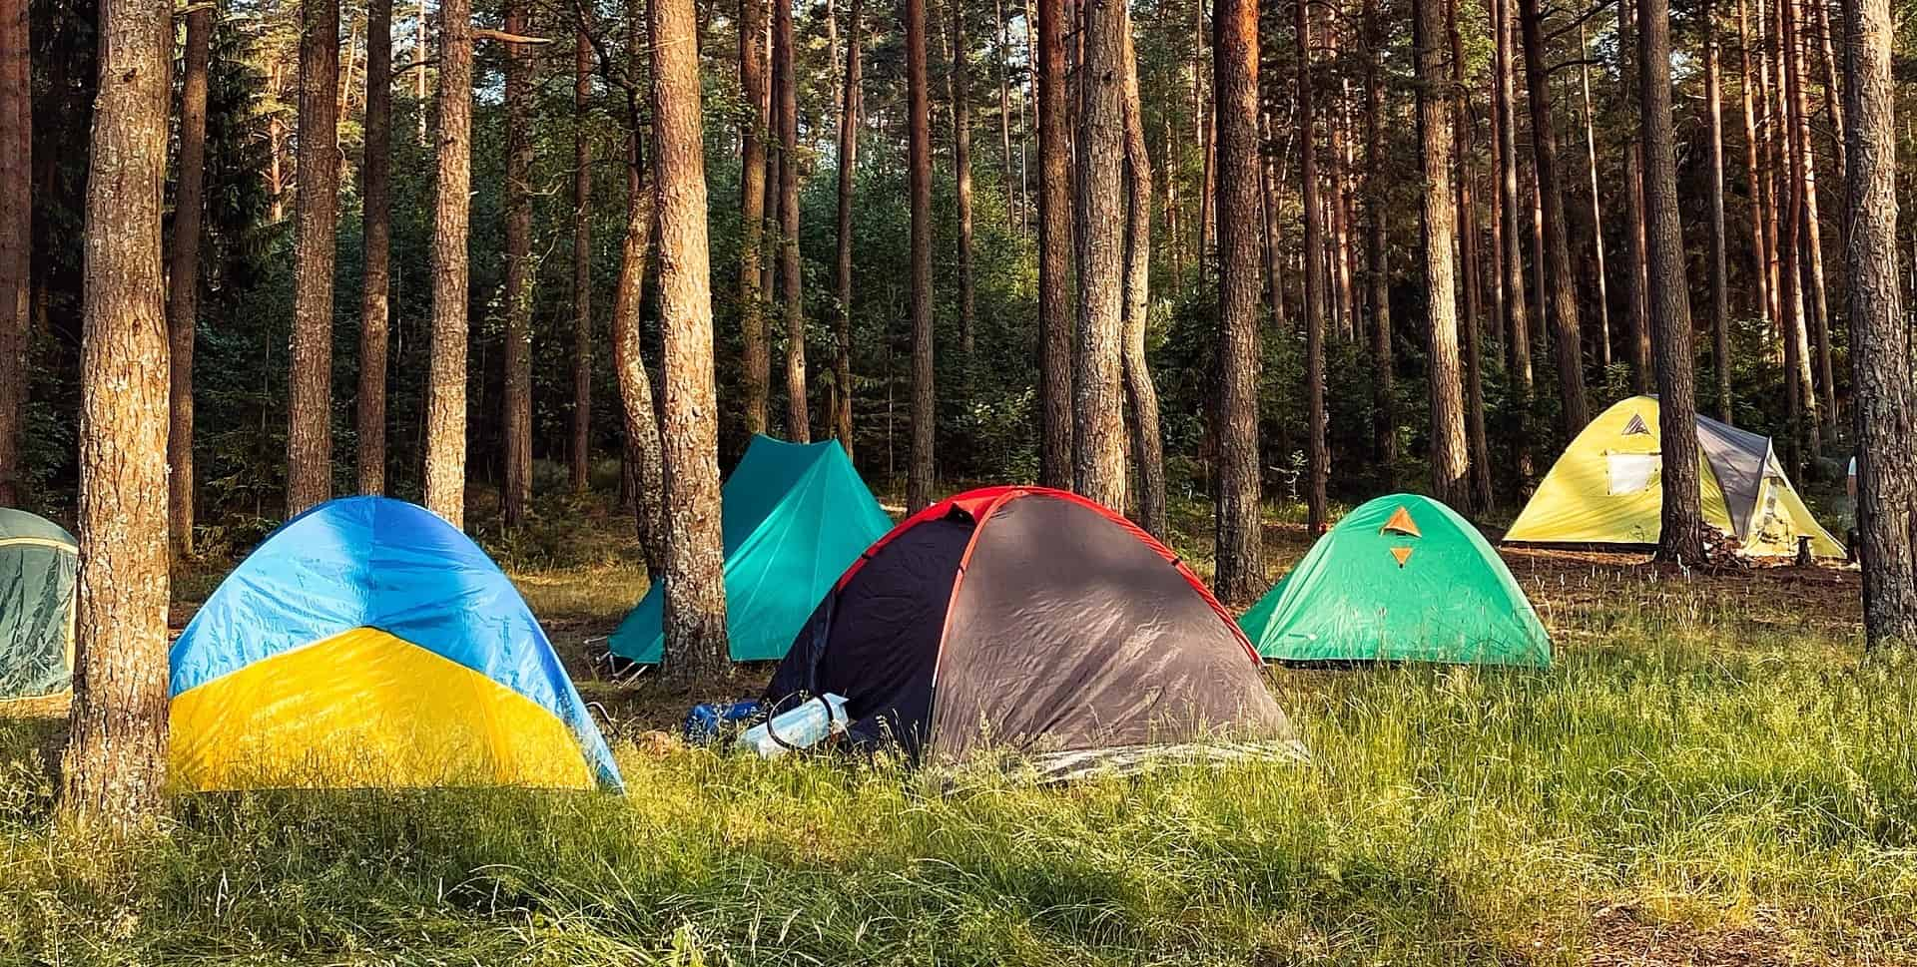
4- Resource Inventory and Assessment

Slide 16
4- Resource Inventory and Assessment
    Informs Strategic Planning
    - Provides a foundation for effective recreational and tourism development
    - Helps set priorities based on existing assets and gaps
    Supports Sustainable Use of Resources
    Identifies sensitive or vulnerable areas needing protection
    Guides appropriate levels and types of recreational use

Slide 17
4- Resource Inventory and Assessment
    Enhances Decision-Making
    - Offers data for site selection, zoning, and infrastructure planning
    - Reduces risks of overdevelopment or resource conflict
    Promotes Efficient Resource Allocation
    - Ensures investments target areas with the highest potential or need
    - Avoids duplication and misuse of limited resources

Slide 18
4- Resource Inventory and Assessment
    Encourages Community Engagement
    - Involves local stakeholders in recognizing valued assets
    - Builds support for conservation and development efforts
    Enables Monitoring and Evaluation
    - Provides a baseline to track changes in resource conditions over time
    - Facilitates adaptive management and policy adjustments

Slide 19
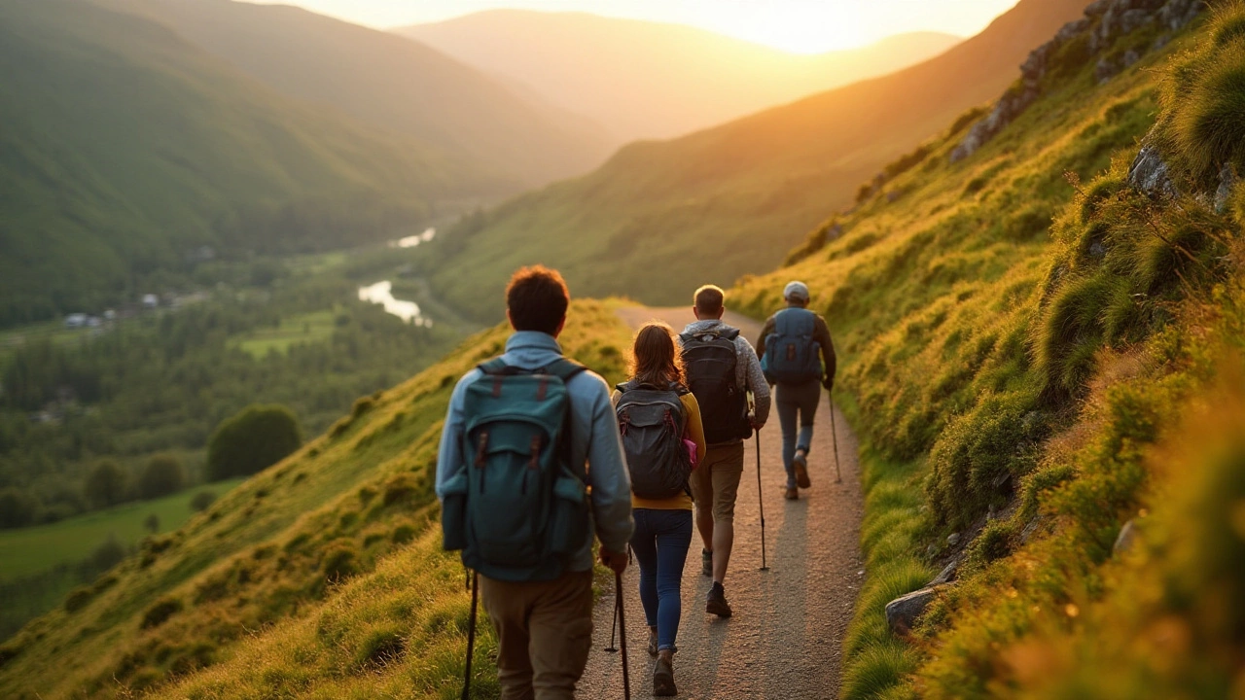
5- Recreation and Conservation Standards

Slide 20
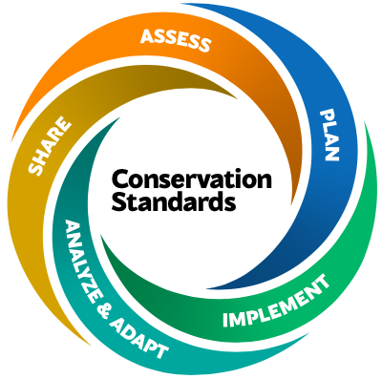
5- Recreation and Conservation Standards
    The Conservation Standards Framework
    - Provides an evidence-based, structured approach to
    conservation initiatives
    - Ensures effectiveness, impact, and continuous learning
    Five Key Steps of the Conservation Standards:
    - Assess - Plan
    - Implement - Analyze and Adapt
    - Share

Slide 21
5- Recreation and Conservation Standards
5.1- Assess:
A- Purpose and Team
- Define the aim of the assessment
- Identify and organize a multidisciplinary planning team
Assess
Purpose & team
Scope & vision
Targets & viability
Threats
Conservation situation

Slide 22
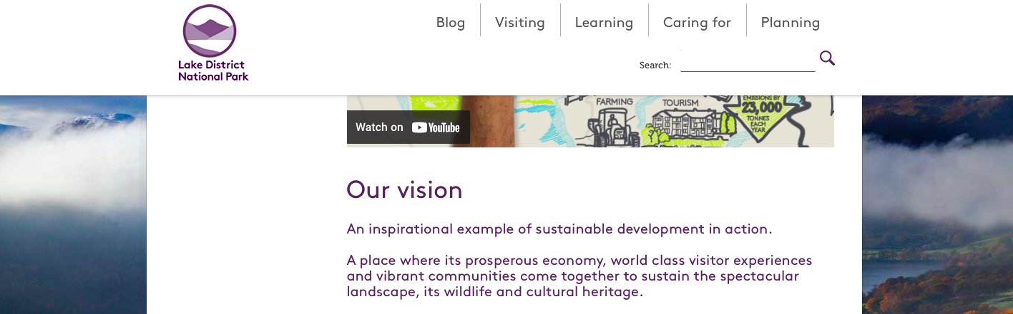
5- Recreation and Conservation Standards
Assess
Purpose & team
Scope & vision
Targets & viability
Threats
Conservation situation
B- Scope and Vision
- Establish the geographic and thematic boundaries
- Create a shared long-term vision for conservation success

Slide 23
5- Recreation and Conservation Standards
C- Targets and Viability
- Identify key conservation targets
- Evaluate the health and viability of each target
Assess
Purpose & team
Scope & vision
Targets & viability
Threats
Conservation situation

Slide 24
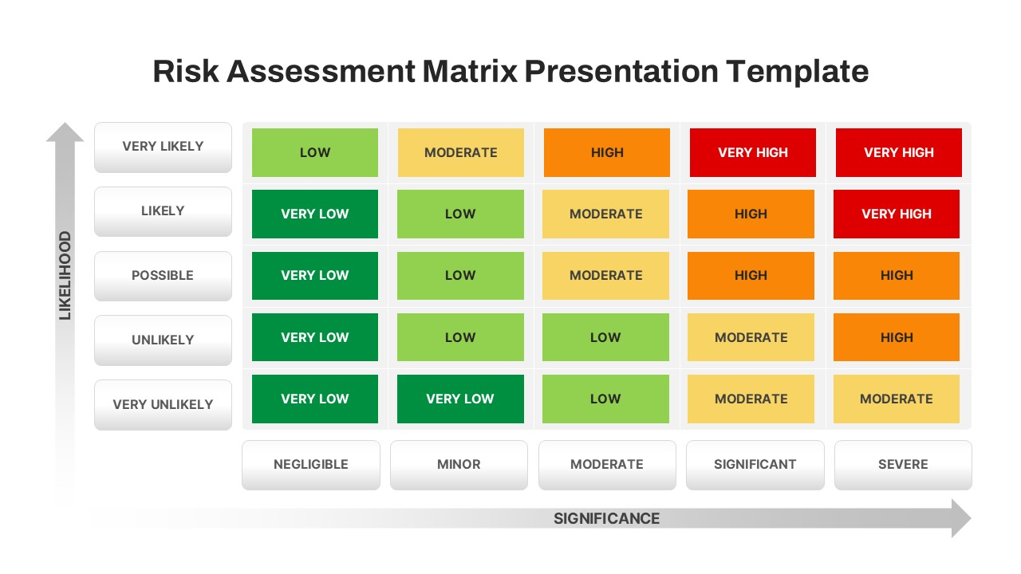
5- Recreation and Conservation Standards
D- Threats
- Identify direct and indirect
threats to conservation targets
- Rank threats by severity, scope,
and irreversibility

Slide 25
5- Recreation and Conservation Standards
E- Conservation Situation Analysis
- Summarize the context:
ecological, social, political, and economic
- Map relationships between targets, threats, and key actors
Assess
Purpose & team
Scope & vision
Targets & viability
Threats
Conservation situation

Slide 26
5- Recreation and Conservation Standards
5.2- Plan:
- Summarize the context:
ecological, social, political, and economic
- Map relationships between targets, threats, and key actors

Slide 27
5- Recreation and Conservation Standards
5.2- Plan:
A- Goals
- Define the desired long-term outcomes
- Should be SMART:
Specific, Measurable, Achievable, Relevant, Time-bound
- Aligned with the vision and based on assessment findings
Plan
Goals
Strategies
Theories of change
Monitoring
Operational

Slide 28
5- Recreation and Conservation Standards
B- Strategies
- Define how to achieve the goals
- Combine direct actions, policy efforts, and community engagement
- Prioritize strategies based on feasibility and impact
Plan
Goals
Strategies
Theories of change
Monitoring
Operational

Slide 29
5- Recreation and Conservation Standards
C- Theory of Change
- Why do you believe your actions will work
- Logical model showing how strategies lead to desired outcomes
- Links inputs → outputs → outcomes → long-term impacts
- Helps test assumptions and refine actions
Plan
Goals
Strategies
Theories of change
Monitoring
Operational

Slide 30
5- Recreation and Conservation Standards
D- Monitoring Plan
- Identify indicators to track progress
- Include baseline data, targets, and data collection methods
- Supports learning and accountability
Plan
Goals
Strategies
Theories of change
Monitoring
Operational

Slide 31
5- Recreation and Conservation Standards
E- Operational Planning
- Translate strategies into specific activities
- Assign responsibilities, set timelines, and budget
- Plan for risk management, partnerships, and resource needs
Plan
Goals
Strategies
Theories of change
Monitoring
Operational

Slide 32
5- Recreation and Conservation Standards
5.3- Implement
- Put your strategies and plans into action
Key Activities:
- Carry out fieldwork, restoration, community outreach,
or policy efforts
- Manage logistics (staffing, budgeting, timelines)
- Coordinate with stakeholders and partners
- Ensure compliance with legal and environmental standards

Slide 33
5- Recreation and Conservation Standards
5.4- Analyze and Adapt
- Monitor progress and evaluate the effectiveness of actions.
Key Activities:
- Collect data based on the monitoring plan
- Compare results to goals and expected outcomes
- Identify what’s working and what’s not
- Adjust strategies and operations as needed

Slide 34
5- Recreation and Conservation Standards
5.5- Share
- Communicate results, lessons, and experiences.
Key Activities:
- Publish reports and case studies
- Present findings to communities, funders, and partners
- Facilitate knowledge exchange across conservation projects
- Promote transparency and learning in the conservation field

Slide 35
5- Recreation and Conservation Standards
Discussion
Based on conservation standards:
- Choose a site and describe five major hypothetical threats.
- Categorize each threat according to its likelihood and severity;
- And outline strategies to mitigate or overcome them

Slide 36
Thank you
      European Institute of Innovation, Entrepreneurship and Technology
      Lessingstraße 79,
      13158 Berlin, Germany
      Phone: +49 176 55524449
      Email: info@eiiet.com
Discover the world of eiIET

