Slide 1
Introduction to the Hotel Industry
European Institute of Innovation, Entrepreneurship and Technology
Lessingstraße 79, 13158 Berlin, Germany
Presenter Vaibhav Sai Sri| Berlin
      Lessingstraße 79,
      13158 Berlin, Germany
      Phone: +49 30 233618555
      Fax: +49 30 233618556
      Email: info@eiiet.com

Slide 2

Index
Introduction to the Hotel Industry
Types of Hotels and Services Offered
Services Marketing in the Hotel Industry
Analysis of the Hotel Industry Market
Contribution to Local Tourism
Economic Contributions of the Hotel Industry
Challenges and Opportunities in the Hotel Industry
Case Study: Hotel Industry Impact on a Specific Region
Conclusion

Slide 3
Introduction to the Hotel Industry
      Definition:
      Hotels provide temporary accommodation and related services to travelers.
      Importance:
      A major segment of the global hospitality industry, contributing significantly to GDP.
      Types of Hotels:
      Ranges from luxury resorts to budget hotels and boutique options.
      Core Services:
      Includes room accommodation, food and beverage, leisure services, and business facilities.
    Projected Growth Rate (CAGR) from 2022 to 2026: ~4.7% annually.

Slide 4
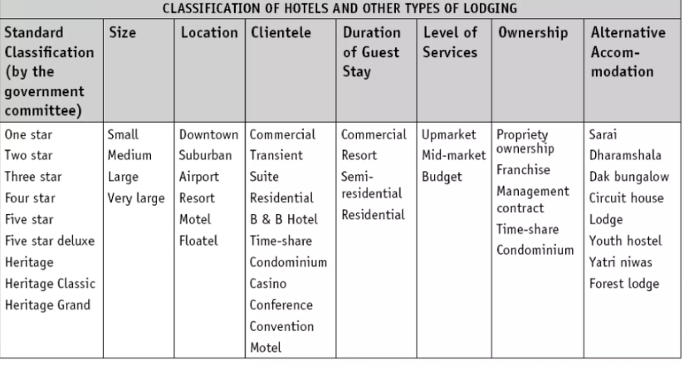
Types of Hotels and Services Offered
      Luxury Hotels: High-end properties with extensive services like spas, fine dining, and concierge.
      Business Hotels: Focus on business travelers, offering amenities like meeting rooms and Wi-Fi.
      Budget Hotels: Basic accommodations at affordable prices, focusing on practicality.
      Resorts: Provide vacation experiences with recreational activities, spas, and all-inclusive options.
      Common Services: Room service, dining, leisure amenities, concierge, and event spaces.
      Reference:
      Introduction to Different Types of Hotels | [You tube]

Slide 5
Services Marketing in the Hotel Industry
Branding & Positioning:
Hotels differentiate through location, price, and customer experience.
Personalized Marketing:
Tailored services based on customer preferences and behavior.
Digital Marketing:
Using social media, SEO, and OTAs to attract and retain guests.
Customer Loyalty Programs:
Encourage repeat visits with rewards and discounts.
Reputation Management:
Managing online reviews and guest feedback to build trust.

Slide 6
Analysis of the Hotel Industry Market
Sustainability:
Increasing demand for eco-friendly hotels and sustainable travel options.
Technology Integration:
Smart room features, AI concierge services, and mobile check-ins.
Experience-Driven Travel:
Guests seeking unique, local experiences over standard amenities.
Global Trends:
Shift toward wellness travel, remote work-friendly hotels, and health-conscious services.
Economic Sensitivity:
Hotels are affected by global economic conditions and travel disruptions.
      Reference:
      Trends in the Hospitality Industry| [You tube]

Slide 7
Contribution to Local Tourism
Tourism Driver:
Hotels attract tourists by offering accommodation and local experiences.
Local Partnerships:
Collaboration with local tourism boards and businesses to promote destinations.
Job Creation:
Hotels provide employment in various sectors, such as hospitality, management, and customer service.
Revenue Generation:
Hotel guests contribute to the local economy through spending on food, entertainment, and services.
Multiplier Effect:
Hotels boost other local businesses, including restaurants, tour operators, and retail.

Slide 8
Economic Contributions of the Hotel Industry
Job Creation:
Hotels provide direct and indirect employment opportunities in diverse roles.
Tax Revenue:
Hotels contribute to local taxes, including occupancy, property, and sales taxes.
Infrastructure Development:
Investments in local infrastructure, including transport and utilities, often accompany hotel development.
Economic Stimulus:
Hotels drive spending in the local economy, particularly in tourist-heavy regions.
Business Investment:
Hotels often encourage investment in local areas, boosting economic development.

Slide 9
Challenges and Opportunities in the Hotel Industry
Competition from Short-Term Rentals:
Platforms like Airbnb offer alternative lodging options.
Economic Uncertainty:
Global events (e.g., recessions, pandemics) disrupt travel and hotel revenues.
Staffing Issues:
Difficulty attracting and retaining skilled workers, especially in housekeeping and management.
Sustainability:
Growing demand for eco-friendly operations presents new opportunities for differentiation.
Technological Advances:
Innovations like mobile check-ins and AI-driven experiences present growth opportunities.

Slide 10
Case Study: Hotel Industry Impact on a Specific Region
Example: Las VegasTourism
Growth:
Hotels are central to Las Vegas’ tourism, attracting millions annually.
Economic Impact:
The hotel industry generates billions in revenue for the local economy.
Job Creation:
Supports tens of thousands of jobs in hospitality, retail, and entertainment.
Local Businesses:
Hotels contribute to local retail, dining, and entertainment industries.
Sustainability:
Recent trends show a shift toward sustainable hotels and eco-friendly initiatives in Las Vegas.

Slide 11
Conclusion
Key Role of Hotels:
Hotels are vital to tourism, economic growth, and local development.
Competitive Landscape:
The industry faces challenges from new competitors and changing market dynamics.
Customer-Centric Approach:
Success depends on offering exceptional customer experiences and leveraging technology.
Future Outlook:
Sustainability, technological innovation, and personalized experiences will define future growth.
Closing Remarks:
Hotels will continue to evolve to meet changing consumer demands and global trends.

Slide 12
Thank you
      European Institute of Innovation, Entrepreneurship and Technology
      Lessingstraße 79,
      13158 Berlin, Germany
      Phone: +49 176 55524449
      Email: info@eiiet.com
Discover the world of eiIET

