Slide 1
Operations Management in Hospitality
European Institute of Innovation, Entrepreneurship and Technology
Lessingstraße 79, 13158 Berlin, Germany
Mahmoud Abdou| Berlin
      Lessingstraße 79,
      13158 Berlin, Germany
      Phone: +49 30 233618555
      Fax: +49 30 233618556
      Email: info@eiiet.com

Slide 2
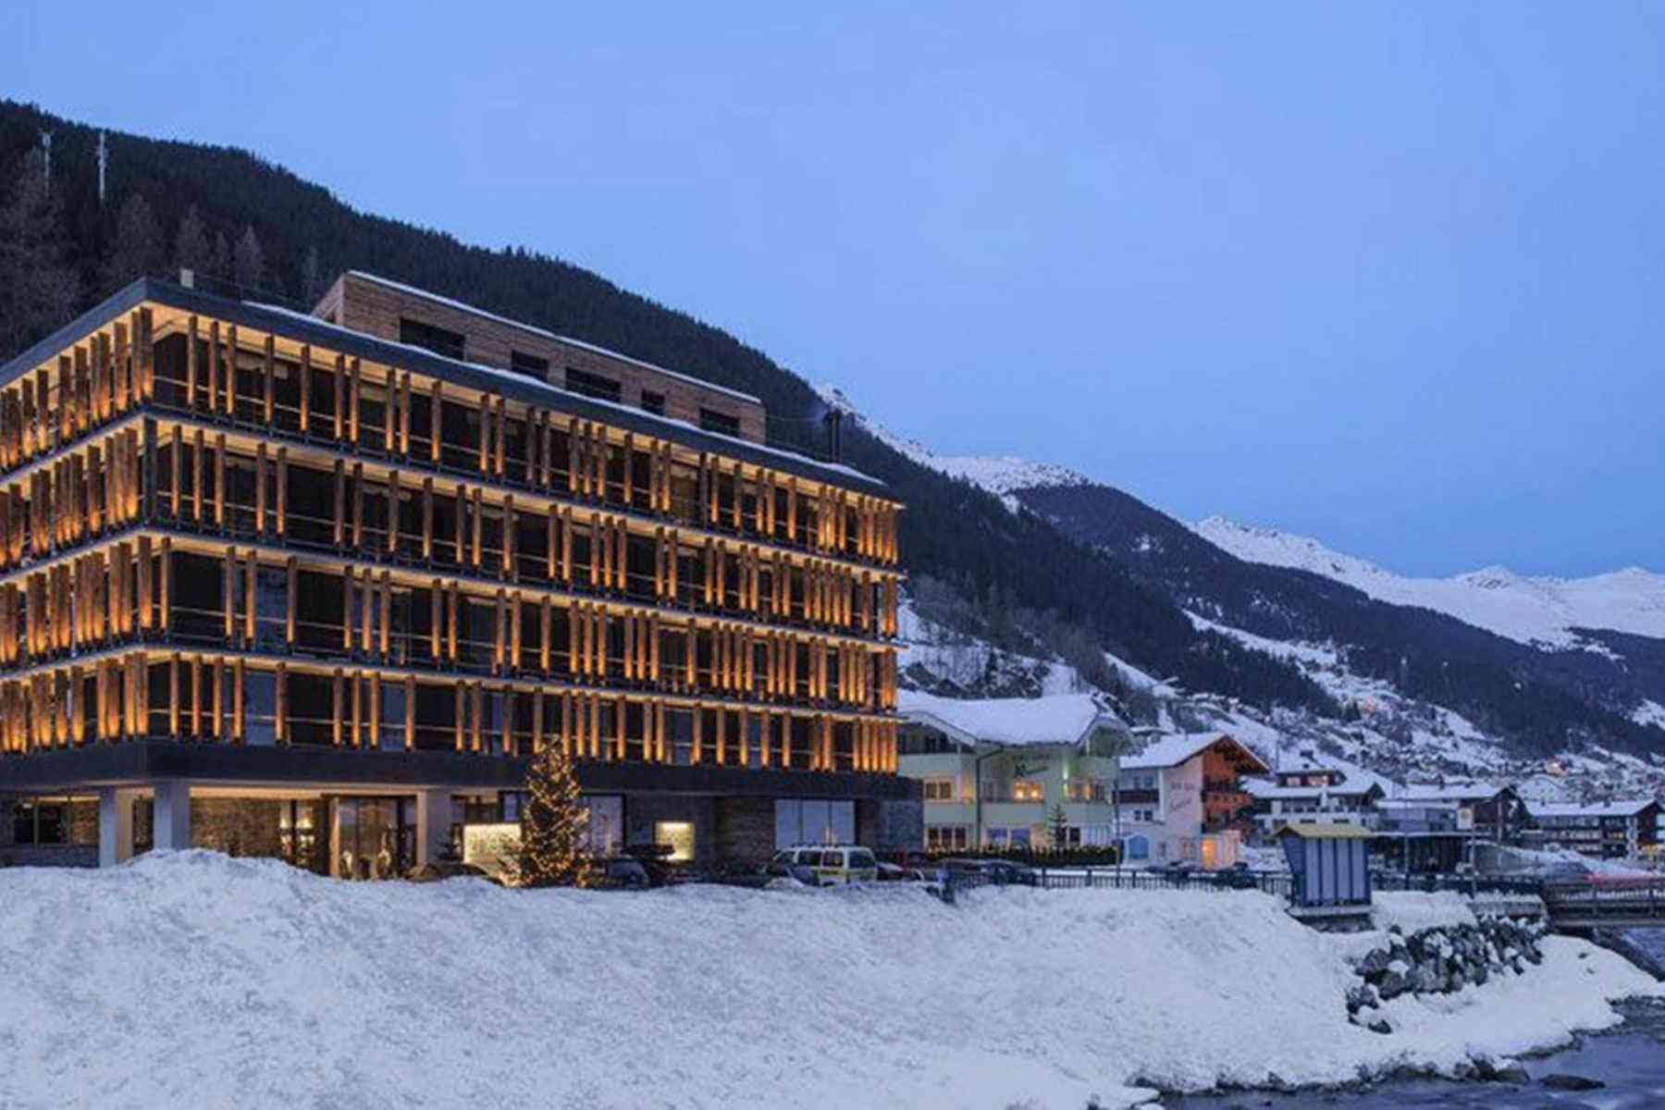
Outline:
1- Revenue Management Overview
2- Fundamentals of Hotel Revenue Management
3- Benefits of Revenue Management
4- Characteristics of Hospitality Products

Slide 3

1- REVENUE MANAGEMENT

Slide 4
1- Revenue Management
Revenue management matches supply with demand.
Customers are segmented by their purchase intentions.
Capacity is allocated to each segment strategically.
It aim to maximize the firm’s revenues

Slide 5
1- Revenue Management
Origin: Airline industry post-deregulation, in 1970
Purpose: Maximize revenue from seats
Strategy: Discount some seats, keep full-price sales
Goal: Fill flights while staying profitable.

Slide 6
1- Revenue Management
Dynamic Pricing: Prices adjust by demand, booking time, and segment.
High Demand: Prices rise.
Low Demand: Prices drop to fill seats.

Slide 7
1- Revenue Management
It is defined as:
“The application of information systems and pricing strategies to allocate the right capacity to the right customer at the right price at the right time” (Ivanov, 2014).

Slide 8

1- Revenue Management
- The Right Capacity:
Capacity is the total number of units a firm can sell in a time period.
Capacity is fixed and perishable.
Right capacity means allocating inventory to the most profitable customers.
It avoids simple first-come, first-served decisions.
It aims to use limited capacity to maximize revenue.

Slide 9
1- Revenue Management
- Right Customer:
Not all customers bring the same profit.
Some require too many resources.
Others pay too little.
The right customer is “the segment the hotel can serve profitably”.
Example: During fairs, hotels set minimum-stay rules to avoid low-value one-night bookings.

Slide 10
1- Revenue Management
- Right Price:
Price directly impacts revenue.
Hotels adjust prices for different segments to attract profitable customers.
The right price is “what customers are willing to pay and the hotel is willing to charge”.
Overpricing risks losing future guests.

Slide 11
1- Revenue Management
- Right Time:
Timing affects the success of offers.
Too early: ignored;
too late: missed.
Depends on the booking patterns of each segment.

Slide 12

2- FUNDAMENTALS OF HOTEL REVENUE MANAGEMENT

Slide 13
2- Fundamentals of Hotel Revenue Management
- Revenue management relies on economic principles that guide pricing and capacity decisions.
- These assumptions include:
Product perishability | Limited capacity
High fixed and low variable costs | Unequal demand
Possibility to forecast demand | Possibility for advanced booking
Different price elasticities | Different willingness-to-pay
Possibilities to segment market demand

Slide 14
2- Fundamentals of Hotel Revenue Management
1- Perishable Inventory:
Rooms, seats, or tables cannot be stored for later sale.
Unsold units represent lost, unrecoverable revenue.

Slide 15
2- Fundamentals of Hotel Revenue Management
2- Limited capacity:
Hospitality businesses have limited capacity.
Once fully booked, extra demand can’t be met immediately.
Examples: Hotels need new rooms, airlines need later flights, restaurants need available tables.

Slide 16
2- Fundamentals of Hotel Revenue Management
3- High fixed and low variable costs:
Fixed Costs: Do not change with guest numbers.
Variable Costs: Change according to the number of guests.
Extra guests cost little to serve.
Expanding capacity is costly.
Prices can be lowered to fill space.
Better to sell than leave capacity unused.

Slide 17
2- Fundamentals of Hotel Revenue Management
4- Fluctuating Demand:
Demand varies over time.
Prices adjust to low or high-demand periods.
Boosts off-peak bookings and eases peak demand
Smooth demand and maximize revenue.

Slide 18
2- Fundamentals of Hotel Revenue Management
5- Possibility to forecast demand
Revenue management needs predictable demand.
Pricing decisions rely on accurate forecasts.
If demand is unpredictable, dynamic pricing fails.
Then the hotel should use constant prices.

Slide 19
2- Fundamentals of Hotel Revenue Management
6- Market Segmentation:
Revenue management needs diverse demand.
Hotels must be able to segment customers.
Without segmentation, no need for marketing mix.
Tourism demand is naturally varied.

Slide 20
2- Fundamentals of Hotel Revenue Management
7- Different Price Elasticities
Different segments react differently to price changes.
customers can be price-sensitive
This lets hotels charge different prices.
Elasticity indicates how demand responds to price.

Slide 21
2- Fundamentals of Hotel Revenue Management
8- Different willingness-to-pay
The highest price a customer is willing to pay
Lower price results in consumer surplus, lost revenue.
Different segments means different willingness-to-pay.
Hotels use price discrimination to maximize revenue

Slide 22
2- Fundamentals of Hotel Revenue Management
9- Advance Sales:
Hotels can be booked in advance.
Secures accommodation for tourists.
Provides a long selling window.
- Revenue management can:
Segment customers by booking time.
Track bookings and adjust prices or availability.

Slide 23

3- BENEFITS OF REVENUE MANAGEMENT

Slide 24

3- Benefits of Revenue Management
A- Increased Revenue
- Optimized Occupancy:
Yield management helps sell rooms at the most profitable rate.
- Higher Pricing in High Demand:
When demand rises, prices can be increased to boost revenue.

Slide 25
3- Benefits of Revenue Management
B- Competitive Analysis:
Yield management aligns prices with the market.
Track competitors’ pricing patterns.
Use competitors’ strategies to adjust prices dynamically.
Competitor insights help increase incremental revenue.

Slide 26
3- Benefits of Revenue Management
C- Decreased Errors:
Yield management relies on precise demand forecasting.
Better data reduces miscalculations and risk.

Slide 27

4- THE CHARACTERISTICS OF HOSPITALITY PRODUCTS

Slide 28

1- Characteristics of Hospitality Products
Hospitality products have different characteristics.
They include intangibility, perishability, inseparability, and heterogeneity.
They are more of an experience than a physical good.

Slide 29
A- Inseparability:
Service is produced and consumed at the same time.
Guests must be physically present.
Customers participate in service delivery.
Experience is co-created with staff.
Interaction quality affects satisfaction.

Slide 30
B- Simultaneity:
A hotel service cannot be produced in advance or stored.
It cannot be inspected before it is delivered
Guests experience the service in real time

Slide 31
C- Perishability
Unsold services cannot be stored for future use.
If not consumed at the moment, the value is lost forever.

Slide 32

D- Intangibility
Services cannot be fully experienced before purchase.
Customers rely on pre-purchase cues
Intangible elements influence customer satisfaction.
Intangibility makes pre-purchase evaluation difficult.

Slide 33
E- Heterogeneity:
Quality varies depending on the staff, time, and conditions.
Customer experiences are never the same.
Even standardized chains cannot guarantee identical experiences.
Variability is inherent in service delivery.

Slide 34
Thank you
      European Institute of Innovation, Entrepreneurship and Technology
      Lessingstraße 79,
      13158 Berlin, Germany
      Phone: +49 176 55524449
      Email: info@eiiet.com
Discover the world of eiIET

