Slide 1
Tourist Regions and Attractions
European Institute of Innovation, Entrepreneurship and Technology
Lessingstraße 79, 13158 Berlin, Germany
Mahmoud Abdou| Berlin
      Lessingstraße 79,
      13158 Berlin, Germany
      Phone: +49 30 233618555
      Fax: +49 30 233618556
      Email: info@eiiet.com

Slide 2
Index
-Leisure, Recreation and Tourism.
- Geography and Tourism
- Forms of tourism

Slide 3
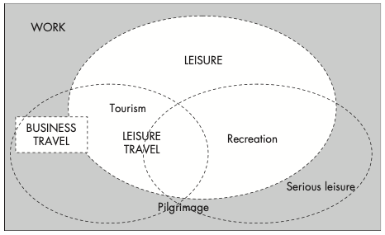
1- Leisure, Recreation and Tourism
      1.1- Leisure:
    - Leisure is often viewed as a measure of time.
    - It typically refers to the time remaining after fulfilling
    work, sleep, household chores, and personal obligations.
    - In essence, leisure is free time that individuals
    can spend as they choose.
Hall and Page, 2014

Slide 4
1- Leisure, Recreation and Tourism
      1.1- Leisure:
    - The concept of leisure raises the question of whether all free time can truly be considered leisure.
    - For example, the unemployed may view their free time as enforced leisure rather than voluntary.
    - Similarly, volunteers at a sporting event might regard their activity as serious leisure rather than just free time.
    - These examples suggest that leisure is not only a measure of time but also an attitude of mind.
    - An essential component of leisure is the element of choice—the freedom to decide how to use that time.

Slide 5
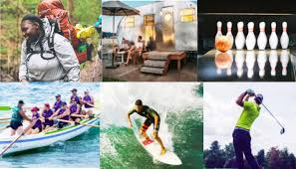

1- Leisure, Recreation and Tourism
      1.2- Recreation:
    - Recreation typically refers to the variety of activities undertaken during leisure time.
    - The main purpose of recreation is to refresh a person’s strength and spirit, such as:
    Watching television at home
    To holidaying abroad

Slide 6
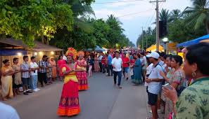
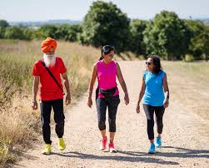
1- Leisure, Recreation and Tourism
      1.2- Recreation:
    A useful distinction can be made between different types of leisure pursuits:
    Arts, cultural activities, and entertainment
    Physical activities
    Sports can be further distinguished from other physical recreation because:
    They involve competition
    Participants must follow rules set by a recognised authority

Slide 7
1- Leisure, Recreation and Tourism
      1.3- Tourism:
    - If leisure is considered a measure of time, and recreation refers to the activities done during that time, then what is tourism?
    - Tourism can be seen as one type of recreational activity.
    - How can we differentiate between recreation and tourism?
    - A helpful way to understand the difference is to imagine a spectrum:
    At one end: Recreation based at home or in the local area.
    At the other end: Recreational travel, which involves:
    Greater distances
    Possibly overnight accommodation

Slide 8
1- Leisure, Recreation and Tourism
      1.3- Tourism:
    - From a geographical perspective, tourism is viewed as one form of temporary or leisure mobility.
    - This perspective acknowledges that technological advancements and societal changes have increased people's capacity to travel extensively.
    - Tourism can thus be understood as a form of voluntary, temporary mobility in relation to an individual’s place of residence.
    - It involves people choosing to temporarily leave their usual environment for leisure purposes

Slide 9
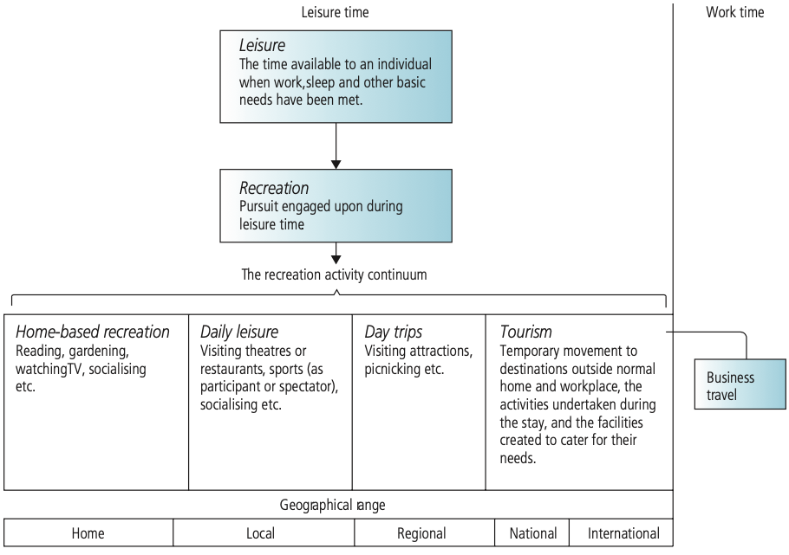
1- Leisure, Recreation and Tourism
Boniface, Cooper And Cooper, 2021

Slide 10
1- Leisure, Recreation and Tourism
      1.3- Tourism:
    - The mobilities approach brings attention to the international debate over the definition of tourism.
    - There are two main ways to investigate this problem.
    - Defining tourism from the demand side, focusing on the tourist (the person traveling).
    - The United Nations Statistical Commission defines tourism as:
    "The activities of persons traveling to and staying in places outside their usual environment for not more than one consecutive year for leisure, business, and other purposes."

Slide 11
1- Leisure, Recreation and Tourism
      1.3- Tourism:
    - This definition raises several issues:
    What is a person’s usual environment?
    The inclusion of business and other purposes of visit requires a broader understanding of tourism, not just as a recreational pursuit.
    Certain types of travelers are excluded from this definition. Tourism is just one part of the broader spectrum of travel, which includes:
    Daily commutes to work or for shopping
    Migration, where the traveler intends to take up permanent or long-term residence in another area

Slide 12
1- Leisure, Recreation and Tourism
      1.3- Tourism:
    - The tourism sector can also be defined from the supply-side point of view.
    - The challenge lies in disentangling tourism businesses and jobs from the rest of the economy.
    - After years of debate, the accepted approach is the tourism satellite account (TSA), adopted by the United Nations in 2000.
    - The TSA measures the demand for goods and services generated by visitors to a destination.
    - It allows tourism to be compared with other sectors of the economy by calculating its contribution to:
    Investment
    Consumption
    Employment
    Gross Domestic Product (GDP)
    Taxation

Slide 13
2- Geography and Tourism
    - When studying the geography of travel and tourism, three essential concepts must be considered:
    Spatial Scale:
    - Understanding tourism at different levels: local, regional, national, and global.
    The Geographical Components of the Tourism System:
    - Includes tourist-generating areas, transit routes, and tourist destination areas.
    Spatial Interaction Between the Components of the Tourism System:
    - Focuses on the movement of people, goods, and services between different parts of the tourism system

Slide 14
2- Geography and Tourism
    2.1. Spatial Scale in Geography and Tourism
    - Geographers study the spatial expression of tourism as a human activity.
    - They focus on both tourist-generating areas, tourist-receiving areas, and the links between them.
    - This study can be conducted at various scales, including:
    Global or Continental Scale
    Distribution of major climate zones and ecosystems
    Air and shipping routes
    Patterns of migration

Slide 15
2- Geography and Tourism
    2.1. Spatial Scale in Geography and Tourism
    National Scale:
    Identification of a country's transport networks
    Mapping of tourist regions
    Population distribution
    Regional Scale:
    Assessment of tourism resources in a particular part of a country
    Local Scale:
    Location of specific attractions
    Configuration of holiday resorts

Slide 16
2- Geography and Tourism
    2.1. Spatial Scale in Geography and Tourism
    Flows of Leisure Tourism in Europe: Importance of Spatial Scale
    International Scale:
    - The dominant flow of tourists is from north to south (e.g. Northern Europeans traveling to Southern Europe for sun and sea tourism).
    Regional Scale:
    -More diverse patterns of movement emerge, such as:
    Travel between cities:
    Travel from cities to the coast or countryside
    Local Scale:
    - Focus is on day-trip patterns, where people:
    Travel short distances
    Move from their accommodation within a holiday area to nearby attractions or sites.

Slide 17
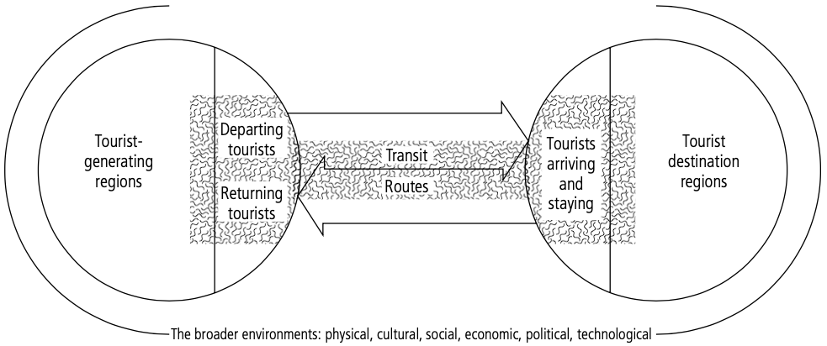
2- Geography and Tourism
    2.2. The geographical components of the tourism system
    From a geographical perspective, tourism consists of three major components:
    Generating Areas (Places of Origin):
    - Locations where tourists live and begin their journey.
    - Reflect economic, social, and cultural
    conditions that influence travel
    behavior.

Slide 18
2- Geography and Tourism
    2.2. The geographical components of the tourism system
    Generating Areas (Places of Origin):
    - Tourist-generating areas represent the main tourist markets in the world.
    - These are typically economically developed regions with high levels of disposable income and leisure time.
    As a result:
    - The main marketing functions of the tourism industry are concentrated in these areas.
    - Tourism promotion, advertising, and sales activities are primarily targeted at potential travelers from these regions.

Slide 19
2- Geography and Tourism
    2.2. The geographical components of the tourism system
    Receiving Areas (Tourist Destinations):
    - Locations where tourists travel to and spend time.
    - These areas experience economic, environmental, and social impacts from tourism.

Slide 20
2- Geography and Tourism
    2.2. The geographical components of the tourism system
    Receiving Areas (Tourist Destinations):
    - These areas typically offer features and attractions not found in the tourists' generating areas.
    - The tourism industry in receiving areas includes:
    Visitor attractions (natural, cultural, historical, or man-made)
    Accommodation sector (hotels, resorts, guesthouses)
    Retailing and service functions (shops, travel services, guides)
    Entertainment and recreation facilities (theatres, amusement parks,
    sports venues)

Slide 21
2- Geography and Tourism
    2.2. The geographical components of the tourism system
    Transit Routes:
    - The pathways that connect generating and
    receiving areas.
    - Include transport infrastructure
    (e.g., roads, railways, air routes).

Slide 22
2- Geography and Tourism
    2.2. The geographical components of the tourism system
    In each part of the system, tourists interact with different segments of the travel and tourism industry, such as:
    - Transportation services (during transit)
    - Hospitality and attractions (at the destination)
    - Travel agencies and information services (in the generating area)

Slide 23
2- Geography and Tourism
    2.3. Spatial interaction between the components of the tourism system: tourist flows
    Tourist Flows as Spatial Interaction:
    - Tourist flows represent a form of spatial interaction between:
    A destination area with a surplus of a commodity or resource (e.g., surfing beaches, ski slopes).
    A generating area with a deficit or demand for that resource.

Slide 24
2- Geography and Tourism
    2.3. Spatial interaction between the components of the tourism system: tourist flows
    Tourist flows are influenced by two main types of factors:
    A- Push Factors (from the generating area):
    - Reasons motivating individuals to leave their home area, such as:
    Levels of affluence – availability of disposable income for travel.
    Mobility – access to transport and the ability to travel easily.
    Holiday entitlement – amount of paid leave or vacation time granted by employers
    Climate (e.g., cold weather at home)
    Work stress
    Desire for adventure or relaxation

Slide 25
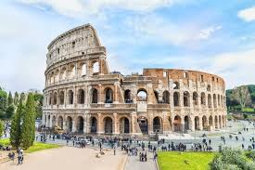
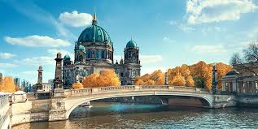
2- Geography and Tourism
    2.3. Spatial interaction between the components of the tourism system: tourist flows
    B- Pull Factors (at the destination)
    - Features that attract tourists to a particular location, such as:
    Accessibility – how easy it is to reach the destination
    (e.g., transport infrastructure, visa policies).
    Attractions – natural, cultural, or man-made sites of interest.
    Amenities – facilities and services available to tourists (e.g., hotels, restaurants, entertainment).
    Relative cost of the visit – affordability compared to other destinations.
    Marketing and promotion – the effectiveness of advertising and
    branding in attracting visitors

Slide 26
3- Forms of Tourism
    - The geographical components of tourism, combined with concepts like spatial scale and tourist flows, result in a diverse range of tourism forms.
    These can be categorized based on the following criteria:
    - Type of Destination
    - The characteristics of the tourism system
    - The market
    - The distance travelled.

Slide 27
3- Forms of Tourism
    3.1. Type of Destination
    - Distinction Between International and Domestic Tourism
    Domestic Tourism
    Involves individuals travelling within their own country.
    Tourists do not cross national borders.
    Often more accessible and cost-effective.
    International Tourism
    Involves travel to a country other than the one in which the tourist normally resides.

Slide 28
3- Forms of Tourism
    3.1. Type of Destination
    International Tourism can be further divided into:
    Inbound Tourism
    Non-residents traveling into a specific country.
    Example: A French tourist visiting Germany contributes to Germany’s inbound tourism.
    Outbound Tourism
    Residents of a country traveling abroad to other countries.
    Example: A German tourist visiting Thailand contributes to Germany’s outbound tourism.

Slide 29
3- Forms of Tourism
    3.1. Type of Destination
    - Factors Affecting International vs. Domestic Tourism
    - International Tourism
    Involves crossing national borders.
    May require:
    Use of different currencies
    Navigating language barriers
    Complying with immigration and visa requirements

Slide 30
3- Forms of Tourism
    3.1. Type of Destination
    - Factors Affecting International vs. Domestic Tourism
    - Domestic Tourism
    Easier to undertake due to:
    Familiarity with language and customs
    No border crossings or currency exchange
    Greater convenience and lower cost

Slide 31
3- Forms of Tourism
    3.1. Type of Destination
    Factors Affecting International vs. Domestic Tourism
    - Influence of Country Size
    Larger countries (e.g., United States):
    Tend to have a greater variety of attractions
    Offer extensive domestic tourism opportunities
    High percentage of tourism is domestic (e.g., 90% in the U.S.)
    Smaller countries (e.g., the Netherlands):
    Easier access to neighboring nations
    Higher proportion of international travel (e.g., around 50% domestic tourism)

Slide 32
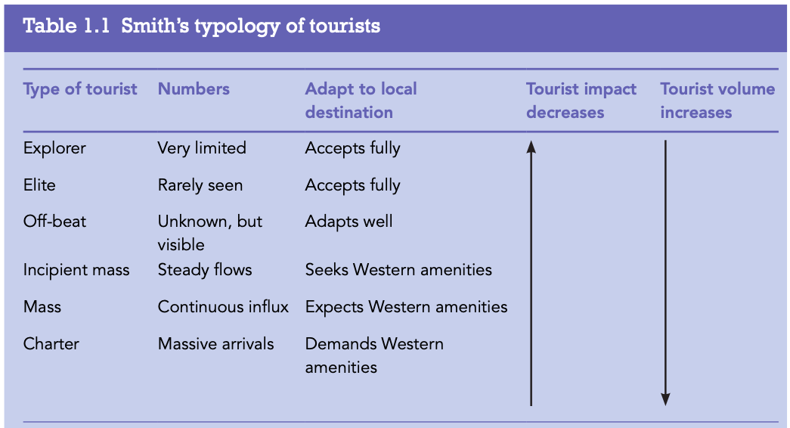
3- Forms of Tourism
    Classification of Tourists:
    Explorer:
    Travel in small numbers
    Fully accept and adapt to local conditions.
    Self-sufficient and well-prepared.
    Typically engage in non-mainstream,
    niche tourism activities.
    Often motivated by research, adventure,
    or exploration rather than leisure or
    Comfort.
Boniface, Cooper And Cooper, 2021

Slide 33
3- Forms of Tourism
    Classification of Tourists:
    Elite:
    Travel off the beaten track for pleasure.
    Have extensive travel experience – "they have done it all"
    Now seek something different or unique.
    Use tourist facilities (e.g., accommodation, transport).
    Adapt easily to local conditions.
    Often motivated by a desire for:
    Authentic cultural experiences
    Personal enrichment
    Escaping mass tourism
Boniface, Cooper And Cooper, 2021

Slide 34
3- Forms of Tourism
    Classification of Tourists:
    Off-beat:
    Not as wealthy as elite tourists.
    Seek an "added extra" or unique experience within a standard tour.
    Interested in going slightly beyond mainstream tourism
    Adapt well to local conditions.
    Can cope with local environments for a few days.
    Likely motivated by:
    A desire for novelty
    A taste of authenticity without full immersion
Boniface, Cooper And Cooper, 2021

Slide 35
3- Forms of Tourism
    Classification of Tourists:
    Incipient mass:
    Travel in a steady flow, typically as small groups or individuals
    Prefer comfort and amenities such as:
    Central heating, air conditioning, and modern facilities.
    Willing to tolerate the absence of amenities for a short
    time.
    View discomfort as part of the travel experience
    Seek a balance between comfort and authentic
    experiences.
Boniface, Cooper And Cooper, 2021

Slide 36
3- Forms of Tourism
    Classification of Tourists:
    Mass:
    Consists of large numbers of tourists
    Often from Europe, North America, or Asia.
    Typically have middle-class values and relatively
    high incomes.
    Highly seasonal travel patterns
    (e.g. summer or holiday periods).
Boniface, Cooper And Cooper, 2021

Slide 37
3- Forms of Tourism
    Classification of Tourists:
    Mass:
    Expect:
    Western-style amenities (e.g., modern hotels, familiar food)
    Multi-lingual guides
    Organized, structured experiences
    Motivated by:
    Comfort and convenience
    Leisure and relaxation
    Safe, predictable environments
Boniface, Cooper And Cooper, 2021

Slide 38
3- Forms of Tourism
    Classification of Tourists:
    Charter:
    Represents full-blown, mass-market tourism
    Involves high volumes of tourists
    Totally dependent on the travel trade (e.g., package tours, tour operators)
Boniface, Cooper And Cooper, 2021

Slide 39
3- Forms of Tourism
    Classification of Tourists:
    Charter:
    Tourists have:
    Standardised tastes and expectations
    Little to no interest in the uniqueness of the destination
    The country of destination is largely irrelevant to the tourist experience
    Focus is on:
    Low cost
    Convenience
    All-inclusive, familiar offerings
Boniface, Cooper And Cooper, 2021

Slide 40
3- Forms of Tourism
    3.2. The Characteristics of the Tourism System
    - Tourism types are shaped by the destination, which in turn affects:
    The market (types of tourists and their motivations)
    The transportation modes used
    The overall tourism product and experience

Slide 41
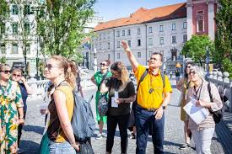
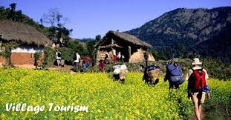
3- Forms of Tourism
    Forms of Tourism by Destination Type
    Rural Tourism:
    - Tourism focused on the countryside, often involving farm stays, nature walks, and village life.
    Urban Tourism:
    - Tourism centered in towns and cities, featuring shopping, cultural sites, events, and nightlife.

Slide 42
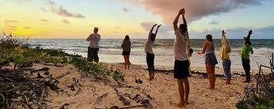
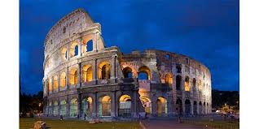
3- Forms of Tourism
    Forms of Tourism by Destination Type
    Health and Wellness Tourism:
    - Travel aimed at improving physical, mental, and spiritual well-being.
    - Includes spas, beauty treatments, fitness retreats, and mindfulness practices.
    - Traditionally centered on thermal resorts and spa towns.
    Heritage Tourism:
    - Focuses on experiencing tangible historical elements (e.g. monuments, architecture, ruins).
    and travel to sacred places.

Slide 43
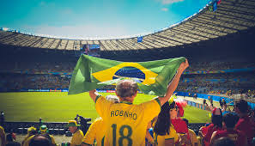
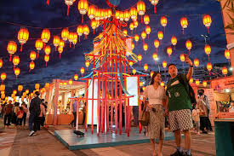
3- Forms of Tourism
    Forms of Tourism by Destination Type
    Cultural Tourism:
    - Involves discovering and engaging with a different way of life, customs, arts, festivals, and local traditions.
    Sport Tourism:
    - Can involve spectators attending events (like the Olympics or football matches) or participants in sporting activities.

Slide 44
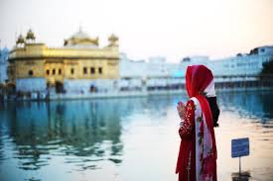
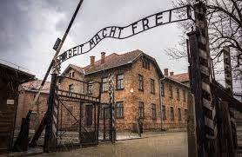
3- Forms of Tourism
    Forms of Tourism by Destination Type
    Dark Tourism:
    - Visits to sites associated with tragedy, death, or disaster, such as battlefields, genocide memorials, or former prisons.
    Faith-Based Tourism:
    - Motivated by religious beliefs, involving pilgrimages and travel to sacred places.

Slide 45
3- Forms of Tourism
    3.3. The Market
    - The tourism market can be defined as a segment of the population expressing a demand for specific tourism products or experiences.
    - This demand is often linked to the purpose of the visit:
    Holiday Tourism:
    This is the most common form of tourism, primarily driven by leisure and recreation.
    Sun, Sand, and Sea Tourism:
    - Focuses on destinations with beaches and good weather.
    - Tourists are drawn to beach-related activities like swimming, sunbathing, and water sports.
    Touring, Sightseeing, and Culture Tourism:
    - Focuses on exploring new destinations.
    - Tourists are interested in experiencing different cultures, lifestyles, and historical or cultural attractions.

Slide 46
3- Forms of Tourism
    3.3. The Market
    B- Common-Interest Tourism
    - This type of tourism involves travelers who visit destinations with a specific purpose that they share with the people or places at the destination.
    - It includes various categories, such as:
    Visiting Friends and Relatives (VFR):
    - Tourists travel to reconnect with family or friends, often resulting in less demand for serviced accommodation or standard tourist services.
    Religious Tourism:
    - Travel motivated by religious practices, pilgrimages, or visits to sacred sites.

Slide 47
3- Forms of Tourism
    3.3. The Market
    Health Tourism:
    - Travel for medical treatment, wellness, or holistic health experiences.
    - Educational Tourism:
    Travel motivated by learning or study, including academic exchanges, conferences, or specialized courses.
    Key Characteristics:
    Limited Demand:
    - Common-interest tourists, especially VFR visitors, may not require traditional tourist services such as hotels, restaurants, or guided tours, as their focus is more personal or purpose-driven.
    Cultural or Emotional Connection:
    - It often relies on deep personal connections to the destination, whether family ties, religious beliefs, or shared interests in health or education.

Slide 48
3- Forms of Tourism
    3.3. The Market
    Business and Professional Tourism
    - This category of tourism is primarily driven by work-related or professional purposes
    - It includes activities such as:
    A- MICE Tourism:
    MICE stands for Meetings, Incentives, Conferences, and Exhibitions.

Slide 49
3- Forms of Tourism
    3.3. The Market
    Business and Professional Tourism
    B- Corporate Travel:
    -Employees or executives traveling for business-related purposes
    Key Characteristics:
    Work-Oriented:
    - Business tourism is focused on professional activities, meaning there is often limited leisure time for tourists during their stay.
    Demand for Specific Services:
    - Business tourists typically require conferencing facilities, event management services, and high-quality business amenities like Wi-Fi, meeting rooms, and transportation.
    Economic Impact:
    - Business tourism, especially MICE, often brings higher spending due to the nature of the industry (luxury hotels, high-end services, etc.).

Slide 50
3- Forms of Tourism
    3.3. The Market
    - Tourism can also be analyzed based on the type of travel arrangements purchased.
    A- Inclusive Tours:
    An inclusive tour bundles two or more components of the trip together, such as transport, accommodation, and activities at a single price.
    Characteristics:
    - Typically offered by tour operators.
    - Provides a set itinerary with pre-arranged accommodations and activities.
    - Popular for group tours or packaged vacations.
    - Convenient and cost-effective for travelers who prefer a hassle-free experience.

Slide 51
3- Forms of Tourism
    3.3. The Market
    B- Independent Travel:
    - Independent travelers purchase various elements of their trip separately, such as flights, hotel bookings, and activities.
    Characteristics:
    - Offers greater flexibility and personalization.
    - Travelers make their own arrangements for transportation, accommodation, and other trip details.
    - Often preferred by individuals or couples who enjoy exploring destinations on their own schedule.
    - Can be more time-consuming and require more effort in planning.

Slide 52
3- Forms of Tourism
    3.3. The Market
    C- Tailor-Made Travel:
    - A combination of both inclusive tours and independent travel, where elements are customized to the traveler’s preferences.
    Characteristics:
    - Travelers can select individual components (like accommodation, activities, or transportation) but have the flexibility of customized itineraries.
    - Common in luxury travel or for those who want a personalized experience without the full complexity of independent travel.
    - The Internet has made it easier for travelers to mix and match services (e.g., booking flights, hotels, and activities online).

Slide 53
3- Forms of Tourism
    3.3. Distance Traveled
    The distance traveled is a key factor in defining types of tourism.
    - It is often categorized into long-haul, medium-haul, and short-haul tourism.
    - This distinction is important for various aspects, such as aircraft operations, marketing strategies, and understanding tourist behaviors.

Slide 54
3- Forms of Tourism
    3.3. Distance Traveled
    A- Long-Haul Tourism:
    - Travel that typically covers a distance of at least 3,000 kilometers.
    Characteristics:
    - Often involves international travel, usually between continents (e.g., Europe to Asia, North America to Australia).
    - Requires longer flights, often intercontinental.
    - More expensive due to the length of travel and higher airfares.
    - Tourists are often seeking unique or exotic destinations far from home, such as tropical islands, historical landmarks, or large cultural cities.

Slide 55
3- Forms of Tourism
    3.3. Distance Traveled
    Medium-Haul Tourism:
    - Travel distances between 1,000 km (620 miles) and 3,000 km (2,000 miles).
    Characteristics:
    - Typically involves regional international travel.
    - Flights are generally moderate in duration, neither too short nor extremely long.
    - The destination is likely within the same continent or neighboring continents, such as Europe to the Middle East or Europe to North Africa.
    - Culturally rich destinations or well-known tourist regions are popular for medium-haul travelers.

Slide 56
3- Forms of Tourism
    3.3. Distance Traveled
    Short-Haul Tourism:
    Travel covering distances of less than 1,000 kilometers (620 miles), typically considered domestic or regional travel.
    Characteristics:
    - Often involves easy and quick access, such as weekend trips or short vacations.
    - Cost-effective due to the short flight durations.
    - Low-cost carriers and regional transport (e.g., trains, buses) are often used for this type of travel.
    - Destinations are usually within a country or a neighboring country, appealing to people seeking quick getaways or short-term vacations.

Slide 57
Thank you
      European Institute of Innovation, Entrepreneurship and Technology
      Lessingstraße 79,
      13158 Berlin, Germany
      Phone: +49 176 55524449
      Email: info@eiiet.com
Discover the world of eiIET

