Slide 1
Sociology of Tourism
European Institute of Innovation, Entrepreneurship and Technology
Lessingstraße 79, 13158 Berlin, Germany
Mahmoud Abdou| Berlin
      Lessingstraße 79,
      13158 Berlin, Germany
      Phone: +49 30 233618555
      Fax: +49 30 233618556
      Email: info@eiiet.com

Slide 2
Index
-Travel Behavior and Tourism Motivation
-Consumer Behavior and the Decision-Making Process
-Factors Influencing Consumer Behavior
-Tourist Roles and Typologies

Slide 3
1- Travel Behavior and Tourism Motivation
      Studies on travel behavior and tourism motivation focus on the tourists and the decision-making process they undergo when planning and booking a holiday.
      Travel Behavior:
    - This refers to the patterns and habits of tourists, including how, when, and why they travel.
    - It encompasses various factors such as destination choice, mode of transportation, travel frequency, and spending patterns
    Tourism Motivation:
    - This examines the underlying reasons and psychological drivers that influence individuals to travel.
    - It includes intrinsic factors like the desire for adventure, relaxation, or cultural exploration, as well as extrinsic factors such as social status or work obligations

Slide 4
1- Travel Behavior and Tourism Motivation
      Travel Behavior Theories:
    - they focus on understanding how tourists act and the types of activities they engage in during their holidays.
    - They try to comprehend and explain how individuals behave while traveling, including their choices, activities, and interactions with the environment during a trip.
    - Key theories encompass, planned behavior theory, push-pull theory, destinations choice model, and time-space geography
    Tourism Motivation Theories:
    - aim to uncover why tourists travel and explore the psychological processes driving their choices
    - These theories investigate the internal and external factors that influence travel behavior, helping to understand what inspires individuals to leave their usual environment and seek experiences elsewhere

Slide 5
1- Travel Behavior and Tourism Motivation
      These motivations can be classified according to:
      Intrinsic Motivations:
    - These are internal desires, such as the need for relaxation, adventure, self-discovery, or cultural enrichment.
    - Example: A person might travel to escape daily stress or to fulfill a personal quest for knowledge
    Extrinsic Motivations:
    - External factors like social recognition, prestige, or obligations.
    - Example: Traveling for business, family gatherings, or to showcase status through luxury vacations.

Slide 6
1- Travel Behavior and Tourism Motivation
      - Consumer travel behavior is influenced by a complex set of factors, which can be broadly categorized into internal and external factors.
      - The internal factors can be further divided into four main types: personal factors, psychological factors, cultural factors, and social factors.
      Personal factors:
    - Age and lifestage
    - Lifestyle
    - personality
    - Self-Image

Slide 7
1- Travel Behavior and Tourism Motivation
      Personal factors
      Age and lifestage:
    - Consumers in their early 20s tend to prefer different types of holidays, modes of travel, and accommodation compared to those over 55 years old
    - The stage of the family life cycle significantly affects travel behavior
    - Family-focused resorts cater to families with entertainment and facilities such as baby gyms and teen lounges
    - Airlines have introduced designated seating areas for parents traveling with children, enhancing the travel experience for families
    - In the early stages of the life cycle, consumers face busier lives and limited time
    - As a result, they prioritize convenience, flexibility, and accessibility
    - Marketers can assist these consumers by providing: easily accessible information to aid decision-making, online services for convenience, faster transaction options to save time

Slide 8
1- Travel Behavior and Tourism Motivation
      Personal factors
      Age and lifestage:
    - As consumers progress towards the later stages of the life cycle, they typically have:
    - More disposable income.
    - Greater discretionary time, enabling them to travel.
    - This segment, also known as "senior tourism," includes travelers aged 60 and above.
    - Often referred to as "grey gappers" or "silver tourists," they tend to:
    - Visit multiple destinations.
    - Spend significant amounts of money, often called "silver dollars”.

Slide 9
1- Travel Behavior and Tourism Motivation
      Personal factors
      Lifestyle:
    - Lifestyle refers to a person's pattern of living, reflected in their activities, interests, and opinions (AIOs).
    - Even people who share the same culture, social class, or reference group can have different lifestyles.
    - A method used to study lifestyles by measuring individuals' AIOs (activities, interests, and opinions).
    - Key Components of Lifestyle:
    - Activities: work, hobbies, holidays, shopping, sports, recreational activities, entertainment, and social events.
    - Interests: home, job, community, food, and media.
    - Opinions: beliefs about various topics, such as politics, religion, economics, future events, education, products, and culture

Slide 10
1- Travel Behavior and Tourism Motivation
      Personal factors
      Personality and self-image:
    - An individual’s personality significantly impacts their travel and tourism purchasing decisions.
    - Traits such as being adventurous or cautious, sociable or introverted, confident or shy influence the type of holiday chosen.
    - Sociable individuals, such as backpackers, often prefer social environments like hostels.
    - Personality is closely tied to self-image or self-concept, which reflects how individuals see.
    - Shy or introverted individuals may avoid highly social trips.
    - However, this relationship is debatable; introverts might choose such trips to challenge themselves and become more outgoing

Slide 11
1- Travel Behavior and Tourism Motivation
      Psychological Factors
    - Psychological factors play a crucial role in determining an individual’s decisions to purchase tourism products. They include behavior, perceptions, attitudes, and motivation.
    Behavior:
    - Tourist buying behavior is significantly influenced by perception, which refers to how consumers interpret and process information through their senses.
    - Perception is shaped by motivation, learning, and attitudes, with a strong connection to prior travel experiences.
    - Perception involves how individuals interpret sensory inputs (sight, hearing, taste, touch, smell) to make decisions about tourism offerings
    - Since tourism products are intangible (they cannot be seen or physically tested before purchase), consumers rely on their perceptions to guide their decisions.

Slide 12
1- Travel Behavior and Tourism Motivation
      Psychological Factors
    Learning:
    - Learning refers to the process by which individuals acquire knowledge and experience related to purchasing and consuming tourism products, which they then apply to future decisions.
    - People gain knowledge through direct consumption (experiencing tourism offerings), as well as indirect sources, such as listening to others' experiences or reading reviews.
    - Over time, consumers accumulate a mental inventory of tourism products, including both positive and negative experiences, which influences their future choices

Slide 13
1- Travel Behavior and Tourism Motivation
      Psychological Factors
    Attitudes:
    - An attitude is an evaluative judgment or level of liking towards an object, person, or event. People develop attitudes based on their feelings and thoughts about various subjects, including travel and tourism.
    - Attitudes play a crucial role in shaping purchasing behavior, influencing how consumers view and react to brands, products, or services.
    - In tourism, attitudes extend to knowledge of destinations, as well as experiences with people and events
    - Negative experiences, such as poor service at a hotel or an overcrowded, polluted destination, can lead to negative attitudes that prevent future purchases or visits
    - Consumers are increasingly concerned about ethical consumption, avoiding destinations or services that are environmentally irresponsible, unethical, or detrimental to local communities
    - A bad experience in the tourism or hospitality industry (e.g., at a hotel or restaurant) can result in a negative attitude, making the consumer less likely to return or recommend the service.

Slide 14
1- Travel Behavior and Tourism Motivation
      Psychological Factors
    Motivation:
    - Understanding why consumers select particular tourism products and destinations is a complex process.
    - Motivation is a state of arousal or drive that prompts individuals to take action to achieve specific goals.
    - The term motivation is often overused in the tourism industry and should not be confused with the reason for travel. For example, “to visit friends or family” is a reason for travel, but not necessarily a motivation for travel.
    - There are numerous factors that influence why consumers choose to purchase tourism offerings. Understanding these motivations is crucial for tourism marketers.
    - Consumers are increasingly concerned about ethical consumption, avoiding destinations or services that are environmentally irresponsible, unethical, or detrimental to local communities
    - It can be difficult for consumers to articulate the specific motivational factors behind their decision to travel. Often, they may not fully recognize or be able to express the underlying reasons that prompt their need for travel.

Slide 15
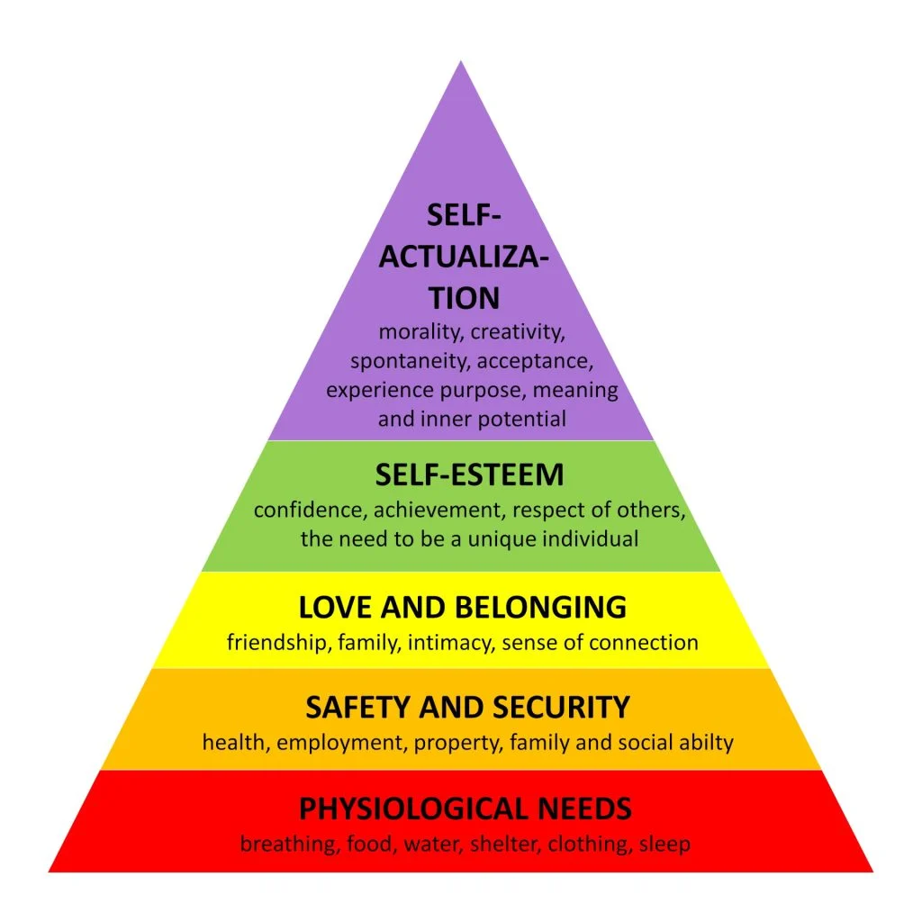
1- Travel Behavior and Tourism Motivation
      - Psychological Factors
    Motivation:
    - One of the most widely used theories of motivation in
    marketing is Maslow’s Hierarchy of Needs,
    which proposes a pyramid structure of human needs.
    - The theory suggests that when an individual's goals
    are achieved, their needs subside,
    and they return to a state of normality until new needs emerge.

Slide 16
1- Travel Behavior and Tourism Motivation
      Psychological Factors
    Motivation:
    - Maslow suggested that basic needs (such as physiological needs and safety) must be regularly met before individuals focus on higher-level needs like social needs or esteem needs.
    - In the tourism industry, if consumers perceive that a hotel chain effectively satisfies their basic needs (e.g., food, shelter, and security), these foundational needs become less significant to them
    - Once these lower-level needs are satisfied, marketers should focus on appealing to higher-level needs, such as status or self-esteem, in order to attract and retain consumers. For instance, a luxury hotel or a branded resort can position itself as a status symbol, offering premium services or exclusivity to appeal to consumers seeking higher-level satisfaction.

Slide 17
1- Travel Behavior and Tourism Motivation
      Cultural Factors
    - Culture is the sum total of learned beliefs, values, and customs that influence the consumer behavior of members of a particular society.
    - Culture is made up of what a group has in common and what distinguishes it from other groups.
    - These elements, including language, food, clothing, art, religion, and architecture, are often passed down from one generation to another, shaping societal norms and individual behaviors.
    - Culture plays a significant role in the tourism industry as it shapes the preferences and behaviors of tourists.
    - People tend to choose destinations that align with their cultural values or interests.
    - From food preferences to the types of experiences sought (e.g., religious or historical sites, festivals), culture shapes demand in the tourism sector.

Slide 18
1- Travel Behavior and Tourism Motivation
      Cultural Factors
      Culture and Ethnic Groups:
    - Culture is the sum total of learned beliefs, values, and customs that influence the consumer behavior of members of a particular society.
    - Culture is made up of what a group has in common and what distinguishes it from other groups.
    - These elements, including language, food, clothing, art, religion, and architecture, are often passed down from one generation to another, shaping societal norms and individual behaviors.
    - Culture plays a significant role in the tourism industry as it shapes the preferences and behaviors of tourists.
    - People tend to choose destinations that align with their cultural values or interests.
    - From food preferences to the types of experiences sought (e.g., religious or historical sites, festivals), culture shapes demand in the tourism sector.

Slide 19
1- Travel Behavior and Tourism Motivation
      Cultural Factors
      Social grade:
    - Social grade (or class) refers to the classification of individuals based on factors such as occupation, education, income, and lifestyle. A typical class structure entails an upper, middle, and lower class. Social class is usually identified by occuption level, education, lifestyle and income
    - Consumers' social class determines their disposable income, which in turn influences their spending behavior.
    - Higher-income individuals tend to spend more on luxury or premium travel experiences, while lower-income individuals might prioritize more affordable options.
    - A typical class structure entails an upper, middle, and lower class. Social class is usually identified by occuption level, education, lifestyle and income.

Slide 20
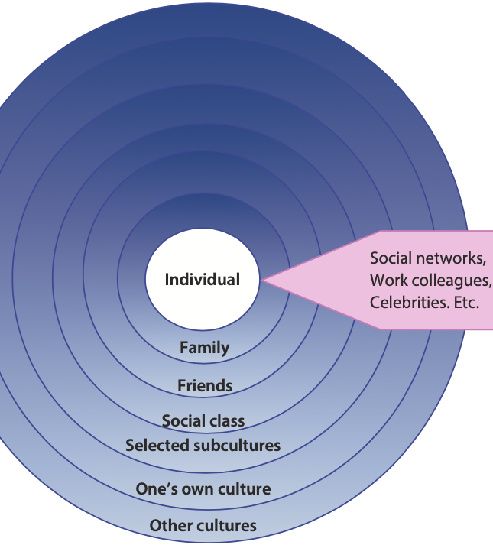
1- Travel Behavior and Tourism Motivation
      -Social factors
      - Consumers’ decisions are heavily influenced by the people they
      interact with, either directly or through observation.
      - These social factors encompass reference groups and family –
      Consumers' social class determines their disposable income,
      which in turn influences their spending behavior.

Slide 21
1- Travel Behavior and Tourism Motivation
      Reference groups:
    - A reference group is a group of people that influences an individual’s buying behavior.
    - Consumers often base decisions, such as choosing a holiday destination, on the preferences and behaviors of these groups.
    - Reference groups influencing consumer behavior can be diverse, including family and friends, celebrities, social clubs, workplace and colleagues, social networking sites, educational institutions, religious organizations.

Slide 22
2- -Consumer Behavior and the Decision-Making Process
    - understanding how consumers make decisions and consume tourism activities is critical for tourism management.
    - This understanding helps businesses and destinations adapt to the diverse needs of tourists, craft compelling marketing messages, design relevant products and services, and ensure high levels of customer satisfaction.
    - By appreciating the variety in consumer behavior, tourism managers can effectively meet demand, enhance experiences, and ultimately drive growth in the tourism industry.

Slide 23
2- -Consumer Behavior and the Decision-Making Process
    - Tourists, as consumers, make purchasing decisions for goods and services that satisfy their personal needs during travel.
    - It involves five stages, which represent the steps a tourist goes through before, during, and after purchasing travel-related goods and services.
    - 1st stage: The recognition of a need:
    - 2nd stage: Information searching
    - 3rd Stage: The Evaluation of Alternatives
    - 4th Stage: The Purchase Decision
    - 5th Stage: Post-Purchase Behavior

Slide 24
2- -Consumer Behavior and the Decision-Making Process
      The recognition of a need:
    - the potential tourist perceives a gap between their current situation and their desired experience
    - This is the initial step that triggers the decision to travel.
    - It involves the realization that there is a gap between where the tourist is (their current situation) and where they want to be (their desired experience or state).
    - Actual State: This represents the tourist’s current situation or condition. For example, they might be feeling stressed, bored, or tired from daily life and want a change of environment or relaxation
    - Desired State: This is the tourist’s ideal or desired situation. It could involve various motivations such as relaxation on a beach, cultural exploration, adventure, or spending quality time with family. The desired state reflects the kind of holiday or experience they are looking for.
    - Desired State: The desired state reflects the kind of holiday or experience they are looking for.

Slide 25
2- -Consumer Behavior and the Decision-Making Process
      Information searching :
    - In this stage, some consumers may overlook the information search stage if their desire or need is strong enough, or if a suitable product/service is readily available.
    - This can take place when the consumer already has a clear idea of what they want or is familiar with the options.
    - Information can be gathered from various sources, such as personal sources (family, friends, neighbours, colleagues), commercial sources (advertising, sales people, displays, other marketing material) or public sources (reviews, newspapers).

Slide 26
2- -Consumer Behavior and the Decision-Making Process
      The Evaluation of Alternatives:
    - In the competitive tourism industry, there are typically multiple products and services that meet similar needs, so the consumer must choose the most suitable one.
    - The evaluation is based on the consumer’s specific needs and preferences, which influence their decision-making.
    - Tourism products and services often involve a mix of different elements or attributes (e.g., price, quality, location, amenities), so the consumer assesses which ones best fulfill their needs.
    - After evaluating the options, the consumer ranks the products or services based on how well they meet their needs and preferences.
    - This ranking helps in narrowing down the choice to a few viable options.
    - Following the evaluation, the consumer forms a purchase intention – the likelihood or decision to proceed with booking or purchasing a particular product or service.

Slide 27
2- -Consumer Behavior and the Decision-Making Process
      The Purchase Decision stage:
    - After the purchase intention is specified, the consumer selects their most preferred product or service during the Purchase Decision stage, which outlines the 4th stage.
    - However, this decision can be influenced by:
    Attitudes of Others:
    - Opinions from partners, children, friends, family, or social networks can impact the final choice. The consumer may reconsider or change their decision based on these external perspectives.
    - Unexpected Situations:
    - External factors beyond the consumer’s control, such as price increases, a sudden loss of income, illness, or other unforeseen circumstances, may also affect the purchase decision before it is finalized.

Slide 28
2- -Consumer Behavior and the Decision-Making Process
      Post-Purchase Behavior:
    This stage can examined through different lenses:
    Satisfaction or Dissatisfaction:
    - After purchasing and consuming a product or service, the consumer experiences either satisfaction or dissatisfaction.
    - This outcome depends on how well the product or service meets or exceeds the consumer's pre-purchase expectations compared to the perceived performance.
    - Expectation vs. Performance:
    - If the product or service meets or exceeds the consumer's expectations, satisfaction results :
    - If the product or service falls short of expectations, dissatisfaction occurs.

Slide 29
2- -Consumer Behavior and the Decision-Making Process
      Post-Purchase Behavior:
    Influencing Factors on Expectations: Expectations are not always clear or straightforward. They are shaped by various factors:
    - Past experiences: Previous experiences with similar products or services influence future expectations.
    - Social influences: Recommendations or opinions from others (family, friends, social media) impact expectations.
    - Other information sources: Advertising, reviews, and word-of-mouth also play a role in shaping what the consumer anticipates
    - Gap Between Expectations and Performance:
    - The larger the gap between expectations and the actual performance of the product or service, the greater the customer dissatisfaction.
    - A larger gap increases the likelihood that the consumer will be dissatisfied and less likely to repurchase the same product or service.

Slide 30
3- Motivation Theories
    - Motivation is a state of need or a condition that prompts a tourist to take action.
    - In the tourism context, it prompts individuals to go on a holiday that is expected to provide satisfaction by fulfilling that need or addressing the underlying condition
    - The study of tourist motivation aims to understand why people choose to travel, why they select specific destinations, and why they engage in particular activities during their holidays
    - The motivation to travel can be understood as the result of a psychological need (which the tourist may not even be consciously aware of) or as driven by the purpose or choice of the trip
    - We should bear in mind that the sociological and psychological approaches for tourism motivations are often overlap

Slide 31
3- Motivation Theories
      Escape-Seeking Theory:
    - In this theory, Iso-Ahola (1982) suggested that tourism motivation consists of two components: escape and seeking. Tourists are driven to escape their routine environments while simultaneously pursuing intrinsic rewards.
    - In this context, travel is often motivated by a combination of these two elements:
    Escape from negative circumstances (e.g., stress).
    Seeking positive experiences (e.g., excitement, novelty).
    - He also suggested that tourism motivation has both a psychological (personal) and a social (interpersonal) component.
    -

Slide 32
3- Motivation Theories
      1- Escape-Seeking Theory:
    - He proposed four dimensions of tourism motivation:
    - Personal seeking: Intrinsic rewards, such as excitement, adventure, relaxation, or novelty.
    - Personal escape: Escaping from routine, stress, or undesirable environments.
    - Interpersonal seeking: Connecting with others, forming new relationships, participating in group activities, or seeking a sense of community.
    - Interpersonal escape: Escaping from social interactions or pressures.
    - These four dimensions act as push factors, driving tourism behavior.

Slide 33
3- Motivation Theories
      2- Push/Pull Factors:
    - Pull factors refer to destination-specific attributes or external motivations—specifically, the attractions or overall appeal of a destination that "pull" tourists toward it.
    - During the decision-making process, the prospective tourist will have gathered adequate information about the holiday or destination, and appealing products and services will act as pull factors that influence their final decision
    On the other side:
    - Push factors are internal motivations that influence an individual's decision-making process..
    - These factors are person-specific and include aspects such as needs and preferences e.g., seeking social interaction, exploring new skills, achieving personal goals, and prestige and recognition
    - Interpersonal escape: Escaping from social interactions or pressures.
    - These four dimensions act as push factors, driving tourism behavior.
    Push and pull factors have become central concepts in explaining tourist motivation.

Slide 34
3- Motivation Theories
      3- Maslow's hierarchy of needs :
    - Maslow's hierarchy of needs (1943) is widely regarded as the most influential theory on motivation and is easily applicable to understanding tourism motivation.
    - Maslow introduced five different needs, namely physiological (thirst, hunger, sleep), safety (security, stability, protection), social (love, affection, belongingness, interpersonal relationships), esteem (self- esteem, self-respect, prestige, status), and self-actualization (growth, advancement, creativity).
    - It is assumed that lower-level needs must be satisfied before higher-level needs become relevant. For example, if you are hungry, socializing with friends is unlikely to be a priority. Likewise, if you feel lonely, making connections with others will be more important than improving yourself or your career.

Slide 35
3- Motivation Theories
      3- Maslow's hierarchy of needs :
    - Applying Maslow’s hierarchy of needs to tourism highlights that one area of need often takes priority over others.
    - For some tourists, the primary motivation is relaxation, fulfilling their physiological needs by opting for a beach holiday.
    - Others travel to visit friends and family, seeking love and affection, or to make new social connections.
    - Additionally, some tourists aim to enhance their self-esteem and personal growth by participating in a - ctivities and exploring new cultures, using travel as an opportunity for skill development and learning
    - However, contrary to Maslow's suggestion, tourism motivation is not always driven by lower-level needs. Instead, any need within the hierarchy can serve as the primary motivator
    - As a result, the hierarchical structure may not fully apply in the context of tourism

Slide 36
3- Motivation Theories
      4- Travel Career Ladder (TCL):
    - Pearce (1988) developed the Travel Motivation Theory, also known as the Travel Career Ladder (TCL).
    - The word "career" indicates that tourists systematically move through stages or follow foreseeable travel patterns. Some may ascend the ladder, while others may remain at a particular level.
    - A key idea of the TCL is that tourist motivation evolves with travel experience. Depending on previous travels or life stage, different needs become more prominent and influence tourism motivation.
    - This theory proposes that tourist motivation consists of five levels, with travelers' needs classified into a hierarchical structure or ladder as follows:
    - Lowest level: Relaxation needs
    - Second level: Stimulation needs
    - Third level: Relationship needs
    - Fourth level: Self-esteem and development needs
    - Fifth level: Fulfillment needs

Slide 37
3- Motivation Theories
      4- Travel Career Ladder (TCL):
    - This approach is easily applicable to tourism. Tourists may be motivated to travel to fulfill their need for rest and relaxation (physiological needs), or they may visit friends and family (social needs).
    - Each level of needs can be divided into two categories: self-directed and directed at others.
    Relaxation needs:
    - Self-directed: Focus on bodily reconstitution and relaxation, concentrating on the tourist themselves.
    Other-directed: Require others to provide external excitement and novelty to satisfy these needs.
    Relationship needs:
    - Self-directed: Involve visiting friends and family to maintain relationships and give love and affection.
    Other-directed: Concern initiating relationships (meeting new people), receiving affection, or being part of a group

Slide 38
4- Tourist Roles and Typologies
      1- Sunlust vs Wanderlust
      - Gray (1970) categorizes tourists based on the purpose of their trip into two groups: sunlust and wanderlust tourists.
    - Each level of needs can be divided into two categories: self-directed and directed at others.
    Sunlust Tourists:
    - Focus on rest and relaxation.
    - Prioritize pleasant climates, comfort, and familiar amenities.
    - Prefer hassle-free, relaxing vacations with minimal excitement
    Wanderlust Tourists:
    - Motivated by a desire to explore and experience new cultures.
    - Value entertainment in the form of engaging with local people and cultural experiences.
    - Prioritize learning and adventure as key elements of their holiday

Slide 39
4- Tourist Roles and Typologies
      2- Allocentric vs Psychocentric (Venturers vs Dependable)
      - Plog (2001) categorized tourists based on personality traits and features to understand their travel behavior.
      - The main differences are based on the level of travel and the nature of the travel experience.
    Allocentric Tourists:
    Adventurous and Independent:
    - Allocentric tourists are adventurous travelers who actively seek new, unfamiliar, and diverse experiences.
    - They are independent, open to exploring different cultures, and motivated by challenges and novelty.
    Risk-Taking and Desire for New Experiences:
    - They are willing to take risks to immerse themselves in fresh experiences and environments.
    - Their travel style is driven by a desire for novelty and immersion, avoiding routines and mass tourism experiences.

Slide 40
4- Tourist Roles and Typologies
      2- Allocentric vs Psychocentric (Venturers vs Dependable)
    Allocentric Tourists:
    Accommodation Preferences:
    - They prefer unconventional accommodations, often choosing local options that provide unique, authentic experiences over typical hotel stays.
    - Spending Habits:
    - Venturers tend to spend their disposable income on authentic local arts, crafts, and experiences, prioritizing authenticity over mainstream tourism products.
    Cultural Engagement:
    - Engaging with locals, participating in cultural customs, and embracing active pastimes are central to their travel experiences.
    Independence and Avoidance of Group Tours:
    - They highly value independence, usually arranging their travels on their own and avoiding structured, pre-arranged group tours

Slide 41
4- Tourist Roles and Typologies
      2- Allocentric vs Psychocentric (Venturers vs Dependable)
    Psychocentric Tourists:
    Preference for Familiar and Safe Environments:
    - Dependables prefer comfortable, familiar surroundings and safe environments.
    - They seek relaxation and are less inclined to take risks during their travels.
    Cautious and Risk-Averse:
    - These tourists are cautious, conservative, and risk-averse, often avoiding challenges and prioritizing security.
    - They rely on well-known, trusted brands, associating these with safety.
    Travel and Accommodation Preferences:
    - They typically visit popular domestic attractions and mass tourism

Slide 42
4- Tourist Roles and Typologies
      2- Allocentric vs Psychocentric (Venturers vs Dependable)
    Psychocentric Tourists:
    Travel and Accommodation Preferences:
    - They typically visit popular domestic attractions and mass tourism resorts
    - They prefer a "home-from-home" experience, using their own car or caravans as the main mode of transportation, and tend to stay in mobile homes, hotels, or motels for familiarity and comfort.
    Low Activity and Structured Holidays:
    - They engage in minimal activity while on holiday, often sticking to familiar recreational activities.
    - They favor structure and routine, typically opting for package holidays, guided tours, or all-inclusive resorts.
    Spending and Purchases:
    Dependables tend to spend less money and generally make purchases like souvenirs as reminders of their trips.
    Travel Companions and Return Visits:
    They usually travel with family or friends and are more likely to return to destinations they have already visited

Slide 43
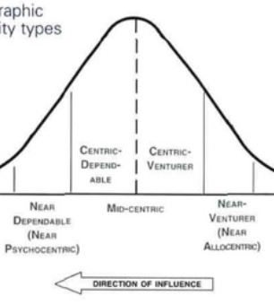
4- Tourist Roles and Typologies
      2- Allocentric vs Psychocentric (Venturers vs Dependable)
    The critique of the Allocentric vs Psychocentric
- However, this dichotomy outlines two extreme
tourist personalities and behaviors, and it would
be too difficult to put most individuals into either
one of these categories.

Slide 44
4- Tourist Roles and Typologies
      2- Allocentric vs Psychocentric (Venturers vs Dependable)
    The critique of the Allocentric vs Psychocentric
    -The majority of tourists fall between the two extremes and can be further categorized as
    - Dependable: Highly conservative, risk-averse, preferring familiar, safe environments.
    - Near-Dependable: Slightly more open but still prefer structured, familiar experiences.
    - Centric-Dependable: A mix of comfort and willingness to engage in new experiences.
    - Centric-Venturer: Balanced between seeking novelty and appreciating comfort.
    - Near-Venturer: More adventurous than centric-dependables, but still value some security.
    - Venturer: Highly adventurous, seeking challenges, and willing to take risks in unfamiliar settings.

Slide 45
4- Tourist Roles and Typologies
      3- Cohen’s typology
    -Cohen’s (1972) typology of tourists outlines four distinct categories based on how tourists interact with the tourism industry and the destinations they visit.
    - This framework is positioned on a continuum that ranges from familiarity (seeking comfort and known environments) to strangerhood (embracing novelty and the unfamiliar).
    - Cohen’s concept of the "environmental bubble" explains how tourists experience travel while still being influenced by their home culture, environment, and societal norms, meaning that the extent to which the home environment forges the tourist results in different reactions to and preferences for new places and cultures.
    - In other words, not all tourists are equally controlled by the environmental bubble.
    - Similarly to Plog’s perception, some individuals prefer experiences and places that remind them of their home environment, whereas others are more adventurous and seek out more novelty and exciting experiences.

Slide 46
4- Tourist Roles and Typologies
      3- Cohen’s typology
    - Cohen’s categorization include:
    1- The organized mass tourist
    - The organized mass tourist is the least adventurous type of traveler, seeking maximum convenience and comfort.
    - They rely heavily on prearranged package holidays with fixed itineraries, ensuring that every aspect of the trip—accommodation, transport, and activities—is handled by the tourism industry.
    - Their travel experience remains within the boundaries of the “tourist bubble”, a controlled environment designed to minimize exposure to unfamiliar cultures or situations.
    Key characteristics include:
    Preference for Familiarity:
    - They choose Western-style hotels, dining, and attractions that offer comfort similar to their home environment.

Slide 47
4- Tourist Roles and Typologies
      3- Cohen’s typology
    Dependence on the Industry:
    - These tourists favor all-inclusive packages that provide predictability and remove the need for independent planning.
    Familiarity level:
    - High-tourists stay within familiar, pre-arranged experiences If they do seek unique experiences, these are carefully controlled to avoid discomfort or unpredictability.
    - If they seek unique experiences, they are carefully controlled to avoid discomfort or unpredictability.
    Destination Choices:
    - They often stick to popular, well-developed tourist areas, either within their own country or internationally, where the infrastructure caters specifically to mass tourism

Slide 48
4- Tourist Roles and Typologies
      3- Cohen’s typology
    2-The Individual Mass Tourist:
    - This type of tourist still depends on institutionalized tourism services (e.g. scheduled flights, tour operator and travel agency services and bookings, transfers) but enjoys more freedom in their travel experience.
    - They prefer the structure and convenience provided by established tourism infrastructure, yet they have more control over their itinerary compared to those who rely entirely on prearranged package holidays.
Key characteristics of the individual mass tourist include:
Greater Independence:
- Unlike the organized mass tourist, this type does not follow a rigid, all-inclusive package.
- They still book through travel agents or tour operators but exercise more freedom in their choices, such as picking specific destinations or activities.

Slide 49
4- Tourist Roles and Typologies
      3- Cohen’s typology
Key characteristics of the individual mass tourist include:
Prearranged Travel:
- Most of their travel arrangements, such as flights, hotel bookings, and transfers, are planned before departure. However, they maintain flexibility in the destinations and activities they choose.
Familiar Tourist Spots:
- While the individual mass tourist tends to visit well-known tourist attractions—similar to the organized mass tourist—they retain control over how and when they visit these places.
Comfort and Convenience:
- They still favor comfort and convenience but might opt for more personalized or diverse travel experiences within the tourist infrastructure.

Slide 50
4- Tourist Roles and Typologies
      3- Cohen’s typology
The key differences between the organized and Individual Mass Tourist:
The key differences lie in their level of independence and the degree to which they rely on the tourism industry for organizing their trips
Organized Mass Tourist:
- Prefers highly structured and prearranged holidays, often with set itineraries.
- Typically stays within the tourist infrastructure, like Westernized hotels, and relies on mass tourism environments created by the tourism industry.
- These tourists tend to stay within the ‘tourist bubble,’ meaning they experience destinations through the lens of what the tourism industry has designed for them.
- Their focus is on comfort and familiarity, seeking an environment where most aspects of the travel experience are pre-planned

Slide 51
4- Tourist Roles and Typologies
      3- Cohen’s typology
The key differences between the organized and Individual Mass Tourist:
Individual Mass Tourist:
- While still relying on the tourist infrastructure (e.g., scheduled flights, hotels, and other services), they have more flexibility and autonomy in their travel choices.
- They tend to book trips with a greater degree of personal choice, such as selecting their own activities or modifying aspects of the itinerary.
- This type of tourist still visits popular tourist destinations but maintains more control over the arrangements than the organized mass tourist.
- They may seek more customization but still prefer familiar, controlled aspects of tourism, and the majority of their travel is often pre-arranged.

Slide 52
4- Tourist Roles and Typologies
      3- Cohen’s typology
- The organized mass tourist and the individual mass tourist are also referred to as institutionalized tourist types. They are characterized by their heavy reliance on the tourism industry to organize, plan, and control most aspects of their travel.
- However, the explorer and drifter are described as the non-institutionalized tourist types.
The explorer
- The explorer is an independent traveler who values autonomy and often seeks experiences that take them off the beaten track.
- While they may occasionally rely on basic tourist infrastructure (such as transport or accommodations), their main goal is to immerse themselves in the local culture and environment, often avoiding the heavily touristed areas.

Slide 53
4- Tourist Roles and Typologies
      3- Cohen’s typology
The explorer tourist type is characterized by:
Independence in Travel:
- The explorer prefers to plan their own itinerary, relying on personal research (such as travel articles) rather than promotional materials like brochures or packaged tours.
- This allows them to customize their experience based on personal interests and the desire for authenticity.
Off the Beaten Track:
- A key trait of the explorer is the desire to travel to less-known or more remote destinations. They prioritize cultural immersion, local experiences, and interactions with locals over conventional tourist attractions.

Slide 54
4- Tourist Roles and Typologies
      3- Cohen’s typology
The explorer tourist type is characterized by:
Escaping the Environmental Bubble:
- Although the explorer strives to move beyond the typical tourist spaces, they are not entirely opposed to using the “tourist bubble” if necessary (e.g., when logistical challenges arise or when the journey becomes too difficult).
- This indicates a flexibility that allows them to balance their adventurous spirit with practical needs.
Temporary Return to the ‘Tourist Bubble’:
- In situations where the environment becomes too tough or unfamiliar, explorers may temporarily return to more structured, familiar spaces, but this is a last resort, with the preference being to remain outside the tourist mainstream as much as possible

Slide 55
4- Tourist Roles and Typologies
      3- Cohen’s typology
The drifter
- The drifter represents the ultimate in independent and immersive travel. Here's how they are typically characterized:
Complete Independence:
- Drifters have no fixed itinerary. They prioritize spontaneity, letting their travel experience unfold organically without relying on prearranged plans or schedules.
- This allows for deep immersion in new environments.
Strong Local Interaction:
The drifter seeks to live like a local, often working alongside residents, staying in local accommodations, and embracing the culture in its most authentic form.

Slide 56
4- Tourist Roles and Typologies
      3- Cohen’s typology
This deep level of interaction is key to their travel experience.
Avoidance of Tourism Hotspots:
- Unlike other types of tourists, drifters actively avoid popular tourist destinations, focusing instead on finding hidden gems and untouched locations.
- They intentionally steer clear of the traditional tourism industry as much as possible.
Seeking Novelty and Excitement:
- Drifters are motivated by a desire for new, unusual, and often challenging experiences.
- They are not deterred by discomfort or danger, instead embracing it as part of the adventure

Slide 57
4- Tourist Roles and Typologies
      The key differences between the explorer and the drifter:
      Degree of Independence:
      Explorer:
      - While explorers are independent travelers, they still make use of some aspects of the tourism infrastructure, like transportation and accommodations.
      - Their travel is planned, but they try to go beyond the tourist bubble when possible, seeking out more authentic and off-the-beaten-path experiences.
      Drifter:
      - Drifters, on the other hand, are fully independent. They avoid the tourism industry almost entirely, with no fixed plans, relying entirely on spontaneous decisions and local guidance.
      - They embrace a completely unpredictable travel style

Slide 58
4- Tourist Roles and Typologies
      The key differences between the explorer and the drifter:
      Cultural Immersion:
      Explorer:
      - Explorers engage with local cultures, but they are less likely to immerse themselves completely in everyday local life. Their travel may still include visits to tourist spots, although they seek more unique experiences than typical tourists.
      Drifter:
      - Drifters are highly immersed in local culture. They seek to live and work with locals, completely avoiding tourist centers and industry-led experiences, instead opting for a lifestyle closely connected to the community they are in.

Slide 59
4- Tourist Roles and Typologies
      The key differences between the explorer and the drifter:
      Tourism Infrastructure:
      Explorer:
      - While explorers prefer to stray from traditional tourist routes, they occasionally rely on the tourism infrastructure, such as tour operators and travel agencies, for certain needs.
      - Their travel is guided by some level of planning and structured organization.
      Drifter:
      - Drifters have minimal reliance on tourist infrastructure. They seek novelty and are willing to face discomfort or uncertainty to avoid the tourism system entirely.

Slide 60
4- Tourist Roles and Typologies
      The key differences between the explorer and the drifter:
      Risk and Comfort:
      Explorer:
      - Explorers may seek challenges, but they are not typically drawn to risk or discomfort to the extent of drifters. - They balance exploration with some comfort and familiarity, often using travel guides or articles for inspiration.
      Drifter:
      - Drifters actively seek risk, discomfort, and excitement.
      - They are motivated by the desire to experience the unknown and often pursue situations that others may avoid due to their level of unpredictability and potential for discomfort.

Slide 61
4- Tourist Roles and Typologies
      4-Smith’s typology:
      - Smith (1989) built on Cohen's typology by identifying seven tourist types, which are categorized based on numbers and frequency by which these tourist typologies can be observed.
      - These categories range from the rarest and most independent types to the most common, largely passive types of tourists.
      Explorer:
      - The smallest and least common segment of tourists.
      - These tourists are highly independent and adapt fully to local traditions and cultures, seeking out authentic experiences.
      Elite Tourist:
      - Also rare, but these tourists are able to fully adapt to local traditions and cultures, much like the explorer.

Slide 62
4- Tourist Roles and Typologies
      4-Smith’s typology:
      Off-Beat Tourist:
      - Less common than the elite tourist but still not frequently encountered.
      - This type of tourist adapts well to local environments and traditions but may not do so as seamlessly as the explorer or elite tourist.
      Unusual Tourist:
      - Seen occasionally and adapts partially to local cultures, but not to the same extent as the off-beat tourist.
      - These tourists may seek novelty but engage less fully with local traditions.

Slide 63
4- Tourist Roles and Typologies
      4-Smith’s typology:
      - Incipient Mass Tourist:
      More common than the previous types, the incipient mass tourist seeks active participation in their holiday experience, making individual efforts to shape their travel experience.
      Mass Tourist:
      - The most common type of tourist today, mass tourists generally expect the tourism industry to provide an experience with minimal effort on their part.
      - They often follow pre-arranged itineraries and visit popular destinations with little engagement with local cultures.
      Charter Tourist:
      - Appears in the largest numbers, often associated with package holidays or chartered flights.
      - This group "demands" tourism services, focusing on convenience and standardized offerings rather than cultural engagement

Slide 64
4- Tourist Roles and Typologies
      A Critical Overview for the Tourist’s Typology
      -While typologies are valuable for understanding tourists' behavior, characteristics, and personal traits—making them useful for marketing purposes such as identifying market segments and developing tailored products and services—they have been criticized for several reasons:
      - Focus on observable behavior: They focus solely on observable behavior without explaining the underlying motivations.
      - Generalization: They generalize characteristics and personality traits, potentially leading to stereotypes.
      - Overlap between types: For example, Smith’s typology shows little distinction between mass and charter tourists.
      - Exclusion of key factors: Important factors such as travel experience, age, gender, or income are often excluded.
      - Lack of dynamism: Typologies should not be viewed as static; tourists may move between classifications over time.

Slide 65
4- Tourist Roles and Typologies
      The Tourist Gaze
      - The tourist gaze can be seen as a key aspect of tourist motivation, driven by the need to see and observe sights, places, and people that are unusual.
      - The tourist gaze stems from the activity that any tourist engages in while on holiday, namely the importance of the visual gaze.
      - For instance, we look at places, people, landscapes, buildings, and performances.
      - Tourists travel to experience something different from their everyday routine, which is why visual consumption is inherent to any travel experience.
      - Why do we travel to Egypt, India, Italy, and Spain?

Slide 66
4- Tourist Roles and Typologies
      A fundamental aspect of the tourist gaze is the distinction between the ordinary and the extraordinary.
      Attractions are marked as worth seeing through a process known as site sacralization, which involves several key steps:
      - The sight is named.
      - The sight is framed and elevated in importance (e.g., creating a narrative or context that enhances its value and significance).
      - The sight is enshrined as a symbol of value (e.g., highlighting the place social, cultural, historical, religious, or political meanings and events).The sight is reproduced mechanically (e.g., in souvenirs).
      - The sight is reproduced socially, with new sights being established and naming themselves after the original sight.

Slide 67
4- Tourist Roles and Typologies
      - Another core aspect of Urry's conception is observing ordinary aspects in an unusual context, such as everyday routines in China as a communist country.
      - Additionally, everyday activities on holiday (e.g., shopping, eating, drinking) are seen as extraordinary because they are shaped by the visual gaze in an unfamiliar environment.
      Furthermore, Urry distinguishes between the romantic and collective gaze.
      Romantic gaze:
      - Characterized by solitude, privacy, and personal relationships with the object of the gaze.
      - Example: Enjoying a beautiful landscape on your own in the mountains.
      - If too many people are present, it affects the quality of the experience.
      - This type of attraction necessitates a solitary, romantic gaze.

Slide 68
4- Tourist Roles and Typologies
      Collective gaze:
      - Emphasizes the presence of other people when looking at the object.
      - Example: Attending a festival, where the other visitors are essential to the atmosphere and attractiveness of the event.
      - Or traveling to larger cities where the cosmopolitan character is the key attraction.
      - The experience would feel strange if you were there alone, and the enjoyment would diminish.

Slide 69
4- Tourist Roles and Typologies
      Critique of the Tourist Gaze Theory:
      - The idea of the tourist gaze has been criticized and developed over the years.
      - Much of the critique has focused on the visual aspects, while traveling encompasses physical and corporeal experiences, engaging all the senses.
      - Moreover, restricting the tourist experience to just the gaze may overlook the 'second gaze', which goes beyond surface-level perceptions and acknowledges the unseen and unsaid elements that are integral to the experience.

Slide 70
Thank you
      European Institute of Innovation, Entrepreneurship and Technology
      Lessingstraße 79,
      13158 Berlin, Germany
      Phone: +49 176 55524449
      Email: info@eiiet.com
Discover the world of eiIET

