Slide 1
The Dynamics of Leadership and Decision-Making in the 21st Century
European Institute of Innovation, Entrepreneurship and Technology
Lessingstraße 79, 13158 Berlin, Germany
Presenter Vaibhav Sai Sri| Berlin
      Lessingstraße 79,
      13158 Berlin, Germany
      Phone: +49 30 233618555
      Fax: +49 30 233618556
      Email: info@eiiet.com

Slide 2
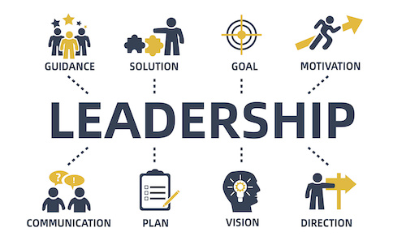
Index
Introduction
Leadership Styles and Their Impact
Cognitive Biases in Decision-Making
Leadership in the Digital Age
Cross-Cultural Leadership Challenges
Ethical Leadership and Corporate Responsibility
Future Trends in Leadership
Interactive Scenario and Reflection
Conclusion and Key Takeaways

Slide 3
Introduction
What is Leadership?
The ability to influence and inspire others toward a common goal.
Why Decision-Making Matters?
Leaders make critical choices that shape organizations' futures.
Key Themes:
Leadership styles, cognitive biases, digital age challenges.
Purpose:
Understand modern leadership through case studies and activities.

Slide 4
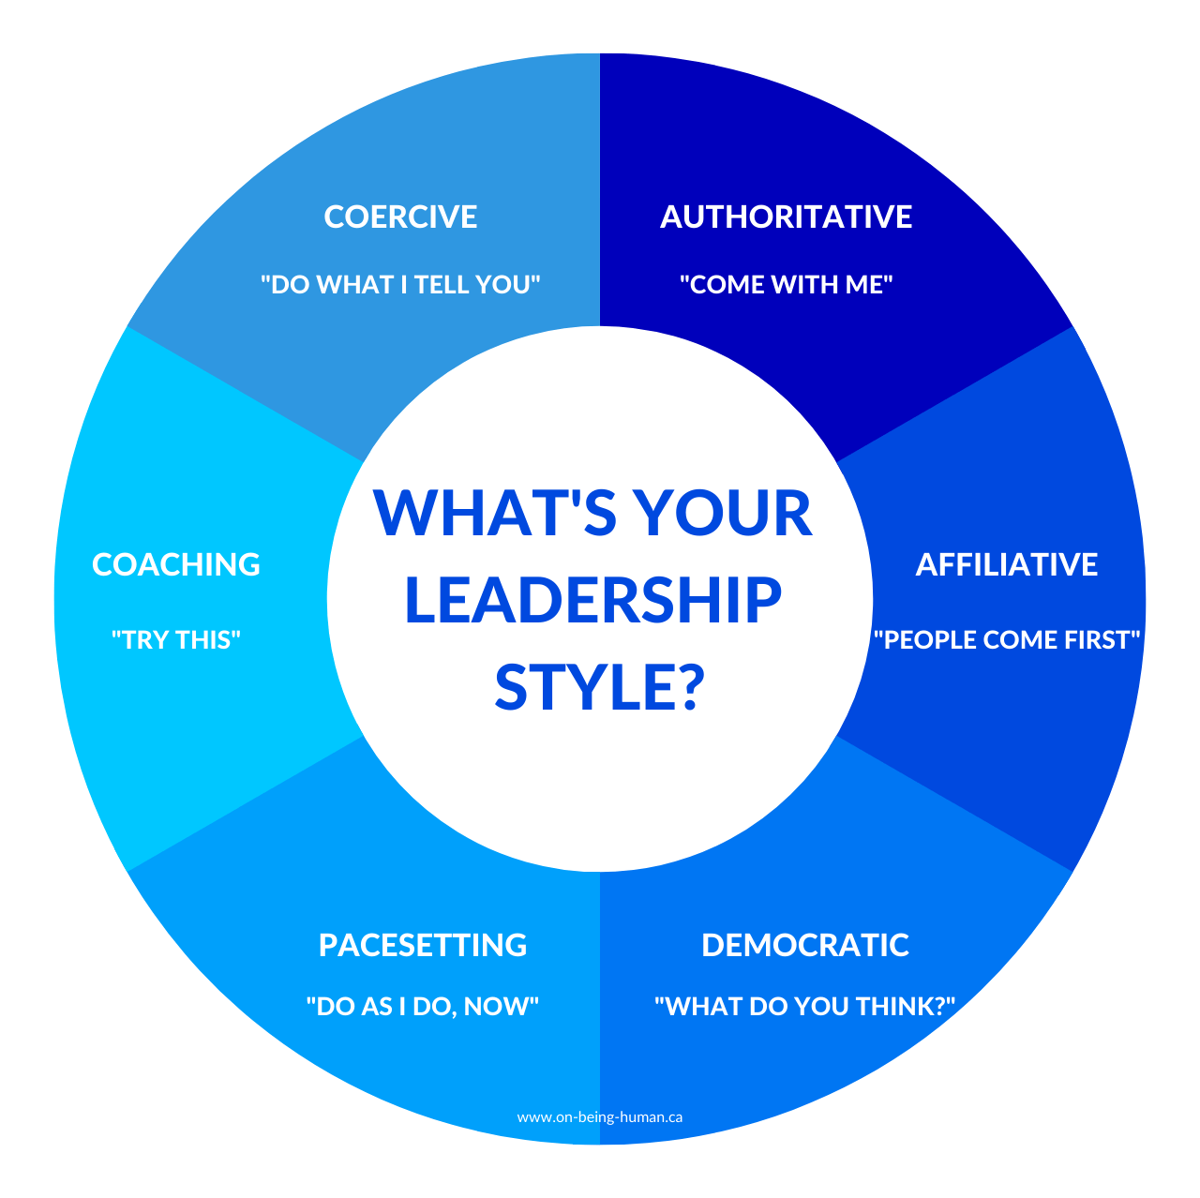
Leadership Styles
Transformational Leadership
Focuses on vision, inspiration, and change.
Transactional Leadership
Focus on structure, rewards, and performance.
Servant Leadership
Prioritizes the well-being and development of others.
Activity:
Reflect on your leadership style using a self-assessment.

Slide 5
Cognitive Biases in Decision-Making
Overconfidence Bias:
Leaders overestimate their ability.
Groupthink:
The tendency to conform to group decisions
Anchoring Bias:
Initial information heavily influences decisions.
Case Study:
Nokia's failure due to groupthink and overconfidence.

Slide 6

Leadership in the Digital Age
Digital Leadership:
Managing remote teams and using technology effectively.
AI in Decision-Making:
Using data analytics and AI for strategic choices.
Microsoft’s Remote Leadership:
Emphasis on trust and flexibility.

Slide 7
Cross-Cultural Leadership Challenges
Hofstede's Dimensions:
Cultural differences in power distance, individualism, etc.
Managing Diversity:
How to lead across different cultures effectively.
Case Study: Google’s leadership in a global workforce.

Slide 8
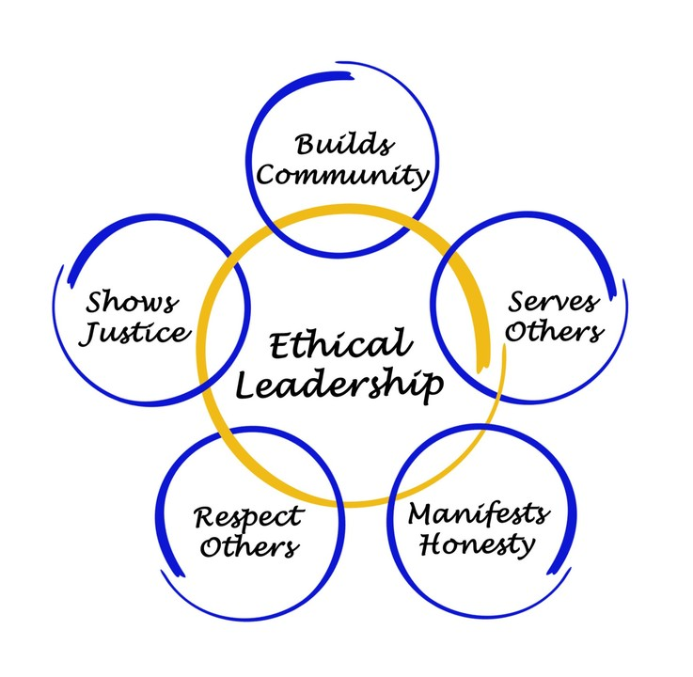
Ethical Leadership and Corporate Responsibility
Ethical Leadership:
Making decisions that balance profit with social responsibility.
Satya Nadella’s Approach:
Empathy-driven leadership at Microsoft.
Unethical Leadership:
Wells Fargo’s scandal and the cost of unethical behaviour.

Slide 9
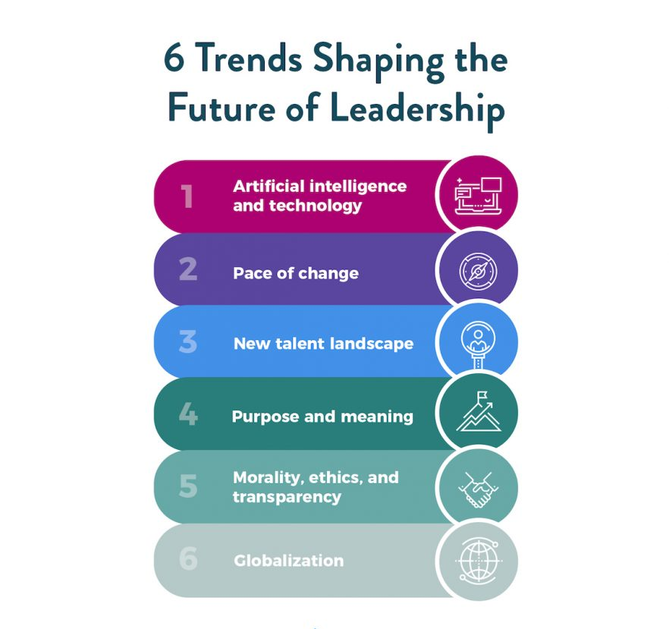
Future Trends in Leadership
Sustainability:
Leaders must integrate sustainability into their decisions.
AI & Big Data:
AI tools are shaping future leadership decisions.
Adaptive Leadership:
Ability to respond to rapidly changing environments

Slide 10
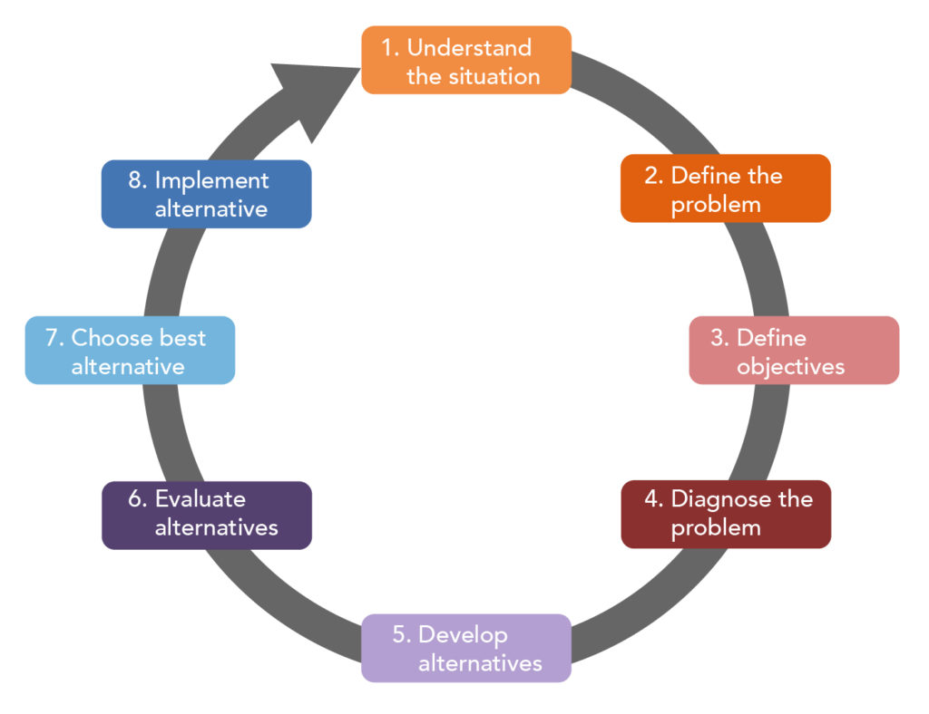
Interactive Scenario and Reflection
Scenario:
Leading a global crisis—balancing sustainability and profit.
Activity:
Groups present solutions to a crisis management challenge.

Slide 11
Conclusion and Key Takeaways
Summary:
Leadership is evolving with technology, ethics, and cultural awareness.
Key Skills:
Adaptability, strategic thinking, and empathy.
Final Thought:
Leadership in the future will require continuous adaptation and ethical decision-making.
Discussion:
What makes a great leader in today’s world?

Slide 12
Thank you
      European Institute of Innovation, Entrepreneurship and Technology
      Lessingstraße 79,
      13158 Berlin, Germany
      Phone: +49 176 55524449
      Email: info@eiiet.com
Discover the world of eiIET

