Slide 1
Operations Management in Hospitality
European Institute of Innovation, Entrepreneurship and Technology
Lessingstraße 79, 13158 Berlin, Germany
Mahmoud Abdou| Berlin
      Lessingstraße 79,
      13158 Berlin, Germany
      Phone: +49 30 233618555
      Fax: +49 30 233618556
      Email: info@eiiet.com

Slide 2

Index
- Components of Guest Experiences
- Product and Process
- People and Physical Evidence
- Place, Promotion and Price
- Designing Guest Experiences

Slide 3
1- Components of Guest Experiences
      1.1- Customer Experience Management
      - “The practice of designing and reacting to customer interactions to meet or exceed their expectations,
      leading to greater customer satisfaction, loyalty, and advocacy”.
      Hospitality Services:
      - Packaged goods: experience = purchase + use.
      - Hospitality: experience is complex and changing.
      - Experiences involve multiple senses and dimensions.
      - Service is a journey, not a single product.

Slide 4
1- Components of Guest Experiences
      - Framework needed to evaluate hospitality experiences.
      - Seven Ps framework helps evaluate and design service offerings.
Products
Process
People
Components of Guest Experiences
Physical Evidence
Place
Promotion
Price

Slide 5
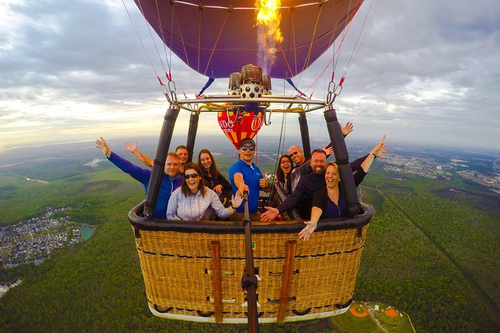
A- The Product

Slide 6
1- Components of Guest Experiences
      A- Product
      - In services, “product” refers to the outcomes of the guest experience
      - Includes tangible elements
      - Also includes intangible outcomes
      - Represents what the guest receives throughout the service journey
Products
Process
People
Components of Guest Experiences
Physical Evidence
Place
Promotion
Price

Slide 7
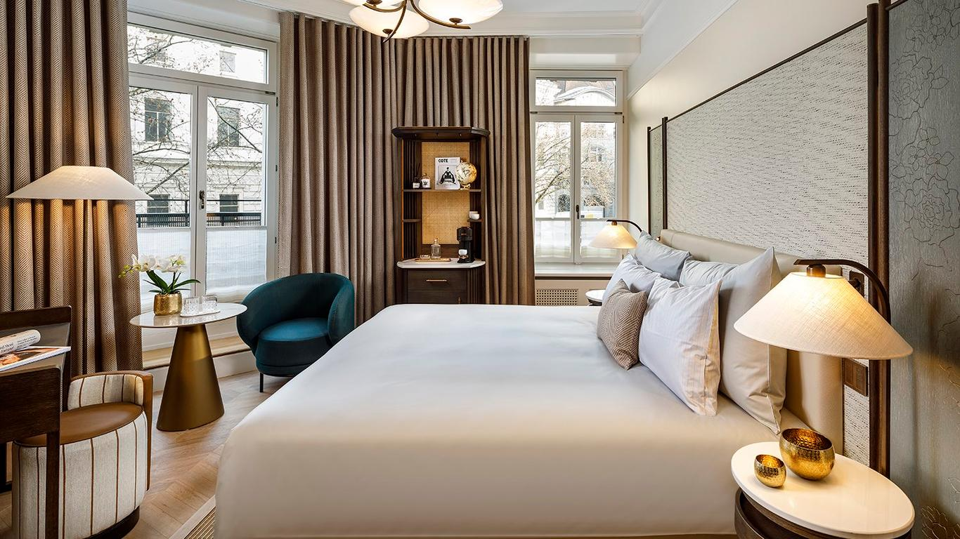

1- Components of Guest Experiences
      A- Product
      Service Outcomes in Hospitality
      - Hospitality “products” are experiential outcomes that affect
      the guest physically and emotionally.
      Examples:
      Positive:
      - Rest from a hotel stay, energy from a meal, relaxation from a spa treatment
      Negative:
      - Discomfort, illness, or pain from poor service delivery
      - Businesses must consider physiological effects on guests

Slide 8
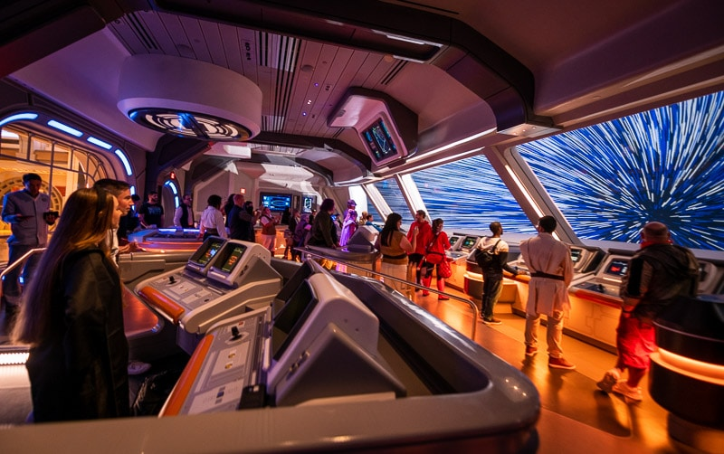
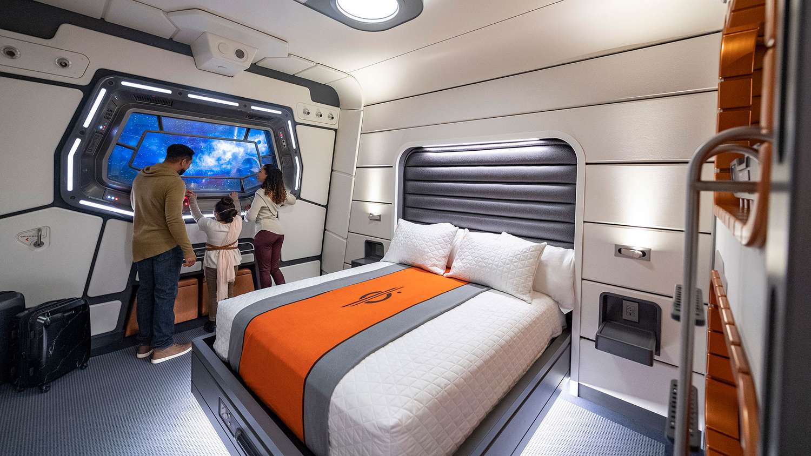
1- Components of Guest Experiences
      A- Product
      Psychological Transformations in Guest Experiences
      - Hospitality experiences create emotional and psychological effects
      - Guests may gain:
      Education: Learning and knowledge development
      Escapism: Immersive experiences that transport guests:
      Example:
      Galactic Starcruiser, Disney World

Slide 9
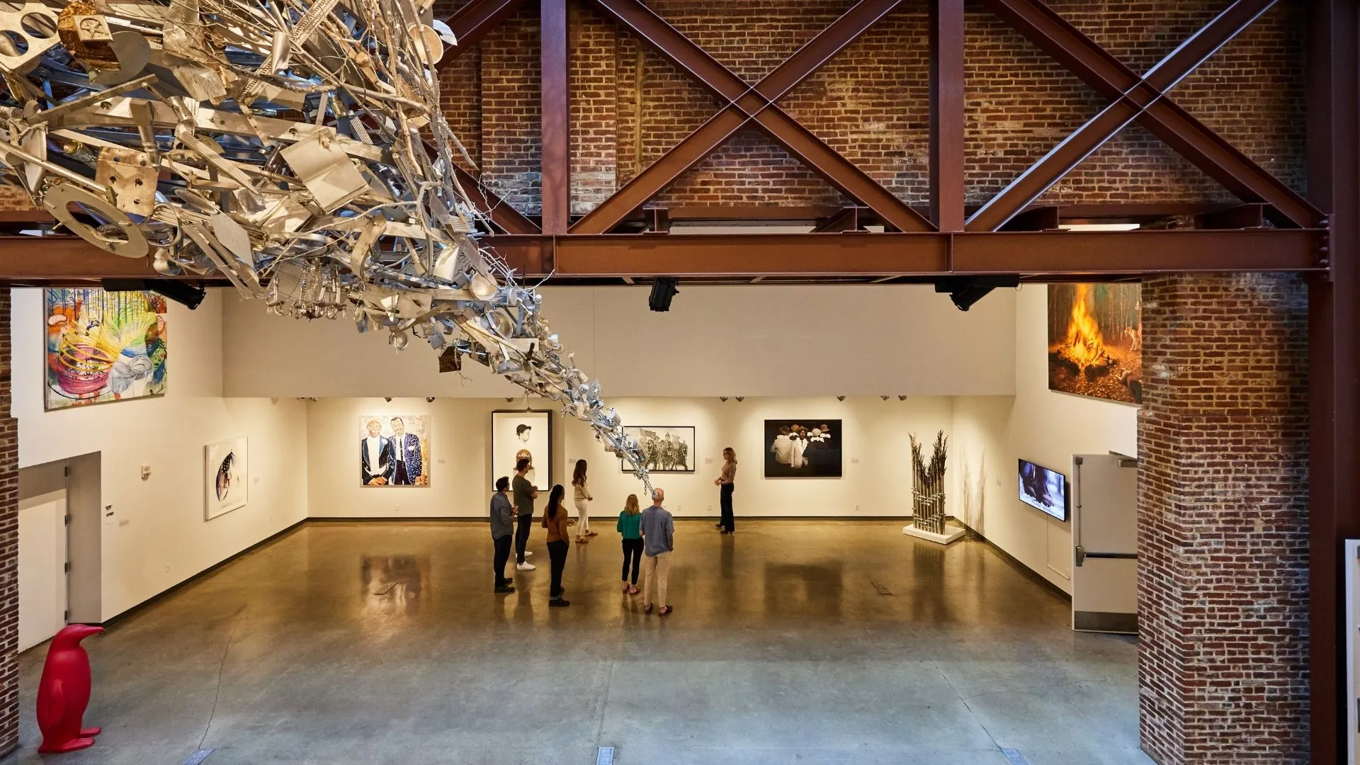
1- Components of Guest Experiences
      A- Product
      Psychological Transformations in Guest Experiences
      - Entertainment: Amusement and engagement
      - Esthetic: Emotional or artistic stimulation
      Example: 21c Museum Hotels
      Combines lodging with contemporary art.
      Guests view curated art in a stylish hotel.
      Blends stay with cultural and artistic experiences.

Slide 10
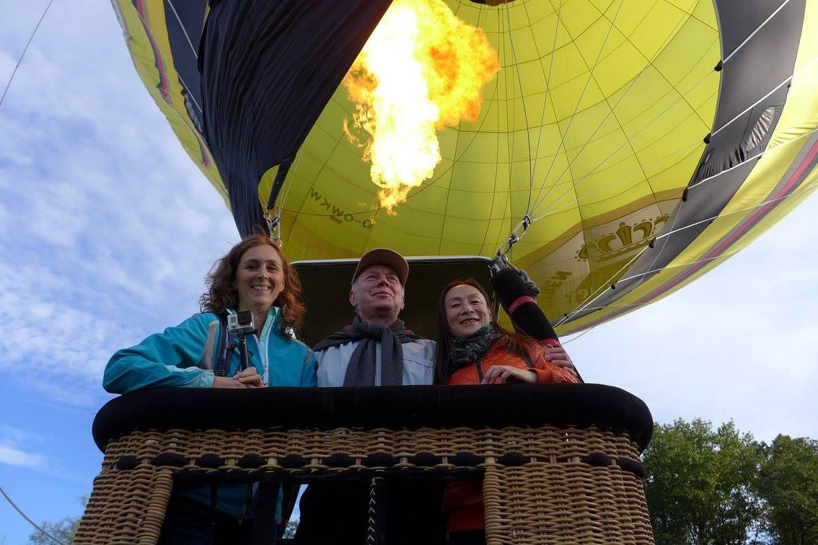
1- Components of Guest Experiences
      A- Product
      Example:
      - A tourist books a hot air balloon ride.
      - The product is the ride itself
      The thrill, the view, and the unique experience.
      - Guests expect safety, excitement, and memorable scenery

Slide 11

B- The Process

Slide 12
1- Components of Guest Experiences
      B- Process
      Customer Journey made up of 5 stages:
      - Guest recognizes a need
      - Guest identifies possible service options
      - Guest evaluates the alternatives
      - Guest selects a preferred option
      - Guest experiences the service and need is fulfilled
Products
Process
People
Components of Guest Experiences
Physical Evidence
Place
Promotion
Price

Slide 13
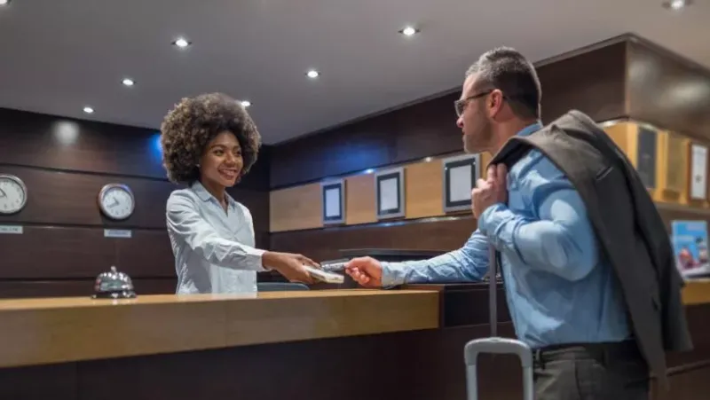
1- Components of Guest Experiences
      B- Process
      Quality services should provide:
      - Reliability
      - Responsiveness and empathy
      - Appropriate tangibles:
      Facilities, equipment, environment

Slide 14
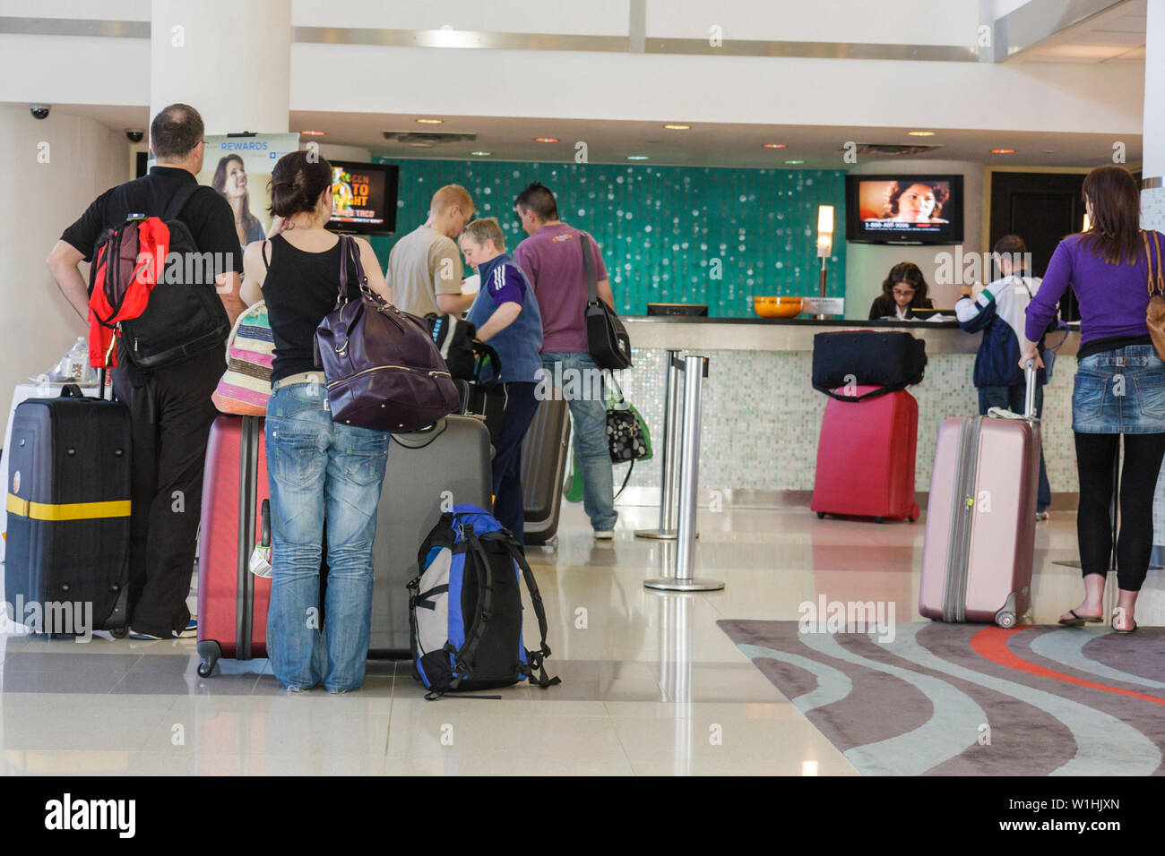
1- Components of Guest Experiences
      B- Process
      Operational efficiency:
      - Capacity analysis helps optimize service flow
      Key concepts:
      - are important for understanding how service processes work
      Include:
      - Throughput time: Total time to complete service
      - Throughput rate: Number of customers served per unit time
      - Bottleneck: Step with the lowest capacity limiting output

Slide 15
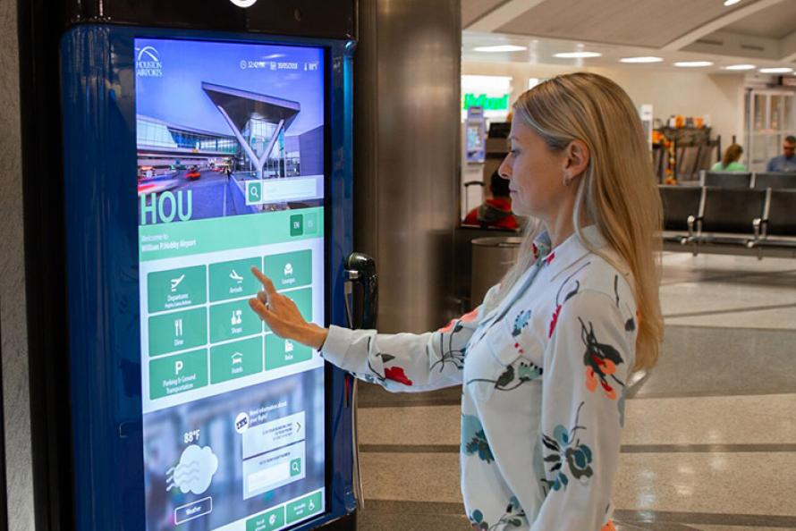
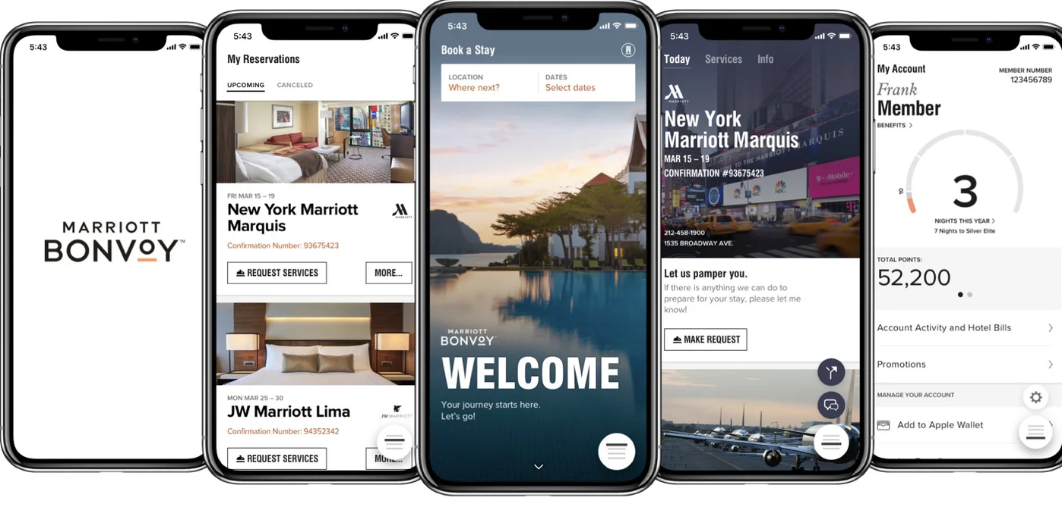
1- Components of Guest Experiences
      B- Process
      Technology’s role:
      - Automation reduces costs and waiting times
      - Examples:
      Self-check-in kiosks, mobile apps, keyless entry
      - In restaurants:
      Ordering kiosks, tabletop payment systems

Slide 16
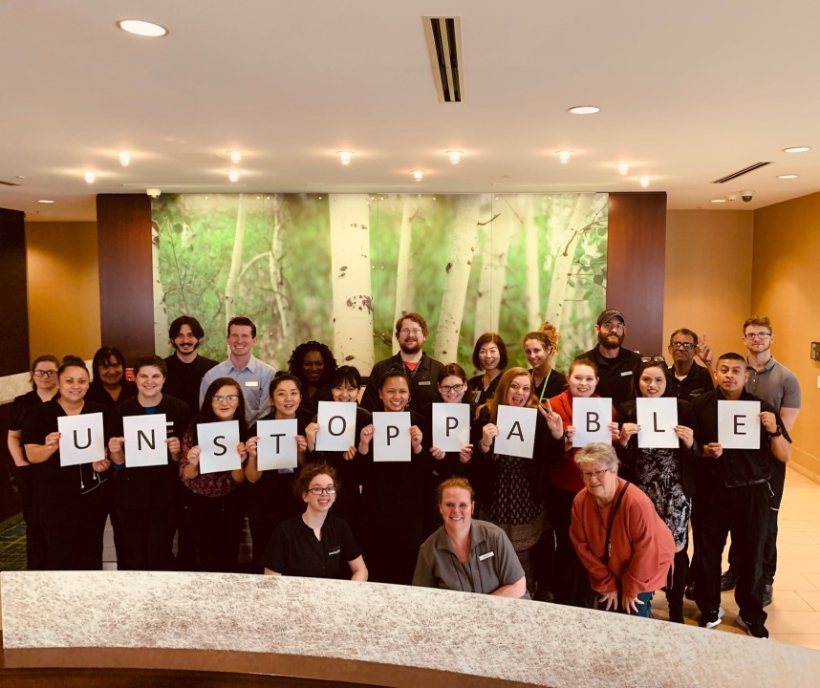
C- People

Slide 17
1- Components of Guest Experiences
      C- People
      - Hospitality is a human-centered business
      - Defined by interactions between guests and service professionals
Products
Process
People
Components of Guest Experiences
Physical Evidence
Place
Promotion
Price

Slide 18
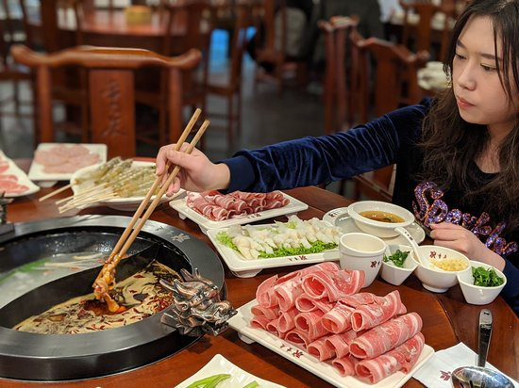
1- Components of Guest Experiences
      C- People
      - Guests and service organizations co-create experiences
      - Some restaurants handle full food preparation, others engage guests in cooking
      - Chinese hotpot / Japanese yakiniku – guests cook at their tables
      - Benefits:
      Engages guests, reduces employee workload
      - Limitations:
      Not suitable for all types of businesses

Slide 19
1- Components of Guest Experiences
      C- People
      Cultural Considerations
      - Guest socioeconomic, ethnic, and linguistic backgrounds
      should guide service design
      - Respect local cultural norms
      - Regionalize offerings to match local preferences and supply chains
      Purpose:
      - Show respect and ensure services meet guest needs

Slide 20
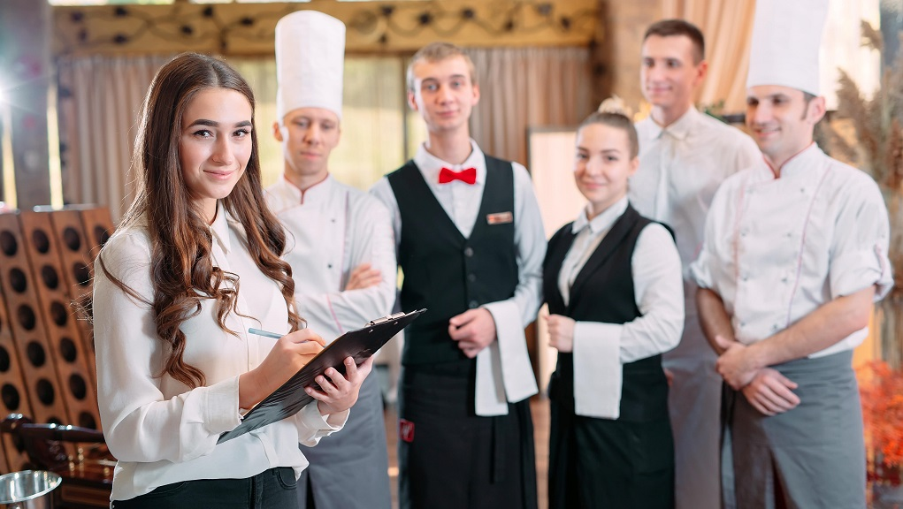
1- Components of Guest Experiences
      C- People
      Employees:
      - Key to delivering quality service experiences
      - Hiring and training skilled staff is vital
      - A strong service culture enhances guest satisfaction
      Employee empowerment enables:
      - Problem-solving
      - Exceeding guest expectations
      - Creating memorable experiences

Slide 21
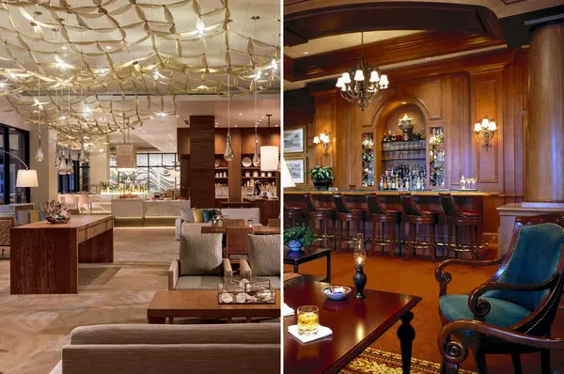
D- The Physical Evidence

Slide 22
1- Components of Guest Experiences
      D- Physical Evidence:
      - Physical evidence supports service delivery
      - Furniture and fixtures create mood and atmosphere
      - Equipment enables service
Products
Process
People
Components of Guest Experiences
Physical Evidence
Place
Promotion
Price

Slide 23
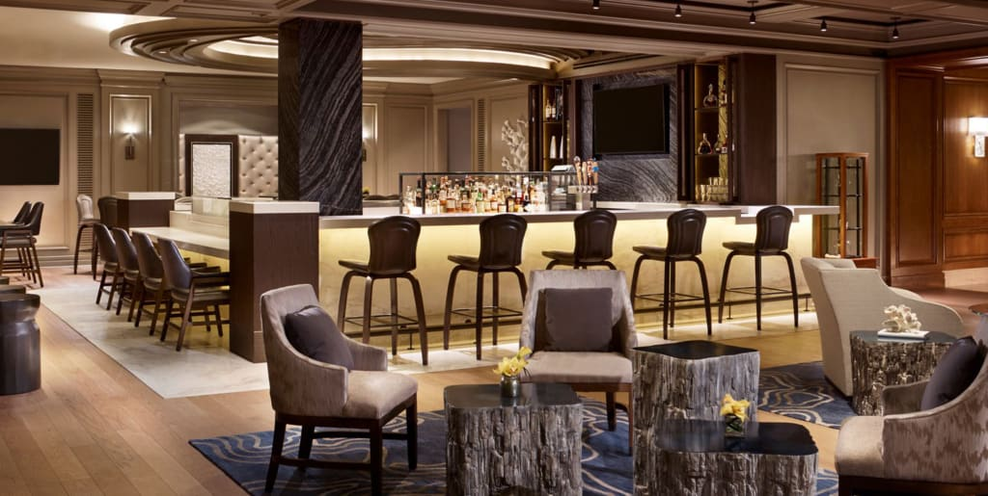
1- Components of Guest Experiences
      D- Physical Evidence:
      - Furniture and Fixtures
      - Chairs, tables, counters, lamps, décor
      - Create mood and atmosphere
      - Enhance comfort and guest experience
      Equipment
      - Tools and devices for service
      - Enable efficient service delivery

Slide 24
1- Components of Guest Experiences
      D- Physical Evidence :
      - Operating Supplies and Equipment
      - Tangible items used in the delivery of a service.
      - It includes Props and Artifacts
Products
Process
People
Components of Guest Experiences
Physical Evidence
Place
Promotion
Price

Slide 25
1- Components of Guest Experiences
      D- Physical Evidence :
      A- Props
      - Items used by guests or employees during the service.
      - Facilitate service delivery and reinforce branding or theming.
      Examples:
Products
Process
People
Components of Guest Experiences
Physical Evidence
Place
Promotion
Price
Guest-use items | Thematic/branding items
Staff items | Operational items

Slide 26
1- Components of Guest Experiences
      D- Physical Evidence:
      B- Artifacts
      -Tangible items remaining after the service has been delivered.
      - Serve as proof of service, create lasting impressions, and reinforce branding.
      It includes:
Products
Process
People
Components of Guest Experiences
Physical Evidence
Place
Promotion
Price
Receipts | Branded pens or matchboxes
Souvenirs or memorabilia sold by the company | Takeaway food

Slide 27
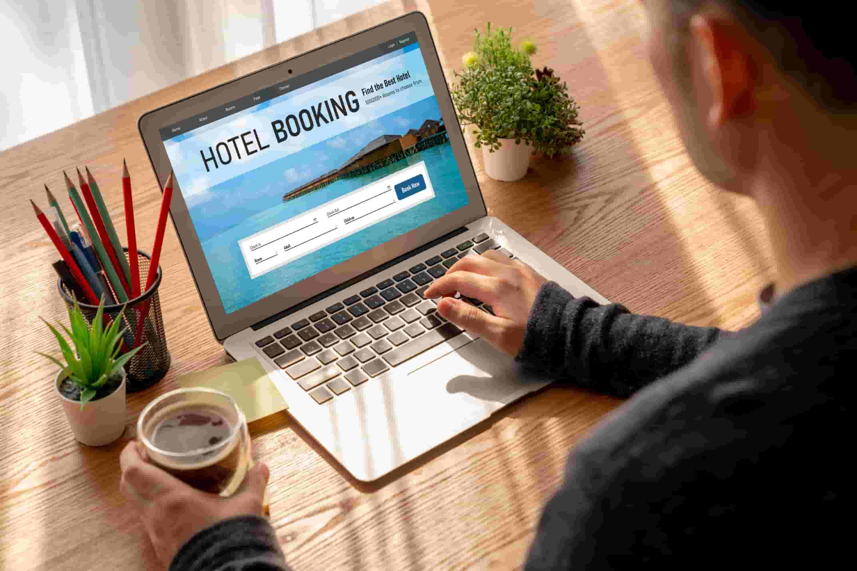
E- The Place

Slide 28
1- Components of Guest Experiences
      E- Place
      - Refers to where services are delivered and how guests access or arrange them
      A- Physical Environment
      - Servicescape:
      Basic environment where services occur, shaping guest perceptions.
      - Worldbuilding:
      In theme parks, it becomes worldbuilding
      Examples:
      Harry Potter World, Star Wars: Galaxy’s Edge.
Products
Process
People
Components of Guest Experiences
Physical Evidence
Place
Promotion
Price

Slide 29

1- Components of Guest Experiences
      B- Channel Placement
      - Channels through which guests research, book, or initiate services.
      Booking options:
      Dimensions of channels:
Direct booking | Third-party booking
Walk-in reservations

Slide 30

F- Promotion

Slide 31
1- Components of Guest Experiences
      F- Promotion
      - It refers to how service experiences are communicated
      and advertised to potential guests.
      - Role of Promotion
      - Communicates service offerings and brand identity
      - Shapes guest expectations before the experience
Products
Process
People
Components of Guest Experiences
Physical Evidence
Place
Promotion
Price

Slide 32
1- Components of Guest Experiences
      A- Setting and Managing Guest Expectations
      - Promotions influence what guests expect regarding
      service quality and value.
      Expectation outcomes:
      - Guest satisfaction
      - Guest dissatisfaction
Products
Process
People
Components of Guest Experiences
Physical Evidence
Place
Promotion
Price

Slide 33
1- Components of Guest Experiences
      A- Setting and Managing Guest Expectations
      Business implication:
      - Advertising should accurately reflect the service.
      - Marketing campaigns should align guest expectations
      with the actual experience
Products
Process
People
Components of Guest Experiences
Physical Evidence
Place
Promotion
Price

Slide 34


1- Components of Guest Experiences
      B- Promotional Touchpoints Along the Customer Journey
      - Promotion also includes direct interactions with
      guests before the service.
      Examples of touchpoints:
      - Direct marketing: email, text messages, sales representatives.
      - Partnerships and collaborations with other brands.
      Purpose:
      - Ensure communication matches the brand’s tone and concept.
      - Help guests evaluate and anticipate the service appropriately.

Slide 35

G- Price

Slide 36
1- Components of Guest Experiences
      G- Price
      - Price is the amount guests pay for a service.
      - It shapes their experience, expectations, and sense of value.
      A- Role of Price in Guest Experience
      - Price affects how guests judge value and quality.
      - It shapes expectations and satisfaction.
      - When guests pay influences their experience.
      - What is included or excluded also impacts perception.
Products
Process
People
Components of Guest Experiences
Physical Evidence
Place
Promotion
Price

Slide 37
1- Components of Guest Experiences
      B- Pricing Considerations
      Timing of payment:
      - Guests may pay in advance, during, or after the service.
      Inclusions and exclusions:
      - Some items are free, others cost extra
      - These choices affect how fair and valuable the service feels.
Products
Process
People
Components of Guest Experiences
Physical Evidence
Place
Promotion
Price

Slide 38

1- Components of Guest Experiences
      C- Strategic Importance of Pricing
      - Price should fit the brand’s quality and market position.
      - Upselling and cross-selling must be timed carefully.
      - Fair and clear pricing builds trust and satisfaction.

Slide 39
      Discussion
      Choose a hotel or restaurant you are familiar with:
      For each part of its service (product, price, place, promotion, people, process, physical evidence),
      give examples of what guests experience.
      Then pick two parts and suggest how they could be improved.

Slide 40
Thank you
      European Institute of Innovation, Entrepreneurship and Technology
      Lessingstraße 79,
      13158 Berlin, Germany
      Phone: +49 176 55524449
      Email: info@eiiet.com
Discover the world of eiIET

