Slide 1
Culturally Inclusive Meal Plans for Eco-Tourism Destinations
Presenter- Ankit Tomar

Slide 2

Introduction
1. Importance of dietary meal plan in tourism.
2. Overview of eco-tourism and its growth.
3. Objective: As a Nutrition and food services consultant, to create culturally inclusive meal plan for three global destinations.

Slide 3
Eco-Tourism & Food Connection
Importance of meal planning in eco-tourism.
Role of dietary meal plan in culturally sensitive tourism.
Natural diet + Nature = Eco-tourism & Food connection.
Connection of both helps in economic benefits.
Provides environmental benefits.

Slide 4
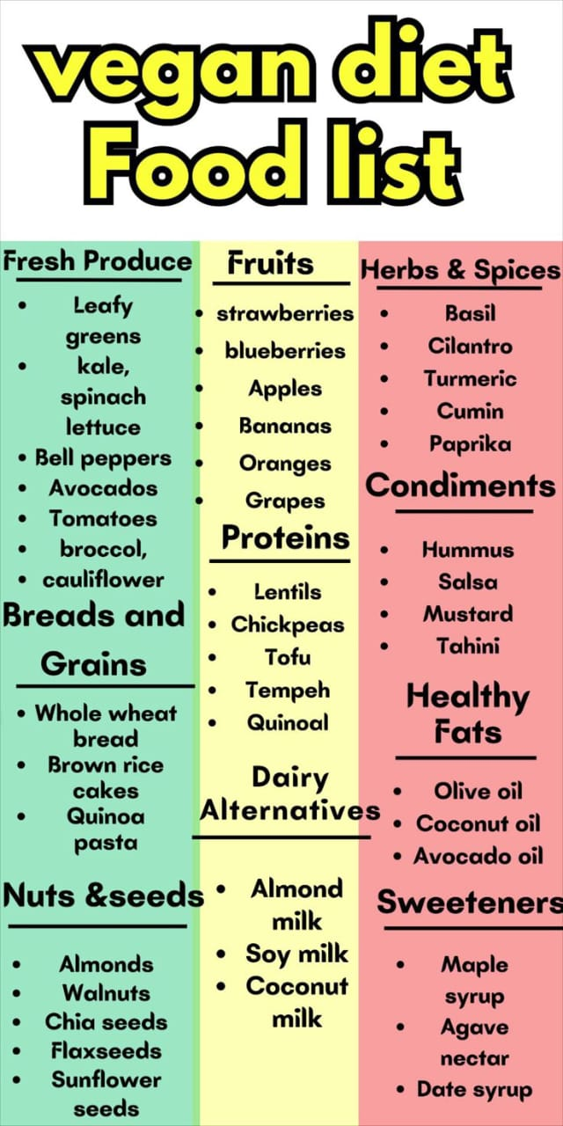
Key Dietary Needs
Vegan
Gluten-free
Diabetic
Religious Restrictions

Slide 5
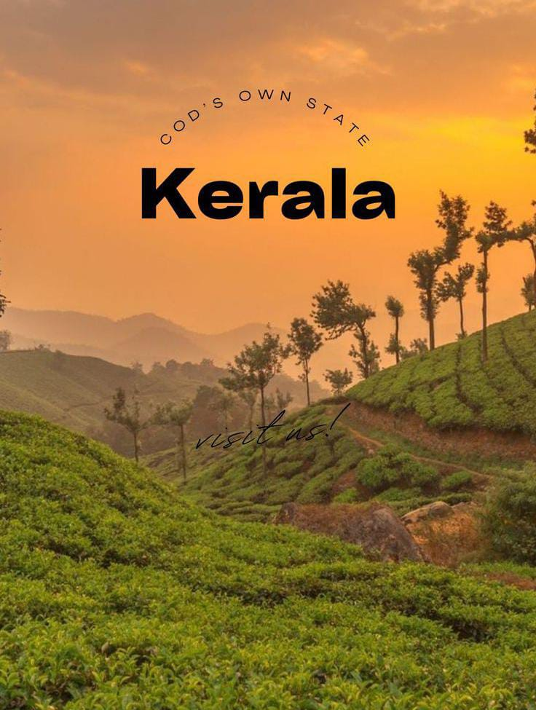
Destination 1- Kerala (India)
Dietary culture: Coconut, rice, vegetarian and Ayurvedic food.
Religious considerations ( no onion, garlic, non-veg),
for Jain preference.
Challenges : Sourcing gluten free grains and
monsoon impact on food.
Languages: Hindi, English, Malayalam

Slide 6

Destination 2- Black Forest Region (Germany)
Dietary culture: Bread, gluten, dairy and meat, sausages.
Religious Considerations are kosher or halal rarely available.
Challenges: Gluten free options, limited supply in this area,
high sugar consumption
Languages: English, German, Turkish.

Slide 7

Destination 3- Bali (Indonesia)
Dietary Culture: Vegan food, fruits and vegetables,
seafood.
Religious Considerations: Balinese Hindu restrict
the consumption of beef.
Challenges: Highly usage of sugar in sauces,
limited labelling.
Languages: English, Indonesia.

Slide 8
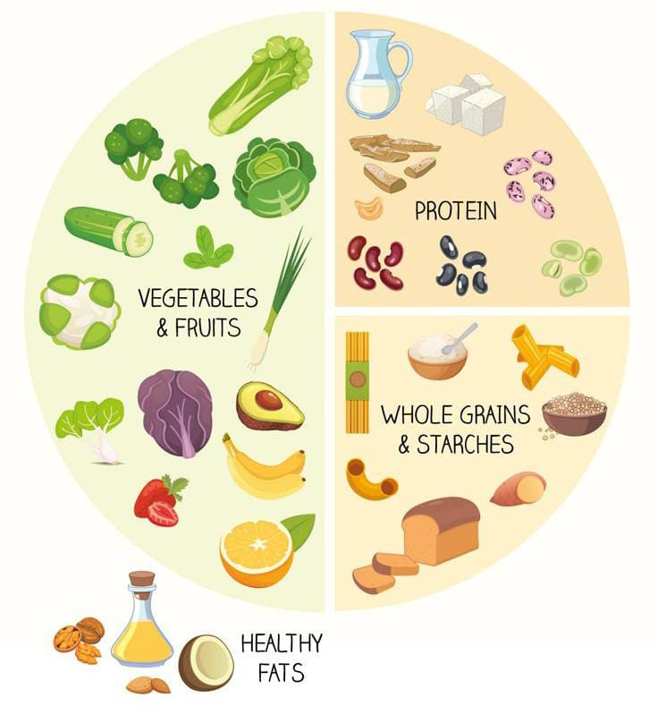
WHO Guidelines for Healthy Meals
Consume less amount of salt, sugar and unhealthy fats.
Maintain hygiene in every food practice.
Consume a fix amount of protein, fibre, fat, etc.
Eat fruits and vegetables by replacing the snacks.
Mostly consume boiled and steamed food
instead of fried food.

Slide 9
Guidelines for local Hospitality partners
Providing training to kitchen and service staff.
Responsibility of sourcing the raw material and ingredients.
Clear labelling and communication templates.
Understand relationship between cultural and dietary needs.

Slide 10
Real World Examples
Six Senses resorts: Offers plant-based menu.
Eco Hotels: Offers vegetarian and halal options as per tourist`s request. They are health conscious for tourists.
Inkaterra Hotels: They offer organic food, that`s cause the partnership with local farmers, and train their staff members to handle guests.

Slide 11
Conclusion
By integrating dietary meal plans into eco-tourism, we can create more sustainable travel experience for tourists.
Food is more than sustenance.
Local ingredients and culture can meet dietary standards without compromising anything.
Culturally inclusive meal planning enhances experience for travellers.

