Slide 1
Operations Management in Hospitality
European Institute of Innovation, Entrepreneurship and Technology
Lessingstraße 79, 13158 Berlin, Germany
Mahmoud Abdou| Berlin
      Lessingstraße 79,
      13158 Berlin, Germany
      Phone: +49 30 233618555
      Fax: +49 30 233618556
      Email: info@eiiet.com

Slide 2

Index
1. The role of revenue management in relationship
marketing
2. Lifetime Value and the Integration of CRM and
Revenue Management
3. Gamification, Engagement Economy, and CRM in
Hospitality
4. Ethical Issues in Hotel Revenue Management
5. Acceptable and Unacceptable Revenue
Management Practices

Slide 3

1- The Role of RevenueManagement in Relationship Marketing
Definition: - A strategic approach to selling the right product to the right customer at the right time for the right price through the right channel. Core Focus: Pricing optimization Inventory control Demand forecasting Short-term revenue maximization
What is Revenue Management?

Slide 4
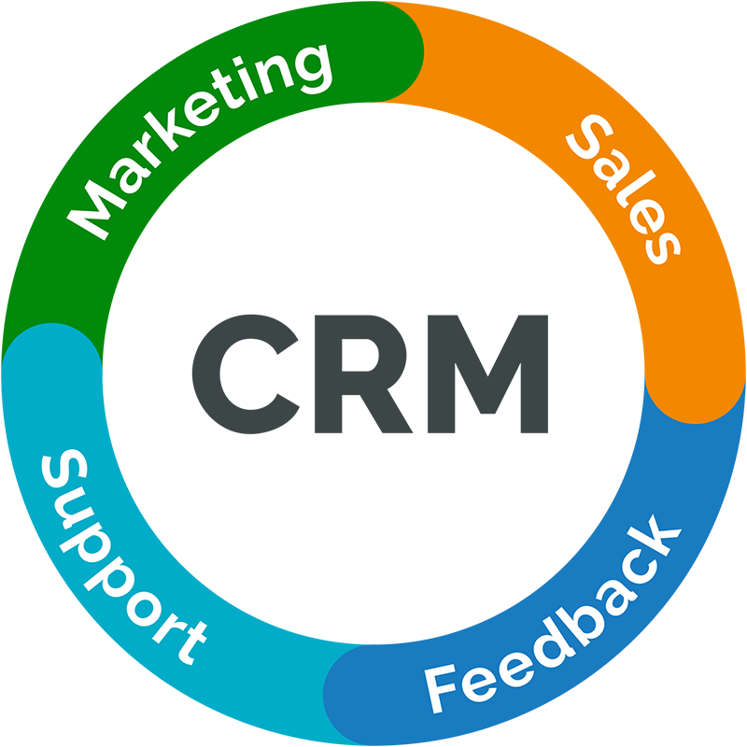
1- The Role of RevenueManagement in Relationship Marketing
Definition: - A strategy aimed at building and maintaining long-term, mutually beneficial relationships with customers. Core Focus: Customer retention Customer lifetime value Personalization Loyalty programs Long-term profitability
What is Customer Relationship Management (CRM)?

Slide 5
1- The Role of RevenueManagement in Relationship Marketing
Why RM and CRM Seem to Conflict RM increases prices when demand is high CRM emphasizes fairness and trust Dynamic pricing may frustrate loyal customers Short-term gains vs long-term loyalty
The conflict between RM and CRM

Slide 6
1- The Role of RevenueManagement in Relationship Marketing
It is believed that RM tools can: Reward loyal customers Segment customers by value Offer personalized pricing Prioritize high-value guests
Why RM and CRM Are Complementary

Slide 7
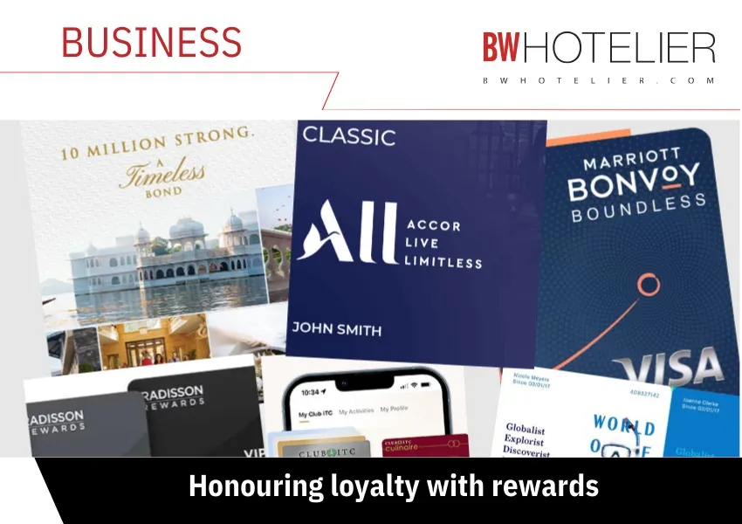
1- The Role of RevenueManagement in Relationship Marketing
Loyalty programs: Encourage repeat purchases Increase total spending Provide customer data for segmentation Support differential pricing strategies
Loyalty Programs as a Bridge Between RM and CRM

Slide 8
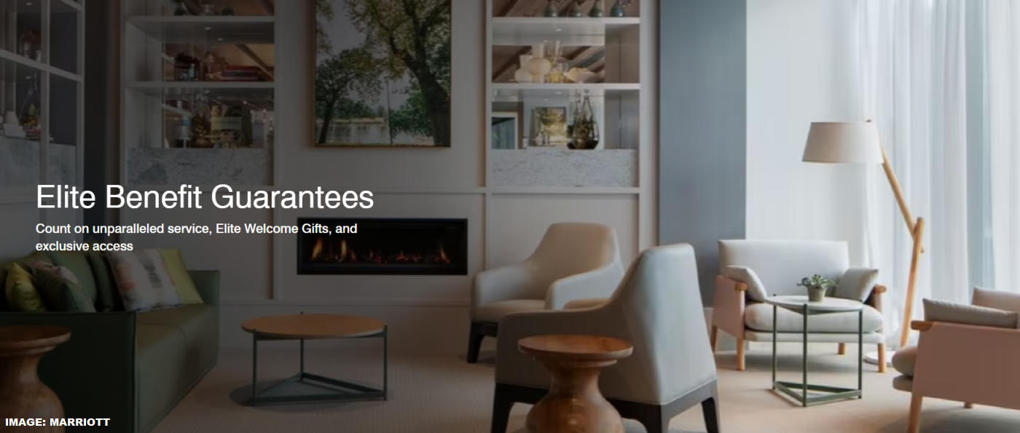
1- The Role of RevenueManagement in Relationship Marketing
Examples from major hotel chains: Marriott International – Member-exclusive rates Hilton Worldwide – Points, upgrades, flexible cancellation Revenue Logic: Loyal guests → higher lifetime value Higher spending per stay Reduced acquisition cost
Elite Member Benefits & Revenue Strategy

Slide 9
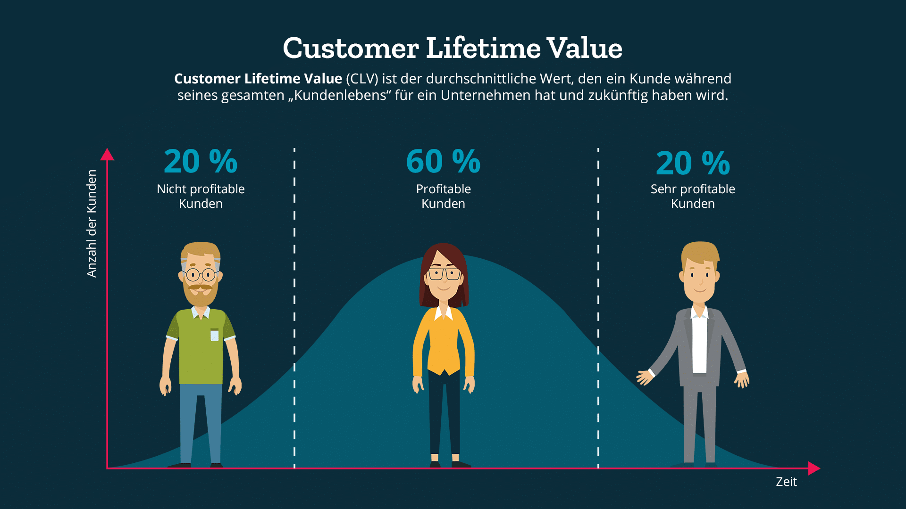
2- Lifetime Value and the Integration of CRM and Revenue Management
Definition: - Total net profit a company expects from a customer over the entire relationship. RM supports CLV by: Identifying high-value segments Protecting inventory for loyal guests Offering targeted promotions
Customer Lifetime Value (CLV)

Slide 10
2- Lifetime Value and the Integration of CRM and Revenue Management
- The relationship between hotel and guest extends over time Trust and loyalty are strengthened Repeat bookings become predictable Long-term customers = Stable revenue stream
Customer Lifetime Value (CLV)

Slide 11
2- Lifetime Value and the Integration of CRM and Revenue Management
Hotels can: Offer special member rates Guarantee room availability for elite members Provide early access to discounted inventory Use personalized dynamic pricing Key Idea: Price differentiation can reward loyalty instead of harming it.
Pricing & Loyalty Integration

Slide 12
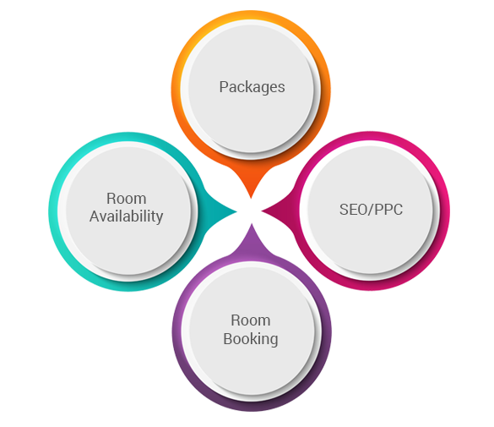
2- Lifetime Value and the Integration of CRM and Revenue Management
A- Increased purchase quantity More frequent stays Longer stays within the chain B- Increased prices of purchased products Upgrading to higher room categories Choosing premium room types
Drivers of Increasing Annual Profitability

Slide 13
2- Lifetime Value and the Integration of CRM and Revenue Management
C- Increased purchases of additional services Food & Beverage outlets Spa services Events and meetings D- Decreased operating costs Better knowledge of guest preferences Faster and more efficient service Lower marketing and acquisition costs
Drivers of Increasing Annual Profitability

Slide 14
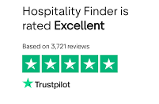
2- Lifetime Value and the Integration of CRM and Revenue Management
E- Word-of-Mouth and Indirect Revenue Effects - Satisfied customers attract new guests through: Reviews on Booking.com, Tripadvisor, Facebook, etc. Personal recommendations Impact: Reduced acquisition costs Increased brand credibility Expanded customer base
Drivers of Increasing Annual Profitability

Slide 15
2- Lifetime Value and the Integration of CRM and Revenue Management
CRM recognizes: Different customers generate different levels of profitability Some customers may have negative lifetime value Some segments are too costly to serve Strategic Implication: Hotels should prioritize profitable segments.
Targeting Positive Lifetime Value Segments

Slide 16
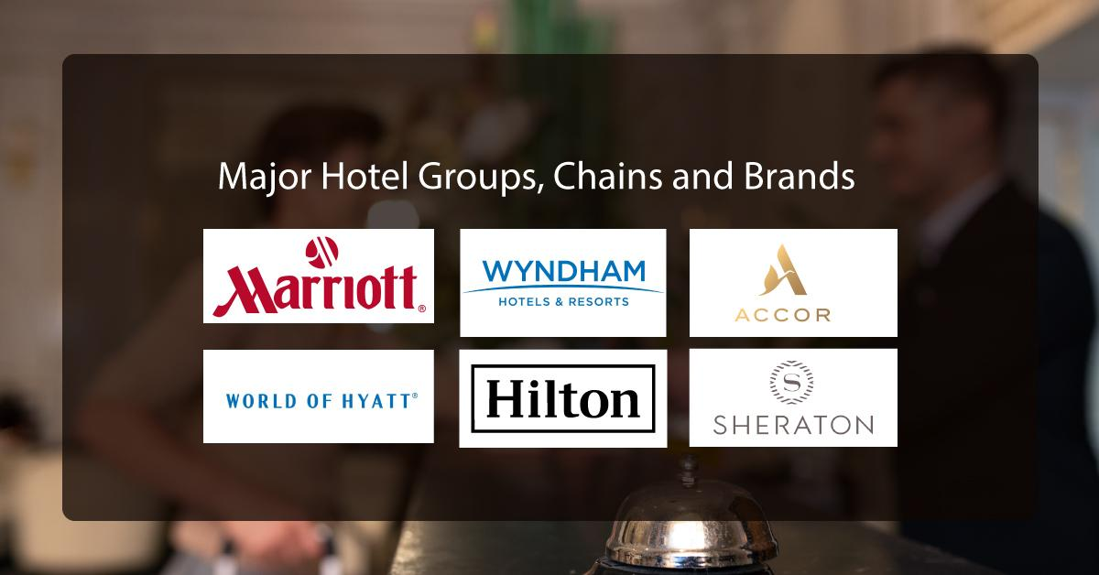
2- Lifetime Value and the Integration of CRM and Revenue Management
Hotel chains should: Identify high-value customer segments Avoid segments with negative lifetime value Use data analytics for segmentation Align pricing and service strategies accordingly
Targeting Positive Lifetime Value Segments

Slide 17
2- Lifetime Value and the Integration of CRM and Revenue Management
CRM: Focuses on long-term relationship building Identifies valuable customers Revenue Management (RM): Uses pricing and inventory tools Supports profitability optimization
The Connection Between CRM and Revenue Management

Slide 18
2- Lifetime Value and the Integration of CRM and Revenue Management
In recent years, CRM has evolved through: The concept of Gamification The concept of the Engagement Economy Shift in focus: From simple loyalty → to active customer engagement and emotional connection
Evolution of Customer Relationship Management (CRM)

Slide 19

3- Gamification, Engagement Economy and CRM in Hospitality
External gamification: Involves existing or prospective customers Improves relationships between businesses and customers Increases engagement and identification with the product Outcome: Stronger loyalty Higher revenues
What is Gamification?

Slide 20
3- Gamification, Engagement Economy and CRM in Hospitality
- In hospitality, gamification is mainly expressed through: Loyalty programs Points collection systems Membership levels (tiered status systems) Status-based rewards Customers are motivated by:
What is Gamification?
Progression | Achievement
Recognition | Exclusivity

Slide 21
3- Gamification, Engagement Economy and CRM in Hospitality
Typical features: Earning points per stay Advancing to higher membership levels Unlocking exclusive benefits Examples of rewards:
What is Gamification?
Free overnight stays | Complimentary services
Room upgrades | Free airline miles and flight tickets

Slide 22

3- Gamification, Engagement Economy and CRM in Hospitality
The Engagement Economy focuses on: Active participation rather than passive consumption Emotional connection with the brand Continuous interaction between company and customer Hotels use social media platforms to: Engage customers Build loyalty Promote competitions and quizzes Encourage user-generated content
The Engagement Economy

Slide 23
3- Gamification, Engagement Economy and CRM in Hospitality
- Hotels must maintain good relationships not only with customers, but also with: Online Travel Agencies (OTAs) Tour operators Travel agents Wholesalers Corporate booking partners - Distributors are strategic revenue partners.
Importance of Distributor Relationships

Slide 24
3- Gamification, Engagement Economy and CRM in Hospitality
- Distribution channel cannibalisation occurs when a hotel’s pricing strategy undermines its intermediaries. Key Cause: Opportunistic pricing behavior by the hotel. - The prices charged directly by the hotel act as a price ceiling for distributors. If: Hotel direct price is less than the distributor price Then: Distributors lose competitiveness Customers bypass intermediaries Trust deteriorates
What is Distribution Channel Cannibalisation?

Slide 25
3- Gamification, Engagement Economy and CRM in Hospitality
Consequences of Cannibalisation Stop promoting the hotel Reduce room allocations Prioritize competitor properties Terminate contracts Hotels must balance: Direct booking incentives Fair distributor pricing Contractual rate parity agreements
What is Distribution Channel Cannibalisation?

Slide 26
4- Ethical Issues in Hotel Revenue Management
Revenue Management (RM): Improves occupancy Maximizes revenue Enhances profitability However, it has received significant criticism regarding: Fairness Transparency Customer trust Ethical implications
Revenue Management: Benefits vs Criticism

Slide 27
4- Ethical Issues in Hotel Revenue Management
The two most controversial RM practices are: Price discrimination Overbooking These practices often trigger customer dissatisfaction. Customers may feel deceived when: They discover they paid more than other guests The same room is sold at different prices
Main Ethical Concerns:

Slide 28
4- Ethical Issues in Hotel Revenue Management
The two most controversial RM practices are: Price discrimination Overbooking These practices often trigger customer dissatisfaction. Customers may feel deceived when: They discover they paid more than other guests The same room is sold at different prices Impact: Reduced trust Lower satisfaction Negative word-of-mouth
Main Ethical Concerns:

Slide 29
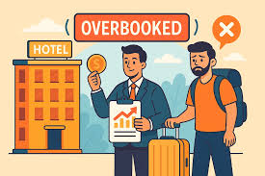
4- Ethical Issues in Hotel Revenue Management
Overbooking increases revenue but creates risk. - When guests are “walked” to another hotel: They feel disappointed They perceive breach of trust They question service reliability - Insufficient compensation worsens the situation.
Overbooking & Walking Guests:

Slide 30
4- Ethical Issues in Hotel Revenue Management
- Customer perception of fairness is influenced by: Transparency of pricing Clarity of rate fences Explanation of price differences Clear cancellation and amendment terms Fair compensation policies - Lack of information = Perceived injustice.
Fairness Perception in RM

Slide 31
4- Ethical Issues in Hotel Revenue Management
- Rate fences are acceptable when: They are clear They are understandable Customers perceive them as logical - Examples of acceptable fences: Advance purchase discounts Non-refundable vs flexible rates Loyalty program rates
Fairness Perception in RM

Slide 32
5- Acceptable and Unacceptable Revenue Management Practices
Customers generally consider the following practices acceptable: A- Full Transparency Providing complete information about: Prices Booking conditions Cancellation terms Hiding information destroys trust
4.1- Acceptable Revenue Management Practices

Slide 33
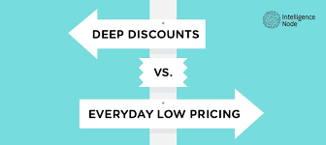
5- Acceptable and Unacceptable Revenue Management Practices
B- Deep Discounts for Stricter Conditions - Customers accept: - Lower rates - In exchange for: Non-refundable bookings Stricter cancellation policies Limited flexibility
4.1- Acceptable Revenue Management Practices

Slide 34
5- Acceptable and Unacceptable Revenue Management Practices
C- Price Differences for Perceived Differences - Customers accept different prices when: The product is clearly different The value proposition changes - Examples: Weekend vs weekday prices Flexible vs non-refundable rates Standard room vs deluxe room
4.1- Acceptable Revenue Management Practices

Slide 35
5- Acceptable and Unacceptable Revenue Management Practices
Customers consider the following practices unfair: A- Insignificant Discounts with Strict Conditions Very small price reduction But strict cancellation or amendment penalties
4.2- Unacceptable Revenue Management Practices

Slide 36
5- Acceptable and Unacceptable Revenue Management Practices
B- Changing Booking Terms Without Informing the Customer - Examples: Modifying cancellation policies Introducing new fees Changing payment conditions - Impact: Perceived deception Trust erosion Negative word-of-mouth
4.2- Unacceptable Revenue Management Practices

Slide 37
Thank you
      European Institute of Innovation, Entrepreneurship and Technology
      Lessingstraße 79,
      13158 Berlin, Germany
      Phone: +49 176 55524449
      Email: info@eiiet.com
Discover the world of eiIET

