Slide 1
Research on Tourism Services
Mahmoud Abdou| Berlin
      Lessingstraße 79,
      13158 Berlin, Germany
      Phone: +49 30 233618555
      Fax: +49 30 233618556
      Email: info@eiiet.com

Slide 2
Index
- Distribution Channels in Tourism
- The Range of Tourism and Hospitality Intermediaries
- The Marketing Mix
-Tourism Products and Services Characteristics

Slide 3
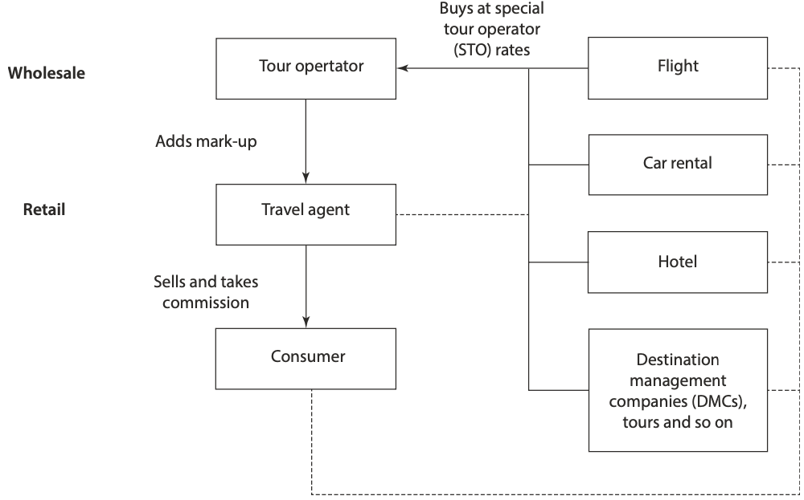
1- Distribution Channels in Tourism
    - Tourism products are intangible, meaning they cannot be physically transported like physical goods”.
    - Instead, tourism organizations must attract consumers through direct or indirect sales, utilizing various distribution channels.
    - These channels are unique because they
    influence travelers' itineraries, and
    consumers actively participate in
    the distribution process.

Slide 4
1- Distribution Channels in Tourism
    - Additionally, tourism providers typically pay commissions to intermediaries, such as travel agents,
    who connect them with customers.
    - This relationship can impact pricing,
    competitiveness, and profitability for
    tourism businesses
    - Intermediaries also play an important
    role in providing information and services
    to tourism consumers, often referred to
    as part of the "travel industry.

Slide 5
1- Distribution Channels in Tourism
    - Distribution is a key element in the traditional marketing mix, alongside product, price, and promotion.
    - It refers to the availability and delivery of products to consumers.
    - These channels are unique because they influence travelers' itineraries, and consumers actively participate in the distribution process
    - The term "distribution channels" (or "the chain of distribution") describes the system through which a product reaches the consumer.
    - In tourism, products are typically distributed through intermediaries, which may include wholesalers like tour operators who bundle services into packages, or retailers such as travel agents who sell these packages or individual offerings to consumers.

Slide 6
1- Distribution Channels in Tourism
    - Historically, the distribution process was more straightforward, but it was never as simple as it appeared.
    - Travel agents didn't always go through tour operators, and consumers could book directly with service providers like airlines, hotels, and car rental companies, although many preferred the convenience of using an agent.
    - Many tourism providers also opt to sell directly to consumers, bypassing intermediaries—a practice known as "disintermediation.”
    - Retailers, or agents, play a vital role in linking providers with consumers by facilitating the flow of information and offerings, ensuring a smooth distribution process.

Slide 7
1- Distribution Channels in Tourism
    1.1- Levels of Distribution in Tourism and Hospitality
    - Tourism products can be sold to consumers through various distribution channels, each offering different ways to access tourism products and information about services - Instead, tourism organizations must attract consumers through direct or indirect sales, utilizing various distribution channels.
    - A marketing channel refers to a chain of organizations involved in managing the processes and activities necessary to move products from suppliers to end consumers - Additionally, tourism providers typically pay commissions to intermediaries, such as travel agents, who connect them with customers.
    - These channels can range from simple one-level direct access to more complex multi-level arrangements involving multiple intermediaries.
    - Typically, the longer the distribution channel, the higher the cost of the tourism and hospitality offerings for consumers.

Slide 8
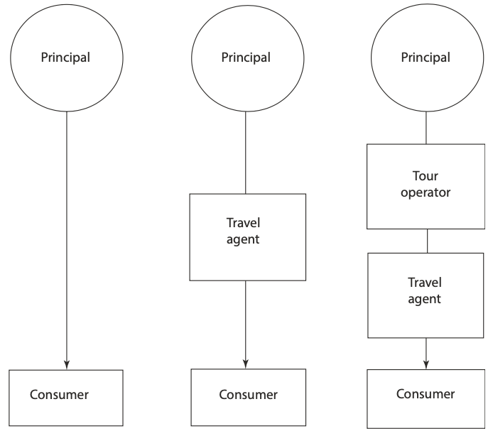
1- Distribution Channels in Tourism
    1.1- Levels of Distribution in Tourism and Hospitality
    - The simplest form of distribution is direct sales to the consumer, where there is a single-level channel. For example, a hotel might sell a room directly to the person who
    will stay in it.
    - Similarly, a tour operator or principal might sell directly to
    the consumer. However, this approach requires staff to
    process and manage the bookings.
    ..

Slide 9
1- Distribution Channels in Tourism
    1.1- Levels of Distribution in Tourism and Hospitality
    - The second form of distribution is indirect, involving longer, multi-level channels, known as a “multi-channel distribution system.”
    - In this system, a tourism organization sets up two or more
    marketing channels to reach one or more consumer segments.
    - For instance, a tourism provider, such as a hotel, resort,
    airline, or cruise company, may choose to sell through
    intermediaries like travel agents or tour operators.
    Tour operators sometimes use travel agents as intermediaries.

Slide 10
1- Distribution Channels in Tourism
    1.1- Levels of Distribution in Tourism and Hospitality
    - A common example is when tour operators work with hoteliers and airlines to buy accommodation and airline seats, then package these into holiday offers.
    - Travel agents then sell these packages for a commission from the tour operator, with the tour operator acting as a wholesaler and the travel agent as a retailer.
    - The number and type of links in the distribution chain vary based on the tourism offering, the customer type, and the tourism organization.
    - Smaller businesses might sell directly or through one intermediary, targeting one type of customer.
    - In contrast, larger tourism organizations or multinational corporations (MNCs) often have more complex distribution strategies, using various methods to target different market segments.
    - As a result, the distinctions between different levels in the travel industry are becoming less defined, with larger companies increasingly controlling every link in the supply chain

Slide 11
1- Distribution Channels in Tourism
    1.2- Intermediaries in Tourism
    - An intermediary in tourism refers to any business or person in the distribution chain who acts as a link between the tourism supplier or principal and the consumer.
    - These intermediaries play a vital role in the tourism industry, with travel agents, tour operators, wholesalers, and online travel agents (OTAs) being some of the most well-known.
    - They connect tourists with suppliers such as airlines, hotels, car hire companies, and destination management companies (DMCs)- Additionally, tourism providers typically pay commissions to intermediaries, such as travel agents, who connect them with customers.
    - While consumers are increasingly planning and booking their trips independently, intermediaries remain essential in reaching a wide audience, especially for international and long-haul markets

Slide 12
1- Distribution Channels in Tourism
    1.2- Intermediaries in Tourism
    - They also help to promote new destinations and encourage tourists to spend more time exploring what a destination has to offer.
    - Both tourism suppliers and consumers now have multiple options for distribution methods, including travel agencies, call centers, sales representatives, and even supermarkets
    - Distribution channels significantly impact consumer behavior and affect the tourism industry's ability to meet consumer demands efficiently.

Slide 13
1- Distribution Channels in Tourism
    1.2- Intermediaries in Tourism
    - In tourism, intermediation can be complex, as suppliers and intermediaries sometimes switch roles within the distribution chain.
    - Similarly, airlines may encourage consumers to book flights online while also offering third-party services such as car rentals and hotel bookings.

Slide 14
2- The Range of Tourism and Hospitality Intermediaries
    - There is a diverse range of intermediaries in the tourism and hospitality sector, acting between suppliers and consumers at various levels of the distribution system.
    - These intermediaries can be categorized into indirect and direct channels, each with distinct characteristics.
    2.1- Indirect Intermediaries
    There are a number of indirect marketing channels or intermediaries in tourism. These intermediaries are usually referred to as the travel trade (or travel industry).

Slide 15
2- The Range of Tourism and Hospitality Intermediaries
    2.1- Indirect Intermediaries
    2.1.1. Tour Operators
    - The main role of a tour operator is to combine the key elements of a holiday, such as transport, accommodation, and additional services, into a single product or package, which is then sold to consumers through travel agents, airline sales offices, or other intermediaries.
    - For many tourism providers, particularly those with limited resources, tour operators have served as the primary channel to reach international markets, although the rise of the internet has shifted this dynamic.
    - The tour operating business remains an important and competitive sector in the tourism industry, marked by expansion, mergers, and acquisitions.

Slide 16
2- The Range of Tourism and Hospitality Intermediaries
    2.1- Indirect Intermediaries
    2.1.1. Tour Operators
    - In the distribution chain, tour operators act as
    wholesalers (or middlemen) in the tourism industry.
    - They purchase tourism products in bulk from
    principals, such as airlines, hotels, and car rental
    companies, and then resell these products through
    retail travel agencies.
Tour Operators
outbound tour operators
specialist tour operators
retail travel agents
online travel agents
domestic tour operators
destination management companies
franchises

Slide 17
2- The Range of Tourism and Hospitality Intermediaries
    2.1- Indirect Intermediaries
    2.1.1. Tour Operators
    - Tour operators take on the wholesaler role by buying various tourism offerings, like airline seats or hotel bed spaces, in bulk and selling them either to travel agents or directly to tourists.
    - There are different types of tour operators including
    domestic tour operators, outbound tour
    operators, specialist tour operators, destination
    management companies, retail travel agents,
    online travel agents, and franchises.
Tour Operators
outbound tour operators
specialist tour operators
retail travel agents
online travel agents
domestic tour operators
destination management companies
franchises

Slide 18
2- The Range of Tourism and Hospitality Intermediaries
    2.1- Indirect Intermediaries
    2.1.1. Tour Operators
    Domestic tour operators
    - Domestic tour operators, who organize package holidays and tours within a specific country, make up a smaller part of the tourism industry compared to those organizing international tours.
    - This is because, nowadays, it is relatively easy for tourists to arrange their travel plans within their own home country
Tour Operators
outbound tour operators
specialist tour operators
retail travel agents
online travel agents
domestic tour operators
destination management companies
franchises

Slide 19
2- The Range of Tourism and Hospitality Intermediaries
    2.1- Indirect Intermediaries
    2.1.1. Tour Operators
    Outbound Tour Operators (OTOs)
    - Outbound tour operators specialize in offering holidays abroad.
    - They sell package tours to individuals or groups from their own country, sending them to one or more foreign destinations for a specific period.
Tour Operators
outbound tour operators
specialist tour operators
retail travel agents
online travel agents
domestic tour operators
destination management companies
franchises

Slide 20
2- The Range of Tourism and Hospitality Intermediaries
    2.1- Indirect Intermediaries
    2.1.1. Tour Operators
    Outbound Tour Operators (OTOs)
    - OTOs handle travel documents, transportation to the tour’s starting point, and coordinate with inbound tour operators or destination management companies (DMCs) and ground handlers to provide accommodations, transportation, local sightseeing, and additional services as required during the tour.
    - Typically, OTOs collaborate with inbound operators and ground handlers to meet tour groups at the airport, transfer them to accommodations, and arrange local sightseeing tours,
    which can range from single-day to multi-day excursions.
    - These tours can be tailored for both business and leisure purposes.
Tour Operators
outbound tour operators
specialist tour operators
retail travel agents
online travel agents
domestic tour operators
destination management companies
franchises

Slide 21
2- The Range of Tourism and Hospitality Intermediaries
    2.1- Indirect Intermediaries
    2.1.1. Tour Operators
    Inbound tour operators (ITOs)
    - Inbound tour operators specialize in managing incoming foreign or overseas tourists and play a different role compared to outbound operators.
    - Some ITOs function as ground-handling agents, responsible for organizing hotel accommodations on behalf of overseas tour operators.
    - Others offer a comprehensive range of services, such as arranging coach
    tours and other modes of transportation, booking theater tickets,
    providing currency exchange, organizing sightseeing tours,
    and arranging visits to local attractions.
    - They may also offer study tours and special interest tourism holidays.
Tour Operators
outbound tour operators
specialist tour operators
retail travel agents
online travel agents
domestic tour operators
destination management companies
franchises

Slide 22
2- The Range of Tourism and Hospitality Intermediaries
    2.1- Indirect Intermediaries
    2.1.1. Tour Operators
    Specialist Tour Operators
    - Specialist (or independent) tour operators cater to niche tourism markets, which can be domestic, inbound, or outbound. These operators may focus on specific activities, destinations, or target markets.
    - Some even specialize based on the mode of transport, such as coach travel, cruises, or rail travel. Specialist tour operators typically target niche markets and special interest tourism (SIT)
    activities. Examples include sports enthusiasts (golf, angling), cruisers,
    hobby tourists (tourists who are interested in activities such as
    bird-watching, antique-collecting, painting, photography, naturism,
    cycling, wine-tasting, and gastronomy), adventure tourists, and marine tourists.
Tour Operators
outbound tour operators
specialist tour operators
retail travel agents
online travel agents
domestic tour operators
destination management companies
franchises

Slide 23
2- The Range of Tourism and Hospitality Intermediaries
    2.1- Indirect Intermediaries
    Destination Management Companies
    - Destination Management Companies (DMCs) handle all of a tourist’s or delegate's travel arrangements once they arrive at a destination.
    - They manage ground arrangements, including booking accommodation,
    restaurants, and activities such as golf, as well as arranging transportation,
    tourist guides, entertainment, adventure activities, and tours.
    - A DMC is a professional service company with extensive knowledge and
    experience of the local conditions and tourism resources in a particular region.
Tour Operators
outbound tour operators
specialist tour operators
retail travel agents
online travel agents
domestic tour operators
destination management companies
franchises

Slide 24
2- The Range of Tourism and Hospitality Intermediaries
    2.1- Indirect Intermediaries
    Destination Management Companies
    - DMCs act as essential intermediaries, working on behalf of international, inbound, and domestic tour operators, travel agents, and suppliers.
    - They are also known as ground handlers, reception operators, or handling agencies in different regions.
    - A DMC collaborates with outbound agencies, using a budget to create tailored
    programs or itineraries for clients.
    - They may also manage corporate branding and oversee all aspects of
    operations at the destination, including conferencing arrangements.
    - Some DMCs even own travel products along the distribution chain.
Tour Operators
outbound tour operators
specialist tour operators
retail travel agents
online travel agents
domestic tour operators
destination management companies
franchises

Slide 25
2- The Range of Tourism and Hospitality Intermediaries
    2.1- Indirect Intermediaries
    Retail Travel Agents
    - Travel agents are well-known intermediaries in the tourism industry, serving as the retailing arm of the sector and playing a crucial role in the distribution chain.
    - They act as convenient outlets where holidays and other travel-related services can be purchased.
    - Travel agents organize personal travel and accommodation for travelers and typically work on behalf of tourism principals, such as hotels, airlines, railways, and cruise lines, as well as
    other intermediaries like package tour operators, DMCs, and tour brokers.
    - Unlike tour operators and principals, travel agents do not purchase or hold
    stock of travel products.
Tour Operators
outbound tour operators
specialist tour operators
retail travel agents
online travel agents
domestic tour operators
destination management companies
franchises

Slide 26
2- The Range of Tourism and Hospitality Intermediaries
    2.1- Indirect Intermediaries
    Retail Travel Agents
    - While travel agents and tour operators share similarities, the key difference lies in their business models.
    - Travel agents generally focus on their retail space, whereas tour operators tend to sell through travel agents and focus on creating tailored holiday packages for specific groups of customers.
    - The main function of a travel agency is to supply travel services to the public.
    - Travel agents handle both leisure and corporate travel and also provide valuable
    information and advice on travel services.
    - This includes helping with visa applications, making reservations for visitor
    attractions and entertainment venues, and planning itineraries.
Tour Operators
outbound tour operators
specialist tour operators
retail travel agents
online travel agents
domestic tour operators
destination management companies
franchises

Slide 27
2- The Range of Tourism and Hospitality Intermediaries
    2.1- Indirect Intermediaries
    Online Travel Agents
    - Online travel agents (OTAs) are electronic retailers that provide a convenient booking platform for consumers, making them a crucial part of the distribution system for tourism businesses, such as hotels.
    - OTAs operate entirely through the internet and do not have a physical presence, unlike traditional travel agencies. Some well-known OTAs include websites like Lastminute.com and Expedia.com.
    - These online platforms allow consumers to choose from a wide selection of hotels and other travel services worldwide.
    - However, contrary to popular belief, OTAs do not always offer the lowest prices.
    - In some cases, it might even be cheaper for consumers to contact the hotel
    directly via phone or email to make a booking.
Tour Operators
outbound tour operators
specialist tour operators
retail travel agents
online travel agents
domestic tour operators
destination management companies
franchises

Slide 28
2- The Range of Tourism and Hospitality Intermediaries
    2.1- Indirect Intermediaries
    Franchises
    - Franchises are businesses where a franchiser allows a franchisee to sell or distribute its products or services using its trademark, name, and advertising.
    - For a business to offer a franchise, it typically needs to be large enough to provide management support, a solid business concept, and financial backing.
    - Franchising has become increasingly popular in the tourism industry,
    especially in the hotel sector. Well-known hotel franchises include Best Western Hotels and Holiday Inn Hotels.
Tour Operators
outbound tour operators
specialist tour operators
retail travel agents
online travel agents
domestic tour operators
destination management companies
franchises

Slide 29
2- The Range of Tourism and Hospitality Intermediaries
    2.2- direct Intermediaries
    - Direct booking systems are rapidly expanding due to advancements in digital technology, allowing consumers to book tourism products from the comfort of their homes, workplaces, or while on the move.
    - Additionally, technology provides consumers with all the necessary information to make informed travel decisions.
    - Over the past decade, there has been a significant increase in the availability of information and booking options through online communication systems.
    - The same technology that revitalized the role of travel agencies is now accessible directly to consumers.
    - Digital technology—especially the internet and call centers—has played a key role in disintermediation, a term that refers to consumers bypassing traditional intermediaries to deal directly with tourism principals and suppliers.

Slide 30
2- The Range of Tourism and Hospitality Intermediaries
    2.2- direct Intermediaries
    - Digital Technology
    - Digital technology has significantly impacted travel distribution, particularly through the rise of internet-based (online) booking systems.
    - These systems are increasingly replacing traditional travel agents in the distribution chain, making it easier for leisure tourists to search for travel information and make their own bookings by purchasing individual elements of a holiday package from various providers.
    - Additionally, the growth of Online Travel Agents (OTAs), such as Expedia.com, has challenged traditional "bricks and mortar" travel agents, prompting them to reconsider their roles as "specialist" travel agents.
    - However, tour operators seem to have benefited, as internet technology allows them to offer flexible packages and engage directly with consumers.

Slide 31
2- The Range of Tourism and Hospitality Intermediaries
    2.2- direct Intermediaries
    - Digital Technology
    - The use of mobile devices to access travel websites has also surged. Mobile phones, essentially "smart computers," serve as a single point of contact for consumers.
    - These devices, including smartphones, tablets, and iPads, enable users to search for travel information, compare travel services, and use travel apps.
    Airlines, particularly low-cost carriers, tour operators, travel agents, and hotels (especially smaller ones) are increasingly controlling distribution and reducing costs by leveraging the internet.
    - Additionally, innovations like artificial intelligence (AI), virtual reality (VR), and speech recognition technologies are providing seamless travel experiences.
    - Examples include keyless hotel room access using mobile phones, robotic multilingual concierges, real-time luggage tracking via apps, and all-in-one apps for planning, booking, and managing travel needs

Slide 32
2- The Range of Tourism and Hospitality Intermediaries
    2.2- Direct Intermediaries
    - Global Distribution Systems
    - Global Distribution Systems (GDS) offer travel agents access to a vast array of travel products and services, such as flights, accommodations, and car rentals, in real-time.
    - Unlike consumers who book directly through websites, travel agents use these systems, which rely on advanced software to analyze and access available flights, creating itineraries based on specific criteria like price, routing, or preferred airlines.
    - Once a booking is made through a GDS, payment is processed via a billing and settlement plan. This level of functionality cannot be easily replicated by consumers on the internet.

Slide 33
2- The Range of Tourism and Hospitality Intermediaries
    2.2- Direct Intermediaries
    - Virtual Reality
    - Virtual Reality (VR) is the use of computer-generated, three-dimensional environments that enable users to experience a virtual world, simulating one or more of their five senses in real-time.
    - Many tourism organizations now use VR or similar technologies to engage potential tourists. For example, consumers can access 360-degree virtual tours of hotels, destination marketing organizations (DMOs), theme parks, museums, national parks, wine farms, and other destinations online.
    - VR allows users to visually and audibly experience a simulated travel environment.
    - This technology can give users a preview of what a resort is like, including weather and beach conditions, and can also transport them to inaccessible locations or even imaginary places.

Slide 34
2- The Range of Tourism and Hospitality Intermediaries
    2.2- Direct Intermediaries
    - Augmented Reality
    - Augmented Reality (AR) enhances the travel experience by overlaying three-dimensional models of destinations and allowing travelers to "meet" virtual tour guides.
    - AR also aids navigation in unfamiliar areas, providing real-time information about local attractions and destinations as tourists point their smartphones at them.
    - This technology has become increasingly popular in the travel industry, as it enables businesses, including hotels and tourism services, to enrich physical environments, such as local attractions and hotel rooms, to attract customers.

Slide 35
2- The Range of Tourism and Hospitality Intermediaries
    2.2- Direct Intermediaries
    - Augmented Reality
    - Mobile Augmented Reality (MAR) simplifies this process for tourists.
    - For example, MobiAR is an Android-based service platform that allows users to explore multimedia content and access tourist information about a city through their mobile devices, enhancing the overall travel experience

Slide 36
3- Tourism Products and Services Characteristics
    Intangibility
    - Intangibility refers to the fact that consumers cannot see, taste, feel, hear, or smell a service before purchasing
    it.
    - Since services cannot be evaluated or tested in advance, consumers often rely on word-of-mouth recommendations based on others' experiences.
    - For example, when seeking a good value-for-money (VFM) restaurant, people may ask friends or locals, such as a hotel receptionist or concierge, for suggestions.
    - Alternatively, consumers might focus on tangible cues associated with the service, such as the cleanliness of a restaurant, the appearance of employees' uniforms, or the quality of promotional materials like brochures.

Slide 37
3- Tourism Products and Services Characteristics
    Inseparability
    - A customer can evaluate a car primarily based on its tangible features, such as specifications, color, and sound, allowing managers ample time to plan these aspects and ensure quality control for customer satisfaction.
    - The manufacturing process, delivery method, or personnel involved usually holds little importance to the customer when assessing the product.
    - In contrast, services operate differently, as they are often sold before being created and consumed simultaneously.
    - For instance, an airline seat does not exist as a consumable offering until purchased, and the flying experience itself is simultaneously produced and experienced by the customer.

Slide 38
3- Tourism Products and Services Characteristics
    Variability
    - Manufactured products like cars undergo strict quality control processes involving inspectors and robots to ensure standardization and consistency in production. This allows for uniformity across all products, minimizing variations.
    - Tourism and hospitality offerings, however, are inherently different because they are human-produced and subject to variability. For example, flight attendants, who are part of an airline’s service offering, are individuals with their own strengths and challenges.
    - Unlike machines, they cannot deliver the same level of service consistently. A passenger may receive excellent service one day and average service the next due to factors like the flight attendant’s personal circumstances or mood.

Slide 39
3- Tourism Products and Services Characteristics
    Perishability
    - Tourism offerings are inherently perishable, meaning they cannot be saved, stored, resold, or returned once their designated time has passed. For example, a hotel room left unbooked today cannot generate revenue tomorrow for its missed usage.
    - While the physical room remains, what is actually sold is the right to use the room for a specific time. Once that time passes without a booking, the potential revenue is permanently lost.
    - This perishable nature extends to other sectors in tourism, such as airlines and transport operators, where seats function similarly to hotel rooms. A seat on a flight that departs with vacancies represents unrecoverable revenue. Since these offerings have a fixed capacity, their profitability depends on aligning supply with demand at the right time.

Slide 40
3- Tourism Products and Services Characteristics
    Non-ownership
    - Unlike tangible goods, such as cars, which are owned permanently after purchase, tourism offerings provide only temporary access or use.
    - Consumers do not retain physical products from their tourism experiences.
    - Ownership of tourism services or products (e.g., hotel rooms, rental cars) is not transferred to the consumer.
    - Customers pay for the right to use these services temporarily.
    - All that consumers take home are souvenirs and intangible memories of the experience

Slide 41
3- Tourism Products and Services Characteristics
    Seasonality
    - According to scholar “tourism has one of the most highly seasonal patterns of demand for any product”.
    - Tourism demand varies significantly across different times of the year, often influenced by factors such as weather, holidays, and school schedules.
    - Seasonality heavily influences when tourism companies and Destination Marketing Organizations (DMOs) launch marketing campaigns.
    - Businesses, like holiday resorts, may tailor marketing strategies to specific seasonal periods.
    - A resort, for instance, could offer special promotions and direct marketing campaigns targeting repeat visitors during quieter months, such as September to November, after school holidays.

Slide 42
3- Tourism Products and Services Characteristics
    Fixed Location
    - Tourist destinations and tourism/hospitality businesses (e.g., hotels, resorts, attractions) operate from specific, immovable locations.
    - Since the services cannot move to the consumer, effective communication and promotional strategies are critical to attract visitors.

Slide 43
3- Tourism Products and Services Characteristics
    Loyalty
    - Consumers may well – to some extent – be loyal to a particular hotel group brand (such as Holiday Inn Express), a local restaurant, a restaurant chain (such as Nando’s) or an air- line (such as Emirates).
    - They tend to be loyal to restaurants and hotels that have met their needs. Some consumers enjoy visiting
    different destinations, while others may go to the same resort or hotel at a holiday destination every year for many years.
    - A professional con- ference organiser (PCO) will be reluctant to change hotels if the hotel he or she has always used has been doing a good job in hosting conferences.
    - Some consumers also remain loyal to a particular destination. Similarly, there are people who visit a destination only once.
    - It is therefore impossible to generalise about whether or not consumers are loyal to a particular tourism product offering; it depends on availability (ease of purchase) and affordability (amount of disposable income).

Slide 44
3- Tourism Products and Services Characteristics
    High Cost
    Tourism and hospitality businesses typically face high fixed costs and relatively low variable costs. Fixed costs are expenses that must be paid regardless of the level of business activity, such as permanent staff wages, rent, utilities, and marketing.
    Variable costs, on the other hand, depend on the number of customers served and may include additional staffing, maintenance, or meal preparation. While variable costs fluctuate with occupancy rates, fixed costs remain constant, creating a challenging financial environment for these businesses.
    Furthermore, tourism and hospitality offerings are often significant, high-cost purchases for consumers. Expenses like holidays, airline tickets, or hotel stays can represent a major portion of a consumer’s annual spending.
    As a result, consumers tend to carefully evaluate their options and compare alternatives before making a decision. This characteristic highlights the importance of strategic marketing to attract and retain customers in such a competitive industry.

Slide 45
3- Tourism Products and Services Characteristics
    Distribution Channels
    Unlike fast-moving consumer goods (FMCGs), which are physically transported to warehouses, retailers, or directly to customers, the tourism industry involves no physical distribution of products.
    Instead, consumers must travel to the tourism offering or destination. In fact, the journey itself—such as a flight or another mode of transport—is often an integral part of the overall tourism experience.
    Tourism services require consumers to travel to the "service factory" (the destination) to consume the service, rather than the service being delivered to them.
    The distribution of tourism offerings typically involves numerous marketing intermediaries. The industry relies on a wide range of distribution channels and specialized intermediaries, such as travel agencies, sales representatives, call centers, tour operators, sales outlets, and incentive travel planners.
    These entities play a crucial role in connecting consumers with tourism products and experiences

Slide 46
3- Tourism Products and Services Characteristics
    Interdependence of Tourism Offerings
    The tourism and hospitality industry is highly interdependent, as most consumers rely on multiple services and products, often provided by different businesses, to complete their overall experience.
    These interconnected offerings depend on one another to deliver a seamless experience, a characteristic that is unique to the tourism industry.
    For example, a delayed flight can disrupt the start of a holiday, potentially affecting accommodations, transportation, or scheduled activities at the destination.
    Any disruption in one component of the service chain can negatively impact the consumer's overall experience, underscoring the importance of coordination and reliability across all involved providers

Slide 47
3- Tourism Products and Services Characteristics
    External Shocks and Events
    The tourism and hospitality industry is particularly vulnerable to external shocks that can disrupt operations and significantly impact demand.
    These include wars, diseases, extreme weather events, political elections and events, adverse publicity, terrorist attacks, transport accidents, pollution, earthquakes, volcanic eruptions, strikes, electricity shortages, and economic downturns, including recessions and fluctuations in exchange rates.
    Even minor weather changes, such as unexpected rain during summer at coastal resorts or insufficient snow in European ski resorts during winter, can influence consumer demand.
    These external factors are often beyond the control of marketers and managers, making it challenging to predict sales volumes accurately.
    Additionally, they can affect product quality and customer satisfaction, presenting a persistent challenge for the tourism industry.

Slide 48
Thank you
      European Institute of Innovation, Entrepreneurship and Technology
      Lessingstraße 79,
      13158 Berlin, Germany
      Phone: +49 176 55524449
      Email: info@eiiet.com
Discover the world of eiIET

