Slide 1
Hospitality Revenue Management and Marketing Integration
European Institute of Innovation, Entrepreneurship and Technology
Lessingstraße 79, 13158 Berlin, Germany
Presenter Vaibhav Sai Sri| Berlin
      Lessingstraße 79,
      13158 Berlin, Germany
      Phone: +49 30 233618555
      Fax: +49 30 233618556
      Email: info@eiiet.com

Slide 2

Index
Introduction to Revenue Management
Role of Marketing in Revenue Optimization
Dynamic Pricing Strategies
Revenue Management Tools
Cross-functional Collaboration
Personalization in Revenue Management
Case Study 1: Successful Integration
Case Study 2: Common Pitfalls
Challenges in Revenue Management
Future of Revenue and Marketing Integration
Conclusion

Slide 3
Introduction to Revenue Management
      Definition:
    Balancing supply and demand to maximize revenue.
      Core Objectives:
    Optimize pricing strategies.
    Manage inventory effectively.
      Importance in Hospitality:
    Essential for hotels, restaurants, and travel services.
      Key Metrics:
    Revenue per Available Room (RevPAR).
    Average Daily Rate (ADR).

Slide 4
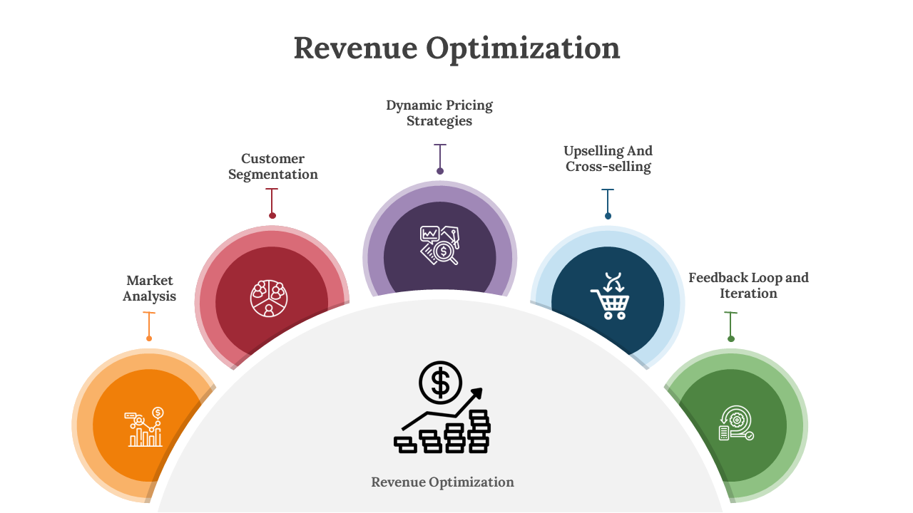
Role of Marketing in Revenue Optimization
      Driving Demand:
    Creating targeted marketing campaigns to boost bookings.
      Aligning Promotions:
    Ensuring promotional offers support revenue goals.
      Customer Segmentation:
    Targeting specific demographics during peak and off-peak seasons.
      Brand Positioning:
    Differentiating services to attract higher-paying customers.

Slide 5
Dynamic Pricing Strategies
      Definition:
    Adjusting prices based on real-time supply and demand.
      Seasonality:
    Higher prices during peak seasons/events.
      Demand Forecasting:
    Utilizing data to predict booking trends.
      Competitive Pricing:
    Monitoring competitor rates to stay competitive.

Slide 6
Revenue Management Tools
      Revenue Management Systems (RMS):
    Software solutions like Duetto, IDeaS.
      Integration with Marketing Platforms:
    Linking RMS with Google Ads, social media.
      Data Analytics:
    Leveraging big data for accurate forecasting.
      Automation Features:
    Automating price adjustments and inventory control

Slide 7

Cross-functional Collaboration
      Marketing and Revenue Teams Alignment:
    Regular meetings to synchronize strategies.
      Shared Goals:
    Unified objectives for revenue growth and brand awareness.
      Data Sharing:
    Utilizing CRM and RMS data for informed decision-making.
      Coordinated Campaigns:
    Joint initiatives for promotions and pricing.

Slide 8
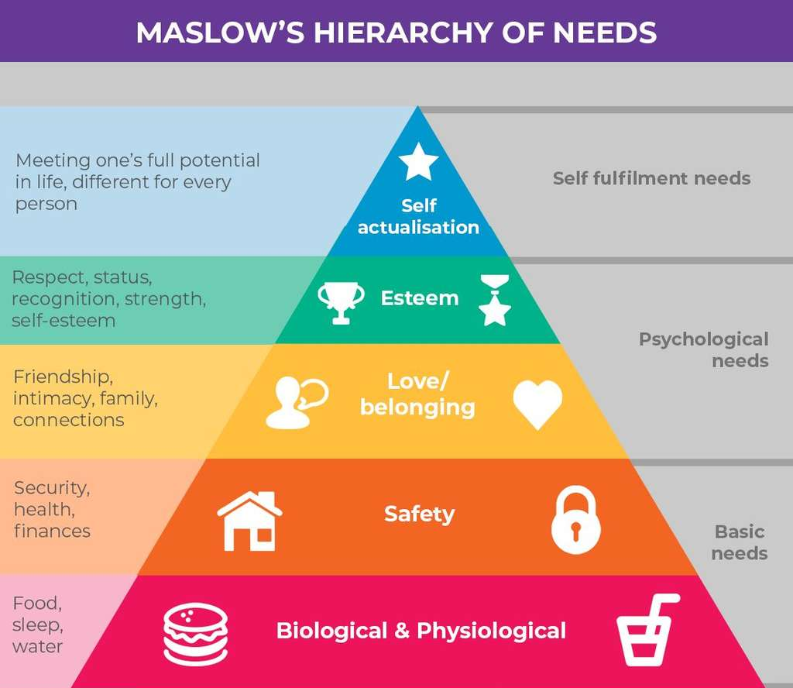
Personalization in Revenue Management
      AI and Big Data Utilization:
    Analyzing customer behavior for tailored pricing.
      Personalized Offers:
    Custom deals based on past bookings and preferences.
      Enhanced Guest Experience:
    Providing value-added services through personalized pricing.
      Increased Loyalty:
    Boosting repeat business with customized incentives.

Slide 9
Case Study 1: Successful Integration
      Company: Marriott International
      Strategy:
    Implemented dynamic pricing aligned with targeted email campaigns.
      Actions Taken:
    Utilized RMS to adjust rates based on booking patterns.
      Results:
    Increased booking rates by 15% during low-occupancy periods.
      Lessons Learned:
    Importance of data-driven decision-making.

Slide 10
Case Study 2: Common Pitfalls
      Company: Example Hotel Chain
      Issue:
    Over-discounting during promotions leading to revenue loss.
      Mistakes Made:
    Lack of alignment between marketing offers and revenue goals.
      Consequences:
    Decreased average daily rate and overall profitability.
      Lessons Learned:
    Balance between attracting customers and maintaining profitability.

Slide 11

Challenges in Revenue Management
      Customer Resistance:
    Negative perceptions of fluctuating prices.
      Ethical Concerns:
    Potential accusations of price gouging.
      Technology Dependence:
    Risks of over-reliance on automated systems without human oversight.
      Market Volatility:
    Adapting to sudden changes in demand due to external factors

Slide 12
Future of Revenue and Marketing Integration
      AI-driven Predictive Analytics:
    Enhanced forecasting accuracy and personalized marketing.
      Internet of Things (IoT):
    Smart rooms and devices for real-time pricing adjustments.
      Real-time Demand Forecasting:
    Utilizing advanced algorithms for immediate strategy shifts.
      Sustainability Integration:
    Aligning revenue strategies with eco-friendly practices

Slide 13
Conclusion
      Summary of Key Points:
    Integration of revenue management and marketing is crucial.
      Adaptability:
    Continuous evolution to meet market and technological changes.
      Technology’s Role:
    Leveraging AI, big data, and IoT for enhanced strategies.
      Final Thought:
    "The right price, for the right guest, at the right time."

Slide 14
Thank you
      European Institute of Innovation, Entrepreneurship and Technology
      Lessingstraße 79,
      13158 Berlin, Germany
      Phone: +49 176 55524449
      Email: info@eiiet.com
Discover the world of eiIET

