Slide 1
Information and Communication
OPTION 2: ETHICAL DATA COMMUNICATION IN SMART HOTELS
Submitted by : Pradeep Shubash

Slide 2

Introduction
Nowadays, hotels use AI, IoT, and big data analysis to improve the experience for their guests.
These technologies support hotels in streamlining their work, catering to clients personally, and anticipating what they require. Still, as AI is applied more in smart hotels, it can raise questions about ethics and how hotel staff communicate about the use of guest data.
A major hotel chain has realized that, as concerns about privacy increase worldwide, it must ensure that its collection, use, and storage of guest information through AI becomes more transparent.
https://www.tourismmarketingandmanagement.com/2022/12/20/enhancing-customer-experience-with-smart-hotel-technologies/
Notes:
This report is designed to develop a package for guests that presents all related data usage, privacy, and consent information. It comprises email templates, posters, and voice assistant scripts in different languages for better ethical data communication. The report looks into the typical ethical problems linked to AI and data privacy in smart hotels and presents solutions. The hotel chain wants to be known for its honesty, responsibility, and better guest services by making sure all policies are obeyed.

Slide 3
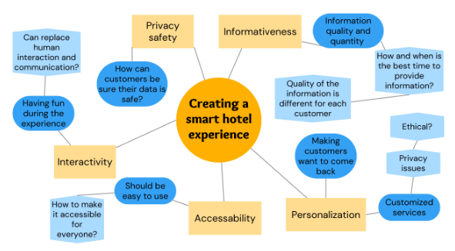
Ethical Communication in Smart Hospitality Settings
Ethical communication in hospitality has progressed as technologies have improved.
Since smart technology is now common, hotels consider guest data to be very valuable.
Whether checking in at the front desk or using room settings, guests hand over personal data to smart hotels (Negro, 2022).
So, being ethical in communication means following the GDPR and also telling guests, in a friendly manner, how their data is used by the business.
https://www.tourismmarketingandmanagement.com/2022/12/20/enhancing-customer-experience-with-smart-hotel-technologies/
Notes:
Smart hotels are met with different difficulties compared to others. Users can sometimes lack an understanding of how AI is being used in their products or systems. When guests don’t know about all the systems in use at a hotel, they might feel their privacy is being ignored or violated (Pan et al. 2021). For this reason, the hotel chain sets out to close this gap by intentionally communicating with guests to make sure they trust the team and give their consent to any procedures.

Slide 4
Email Template – Pre-Arrival
Subject Line: Your Upcoming Stay & Our Commitment to Your Privacy
Body:
Dear [Guest Name],
We are looking forward to welcoming you to our Hotel. As part of our commitment to providing you with a seamless and personalized experience, we use AI-powered technologies that help us understand your preferences and improve our services.
We value and appreciate your privacy. To understand your preferences, we gather information about your stay, your room, or anything else you request. Your information is taken care of and will not be given away to anybody
without your permission.
The moment you walk into the venue or open our app, you can set what data you want to share and how often.
Thank you for trusting us.
Warm regards,
Guest Services Team
[Hotel Name]
Notes:
Hospitality AI uses a custom email to notify guests in advance about the data it collects and the AI systems it implements. It is approachable and explains everything we need to do in clear and simple terms. In this way, guests know that the company is transparent, and it encourages its users to take care of their privacy however they want.

Slide 5

Hotel Display Posters – On-Site Communication

Slide 6
Multilingual Voice Assistant Scripts
English:
“Hello! Before we begin, I’d like to let you know that I may collect information to personalize your experience. Do you consent to this?”
Spanish:
“¡Hola! Soy tu asistente de habitación. Antes de comenzar, me gustaría informarte que puedo recopilar información para personalizar tu experiencia. ¿Das tu consentimiento?”
French:
“Bonjour ! Je suis votre assistant de chambre. Avant de commencer, je souhaite vous informer que certaines données seront collectées pour personnaliser votre séjour. Donnez-vous votre consentement ?”

Slide 7
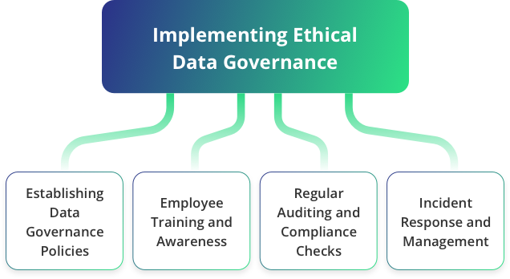
Importance of Culturally Responsive Communication
In today’s world, global hospitality calls for hotels to deliver communication on data usage that both informs well and fits local cultures.
Because people come from diverse backgrounds and countries, how privacy, consent, and data ethics are understood can be quite different.
People from Europe who follow strict GDPR laws are likely to expect more detailed information about data handling, robust controls for users, and specific forms of consent (Bryndin, 2021).
However, those coming from areas with weaker data protection laws may not realize what they have agreed to, so they can be at higher risk.
https://www.xerago.com/Industries/Hospitality/guest-data-and-privacy
Notes:
Since these barriers exist, hotels have to improve their communication methods and use more than just direct translations. Since privacy policies and consent notices are meant for everyone, they should be available in several major languages to consider the differences in their clients’ languages. Furthermore, choosing instances that are meaningful in a variety of cultures will help everyone relate better. For this, when explaining preferences, mention cases where people prefer vegetarian dishes in India or halal meals in the Middle East.
Displaying icons, infographics, and short videos helps avoid using too many words and makes explanations easier for people who are not native or have a lower level of reading. Because these tools are used everywhere, they help simplify the idea of complex data.
Hotel staff should also be taught how to interact properly and respect guests from many cultures. Employees learn the skills necessary to address cultural matters, prevent confusion, and earn the trust of their customers (Sarigiannidis et al. 2021). When hotels include cultural, visual, and linguistic elements in how they communicate, they underline their support for all types of guests and for proper and ethical business.

Slide 8
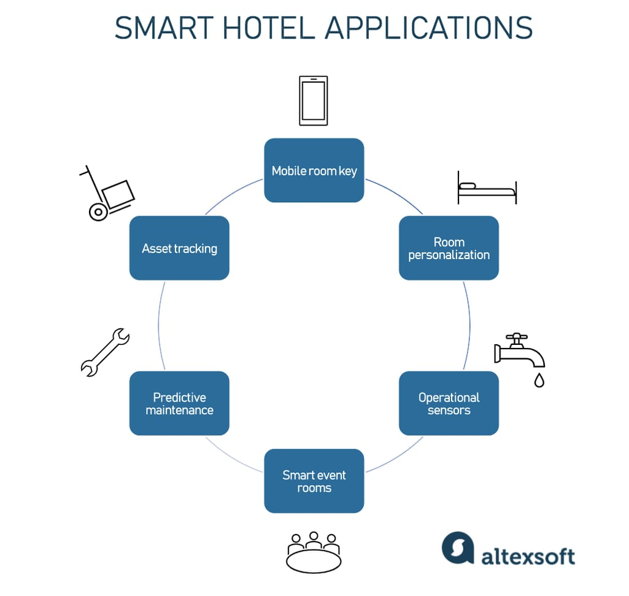
Training Staff for Ethical Communication
When technology and humans meet in hotels, staff need to ensure ethical practices by sharing details about the hotel’s use of AI and its data.
Since guests come into contact with hotel staff many times, staff should be able to explain to them how data is managed and safeguarded (Gaur et al. 2021).
It is important to outline the AI elements at work in the hotel, such as controlling rooms, recognizing guests for check-in, and personalizing suggestions, and to discuss the policies for handling guest personal information.
By understanding these processes, a guest is more likely to feel secure while on the property.
https://www.altexsoft.com/blog/smart-hotel-infrastructure/
Notes:
Hotels should provide a range of training classes to help staff understand the job and develop their social skills when interacting with guests. Employees should be trained by acting out guest scenarios, such as answering and addressing specific inquiries and problems. Should a guest state that they do not wish to give their biometric data, the team should help them without hesitation and explain (Milwood et al. 2023). A workshop on GDPR will inform staff about data protection laws, so they are less likely to violate the rules.
Still, you need more than technical knowledge. Soft skills play an important role in ethical communication in hospitality. Those leading these talks should be mindful, take their time, and be aware of different cultures. Many guests might be unsure about using AI, so hotel staff must be able to support and help them (Zarezadeh et al. 2022). If hotel staff balance following the law with emotional intelligence, the workplace will become more ethical, respectful, and inclusive. Overall, trained employees strengthen clear operations and ensure a better guest experience. When communication is ethical, guests trust the brand more, consent to AI use, and view the hotel as a leader in the future of tourism transformed by AI.

Slide 9
Leveraging Technology for Transparent Communication
To stay relevant in this digital age, hotels should ensure that guests’ data privacy is respected by including ethical communication in the technology found in their rooms.
Since artificial intelligence affects many hotel services and personalizes everything for guests, guests must be fully aware of how their data is processed (Florido, 2024).
A privacy dashboard included in the hotel’s mobile application is an excellent method for promoting transparency.
Using the tool, guests may track what data companies process, decide what their data is used for, and remove this access as they wish.
Notes:
Another important feature is getting real-time notifications about data access. Guests are alerted whenever any of their personal information is used, such as when the heat in their room is set and when they unlock their room with biometrics (Wang, 2025). It alerts guests to any concerns and ensures that the hotel promotes transparency and mutual acceptance in its interactions. Summaries of post-checkout analytics can be a new way to increase transparency. They can explain how using the guest’s data led to more eco-friendly energy use, particular meal selection or enjoyment of smart entertainment. They tell guests how AI will be used at the resort and also make sure they recognize the sound use of their information.
As a result, the hotel is considered a responsible user of data among its peers. When people understand what is going on and feel they are in charge, they tend to rely on the technology and use its services. If smart hotels display ethical principles within their computer systems, the technology can help create transparency, accountability, and increase guests’ satisfaction, establishing a new standard for ethics in hospitality.

Slide 10
Ethical Dilemmas in Smart Hotels
Still, even as more transparency is introduced, using AI in hotels brings up some ethical issues.
Informed consent is a serious concern that needs to be considered.
Guests can often miss important details in the terms or terms that are difficult to find on a website.
This questions the basis of ethical communication.
Figuring out how to collect the least amount of data possible is also a challenge.
Notes:
Since AI systems collect more data than they need, it leads people to ask if they are doing too much. By watching customers with sensors without asking their permission, businesses may make their guests feel like they are under constant observation.
Some are also concerned about algorithms being biased. If the training for hotel AI systems includes biased information, the service is likely to become unequal (Zarezadeh et al. 2022). Sometimes, predictive recommendations and automated upgrades could easily let some guests miss out on certain services, as they previously fit particular stereotypes.
In the end, keeping data secure raises ethical issues. Personal data is stored by hotels in large quantities, so a hack could cause identity theft or other types of cybercrime. Despite the focus on technology, it should always be managed alongside secure data protection.

Slide 11
Mitigation Strategies for Ethical Concerns
To address the ethical dilemmas outlined above, smart hotels must adopt a multi-faceted strategy grounded in transparency, accountability, and fairness.
First, the hotel chain should implement plain language privacy notices across all platforms (Florido, 2024).
These notices should clearly state what data is collected, how it is used, and how guests can control their data.
Simplifying consent forms and allowing opt-in rather than opt-out procedures ensures that consent is genuinely informed.
Second, the principle of data minimization must be embedded into system design.
Notes:
AI developers and hotel IT teams should work together to identify the minimum data required for each feature and avoid storing unnecessary personal information. This not only reduces ethical risks but also lowers the impact in the event of a data breach.
Next, regular checks are needed to ensure fairness in AI systems. Independent assessors may determine that some people are being negatively affected by AI and advise on improving the data it is trained on (Das, 2023). Having a broad team consisting of both developers and ethics experts can assist in discovering weak spots in how a system is built.
Lastly, protecting your company’s cybersecurity is necessary. In order to secure guest data, you need encryption, two-factor authentication, and safe cloud services. Staff training about cybersecurity at regular intervals can better prepare workers.
In the end, hotels should enable guests to report anything they find confusing about how their data is being managed. As a result, hotels can develop trust and update their materials and technology in later periods.

Slide 12
Conclusion
With the rise of smart hotels, the tourism and recreation industry is now able to provide guests with personalized service and greater efficiency.
Even so, they must be responsible for guest data and privacy more than other businesses.
The assignment provides an organized strategy for a hotel chain that wants to make its use of AI more understandable to everyone.
Letting guests know about their data in an ethical way is possible by using emails, appealing posters, and multilingual scripts.
Notes:
Hotels should focus on avoiding misleading guests by handling issues such as informed consent, using only appropriate data, managing biased algorithms, and ensuring data security. Transparent speech, routine checks, thoughtful designs, and effective cybersecurity make the hotel chain not only technology-focused but also responsible in the travel industry worldwide.

Slide 13
References
Negro, P. (2022). The Smart Hotel: a contactless and digital journey towards sustainability in Malta. The Online Open Access Repository of the Institute of Tourism Studies (Malta). Retrieved from: https://futouristic.scholasticahq.com/article/94248.pdf on 18th May, 2025.
Pan, B., Lin, M. S., Liang, Y., Akyildiz, A., & Park, S. Y. (2021). Social, ethical, and moral issues in smart tourism development in destinations. Journal of Smart Tourism, 1(1), 9-17. Retrieved from: https://koreascience.kr/article/JAKO202124462471971.pdf on 18th May, 2025.
Bryndin, E. (2021). Implementation of competencies by smart ethical artificial intelligence in different environments. Software Engineering, 8(4), 24-33. Retrieved from: https://www.academia.edu/download/66724128/Implementation_of_Competencies_by_Smart_Ethical_Artificial_Intelligence.pdf on 18th May, 2025.
Sarigiannidis, C., Halkiopoulos, C., Giannopoulos, K., Giannopoulou, F., Politis, A. E., Boutsinas, B., & Kollias, K. (2021, June). Do hotels care? A proposed smart framework for the effectiveness of an environmental management accounting system based on business intelligence technologies. In Culture and Tourism in a Smart, Globalized, and Sustainable World: 7th International Conference of IACuDiT, Hydra, Greece, 2020 (pp. 635-647). Cham: Springer International Publishing. Retrieved from: https://www.researchgate.net/profile/Constantinos-Halkiopoulos/publication/352594135_Do_Hotels_Care_A_Proposed_Smart_Framework_for_the_Effectiveness_of_an_Environmental_Management_Accounting_System_Based_on_Business_Intelligence_Technologies/links/6116cc5b169a1a0103fc7364/Do-Hotels-Care-A-Proposed-Smart-Framework-for-the-Effectiveness-of-an-Environmental-Management-Accounting-System-Based-on-Business-Intelligence-Technologies.pdf on 18th May, 2025.
Gaur, L., Afaq, A., Solanki, A., Singh, G., Sharma, S., Jhanjhi, N. Z., ... & Le, D. N. (2021). Capitalizing on big data and revolutionary 5G technology: Extracting and visualizing ratings and reviews of global chain hotels. Computers and Electrical Engineering, 95, 107374. Retrieved from: https://www.academia.edu/download/89908865/109566_8795_1.pdf on 18th May, 2025.
Milwood, P. A., Hartman-Caverly, S., & Roehl, W. S. (2023). A scoping study of ethics in artificial intelligence research in tourism and hospitality. In ENTER22 e-Tourism Conference (pp. 243-254). Springer, Cham. Retrieved from: https://scholarshare.temple.edu/bitstream/handle/20.500.12613/10847/RoehlEtAl-ConferenceProceeding-2023-01.pdf?sequence=1 on 18th May, 2025.
Zarezadeh, Z. Z., Rastegar, R., & Xiang, Z. (2022). Big data analytics and hotel guest experience: a critical analysis of the literature. International Journal of Contemporary Hospitality Management, 34(6), 2320-2336. Retrieved from: https://vtechworks.lib.vt.edu/bitstreams/11b36eeb-c034-4c78-9e1a-e88f54713365/download on 18th May, 2025.
Florido-Benítez, L. (2024). The cybersecurity applied by online travel agencies and hotels to protect users’ private data in smart cities. Smart Cities, 7(1), 475-495. Retrieved from: https://www.mdpi.com/2624-6511/7/1/19/pdf on 18th May, 2025.
Adamış, E., & Pınarbaşı, F. (2022). Unfolding visual characteristics of social media communication: reflections of smart tourism destinations. Journal of Hospitality and Tourism Technology, 13(1), 34-61. Retrieved from: https://www.academia.edu/download/100261032/Unfolding_visual_characteristics_of_social_media_communication.pdf on 18th May, 2025.
Wang, P. Q. (2025). Personalizing guest experience with generative AI in the hotel industry: there's more to it than meets a Kiwi’s eye. Current Issues in Tourism, 28(4), 527-544. Retrieved from: https://www.tandfonline.com/doi/pdf/10.1080/13683500.2023.2300030 on 18th May, 2025.
Das, M. P. (2023). Technology and Guest experience: innovations reshaping hotel management. International Journal for Multidimensional Research Perspectives, 1(3), 76-95. Retrieved from: https://www.researchgate.net/profile/Chandigarh-Philosophers/publication/379411864_Technology_and_Guest_Experience_Innovations_Reshaping_Hotel_Management/links/6607af8a390c214cfd28f484/Technology-and-Guest-Experience-Innovations-Reshaping-Hotel-Management.pdf on 18th May, 2025.

Slide 14


