Slide 1
Tools & Software in the Hospitality Industry
Prof. Dr. Jay Kumar Thakur| Berlin
      Lessingstraße 79,
      13158 Berlin, Germany
      Phone: +49 30 233618555
      Fax: +49 30 233618556
      Email: info@eiiet.com

Slide 2
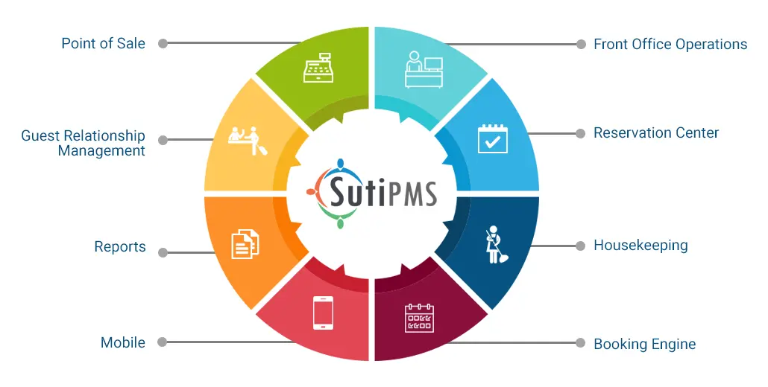
Agenda
Industry stacks overview (Germany focus)
Restaurants: POS, reservations, delivery, ops, CRM
Hotels: PMS, distribution, RMS, guest tech, ops
Tourism/DMOs & tour/activity operators: booking & CRM
Cross‑cutting: compliance, payments, analytics, communications
Mini‑cases & discussion prompts

Slide 3
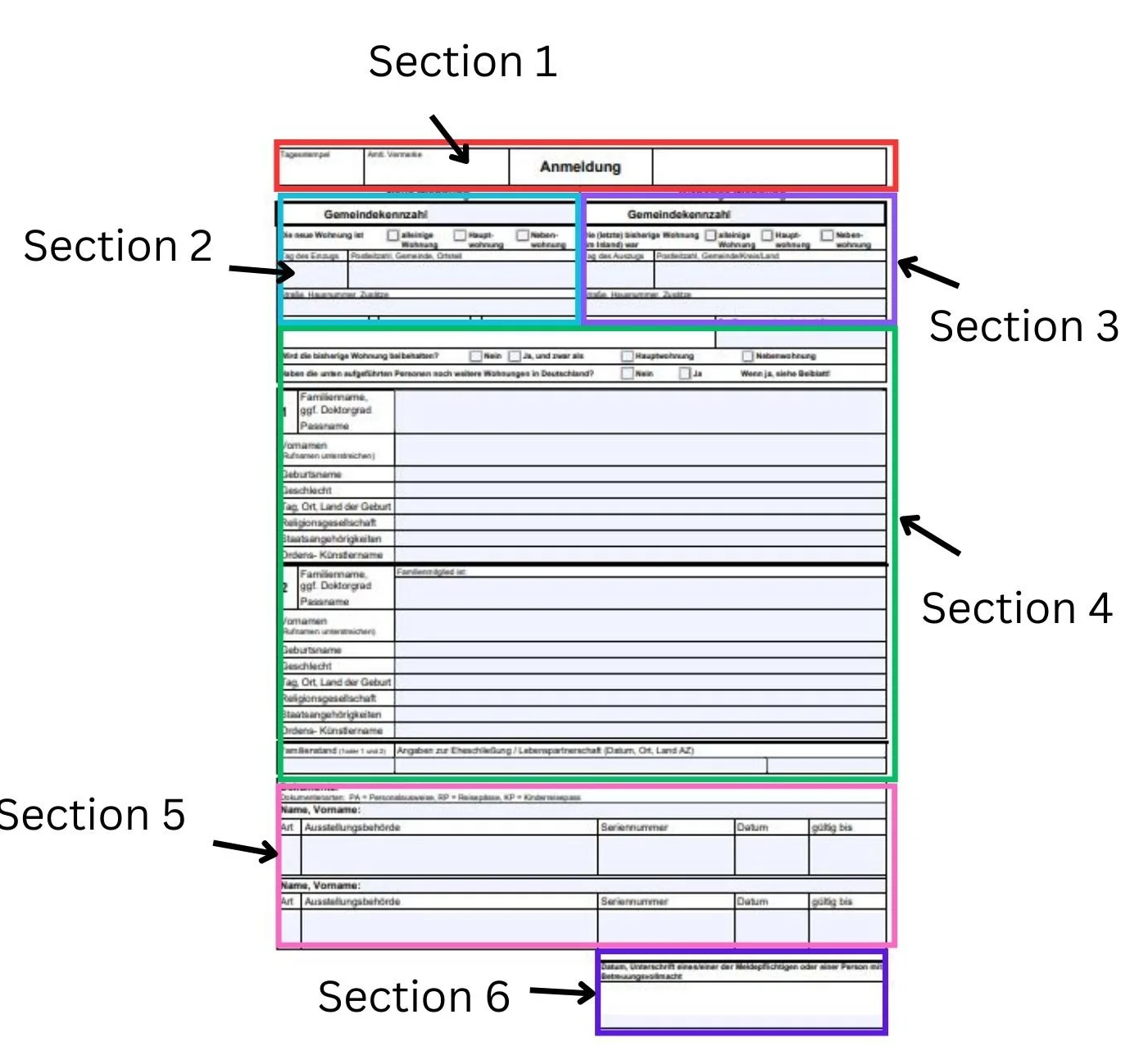
Compliance Snapshot (Germany/EU)
GDPR/DSGVO - Data minimisation, consent, DPA with vendors, retention
KassenSichV + TSE - Mandatory for POS systems; digital signatures & audit trails
GoBD - Proper bookkeeping & data access for audits
Bundesmeldegesetz (Hotels) - Guest registration (digital options), secure storage
Payment rails - SEPA, Girocard, Apple/Google Pay; PCI DSS for card handling

Slide 4
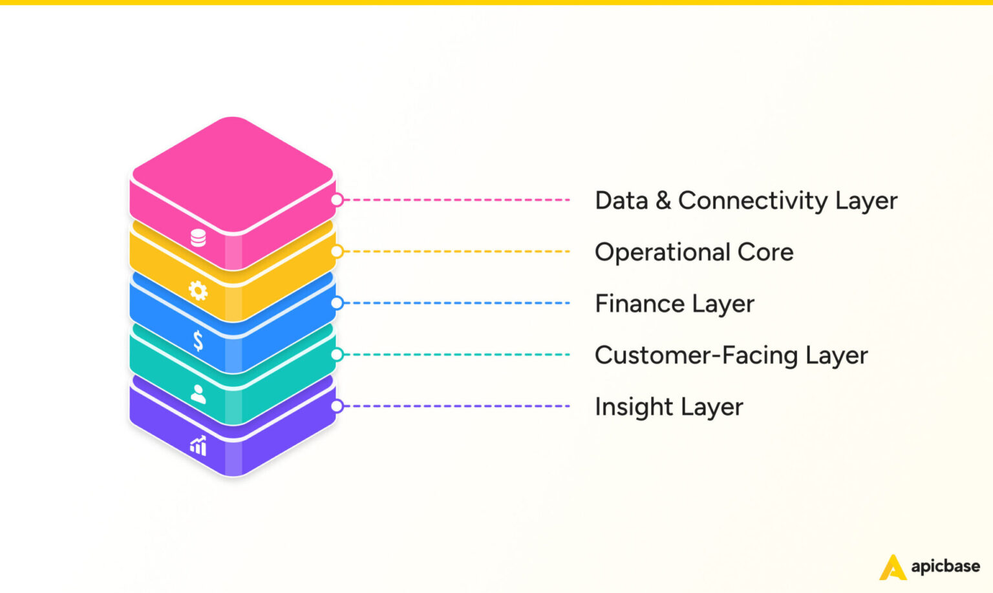
Restaurants: Core Stack
POS System: Manages orders, payments, and inventory.
Online Ordering: Expands reach, boosts sales.
CRM: Personalizes customer experience.
Inventory Management: Tracks stock and supplies.
Analytics and Reporting: Provides operational insights.

Slide 5
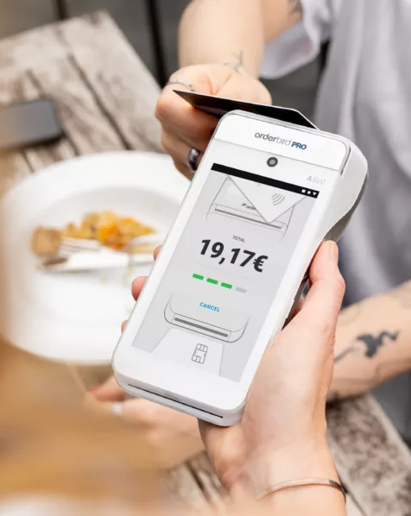
POS & Payments
POS platforms - orderbird (DE), Lightspeed (ex‑Gastrofix), Vectron, gastronovi
TSE compliance - Certified TSE module; export for audits (DSFinV‑K)
Payment processing - SumUp (DE), Adyen, Stripe; terminals via Payone/Worldline
Table‑side & QR - Order/pay at table; split bills; tip capture

Slide 6
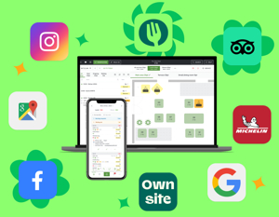
Reservations & Table Management
Table platforms - TheFork/Bookatable, OpenTable, Quandoo, resmio (DE)
No‑show protection - Deposits, card capture, reminders
Channel visibility - Google Reserve, Instagram action buttons

Slide 7

Delivery & Aggregators
Marketplaces
- Lieferando (DE), Wolt, Uber Eats
Menu & order hubs
- Deliverect, Otter for aggregator consolidation
Ops sync
- Menu 1‑source‑of‑truth; auto‑86; driver ETAs on KDS

Slide 8
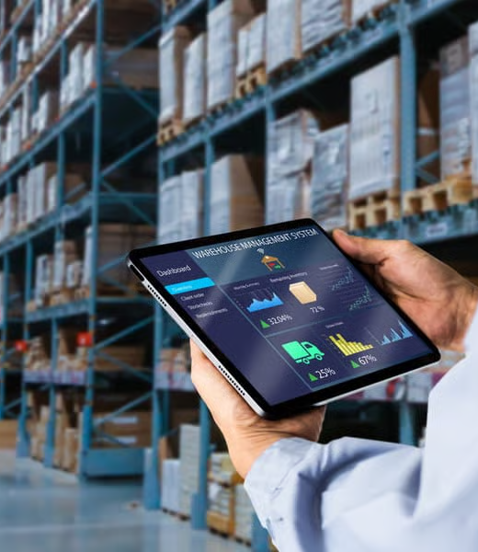
Inventory, Procurement & HACCP
Procurement
- Choco (Berlin), METRO integrations
Inventory & recipes
- MarketMan, gastronovi, calc for COGS & allergens
HACCP & checklists
- Flowtify (DE), digital logs & temperature records

Slide 9
Workforce & Scheduling
Scheduling & time
- gastromatic (DE), Papershift (DE), Planday
Payroll integration
- DATEV exports, break rules, labor cost forecasts
Staff comms
- Shift swaps, broadcast updates, policy acks

Slide 10

CRM, Loyalty & Feedback
Guest CRM
- SevenRooms, Zenchef, voucher & membership engines
Reviews & reputation
- Customer Alliance (Berlin), TrustYou, Google/My Business, TripAdvisor, Resmio,
Campaigns
- Brevo (Sendinblue), Mailchimp—GDPR settings & consent

Slide 11
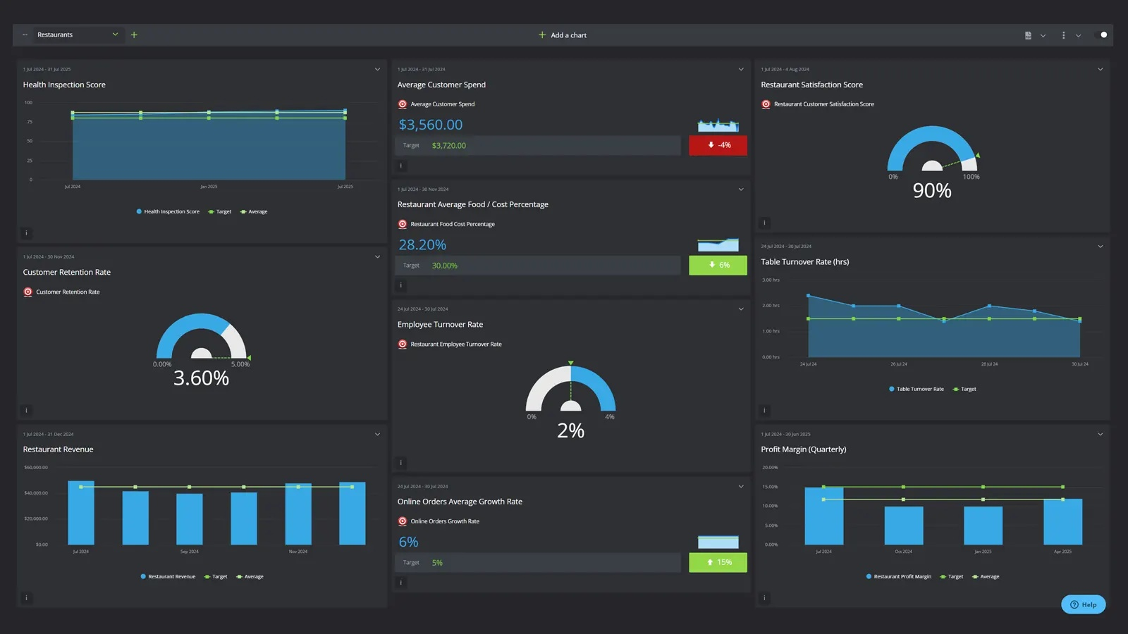
Analytics & BI
Dashboards
- POS + delivery + labor unified KPIs
GDPR‑friendly web analytics
- Matomo (self‑hosted) vs Google Analytics
Forecasting
- Menu mix, price tests, demand curves

Slide 12
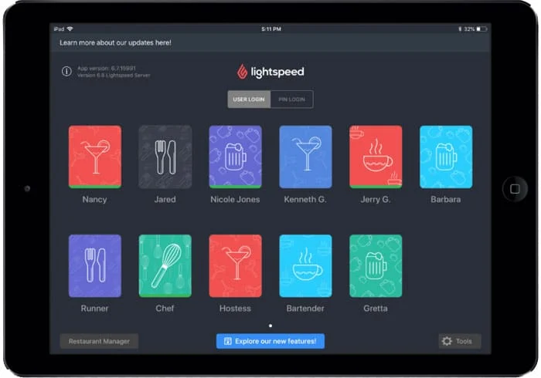
Sample Stack: Multi‑Unit Casual Dining
Core
- Lightspeed or orderbird + certified TSE
Bookings
- TheFork + Google Reserve + resmio for website
Delivery
- Lieferando + Deliverect aggregator
Ops
- Choco procurement + Flowtify HACCP
People
- gastromatic + DATEV
Growth
- SevenRooms CRM + Customer Alliance reviews

Slide 13
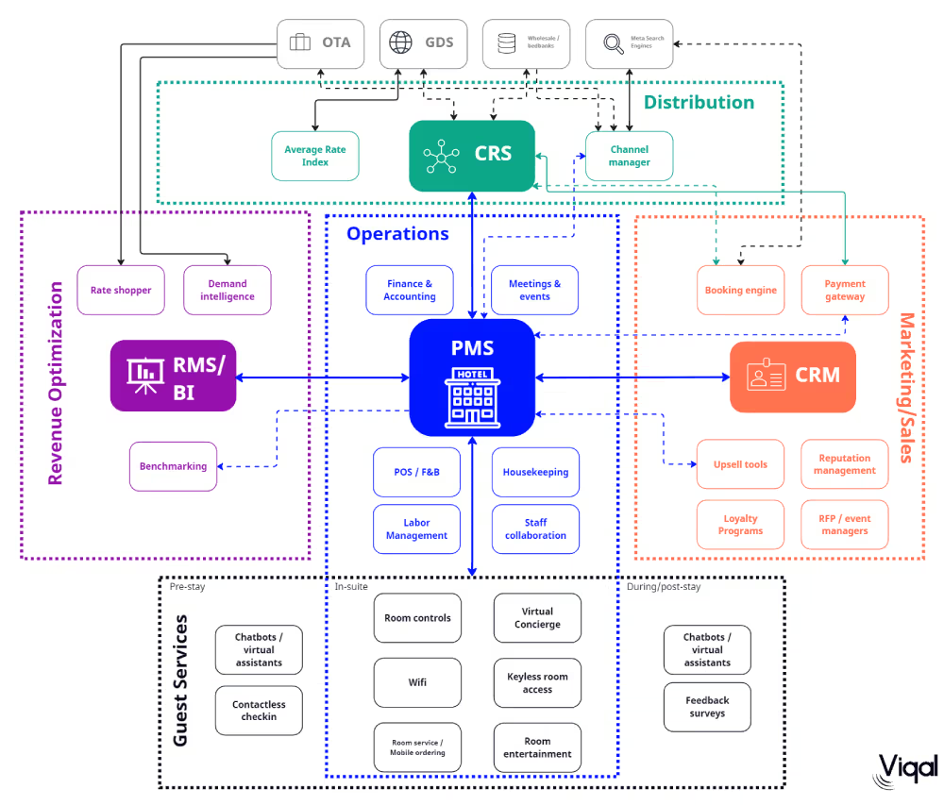
Hotels: Core Stack
Property Management System (PMS)
Central Reservation System (CRS)
Customer Relationship Management (CRM)
Point of Sale (POS)
Channel Manager
Revenue Management System (RMS)
Staff Scheduling & Workforce Management
Analytics & Reporting Tools

Slide 14
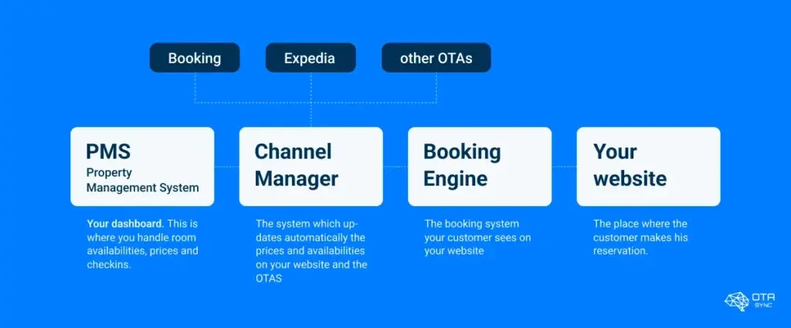
PMS, CRS & Distribution
PMS
- SIHOT (DE/AT), protel, Mews, Oracle OPERA
Channel mgmt/CRS
- D‑EDGE, SiteMinder, Hotel Spider
Booking engine
- Direct web engine with meta connectivity (Google, Trivago)
German channels
- HRS (Cologne), Booking.com, Expedia

Slide 15
Revenue, Rates & BI
RMS
- IDeaS, Duetto, Pace/Revenue
Market intelligence
- OTA Insight/Lighthouse, STR (benchmarking)
Financial BI
- Fairmas (DE) forecasts & budgeting

Slide 16
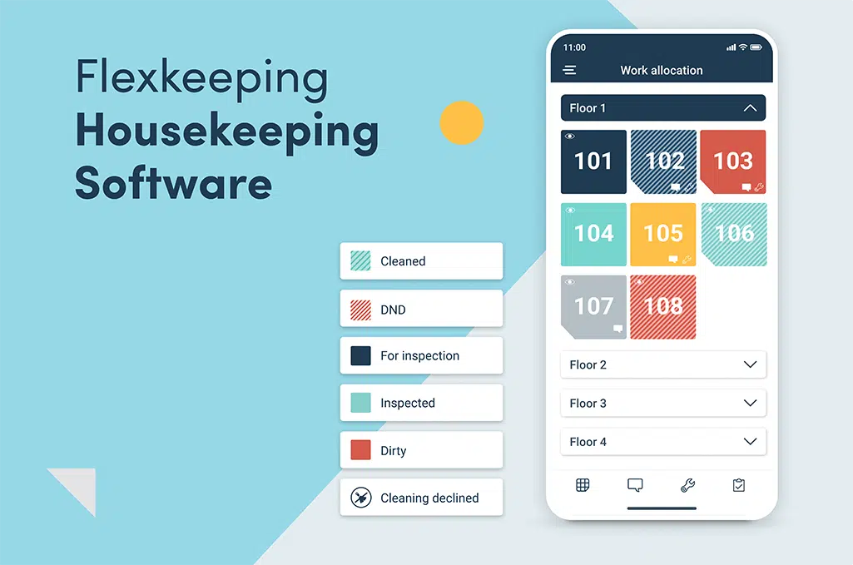
Guest Experience & Operations
Housekeeping & ops
- hotelkit (AT/DE), Flexkeeping, Optii
Digital check‑in & keys
- hotelbird (DE), straiv (AT/DE), SALTO/Assa Abloy locks
Messaging & upsell
- WhatsApp Business (with policy care), Messenger, Oaky
Review mgmt
- TrustYou (DE), ReviewPro (Shiji)

Slide 17

F&B & POS in Hotels
Hotel F&B POS
- Oracle Simphony, gastronovi, Lightspeed
KassenSichV
- TSE across outlets; consolidated exports
Interfaces
- Room charge to PMS, 2‑way folio sync

Slide 18
Compliance & Data
Guest registration
- BMG digital processes, ID validation & retention
GDPR
- RoPA, DPIAs for guest‑facing apps, DSR workflows
Security
- SAML/SSO, MFA, role‑based PMS access

Slide 19
In‑Class Discussion & Activities
Analyze case studies on restaurant, Hotel and Tourism Company tech stack and customer service challenges.
Group activity: Design a simple restaurant Technology Plan.
Discussion: How can hotels balance automation and authenticity?

Slide 20
Customer Relationship Management (CRM)
Why CRM Matters in Hospitality
• High competition and low switching costs
• Repeat guests = higher profitability
• Personalization improves satisfaction and brand value
• Data-driven insights enhance marketing and service delivery
Types of CRM Systems
Operational CRM: Reservation systems, front office, POS
• Analytical CRM: Data mining, guest segmentation, forecasting
• Collaborative CRM: Integration between marketing, sales, and service teams

Slide 21
Customer Relationship Management (CRM)
CRM Technology in Modern Hotels
• PMS integration (Opera, Cloudbeds)
• Loyalty apps and mobile check-ins
• Chatbots, AI-driven guest messaging
• Data analytics dashboards
Guest Data and Personalization
Using guest preferences to tailor services
• Example: Marriott Bonvoy, Hilton Honors
• Ethical use of data (GDPR compliance)

Slide 22
Customer Relationship Management (CRM)
CRM Strategy Framework
1. Data acquisition (bookings, social media, feedback)
2. Segmentation (business vs. leisure, frequency, spending)
3. Engagement (email, app, loyalty program)
4. Measurement (KPIs: retention rate, NPS, RevPAR impact)
Challenges in CRM Implementation
• Data silos and integration problems
• Privacy and data protection
• Staff training and adoption resistance
• High cost of system updates

Slide 23
Customer Relationship Management (CRM)
Emerging Trends
• AI & predictive analytics for demand forecasting
• Social CRM (Instagram, TripAdvisor interactions)
• Voice assistants and IoT integration in rooms
• Blockchain for loyalty programs
Best Practices
• Unified customer database
• Regular CRM audits
• Employee involvement in personalization
• Real-time guest feedback systems

Slide 24
Sample Stack: 80‑Room Independent
Core
- Mews PMS + D‑EDGE channel + direct engine
RMS & BI
- IDeaS + Fairmas + Lighthouse market data
Guest tech
- hotelbird kiosk/app + SALTO + TrustYou
Ops
- hotelkit + Housekeeping module + maintenance tickets
F&B
- Simphony with TSE + room‑charge integration

Slide 25
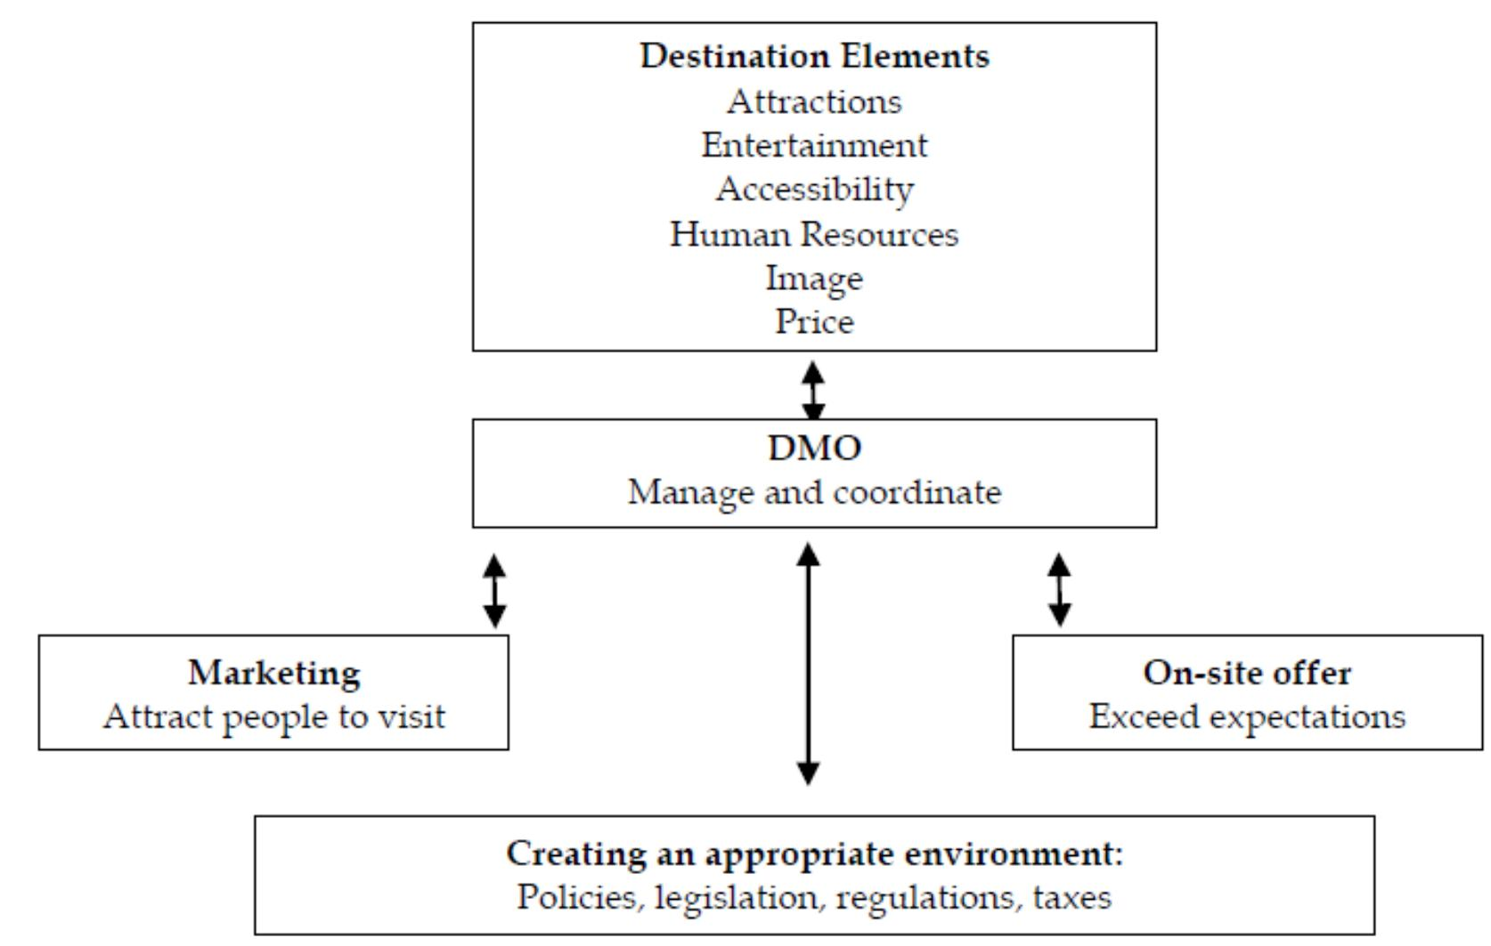
Tourism / DMOs / Tours & Activities
Tourism: Travel for leisure or business to explore destinations.
DMOs (Destination Management Organizations): Coordinate marketing, planning, and services to promote destinations and ensure sustainable tourism.
Tours & Activities: Curated experiences offering cultural, adventure, or leisure opportunities for visitors.

Slide 26

Booking, Ticketing & Distribution
Tour/Activity platforms
- booking kit (DE), Regiondo (DE), Fare Harbor, Trek Soft
OTAs
- GetYourGuide (DE), Viator, Tiqets
Capacity & slots
- Real‑time inventory, mobile tickets, QR validation

Slide 27
DMO & Destination Tools
Content & maps
- Outdoor active (DE), Feratel, TOMAS
CRM for DMOs
- Simple view, newsletter via Brevo/Clever Reach (DE)
City passes & bundles
- Integrations with transport/museums; dynamic pricing emerging

Slide 28
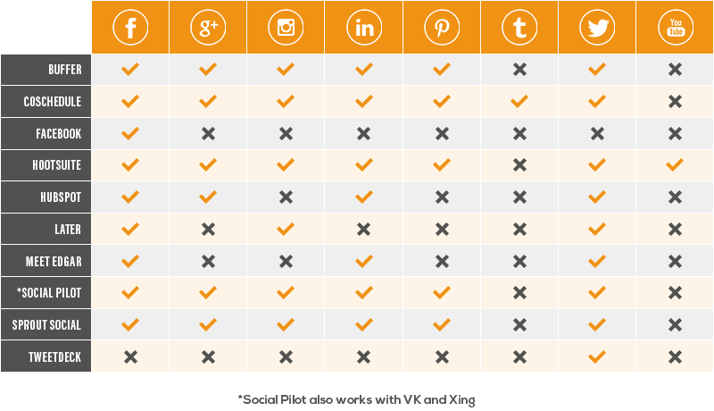
Marketing, Analytics & Community
Web & analytics
- CMS + Matomo/GA; consent management (CMP)
Social scheduling
- Buffer, Hootsuite; UGC curation
Reputation
- Centralised review tracking across partners

Slide 29
Sample Stack: Regional DMO
Attractions
- booking kit for partners + unified calendar
Visibility
- Outdoor active trails + Google Things to do
CRM
- Clever Reach (DE) segmented newsletters + events CRM
Insights
- Matomo dashboards; seasonal demand analysis

Slide 30
Cross‑Cutting: Integration, Data & Comms
Seamless Integration
- Real-time APIs connect PMS, POS, CRM, and RMS
Robust Data Architecture
- Use middleware, EU-based warehousing with BI layers for analytics.
Data Governance & Security
- GDPR compliant, encrypted data, clear ownership, and regular backups
Effective Communication
- Mobile-first frontline tools, guest communication with WhatsApp Business

Slide 31
Integrations & Data Architecture
APIs & webhooks
- Real‑time sync PMS↔POS↔CRM↔RMS
Middleware
- n8n (self‑hosted, EU), Make.com; SFTP where needed
Warehousing
- PostgreSQL/Snowflake (EU region), BI layers
Data governance
- Data catalog, ownership, SLAs, backups/encryption

Slide 32
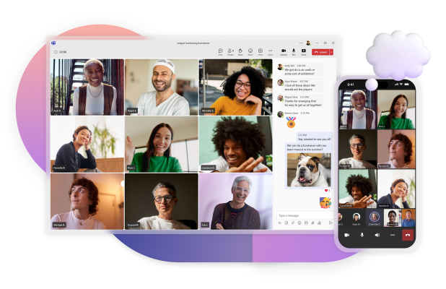
Communication & Collaboration
Frontline comms
- Beekeeper (CH), Teams, Slack
Task mgmt
- Asana, Trello, hotelkit tasks, Quore
SOPs & training
- Notion/Confluence; micro‑learning & checklists
Guest comms policy
- WhatsApp Business archiving, consent, opt‑out

Slide 33
Selection Criteria & TCO
Function & UX
- Role fit, multilingual, mobile‑first
Compliance & security
- GDPR, TSE, ISO 27001 statements, DPAs
Ecosystem & support
- German support SLAs; partner network
Costs & lock‑in
- Contracts, data export, migration paths

Slide 34
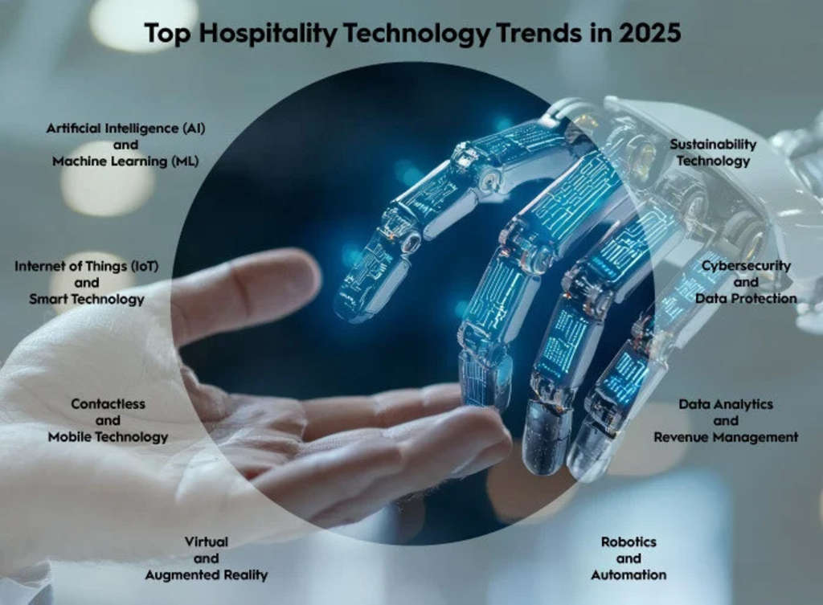
Trends to Watch (2025+)
AI
- Demand forecasting, dynamic pricing, staff rostering, chatbots
Contactless journeys
- Kiosk/app check‑in, mobile keys, QR menus
Sustainability tech
- Energy mgmt (Betterspace), waste tracking
Identity & payments
- Network tokenization, SCA, tap‑to‑pay

Slide 35
In‑Class Discussion & Activities
Discuss key components of restaurant operations and technology.
Role-play: Assign student roles to simulate a restaurant environment.
Analyze case studies on restaurant tech stack and customer service challenges.
Group activity: Design a simple restaurant floor plan or menu concept.
Technology demo: Practice using POS system or digital order management.
Problem-solving: Identify solutions for common restaurant operational issues.
Reflection: Discuss the impact of technology on customer experience.

Slide 36
Activities
Stack comparison
- Pick a German restaurant/hotel; map current vs target stack
Data flow sketch
- Draw integrations and data ownership, note GDPR risks
Vendor RFP
- Draft top 10 requirements and evaluation rubric
KPI dashboard
- Define 8–10 cross‑system KPIs for weekly review

