Slide 1
Planning and Management of Sustainable
European Institute of Innovation, Entrepreneurship and Technology
Lessingstraße 79, 13158 Berlin, Germany
Mahmoud Abdou| Berlin
      Lessingstraße 79,
      13158 Berlin, Germany
      Phone: +49 30 233618555
      Fax: +49 30 233618556
      Email: info@eiiet.com

Slide 2

Outline:
Resource Planning and Destination Development
Destination Development Elements
Protected Areas and National Parks in
Sustainable Tourism
4. Ras Mohammed National Park, Egypt
5. Environmental Impact Mitigation

Slide 3
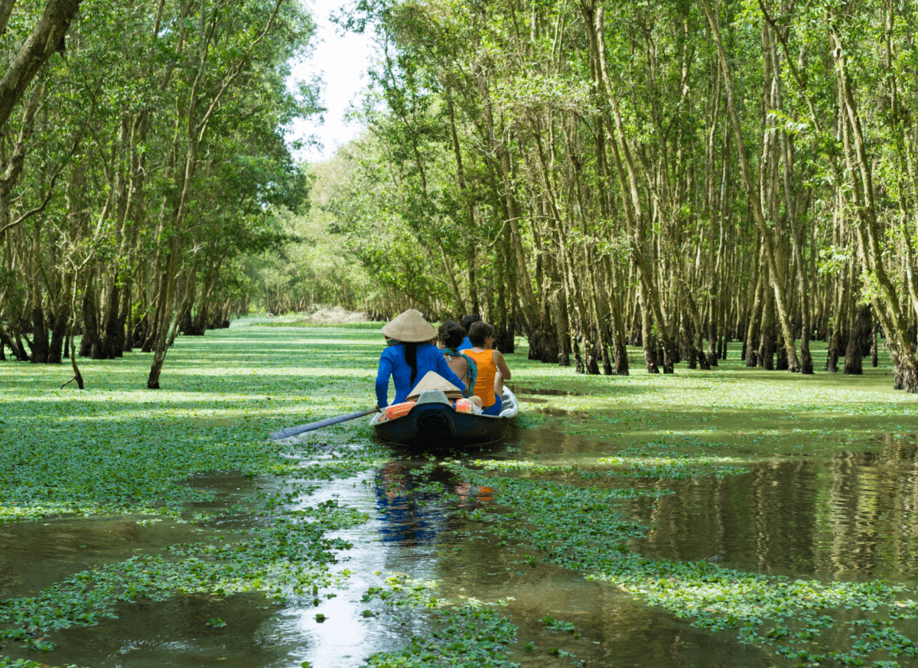
1- Resource Planning and Destination Development

Slide 4
1- Destination Management
      - It is the coordinated and strategic organization of all the elements that contribute to a tourist destination.
      - This includes:
Attractions | Amenities
Access | Marketing
Pricing

Slide 5
1- Destination Management
      - Destination Mangement helps:
      - Prevent duplication in:
      Promotion
      Visitor services
      Training and business support
      -Identify management gaps
      Unaddressed issues or underdeveloped areas
      - Encourage collaboration across sectors

Slide 6
1- Destination Management
      Common Drivers Behind Destination Management:
      A- Improving Tourism Yield
      - Lengthen visitor stay
      - Increase visitor spending
      - Maximize capacity usage
      B- To protect communities and provide viable livelihoods
      - Creates alternative income streams
      - Revitalizes local businesses
      - Underpins community stability and long-term viability

Slide 7
1- Destination Management
      C- To reduce seasonality
      - Distribute visitor flow more evenly across the year
      - Maximize use of tourism infrastructure year-round
      - Promote off-season activities
      D- To spread the benefits of tourism more widely
      - Encourage broader visitor dispersal across regions
      - Support under-visited areas to participate in tourism growth
      - Ease pressure on over-visited hotspots

Slide 8
1- Destination Management
      E- To increase awareness and enhance the image of the destination
      - Develop unique and memorable visitor experiences
      - Promote creatively and strategically
      - Use travel influencers and social media
      F- To ensure long term sustainability
      - Maintains destination quality over time
      - Supports local communities and culture

Slide 9
1- Destination Management
      G- To protect cultural or natural assets
      - Supports site preservation and funding
      - Stimulates tourism revenue to fund protection efforts
      - Helps balance visitor access with conservation

Slide 10
2- Destination Development Elements

Slide 11
2- Destination Development Elements
      2.1- Infrastructure and facility planning
      A- Roads and Signage
      - Ensure well-maintained, connected roads
      - Use clear, multilingual signage
      - Improve orientation and visitor safety
      B- Transportation Systems
      - Plan for efficient and accessible transport.
      - Create designated parking zones to reduce congestion.
      - Encourage low-impact transport options to support sustainability.

Slide 12
2- Destination Development Elements
      C- Visitor Centers
      - Offer maps, brochures and local info
      - Provide rest areas and visitor amenities
      - Support education and destination interpretation.
      D- Communication Networks
      - Provide internet and mobile access
      - Enable digital bookings and navigation
      - Support emergencies with reliable channels

Slide 13
2- Destination Development Elements
      2.2- Accessibility and Inclusivity
      A- Adapting Activities:
      - Offer inclusive programs for all ages and abilities.
      - Engage underserved and diverse groups.
      B- Inclusive Design:
      - Ensure wheelchair accessibility
      - Address sensory needs
      - Provide multilingual signs/materials to reduce language barriers.

Slide 14
2- Destination Development Elements
      2.3- Zoning and Land-Use Planning
      A- Designated Areas
      - Allocate land for tourism use
      - Prevent land-use conflicts
      - Support organized development
      B- Sustainable Development
      - Align tourism with conservation goals
      - Protect nature and heritage
      - Avoid overdevelopment

Slide 15
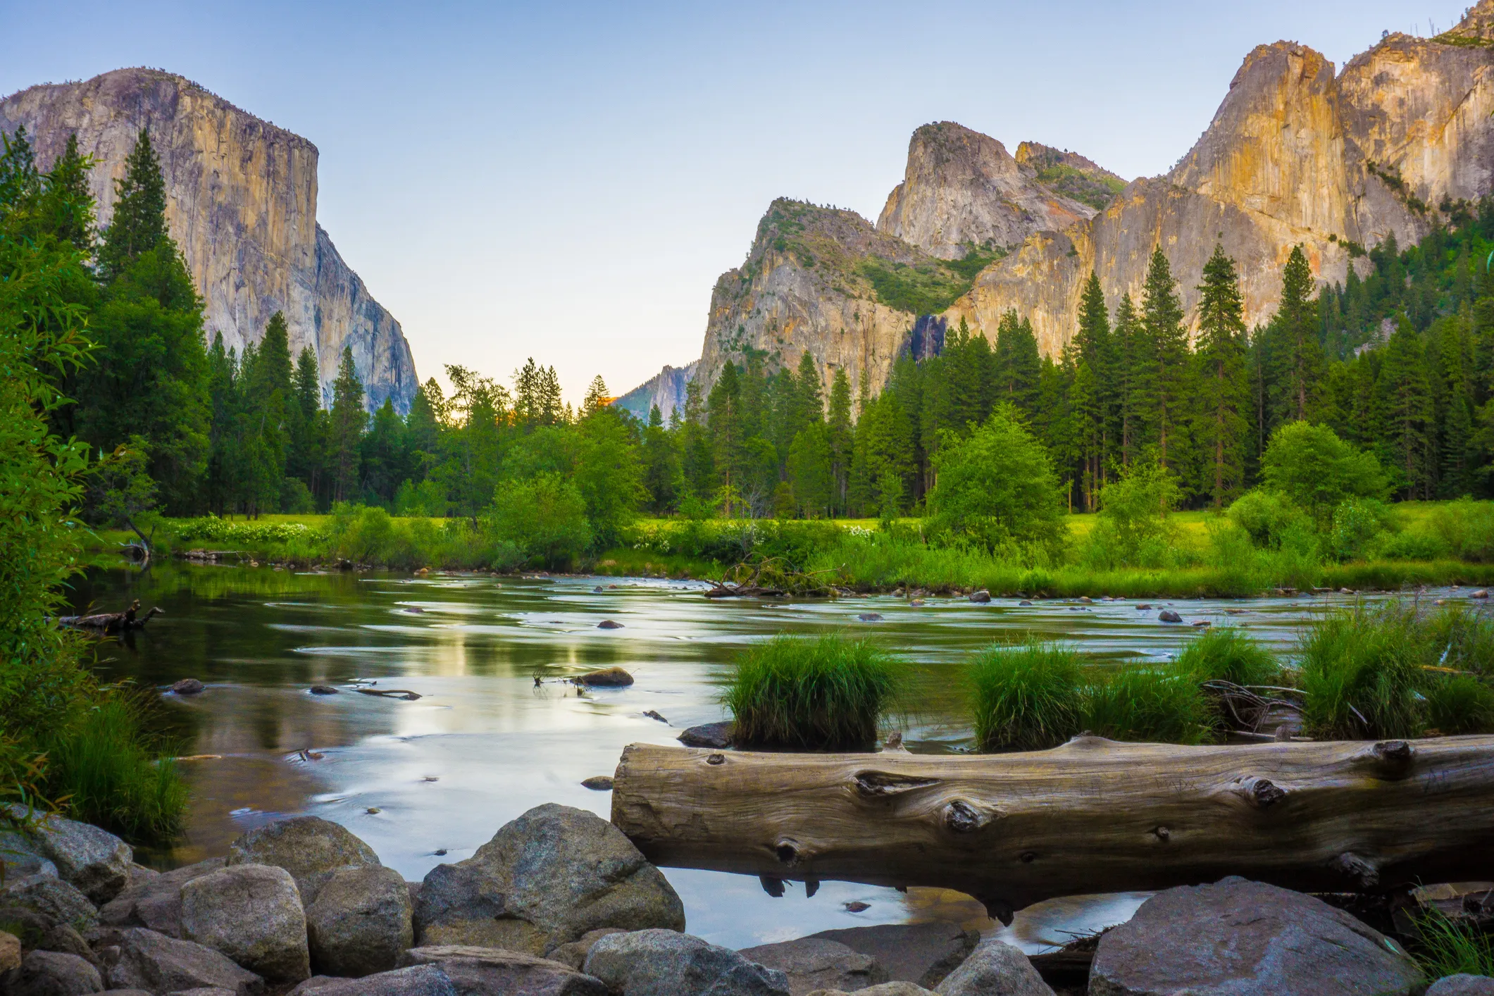
3- Role of Protected Areas and National Parks as Planning Units

Slide 16
3- Protected Areas and National Parks in Sustainable Tourism
      - Serve as critical planning units for sustainable tourism
      - Provide a framework to:
      Manage visitor impacts
      Conserve natural and cultural resources
      Generate economic benefits for local communities
      - Use detailed management plans addressing:
      Ecological dimensions
      Social dimensions
      Economic dimensions

Slide 17
3- Protected Areas and National Parks in Sustainable Tourism
      -Role of Protected Areas and National Parks as Planning Units
      - Resource Management:
      Preserve ecosystems, species, and landscapes
      Serve as ideal units to plan tourism respecting conservation goals
      - Geographic Focus
      - Contained units for monitoring and managing tourism impacts
      Visitor numbers
      Infrastructure development
      Resource use

Slide 18
3- Protected Areas and National Parks in Sustainable Tourism
      Role of Protected Areas and National Parks as Planning Units
      - Integration of Multiple Goals
      - Management plans balance:
      Conservation
      Recreation
      Local economic development
      Cultural heritage preservation
      - Supports a holistic approach to sustainable tourism

Slide 19
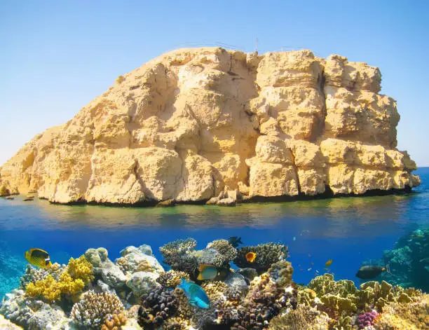
4- Ras Mohammed National Park, Egypt

Slide 20
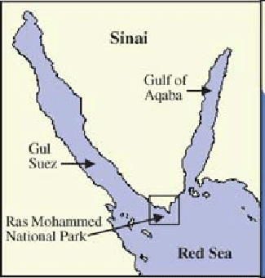
4- Ras Mohammed National Park, Egypt
      - Established: 1983 as Egypt’s first national park.
      - Location:
      Southern tip of the Sinai Peninsula
      - Significance:
      World-renowned for coral reefs, marine biodiversity and
      dramatic desert-marine landscapes.
      - Tourism Role:
      A key dive and snorkeling destination

Slide 21

4- Ras Mohammed National Park, Egypt
      4.1- Tourism Pressures on Coral Reef Ecosystems
      Physical Damage:
      - Anchors, divers, and snorkelers harm coral structures
      Waste and Pollution:
      - Boats and visitors contribute to water contamination
      Habitat Disturbance:
      - Impacts marine species and biodiversity
      Overcrowding:
      - Visitor numbers can exceed local carrying capacity

Slide 22
4- Ras Mohammed National Park, Egypt
      4.4- Planning and Management Measures for Sustainable Tourism
      A- Zoning System
      Core Conservation Zones:
      - Strictly protected, no tourism
      Recreational Zones:
      - Diving and snorkeling allowed under guidelines
      Buffer Zones:
      - Limited low-impact activities

Slide 23
4- Ras Mohammed National Park, Egypt
      4.2- Planning and Management Measures for Sustainable Tourism
      B- Visitor Management Tools
      - Entrance fees fund conservation and park operations
      - Limits on boat anchoring; use of fixed mooring buoys
      - Trained park rangers monitor visitor behavior and ecosystem health

Slide 24
4- Ras Mohammed National Park, Egypt
      4.2- Planning and Management Measures for Sustainable Tourism
      C- Environmental Impact Mitigation
      - Conduct Environmental Impact Assessments for new facilities
      - Education programs and signage for reef-safe practices
      D- Community and Stakeholder Engagement
      - Collaborate with local dive operators, NGOs, and government agencies
      - Public awareness campaigns promoting sustainable diving

Slide 25
4- Ras Mohammed National Park, Egypt
      4.3- Outcomes of Protected Area Management
      Environmental:
      - Coral reef degradation slowed in managed zones
      Economic:
      - Stable tourism revenues reinvested in park maintenance
      Model Example:
      - Ras Mohammed demonstrates how protected areas balance tourism growth with ecosystem conservation

Slide 26
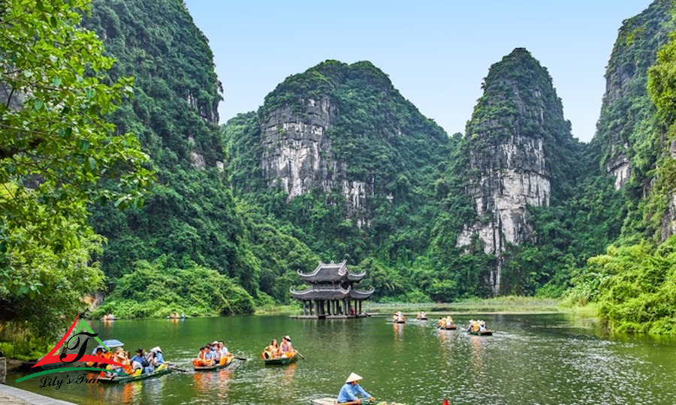
5- Environmental Impact Mitigation

Slide 27
5- Environmental Impact Mitigation
      - A systematic process to identify and evaluate potential effects
      - Applied to projects, plans, programs, or policies
      - Assesses impacts on physical, biological, cultural
      and socioeconomic environments.
      - The EIA includes 7 stages:
EIA
Screening
Impact Management
The EIA Report
Review & Licensing
Monitoring
Scoping
Impact Assessment & Mitigation

Slide 28
5- Environmental Impact Mitigation
      A- Screening in EIA
      - First stage of the EIA process
      - Determines whether a full assessment is needed or not
      - Follows legal procedures to ensure consistency across projects
      Key Contributions of Screening
      - Enables informed decision-making through factual analysis
      - Filters out unsound proposals early
      - Helps refine projects or policies to reduce negative impacts
EIA
Screening
Impact Management
The EIA Report
Review & Licensing
Monitoring
Scoping
Impact Assessment & Mitigation

Slide 29
5- Environmental Impact Mitigation
      B- Scoping in EIA
      - Identifies key issues to focus on
      - Eliminates less relevant concerns
      - Sets the boundaries and framework for the EIA process
      Purpose of Scoping
      - Define what to analyze and how
      - Reduce risk of overlooking or overloading issues
      - Ensure a focused, efficient assessment
EIA
Screening
Impact Management
The EIA Report
Review & Licensing
Monitoring
Scoping
Impact Assessment & Mitigation

Slide 30
5- Environmental Impact Mitigation
      C- Impact Assessment in EIA
      - Evaluates the environmental and social impacts.
      - Uses qualitative and quantitative data
      - Supports informed decision-making and alternative selection
      Mitigation Measures
      - Actions to prevent, reduce, or compensate for identified impacts:
      Prevention: Avoiding impacts completely
      Reduction: Minimizing severity or duration of impacts
      Compensation: Offsetting unavoidable impacts
EIA
Screening
Impact Management
The EIA Report
Review & Licensing
Monitoring
Scoping
Impact Assessment & Mitigation

Slide 31
5- Environmental Impact Mitigation
      D- Impact Management in EIA
      - Involves planning, managing, and monitoring mitigation actions throughout the project lifecycle
      - Aims to address ongoing risks, such as:
      Technology failures
      Natural disasters
      Environmental Management Plan (EMP)
      - A mandatory component of most EIA reports
      Specific mitigation measures
      Monitoring protocols
      Roles and responsibilities for implementation
      Emergency response strategies
EIA
Screening
Impact Management
The EIA Report
Review & Licensing
Monitoring
Scoping
Impact Assessment & Mitigation

Slide 32
5- Environmental Impact Mitigation
      E- The EIA Report
      - A comprehensive document that compiles all findings from the EIA process, including:
      - Project description
      - Environmental and social impact assessment
      - Mitigation measures
      - Management and monitoring plans
EIA
Screening
Impact Management
The EIA Report
Review & Licensing
Monitoring
Scoping
Impact Assessment & Mitigation

Slide 33
5- Environmental Impact Mitigation
      F- Review and Licensing
      - Final Step of the EIA Process
      - To evaluate the quality of the EIA report and decide whether the project can be approved.
      In the Review stage:
      - Authorities assess the data, methods, and conclusions in the EIA report.
      - Determine whether the project adequately addresses environmental
      and social risks.
      Can result in:
      - Project approval (license granted)
      - Request for changes or more data
      - Rejection of the project
EIA
Screening
Impact Management
The EIA Report
Review & Licensing
Monitoring
Scoping
Impact Assessment & Mitigation

Slide 34
5- Environmental Impact Mitigation
      G. Monitoring
      - To track environmental and social impacts throughout the entire project lifecycle.
      Ensures that:
      - Mitigation measures are implemented effectively
      - The Environmental Management Plan (EMP) is followed
      - Contingency plans are ready for unexpected issues
EIA
Screening
Impact Management
The EIA Report
Review & Licensing
Monitoring
Scoping
Impact Assessment & Mitigation

Slide 35
Thank you
      European Institute of Innovation, Entrepreneurship and Technology
      Lessingstraße 79,
      13158 Berlin, Germany
      Phone: +49 176 55524449
      Email: info@eiiet.com
Discover the world of eiIET

