Slide 1

Sustainable Tourism in Canada: Concept, Challenges & Roadmap
Submitted by : SHUBHAM

Slide 2
What is Sustainable Tourism?
Tourism that meets present needs without harming future generations.
Integrates environmental, social, and economic sustainability.
Focuses on reducing waste, emissions, and overuse of natural resources.
Supports Indigenous communities, heritage conservation, and local jobs.
Aligned with UN SDGs and Canada’s Federal Sustainable Development Strategy.

Slide 3
Why It Matters for Canada
Canada is home to vast natural landscapes: Rockies, Arctic, and 48 national parks.
Tourism contributes over $100 billion annually to the Canadian economy.
Growing global demand for eco-friendly travel boosts Canada’s competitiveness.
Indigenous tourism offers authentic cultural experiences and reconciliation pathways.
Climate change (wildfires, melting glaciers) directly impacts tourism seasons.

Slide 4
Key Challenges: Environmental
Wildfires, floods, and rising temperatures disrupt seasonal tourism.
Overcrowding in hotspots like Banff, Jasper, and Niagara Falls.
Wildlife disturbance and habitat degradation from unmanaged tourism.
Heavy carbon footprint from long-haul travel into Canada.
Waste and water stress in remote northern communities.

Slide 5
Key Challenges: Socio-economic & Governance
Overtourism strains local infrastructure in popular destinations.
Revenue leakage from foreign-owned operators reduces local benefits.
Limited capacity building for Indigenous and rural communities.
Inconsistent adoption of sustainable standards across provinces.
Balancing economic growth with conservation responsibilities.

Slide 6

Canada’s Policy Landscape
Federal Sustainable Development Strategy 2022–2026 guides eco-practices.
Parks Canada promotes conservation-linked tourism in protected areas.
Provincial eco-tourism policies encourage green infrastructure.
Support for Indigenous tourism through the Indigenous Tourism Association of Canada (ITAC).
Incentives for clean energy, green buildings, and EV mobility in destinations.

Slide 7
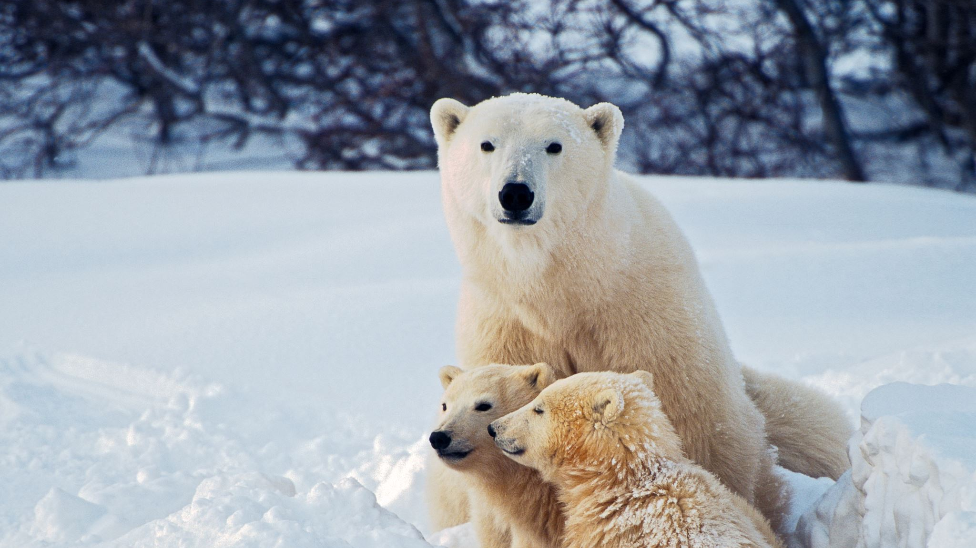
Case Examples
Banff & Jasper National Parks: Visitor caps and wildlife corridor protections.
Churchill, Manitoba: Polar bear tourism with strict ecological guidelines.
Tofino, British Columbia: Sustainable surf tourism and eco-lodges.
Nunavut & Yukon: Indigenous-led tourism preserving Arctic traditions.
Niagara Region: Green initiatives to reduce congestion and pollution.

Slide 8
Implementation Strategies
Apply visitor carrying capacity and limit peak-season crowds.
Invest in green mobility: EV buses, cycling paths, and public transit.
Promote zero-waste and water efficiency at major tourist hubs.
Strengthen Indigenous partnerships in decision-making and ownership.
Expand eco-certification for hotels, lodges, and tour operators.

Slide 9
Stakeholders & Their Roles
Federal/Provincial Governments: Standards, funding, and enforcement.
Parks Canada: Conservation management in national parks.
Indigenous communities: Lead authentic tourism and cultural preservation.
Private operators: Adopt green technologies and fair employment.
NGOs & Academia: Research, training, and impact evaluation.

Slide 10
Financing Sustainable Tourism
Federal and provincial grants for eco-tourism projects.
Green bonds and sustainable investment funds for infrastructure.
Tax credits for businesses adopting green practices.
Public–private partnerships for conservation and mobility projects.
Visitor fees reinvested into local conservation and community development.

Slide 11
Measuring Progress
Climate: CO₂ emissions per tourist, EV share in destinations.
Water: Consumption per visitor, % recycled/reused water.
Waste: Kg waste per tourist, % diverted from landfills.
Economy: % local spend, Indigenous business participation.
Culture/Nature: Protected sites with conservation plans, biodiversity indicators.

Slide 12
12 – 12-Month Roadmap
Pilot sustainable tourism initiatives in Banff and Tofino.
Launch plastic-free guidelines for major festivals and events.
Expand EV charging stations at popular tourist sites.
Train 1,000 tourism operators in eco-certification standards.
Publish annual sustainability scorecards for national parks.

Slide 13
Conclusion
Canada’s tourism must grow responsibly to protect nature and culture.
Focus areas: capacity limits, green mobility, and zero-waste systems.
Indigenous leadership is central to authentic and sustainable tourism.
Transparency and measurement will build trust with global travelers.
Sustainability is Canada’s competitive advantage in global tourism.

Slide 14
References
Destination Canada. (2021). Sustainable travel in Canada: Building a better tomorrow. https://www.destinationcanada.com
Government of Canada. (2022). Federal sustainable development strategy 2022–2026. https://www.fsds-sfdd.ca
Parks Canada. (2020). Sustainable tourism in national parks. https://parks.canada.ca
United Nations World Tourism Organization (UNWTO). (2021). Sustainable tourism development in North America. https://www.unwto.org
McCool, S. F., & Bosak, K. (2019). Sustainable tourism and protected areas: Canadian case studies and lessons. Routledge.
Dolnicar, S., & Grün, B. (2020). Challenges and opportunities for sustainable tourism in Canada. Journal of Sustainable Tourism, 28(9), 1381–1399. https://doi.org/10.1080/09669582.2020.1720691

