Slide 1

Global Horizons Travel & Tours
Comprehensive Marketing Campaign for New Tourism Destination

Slide 2
Introduction to the Campaign
Launching Azure Haven, a new eco-luxury destination in the Maldives.
Promote sustainable tourism.
Drive pre-launch bookings.
2
1
3

Slide 3
Marketing Objectives
01
02
03
Awareness
Bookings
Brand Loyalty
Reach 100,000+ impressions through multi-channel promotion.
Achieve 15% pre-launch reservations.
Strengthen traveler relationships with personalized communication.

Slide 4
Azure Haven – The Destination
Location
Nature
Features
Private island in the Maldives.
Overwater eco-villas with solar power. Coral reef conservation programs.
Spa retreats and adventure excursions.

Slide 5
Target Audience and Segmentation
Luxury Traveler | High-end tourists seeking exclusive experiences.
Eco-Conscious Tourists | Interested in sustainability.
New weds & Couples | Seeking romantic getaways.
Corporate Groups | Hosting retreats and team-building events.

Slide 6
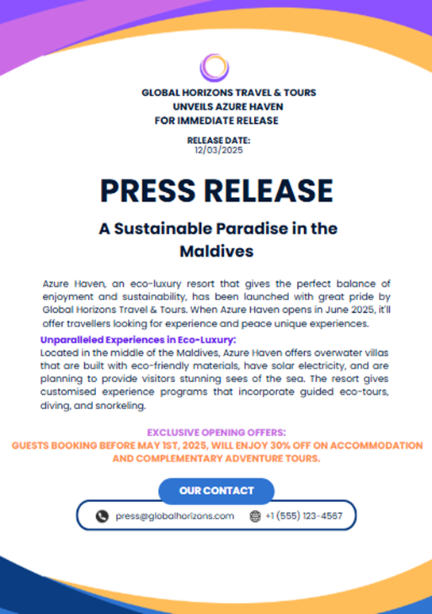
Press Release Overview
Announcing the launch of Azure Haven to global media.
Eco-luxury features like Sustainable accommodations.
Exclusive opening offers such as 30% discount + free excursions.
Encouraging media coverage and inquiries.

Slide 7
Personalized Customer Emails
Discover Azure Haven – Your Eco-Luxury Escape.
Introduction to Azure Haven.
Special opening offers.
Call-to-action (CTA) to encourage early bookings.

Slide 8
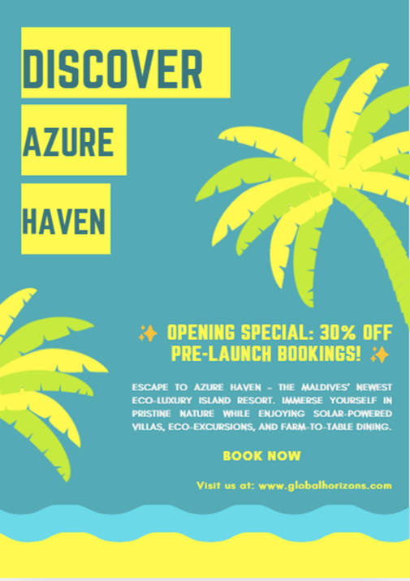
Advertising Copy
Social Media Ad
Escape to Azure Haven – Where Luxury Meets Sustainability
Print Ad
Romantic villa image + persuasive CTA
Feature
Highlighting exclusivity and eco-luxury

Slide 9
Key Communication Strategies
Language
Cultural Sensitivity
Clear, persuasive, and engaging.
Respect for diverse cultures in imagery and references.
Tone
Cultural
Emotionally compelling (e.g., “paradise,” “exclusive”).
Localized language in international ads.

Slide 10
Key Findings and Recommendations
Outcome
Effective communication drives engagement.
Findings
Sustainability messaging attracts eco-conscious travelers.
Recommendations
Expand campaign to influencer collaborations.

Slide 11
Reference
Statista. (2024). Tourism industry in the Maldives. https://www.statista.com
Volgger, M., Erschbamer, G., & Pechlaner, H. (2021). Destination design: New perspectives for tourism destination development. Journal of Destination Marketing & Management, 100561. https://doi.org/10.1016/j.jdmm.2021.100561
World Travel & Tourism Council (WTTC). (2023). Global tourism economic impact report 2022. https://www.wttc.org
Xiao, X., Fang, C., Lin, H., & Chen, J. (2022). A framework for quantitative analysis and differentiated marketing of tourism destination image based on visual content of photos. Tourism Management, 93, 104585. https://doi.org/10.1016/j.tourman.2022.104585

Slide 12
Thank
You

