Slide 1
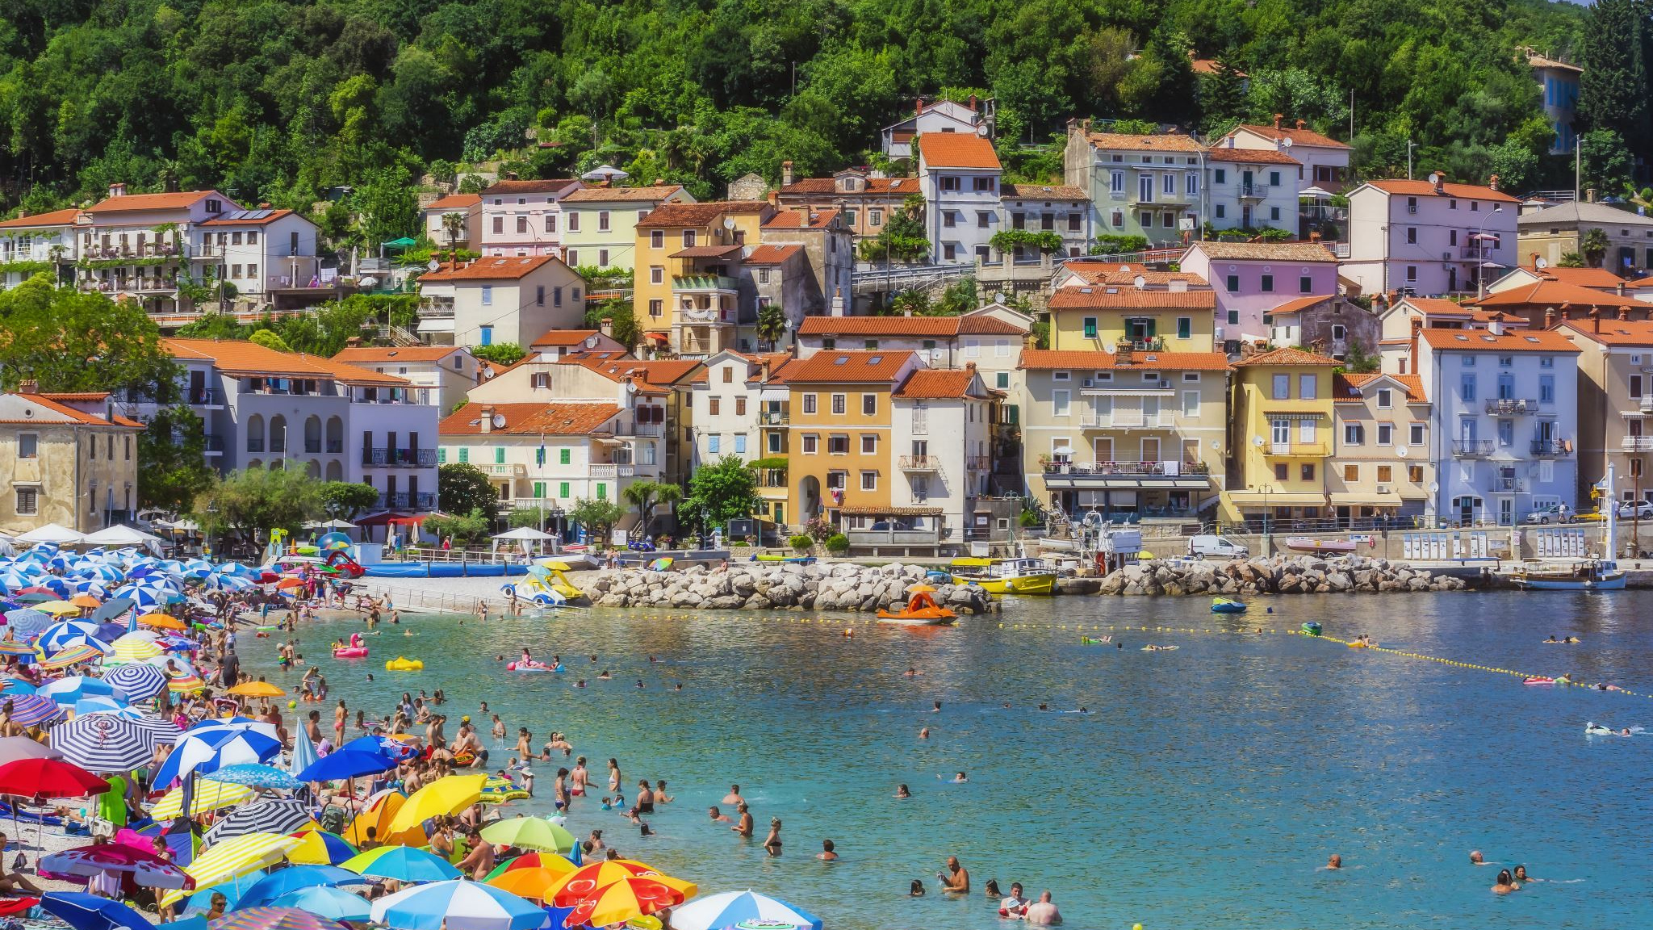
The Benefits and Disadvantages of Tourism
Name: Safin Arafat
ID: DE240023
Subject and Class: Sociology of Tourism

Slide 2

Introduction
What is Tourism?
Movement of people for leisure, business, or cultural experiences.
Why is Tourism Important?
A major contributor to the global economy and job creation.
Objective of the Presentation
To explore the benefits and disadvantages of tourism.
To highlight the need for sustainable tourism practices.

Slide 3

Benefits of Tourism
Economic Benefits of Tourism
Job creation across multiple sectors (Birinci et al., 2018)
Contribution to GDP and foreign exchange earnings (Algieri et al., 2018)
Development of infrastructure and local businesses
Social and Cultural Benefits
Promotes cultural exchange and global understanding (Scott et al., 2019)
Preservation of cultural heritage sites (Bastian et al., 2015)
Community development and empowerment
Environmental Benefits
Promotion of eco-tourism and sustainable travel (Sainaghi & Baggio, 2017)
Increased awareness of environmental conservation
Protection of natural habitats through tourism revenue

Slide 4
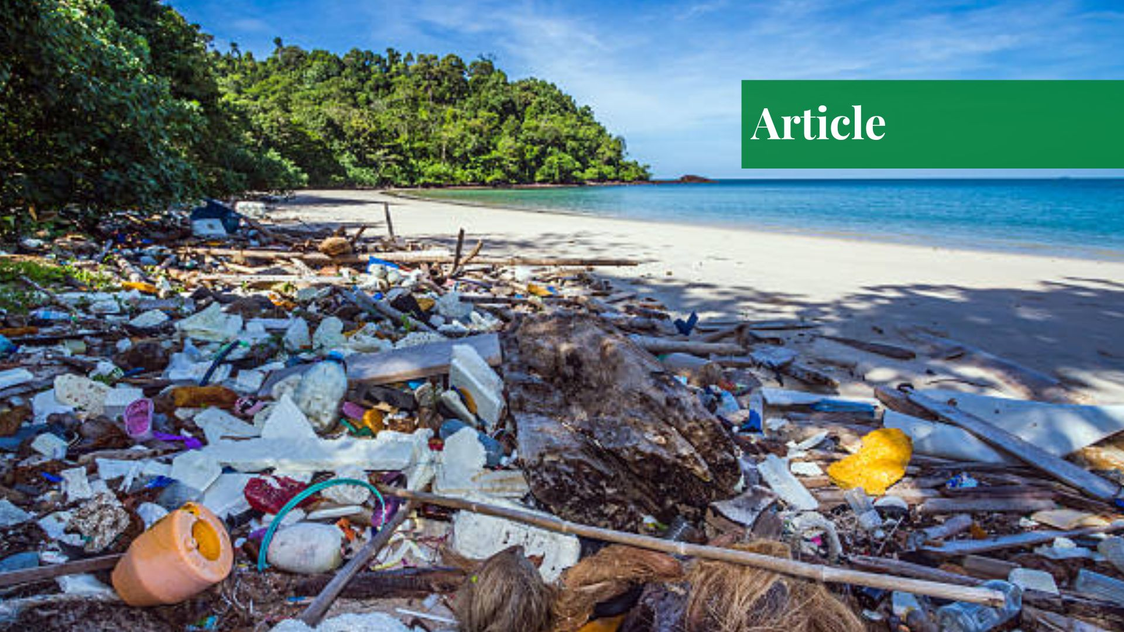
Disadvantages of Tourism
Environmental Disadvantages
Pollution (air, water, and waste) (Reintinger et al., 2016)
Habitat destruction and biodiversity loss
Resource depletion (water, energy, and land use)
Economic and Social Disadvantages
Economic dependence on tourism (Manchanda & Deb, 2022)
Seasonal employment and job insecurity
Cultural commodification and authenticity loss (Koens et al., 2018)
Sustainable Tourism Strategies
Implementing responsible tourism policies
Promoting eco-tourism and local business support
Visitor management and environmental regulations

Slide 5
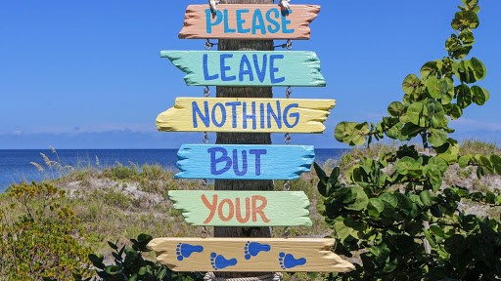
Sustainable Tourism Strategies
Implementing responsible tourism policies
Promoting eco-tourism and local business support
Visitor management and environmental regulations

Slide 6

Conclusion
Tourism offers both opportunities and challenges
Need for a balanced approach with sustainability
Future of tourism depends on strategic management

Slide 7
References
Algieri, B., Aquino, A., & Succurro, M. (2018). International competitive advantages in tourism: An eclectic view. Tourism management perspectives, 25, 41-52.
Bastian, O., Stein, C., Lupp, G., Behrens, J., Renner, C., & Grunewald, K. (2015). The appreciation of nature and landscape by tourism service providers and visitors in the Ore Mountains (Germany). Landscape online, 41-41.
Birinci, H., Berezina, K., & Cobanoglu, C. (2018). Comparing customer perceptions of hotel and peer-to-peer accommodation advantages and disadvantages. International Journal of Contemporary Hospitality Management, 30(2), 1190-1210.
Garrido-Iñigo, P., & Rodríguez-Moreno, F. (2015). The reality of virtual worlds: Pros and cons of their application to foreign language teaching. Interactive Learning Environments, 23(4), 453-470.
Koens, K., Postma, A., & Papp, B. (2018). Is overtourism overused? Understanding the impact of tourism in a city context. Sustainability, 10(12), 4384.
Manchanda, M., & Deb, M. (2022). Effects of multisensory virtual reality on virtual and physical tourism during the COVID-19 pandemic. Current Issues in Tourism, 25(11), 1748-1766.
Reintinger, C., Berghammer, A., & Schmude, J. (2016). Simulating changes in tourism demand: A case study of two German regions. Tourism Geographies, 18(3), 233-257.
Sainaghi, R., & Baggio, R. (2017). Complexity traits and dynamics of tourism destinations. Tourism Management, 63, 368-382.
Scott, N., Zhang, R., Le, D., & Moyle, B. (2019). A review of eye-tracking research in tourism. Current Issues in Tourism, 22(10), 1244-1261.
Tokarchuk, O., Gabriele, R., & Maurer, O. (2016). Tourism intensity impact on satisfaction with life of German residents. Tourism Economics, 22(6), 1315-1331.
Viglia, G., & Dolnicar, S. (2020). A review of experiments in tourism and hospitality. Annals of Tourism Research, 80, 102858.

