Slide 1
Tourist Regions and Attractions
European Institute of Innovation, Entrepreneurship and Technology
Lessingstraße 79, 13158 Berlin, Germany
Mahmoud Abdou| Berlin
      Lessingstraße 79,
      13158 Berlin, Germany
      Phone: +49 30 233618555
      Fax: +49 30 233618556
      Email: info@eiiet.com

Slide 2
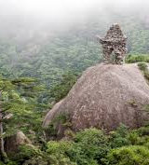
Index
- The Geography of Resources for Tourism
- Planning and Tourism Development
- Geography and the Physical Features
- Geography and the Cultural Features

Slide 3
1- The Geography of Resources for Tourism
      1.1- Characteristics of Tourism Resources:
      A- The Tangibility / Physicality
    Tangibility and Economic Value
    - Tourism resources are typically tangible features such as landscapes, natural sites, and places.
    - These features must be recognized as economically valuable by the tourism sector and tourists.

Slide 4
1- The Geography of Resources for Tourism
    A- The Tangibility / Physicality
    Value is Perception-Driven
    - A place becomes a tourism resource only when perceived as valuable.
    Historical example:
    - Mountains were once seen as dangerous barriers.
    - In the 18th century, perceptions shifted, and they became scenic attractions.

Slide 5
1- The Geography of Resources for Tourism
    A- The Tangibility / Physicality
    Value Can Change Over Time
    Beaches:
    - Not seen as attractive until sunbathing gained popularity in the 1920s.
    - Today, changing again due to health concerns (e.g., skin cancer).

Slide 6
1- The Geography of Resources for Tourism
    B- The Multiple Use
    Shared and Competing Uses
    - Most tourism resources are shared with other sectors:
    - Agriculture - Forestry
    - Water management - Local communities and services
    Tourism is rarely the dominant land use:
    - Exception: resorts or theme parks
    - Example: many beaches are still more vital for local fishing or construction than tourism

Slide 7
1- The Geography of Resources for Tourism
    B- The Multiple Use
    Conflict potential:
    - Tourism often arrives after other land uses are established.
    Multiple use usually requires:
    - Skilful management
    - Coordinated planning among stakeholders

Slide 8
1- The Geography of Resources for Tourism
    C- Perishability
    Physical vulnerability:
    - Tourist pressure can alter or destroy natural and cultural assets.
    Service-based perishability:
    - Tourism services (e.g., hotel beds, theme park rides) are:
    - Time- and location-bound
    - Impossible to store or stockpile

Slide 9
1- The Geography of Resources for Tourism
    C- Perishability
    - Tourism resources cannot be stored or stockpiled.
    - Services like hotel rooms or transport seats are lost if not used in real time.
    This perishability has led to the development of yield management systems:
    - Aim to maximize consumption and revenue
    - Use dynamic pricing, forecasting, and booking strategies

Slide 10
2- Planning and Tourism Development
    - Tourism often targets fragile and unique environments.
    - These areas are attractive but highly sensitive to impact.
    Post-WWII outlook:
    - Tourism promoted as an "industry without chimneys”.
    - Seen as a solution to unemployment and economic stagnation.
    - Focused primarily on income, employment, and development.

Slide 11
2- Planning and Tourism Development
    Neglected Consequences:
    - Environmental degradation
    - Social and cultural disruption
    - These impacts were harder to quantify than economic gains
    Shift Since the 1980s:
    - Sustainable tourism development emerges
    - Emphasis on balancing economic benefits with:
    - Environmental protection
    - Host community well-being

Slide 12
2- Planning and Tourism Development
    1.1- Tourism Planning
    The Role of Tourism Planning
    - From rigid to flexible planning:
    - Shift from fixed physical models to adaptive, benefit-focused strategies
    Core goals of modern tourism planning:
    - Maximise benefits, minimise negative impacts
    - Plan for both the visitor and the resource

Slide 13
2- Planning and Tourism Development
    1.1- Tourism Planning
    Characteristics of Effective Tourism Planning
    - Evidence-based: Grounded in sound research
    - Community involvement: Locals help set goals and priorities
    - Holistic perspective: Tourism is interconnected with the environment, society, and economy
    - Collaborative execution:
    Led by government
    In partnership with the private sector

Slide 14
2- Planning and Tourism Development
    1.1- Tourism Planning Approaches can include:
    What type of tourist will visit?
    - Target audience, preferences, motivations
    What is the scale of tourism?
    - Anticipated volume of visitors, infrastructure needs
    Where will development take place?
    Site selection, zoning, land use compatibility

Slide 15
2- Planning and Tourism Development
    1.1- Tourism Planning Approaches can include:
    What controls will be placed on development?
    - Regulations, sustainability safeguards, visitor limits
    How will development be financed?
    - Public vs private investment, funding models
    What will be the government’s role?
    - Policy-making, enforcement, partnerships

Slide 16
2- Planning and Tourism Development
    1.2- Tourism Planning and Carrying Capacity in Tourism:
    - Carrying capacity refers to the ability of a destination to accommodate tourism without deteriorating its environment, economy, culture, or visitor experience.
    It highlights the relationship between:
    - The resource base (natural, cultural, and infrastructural assets)
    - The market (type and number of tourists).
    It is defined as:
    “The maximum number who can use a site without unacceptable deterioration in the physical environment and without an unacceptable decline in the quality of experience gained by visitors”.

Slide 17
2- Planning and Tourism Development
    2.1- Tourism Planning and Carrying Capacity in Tourism:
    Physical Carrying Capacity
    - Refers to the maximum number of tourists a site can accommodate.
    - Focuses on infrastructure limits (hotel rooms, restaurants, parking).
    - Ensures no immediate physical damage occurs due to overcrowding.

Slide 18
2- Planning and Tourism Development
    2.1- Tourism Planning and Carrying Capacity in Tourism:
    Ecological Carrying Capacity
    - Assesses tourism's impact on natural ecosystems.
    - Ensures long-term sustainability of land, water, flora, and fauna.
    - Considers limits beyond which environmental degradation occurs.

Slide 19
2- Planning and Tourism Development
    2.1- Tourism Planning and Carrying Capacity in Tourism:
    Psychological Carrying Capacity
    - Considers visitor satisfaction and perception.
    - Varies by type of tourist, activity, and destination.
    - Affected by crowding, noise, and perceived quality of experience.

Slide 20
2- Planning and Tourism Development
    2.1- Tourism Planning and Carrying Capacity in Tourism:
    Social Carrying Capacity
    - Examines social and cultural impacts of tourism on host communities.
    - Measures how tourism affects local quality of life, traditions, and values.
    - Reflects resident attitudes toward tourists and tourism development.

Slide 21
2- Planning and Tourism Development
    2.1- Tourism Planning and Carrying Capacity in Tourism:
    Economic Carrying Capacity
    - Focuses on a destination’s ability to support tourism without harming local economies.
    - Ensures tourism does not displace other industries (e.g., fishing, farming).
    - Balances profitability with opportunity costs and economic resilience.

Slide 22
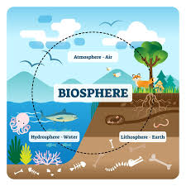
3- Geography and the Physical Features
    Earth’s biosphere consists of:
    Atmosphere (air), Hydrosphere (water), and Lithosphere (land)
    Hydrosphere
    Covers ~71% of the Earth’s surface.
    Five Oceans:
    - Pacific (largest) - Atlantic
    - Indian - Southern
    - Arctic (mostly ice-covered) - Australasia

Slide 23
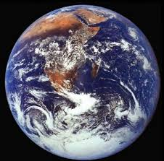
3- Geography and the Physical Features
    Lithosphere (Land)
    Covers 29% of Earth’s surface and comprises the seven Continents:
    - Asia (largest by land & population) -Africa
    - North America - South America
    - Antarctica -Europe (part of Eurasia)
    - Australasia
    Land-Sea Distribution
    - Northern Hemisphere: 40% land
    - Southern Hemisphere: 20% land

Slide 24
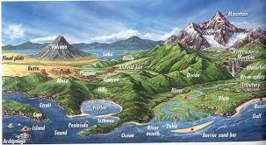
3- Geography and the Physical Features
    3.1- The Land
    The land surface of the Earth consists of different landforms such as:
    - Mountains: Elevated, rugged terrain
    - Hill Lands: Gently sloping, rolling terrain
    - Plateaus: Elevated flatlands
    - Lowland Plains: Flat, low-lying areas

Slide 25
3- Geography and the Physical Features
    3.1- The Land
    - Physical landforms are key attractions for geotourism.
    - Geotourism is a form of tourism centered on geological features.
    Many sites of geological importance are now recognized and protected as UNESCO Global Geoparks.
    Geoparks promote:
    - Education about Earth’s history
    - Conservation of geological heritage
    - Sustainable tourism and community involvement

Slide 26
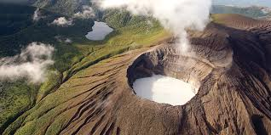
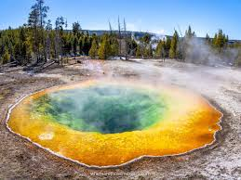
3- Geography and the Physical Features
    3.1- The Land
    These features include:
    A- Geothermal Features:
    - Volcanoes, crater lakes, calderas, lava formations
    - Geysers and hot springs — caused by Earth’s internal disturbances
    - Linked to geologically active zones, like the Pacific Ring of Fire
    - Even inactive volcanic areas may have mineral-rich hot springs with
    therapeutic value
    - These often lead to the development of spas (health resorts)

Slide 27
3- Geography and the Physical Features
    3.1- The Land
    B- Karst Features:
    - Occur in limestone areas
    - Surface streams often disappear underground
    Result in striking landforms such as:
    - Gorges, sinkholes, and caverns
    Only a small fraction of the world’s subterranean cave systems have been:
    - Explored
    - Made safe for tourists as ‘show caves’

Slide 28
3- Geography and the Physical Features
    3.1- The Land
    C- Glaciated Features
    - Formed by frost and slow-moving ice, mainly from the last Ice Age (10,000 years ago)
    Common features include:
    - Spectacular mountain peaks
    - Bowl-shaped cirques (glacial hollows)
    - Moraines (deposited glacial material) in valleys
    - akes and waterfalls

Slide 29
3- Geography and the Physical Features
    3.1- The Land
    Attract tourists for:
    - Adventure and activity holidays (usually niche markets)
    - Winter sports like skiing and snowboarding (mass tourism)
    - Summer tourism highlights regions like the Alps for sightseeing and “lakes and mountains” holidays

Slide 30
3- Geography and the Physical Features
    3.2- The Coast
    Overcrowding and Litter:
    - Common in popular resorts during peak season
    - Linked to mass tourism and throwaway culture
    Coastal Water Pollution:
    - Industrial waste
    - Untreated sewage

Slide 31
3- Geography and the Physical Features
    3.2- The Coast
    Blue Flag Initiative
    - Adopted by many countries
    Criteria include:
    - Water quality monitoring
    - Lifeguard presence
    - Environmental management & education

Slide 32
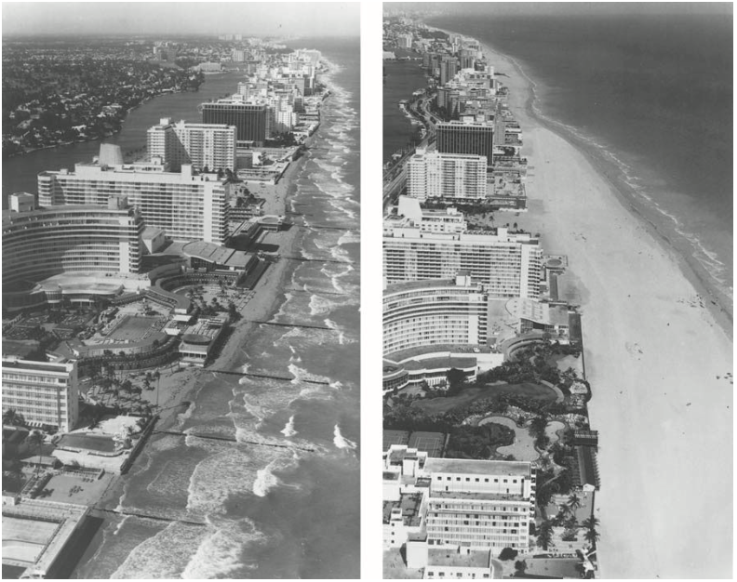
3- Geography and the Physical Features
    3.2- The Coast
    Beach Erosion
    - Caused by winter storms
    Solutions:
    - Costly beach replenishment schemes
    - Importing sand/material from other locations
Part of South Beach, Miami before and after replenishment in the early 1980s.
Source: Boniface and Cooper, (2009).

Slide 33
3- Geography and the Physical Features
    3.2- The Coast
    Coral Reefs and Tourism
    - Found on oceanic islands and tropical mainland coasts
    - Optimal sea temperatures: 23–29°C
    Require:
    - Clear, moderate-depth water
    - No cold currents or large river outflows (e.g., Amazon)

Slide 34
3 Geography and the Physical Features
    3.2- The Coast
    Ecological Importance
    - Extremely diverse ecosystems
    - Vital for marine biodiversity
    Recreational Activities:
    - Snorkelling
    - Scuba diving

Slide 35

3- Geography and the Physical Features
    3.2- The Coast
    Threats to Coral Reefs
    - Global warming (rising sea temperatures)
    - Sediment runoff from coastal development
    - Overfishing & oil spills
    - Sewage pollution
    - Physical damage by careless tourists

Slide 36
4- Geography and the Cultural Features
    4.1- Culture as a Tourism Resource
    Culture and arts are as vital as natural & sports resources
    Includes:
    - Creative industries: arts, entertainment, design
    - Heritage & lifestyle attractions
    Defining ‘Culture’ in Tourism
    - Intellectual view: High arts (theatre, classical music)
    - Tourism view: The Whole way of life of a society

Slide 37
4- Geography and the Cultural Features
    Tourists and Cultural Interest
    - Few are primarily culture-seekers
    - Most are drawn to everyday lifestyle differences
    Common Cultural Attractions
    Gastronomy
    - Performing arts (dance, music)
    - Visual arts & crafts
    - Markets & festivals
    - Folklore & traditions

Slide 38
4- Geography and the Cultural Features
    4.2- Tourism and the Positive Cultural Impacts
    Renewal of Cultural Pride
    - Encourages local communities to value their heritage
    - Boosts self-esteem and pride in cultural identity
    Revitalization of Customs and Traditions
    - Tourism creates demand for:
    Traditional festivals
    Local crafts and art forms
    Helps preserve practices that may otherwise decline

Slide 39
4- Geography and the Cultural Features
    4.2- Tourism and the Positive Cultural Impacts
    Cross-Cultural Exchange and Integration
    Facilitates interaction between hosts and guests through promoting:
    - Tolerance -Global understanding
    - Cultural appreciation
    Stimulus for Conservation and Heritage Preservation
    - Generates funds for protecting:
    Natural environments
    Historical sites and monuments
    Promotes responsible stewardship of cultural assets

Slide 40
4- Geography and the Cultural Features
    4.3- Tourism and the Negative Cultural Impacts
    Influence on Traditions and Customs:
    Cultural Disruption:
    - Alters traditions, customs, and values of host communities.
    One-Sided Exposure:
    - Locals constantly interact with changing tourists; tourists come and go.
    Long-Term Effects:
    - Even short-term tourism can reshape social and cultural structures

Slide 41
4- Geography and the Cultural Features
    4.3- Tourism and the Negative Cultural Impacts
    Cultural Drift and Demonstration Effect
    Cultural Drift:
    - Locals in seasonal destinations (Greece, Turkey) adapt tourists’ behaviors during the tourist season.
    - Later, they revert to their usual ways.
    Demonstration Effect:
    Locals imitate tourists’ language, food, fashion, and entertainment, leading to cultural homogenization.

Slide 42
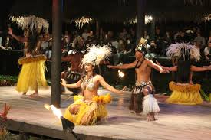
4- Geography and the Cultural Features
    4.3- Tourism and the Negative Cultural Impacts
    The Commodification of Culture
    - Tourists often prefer Western-style comforts
    (fast food, alcohol, brand-name products).
    - Destinations cater to these tastes, sometimes
    overlooking local goods and services.
    - High demand can lead to mass production,
    commercializing and commodifying local culture.

Slide 43
4- Geography and the Cultural Features
    4.3- Tourism and the Negative Cultural Impacts
    Tourist Demand for Traditional Events and ‘Staged Authenticity’
    - Tourists want to experience traditional activities and events.
    - This creates tension between authenticity and commercialization.
    - Many events are performed outside their original context, resulting in staged authenticity.

Slide 44
4- Geography and the Cultural Features
    Tourism and Geography

Slide 45
    Based on your country of origin or personal experience:
    Explain the relationship between tourism and commodification, with a special focus on the following questions:
    - Which aspects of culture are being commodified for tourism purposes (festivals, crafts, traditions)?
    - How has this commodification changed these cultural aspects or the way people engage with them?
    - What are the negative impacts of such commodification on local communities?
    - What strategies can be used to balance tourism development with cultural preservation?

Slide 46
Thank you
      European Institute of Innovation, Entrepreneurship and Technology
      Lessingstraße 79,
      13158 Berlin, Germany
      Phone: +49 176 55524449
      Email: info@eiiet.com
Discover the world of eiIET

