Slide 1
Structure of Tourism Markets
European Institute of Innovation, Entrepreneurship and Technology
Lessingstraße 79, 13158 Berlin, Germany
Mahmoud Abdou| Berlin
      Lessingstraße 79,
      13158 Berlin, Germany
      Phone: +49 30 233618555
      Fax: +49 30 233618556
      Email: info@eiiet.com

Slide 2
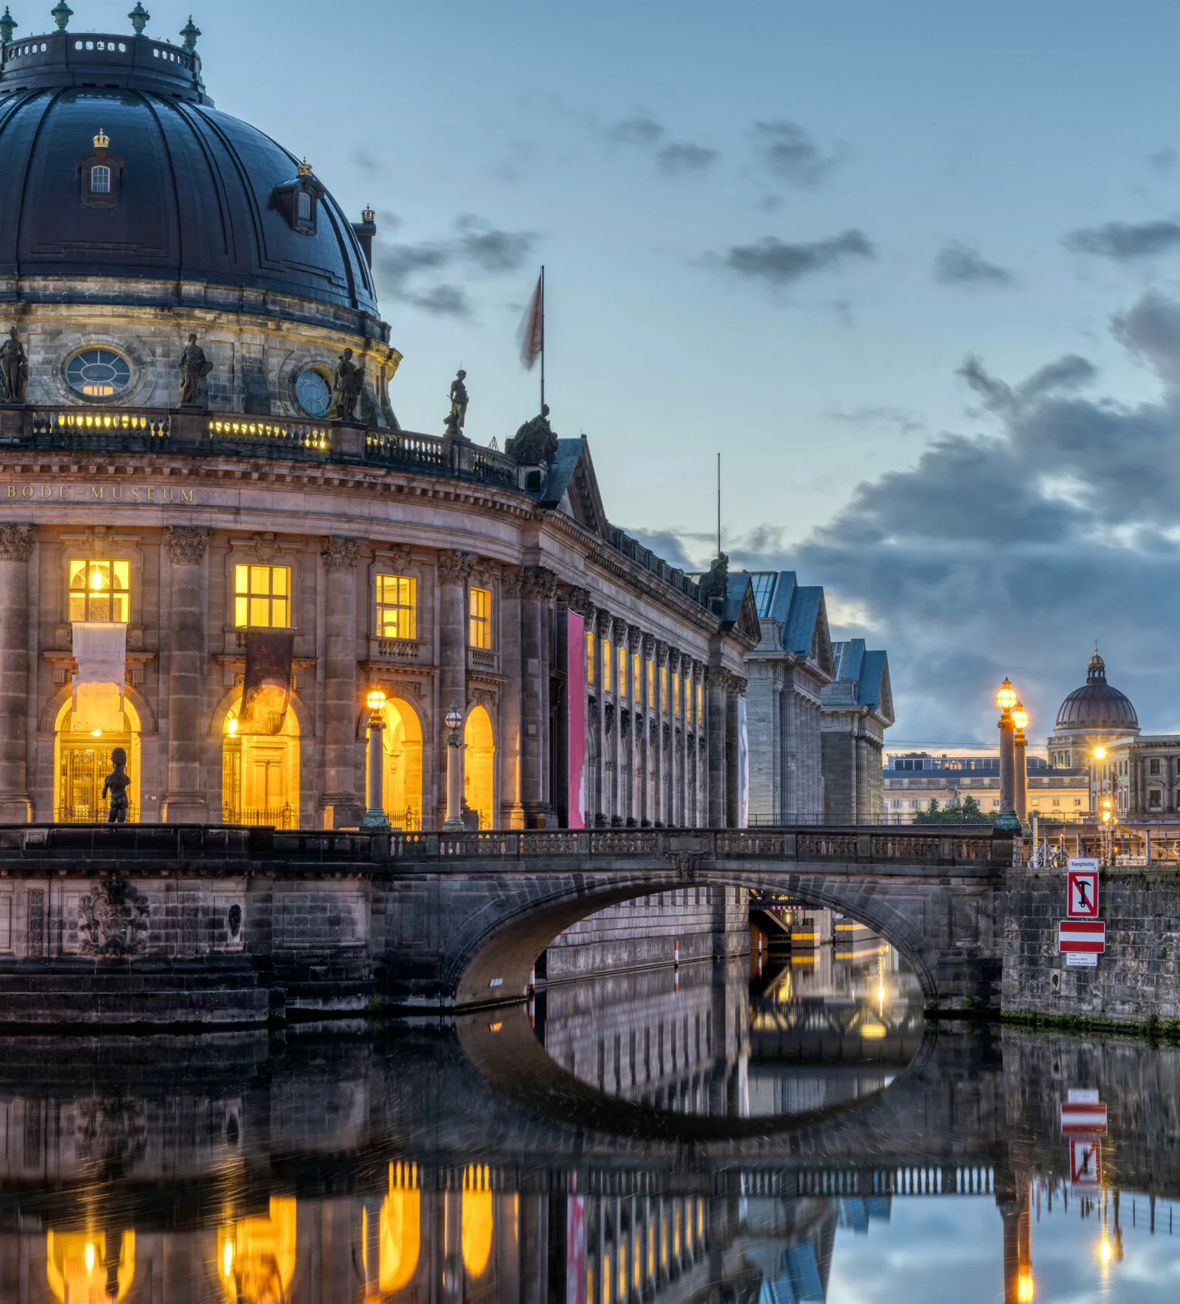
Outline
Tourism Market Segmentation
Benefits of Market Segmentation
Segmentation Variables
Components of Tourism Services

Slide 3
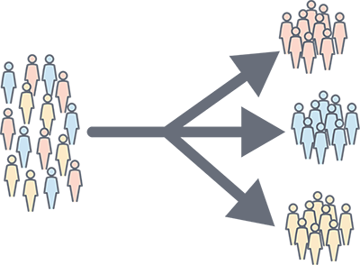
1- Tourism Market Segmentation
A- Tourism Market Segmentation
- Increasing competition in the tourism industry - Need to understand customers’ diverse needs and preferences - Market segmentation: dividing a large market into smaller groups - Groups share similar needs and characteristics

Slide 4
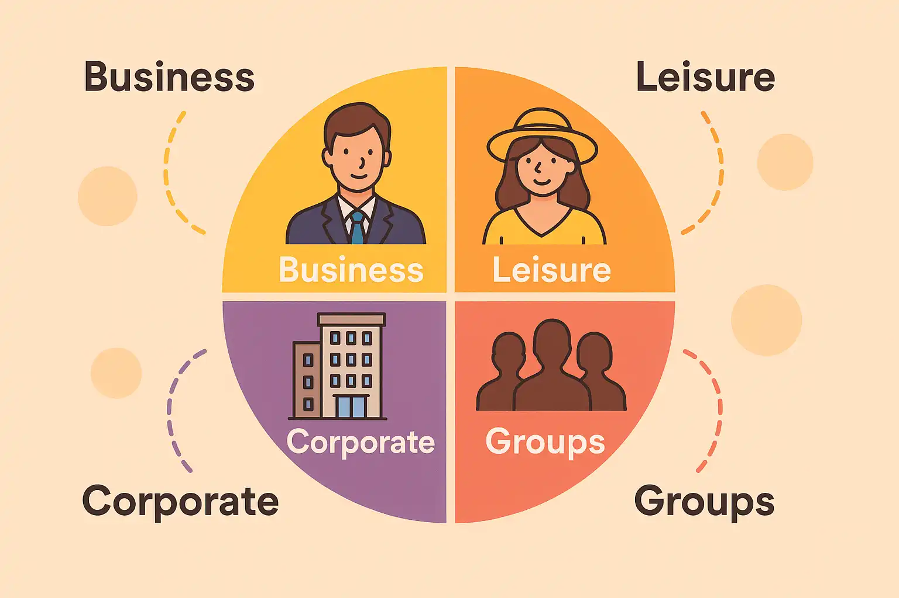
1- Tourism Market Segmentation
B- What Is Market Segmentation in Tourism?
- Dividing the tourism market into smaller consumer groups - Groups share similar needs or characteristics - Helps businesses tailor products and services - Supports targeted marketing messages - Increases customer satisfaction and loyalty

Slide 5
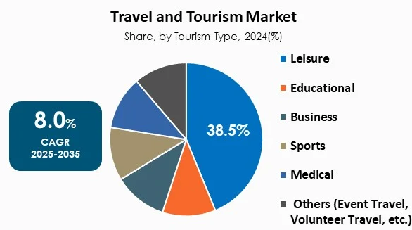
1- Tourism Market Segmentation
C- Why Segment the Tourism Market?
- Market segmentation → Specialisation → Competitive advantage - Focus on the needs of a specific tourist group - Develop expertise in serving that segment - Avoid trying to “be everything to everyone” - Build a stronger competitive position

Slide 6

1- Tourism Market Segmentation
Why Is Market Segmentation Important?
A- Understand customers Identify different needs, interests and behaviours Create more personalised experiences B- Target marketing Develop messages for specific customer groups Improve marketing effectiveness and engagement

Slide 7

1- Tourism Market Segmentation
Why Is Market Segmentation Important?
C- Increase customer satisfaction Offer products and services that match customer needs Encourage repeat visits and positive word-of-mouth D- Boost revenue Attract and retain specific customer segments Increase sales and profitability

Slide 8
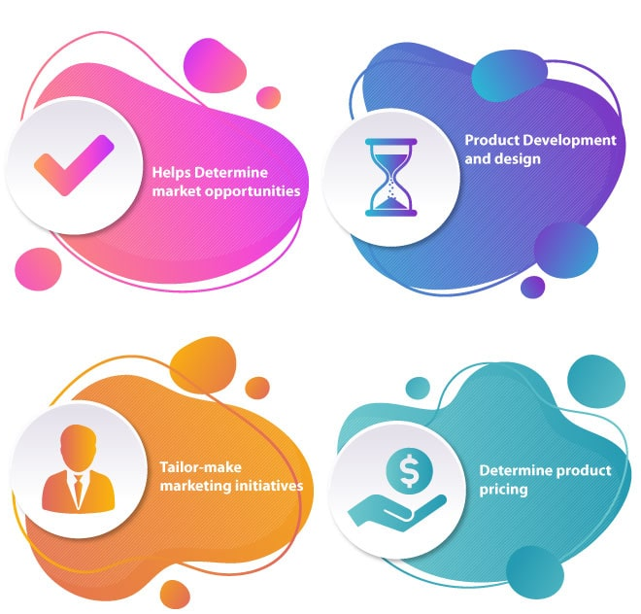
2- Benefits of Market Segmentation
Benefits of Market Segmentation
A- Reduce Competition Compete within a specific market segment Example: Ecotourism destinations B- Focus Product Development Adapt products to specific tourist needs Use resources more effectively Example: Family destination → less need for extensive nightlife

Slide 9
2- Benefits of Market Segmentation
Benefits of Market Segmentation
3- Focus Marketing Efforts Develop messages for the target segment Use the most effective communication channels Example: Young tourists → “Sun & fun” Ecotourists → Nature magazines 4- Increase Customer Satisfaction Better match between destination and tourist needs Higher satisfaction Encourage: Repeat visits and positive word-of-mouth

Slide 10
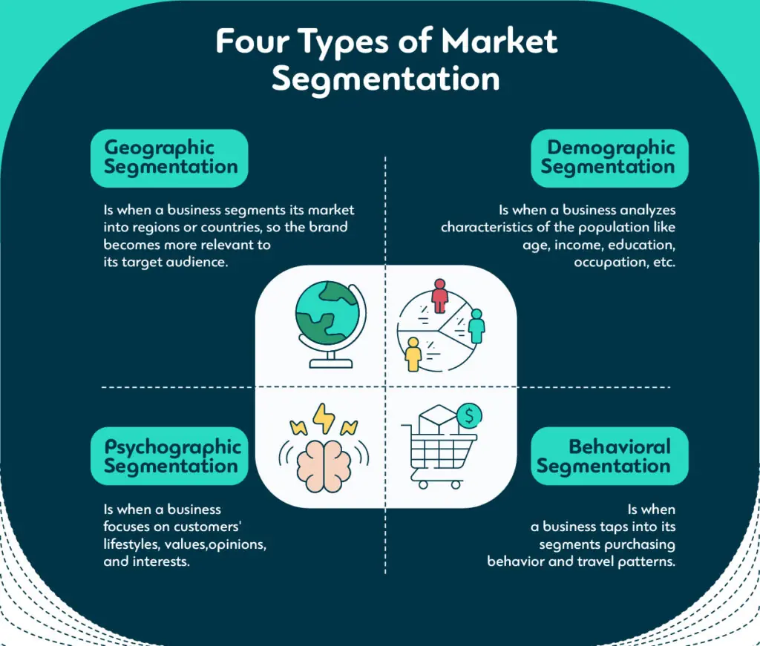
3- Segmentation Variables
Segmentation Standards
- Tourism markets can be segmented according to three main variables: A- Geographic Segmentation Based on where tourists live or come from Local / regional tourists: From nearby areas Domestic tourists: Travel within their own country Inbound tourists: Arrive from another country Helps businesses target specific geographic markets Example: Marketing a ski resort to tourists from regions with cold, snowy winters

Slide 11
3- Segmentation Variables
Segmentation Bases
B- Demographic Segmentation - It divides the tourism market based on measurable, statistical characteristics of tourists. - Age and gender: Different age and gender groups may have different travel preferences. - Ethnicity: May influence cultural needs, dietary requirements, and preferred holiday periods.

Slide 12
3- Segmentation Variables
Segmentation Bases
B- Demographic Segmentation - Disposable income: The amount of money available after paying essential expenses. It influences what type of tourism products tourists can afford. - Family status / household structure: Families may have different tourism needs from couples or business travellers.

Slide 13
3- Segmentation Variables
Segmentation Bases
C- Psychographic Segmentation - Based on personality, lifestyle, interests, values and attitudes Focuses on why tourists travel and what they value - Lifestyle: Active vs relaxed Hiking/sports → active lifestyle Spas/beaches → relaxed lifestyle - Socio-economic factors: Class, education and occupation Influence tastes and spending habits.

Slide 14
3- Segmentation Variables
Segmentation Bases
C- Psychographic Segmentation - Interests: Specific hobbies or passions Golfers, history enthusiasts, birdwatchers - Values and attitudes: Beliefs and principles Environmental values → ecotourism Ethical values → responsible tourism

Slide 15
3- Segmentation Variables
Segmentation Bases
D- Behavioural Segmentation - Based on tourists’ behaviours and actions Travel frequency: How often they travel Spending habits: How much they spend Travel motivations: Why they travel Booking behaviour: How and when they book Destination loyalty: First-time vs repeat visitors

Slide 16
4- Components of the Tourism System
Five Vital Components:
Attraction: Why do tourists visit? Accessibility: How can tourists reach the destination? Accommodation: Where can tourists stay? Amenities: What facilities and services are available? Activities: What can tourists do?
Tourism System Components
Attracations
Accessibility
Accommodation
Amenities
Activities

Slide 17

4- Components of the Tourism System
A- Attraction:
- Attractions are a key component of tourism - Provide the main reason for visiting a destination - Attract tourists from different places - Offer opportunities for experience, enjoyment and participation - Can include: Natural and cultural resources Historical and archaeological sites Events and festivals Leisure and entertainment

Slide 18
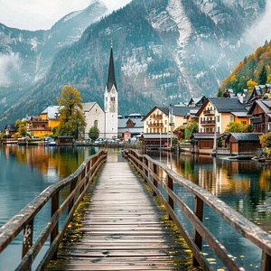
4- Components of the Tourism System
A- Attraction:
1- Natural Attractions 2- Man-made Attractions
Mountains | Beaches
Lakes and rivers | Landscapes
Flora and fauna | Wildlife and national parks
Monuments and historical buildings | Museums
Religious sites | Festivals and events
Theme and leisure parks | Shopping areas

Slide 19
4- Components of the Tourism System
B- Accessibility:
- Accessibility refers to how easily tourists can reach a destination - An attractive destination needs effective transport connections - Accessibility influences: Travel time Travel cost Convenience Destination choice
Tourism System Components
Attracations
Accessibility
Accommodation
Amenities
Activities

Slide 20
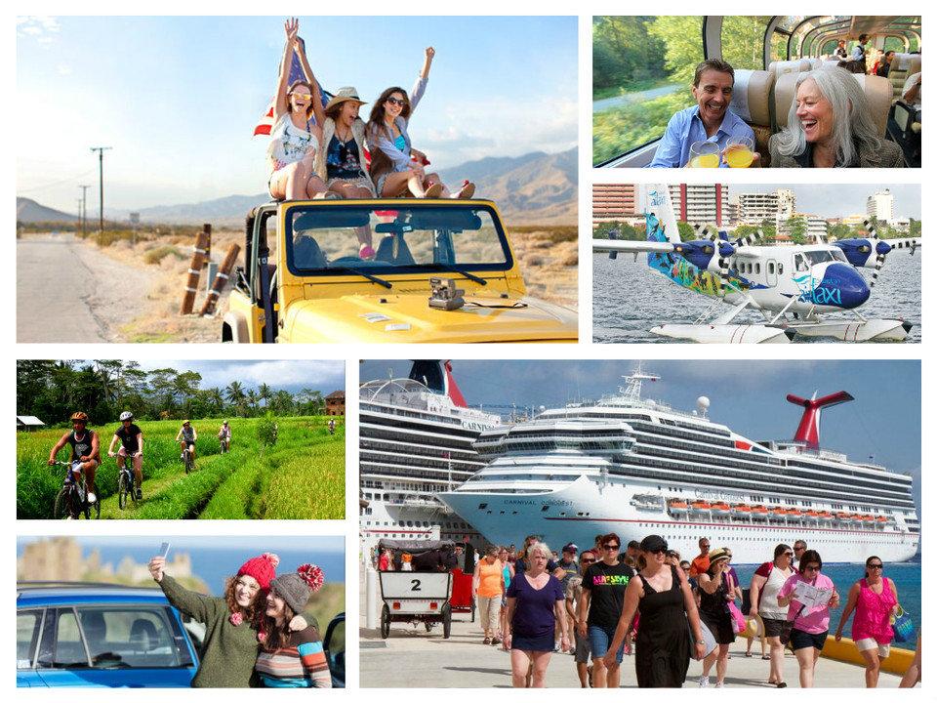
4- Components of the Tourism System
B- Accessibility: Main Types of Transportation
1- Surface Transportation: Roads and railways Suitable for short and medium distances Often relatively affordable 2- Air Transportation Fastest option for long-distance travel Connects distant destinations Generally more expensive 3- Water Transportation Travel by ships, boats and ferries Important for islands and coastal destinations

Slide 21
4- Components of the Tourism System
C- Accommodation:
- Provides lodging, food and beverage services for tourists - Should offer: Comfortable accommodation Good-quality facilities Satisfactory services - Influences tourists’ destination choice and experience
Tourism System Components
Attracations
Accessibility
Accommodation
Amenities
Activities

Slide 22
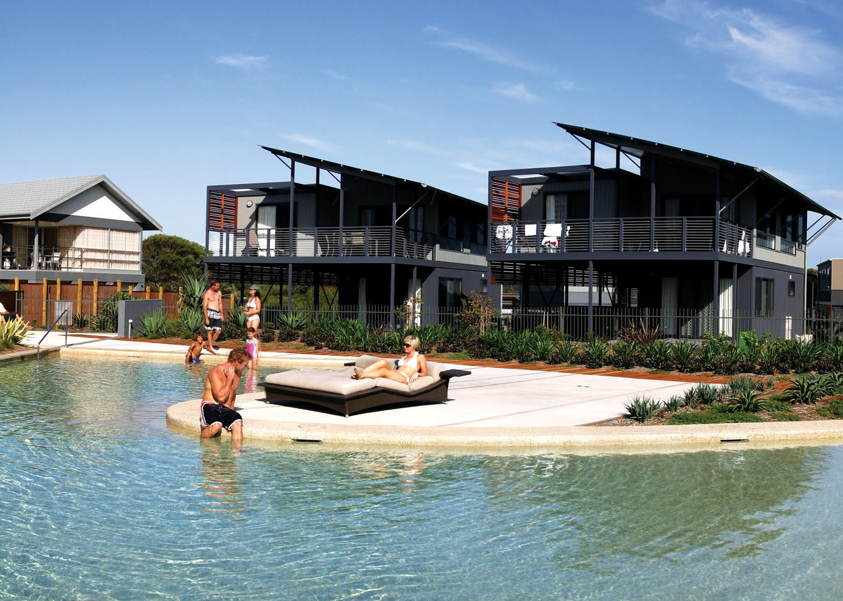
4- Components of the Tourism System
C- Accommodation:
Types of Accommodation 1- Serviced Accommodation - Provides lodging and additional services 2- Self-Catering / Supplementary Accommodation - Provides accommodation with limited or no hotel-style services - Guests may prepare their own food
Hotels | Resorts
Guest houses | Motels
Boutique hotels | Heritage hotels
Youth hostels | Holiday villages

Slide 23
4- Components of the Tourism System
D- Amenities:
- Amenities are the facilities and services that support and enhance the tourist experience Complement the main tourist attractions - Make a destination more convenient, comfortable and enjoyable - Include basic infrastructure and visitor services: Roads and transport infrastructure Internet and telecommunications ATMs and foreign exchange Hospitals and police services Ticketing and visa services
Tourism System Components
Attracations
Accessibility
Accommodation
Amenities
Activities

Slide 24
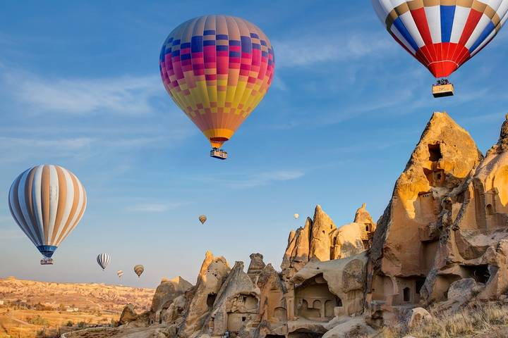
4- Components of the Tourism System
D- Amenities:
- Types of Amenities 1- Natural Amenities 2- Man-made Amenities
Beaches and seashores | Fishing
Trekking and rock climbing | Sightseeing
Rivers and scenic landscapes
Swimming pools | Entertainment and recreation
Music, dance and cinema | Festivals and fairs
Internet and communication services

Slide 25
4- Components of the Tourism System
E- Activities:
- Activities are experiences and actions that tourists can participate in at a destination - Enhance the tourist experience and complement attractions - Allow tourists to experience and interact with the destination Examples: Boating and cruises Guided tours Hiking and trekking Skiing Paragliding
Tourism System Components
Attracations
Accessibility
Accommodation
Amenities
Activities

Slide 26
Thank you
      European Institute of Innovation, Entrepreneurship and Technology
      Lessingstraße 79,
      13158 Berlin, Germany
      Phone: +49 176 55524449
      Email: info@eiiet.com
Discover the world of eiIET

