Slide 1
Health Threats in Tourism
European Institute of Innovation, Entrepreneurship and Technology
Lessingstraße 79, 13158 Berlin, Germany
Mahmoud Abdou| Berlin
      Lessingstraße 79,
      13158 Berlin, Germany
      Phone: +49 30 233618555
      Fax: +49 30 233618556
      Email: info@eiiet.com

Slide 2
Index
- Tourism and the 2003 SARS Outbreak
- Tourism Impacts of Chikungunya Disease
- The Impact of the Ebola Outbreak on Tourism
- Tourism Impacts of the COVID-19 Pandemic

Slide 3
1- Tourism’s Response to the 2003 SARS Outbreak
      Severe Acute Respiratory Syndrome (SARS) – 2003 Outbreak
    Origin:
    - First identified in Guangdong, China (2002); likely transmitted from civet cats or fruit bats to humans.
    Spread:
    - Rapid international transmission via air travel.
    - A single infected doctor at Hong Kong’s Hotel Metropole infected guests who spread SARS globally.

Slide 4
1- Tourism’s Response to the 2003 SARS Outbreak
      Severe Acute Respiratory Syndrome (SARS) – 2003 Outbreak
    Impact:
    - 8,000+ cases reported by WHO by May 2003.
    - 774 deaths across 29 countries on 5 continents by July 2003.
    Air Travel Transmission:
    - Infection rates on planes ranged from 0% to 18.3%.
    - Passengers up to 7 rows away from the source were infected.

Slide 5
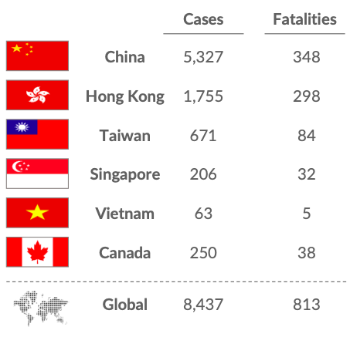
1- Tourism’s Response to the 2003 SARS Outbreak
      - SARS primarily affected countries in Asia
      and parts of Canada.
      - Six nations were identified as the epicenters
      of the outbreak.
Dalberg (2020)

Slide 6
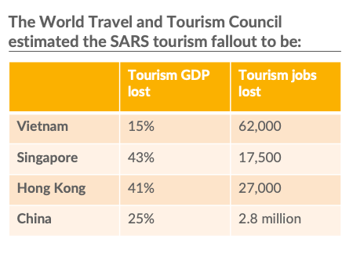
1- Tourism’s Response to the 2003 SARS Outbreak
      - The SARS outbreak led to a notable decline in tourism.
      - The World Travel and Tourism Council provided
      estimates of the resulting fallout.
      Severe decline in tourism across Asia:
      - Thailand: Lost at least $350 million in tourism revenue
      - Malaysia: Tourism receipts fell by 17% compared to 2002
      - Singapore: Tourist arrivals dropped by over 70% from 2002
      - Taiwan: Tourist arrivals declined by 71% between Q1 and Q2 of 2003
Dalberg (2020)

Slide 7
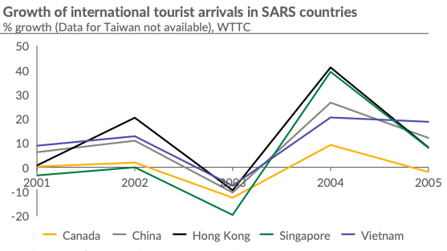
1- Tourism’s Response to the 2003 SARS Outbreak
      SARS Crisis: Continued Impact Beyond 2003
      - Quick tourism rebound in late 2003,
      but lasting effects remained.
      - Significant drop in tourist arrivals in
      Q2 2003 for countries with high SARS
      Cases.
      - Asia experienced an average 9% decline
      in tourist arrivals region-wide.
Dalberg (2020)

Slide 8
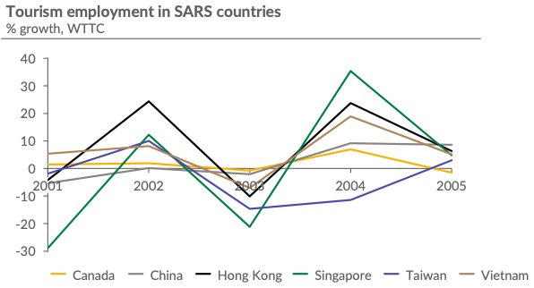
1- Tourism’s Response to the 2003 SARS Outbreak
      SARS Crisis: Continued Impact Beyond 2003
      - WHO travel advisories further
      intensified the decline.
      - Most pronounced impact seen in
      tourism-related employmentof 2003.
Dalberg (2020)

Slide 9
1- Tourism’s Response to the 2003 SARS Outbreak
Dalberg (2020)

Slide 10
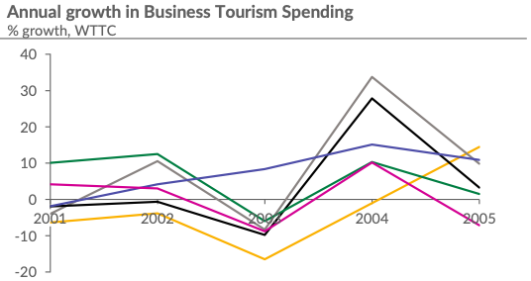
1- Tourism’s Response to the 2003 SARS Outbreak
      SARS Impact on Business Tourism
      - Significant decline in business and leisure
      spending across 6 hotspot markets.
      Business tourism hardest hit:
      - Destinations like Hong Kong and
      Singapore highly dependent on business travelers.
      - WHO travel advisories led to severe reductions
      in business-related visits.
      - Critical disruption to conferences, trade shows,
      and corporate travel.
Dalberg (2020)

Slide 11
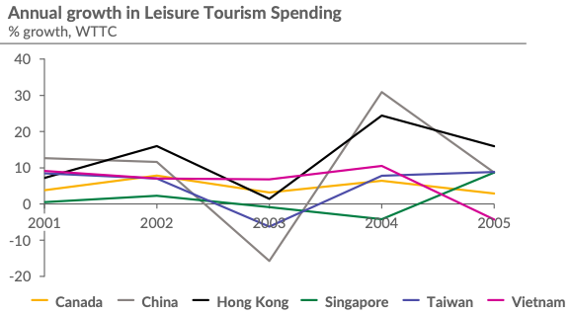
1- Tourism’s Response to the 2003 SARS Outbreak
      SARS Impact on Leisure Tourism
      - Slower recovery of Leisure tourism in non-SARS countries,
      even in countries not directly affected by SARS.
      - Tourist hesitation from unaffected markets
      (Japan) delayed return to destinations
      like Taiwan.
      - Post-crisis marketing campaigns were
      essential to rebuild confidence.
      - Emphasis on health safety and travel
      reassurance to regain tourist flows.
Dalberg (2020)

Slide 12
1- Tourism’s Response to the 2003 SARS Outbreak
Dalberg (2020)

Slide 13
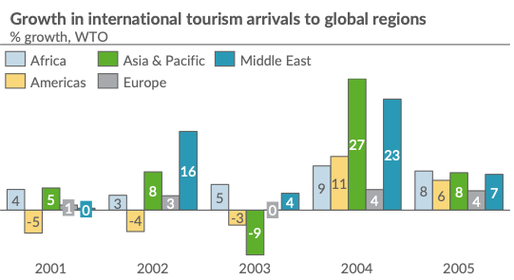
1- Tourism’s Response to the 2003 SARS Outbreak
      Global Impact of SARS on Tourism (2003)
      - Asia: Tourism arrivals declined,
      leading to negative growth in the region.
      - Europe & Middle East: Growth continued,
      but at a slower rate than before.
      - Africa: Tourism increased from 3% to 5%
      despite global challenges.
      - Americas: Continued negative growth
      due to 9/11 spillover and the 2003
      US-Iraq War.
Dalberg (2020)

Slide 14
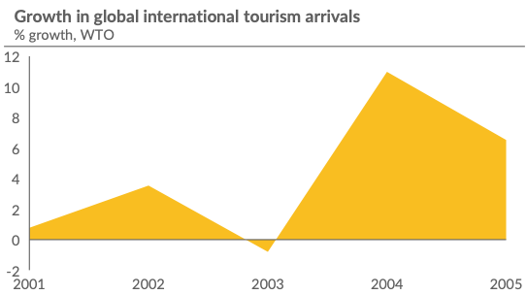
1- Tourism’s Response to the 2003 SARS Outbreak
      Global Impact of SARS on Tourism (2003)
      -Global tourism arrivals declined by 1% in 2003
      - International travelers dropped from 703
      million (2002) to 694 million (2003).
      - Strong rebound in 2004 with one of the
      highest growth rates worldwide.
      -Demonstrates rapid recovery despite SARS
      and other concurrent crises.
Dalberg (2020)

Slide 15
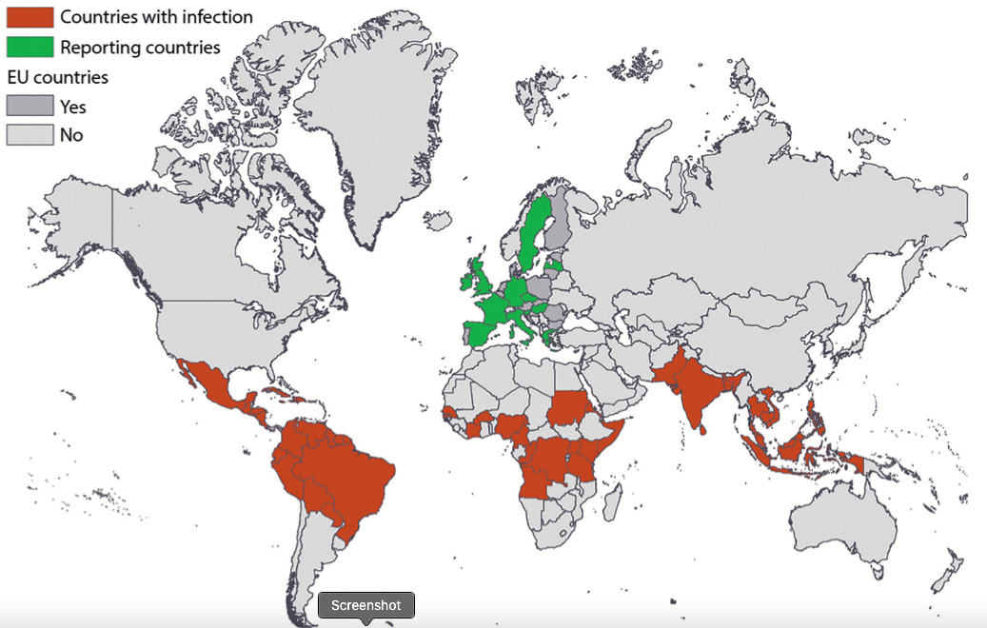
2- Tourism Impacts of Chikungunya Disease
      Chikungunya Disease
      - First isolated in Africa in 1952
      - Mosquito-transmitted alpha virus.
      - Recent outbreaks began in Kenya (2004)
      - Spread to Indian Ocean islands: Reunion,
      Mauritius, Comoros, Seychelles, Madagascar
      (2005–2006).
      - Spread facilitated by travelers to distant
      regions and continents.
Gossner et al., (2020).

Slide 16
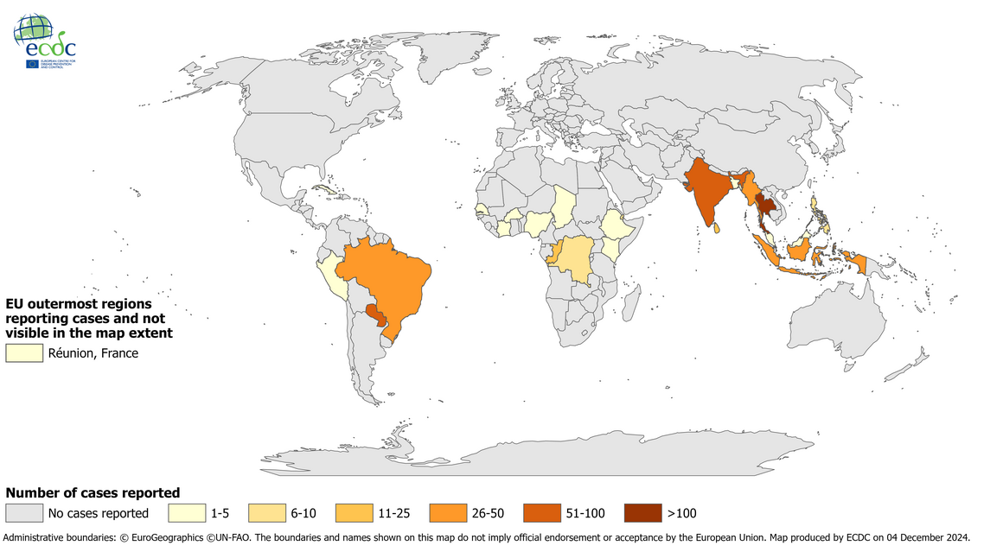
2- Tourism Impacts of Chikungunya Disease
      Chikungunya Disease
      - Outbreaks in India and Indonesia
      - Spread to Europe, US, Australia,
      and Hong Kong via travelers.
      - taly (Ravenna): Traveler from
      India triggered outbreak infecting
      205 locals.
Travel-associated chikungunya cases reported to ECDC, by place of infection, 2019–2023.
Source, https://www.ecdc.europa.eu/en/chikungunya-virus-disease/surveillance/travel-associated-cases?utm_source=chatgpt.com.

Slide 17
2- Tourism Impacts of Chikungunya Disease
      Chikungunya Disease Tourism Impacts:
      Loss of Tourism Revenue
      - Decreased tourist arrivals due to health concerns.
      - Cancellations of trips, tours, and events in affected areas.
      - Reduced income for hotels, airlines, tour operators, restaurants, and local vendors.
      Increased Healthcare Costs
      - Burden on local health systems for diagnosis, treatment, and vector control.
      - Public health campaigns and prevention efforts (e.g., mosquito control programs).

Slide 18
2- Tourism Impacts of Chikungunya Disease
      Chikungunya Disease
      Productivity Losses
      - Infected individuals may be unable to work, especially in tourism and service sectors.
      - Sick days taken by workers reduce productivity and income, especially in informal economies.
      Damage to Country Image
      - Long-term economic implications due to damage to the destination’s international reputation as a safe and healthy place to visit.

Slide 19
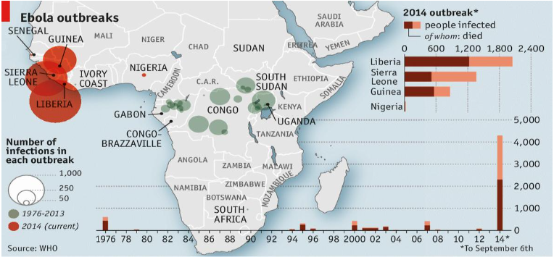
3- The Impact of the Ebola Outbreak on Tourism
      Ebola Virus: History and Impact
      First Identified:
      1976 outbreaks in Sudan and Democratic Republic of
      the Congo (DRC).
      Central Africa:
      - 20 outbreaks since 1976
      West Africa Outbreak:
      - December 2013: First spread to West Africa
      - 2014: Largest Ebola outbreak on record
Source: Sifolo, 2014

Slide 20
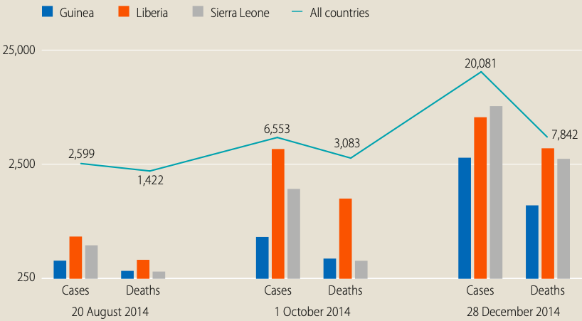
3- The Impact of the Ebola Outbreak on Tourism
      Ebola Virus: History and Impact
      Reemergence:
      - Multiple times in the DRC
      - Guinea in 2021
      Mortality Rate:
      Varies between 30% and 90% depending
      on the virus.
Evolution of the epidemic in Guinea, Liberia and Sierra Leone. Source, UNDG, (2015)

Slide 21
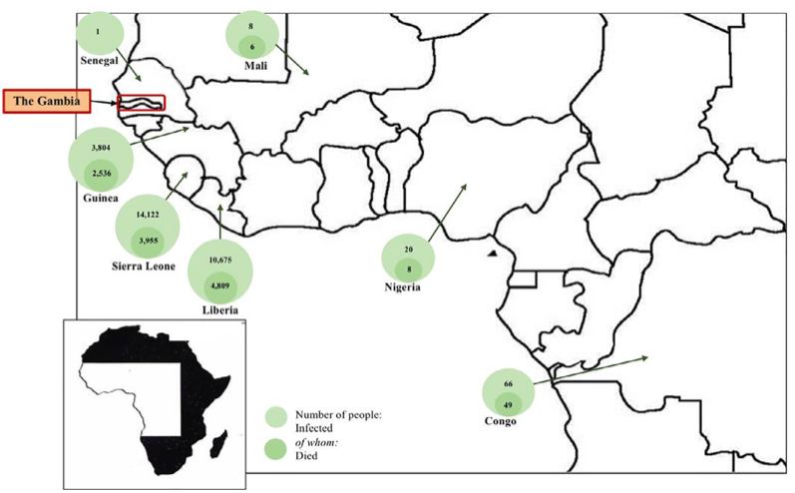
3- The Impact of the Ebola Outbreak on Tourism
      Ebola: Infection and Transmission
      - Natural Host: bats in Africa.
      - Via bat saliva/feces to intermediate hosts
      (monkeys, apes, pigs).
      - Humans infected by handling or
      consuming infected animals (blood, milk,
      raw/undercooked meat)
      Human-to-Human Transmission:
      - Direct contact with blood, secretions, or bodily
      fluids of infected persons.
      - Contaminated needles or medical equipment.
Source: Novelli et al., 2018.

Slide 22
3- The Impact of the Ebola Outbreak on Tourism
      Ebola and Air Travel: Low Transmission Risk
      Not Airborne:
      - Ebola does not spread like influenza or tuberculosis.
      Transmission Requires Direct Contact:
      - With blood, secretions, organs, or bodily fluids of infected persons or animals.
      Low Risk for Travelers:
      - These types of exposure are unlikely during routine air travel.
Source: Novelli et al., 2018.

Slide 23
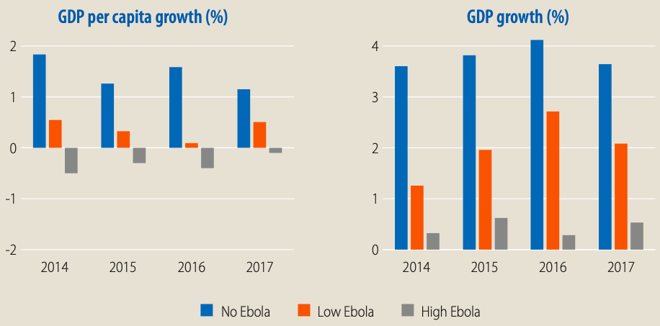
3- The Impact of the Ebola Outbreak on Tourism
      Guinea's Economic Loss from Ebola (2014–2017)
      Economic Impact of Ebola: High Scenario
      GDP Reduction:
      Average GDP growth reduced by 3.4%
      compared to the no-Ebola baseline
      Losses in 2015:
      - Low EVD Scenario: $155.9 million
      - High EVD Scenario: $238.7 million
Impact of the Ebola virus disease on GDP growth and GDP per capita growth in Guinea. Source: UNDG, (2015).

Slide 24
3- The Impact of the Ebola Outbreak on Tourism
      Guinea's Economic Loss from Ebola (2014–2017)
      Low Ebola Scenario:
      - Annual GDP Loss: $184.4 million
      - Impact: 4.9% of average GDP
      High Ebola Scenario:
      - Annual GDP Loss: $315.5 million
      - Impact: 8.6% of average GDP
Impact of the Ebola virus disease on GDP growth and GDP per capita growth in Guinea. Source: UNDG, (2015).

Slide 25
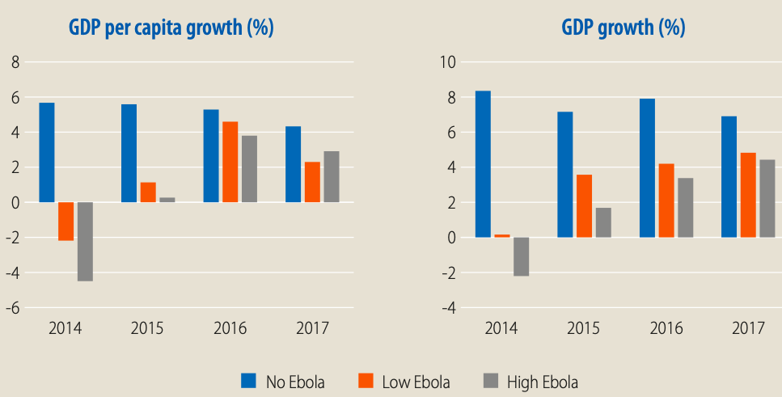
3- The Impact of the Ebola Outbreak on Tourism
      Liberia’s Economic Loss from Ebola (2014–2017)
      Low Scenario
      - GDP Loss in 2015: US$159 million
      - Average Annual Loss: US$187.7 million
      High Scenario
      - GDP Loss in 2015: US$214 million
      - Average Annual Loss: US$245.2 million
Impact of the Ebola virus disease on GDP growth and GDP per capita growth in Guinea. Source: UNDG, (2015).

Slide 26
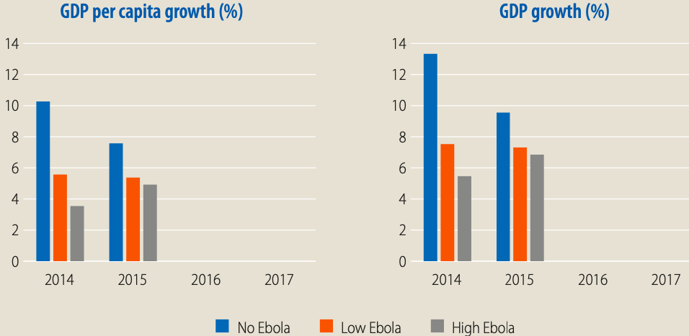
3- The Impact of the Ebola Outbreak on Tourism
      Economic Impact of EVD on Sierra Leone (2014–2017)
      Low Scenario
      - GDP Loss in 2015: US$219 million
      - Average Annual Loss: US$200.7 million
      High Scenario
      - GDP Loss in 2015: US$286 million
      - Average Annual Loss: US$264.3 million
Impact of the Ebola virus disease on GDP growth and GDP per capita growth in Guinea. Source: UNDG, (2015).

Slide 27
4- Tourism Impacts of the COVID-19 Pandemic
      Global Impact of COVID-19 on Tourism
      - Origin: Emerged in China, late 2019
      - Spread: Rapidly affected Asia, Australia, Middle East, Europe, the Americas, and Africa
      Effects:
      - Progressive infection waves triggered economic shutdowns
      - Significant decline in output and demand across major tourism source markets
      - Tourism industry faced inevitable and severe disruptions

Slide 28
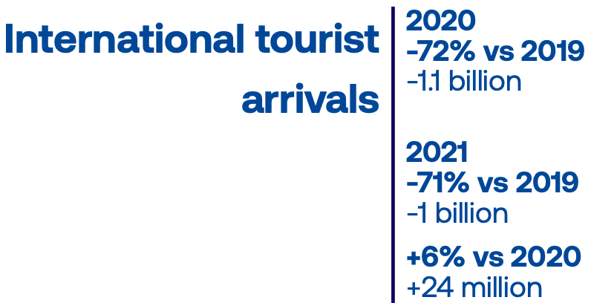
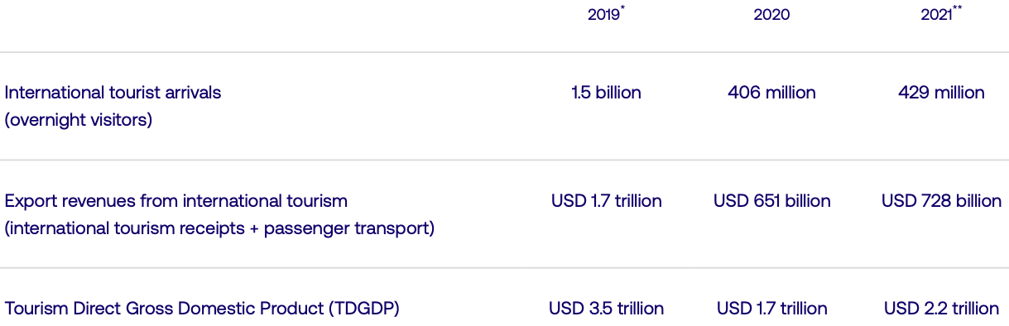
4- Tourism Impacts of the COVID-19 Pandemic
      Global Impact of COVID-19 on Tourism
Source: https://www.unwto.org/impact-assessment-of-the-covid-19-outbreak-on-international-tourism

Slide 29
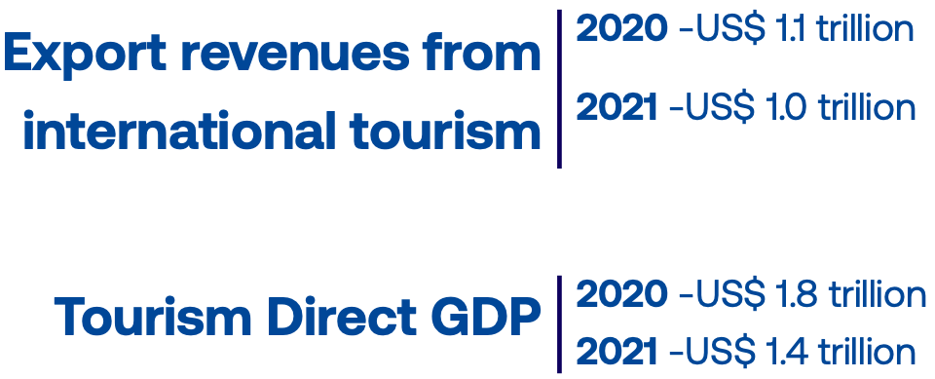
4- Tourism Impacts of the COVID-19 Pandemic
      Global Impact of COVID-19 on Tourism
Source: https://www.unwto.org/impact-assessment-of-the-covid-19-outbreak-on-international-tourism

Slide 30
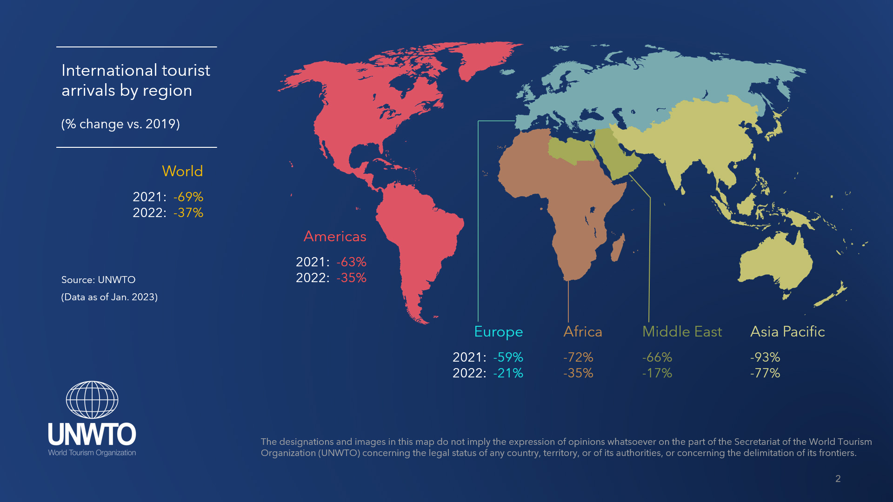
4- Tourism Impacts of the COVID-19 Pandemic
Impact of the Ebola virus disease on GDP growth and GDP per capita growth in Guinea. Source: UNDG, (2015).
Source: https://www.unwto.org/impact-assessment-of-the-covid-19-outbreak-on-international-tourism

Slide 31
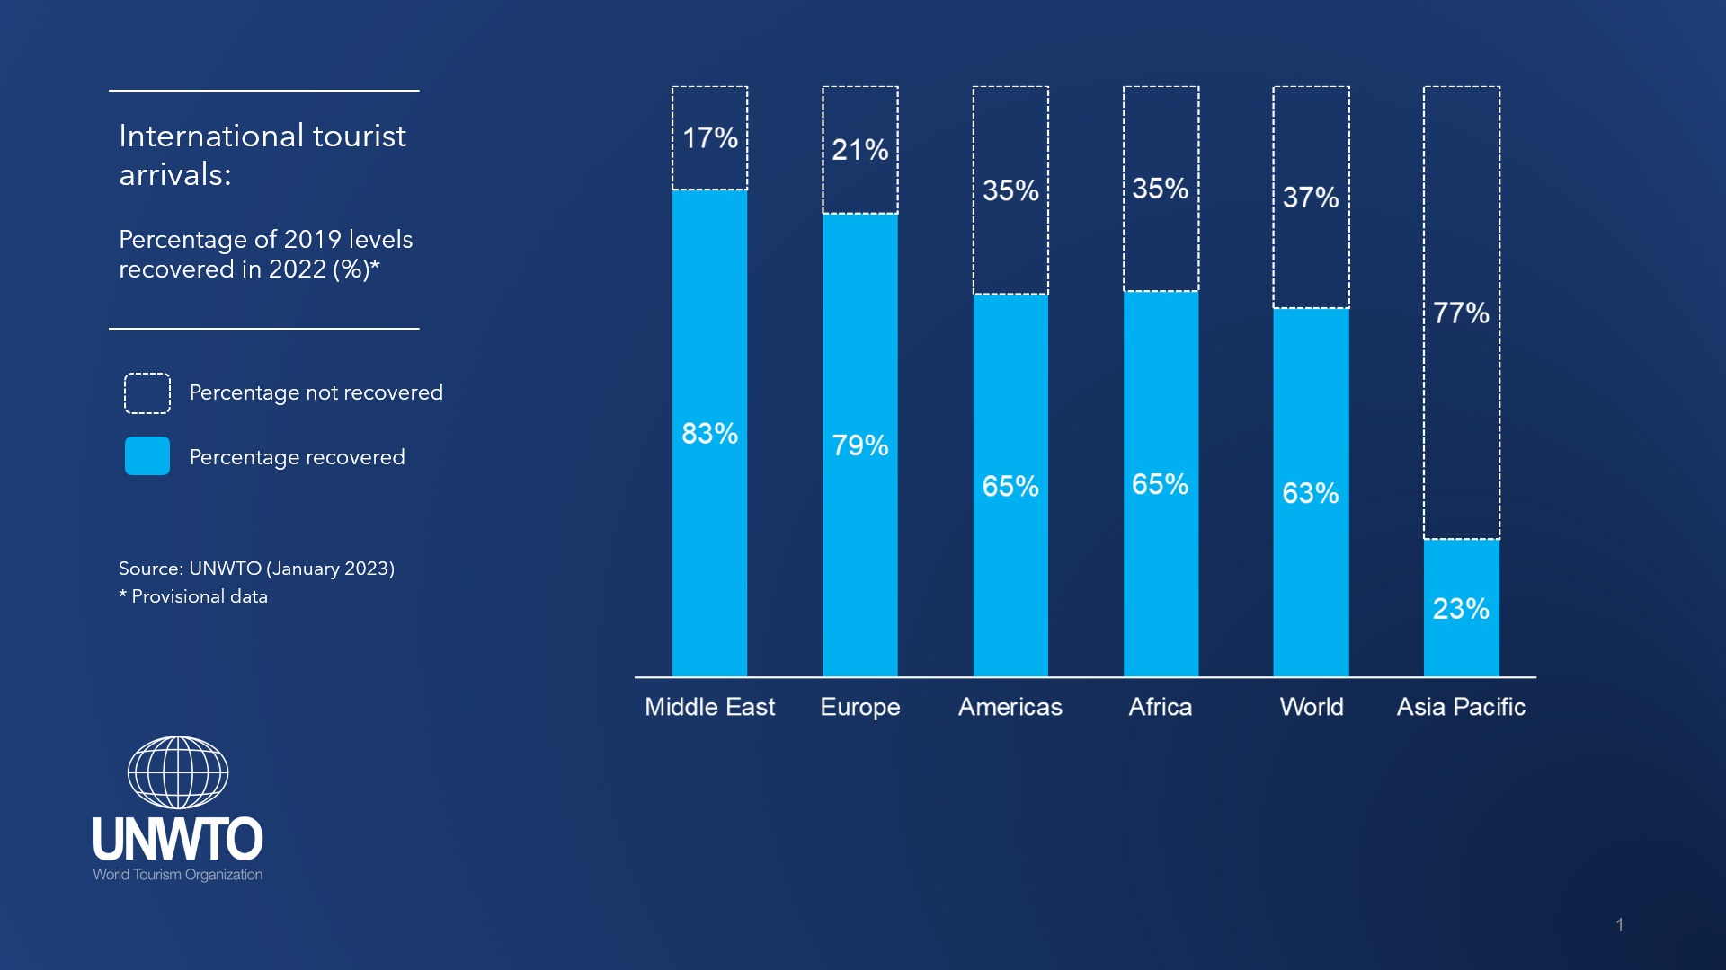
4- Tourism Impacts of the COVID-19 Pandemic
Impact of the Ebola virus disease on GDP growth and GDP per capita growth in Guinea. Source: UNDG, (2015).
Source: https://www.unwto.org/impact-assessment-of-the-covid-19-outbreak-on-international-tourism

Slide 32
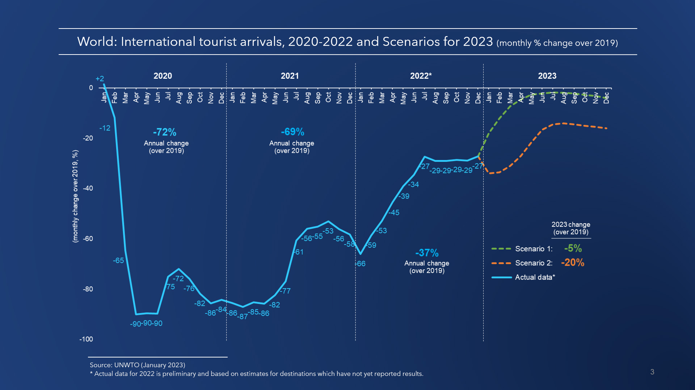
4- Tourism Impacts of the COVID-19 Pandemic
Impact of the Ebola virus disease on GDP growth and GDP per capita growth in Guinea. Source: UNDG, (2015).
Source: https://www.unwto.org/impact-assessment-of-the-covid-19-outbreak-on-international-tourism

Slide 33
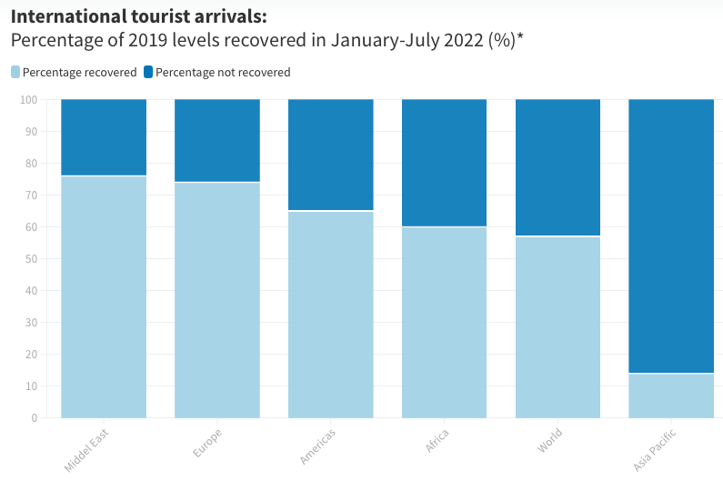
4- Tourism Impacts of the COVID-19 Pandemic
Source: https://www.unwto.org/impact-assessment-of-the-covid-19-outbreak-on-international-tourism

Slide 34
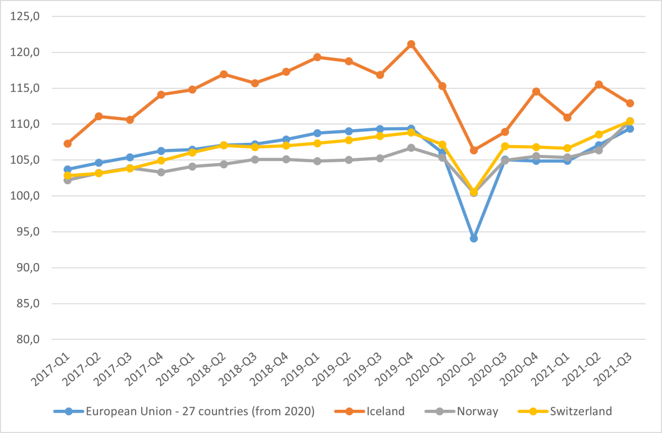
4- Tourism Impacts of the COVID-19 Pandemic
      The effects of the COVID-19 pandemic in the Euand EFTA:
      Gross domestic product
https://www.efta.int/media-resources/news/pandemic-crisis-and-economic-trends-tourism-sector-european-and-efta-countries

Slide 35
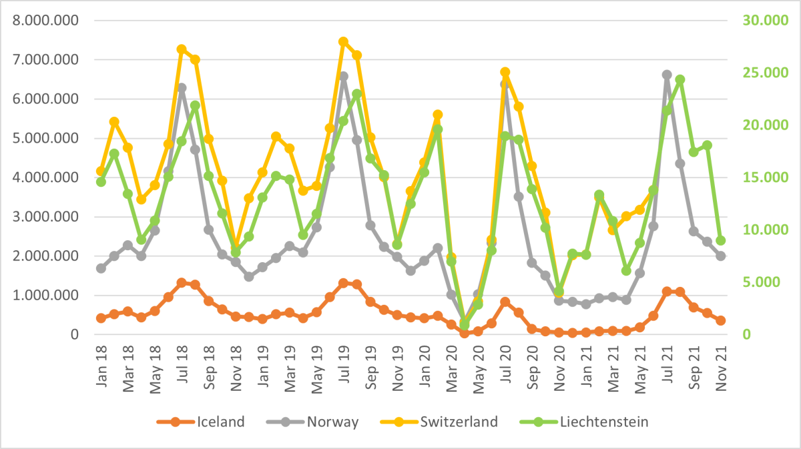
4- Tourism Impacts of the COVID-19 Pandemic
      The effects of the COVID-19 pandemic in the Euand EFTA:
      Total nights spent in tourist accommodation, EFTA countries.
https://www.efta.int/media-resources/news/pandemic-crisis-and-economic-trends-tourism-sector-european-and-efta-countries

Slide 36
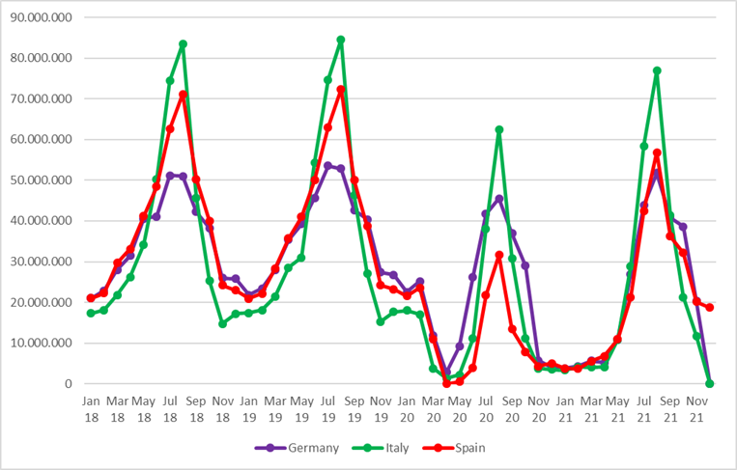
4- Tourism Impacts of the COVID-19 Pandemic
      The effects of the COVID-19 pandemic in the Euand EFTA:
      Total nights spent in tourist accommodation in selected EU
https://www.efta.int/media-resources/news/pandemic-crisis-and-economic-trends-tourism-sector-european-and-efta-countries

Slide 37
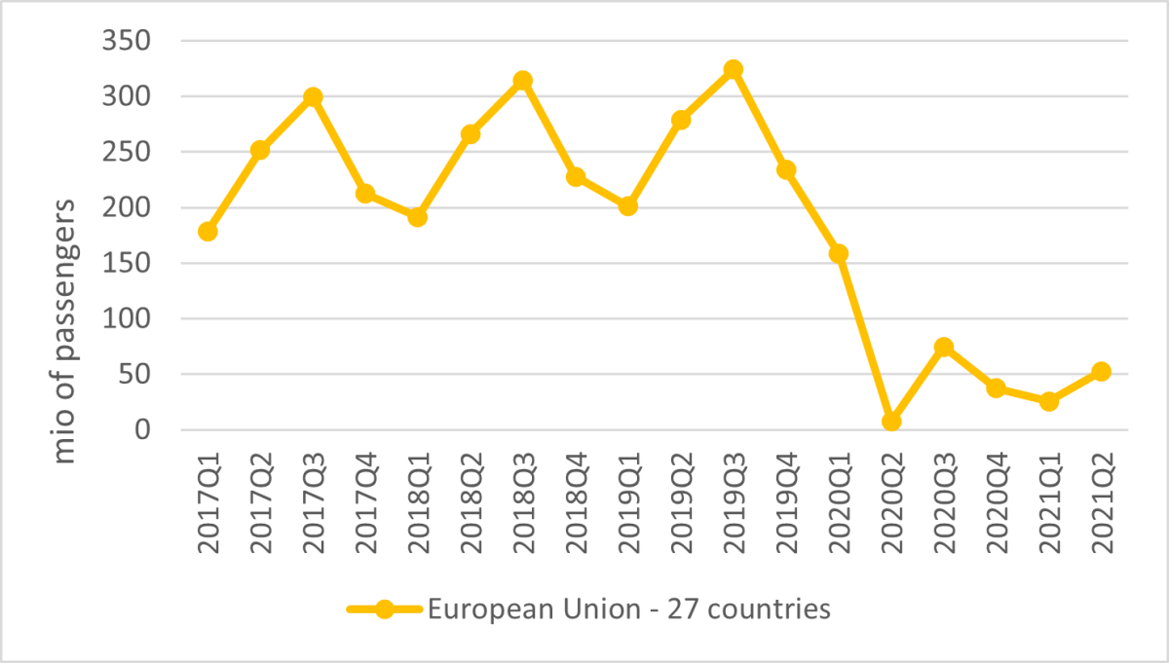
4- Tourism Impacts of the COVID-19 Pandemic
      The effects of the COVID-19 pandemic in the Euand EFTA:
      Air passenger transport:
https://www.efta.int/media-resources/news/pandemic-crisis-and-economic-trends-tourism-sector-european-and-efta-countries

Slide 38
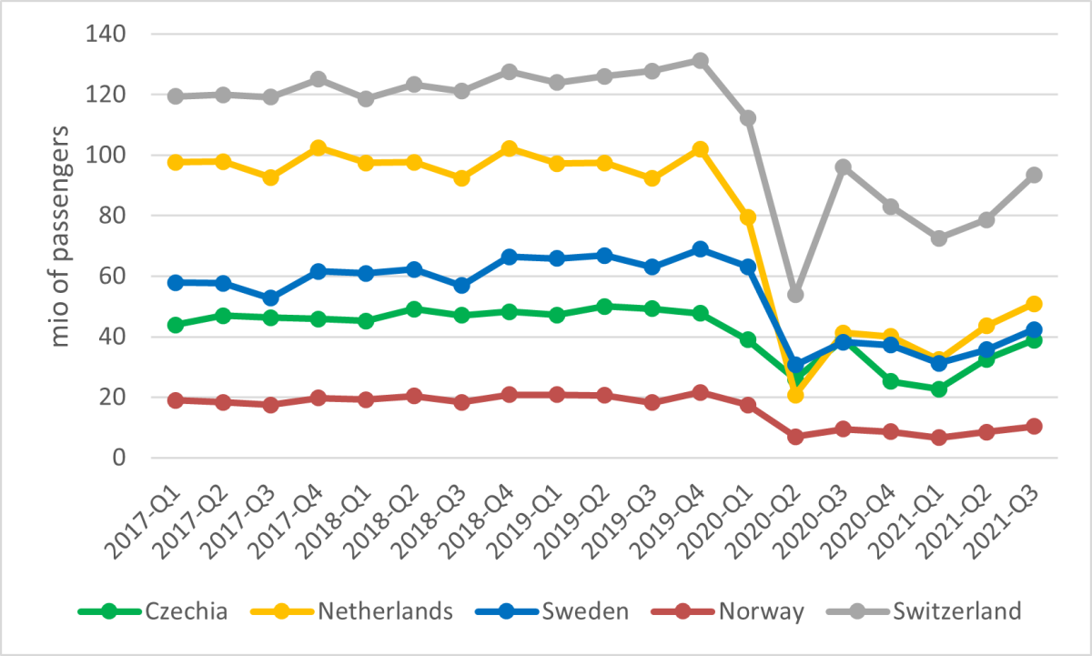
4- Tourism Impacts of the COVID-19 Pandemic
      The effects of the COVID-19 pandemic in the Euand EFTA:
      Railway passenger transport:

Slide 39
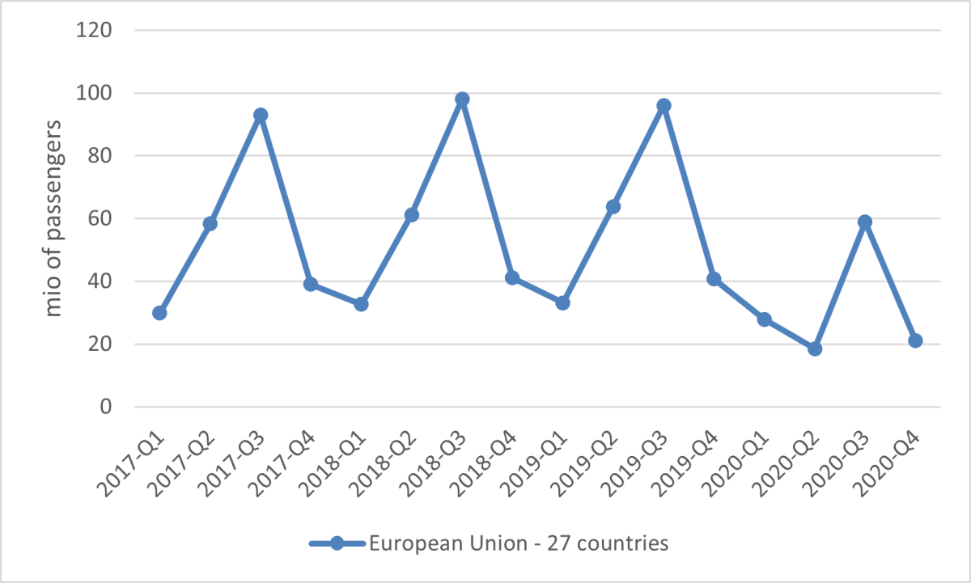
4- Tourism Impacts of the COVID-19 Pandemic
      The effects of the COVID-19 pandemic in the Euand EFTA:
      Maritime passenger transport:
https://www.efta.int/media-resources/news/pandemic-crisis-and-economic-trends-tourism-sector-european-and-efta-countries

Slide 40
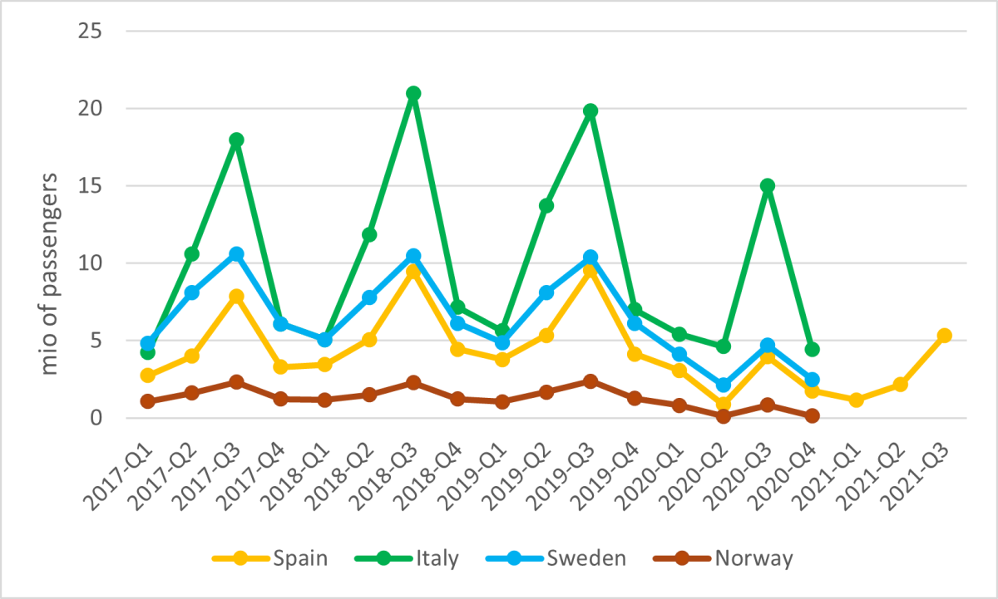
4- Tourism Impacts of the COVID-19 Pandemic
      The effects of the COVID-19 pandemic in the Euand EFTA:
      Maritime passenger transport in selected Countries:
https://www.efta.int/media-resources/news/pandemic-crisis-and-economic-trends-tourism-sector-european-and-efta-countries

Slide 41
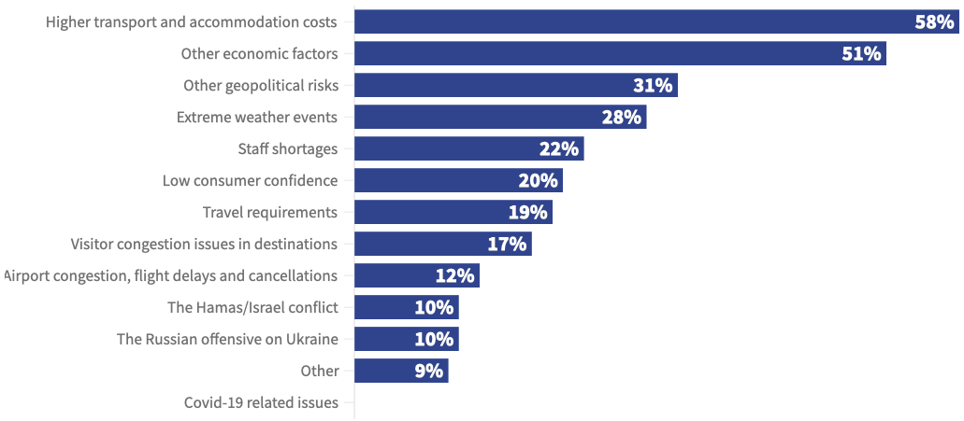
4- Tourism Impacts of the COVID-19 Pandemic
      Factors affecting the recovery of the international tourism:
Source: https://www.unwto.org/impact-assessment-of-the-covid-19-outbreak-on-international-tourism

Slide 42
4- Tourism Impacts of the COVID-19 Pandemic
      The Pandemic Impacts on Tourism. Link
Source: https://www.unwto.org/impact-assessment-of-the-covid-19-outbreak-on-international-tourism

Slide 43
      Discussion
      In light of the recent rise in COVID-19 cases in countries such as Hong Kong, Singapore, China, and Thailand, discuss the following questions:
      - What can governments do to prevent a new wave of COVID-19?
      - How can the tourism sector help reduce the spread of the virus while keeping international travel open?
      - What lessons from the earlier stages of the COVID-19 pandemic can help countries respond better now and in the future?
      - Choose one country (Germany, India, Nepal, Hong Kong, or Thailand) and explain how its tourism industry reacted to earlier waves of COVID-19.
      What actions worked well?
      What actions did not work well?
Source: https://www.unwto.org/impact-assessment-of-the-covid-19-outbreak-on-international-tourism

Slide 44
Thank you
      European Institute of Innovation, Entrepreneurship and Technology
      Lessingstraße 79,
      13158 Berlin, Germany
      Phone: +49 176 55524449
      Email: info@eiiet.com
Discover the world of eiIET

