Slide 1
Leadership in Crisis Management
European Institute of Innovation, Entrepreneurship and Technology
Lessingstraße 79, 13158 Berlin, Germany
Presenter Vaibhav Sai Sri| Berlin
      Lessingstraße 79,
      13158 Berlin, Germany
      Phone: +49 30 233618555
      Fax: +49 30 233618556
      Email: info@eiiet.com

Slide 2
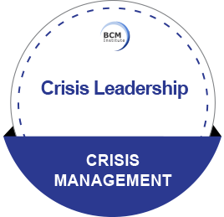
Index
Introduction
Stages of Crisis Management
Key Leadership Traits in Crisis Management
Tools and Frameworks for Crisis Leadership
Case Studies 1 - Johnson & Johnson’s Tylenol Crisis
Case Studies 2 - BP Deepwater Horizon Oil Spill
Case Studies 3 - COVID-19 Pandemic
Interactive Scenario
Conclusion and Key Takeaways

Slide 3
Introduction
Definition: Leadership during crises involves quick decision-making, clear communication, and long-term planning to manage emergencies and their aftermath.
Why It Matters:
Protects organizational integrity and reputation.
Ensures the safety and well-being of stakeholders.
Enables recovery and resilience.

Slide 4
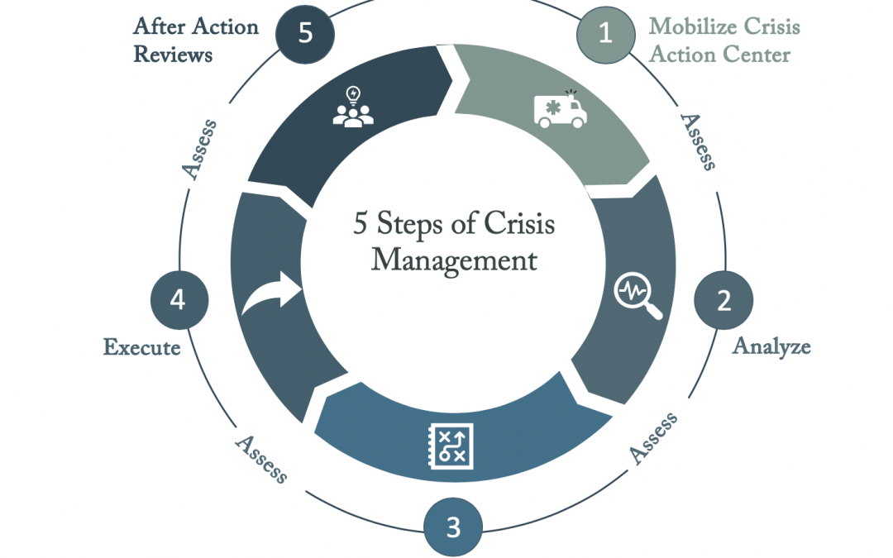
Stages of Crisis Management
Pre-Crisis (Preparedness):
Building contingency plans.
Identifying risks and vulnerabilities.
Crisis Response:
Immediate actions to contain the crisis.
Transparent and consistent communication.
Post-Crisis (Recovery):
Reviewing the crisis response.
Implementing changes to prevent future crises

Slide 5
Key Leadership Traits in Crisis Management
Decisiveness: Making timely and informed decisions.
Resilience: Maintaining composure under pressure.
Empathy: Understanding and addressing stakeholder concerns.
Transparency: Clear communication builds trust.
Adaptability: Adjusting strategies based on new information.

Slide 6
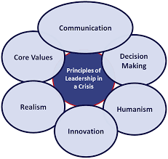
Tools and Frameworks for Crisis Leadership
SWOT Analysis: Assess strengths, weaknesses, opportunities, and threats.
Scenario Planning: Preparing for best- and worst-case outcomes.
Risk Matrix: Evaluating the probability and impact of potential risks.

Slide 7

Case Study 1: Johnson & Johnson’s Tylenol Crisis (1982)
Crisis: Cyanide-laced Tylenol capsules caused fatalities.
Leadership Response:
Immediate product recall (31 million bottles).
Transparent communication with the public.
Introduced tamper-proof packaging.
Outcome: Regained consumer trust and set a new industry standard.

Slide 8

Case Study 2: BP Deepwater Horizon Oil Spill (2010)
Crisis: An explosion caused the worst oil spill in U.S. history.
Leadership Failures:
Delayed response and lack of accountability.
Poor communication with the public and stakeholders.
Lessons Learned: The need for proactive crisis management and transparent leadership.

Slide 9

Case Study 3: COVID-19 Pandemic
Crisis: Global health emergency and economic fallout.
Leadership Response:
New Zealand's Prime Minister Jacinda Ardern: Early lockdowns, clear communication, empathy toward citizens.
Example of balancing public health and economic stability.
Outcome: Low mortality rates and strong public approval.

Slide 10

Interactive Scenario
Scenario: A fictional crisis—a major cyberattack on a financial institution.
Divide participants into groups to play the roles of leaders addressing the crisis.
Tasks include drafting an immediate response plan, public statement, and long-term recovery strategy.
Objective: Highlight decision-making and communication skills under pressure.

Slide 11
Conclusion and Key Takeaways
Crisis leadership is about balancing immediate response with long-term recovery.
Effective leaders:
  Stay transparent and decisive.
  Adapt strategies as crises evolve.
  Learn from past failures to improve preparedness.
Key Takeaways:
Preparedness is critical.
Transparent communication builds trust.
Leadership during crises defines organizational resilience

Slide 12
Thank you
      European Institute of Innovation, Entrepreneurship and Technology
      Lessingstraße 79,
      13158 Berlin, Germany
      Phone: +49 176 55524449
      Email: info@eiiet.com
Discover the world of eiIET

