Slide 1
Anatomy and Physiology
European Institute of Innovation, Entrepreneurship and Technology
Lessingstraße 79, 13158 Berlin, Germany
Mahmoud Abdou| Berlin
      Lessingstraße 79,
      13158 Berlin, Germany
      Phone: +49 30 233618555
      Fax: +49 30 233618556
      Email: info@eiiet.com

Slide 2
Index
- Wellness Tourism
- Typologies of Wellness Tourism
- Medical Tourism

Slide 3
1- Wellness Tourism
    - Journeys focused on achieving overall well-being by balancing key aspects of health, such as physical, mental, psychological, and social well-being.
    - These trips prioritize prevention over treatment, though certain medical procedures may complement lifestyle-based therapies.
    Wellness enthusiasts are often proactive in:
    - Adopting healthier lifestyles.
    - Being conscious about nutrition.
    - Participating in physical exercise.
    - Holistic Approach to Health

Slide 4
1- Wellness Tourism
    - Wellness promotes a comprehensive view of health, focusing on the integration of physical, mental, and spiritual well-being.
    - It encourages individuals to actively participate in protecting and maintaining their health, rather than relying solely on medication.
    Wellness is understood as:
    - “A way of life oriented toward optimal health and well-being, in which the body, mind, and spirit are integrated by the individual to live more fully within the human and natural community.”
    Wellness tourism is described as:
    - “Involves people who travel to a different place to proactively pursue activities that maintain or enhance their personal health and well-being, and who are seeking unique, authentic, or location-based experiences that are not available at home.”

Slide 5
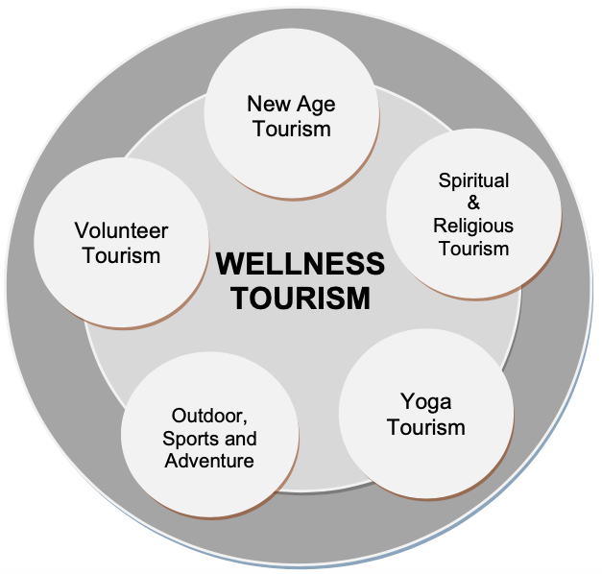
1- Wellness Tourism
    The Wellness Revolution:
    - Driven by individuals seeking to redesign their lives to achieve greater physical, emotional, mental, and spiritual well-being.
    - A response to the complexity and fast pace of modern life,
    offering counterbalancing experiences to promote overall well-being.

Slide 6
1- Wellness Tourism
    Role of Wellness Tourism:
    - Serves as a means for individuals to fulfill their need for relaxation, balance, and self-improvement.
    - Provides diverse services tailored to evolving consumer
    expectations in the pursuit of holistic wellness.

Slide 7
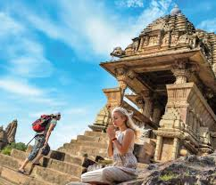
2- Typologies of Wellness Tourism
    4.2- Spiritual Tourism
    - A form of tourism centered on non-religious spiritual well-being.
    - It includes body-mind-spirit activities, visits to retreats and ashrams, and a deepened connection with nature and landscapes.
    Key features include:
    Spirituality and Wellness:
    - Spirituality is often regarded as a key component of overall well-being
    - It reflects a shift from conventional religion to a more transcendent
    form of spirituality.

Slide 8
2- Typologies of Wellness Tourism
    4.2- Spiritual Tourism
    Transcendent Spirituality:
    - This form of spirituality focuses on personal growth that extends beyond the self and ego.
    Secular Spirituality Trend:
    - There is an increasing trend where secular spirituality is replacing traditional religious practices.
    Psychological Perspectives:
    - Some psychologists consider religion potentially harmful to emotional health, whereas others view spirituality as an essential aspect of human identity.

Slide 9
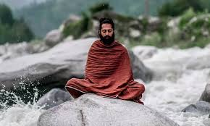
2- Typologies of Wellness Tourism
    4.2- Spiritual Tourism
    The word "spirituality" originates from the Latin term for "breath," symbolizing the essence of life.
    Wheels of Wellness:
    - Some researchers have developed the concept of "wheels of wellness" to illustrate an ideal balance of life activities, often placing spirituality at the core.
    Holistic Nature:
    - Spirituality is considered a comprehensive discipline that
    extends beyond religious exploration.
    Multidimensional Experience:
    - It encompasses various aspects of human life,
    including psychological, physical, historical, political,
    aesthetic, and intellectual dimensions

Slide 10
2- Typologies of Wellness Tourism
    4.2- Spiritual Tourism
    - Some sociologists argue that the rise of individualistic cultures has contributed to increased social alienation, fostering a greater need for spiritual solace.
    - This concept highlights a personal and individualized approach to spirituality, which is particularly relevant in individualistic societies.
    Spiritual Tourism and Social Alienation:
    - The search for a "spiritual center" is a key aspect of tourism, especially for individuals experiencing social alienation.
    Religious and Secular Spiritual Tourism:
    - While spiritual tourism is often associated with religious pilgrimages to sacred sites, secular tourists also pursue spiritual enlightenment through various experiences

Slide 11
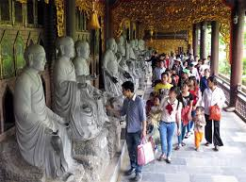
2- Typologies of Wellness Tourism
    4.2- Spiritual Tourism
    Spiritual tourism can include:
    - Visiting religious sites, spiritual landscapes, or pilgrimage centers.
    - Attending ashrams, retreats, or seeking guidance from spiritual teachers.
    - A broader spiritual journey focusing on balancing the body, mind, and spirit, rather than adhering to a specific religious practice.
    - Contemplating nature or landscapes as part of the spiritual experience

Slide 12
2- Typologies of Wellness Tourism
    Yoga Tourism
    Emerging Trend:
    - Yoga tourism has grown in response to the 'travel to feel well' trend, where people seek travel experiences that promote physical, emotional, and spiritual well-being.
    Subset of Wellness Tourism:
    - Yoga focuses on mind-body-spirit practices that enhance overall health.
    Yoga as Union:
    - The word yoga refers to the union of body, mind, and spirit, and is widely
    believed to help reduce stress, improve breathing, build strength,
    and enhance flexibility.

Slide 13

2- Typologies of Wellness Tourism
    Yoga Tourism
    Variety of Styles:
    - Yoga offers a wide range of styles catering to different needs and abilities.
    - From Viniyoga (gentle yoga) to Ashtanga (power yoga), there is something for
    everyone, making it accessible to all.
    Relief for Modern Stress:
    - Yoga has become a powerful remedy for the stress
    and pressures that many individuals face in today’s fast-paced
    society.

Slide 14
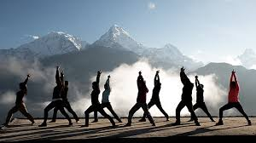
2- Typologies of Wellness Tourism
    Yoga Tourism
    Central to a Balanced Life:
    - Yoga is no longer just a practice but the centerpiece of their pursuit of a balanced life, combining physical activity with mental and spiritual growth.
    Tourism Phenomenon:
    - Yoga has increasingly become a tourism phenomenon, where people travel to
    dedicated yoga retreats or wellness destinations to deepen
    their practice and find inner peace

Slide 15
2- Typologies of Wellness Tourism
    Yoga Tourism
    Central to a Balanced Life:
    - Yoga is no longer just a practice but the centerpiece of their pursuit of a balanced life, combining physical activity with mental and spiritual growth.
    Tourism Phenomenon:
    - Yoga has increasingly become a tourism phenomenon, where people travel to
    dedicated yoga retreats or wellness destinations to deepen their practice and find
    inner peace

Slide 16
2- Typologies of Wellness Tourism
    Outdoor and Adventure Sports (OAS) in Wellness Tourism
    Physical and Psychological Benefits:
    - OAS offer physical and psychological benefits, promoting fitness while also enhancing mental well-being.
    Connection with Nature:
    - Immersion in nature provides a unique opportunity for individuals to
    relax, recharge, and gain a fresh perspective on life, which is essential
    for overall health.

Slide 17

2- Typologies of Wellness Tourism
    Outdoor and Adventure Sports (OAS) in Wellness Tourism
    Experiential Learning Framework:
    - Programmed OAS are often built around an experiential learning framework.
    - It combines physical activity with immersion
    in nature and adventure to foster growth and
    self-discovery.

Slide 18

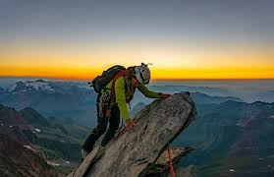
2- Typologies of Wellness Tourism
    Outdoor and Adventure Sports (OAS) in Wellness Tourism
    Impact on Health and Well-being:
    - OAS have the potential to impact the health and well-being of
    participants.
    - Then, it serves as effective interventions for improving mental
    health outcomes.
    - They offer a holistic approach, combining physical challenge with
    emotional and mental restoration through outdoor experiences.

Slide 19
2- Typologies of Wellness Tourism
    Voluntary Tourism
    Definition:
    - Voluntary tourism refers to travelers choosing destinations where their help is needed by local communities.
    - These destinations often require specialized assistance in areas such as education, medical care, construction, environmental conservation, disaster relief, and historic restoration.
    Purpose:
    - The main goal of voluntary tourism is for tourists to contribute to the
    well-being and development of the host communities while experiencing
    a meaningful cultural exchange.

Slide 20
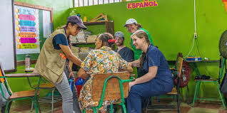
2- Typologies of Wellness Tourism
    Voluntary Tourism
    Positive Impact:
    - Volunteer tourism leads to a positive transfer of benefits between the host communities and participants, including cultural, educational, and scientific benefits.
    Community Engagement:
    - Volunteers not only offer support but also engage
    with local traditions,
    learn about the community's needs, and contribute
    to sustainable development.

Slide 21
2- Typologies of Wellness Tourism
    New Age Tourism
    - New Age tourism focuses on achieving a balance of body, mind, and spirit through alternative and complementary therapies.
    - These experiences typically take place in retreats, wellness centers, or at festivals.
    - It is a response to the limitations of traditional religion in meeting people’s spiritual needs.
    - The movement encourages self-spirituality,
    the idea that spirituality is inherent within the individual.

Slide 22
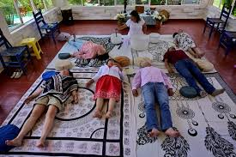
2- Typologies of Wellness Tourism
    Features of New Age Tourism
    Power/Sacred Places:
    - Visiting sacred sites such as temples, holy sites, or sacred stones; engaging in pilgrimages, rituals, or interacting with tribes.
    Wellness and Holistic Health:
    - Practices like reflexology, aromatherapy, and acupuncture
    aimed at physical and mental healing.

Slide 23
2- Typologies of Wellness Tourism
    Features of New Age Tourism
    Divination:
    - Visiting places for fortune-telling, engaging in scrying, tarot card readings, or using pendulums for guidance.
    Greenery and Eco-Spirit:
    - Spiritual visits to natural settings and deep ecology, seeking a connection with nature.

Slide 24
2- Typologies of Wellness Tourism
    Features of New Age Tourism
    Workshops/Seminars/Festivals:
    - Participating in activities focused on visualization, sacred dance, song, or self-development.
    Criticism and Decline:
    - By the 1980s and 1990s, the New Age movement faced criticism.
    - Many of its healing methods were considered unscientific, and some of its leaders were accused of being charlatans.
    - Additionally, some practices were claimed to be linked to the occult or Satanism.

Slide 25
2- Typologies of Wellness Tourism
    Features of New Age Tourism
    Workshops/Seminars/Festivals:
    - Participating in activities focused on visualization, sacred dance, song, or self-development.
    Criticism and Decline:
    - By the 1980s and 1990s, the New Age movement faced criticism.
    - Many of its healing methods were considered unscientific, and some of its leaders were accused of being charlatans.
    - Additionally, some practices were claimed to be linked to the occult or Satanism.

Slide 26
3- Medical Tourism
    - Medical tourism, a sub-category of health tourism, is closely linked to both the healthcare and tourism industries.
    - Patients from wealthier, more developed countries are increasingly traveling to less developed nations for healthcare services.
    - This trend is primarily driven by the affordability of treatments and facilitated by low-cost flights and easy access to online information.
    It is defined as:
    - “consumers who travel across international borders to receive some form of medical treatment. This treatment may span the full range of medical services, but most commonly includes dental care, cosmetic surgery, elective surgery, and fertility treatment.”

Slide 27
3- Medical Tourism
    Main Drivers of Medical Tourism
    - These drivers can be classified into pull and push factors.
    - The push aspects include:
    1- Role of Word-of-Mouth & Testimonials
    - Recommendations from doctors, family, and friends are the most cited push factor in the literature.
    - Positive testimonials and word-of-mouth play a crucial role in shaping international patients' decisions.

Slide 28
3- Medical Tourism
    Main Drivers of Medical Tourism
    2- Inadequate Insurance Coverage & High Treatment Costs
    - Lack of insurance or insufficient coverage is the second most significant push factor.
    - When combined with high medical costs in the home country, patients seek affordable options abroad.

Slide 29
3- Medical Tourism
    Main Drivers of Medical Tourism
    3- Additional Factors Influencing Medical Tourism Decisions
    - Geographical proximity: Closer destinations are more appealing.
    - Cultural & linguistic familiarity: Patients prefer countries where they feel comfortable communicating.
    - Lack of treatment options: Unavailable procedures in the home country encourage outbound medical travel.
    - Desire for privacy: Some patients seek discreet treatment abroad.

Slide 30
3- Medical Tourism
    Pull Factors in Medical Tourism:
    - Pull factors in medical tourism are linked to destination attributes that attract international patients.
    - These can be categorized into healthcare provider-specific factors and destination-specific factors.
    1- Healthcare Provider-Specific Factors
    Lower Treatment Costs:
    - Many patients seek affordable alternatives abroad.
    Service Quality in Healthcare:
    - Service quality in healthcare is a multidimensional concept that influences patient satisfaction and decision-making in medical tourism.

Slide 31
3- Medical Tourism
    1- Healthcare Provider-Specific Factors
    Services & Physical Facilities:
    - Infrastructure, hygiene, and comfort of medical institutions.
    Quality of Care:
    - Effectiveness, safety, and efficiency of treatments.
    Use of State-of-the-Art Medical Technologies:
    - Advanced diagnostic and therapeutic tools.

Slide 32
3- Medical Tourism
    1- Healthcare Provider-Specific Factors
    Patient-Doctor Relationship:
    - Trust, empathy, and communication between healthcare providers and patients.
    Technical Care:
    - Accuracy and adequacy of diagnostic and treatment procedures.
    Art of Care:
    - The service provider’s manner, behavior, and empathy in delivering care

Slide 33
3- Medical Tourism
    1- Healthcare Provider-Specific Factors
    Patient-Doctor Relationship:
    - Trust, empathy, and communication between healthcare providers and patients.
    Technical Care:
    - Accuracy and adequacy of diagnostic and treatment procedures.
    Art of Care:
    - The service provider’s manner, behavior, and empathy in delivering care

Slide 34
3- Medical Tourism
    1- Healthcare Provider-Specific Factors
    Accreditation:
    - Accreditation assures that medical facilities and professionals meet international standards.
    - It enhances trust and signals high-quality care to prospective patients.
    - Countries like Turkey, Thailand, India, Malaysia, and Singapore leverage accreditation to strengthen their medical tourism market.
    - Beyond international patients, accreditation also benefits local populations by improving healthcare services.

Slide 35
3- Medical Tourism
    1- Healthcare Provider-Specific Factors
    Availability of Immediate Treatment Options:
    - Insurance coverage in the destination country.
    - Healthcare infrastructure and hospital capacity.
    - National Health System (NHS) efficiency in the patient’s home country.
    - It is particularly relevant for patients requiring urgent procedures that involve long waiting times at home.

Slide 36
3- Medical Tourism
    2- Destination-Specific Factors in Medical Tourism
    - Destination-specific factors make a country attractive not only for general tourists but also for medical tourists.
    - These factors influence the overall experience, safety, and affordability of receiving treatment abroad.
    A- Destination Infrastructure:
    Medical Tourism Agencies:
    - Facilitate travel, treatment coordination, and patient assistance.
    Transportation Options:
    Accessibility through international airports and local transport networks.

Slide 37
3- Medical Tourism
    A- Destination Infrastructure
    Availability of Insurance:
    - Coverage options for international patients.
    Healthcare Infrastructure & Cost:
    - Countries with well-developed medical services and lower treatment costs attract more patients.
    India & Thailand:
    - Known for cost-effective medical treatments.
    Singapore:
    - Positioned as a high-end medical tourism hub with advanced technologies.

Slide 38
3- Medical Tourism
    Destination-Specific Factors in Medical Tourism
    B- Availability of Specific Treatments:
    - Patients seek medical procedures unavailable or uncovered in their home country.
    - Medical tourism companies in Canada target uninsured or underinsured Americans looking for affordable treatment options abroad.
    - Developing countries with growing medical infrastructure attract aging populations from developed nations seeking complex and expensive treatments.

Slide 39
3- Medical Tourism
    Destination-Specific Factors in Medical Tourism
    C- Legal & Regulatory Protections:
    - Patient-protecting legal frameworks are crucial for international patient confidence.
    Malpractice liability laws:
    Ensuring patient protection.
    Physician licensing & corporate ownership regulations:
    Guaranteeing high medical standards.
    Reputational protection:
    - Ensuring fair practices in medical services

Slide 40
    Discussion
    Describe the potential benefits and risks associated with Medical Tourism from the Patient and host destination’s perspectives.

Slide 41
Thank you
      European Institute of Innovation, Entrepreneurship and Technology
      Lessingstraße 79,
      13158 Berlin, Germany
      Phone: +49 176 55524449
      Email: info@eiiet.com
Discover the world of eiIET

