Slide 1
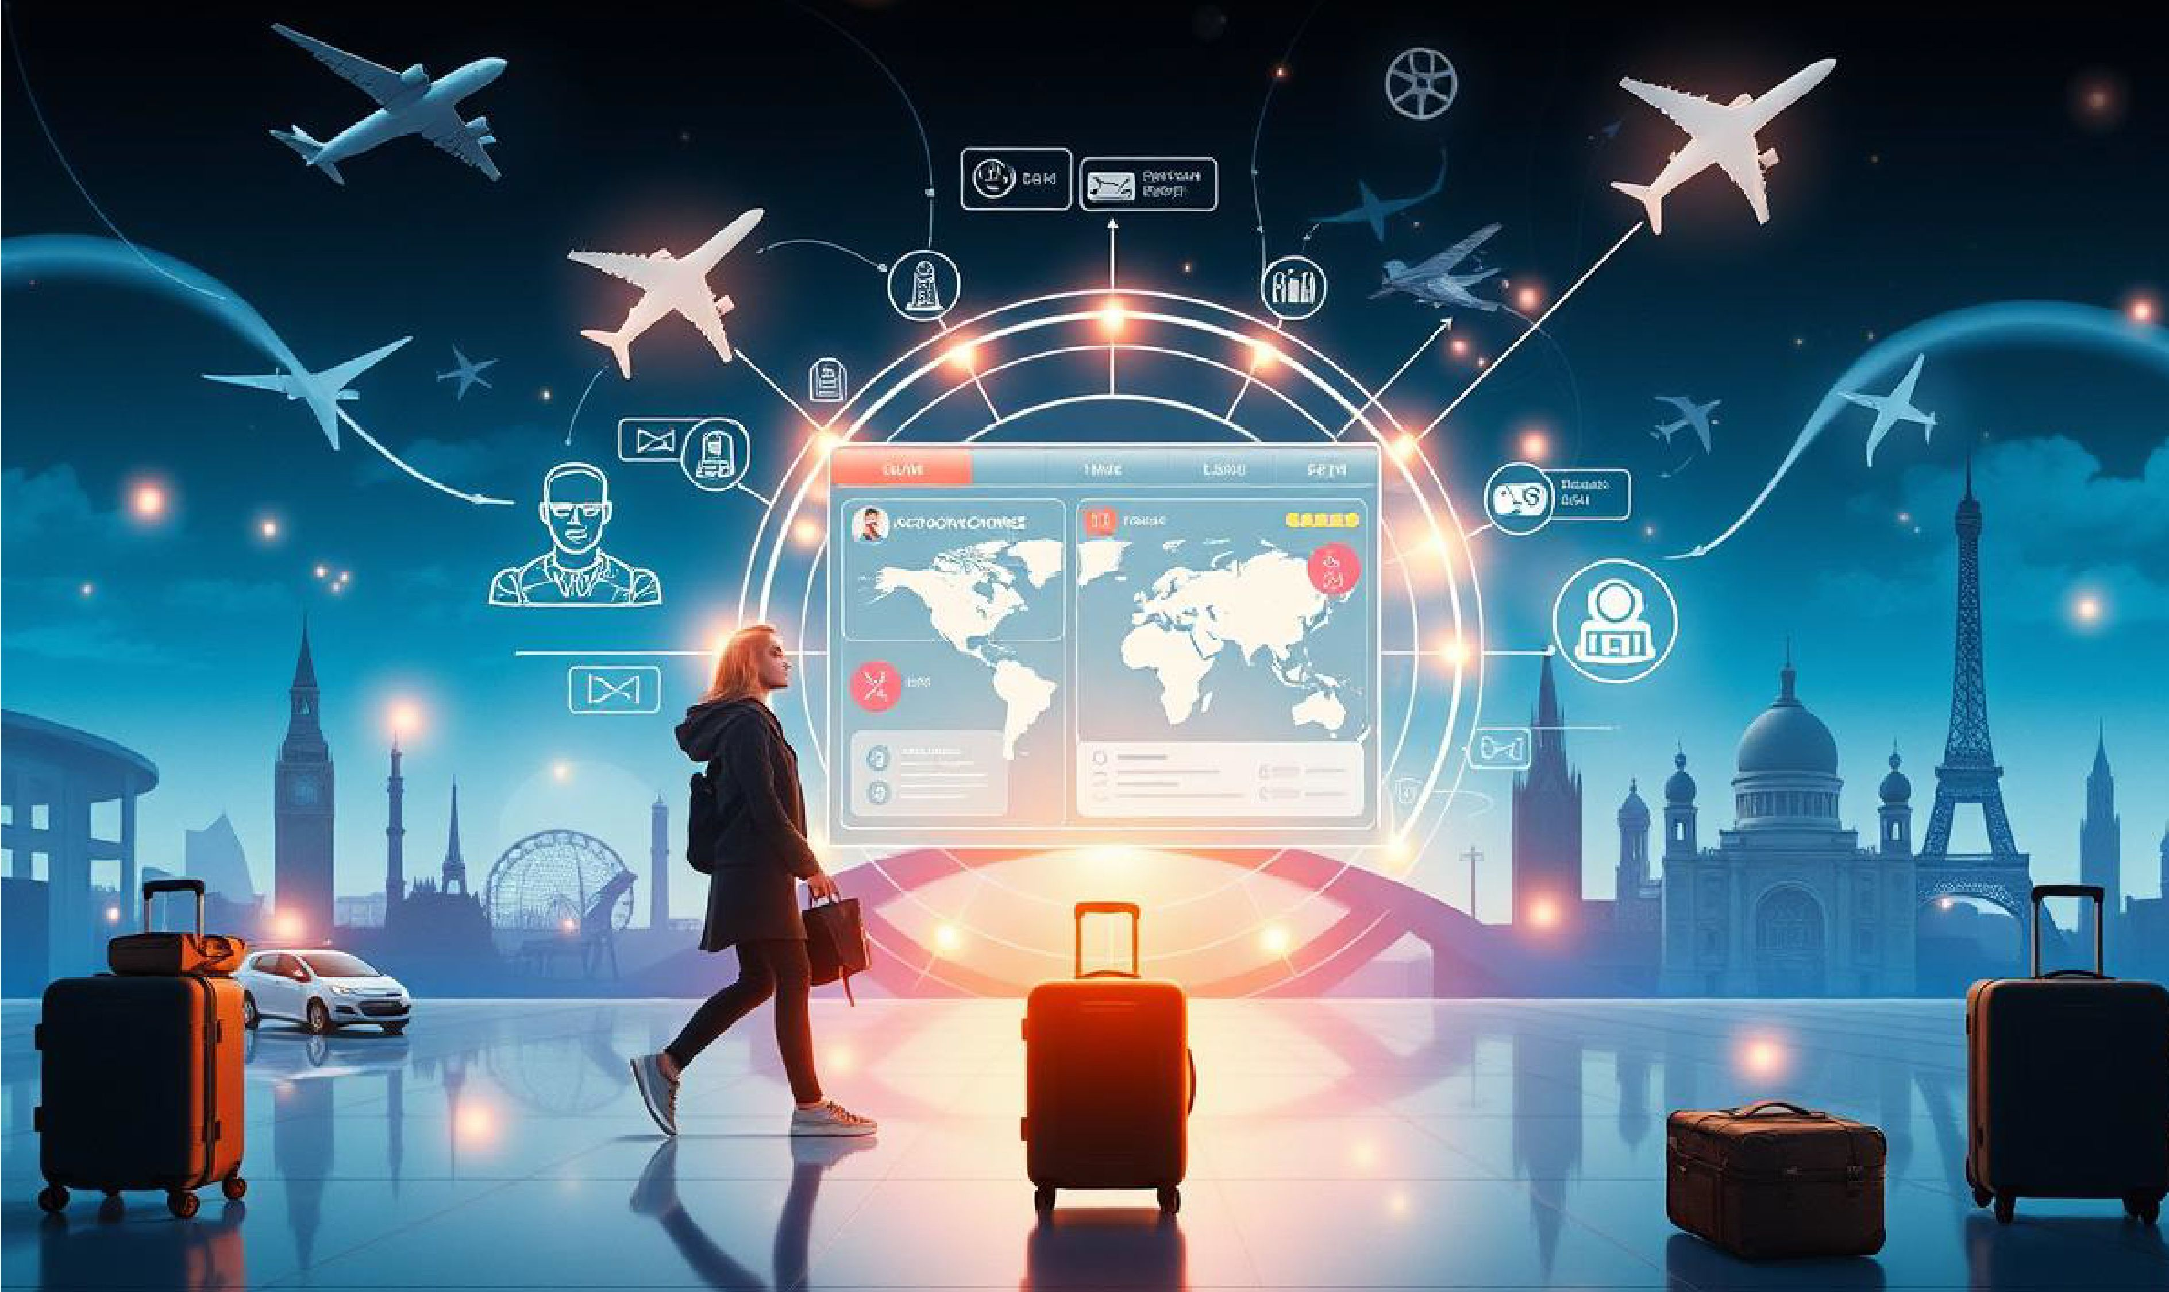
Strategic Communication Plan for AI-Powered Tourism Services
Travel Counsellors
AI Revolutionizing Travel & Tourism Industry

Slide 2
Introduction
In the tourism sector, communication is the method of delivering messages to the target audience
Travel Counsellors was founded in 1994, popular for its customized services in bookings and home-based travel advice (people.travelcounsellors.com, 2025)
The business model of Travel Counsellors focuses on entrepreneurialism, flexibility, and technology (vizologi.com, 2025)
The objective is to generate an effective communication plan for AI-powered Tourism services
The scope is to develop internal training programs for culturally diverse teams and create an FAQ document for customers
Notes:
This travel organization majorly emphasizes establishing long-lasting and strong connections with its potential guests through delivering personalized services that foster customer satisfaction. It has more than 2000 independent Travel counselors across the globe to give travel advice. The unique approach of this company integrates advanced digital technologies along with human expertise to cater precise services to their clients as per their demands and preferences. The objective of the current report is to generate an effective communication plan for AI-powered Tourism services. This comprehensive communication plan will be helpful in mitigating internal staff training in diverse regions, customer adoption, and cultural nuances. Moreover, communication strategies through digital tools will be developed for Travel Counsellors, a UK-based tourism company. The scope of this report is to generate internal training programs for culturally diverse teams and create an FAQ document for customers. Moreover, it focuses on AI chatbot services, global email marketing content, cultural inclusivity, ethical considerations, and measurable success indicators to assess the effectiveness of the communication plan

Slide 3
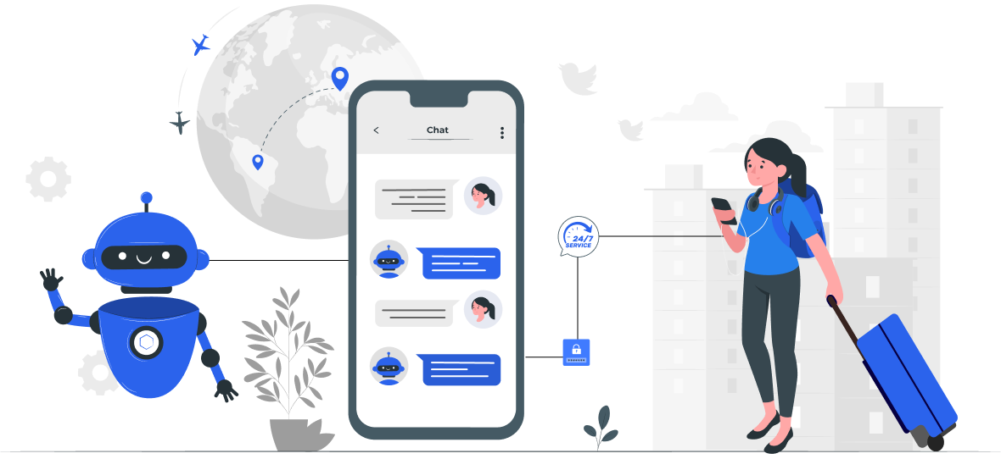
Communication strategy using digital tools
AI-powered Chatbots
Centralized Communication Platforms
Email marketing strategy
Data Analytics
(Source: streebo.com, 2025)
Notes:
Travel Counsellors can implement AI-powered Chatbots to assess client preferences and offer tailored travel recommendations. AI-powered chatbots can deliver customer support 24/7. The company can utilize platforms that combine multiple communication methods, including personalised SMS, email, and in-app messaging, to handle all client interactions in a single location Email automation tools such as Brevo, Hubspot, MailerLite, and ActiveCampaign can help send emails to target customers. This can help attract more customers and retain them. Moreover, this communication strategy by using digital tools can also help Travel Counsellors deliver details and updates of the trip to customers by highlighting the value of their travel agency

Slide 4
Internal training memo for staff in three culturally different regions
Memo:1 (The Staff of the UK)
To
The Staff of the UK,
From: Travel Counsellors
Date: 22.09.25
Subject: Improving customer communication through Digitalisation
I am writing to inform you that we are going to launch a new communication system by implementing AI solutions to enhance customer satisfaction. As service excellence is the fundamental part of our ongoing commitment, this initiative can help in client engagement processes. We have organized training programs for our staff members, which will be held for 10 days in June 2025. Training sessions will be focused on enhancing personalization using AI tools, maintaining GDPR compliance, and optimizing content for accessibility.
Therefore, you are invited to become a part of this workshop to explore the aspects of digital strategies and initiatives adopted by our company. If you have any queries or concerns, feel free to contact me.
Regards,

Slide 5
Memo:2 (The Staff of the UAE)
To
The Staff of the USA,
From: Travel Counsellors
Date: 22.09.25
Subject: Improving customer communication through Digitalisation
We are pleased to invite you to actively participate in our initiative to digitalize to improve customer experience through effective communication with the help of advanced technologies. Therefore, we have organised an upcoming workshop that will focus on "Advanced Data Analytics Techniques" to deliver in-depth knowledge and hands-on experience for our staff members regarding the usage of data analysis to enhance customer satisfaction. As service excellence is the fundamental part of our ongoing commitment, this initiative can help in client engagement processes. Training and workshops will be held for 10 days in July 2025.
If you have any queries or concerns, feel free to contact me.
Regards,

Slide 6
Continued
Memo:3 (The Staff of Netherlands)
To
The Staff of the UAE,
From: Travel Counsellors
Date: 22.09.25
Subject: Improving customer communication through Digitalisation
We are pleased to invite you to actively participate in our initiative to digitalize to improve customer experience through effective communication with the help of advanced technologies. Therefore, we have organised an upcoming workshop that will focus on "Advanced Data Analytics Techniques" to deliver in-depth knowledge and hands-on experience for our staff members regarding the usage of data analysis to enhance customer satisfaction. As service excellence is the fundamental part of our ongoing commitment, this initiative can help in client engagement processes. Training and workshops will be held for 10 days in July 2025.
If you have any queries or concerns, feel free to contact me.
Regards,

Slide 7
FAQ document for customers adapting to AI chatbots
Q1: What is the Travel Counsellors AI chatbot?
Ans: Our AI chatbot is a virtual assistant that is available at all times and can assist you with booking, itinerary updates, travel tips, and FAQs.
Q2: Is there any risk that my personal data will be violated?
Ans: No, we take extra care of your privacy. Global data protection laws are applicable in our operations, including GDPR, and CCPA. Any personal data is encrypted and safe from unauthorised access.
Q3: Can I still talk to a human agent?
Ans: Sure, you can request a live Travel counsellor any time during the chatbot conversation.

Slide 8

CONT......
Q4: How does the chatbot handle different languages?
Ans: The AI chatbot can deal with various languages and adapts to your settings in the chosen language automatically.
Q5: What should happen if the chatbot is unable to resolve my query?
Ans: If the nature of your concern is such that the chatbot can not help you any further, it will instantly connect you with a human travel agent.
Q6: What is the reason for implementing AI at Travel Counsellors?
Ans: To deliver better, personalised, and more efficient travel information, while maintaining our commitment to personal service

Slide 9

Email marketing content for global campaigns
Subject Line: Discover faster and smarter Travel Assistance with AI- Say Hi to our AI Travel Assistant
Header: Travel Counsellors’ new AI chatbot will make your next trip hassle-free.
Customer Privacy, Our Priority
We keep high data protection standards, which make sure that customers' information is safe and only used with your consent.
The Most Inspiring Examples of Email Marketing Campaigns
Notes:
Body: At Travel Counsellors, we are convinced that the best way to service our clients is to combine modern technology with a human touch. We are thrilled to present our new AI-powered chatbot and automated email updates. We conjured them up to simplify the travel process for customers and to give them a prompt, responsive, and personal experience.

Slide 10

CONT....
What’s New:
Instant 24/7 Support: Make a reservation, modify, or receive travel-related information at any time from wherever you are.
Multilingual Assistance: This can be accessed in more than 15 languages.
Protected and Private: Completely adhering to GDPR, CCPA, and local regulations.
7 Signs Your Organization Needs a Good IT Support Partner - Bleuwire
Notes:
The reasons it matters:
Getting prompt responses from customer support during travel bookings presented the primary booking challenge to business travellers. 74% of business travellers are more likely to use digital tools like apps and virtual agents to manage their disrupted trips (Egencia.Co.UK, 2025). This reflects a growing reliance on immediate digital support and the demand for prompt assistance in the travel sector. AI chatbot for Travel Counsellors meets this demand while ensuring that customers never have to wait. Besides that, a report by Forbes reveals that a personalized experience matters to customers as 81% of them will choose businesses that deliver personalized services (Hyken, 2024). Travel Counsellors' automated email marketing focuses on meeting this preference in order to create a strong connection with its customers and enhance their satisfaction, thus leading to increasing customer loyalty.

Slide 11
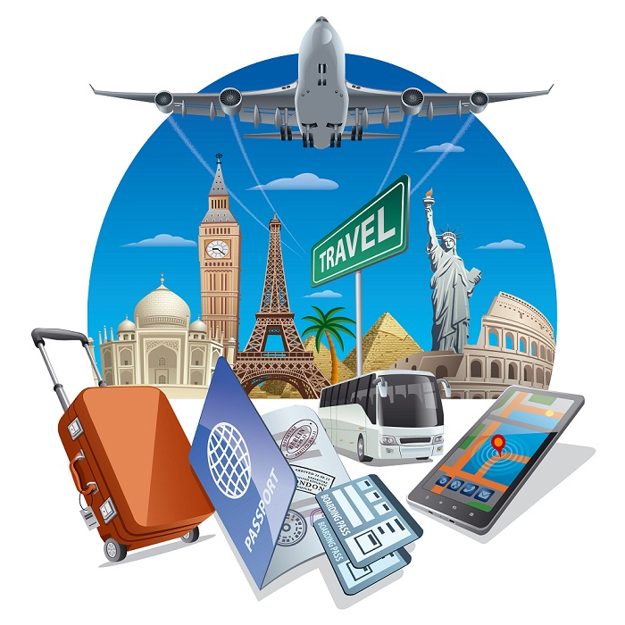
Ethical concerns
Company faces ethical issues of using data regarding clients’ privacy, and the possible excess of AI solutions
Complying with regulations such as the GDPR is vital
Open to the algorithms, perform checks on the algorithms often, and incorporate different datasets into the creation of the algorithms
(Source: sandipuniversity.edu.in, 2025)
Notes:
Being a customer-oriented business, it is crucial for Travel Counsellors to identify several issues regarding the ethics of using data regarding clients’ privacy, and the possible excess of AI solutions. As more and more interactions happen online, personal and contextual information, including travel-related information, preferences, and payment information, needs adequate protection. Furthermore, the use of artificial intelligence for recommending items that may suit a customer or offering automated customer support creates the concern of algorithmic racism. If the data is limited or has some level of bias, in some way, it will result in the provision of differential services to different groups in society.

Slide 12
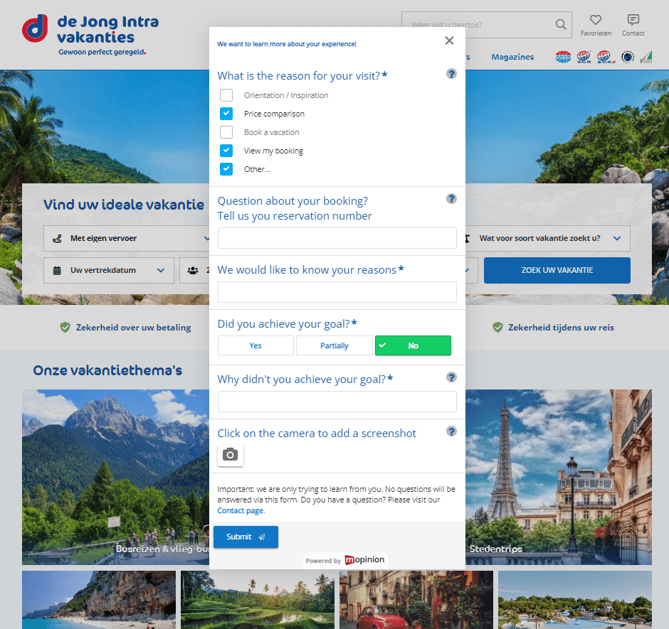
Feedback collection mechanisms and metrics for success
Travel Counsellors needs to have a competent feedback-taking system
Feedback is collected in real-time with the customers
Customer Satisfaction Score (CSAT), Net Promoter Score (NPS), Customer Effort Score (CES), and online review ratings (Giró Manzano, 2021)
(Source: mopinion.com, 2025)
Notes:
There is a list of indicators that should be monitored to assess the performance and make necessary improvements for Travel Counsellors. Other service efficiency measurements include response time, time to resolve an inquiry or complaint, as well as the accuracy of bookings made. This way, Travel Counsellors can efficiently know where major service shortfalls exist and how to proceed to customise Travel Counsellors' product line and services in a timely manner.

Slide 13
Recommendations
Implementing a robust security system
1
Performing regular audits
2
Leveraging social media for customer interactions
3
Notes:
In order to mitigate the data privacy issues in terms of the communication system of Travel Counsellors, it is necessary to implement robust access controls that must be formulated within the communication system. It can help the company to optimize communication protocols and adhere to data sovereignty laws. Performing regular audits can help the company to foster high levels of security in the communication system. By leveraging social media channels such as Facebook, Instagram, and Twitter, the company can engage with clients and establish strong relationships, as well as gather feedback on services

Slide 14
Conclusion
Communication necessitates a reciprocal connection between the delivery of recipients and messages
Leveraging advanced technologies can help to improve the communication system by streamlining processes
Digitalisation makes it simpler to manage interactions with clients and deliver timely updates
Notes:
Communication through digitalisation can also help in personalizing customer experiences, automating daily tasks, and maintaining comprehensive records of interactions with customers. AI-powered chatbots can deliver customer support 24/7. The KPIs include surveys, Customer Satisfaction Score (CSAT), Net Promoter Score (NPS), Customer Effort Score (CES), and online review ratings. Moreover, it is also essential to optimize customer retention rates in the tourism sector.

Slide 15
References
Egencia.Co.UK. (2025). Retrieved from: https://www.egencia.co.uk/en/egencia-survey-reveals-business-travelers-tech-reliance-during-disruption
Hyken, S. (2024, April 14). The personalized customer experience: consumers want you to know them. Forbes. Retrieved from: https://www.forbes.com/sites/shephyken/2024/04/14/the-personalized-customer-experience-customers-want-you-to-know-them/
people.travelcounsellors.com. (2025). Retrieved from: https://people.travelcounsellors.com/gb/about-us/
vizologi.com. (2025). Retrieved from: https://vizologi.com/business-strategy-canvas/travel-counsellors-business-model-canvas/
Giró Manzano, P., (2021). Customer Satisfaction Measurement: strategies, methodologies and factors influencing customer satisfaction measures. Retrieved from: https://openaccess.uoc.edu/handle/10609/131866

