Slide 1
Planning and Management of Sustainable Tourism Spaces
European Institute of Innovation, Entrepreneurship and Technology
Lessingstraße 79, 13158 Berlin, Germany
Mahmoud Abdou| Berlin
      Lessingstraße 79,
      13158 Berlin, Germany
      Phone: +49 30 233618555
      Fax: +49 30 233618556
      Email: info@eiiet.com

Slide 2
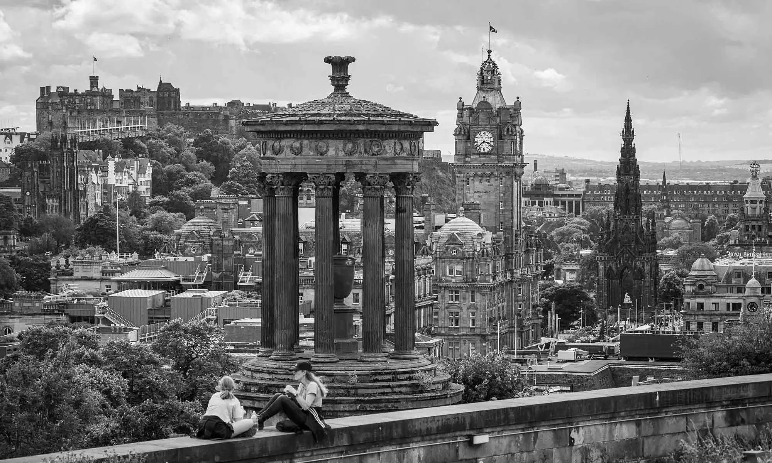
Outline:
1- On the meaning of Crisis
2- Economic Tourism Crises
3- Political Instability And Tourism Crises

Slide 3
1- On the meaning of Crisis
- Normally, there is disagreement regarding a concrete definition of a crisis.
- Nevertheless, it can be defined as a “sudden phenomenon, such as war, terrorist attack, economic decline, extreme natural events/disasters, or pandemics, that have an economic, social, cultural, and political impact on individuals, society, and economies” (European Travel Commission, 2024).
What do we mean by a crisis?

Slide 4
1- On the meaning of Crisis
- Despite the many definitions of a crisis, they share common features:
A triggering event causing major change.
An inability to cope with that change.
A threat to the organization’s core existence.
What do we mean by a crisis?

Slide 5
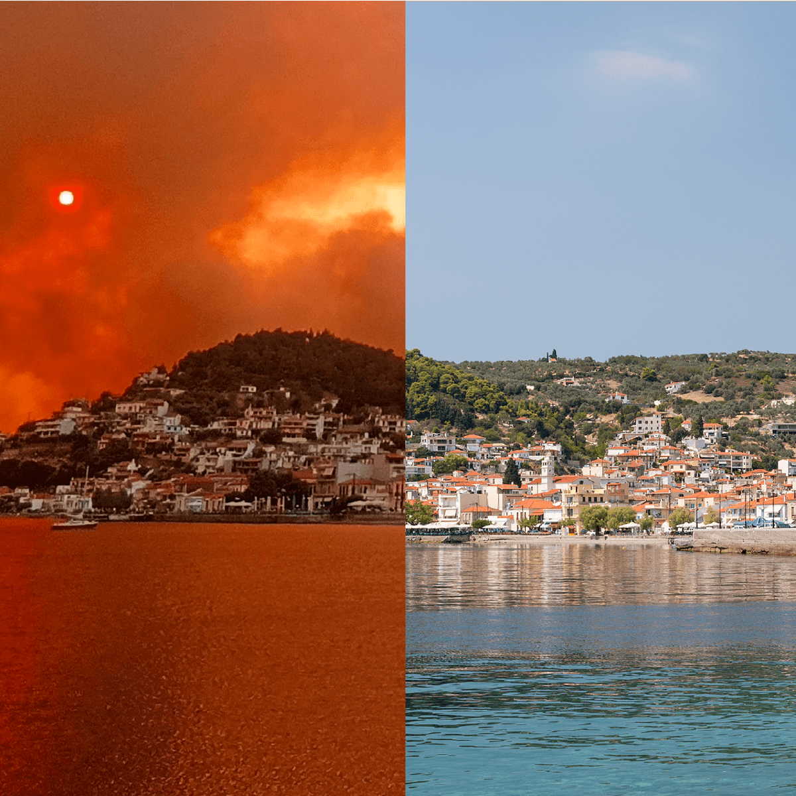
1- On the meaning of Crisis
- Tourism crises often stem from:
Economic Causes
Political Causes
Socio-Cultural Causes
Environmental Causes
Causes of Crisis:

Slide 6
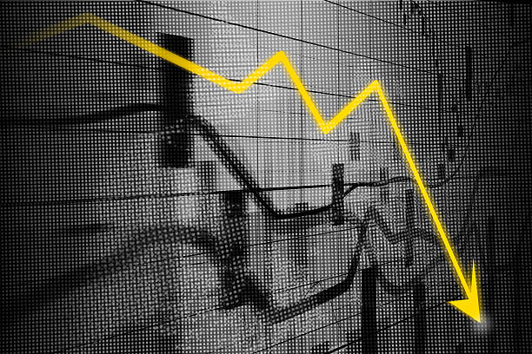
2- Economic Tourism Crises

Slide 7
2- Economic Tourism Crises
- “A crisis for the tourism industry which arises from eco- nomic changes within the tourism system or wider economy” (Henderson, 2007).
- Impact on the Tourism Industry:
Fewer people can afford to travel
Lower spending per tourist
Slower investment in tourism
2.1- Defining Tourism
Crisis:

Slide 8
2- Economic Tourism Crises
- Travel decisions depend heavily on:
The actual cost of travel
The perceived cost of travel
An individual’s financial situation
These factors influence decisions on destination, type of travel, and trip frequency.
2.1- Costs and Consumer Financial Position

Slide 9
2- Economic Tourism Crises
- Income strongly influences participation in leisure tourism.
- Higher disposable income increases travel activity.
- Post–WWII income growth in Western countries expanded long-distance travel.
2.2- Income Levels and Tourism Participation

Slide 10
2- Economic Tourism Crises
- Economic growth creates new middle-class consumers.
- Examples: Korea, Taiwan, Singapore, and China, India
- However,
- Recessions weaken tourism demand and can trigger tourism crises.
- Early 1990s U.S. recession led to decline in Hawaii tourism.
- Japan’s economic problems in the 1990s reduced outbound travel.
2.3- Economic Development and Downturns

Slide 11
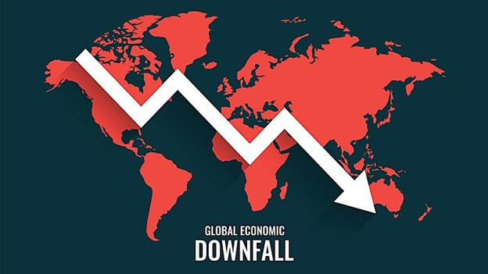
2- Economic Tourism Crises
- Economic downturns and recessions
- Currency and Fluctuation rates
- Loss of market confidence
- Withdrawal of investment funds
2.4- Economic Tourism Crises include:

Slide 12

2- Economic Tourism Crises
2.5- CASE STUDY: THE 2007 ECONOMIC CRISIS (ITALY, SPAIN, AND GREECE)
Economic Tourism Crises include:

Slide 13
2- Economic Tourism Crises
Reduced public spending on tourism infrastructure and services.
Increased taxes on tourism services, raising travel costs for locals and international visitors.
Rising unemployment lowered disposable income, resulting in fewer domestic tourists.
2.5- Key Effects of 2007 Recession

Slide 14
2- Economic Tourism Crises
Decline in International Tourism
Economic instability reduced tourist arrivals
Spain: Fewer visitors from UK & Germany
Italy & Greece: Lower luxury tourism demand
2.5- Key Effects of 2007 Recession

Slide 15

2.6- CURRENCY AND FLUCTUATION RATES

Slide 16
2- Economic Tourism Crises
- Currency values influence tourism trends and investment
Exchange rates affect:
Tourist spending power
Pricing strategies of operators
Destination competitiveness
2.6 - Currency and Fluctuation Rates

Slide 17
2- Economic Tourism Crises
- Impact of Fluctuations:
- Stronger currency:
Fewer inbound tourists, more outbound travel
- Weaker currency:
More inbound tourists, fewer outbound trips
- Price sensitivity:
Tourists adjust travel based on exchange rate
2.6 - Currency and Fluctuation Rates

Slide 18
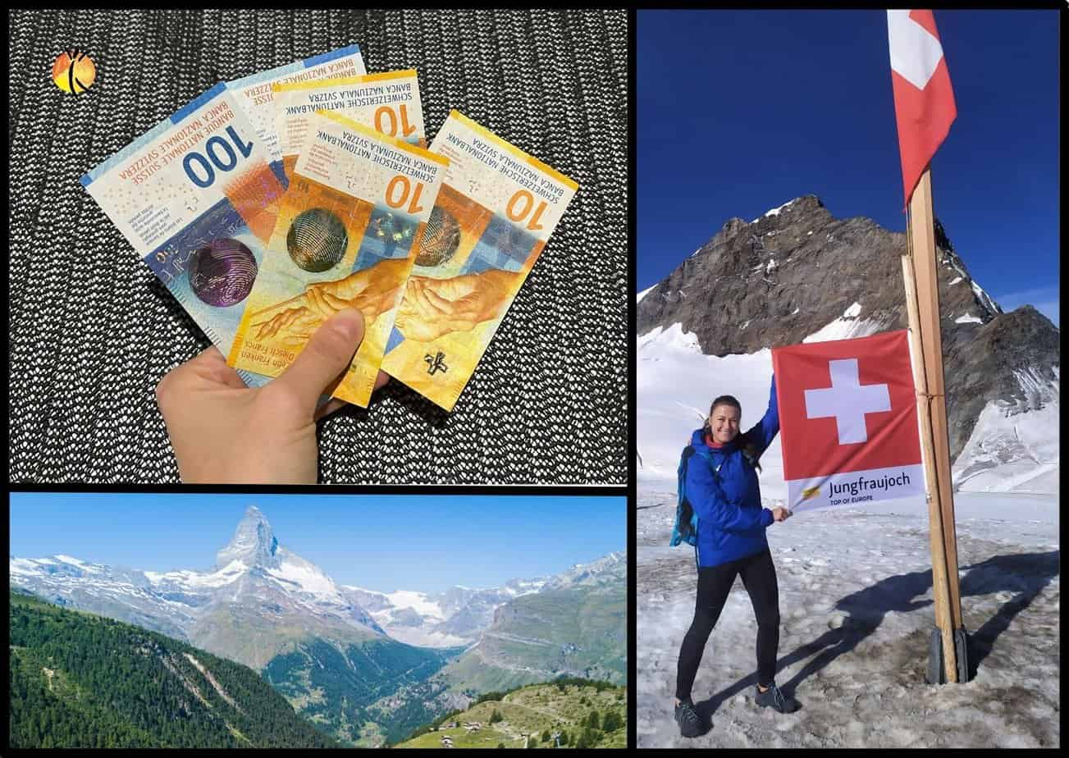
2- Economic Tourism Crises
- Example: Switzerland (1990s)
Strong currency caused a hotel industry crisis
- Effects of currency appreciation:
Foreign tourists found Switzerland expensive
Swiss nationals traveled abroad more
Hotel occupancy rates dropped
2.6 - Currency and Fluctuation Rates

Slide 19
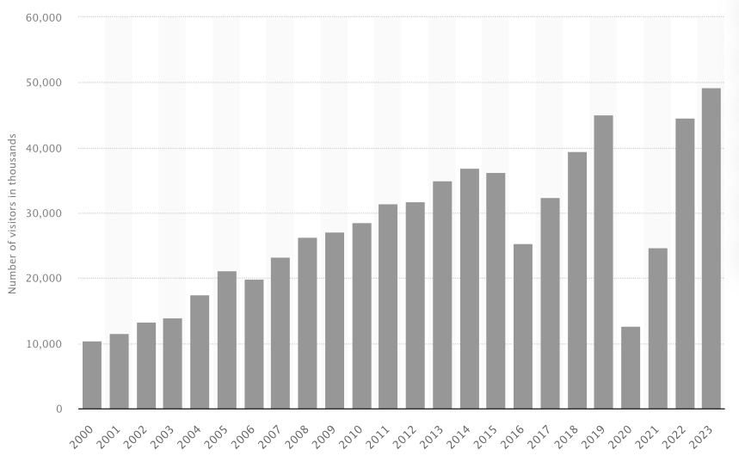
2- Economic Tourism Crises
- The depreciation of currency on the other side can increase the visitor number
- An example includes the Turkish lira
- Effects of currency depreciation
Increasing the number of visitor
Increasing the total number of nights
Increasing the total amount of spending
2.6 - Currency and Fluctuation Rates

Slide 20
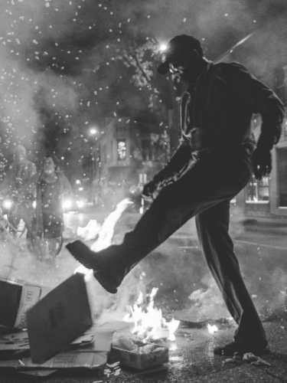
2- Economic Tourism Crises
3- Political Instability And Tourism Crises

Slide 21
3- Political Instability and Tourism Crises
- It is defined as:
- “A crisis for tourists and the tourism industry which is political in its origins”
(Henderson, 2007).
- Political instability includes:
3 - Political Tourism Crises:
International wars | Civil wars
Coups | Terrorism
Riots and social unrest | Strikes

Slide 22
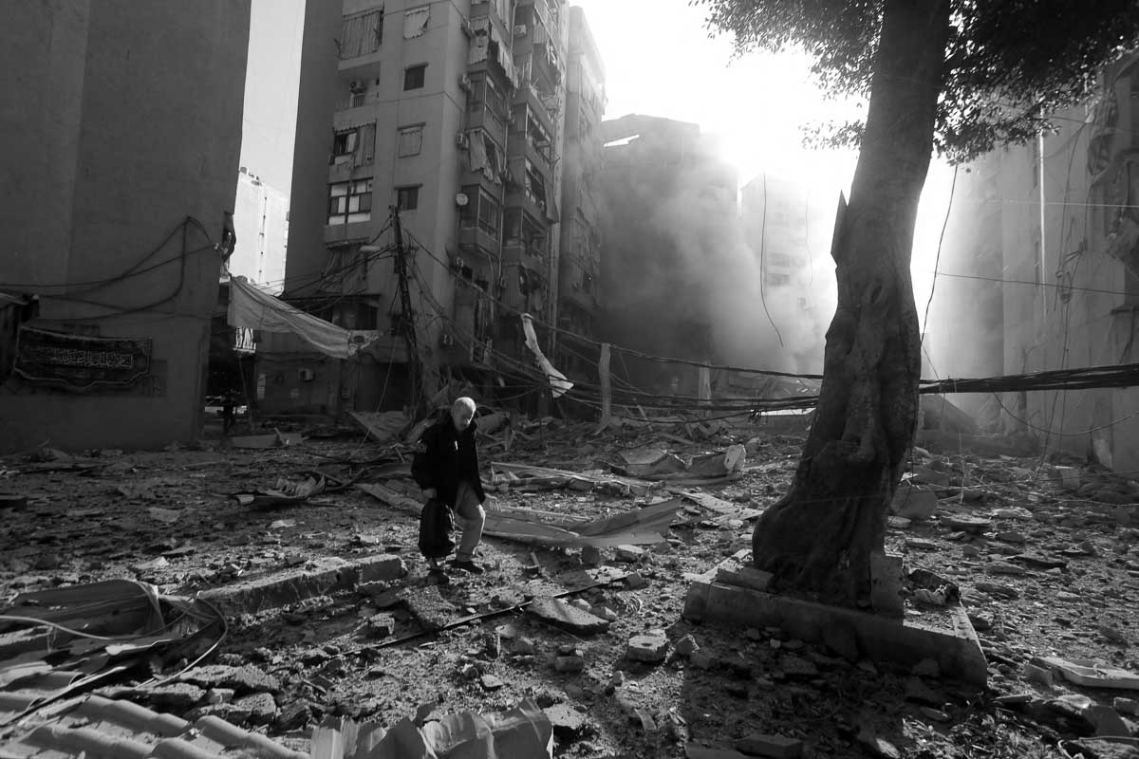
3- Political Instability and Tourism Crises
- Impact on tourists:
Tourists may cancel or postpone trips.
Fear of violence or uncertainty.
- Impact on the tourism industry:
Investment in tourism may slow or stop.
Destination reputation may suffer in the
long term.
3.1 - Political Tourism Crises Impacts:

Slide 23
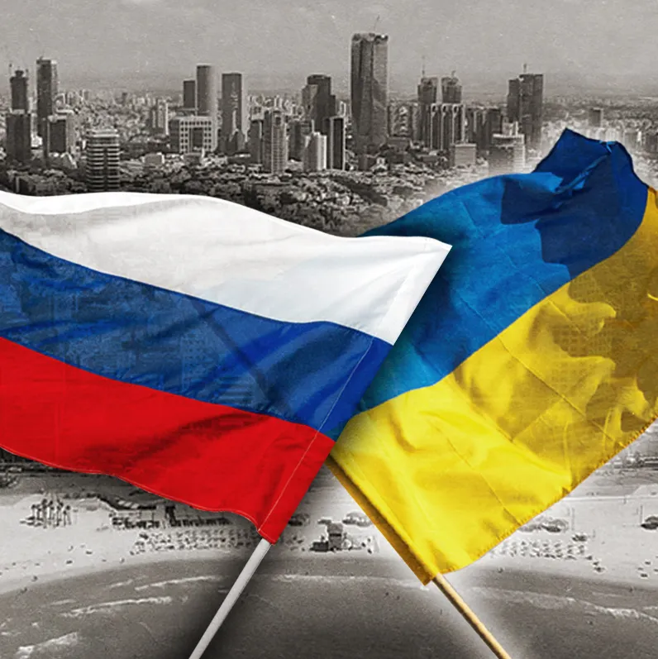
CASE STUDY 1: INTERNATIONAL WARS: THE RUSSIA-UKRAINE WAR

Slide 24
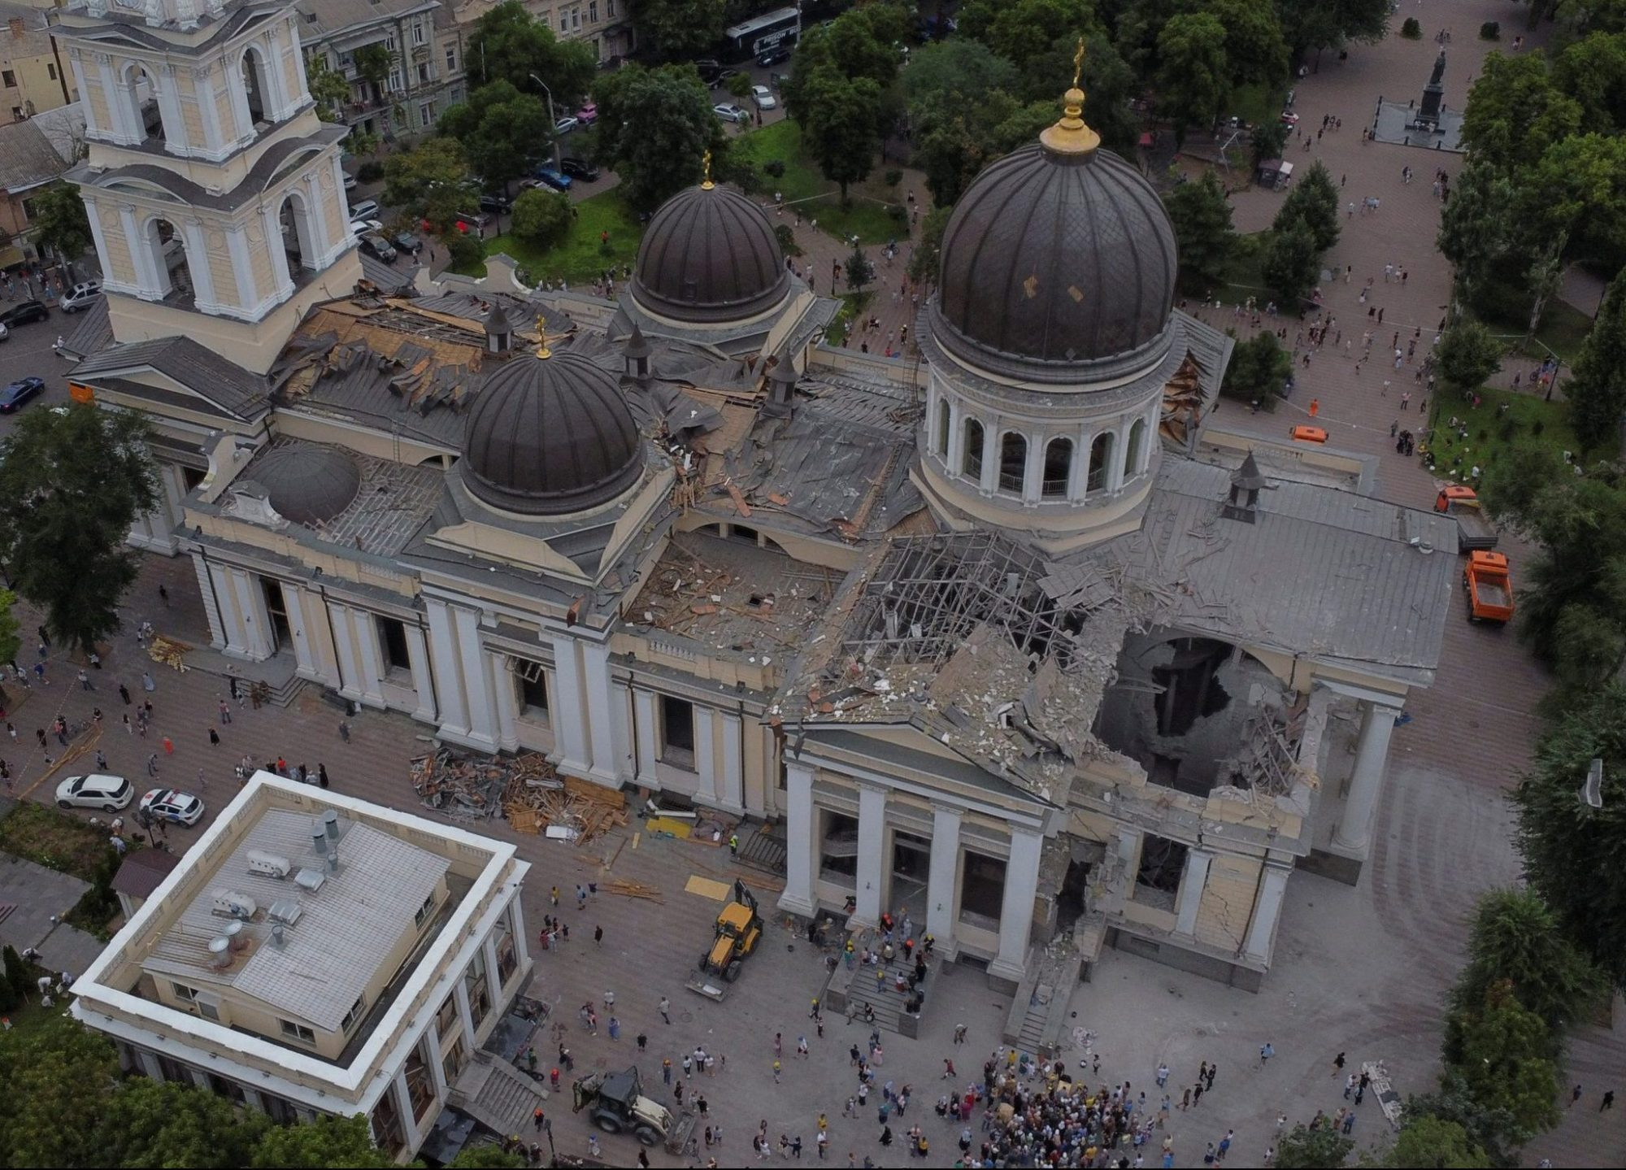
3- Political Instability and Tourism Crises
3.2 - Russia-Ukraine War
Conflict disrupts tourism and global travel
Damages cultural sites and infrastructure
Sharp drop in international visitors

Slide 25
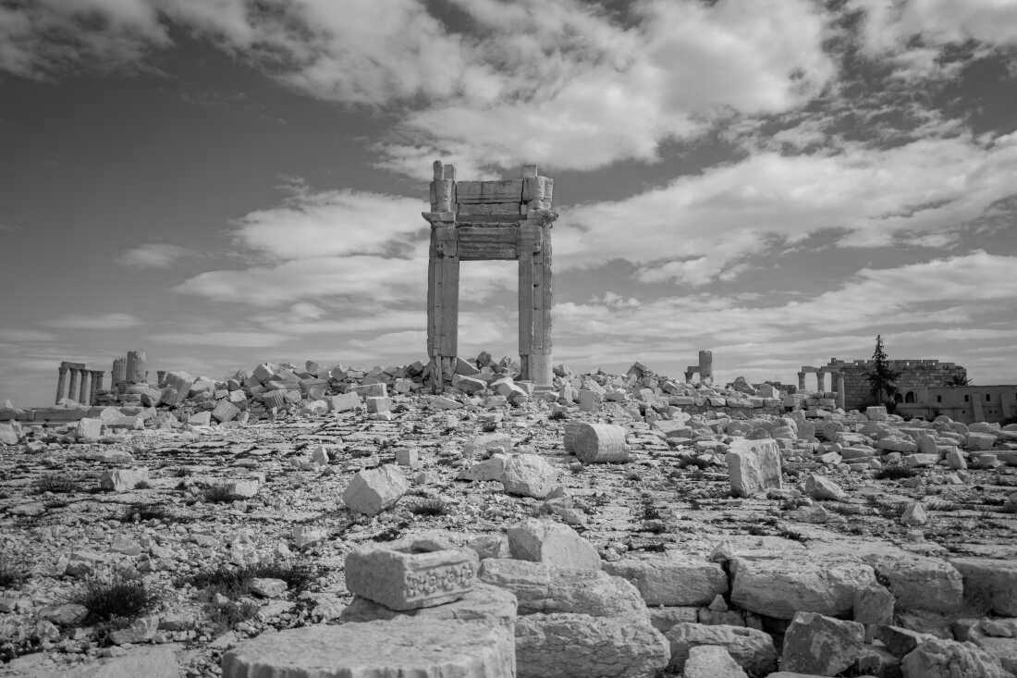
3- Political Instability and Tourism Crises
- Case Study 2: Civil Wars – Syria
Civil wars cause sharp declines in tourism and revenue
Instability and violence deter travelers and damage infrastructure
Syria: Before the 2011 war, it welcomed
About 8.5 million visitors, in 2010
3.3 – Syrian Civial War

Slide 26
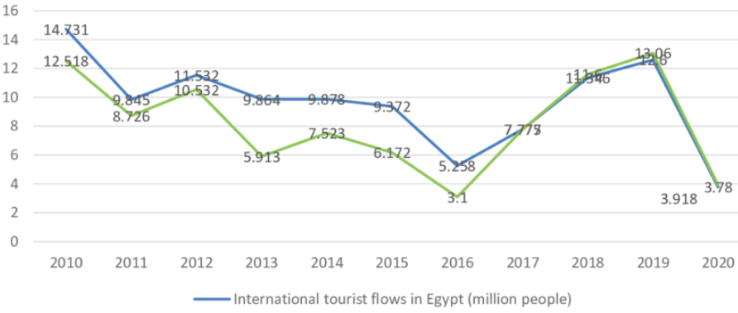
3- Political Instability and Tourism Crises
Political upheaval caused major disruption to tourism
Sharp drop in arrivals
Tourism revenue losses reduced GDP growth to 1.8%
3.4 – Arab Spring (Egypt)

Slide 27
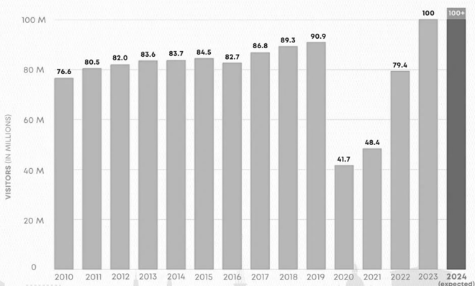
3- Political Instability and Tourism Crises
3.5 – Terrorism in France
- Paris Attacks (Nov 2015)
Major drop in visitor numbers
France had 85M visitors in 2015, but arrivals were expected to fall in 2016
Nice Attack (July 2016)
Tourism in the region fell by 10%
Hotels reported 20–25% revenue losses

Slide 28
Discussion
Choose one economic or political crisis that affected tourism in your country and explain:
Type: Economic or political.
When: Date or period of the crisis.
Impact: Negative effects on the tourism industry.
Response: How the country managed or mitigated it.

Slide 29
Thank you
      European Institute of Innovation, Entrepreneurship and Technology
      Lessingstraße 79,
      13158 Berlin, Germany
      Phone: +49 176 55524449
      Email: info@eiiet.com
Discover the world of eiIET

