Slide 1
Tools & Software in the Hospitality Industry
Prof Dr Jay Kumar Thakur| Berlin
      Lessingstraße 79,
      13158 Berlin, Germany
      Phone: +49 30 233618555
      Fax: +49 30 233618556
      Email: info@eiiet.com

Slide 2
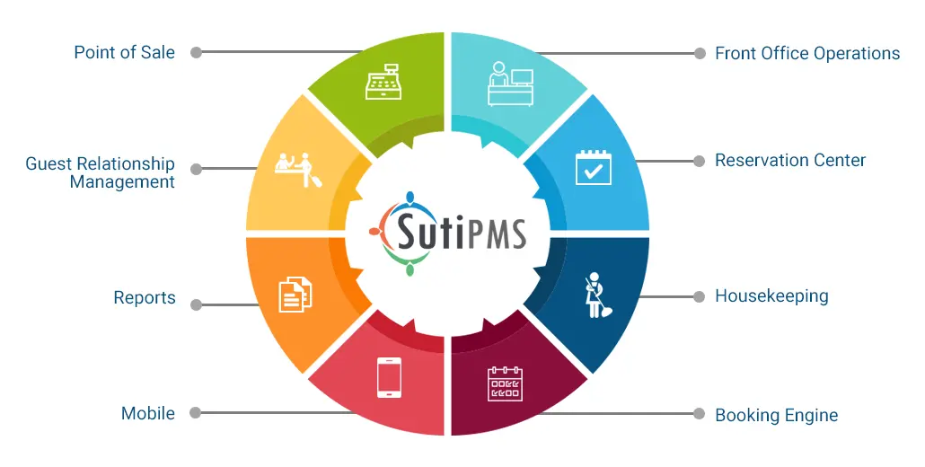
Agenda
Industry stacks overview (Germany focus)
Restaurants: POS, reservations, delivery, ops, CRM
Hotels: PMS, distribution, RMS, guest tech, ops
Tourism/DMOs & tour/activity operators: booking & CRM
Cross‑cutting: compliance, payments, analytics, communications
Mini‑cases & discussion prompts

Slide 3
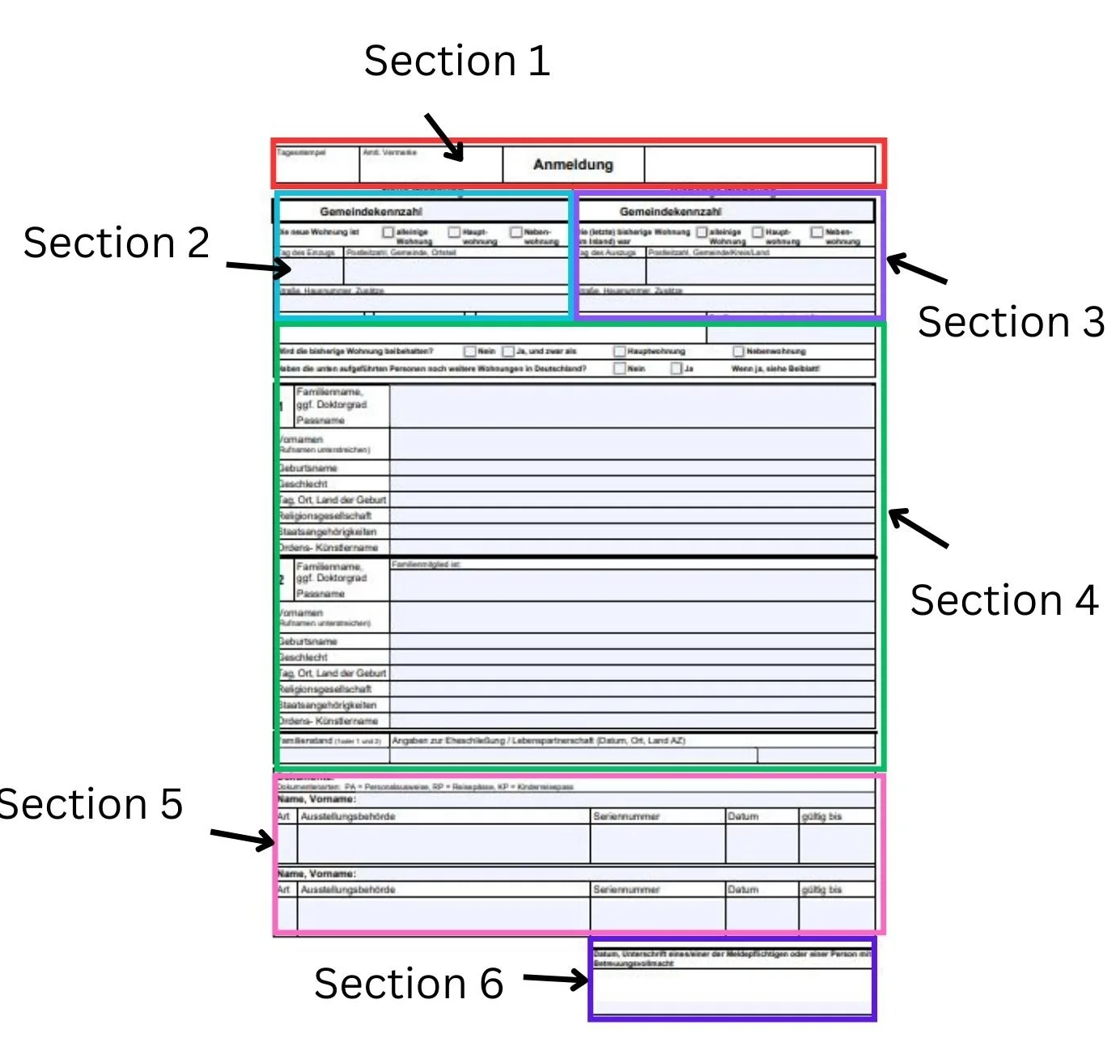
Compliance Snapshot (Germany/EU)
GDPR/DSGVO - Data minimisation, consent, DPA with vendors, retention
KassenSichV + TSE - Mandatory for POS systems; digital signatures & audit trails
GoBD - Proper bookkeeping & data access for audits
Bundesmeldegesetz (Hotels) - Guest registration (digital options), secure storage
Payment rails - SEPA, Girocard, Apple/Google Pay; PCI DSS for card handling

Slide 4
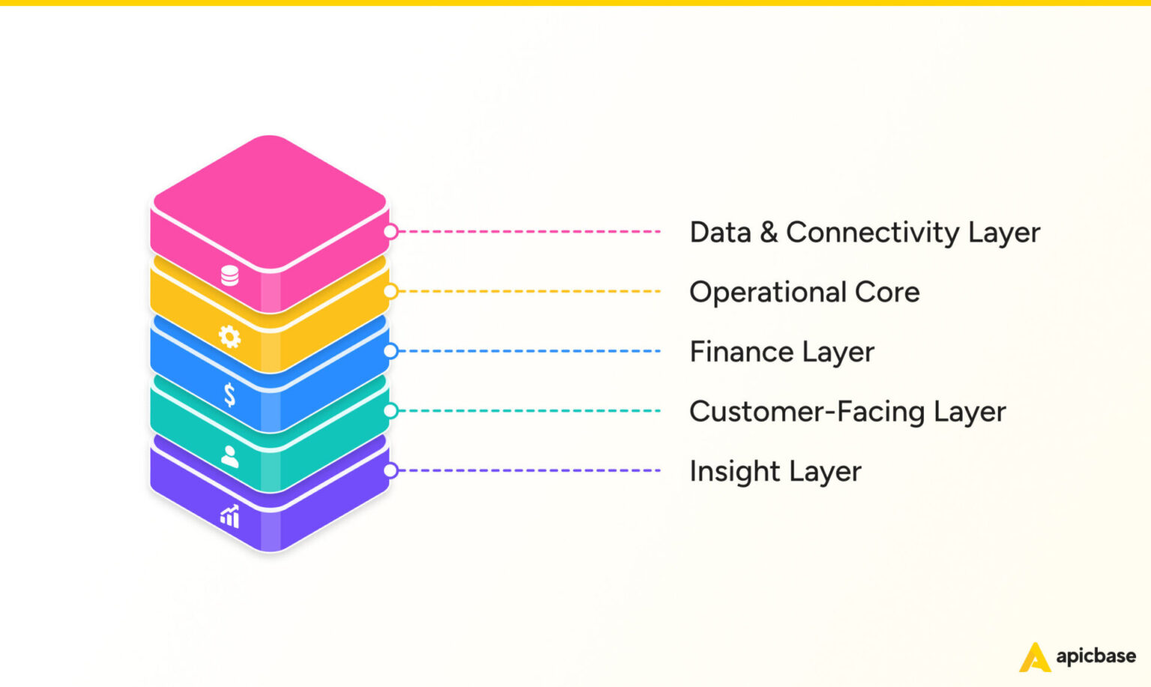
Restaurants: Core Stack
POS System: Manages orders, payments, and inventory.
Online Ordering: Expands reach, boosts sales.
CRM: Personalizes customer experience.
Inventory Management: Tracks stock and supplies.
Analytics and Reporting: Provides operational insights.

Slide 5
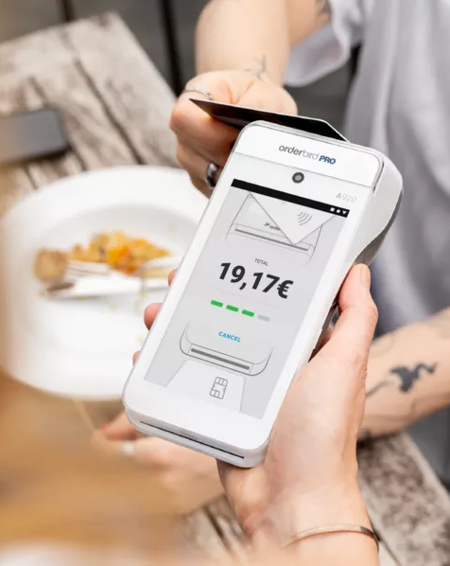
POS & Payments
POS platforms - orderbird (DE), Lightspeed (ex‑Gastrofix), Vectron, gastronovi
TSE compliance - Certified TSE module; export for audits (DSFinV‑K)
Payment processing - SumUp (DE), Adyen, Stripe; terminals via Payone/Worldline
Table‑side & QR - Order/pay at table; split bills; tip capture

Slide 6
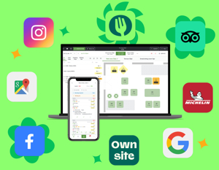
Reservations & Table Management
Table platforms - TheFork/Bookatable, OpenTable, Quandoo, resmio (DE)
No‑show protection - Deposits, card capture, reminders
Channel visibility - Google Reserve, Instagram action buttons

Slide 7

Delivery & Aggregators
Marketplaces
- Lieferando (DE), Wolt, Uber Eats
Menu & order hubs
- Deliverect, Otter for aggregator consolidation
Ops sync
- Menu 1‑source‑of‑truth; auto‑86; driver ETAs on KDS

Slide 8
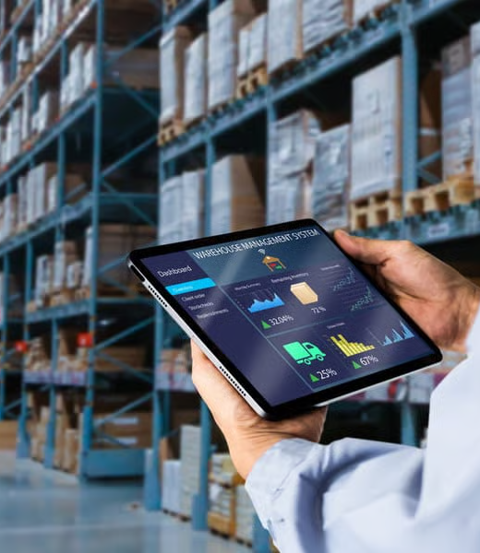
Inventory, Procurement & HACCP
Procurement
- Choco (Berlin), METRO integrations
Inventory & recipes
- MarketMan, gastronovi, calc for COGS & allergens
HACCP & checklists
- Flowtify (DE), digital logs & temperature records

Slide 9
Workforce & Scheduling
Scheduling & time
- gastromatic (DE), Papershift (DE), Planday
Payroll integration
- DATEV exports, break rules, labor cost forecasts
Staff comms
- Shift swaps, broadcast updates, policy acks

Slide 10

CRM, Loyalty & Feedback
Guest CRM
- SevenRooms, Zenchef, voucher & membership engines
Reviews & reputation
- Customer Alliance (Berlin), TrustYou, Google/My Business, TripAdvisor, Resmio,
Campaigns
- Brevo (Sendinblue), Mailchimp—GDPR settings & consent

Slide 11
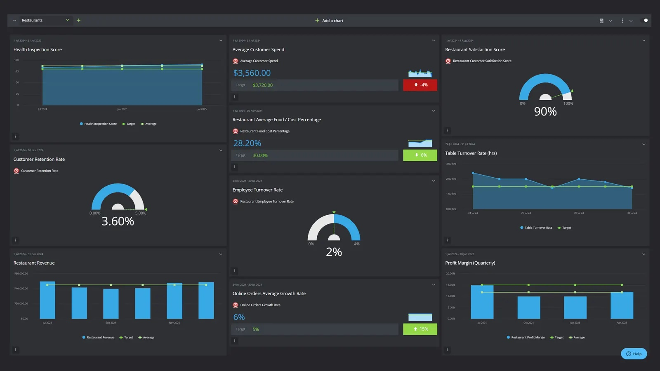
Analytics & BI
Dashboards
- POS + delivery + labor unified KPIs
GDPR‑friendly web analytics
- Matomo (self‑hosted) vs Google Analytics
Forecasting
- Menu mix, price tests, demand curves

Slide 12
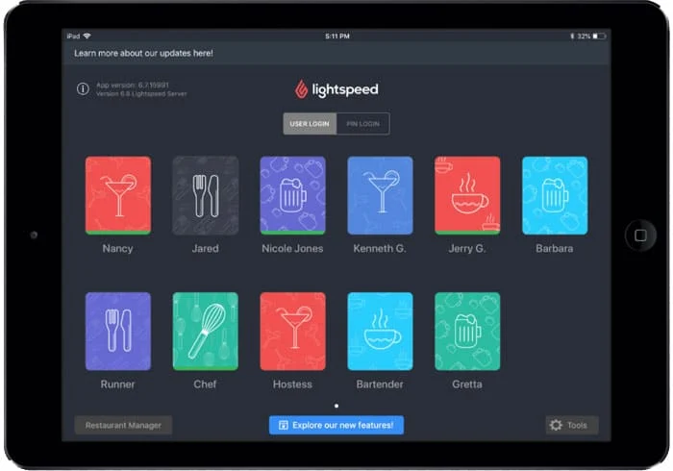
Sample Stack: Multi‑Unit Casual Dining
Core
- Lightspeed or orderbird + certified TSE
Bookings
- TheFork + Google Reserve + resmio for website
Delivery
- Lieferando + Deliverect aggregator
Ops
- Choco procurement + Flowtify HACCP
People
- gastromatic + DATEV
Growth
- SevenRooms CRM + Customer Alliance reviews

Slide 13
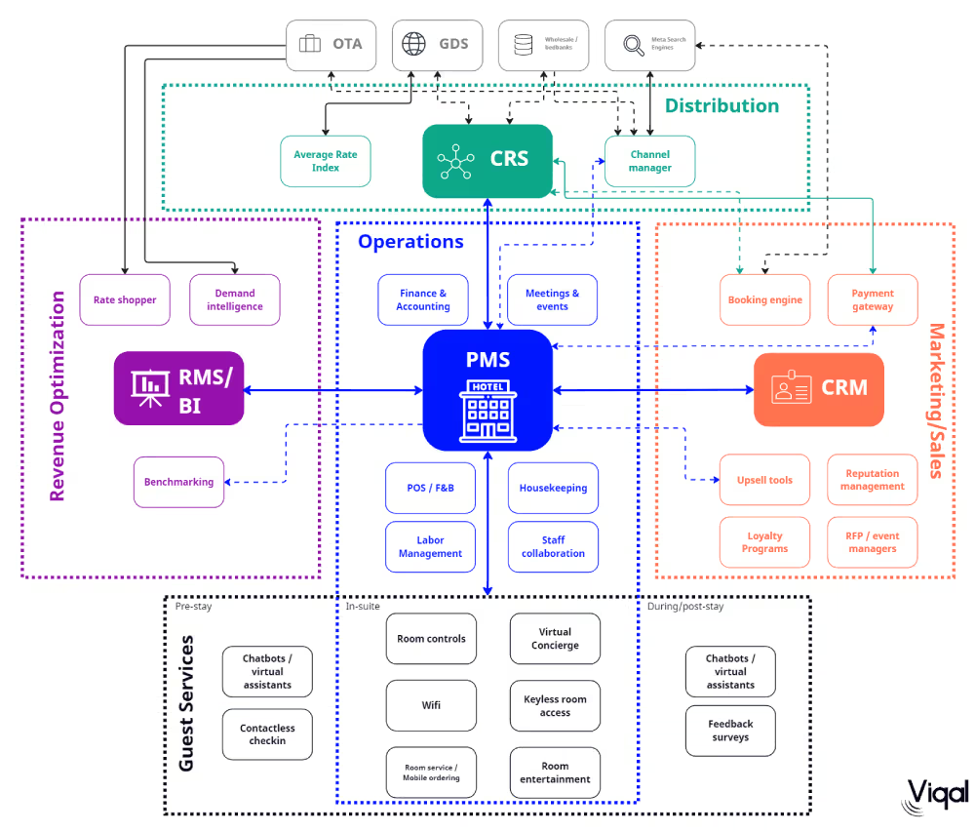
Hotels: Core Stack
Property Management System (PMS)
Central Reservation System (CRS)
Customer Relationship Management (CRM)
Point of Sale (POS)
Channel Manager
Revenue Management System (RMS)
Staff Scheduling & Workforce Management
Analytics & Reporting Tools

Slide 14
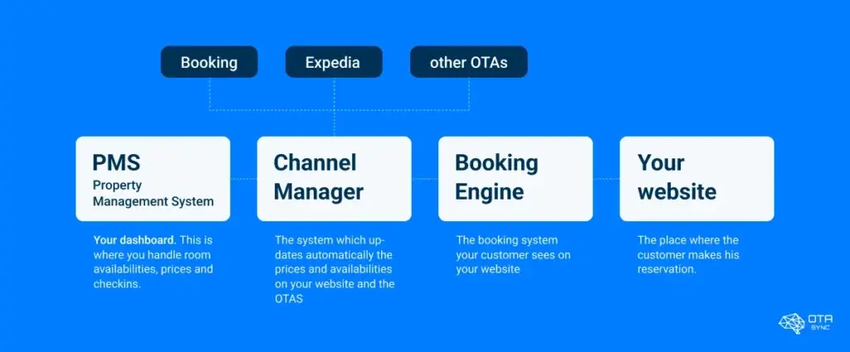
PMS, CRS & Distribution
PMS
- SIHOT (DE/AT), protel, Mews, Oracle OPERA
Channel mgmt/CRS
- D‑EDGE, SiteMinder, Hotel Spider
Booking engine
- Direct web engine with meta connectivity (Google, Trivago)
German channels
- HRS (Cologne), Booking.com, Expedia

Slide 15
Revenue, Rates & BI
RMS
- IDeaS, Duetto, Pace/Revenue
Market intelligence
- OTA Insight/Lighthouse, STR (benchmarking)
Financial BI
- Fairmas (DE) forecasts & budgeting

Slide 16
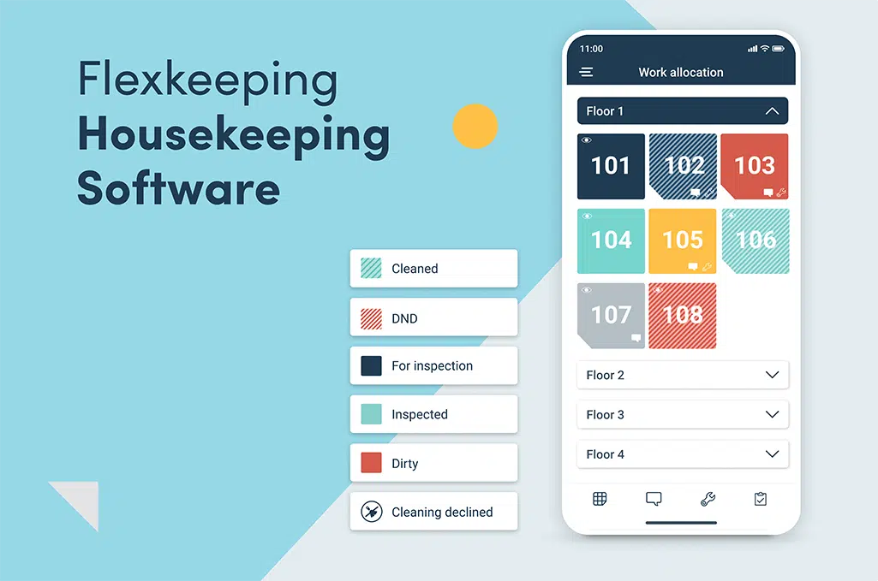
Guest Experience & Operations
Housekeeping & ops
- hotelkit (AT/DE), Flexkeeping, Optii
Digital check‑in & keys
- hotelbird (DE), straiv (AT/DE), SALTO/Assa Abloy locks
Messaging & upsell
- WhatsApp Business (with policy care), Messenger, Oaky
Review mgmt
- TrustYou (DE), ReviewPro (Shiji)

Slide 17

F&B & POS in Hotels
Hotel F&B POS
- Oracle Simphony, gastronovi, Lightspeed
KassenSichV
- TSE across outlets; consolidated exports
Interfaces
- Room charge to PMS, 2‑way folio sync

Slide 18
Compliance & Data
Guest registration
- BMG digital processes, ID validation & retention
GDPR
- RoPA, DPIAs for guest‑facing apps, DSR workflows
Security
- SAML/SSO, MFA, role‑based PMS access

Slide 19
Sample Stack: 80‑Room Independent
Core
- Mews PMS + D‑EDGE channel + direct engine
RMS & BI
- IDeaS + Fairmas + Lighthouse market data
Guest tech
- hotelbird kiosk/app + SALTO + TrustYou
Ops
- hotelkit + Housekeeping module + maintenance tickets
F&B
- Simphony with TSE + room‑charge integration

Slide 20
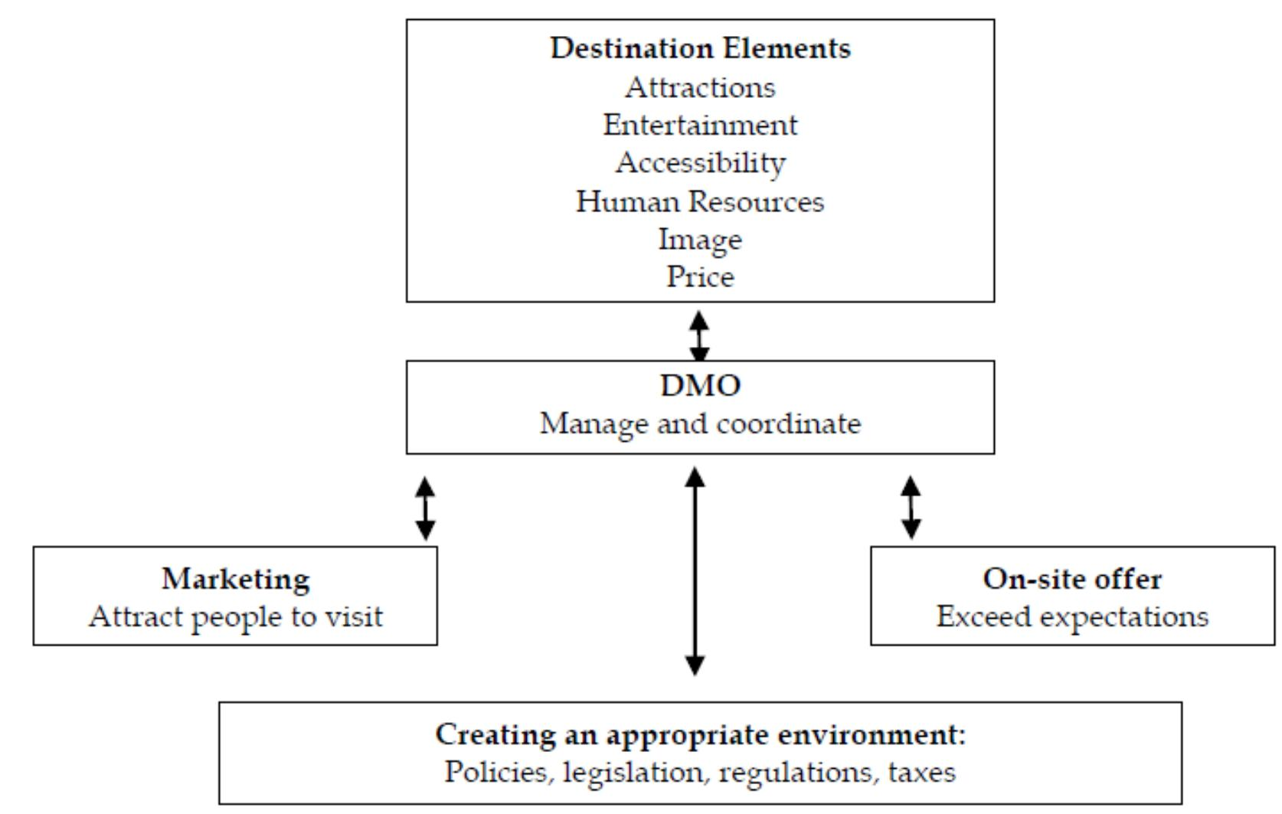
Tourism / DMOs / Tours & Activities
Tourism: Travel for leisure or business to explore destinations.
DMOs (Destination Management Organizations): Coordinate marketing, planning, and services to promote destinations and ensure sustainable tourism.
Tours & Activities: Curated experiences offering cultural, adventure, or leisure opportunities for visitors.

Slide 21

Booking, Ticketing & Distribution
Tour/Activity platforms
- booking kit (DE), Regiondo (DE), Fare Harbor, Trek Soft
OTAs
- GetYourGuide (DE), Viator, Tiqets
Capacity & slots
- Real‑time inventory, mobile tickets, QR validation

Slide 22
DMO & Destination Tools
Content & maps
- Outdoor active (DE), Feratel, TOMAS
CRM for DMOs
- Simple view, newsletter via Brevo/Clever Reach (DE)
City passes & bundles
- Integrations with transport/museums; dynamic pricing emerging

Slide 23
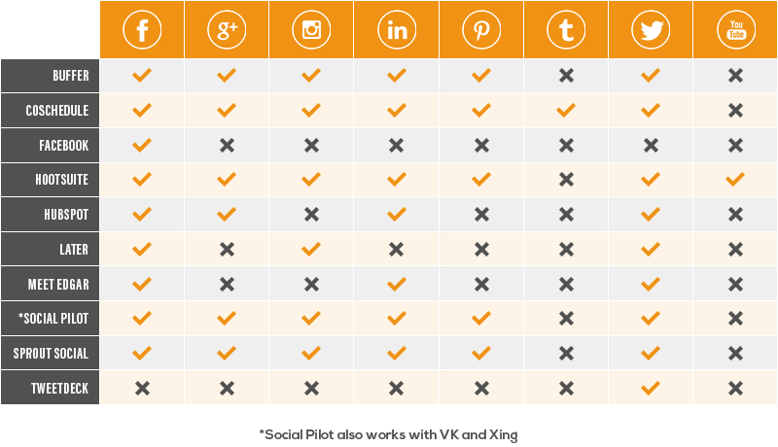
Marketing, Analytics & Community
Web & analytics
- CMS + Matomo/GA; consent management (CMP)
Social scheduling
- Buffer, Hootsuite; UGC curation
Reputation
- Centralised review tracking across partners

Slide 24
Sample Stack: Regional DMO
Attractions
- booking kit for partners + unified calendar
Visibility
- Outdoor active trails + Google Things to do
CRM
- Clever Reach (DE) segmented newsletters + events CRM
Insights
- Matomo dashboards; seasonal demand analysis

Slide 25
Cross‑Cutting: Integration, Data & Comms
Seamless Integration
- Real-time APIs connect PMS, POS, CRM, and RMS
Robust Data Architecture
- Use middleware, EU-based warehousing with BI layers for analytics.
Data Governance & Security
- GDPR compliant, encrypted data, clear ownership, and regular backups
Effective Communication
- Mobile-first frontline tools, guest communication with WhatsApp Business

Slide 26
Integrations & Data Architecture
APIs & webhooks
- Real‑time sync PMS↔POS↔CRM↔RMS
Middleware
- n8n (self‑hosted, EU), Make.com; SFTP where needed
Warehousing
- PostgreSQL/Snowflake (EU region), BI layers
Data governance
- Data catalog, ownership, SLAs, backups/encryption

Slide 27
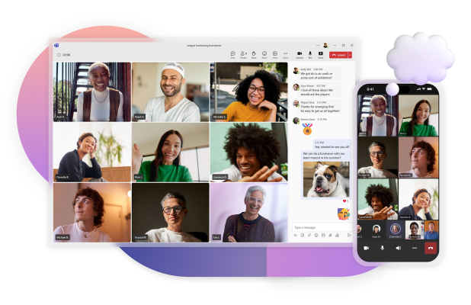
Communication & Collaboration
Frontline comms
- Beekeeper (CH), Teams, Slack
Task mgmt
- Asana, Trello, hotelkit tasks, Quore
SOPs & training
- Notion/Confluence; micro‑learning & checklists
Guest comms policy
- WhatsApp Business archiving, consent, opt‑out

Slide 28
Selection Criteria & TCO
Function & UX
- Role fit, multilingual, mobile‑first
Compliance & security
- GDPR, TSE, ISO 27001 statements, DPAs
Ecosystem & support
- German support SLAs; partner network
Costs & lock‑in
- Contracts, data export, migration paths

Slide 29
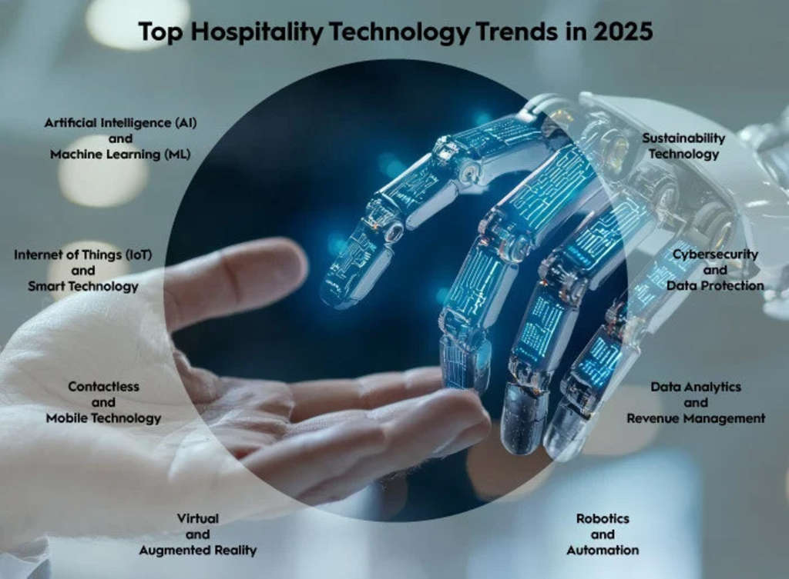
Trends to Watch (2025+)
AI
- Demand forecasting, dynamic pricing, staff rostering, chatbots
Contactless journeys
- Kiosk/app check‑in, mobile keys, QR menus
Sustainability tech
- Energy mgmt (Betterspace), waste tracking
Identity & payments
- Network tokenization, SCA, tap‑to‑pay

Slide 30
In‑Class Discussion & Activities
Discuss key components of restaurant operations and technology.
Role-play: Assign student roles to simulate a restaurant environment.
Analyze case studies on restaurant tech stack and customer service challenges.
Group activity: Design a simple restaurant floor plan or menu concept.
Technology demo: Practice using POS system or digital order management.
Problem-solving: Identify solutions for common restaurant operational issues.
Reflection: Discuss the impact of technology on customer experience.

Slide 31
Activities
Stack comparison
- Pick a German restaurant/hotel; map current vs target stack
Data flow sketch
- Draw integrations and data ownership, note GDPR risks
Vendor RFP
- Draft top 10 requirements and evaluation rubric
KPI dashboard
- Define 8–10 cross‑system KPIs for weekly review

