Slide 1
Health Threats in Tourism
European Institute of Innovation, Entrepreneurship and Technology
Lessingstraße 79, 13158 Berlin, Germany
Mahmoud Abdou| Berlin
      Lessingstraße 79,
      13158 Berlin, Germany
      Phone: +49 30 233618555
      Fax: +49 30 233618556
      Email: info@eiiet.com

Slide 2
Index
- Health and Wellness Enhancement Tools
- Factors influencing the need for wellness tourism

Slide 3
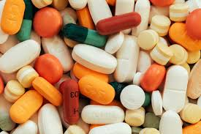
1- Health and Wellness Enhancement Tools
      1.1. Conventional Medicine
    - Provided by qualified doctors
    - nurses
    - physical therapists
    - psychologists

Slide 4
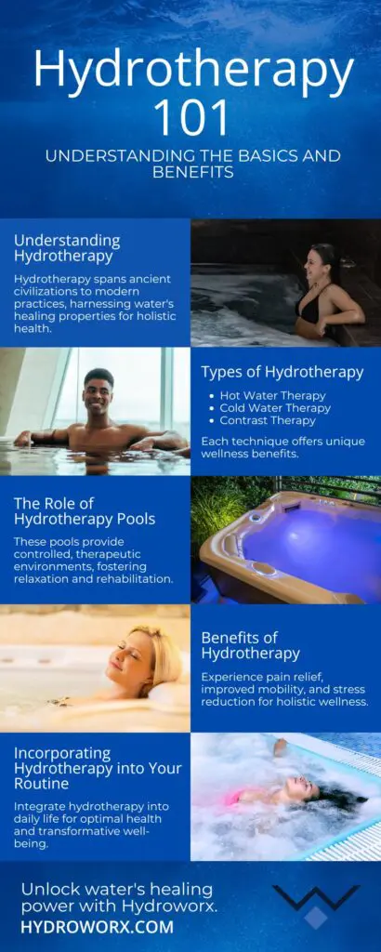
1- Health and Wellness Enhancement Tools
      1.1. Conventional Medicine
    - Many medical spas have waters with special medical or healing properties.
    - These therapeutic waters are believed to aid in various health conditions.
    - Usage of these waters is typically guided by a doctor's prescription.
    - The treatment is usually prescribed for a specific amount of time
    (e.g., 20 minutes per session).

Slide 5
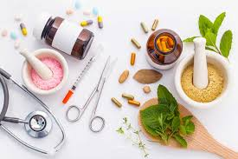
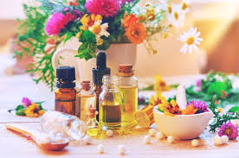
1- Health and Wellness Enhancement Tools
      1.1.1. Complementary and Alternative Medicine
    - Besides conventional medicine, there is a growing field
    known as Complementary and Alternative Medicine (CAM).
    - This medicine is also known as “integrative medicine”.
    - It is believed that CAM was developed long before
    conventional medicine.

Slide 6
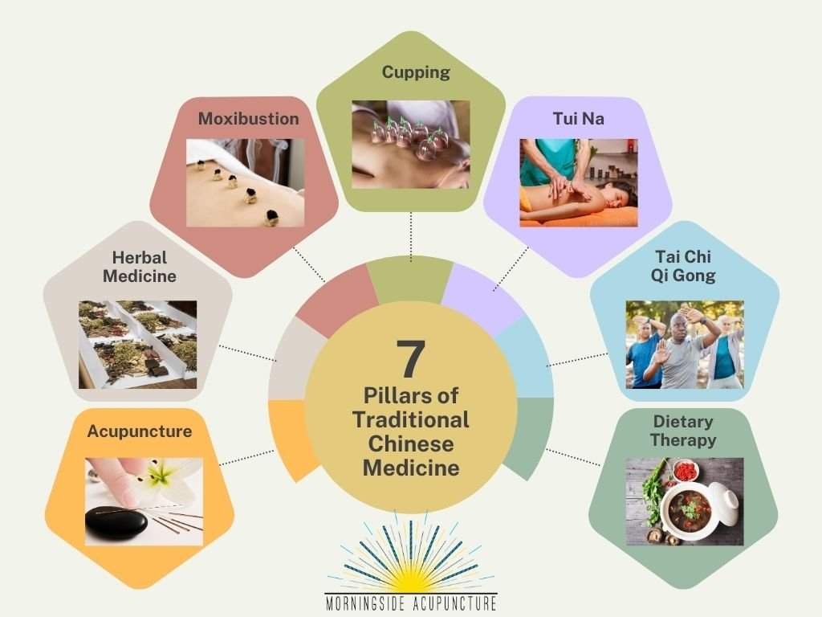
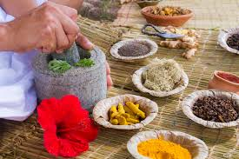
1- Health and Wellness Enhancement Tools
      1.1.1. Complementary and Alternative Medicine
    Examples in Western cultures include:
    - Homeopathic medicine
    - Naturopathic medicine
    In non-Western cultures, examples include:
    - Traditional Chinese Medicine (TCM)
    - Indian Ayurveda
Notes:
Qi Gong uses exercises to optimize energy within the body, mind, and spirit.

Slide 7
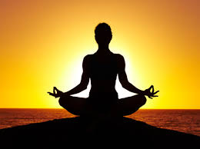
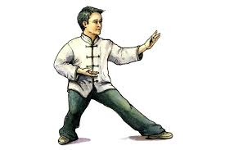
1- Health and Wellness Enhancement Tools
      1.1.1. Complementary and Alternative Medicine
    - Other treatments such as meditation, mental healing, prayer,
    and therapies that use creative expressions like
    art, dance, and music are increasingly being used.
    - Other treatments, such as energy therapies,
    involve the use of energy fields, for example,
    through Therapeutic Touch, Qi Gong, or Reiki.
Notes:
Reike treatment is a sort of alternative medicine focused on balancing the body’s energy.

Slide 8
1- Health and Wellness Enhancement Tools
      1.2. Therapy and Healing
    - If something is described as therapeutic, it means it has healing powers or contributes to improved well-being.
    - Nowadays, the term “therapeutic” is widely used to describe a variety of wellness activities.
    These activities include:
    Relaxing massages
    Yoga classes
    Water-based treatments
    Physical exercise
Notes:
Reike treatment is a sort of alternative medicine focused on balancing the body’s energy.

Slide 9


1- Health and Wellness Enhancement Tools
      1.2. Therapy and Healing
    - Therapeutic centers can include
    Psychological therapy
    Beauty therapy
    Diet therapy
    Detox therapy
    Trauma therapy
    Stress therapy
Notes:
Detoxification or detoxication is the physiological or medicinal removal of toxic substances from a living organism, including the human body, which is mainly carried out by the liver.

Slide 10
1- Health and Wellness Enhancement Tools
      1.2. Therapy and Healing
    Case Study: Hole in the Wall Camps
    -Hole in the Wall Camps are the world’s largest network of camps for children with serious illnesses and life-threatening conditions.
    - Since their founding in 1988, more than 114,000 children from over 30 countries have attended, free of charge.
Notes:
Detoxification or detoxication is the physiological or medicinal removal of toxic substances from a living organism, including the human body, which is mainly carried out by the liver.

Slide 11
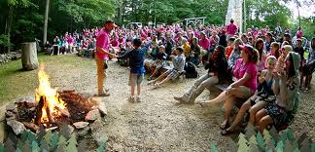

1- Health and Wellness Enhancement Tools
      1.2. Therapy and Healing
    Case Study: Hole in the Wall Camps
    -The main philosophy of the camps is based in:
    - Laughter and More Laughter
    creating joy and laughter to support the healing process
    - Plus Total Care:
    - Fostering a sense of community among children facing similar health challenges
    - Serious Medicine with a Light Touch:
    Offering emotional and psychological support alongside physical care
Notes:
Detoxification or detoxication is the physiological or medicinal removal of toxic substances from a living organism, including the human body, which is mainly carried out by the liver.

Slide 12
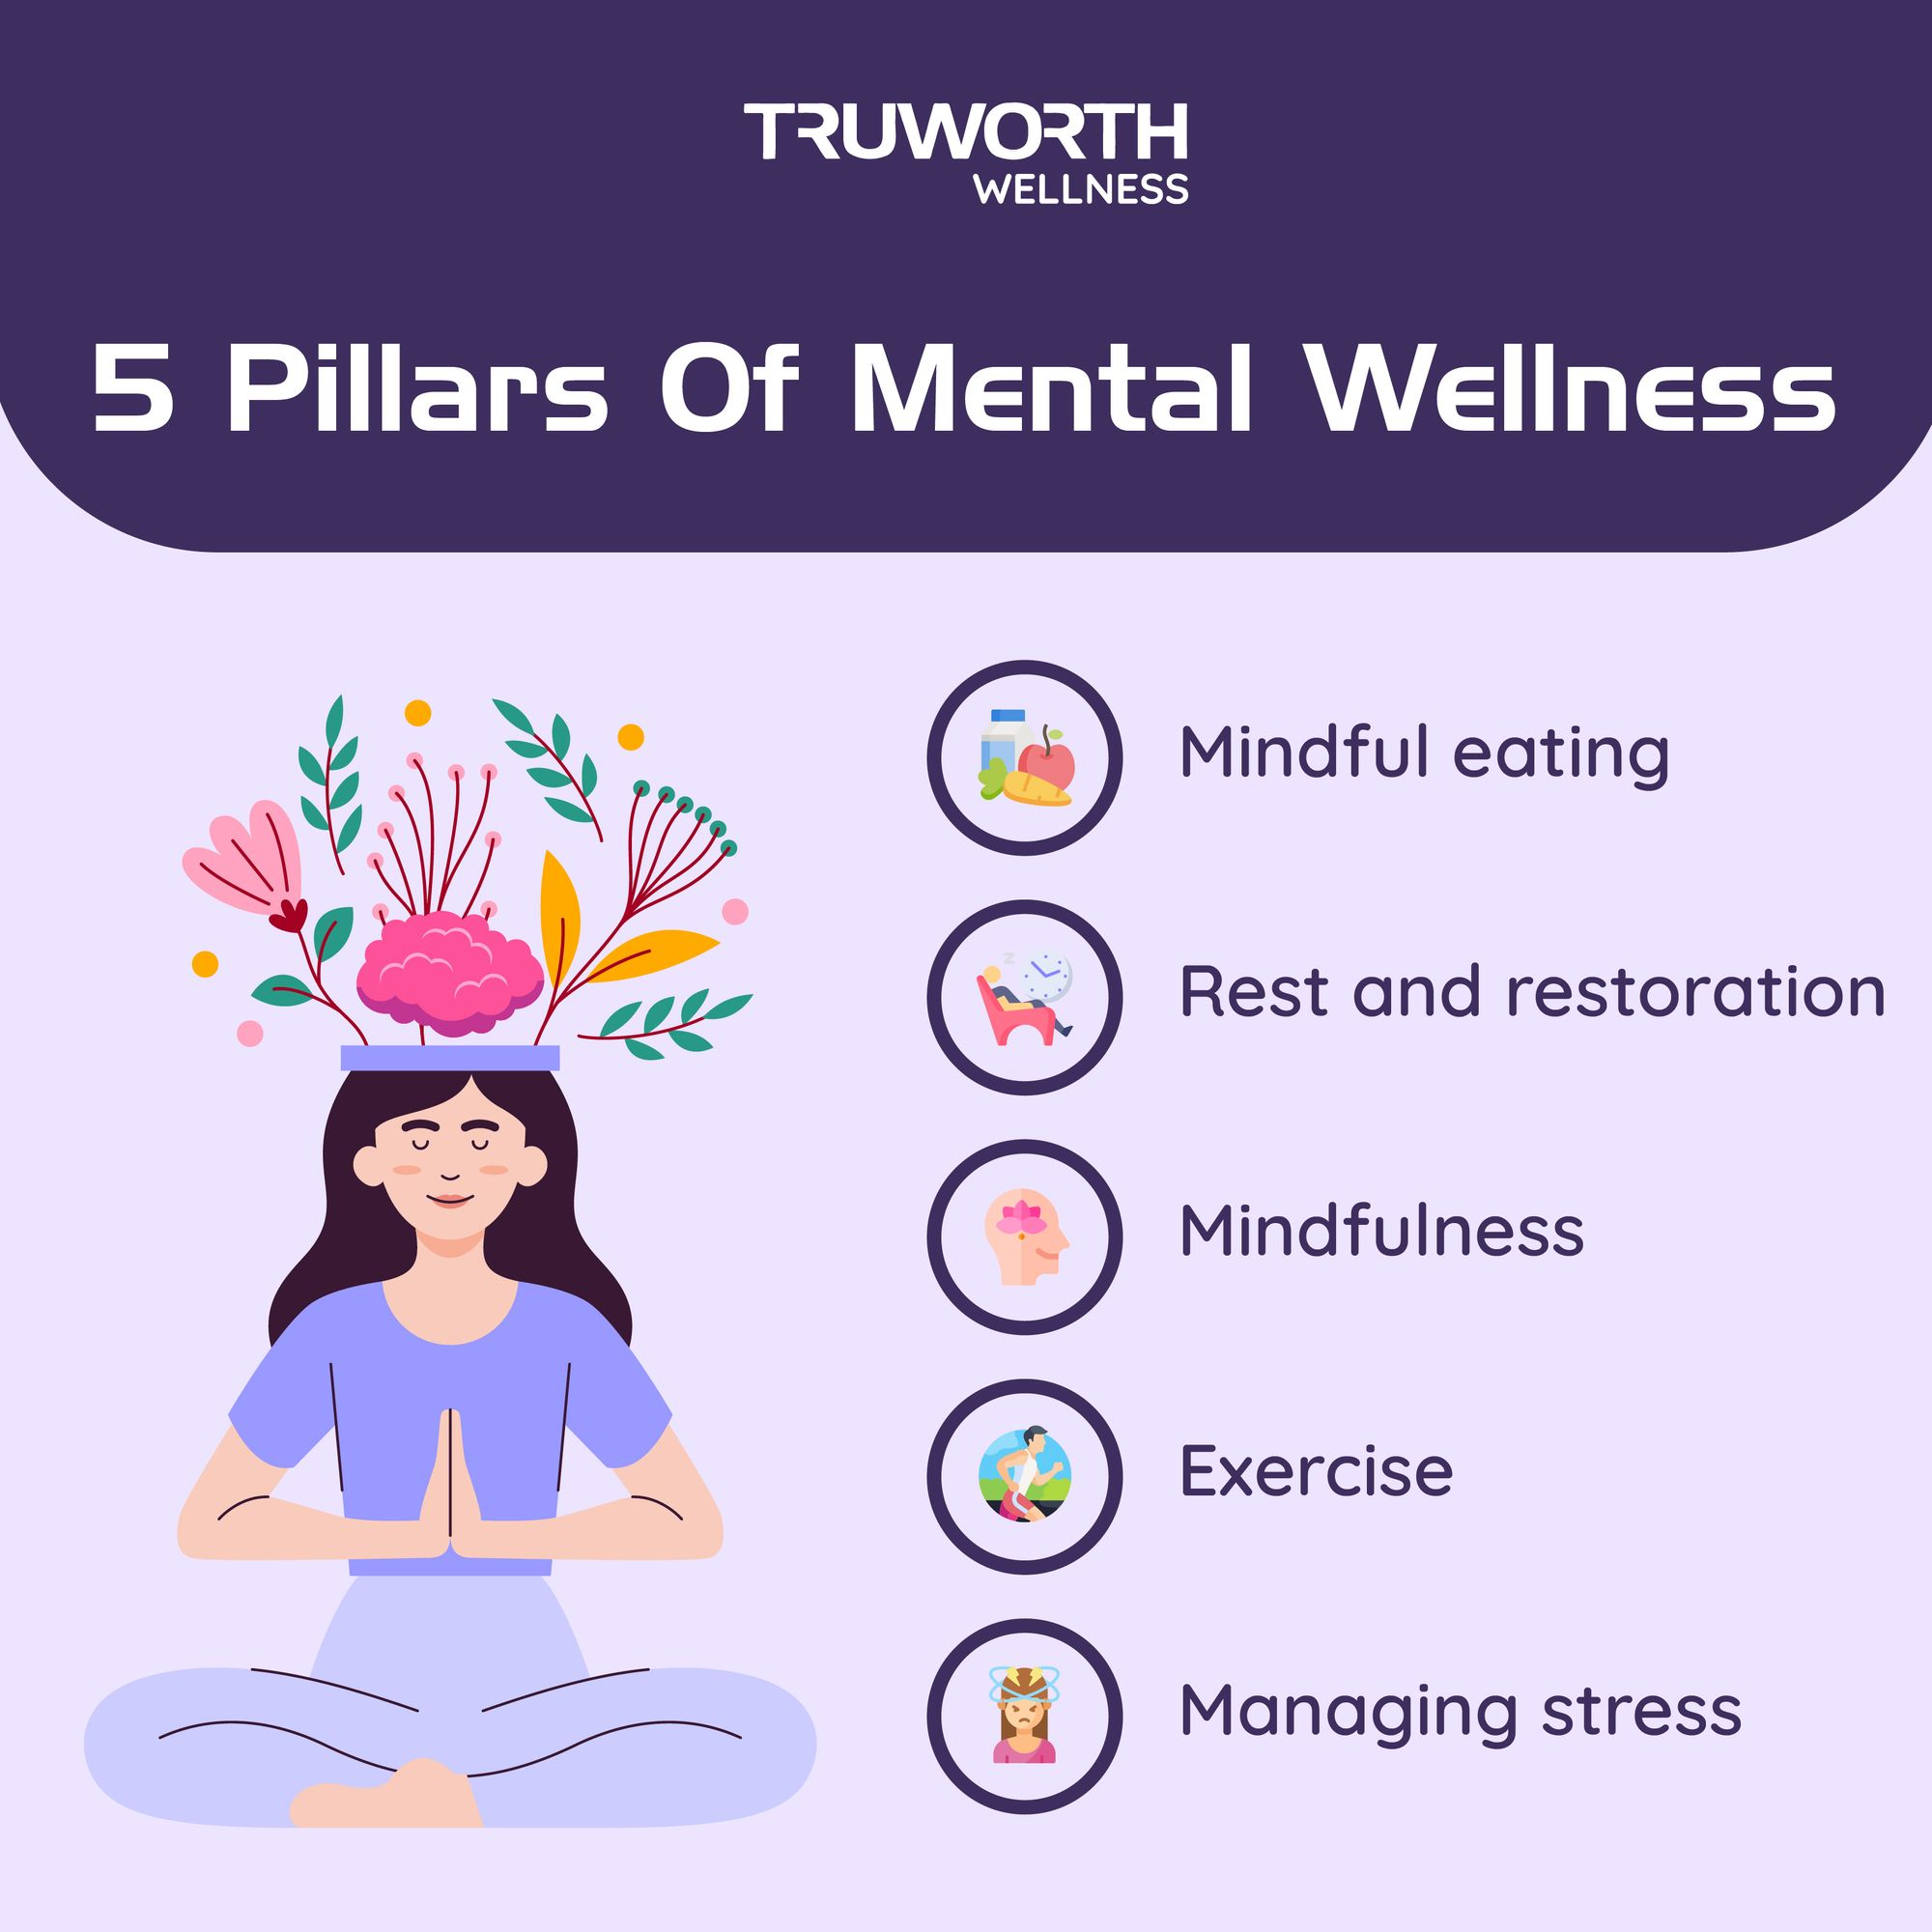
1- Health and Wellness Enhancement Tools
      1.3. Psychology
      - Psychological wellness focuses on the control and balance of the mind and emotions.
      - It involves tools and techniques aimed at enhancing mental
      and emotional well-being, such as:
      Developing mindfulness
      Practicing meditation
      Building self-esteem
      Becoming a better communicator
      Reducing stress
      Managing anxiety
      Overcoming depression
Notes:
Detoxification or detoxication is the physiological or medicinal removal of toxic substances from a living organism, including the human body, which is mainly carried out by the liver.

Slide 13
1- Health and Wellness Enhancement Tools
      1.3. Psychology
      - 1.2.1. Life Coaching
      - Life-coaching is gaining popularity as a form of occupational wellness.
      - It offers practical advice to help individuals achieve personal and professional goals.
      - It is important to note that life-coaching is not counselling and is not therapy.
      Life-coaching is described as:
      A practical, forward-looking approach to gaining clarity on what you don’t like and identifying what you can do about it.
      A powerful support system that helps individuals stay on track and move in the right direction.
      Providing an external perspective on your life, helping to clarify challenges and solutions.
Notes:
Detoxification or detoxication is the physiological or medicinal removal of toxic substances from a living organism, including the human body, which is mainly carried out by the liver.

Slide 14

1- Health and Wellness Enhancement Tools
      1.3. Psychology
      - 1.2.1. Life Coaching
      - Life-coaches typically focus on a range of domains within a person’s life to support holistic growth and well-being, including:
      Work
      Home
      Finances
      Social life
      Partnerships
      Health
      Dreams and aspirations
      Spirituality
      Work/life balance
Notes:
Detoxification or detoxication is the physiological or medicinal removal of toxic substances from a living organism, including the human body, which is mainly carried out by the liver.

Slide 15
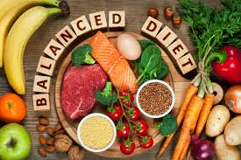
1- Health and Wellness Enhancement Tools
      1.4. Nutrition
      - The topic of healthy nutrition has become a major focus of public education campaigns in many countries.
      - Governments, health organizations, and schools are
      promoting awareness about balanced diets and healthy
      eating habits.
      - Diets, healthy eating, and detoxing have become
      prevalent themes in books, magazines, and TV shows
Notes:
Detoxification or detoxication is the physiological or medicinal removal of toxic substances from a living organism, including the human body, which is mainly carried out by the liver.

Slide 16

1- Health and Wellness Enhancement Tools
      1.4. Nutrition
      - Detox, short for detoxification, refers to the body’s natural and ongoing process of neutralizing or eliminating toxins.
      - Traditionally, detox was associated with treatments for alcohol or drug dependence.
      - Recently, the term has expanded to include a variety of health and wellness practices, such as:
      Special diets
      Herbal remedies
      -These methods aim to help the body remove
      environmental and dietary toxins.
Notes:
Detoxification or detoxication is the physiological or medicinal removal of toxic substances from a living organism, including the human body, which is mainly carried out by the liver.

Slide 17
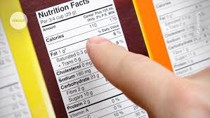
1- Health and Wellness Enhancement Tools
      1.4. Nutrition
      - A detox diet is designed to reduce the intake of harmful chemicals, often by encouraging the consumption of organic foods.
      - It emphasizes foods rich in vitamins, nutrients,
      and antioxidants that support the body’s natural
      detoxification processes.
      - The aim is to help the body eliminate accumulated
      toxins and promote better health.
Notes:
Detoxification or detoxication is the physiological or medicinal removal of toxic substances from a living organism, including the human body, which is mainly carried out by the liver.

Slide 18
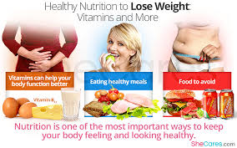
1- Health and Wellness Enhancement Tools
      1.4. Nutrition
      A detox diet is believed to improve various health issues associated with toxin buildup, such as:
      Indigestion
      Bad breath
      Fatigue
      Poor skin quality
      Muscle pain
      Benefits often associated with detox diets include:
      Increased energy levels
      Improved concentration and mental clarity
      A greater sense of overall wellness
Notes:
Detoxification or detoxication is the physiological or medicinal removal of toxic substances from a living organism, including the human body, which is mainly carried out by the liver.

Slide 19
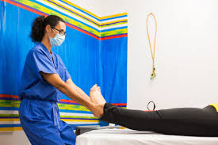
1- Health and Wellness Enhancement Tools
      1.5. Rehabilitation
      - Rehabilitation refers to the process of helping individuals with disabilities, serious, or long-term illnesses to achieve and maintain their optimal levels of functioning in various areas:
      Physical
      Sensory
      Intellectual
      Psychological
      Social
Notes:
Detoxification or detoxication is the physiological or medicinal removal of toxic substances from a living organism, including the human body, which is mainly carried out by the liver.

Slide 20

1- Health and Wellness Enhancement Tools
      1.5. Rehabilitation
      - The goal is to support individuals in living as independently and fully as possible.
      - However, in modern usage, the term ‘rehab’ is more commonly associated with the recovery process for:
      Alcohol addiction
      Drug addiction
      Sex addiction
Notes:
Detoxification or detoxication is the physiological or medicinal removal of toxic substances from a living organism, including the human body, which is mainly carried out by the liver.

Slide 21
1- Health and Wellness Enhancement Tools
      1.5. Rehabilitation
      - An unusual form of tourism, but one that is becoming increasingly familiar, is rehabilitation tourism for individuals with alcohol and drug problems.
      - This involves undergoing rehabilitation treatment in luxury surroundings.
      - Unlike traditional, intensive rehab programs, these luxury experiences offer a more comfortable and indulgent approach to recovery.
      Features of this type of rehab may include:
      Gourmet food
      Spa treatments
      Whale watching and other nature-based activities
      High-end accommodations and personalized care
Notes:
Detoxification or detoxication is the physiological or medicinal removal of toxic substances from a living organism, including the human body, which is mainly carried out by the liver.

Slide 22

1- Health and Wellness Enhancement Tools
      1.5. Rehabilitation
      - Case Study: The Sanctuary in Byron Bay, Australia
      - The Sanctuary is a luxury therapeutic retreat that specializes in the treatment of various physical and psychological conditions, including:
      Addictions
      Alcoholism
      Eating disorders
      Depression
      Anxiety
      Stress-related disorders
      Trauma
      Chronic pain
Notes:
Detoxification or detoxication is the physiological or medicinal removal of toxic substances from a living organism, including the human body, which is mainly carried out by the liver.

Slide 23
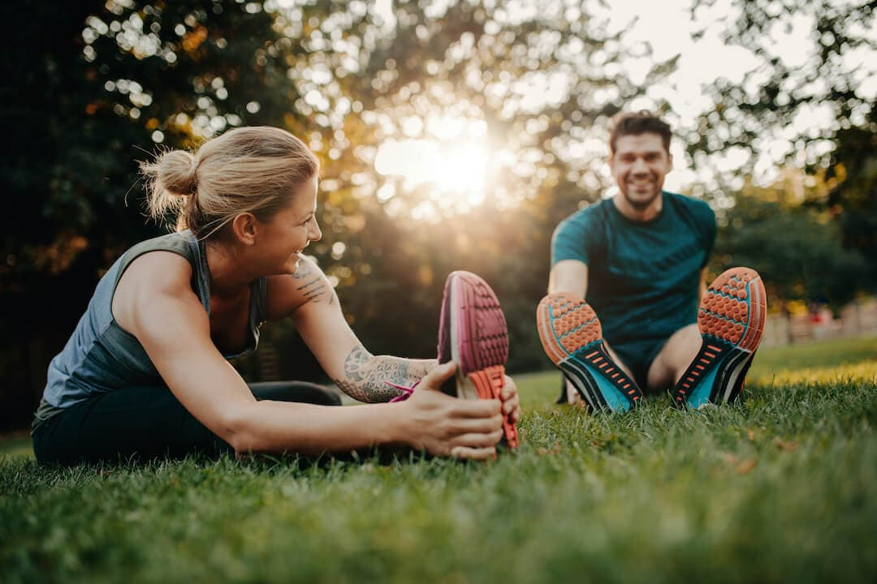
1- Health and Wellness Enhancement Tools
      1.5. Rehabilitation
      - Case Study: The Sanctuary in Byron Bay, Australia
      - It provides a customized program tailored to each individual's unique needs and life experiences.
      - The Sanctuary integrates complementary medical therapies from both Eastern and Western traditions.
      - Its primary goal is personal healing, offering a serene
      and supportive environment for recovery and
      self-discovery.
Notes:
Detoxification or detoxication is the physiological or medicinal removal of toxic substances from a living organism, including the human body, which is mainly carried out by the liver.

Slide 24
1- Health and Wellness Enhancement Tools
      1.5. Rehabilitation
      - Case Study: The Sanctuary in Byron Bay, Australia
      - The Sanctuary helps visitors reconnect with their passions and interests in life as part of the healing process.
      - Guests are encouraged to take part in nature-based excursions, such as:
      Bushwalks and whale watching
      - Participation in creative activities is also promoted, including:
      Dance, art, music, and martial arts
      - The approach is truly holistic, taking into account:
      Diet and nutrition
      Physical exercise
      Spiritual well-being
Notes:
Detoxification or detoxication is the physiological or medicinal removal of toxic substances from a living organism, including the human body, which is mainly carried out by the liver.

Slide 25
And you, which wellness enhancement tool do you prefer?
Notes:
Detoxification or detoxication is the physiological or medicinal removal of toxic substances from a living organism, including the human body, which is mainly carried out by the liver.

Slide 26
2- Factors influencing the need for wellness tourism
      2.1- The Search for Community
    - Communities are becoming increasingly dislocated and fragmented in modern society.
    - Growing international mobility has led many people to leave their hometown or home country.
    - As a result, individuals often spend long periods of their lives far away from family or friends.
    - The number of single people has increased.
    - More women are choosing to pursue a career before settling down, contributing to this trend.

Slide 27
2- Factors influencing the need for wellness tourism
      2.1- The Search for Community
    - The globalization process has expanded the definitions and concepts of community.
    - There is greater acceptance of the fluidity and constant change in social structures.
    - In some cases, virtual communities (e.g., those on the Internet) have replaced traditional, physical communities.
    - These communities are often based on a shared appreciation of entertainment or media-based activities.

Slide 28
2- Factors influencing the need for wellness tourism
      2.1- The Search for Community
    - It is also thought that the "global elite" (e.g., tourists) may be less concerned with a sense of place and community.
    - This group lives in a state of ‘exterritoriality,’ detached from specific locations or communities.
    - They often seek out ‘community-free zones’ that lack local social engagement.
    - These zones include virtually identical ‘socio-cultural bubbles’ such as:
    Global hotel chains
    International restaurant franchises
    Conference centres
    Air-conditioned offices
    Airports

Slide 29
2- Factors influencing the need for wellness tourism
      2.1- The Search for Community
    - Most people have a strong need to belong somewhere.
    - Therefore, there is a general desire for familiarity, continuity, and security in one's surroundings.
    - Places such as yoga centers, ashrams, and spiritual festivals have become sanctuaries that offer an alternative to traditional communities

Slide 30
2- Factors influencing the need for wellness tourism
      2.1- The Search for Community
    - Many wellness tourists seek a sense of community, often found in:
    - Holistic centres
    - Yoga retreats
    - New Age festivals
    - Pilgrimages
    - Although their main focus may be personal growth or self-development, they often seek psychological, emotional, or spiritual communion with others.

Slide 31
2- Factors influencing the need for wellness tourism
      2.2- Obsession with the self and celebrity
      - The concept of "community" is becoming increasingly blurred in modern times.
      - As a result, individuals are becoming more preoccupied with themselves.
      - This shift is largely influenced by new media, technology, and consumer-oriented services.
      - The obsession with the self often manifests in:
      A heightened focus on physical appearance.
      Clothing and fashion.
      Excessive consumption.
      A growing fascination with celebrities, who are portrayed as embodying ideal life traits.

Slide 32
2- Factors influencing the need for wellness tourism
      2.3- The desire to downsize: Voluntary simplicity
      - Wealthy and extravagant lifestyles, filled with too many choices and opportunities, are pushing many people to seek simpler ways of living.
      - The tendency of individuals over 30 to simplify their lives has led to the use of labels such as:
      ‘Downsizers’, ‘Downshifters’, and ‘Simple livers’
      - These individuals voluntarily give up stressful, high-paying jobs in favor of:
      - Jobs that help others
      More free time to enjoy hobbies, family, and friends
      - They prioritize other kinds of 'luxuries' over financial success and material wealth.

Slide 33
2- Factors influencing the need for wellness tourism
      2.4- Towards a New Spirituality
      - Many people are focusing on taking better care of their bodies.
      - They are also searching for new ways to improve their health by paying more attention to their emotional and spiritual well-being.
      - A growing number of individuals aspire to find their spiritual center by exploring other societies and cultures through travel.

Slide 34
2- Factors influencing the need for wellness tourism
      2.4- Towards a New Spirituality
      - Many people are using tourism as a means of visiting locations considered more spiritual than their home.
      - India and Thailand are common examples of such destinations.
      - In these locations, spiritual activities such as yoga, massage, and meditation are often integral parts of everyday life.
      - Many tourists visit these places with the desire to learn how to change their philosophy or approach to life.

Slide 35
2- Factors influencing the need for wellness tourism
      2.5- New media and technology
      -The amount of time individuals spend watching television, surfing the net, or playing computer games has increased exponentially in recent years.
      - Sociological researchers suggest that many people in postmodern societies struggle to differentiate fact from fiction or reality from fantasy.
      - Heritage sites, museums, arts venues, and other tourist attractions must compete for people’s leisure time and the increasing demand for interactive, high-tech experiences.

Slide 36
2- Factors influencing the need for wellness tourism
      2.5- New media and technology
      - The development of entire simulated worlds in hotels or theme parks, especially in destinations like Las Vegas or Dubai, is becoming increasingly popular.
      - Even wellness facilities are adopting themed experiences, such as:
      North African or Turkish-style steam baths
      Scandinavian saunas
      Japanese onsens
      Buddhist meditation zones
      - As a result, visitors can technically feel as though they are anywhere in the world, as long as escapism, entertainment, or excitement is guaranteed

Slide 37
      Discussion
      What are the other factors that have led to an increase in the need for wellness tourism?

Slide 38
Thank You

Slide 39
Thank you
      European Institute of Innovation, Entrepreneurship and Technology
      Lessingstraße 79,
      13158 Berlin, Germany
      Phone: +49 176 55524449
      Email: info@eiiet.com
Discover the world of eiIET

