Slide 1
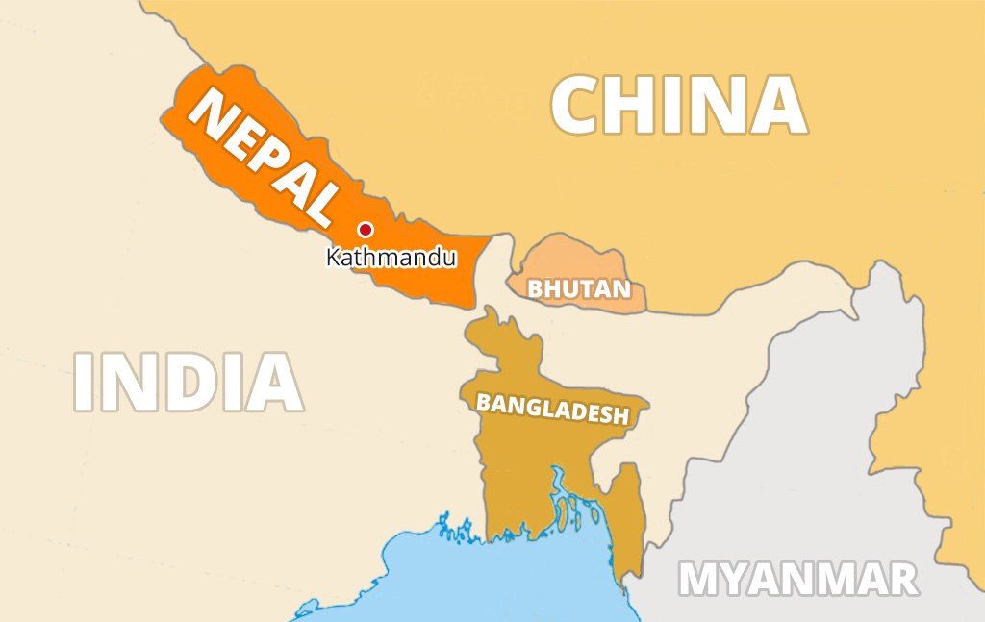
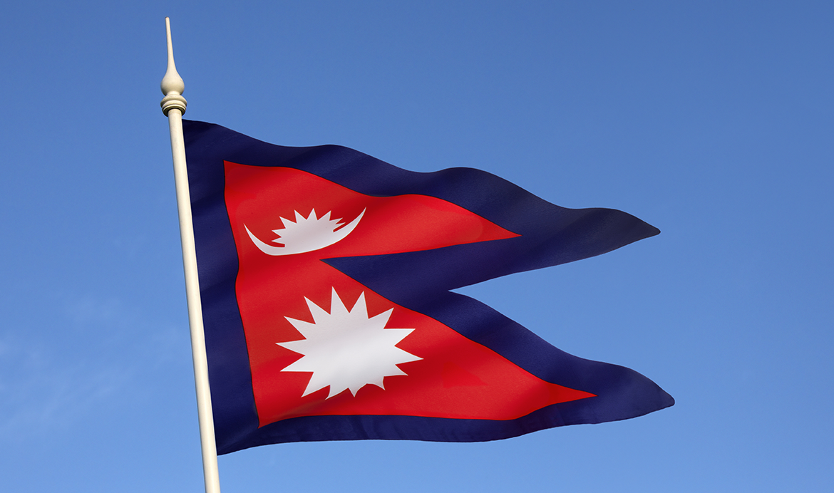
Nepal a Total Tourism Destination
Prepared by :Chandrakala Karki

Slide 2
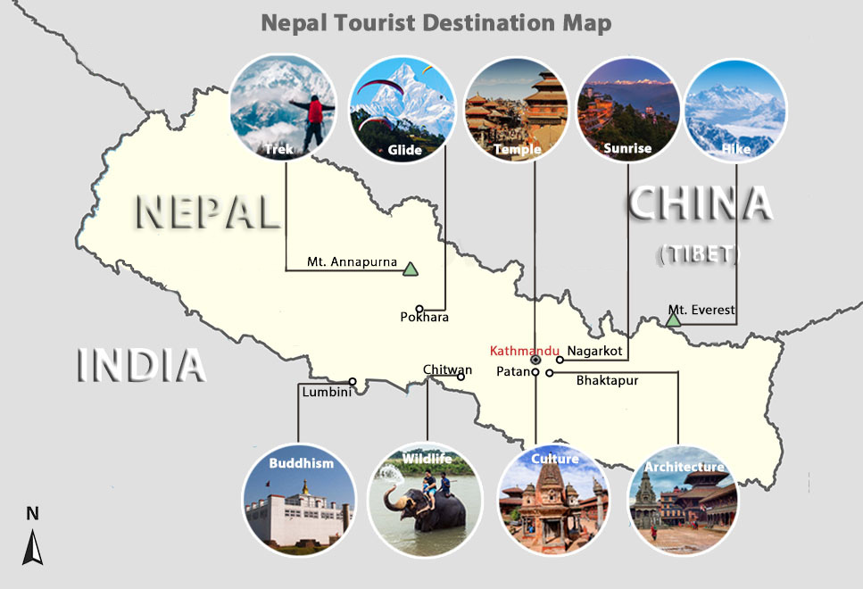
Facts about Nepal
Landlocked country in South Asia, between India and China
Capital city: Kathmandu
Home to Mount Everest, the world’s highest peak
Birthplace of Lord Buddha (Lumbini)
Only country with a non-rectangular national flag
Rich in cultural diversity with over 120 ethnic groups
Major religions: Hinduism and Buddhism
Famous for trekking routes like Everest Base Camp and Annapurna Circuit
Became a federal democratic republic in 2008
Known for festivals like Dashain, Tihar, and Holi

Slide 3
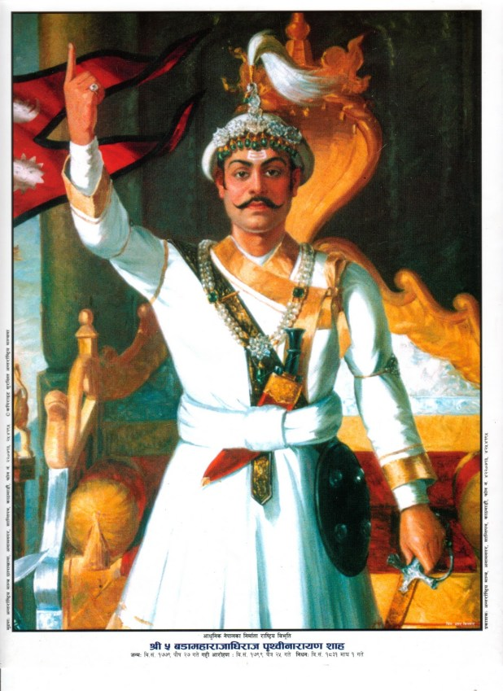
Historical Background Of Nepal
Ancient Era: Inhabited since prehistoric times; early Kirat rulers around 800 BCE.
Licchavi Dynasty (4th–9th century): Flourishing of Hinduism and Buddhism; foundational cultural influences.
Malla Period (10th–18th century): Golden age of art, architecture, and city-states like Kathmandu, Patan, and Bhaktapur.
Unification (1768): King Prithvi Narayan Shah unifies Nepal into a single nation-state.
Modern Period: From monarchy to republic—abolition of the monarchy in 2008 after a civil conflict.

Slide 4
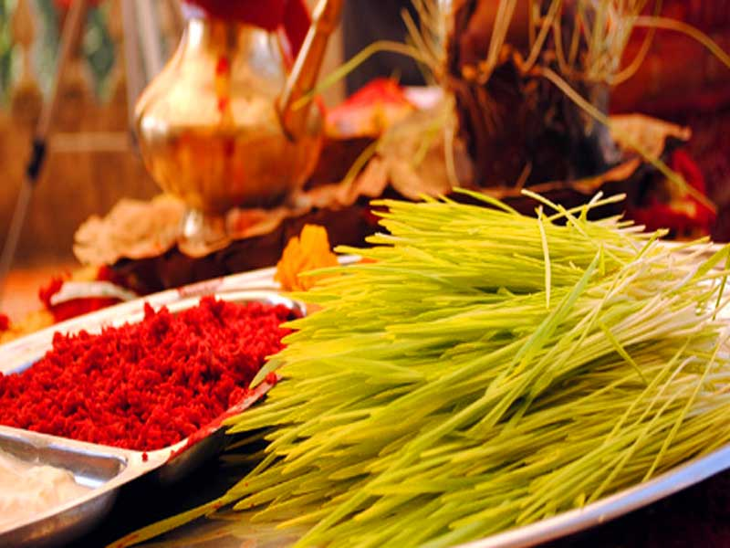
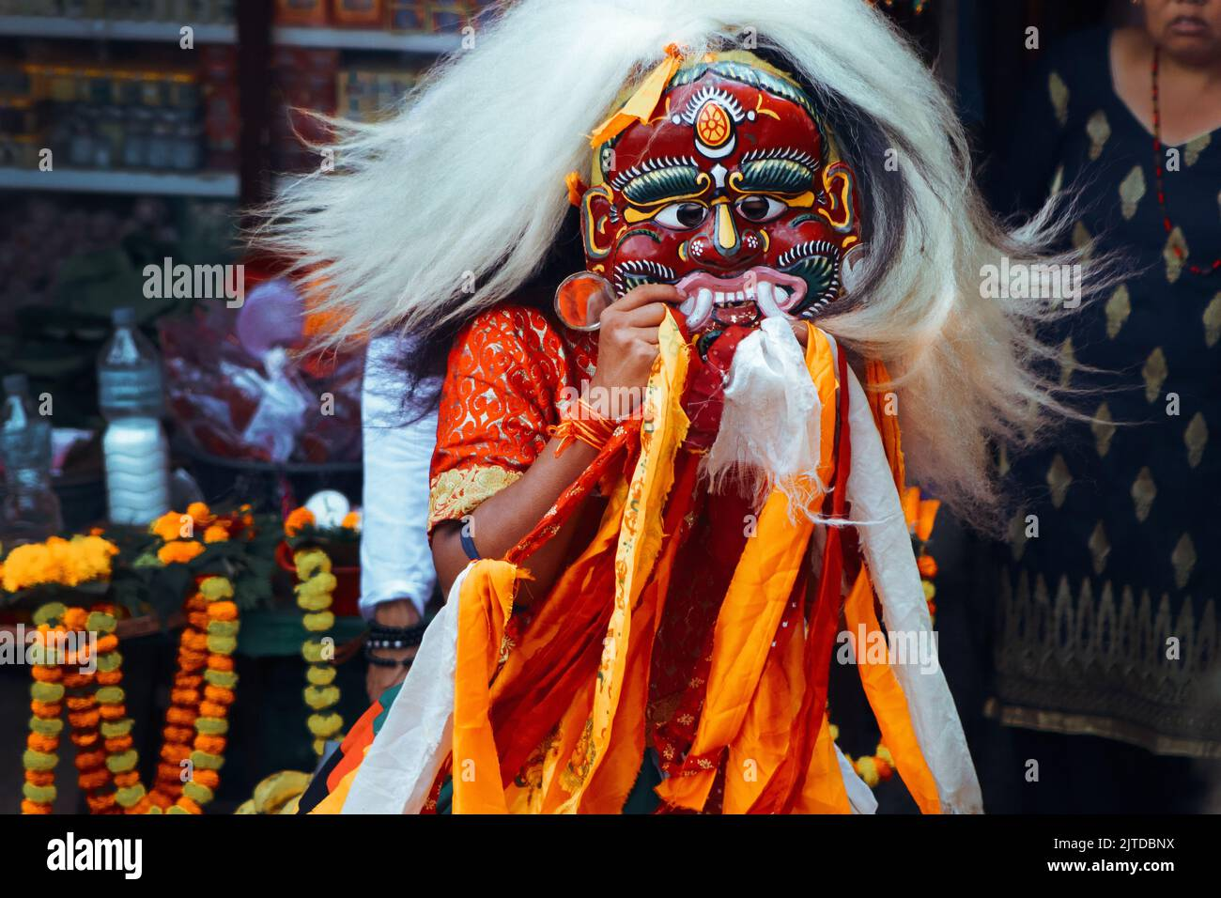
The cultural features of Nepal, including festivals, celebrations, customs, and habits.
Cultural Features of Nepal
Festivals:
  Dashain: The biggest Hindu festival, celebrating the victory of good over evil with family gatherings, animal sacrifices, and blessings from elders.
  Tihar: Known as the Festival of Lights, it honors animals like crows, dogs, and cows, and includes Bhai Tika, celebrating sibling bonds.
  Holi: The colorful spring festival where people throw powdered dyes and water to celebrate joy and renewal.
  Buddha Jayanti: Marks the birth, enlightenment, and death of Lord Buddha, especially significant in Lumbini.
  Indra Jatra & Gai Jatra: Unique to the Kathmandu Valley, featuring masked dances, cow parades, and satirical performances.

Slide 5
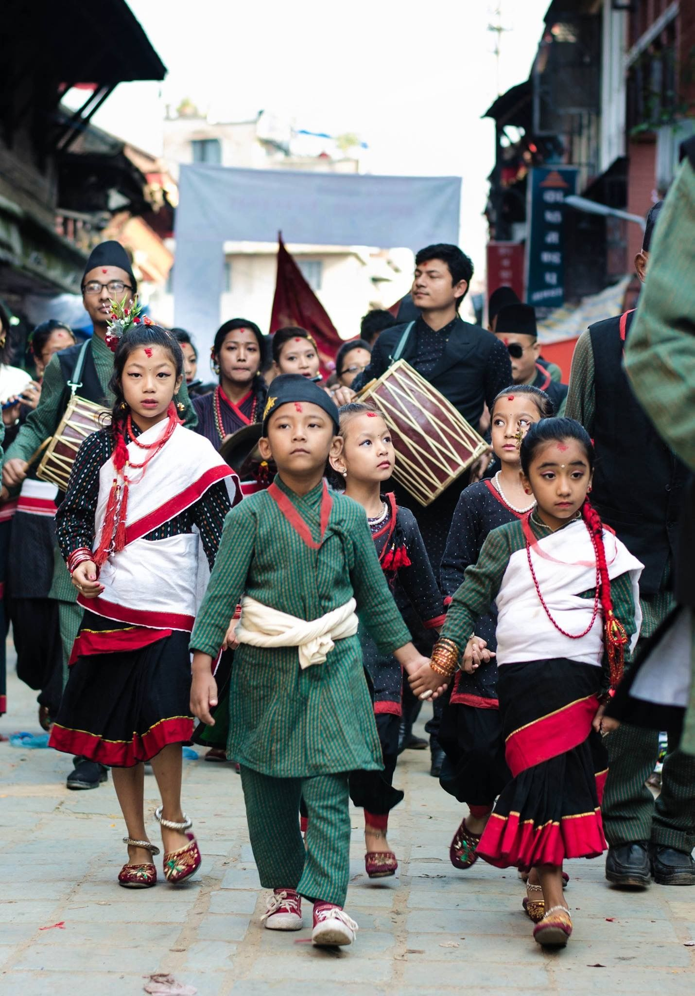
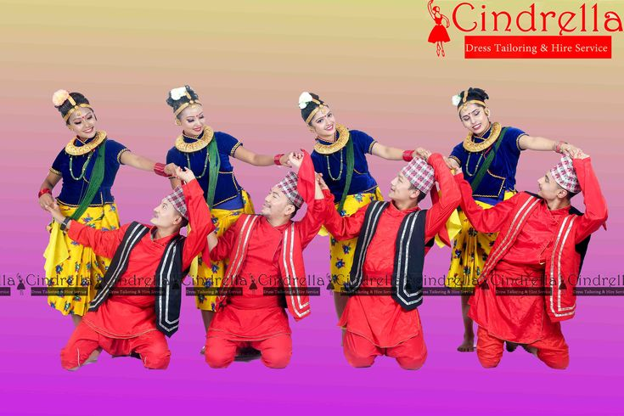
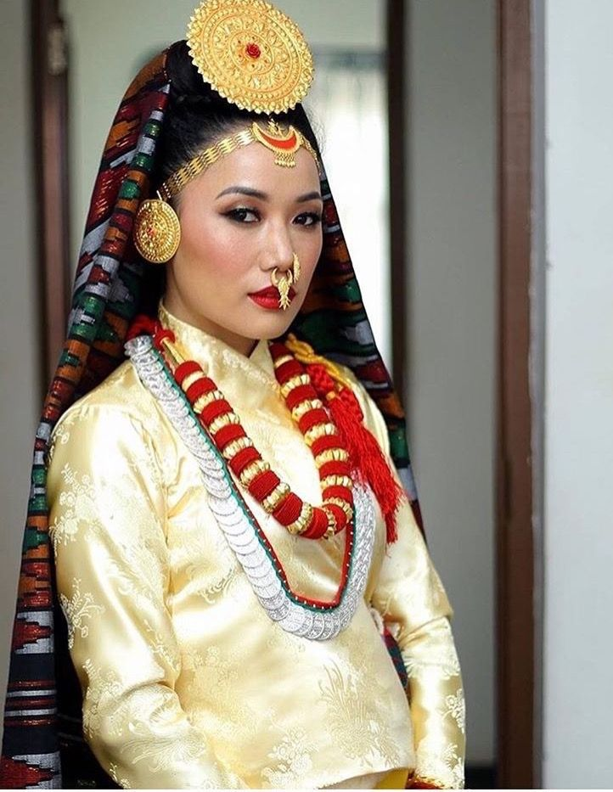

Customs & Traditions:
  Janku: Celebrating elders at milestone ages like 77 or 88 with rituals and feasts.
  Marriage rituals: Some communities follow unique customs like marrying a fruit (wood apple) or the sun before actual marriage.
  Sky burial: Practiced by some Himalayan communities, where bodies are offered to birds as a spiritual rite.
Daily Habits & Social Norms:
Namaste: Traditional greeting with palms pressed together.
Eating customs: Meals are often eaten with the right hand while sitting on the floor; dal bhat (lentils and rice) is a staple.
Religious harmony: Hindus and Buddhists often share temples and festivals, reflecting deep interfaith respect.

Slide 6
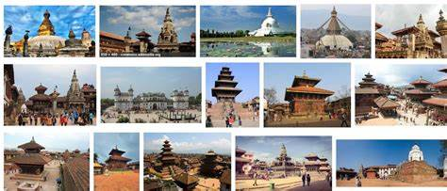
Existing Historical and Archaeological sites of Nepal
UNESCO World Heritage Sites
Kathmandu Valley – Home to seven monument zones including:
  Bhaktapur, Patan, and Kathmandu Durbar Squares
  Swayambhunath (Monkey Temple)
  Boudhanath Stupa
  Pashupatinath Temple
  Changu Narayan Temple
Lumbini – The birthplace of Lord Buddha, featuring the Maya Devi Temple and Ashokan Pillar
Sagarmatha National Park – Encompasses Mount Everest and sacred Himalayan landscapes
Chitwan National Park – A natural heritage site known for its biodiversity
Notable Archaeological Sites
Tilaurakot – Believed to be the ancient capital of the Shakya kingdom, where Prince Siddhartha (Buddha) spent his early life
Ramagrama Stupa – The only intact stupa containing Buddha’s relics
Sinja Valley – Once the capital of the Khasa Kingdom, with ancient inscriptions and water systems
Gotihawa & Nigali Sagar – Sites with Ashokan pillars and Buddhist significance

Slide 7
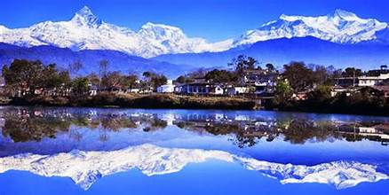
Importance of Tourism Development in Nepal
Himalayan Landscape – Nepal hosts 8 of the world’s 10 tallest mountains, making it a global hub for trekking, mountaineering, and scenic exploration.
Cultural & Religious Heritage – As the birthplace of Lord Buddha and home to countless Hindu and Buddhist sites, Nepal offers deeply spiritual and cultural travel experiences.
Ecological Diversity – From subtropical jungles to alpine meadows, Nepal supports rich biodiversity, attracting ecotourists and wildlife enthusiasts.
Adventure Activities – Its natural terrain supports tourism based on white-water rafting, paragliding, bungee jumping, and mountain biking.
Economic Contribution – Tourism is a major source of income, foreign exchange, and employment, especially benefiting rural and remote communities.
Preservation of Local Traditions – Tourism encourages the safeguarding of Nepalese arts, crafts, festivals, and customs.
Community Empowerment – It supports grassroots initiatives, promotes inclusive growth, and uplifts underrepresented groups.
Strategic Location – Nestled between China and India, Nepal is geopolitically well-placed for cross-border tourism and regional connectivity.

Slide 8
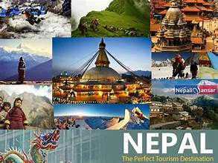
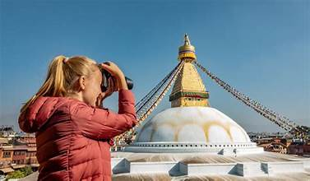
The number of tourists visiting Nepal annually
Nepal welcomed approximately 1,147,567 international tourists in 2024, marking a strong rebound and reaching about 96% of pre-pandemic levels. This growth reflects Nepal’s enduring appeal as a destination for adventure, spirituality, and cultural exploration.
The top source countries included:
India: 317,772 visitors
United States: 111,216 visitors
China: 101,879 visitors
United Kingdom: 57,554 visitors
Germany: 29,801 visitors

Slide 9
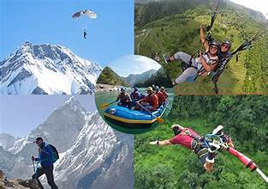
The different touristic activities and entertainment options in the city.
Urban & Cultural Experiences
Sightseeing in Kathmandu Valley: Explore UNESCO World Heritage Sites like Swayambhunath (Monkey Temple), Pashupatinath Temple, Boudhanath Stupa, and Kathmandu Durbar Square.
Thamel District (Kathmandu): A bustling hub for shopping, dining, nightlife, and live music.
Bhaktapur & Patan: Ancient cities known for their preserved architecture, pottery, and traditional festivals.
Nature & Adventure Activities
Trekking & Hiking: Popular routes include Everest Base Camp, Annapurna Circuit, and Langtang Valley.
Paragliding in Pokhara: Soar over Phewa Lake with views of the Annapurna range.
  White-water Rafting: Thrilling rapids on rivers like Trishuli and Bhote Koshi.
Jungle Safari in Chitwan National Park: Spot rhinos, tigers, elephants, and exotic birds.

Slide 10
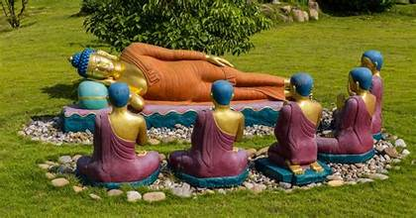
Spiritual & Wellness Tourism
Lumbini: Visit the birthplace of Lord Buddha, a serene pilgrimage site with monasteries from around the world.
Yoga & Meditation Retreats: Found in Kathmandu, Pokhara, and rural monasteries.
Entertainment & Festivals
Indra Jatra & Dashain: Major festivals with traditional dances, chariot processions, and rituals.
Live Music & Cultural Shows: Enjoy Nepali folk music and dance performances in local venues and cultural centers.
Outdoor & Extreme Sports
Bungee Jumping & Zip-lining: Available near Pokhara and the Bhote Koshi gorge.

Slide 11
Conclusion
Whether you're seeking spiritual peace, adrenaline-pumping adventure, or a deep cultural journey, Nepal offers a little bit of everything.
a small country with a vast cultural and natural footprint.
Nepal isn’t just a place you visit—it’s a place you feel. From the snow-capped peaks of the Himalayas to the soulful rhythms of its temples and bustling city streets, every corner of the country tells a story. Whether you’re trekking through quiet mountain trails, watching rhinos roam in the jungle, or joining in colorful festivals, Nepal offers something magical for everyone. But beyond the beauty, tourism here fuels dreams, sustains communities, and keeps ancient traditions alive. It’s not just travel—it’s connection.

Slide 12
Thank you for your Attention
You should visit Nepal once in your Lifetime.

