Slide 1
Tourism Law and Legislation
European Institute of Innovation, Entrepreneurship and Technology
Lessingstraße 79, 13158 Berlin, Germany
Mahmoud Abdou| Berlin
      Lessingstraße 79,
      13158 Berlin, Germany
      Phone: +49 30 233618555
      Fax: +49 30 233618556
      Email: info@eiiet.com

Slide 2

Outline:
1- COVID-19 and tourism consumer protection
2- The development of an International Code for
the Protection of Tourists
3- International Code for the Protection of Tourists
4- The Challenges in Harmonizing Consumer
Protection Standards

Slide 3

1- COVID-19 AND TOURISM CONSUMER PROTECTION

Slide 4
1- COVID-19 and Tourism Consumer Protection
COVID-19 as a Global Tourism Crisis
- March 2020: WHO declares COVID-19 a global pandemic
- Immediate impact on global mobility
- Sudden border closures and travel bans
- Tourism sector among the hardest hit worldwide

Slide 5
1- COVID-19 and Tourism Consumer Protection
Tourists Stranded Abroad
- Millions of tourists stranded internationally
- Limited access to:
Accommodation
Healthcare services
Reliable information
- High levels of uncertainty and insecurity

Slide 6
1- COVID-19 and Tourism Consumer Protection
Tourist Vulnerability During the Crisis
- Tourists placed in a vulnerable legal and economic position
- Confusion over:
Who is responsible for assistance?
Who bears the costs?
- Weak bargaining power within the tourism value chain

Slide 7
1- COVID-19 and Tourism Consumer Protection
Confinement in Tourism Facilities
- Tourists confined in:
Emergence of legal issues related to:
Cruise ships | Resorts
Hotels
Liability | Cost allocation
Duty of care

Slide 8
1- COVID-19 and Tourism Consumer Protection
Lack of Coordination
- Poor coordination among:
Tourism stakeholders
National authorities
Different countries
- Inconsistent and unequal measures
- Disparities even within the same country

Slide 9
1- COVID-19 and Tourism Consumer Protection
Repatriation and Assistance Challenges
- Confusion over responsibility for:
Assisting tourists
Repatriation
- Delays and unequal access to support
- Absence of clear international rules

Slide 10
1- COVID-19 and Tourism Consumer Protection
Role of Travel Insurance
- Epidemics usually excluded from standard travel insurance
- Insurance providers refused responsibility
- Tourists left without financial protection

Slide 11
1- COVID-19 and Tourism Consumer Protection
Flight Cancellations and Refund Issues
- Millions of flights and trips cancelled
- Unequal treatment of tourists:
Full refunds for some
Date/route changes at higher costs
Forced acceptance of vouchers
- Delays of months in receiving compensation

Slide 12
1- COVID-19 and Tourism Consumer Protection
Fragmentation of International Tourism Law
- No unified international legal framework
- Tourist consumer rights weakly protected globally
- COVID-19 exposed major legal gaps

Slide 13
1- COVID-19 and Tourism Consumer Protection
The European Union Case
- EU provides relatively high consumer protection standards
- However:
Disparity in national decisions
Lack of coordination among Member States
Highlighted limits of regional protection

Slide 14
1- COVID-19 and Tourism Consumer Protection
Toward an International Legal Framework
- Need for international rules on:
Tourist assistance in emergencies
Repatriation mechanisms
- Establish minimum global consumer protection standards

Slide 15
1- COVID-19 and Tourism Consumer Protection
Post-COVID Tourism Consumer Protection
- Harmonisation of consumer rights internationally
- Clear definition of tourist rights and obligations
- Special focus on crisis and emergency situations

Slide 16

2- THE DEVELOPMENT OF AN INTERNATIONAL CODE FOR THE PROTECTION OF TOURISTS

Slide 17
2- The Development of an International Code for the Protection of Tourists
UNWTO Initiative (2020)
- September 2020: UNWTO Executive Council establishes an intergovernmental committee
- Objective:
- Develop an International Code for the Protection of Tourists

Slide 18
2- The Development of an International Code for the Protection of Tourists
UNWTO Emergency Recommendations
- October 2020: UNWTO Secretariat issues recommendations
- Focus on assistance to tourists in emergency situations
- Intended to form Chapter 1 of the Code

Slide 19
2- The Development of an International Code for the Protection of Tourists
Building on Previous UNWTO Work
- Draft international conventions on tourist protection
- Previous work on rights and obligations of tourism service providers
- Code builds on existing legal and policy frameworks

Slide 20
2- The Development of an International Code for the Protection of Tourists
Objectives of Chapter 1
- Establish a Common Terminology
- Clarify Scope and Meaning of Terms
- Facilitate Application and Implementation

Slide 21
2- The Development of an International Code for the Protection of Tourists
Objectives of Chapter 2
- Establish Minimum International Standards for Emergency Assistance
- Prevention of Emergencies and Disruptions
Information Provision
Direct Assistance to Tourists in Emergencies
Repatriation and Travel Support
Cooperation and Coordination

Slide 22
2- The Development of an International Code for the Protection of Tourists
Four Core Themes of Chapter 2
- Prevention
- Information
- Assistance
- Repatriation

Slide 23
2- The Development of an International Code for the Protection of Tourists
Ex-Post and Ex-Ante Protection
- Ex-post: Assistance and repatriation during emergencies
- Ex-ante: Prevention and information obligations
- Focus on preparedness and risk reduction

Slide 24
2- The Development of an International Code for the Protection of Tourists
Objectives of Chapter 3
- Harmonize Minimum International Standards for Consumer Protection
- Strengthen Contractual Protection of Tourists
- Ensure Tourist Rights in Emergency Situations
- Set Principles for Digital Tourism Services

Slide 25
2- The Development of an International Code for the Protection of Tourists
Objectives of Chapter 4
- Promote Alternative Dispute Resolution (ADR)
- Reduce Litigation
- Ensure Fair and Non-Discriminatory Solutions
- Provide Expedited and Efficient Processes

Slide 26
2- The Development of an International Code for the Protection of Tourists
Objectives of Chapter 4
- Promote Alternative Dispute Resolution (ADR)
- Reduce Litigation
- Ensure Fair and Non-Discriminatory Solutions
- Provide Expedited and Efficient Processes

Slide 27
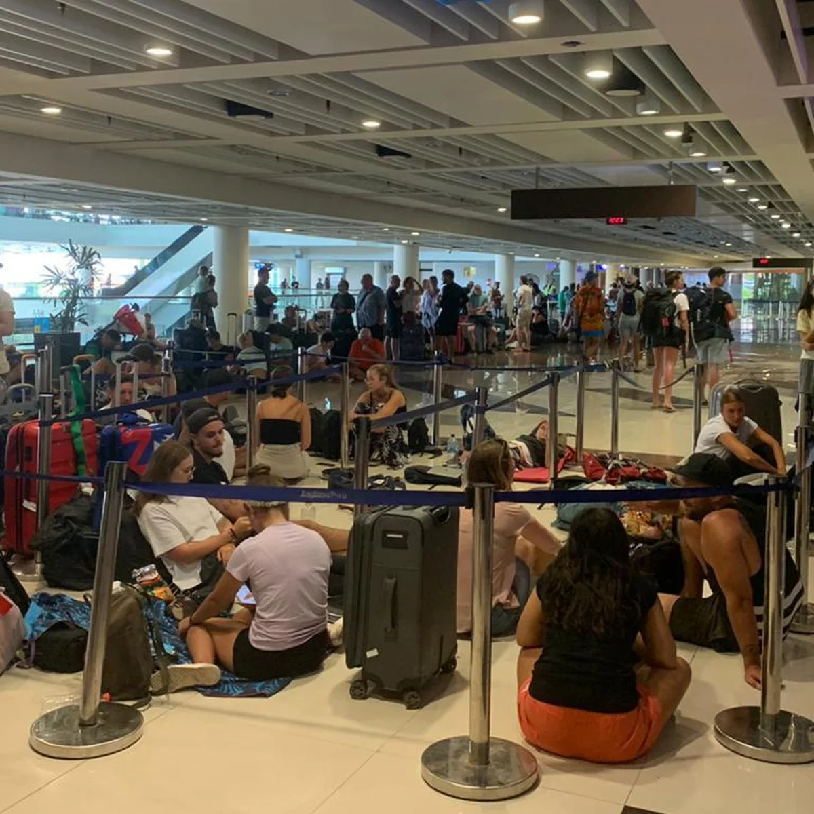
3- INTERNATIONAL CODE FOR THE PROTECTION OF TOURISTS

Slide 28
3- International Code for the Protection of Tourists
Role of UNWTO
- UNWTO leading efforts to develop international standards
- Current work on an International Code for the Protection of Tourists
Builds on earlier, unfinished legal initiatives

Slide 29
3- International Code for the Protection of Tourists
First Draft Convention (2011)
- UNWTO General Assembly launches draft convention
- Initial scope limited to:
Assistance to tourists in emergency situations
Selected accommodation standards

Slide 30
3- International Code for the Protection of Tourists
Origins: Icelandic Volcano Crisis (2010)
- Volcanic ash cloud disrupted global travel
- Airspace closures across Europe
- Thousands of tourists stranded
- Confusion over assistance and responsibilities

Slide 31
3- International Code for the Protection of Tourists
Similarities with COVID-19 Crisis
- Border closures and travel bans
- Stranded tourists worldwide
- Lack of coordination
- Unclear allocation of responsibilities
- COVID-19 impacts far greater in scale

Slide 32
3- International Code for the Protection of Tourists
Request to Expand the Mandate
- Working group included:
Member States
International organizations
- Tourism sector stakeholders
- Argued scope was too narrow

Slide 33
3- International Code for the Protection of Tourists
Why Expansion Was Needed
- Tourism is cross-border by nature
- National laws differ widely
- Existing international rules insufficient
- Need to harmonise national legislations

Slide 34
3- International Code for the Protection of Tourists
Inclusion of Package Travel
- Scope expanded to include package travel
- Coincided with EU revision of Package Travel Directive (1999)
- Strengthened consumer protection dimension

Slide 35
3- International Code for the Protection of Tourists
Legal Design of the Draft Convention
- Combination of:
Mandatory minimum standards
Voluntary recommended practices
- Aim: balance commitment and flexibility

Slide 36
3- International Code for the Protection of Tourists
Guarantees for Ratifying States
- Minimum protection framework ensured
- Flexibility for voluntary implementation of other provisions
- Attempt to encourage broader participation

Slide 37
3- International Code for the Protection of Tourists
Political Challenges
- 2017 survey among Member States
- Very low interest in negotiating binding standards
- Lack of political will

Slide 38
3- International Code for the Protection of Tourists
Link to the International Code
- International Code revives earlier efforts
- Focuses on realistic, flexible standards
- Emphasis on emergencies and consumer rights

Slide 39

4- THE CHALLENGES IN HARMONIZING CONSUMER PROTECTION STANDARDS

Slide 40
4- The Challenges in Harmonizing Consumer Protection Standards
Link to the International Code
- International Code revives earlier efforts
- Focuses on realistic, flexible standards
- Emphasis on emergencies and consumer rights

Slide 41
4- The Challenges in Harmonizing Consumer Protection Standards
Discussion
What are the Challenges in Harmonizing Consumer Protection Standards Globally?

Slide 42
Thank you
      European Institute of Innovation, Entrepreneurship and Technology
      Lessingstraße 79,
      13158 Berlin, Germany
      Phone: +49 176 55524449
      Email: info@eiiet.com
Discover the world of eiIET

