Slide 1
Availability Management in Tourism
European Institute of Innovation, Entrepreneurship and Technology
Lessingstraße 79, 13158 Berlin, Germany
Mahmoud Abdou| Berlin
      Lessingstraße 79,
      13158 Berlin, Germany
      Phone: +49 30 233618555
      Fax: +49 30 233618556
      Email: info@eiiet.com

Slide 2
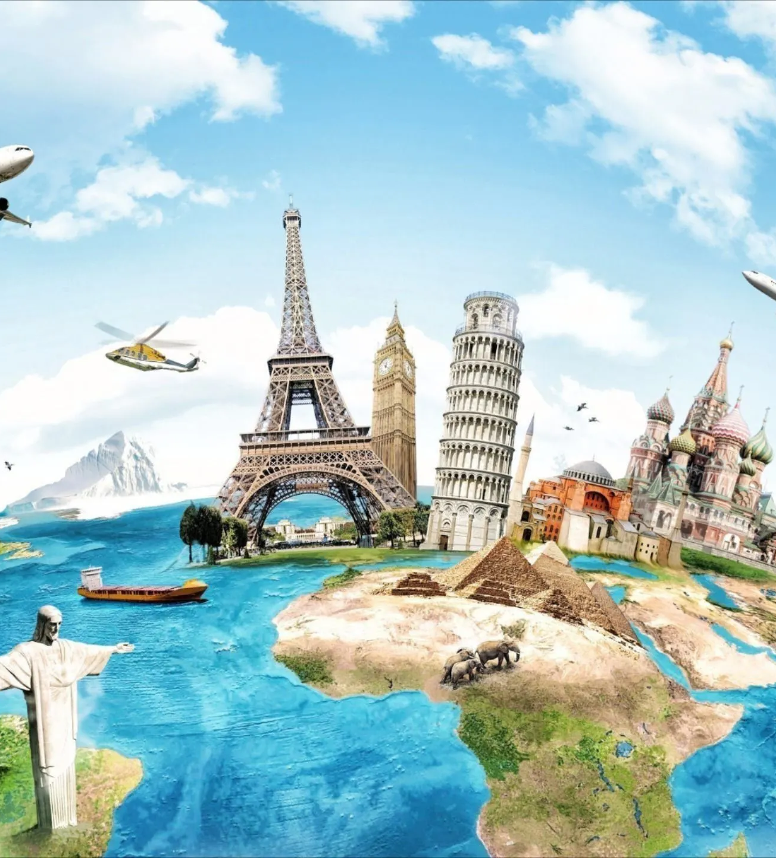
Index
- Distribution Channels in Tourism
Intermediaries in Tourism
Managing the Destribution Costs in Tourism

Slide 3
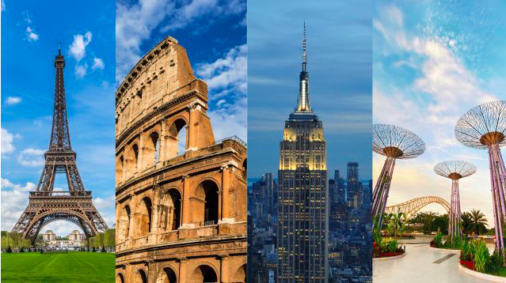
1- DISTRIBUTION CHANNELS IN TOURISM

Slide 4
1- Distribution Channels in Tourism
      - They refer to the pathways through which tourism products and services are offered, delivered, and sold to consumers.
      Also Known As:
      - "The Chain of Distribution"
      - A system linking tourism providers to end consumers through various intermediaries.

Slide 5
1- Distribution Channels in Tourism
      What It Describes:
      - The location and availability of the tourism offering
      - The methods and platforms used to reach consumers
      - The intermediaries involved in connecting supply to demand
The location
The methods
The intermediaries
Distribution Channels

Slide 6
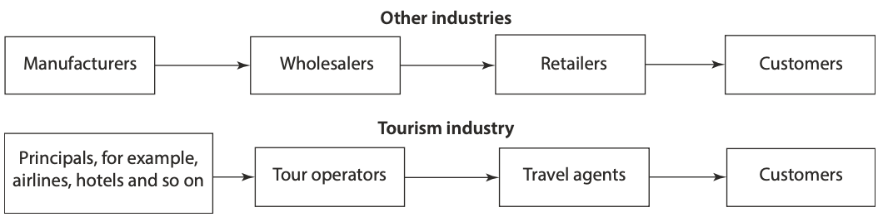
1- Distribution Channels in Tourism
      In the manufacturing Industry
      - Distribution channels move tangible goods from the manufacturer to the consumer
      In the tourism industry
      - They move the consumer to the supplier

Slide 7
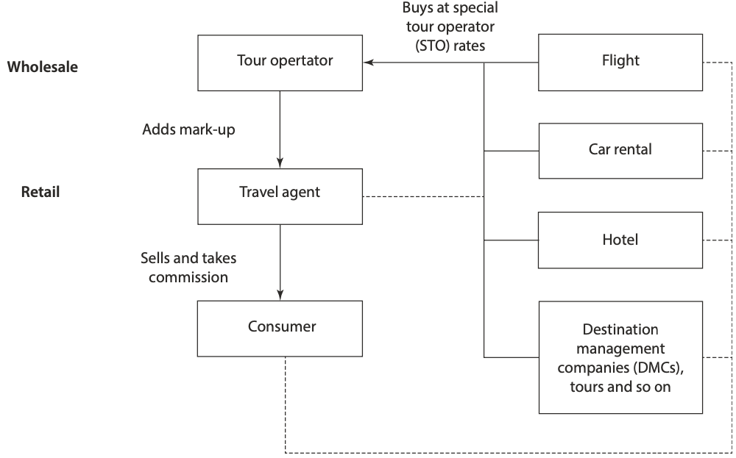
1- Distribution Channels in Tourism
      1.1. Traditional Distribution of Tourism Products
      - Tourism products are often not sold directly by suppliers.
      - Instead, they move through intermediaries
      Main Types of Intermediaries
      Wholesalers (Tour Operators):
      - Consolidate different tourism products
      - Create packages tailored for specific markets
      Retailers (Travel Agents):
      - Sell packages or individual services to end-consumers

Slide 8
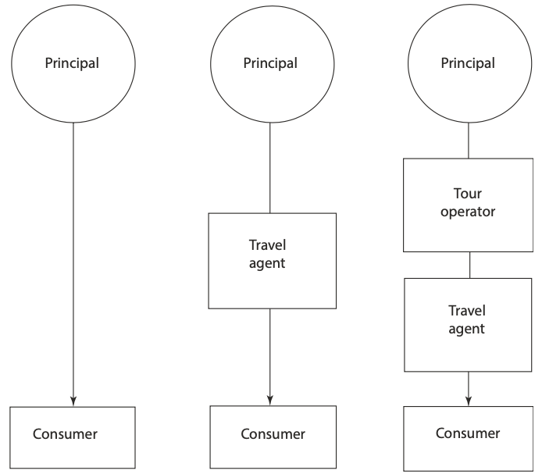
1- Distribution Channels in Tourism
      1.2- Level of Distribution Channels
      One-Level Channel:
      - Direct connection between the supplier and the customer
      Two-Level Channel:
      - Involves one intermediary
      Three-Level Channel:
      - Involves multiple intermediaries

Slide 9
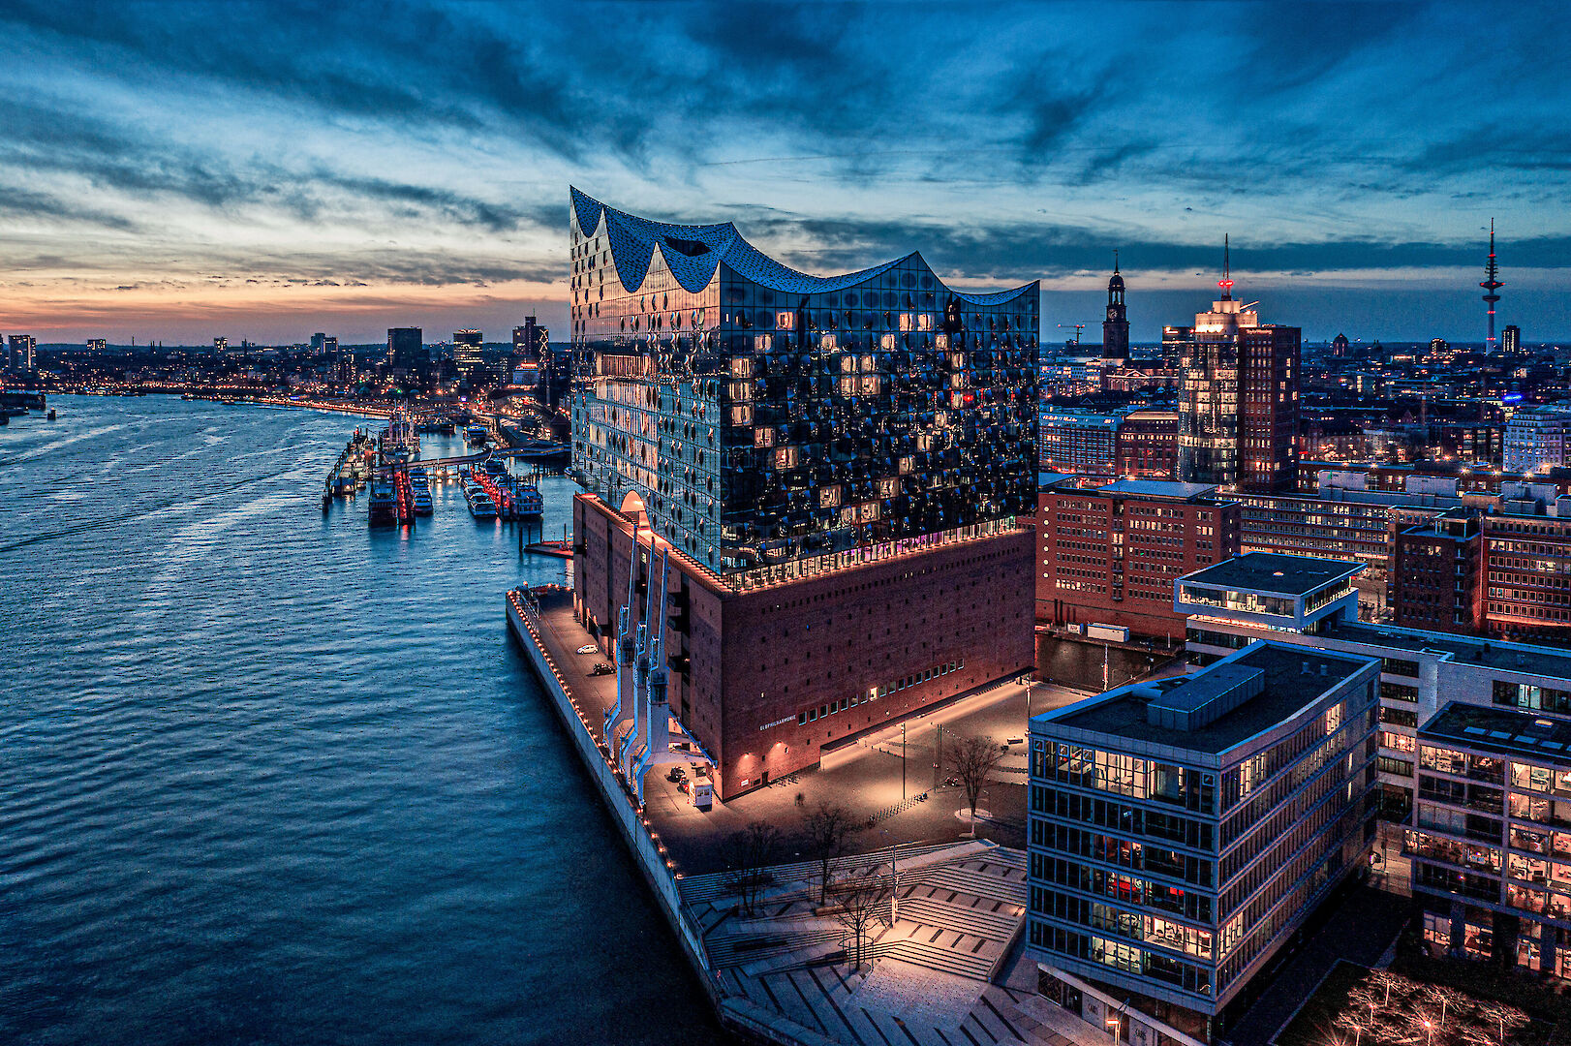
2- INTERMEDIARIES IN TOURISM

Slide 10
2- Intermediaries in Tourism
      - There is a wide range of intermediaries between tourism suppliers and consumers.
      - They can be classified into:
      Indirect Channels
      - Use of intermediaries to reach consumers
      - Often more personal interactions
      Direct Channels
      - No intermediaries; supplier sells directly to the consumer
      - Often technology-driven
Intermediaries in tourism
Indirect Channels
Direct Channels

Slide 11
2- Intermediaries in Tourism
      2.1 Indirect Channels
      A- Tour Operator
    - Tour operators assemble and package the key components of
    a holiday into a single product to be sold to consumers
Indirect Channels
Tour Operators
Destination Management Companies
Retail Travel Agents
Online Travel Agents

Slide 12
2- Intermediaries in Tourism
      B- Destination Management Companies (DMC)
    - A DMC is a “service professional company with a wide range of
    knowledge and experience of the conditions and
    touristic resources of a region”.
    - The manage all tourists travel arrangements upon arrival.
Indirect Channels
Tour Operators
Destination Management Companies
Retail Travel Agents
Online Travel Agents

Slide 13
2- Intermediaries in Tourism
      C- Retail Travel Agents
    - They function as convenient outlets where holidays and
    other travel-related offerings they supply the public with travel services
    - They act as a source of information
    Advice on visa applications
    Reservations for visitor attractions and entertainment venues
    Planning itineraries
Indirect Channels
Tour Operators
Destination Management Companies
Retail Travel Agents
Online Travel Agents

Slide 14
2- Intermediaries in Tourism
      C- Retail Travel Agents
    - They function as convenient outlets where holidays and
    other travel-related offerings they supply the public with travel services
    - They act as a source of information
    Advice on visa applications
    Reservations for visitor attractions and entertainment venues
    Planning itineraries
    Examples include:
    - Thomas Cook - DERTOUR
    - FTI Touristik - Tui
Indirect Channels
Tour Operators
Destination Management Companies
Retail Travel Agents
Online Travel Agents

Slide 15
2- Intermediaries in Tourism
      D- Online Travel Agent
    - Electronic retailers that operate entirely online
    - No physical presence
    - Provide a convenient booking platform for consumers
    - Serve as a key part of the tourism distribution system
    Examples:
    - Booking.com -Expedia
    - Agoda - C.Trip
Indirect Channels
Tour Operators
Destination Management Companies
Retail Travel Agents
Online Travel Agents

Slide 16
2- Intermediaries in Tourism
      2.1.1- The Advantages of Indirect Channels
      - Wider Market Reach
      - Reduced Marketing Costs
      - Sales Expertise and Brand Trust
      - Convenience for the Consumer

Slide 17
2- Intermediaries in Tourism
      2.1.2- The Disadvantages of Indirect Channels
      - Reduced Profit Margins
      -Loss of Control
      - Dependence on Intermediaries
      - Potential for Conflicts

Slide 18
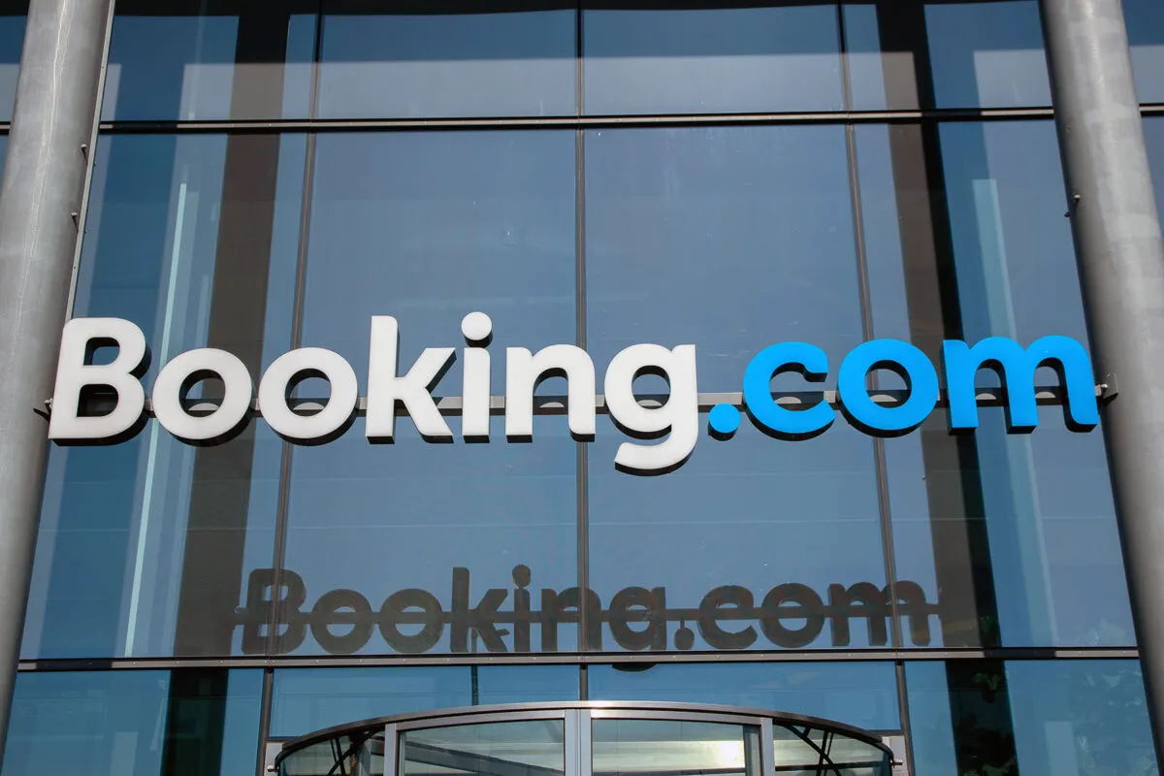
2- Intermediaries in Tourism
      Conflicts between Europe’s hotels and Booking.com:
      - European hotels are intensifying a legal challenge against Booking.com
      - They seek compensation for alleged overcharges
      The Core Issue: “Rate Parity” Clauses
      - Booking.com requires hotels to offer the same or lower prices
      on its platform.
      - Hotels cannot offer better rates on their own websites or
      other channels.
      This practice allegedly led to:
      - Inflated commission rates
      - Restricted price competition

Slide 19
2- Intermediaries in Tourism
      2.2- Direct Channels
      - Selling tourism products and services directly to consumers
      - Noo intermediaries involved
Direct Channels
Company Websites
Social Media
Physical Locations
Call Centres

Slide 20
2- Intermediaries in Tourism
      A- Company Website
      These websites allow customers to:
      - Browse travel options
      - Customize their trips and services
      - Book directly with real-time availability
      - Use secure payment processing
Direct Channels
Company Websites
Social Media
Physical Locations
Call Centres

Slide 21
2- Intermediaries in Tourism
      B- Social Media
      Platforms like Facebook and Instagram enable tourism businesses to:
      - Engage directly with potential customers
      - Showcase tours, activities, and destinations
      - Facilitate bookings through integrated tools or links
Direct Channels
Company Websites
Social Media
Physical Locations
Call Centres

Slide 22
2- Intermediaries in Tourism
      C- Physical Locations
      Companies can sell directly to customers at:
      - Offices - Tour starting points
      - Visitor information centers
      It enhances:
      - Personal interaction and trust
      - Opportunity to answer questions face-to-face
      - Useful for last-minute or walk-in bookings
Direct Channels
Company Websites
Social Media
Physical Locations
Call Centres

Slide 23
2- Intermediaries in Tourism
      D- Call Centres
      - To provide a single point of contact
      Key Functions:
      - Handle inquiries, bookings, and support via phone
      - Ensure efficient call processing
      - Often used by large tourism businesses
Direct Channels
Company Websites
Social Media
Physical Locations
Call Centres

Slide 24
2- Intermediaries in Tourism
      2.2.1- The Advantages of Direct Channels
      - Increased Control
      - Higher Profit Margins
      - Stronger Customer Relationships
      The Disadvantages of Direct Channels
      - High Initial Costs
      - Limited Market Reach
      - Potential for Increased Risk

Slide 25

3- Managing the costs of distribution in tourism

Slide 26
3- Managing Distribution Costs in Tourism
      - To minimize expenses while maximizing reach and revenu
      Strategies to minimize distribution costs:
      Analyze and Optimize Distribution Channels
      - Assess Channel Profitability
      - Reduce Reliance on High-Cost Channels
      - Prioritize Direct Bookings:
      Embrace Technology
      - Mobile Technology
      - Pricing Software

Slide 27
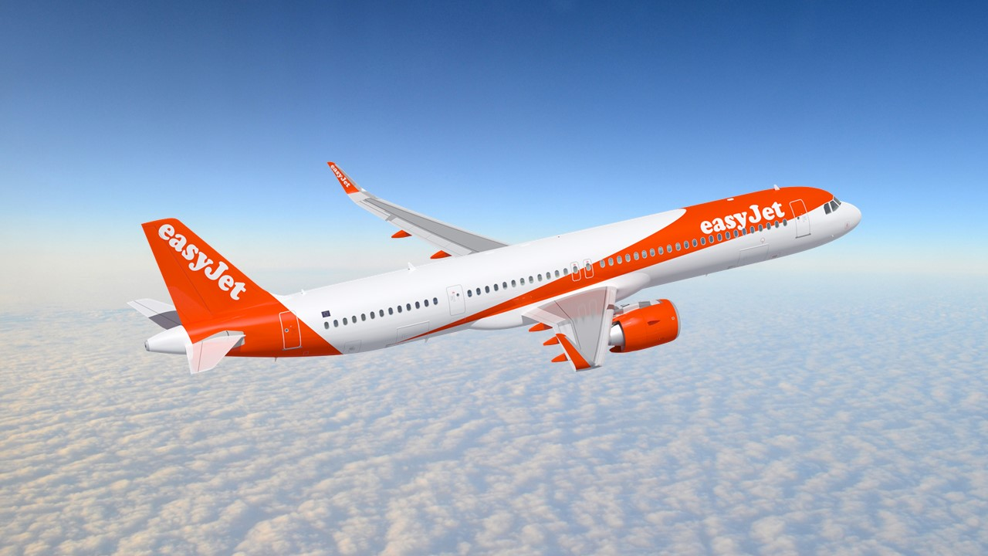
3- Managing Distribution Costs in Tourism
      The Case Study: EasyJet
      - Started business in 1995.
      Key operational features:
      - one type of aircraft -Point-to-point operations
      - Short-haul travel; - No in-flight catering
      - Rapid turnaround times - High aircraft utilisation
      Low distribution costs.

Slide 28
3- Managing Distribution Costs in Tourism
      Distribution Costs Strategies:
      A- Cutting Out the Middleman (disintermediation)
      - This means eliminating intermediaries from the distribution process.
      - Instead, companies sell directly to customers, usually via:
      Telephone bookings
      Their own websites or mobile apps

Slide 29
3- Managing Distribution Costs in Tourism
      B- Rejecting CRS
      - GDS/CRS charge flat fees per ticket, regardless of price
      - For low-margin airlines, this means high distribution costs
      - Not sustainable for budget carriers
      - Avoids GDS fees by promoting direct online bookings
      - Uses differential pricing to encourage customers to book via the Internet

Slide 30
3- Managing Distribution Costs in Tourism
      C- Ticktless Travel
      - No paper or printed ticket needed
      - Passengers receive a booking reference number
      - Increases productivity
      - Reduces costs
      - Speeds up the check-in process

Slide 31
3- Managing Distribution Costs in Tourism
      C- Ticktless Travel
      - No paper or printed ticket needed
      - Passengers receive a booking reference number
      - Increases productivity
      - Reduces costs
      - Speeds up the check-in process

Slide 32
      Discussion
      Compare and contrast two different distribution forms for each of the following:
      - A small independent tour operator
      - A fully integrated mass market tour operator
      -A low-cost airline
      - An owner-managed small resort hotel
      - An international hotel chain.

Slide 33
Thank you
      European Institute of Innovation, Entrepreneurship and Technology
      Lessingstraße 79,
      13158 Berlin, Germany
      Phone: +49 176 55524449
      Email: info@eiiet.com
Discover the world of eiIET

